Slide 1
Attention Engagement
Fennell, G. (1979). Attention Engagement. Current Issues & Research in Advertising, 2(1), 17.

Slide 2
Questions and Motivation
Whose attention are advertisers seeking?
Was this and intentional choice?
Who made the decision on the target audience and why were those people chosen?
Attentional strategy has often been assigned to the “inscrutable creative process,” rather than marketing practitioners.
This has resulted in behavioral science acting as a gatekeeper for content that has already been created.

Slide 3
Purpose
“to initiate a discussion of conceptual issues concerning attention by presenting a formulation for attention allocation”
“to describe a set of options for attention engagement in advertising.” (p. 17)
Fennell wanted to focus attention on the process of engaging an audience’s attention and provide a framework for effectively engaging an audience. This was an opportunity to apply the concepts and model from her 1978 article, Consumer Perceptions of the Product-Use Situation.

Slide 4
Exposure versus Engagement
The issue addressed in this paper is selective engagement – converting targets (prospects) exposed to targets (prospects) engaged
Key questions
  Do targets self-select into engagement?
  Do non-targets self-select differently from targets?
  At what point in an ad do targets need to be engaged?
  How does selective attending differ from selective impact?
  What is the mechanism that results in selective attending?

Slide 5
Targets
Audience
Targets Exposed
Targets Not Exposed
Nontargets Exposed
Population

Slide 6
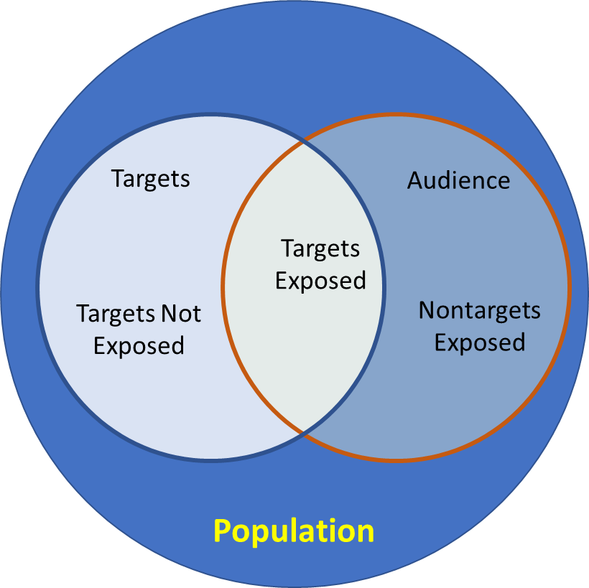

Slide 7
Advertising and Attention
Advertising seeks a two-fold outcome:
  Retention of a representation of the message
  The brand located in the memory network so that it will be in the consumer’s consideration set
Advertising inherently lacks personal relevance, given its mass communication nature
Attention can be voluntary or involuntary

Slide 8
There are three classes of properties by which a stimulus can attract attention (Berlyne, 1960)
  Affective – emotion generation
  Collative – novel, surprising, incongruous
  Intensive – physical properties (brightness, loudness, color)
Fennell combines Kahneman’s voluntary vs. involuntary attention studies with Berlyne’s stimulus properties to explain subjects’ allocation of attention.
She uses her seven classes of motivation (Fennell, 1978) to categorize these.

Slide 9
Seven Motivation Classes –
Perceptions of the Product-Use Situation
Current problem
Potential problem
Normal depletion
Interest opportunity
Sensory enjoyment opportunity
Product-related problem
Satisfaction frustration

Slide 10
Motivation and Attention
Fennell links the different classes of motivation to different forms of attention engagement
  Affective unpleasant
  Affective pleasant
  Repetition

Slide 11
Selected Quotes
“Yet, compared to other aspects of consumer behavior on which marketing and advertising success depends, attentional processes have suffered neglect from theorists and practitioners alike.” p. 17
“. . . The advertiser’s second hurdle, that of converting targets exposed to targets engaged.” p. 18 (selective attention)
“. . . The role of advertising is to inform consumers about the particular set of attributes, i.e., want-satisfying qualities, that a brand claims for itself.” p. 25
“Briefly, consumer wants arise from feelings associated with the way the product-use situation is perceived by the consumer.” p. 26

Slide 12
Selected Quotes (continued)
“I see value in the development of a set of conceptual categories to classify advertising content in behaviorally relevant ways.” p. 32
“. . . Individual differences in the significance of stimuli make it impossible to predict behavior from a knowledge of stimulus conditions alone.” p. 32 (think Prospect vs. Nonprospect)

Slide 13
References
Berlyne, Daniel (1960) Conflict, Arousal and Curiosity. New York: McGraw-Hill Education (UK).
Fennell, G. (1978) ‘Consumers’ Perceptions of the Product-Use Situation’, Journal of Marketing, 42(2), pp. 38–47.
Fennell, G. (1979) ‘Attention Engagement’, Current Issues & Research in Advertising, 2(1), p. 17.
Kahneman, D. (1973) Attention and Effort. Englewood Cliffs, N. J.: Prentice Hall.

