Slide 1
Modeling Variation in Brand Preference:
The Roles of Objective Environment and
Motivating Conditions
Yang, S., Allenby, G., & Fennell, G. (2002) Marketing Science, 21(1), 23-38.
This is a summary and discussion developed by Fennell Story Insights to promote the application and dissemination of Geraldine Fennell’s work.

Slide 2
Summary
This paper presents a novel model for understanding consumer decision-making by focusing on the objective environment and the currently relevant motivations (motivating conditions)
The key takeaway from this paper is that brand preference varies both between consumers in the same objective environment and within individual consumers across different decision instances, due to shifting motivations (motivating conditions). This finding suggests that neither situational variables nor personal characteristics alone can effectively explain or predict consumer choices. Therefore, the most appropriate unit of analysis for marketing research is the person-activity occasion.
In short, the most important determinant of consumer choice is what they are feeling in the moment, which is a function of their environment interacting with their personal characteristics.

Slide 3
Comments by John Story
Fennell’s Motivation for this article
  One of the key components of Fennell’s philosophy is that the appropriate unit of study for marketers is the occasion in which a consumer selects from among a number of market offerings.
  This paper seeks to eliminate the situation (objective environment) and the individual as effective units of analysis due to the heterogeneity of demand (motivating conditions) within each of those.
  As such, the results of this study serve as a prequel to Fennell’s other research, particularly her seminal 1978 article.

Slide 4
Definitions/Clarifications
Objective Environment (Environmental Systems)
  The objective environment comprises aspects of the setting in which an activity takes place
    Working around the house
    At a party or formal dinner
    Buying a gift
    Etc.
Motivating Conditions
  These are the current motivations the consumer is experiencing. They result from the interaction between personal characteristics and the current objective environment
    Thirst, hunger, or other physiological needs
    Seeking social acceptance
    The need for pain relief
    Desire to relax
    Etc.

Slide 5
Simplified Model adapted from Fennell, 1988
and used in this study
Personal Systems
Motivating Conditions
Action
Outcomes, e.g.,
brand preferences
Environmental Systems
Personal Systems refers to metabolic, physical, and psychological characteristics such as personality, stamina, fitness, or other relevant conditions. For instance, someone doing yardwork who is not physically fit might have a greater thirst than someone who vigorously exercises on a regular basis. Someone buying a birthday gift who lacks self-confidence may be more concerned with social acceptance than someone who is confident and assured.
Environmental Systems refers to elements of the physical environment and the current task. For instance, if it is a hot, humid day, someone doing yardwork may quickly become thirsty. The same individual at a formal dinner with their boss will be motivated differently than when having dinner with close friends.
Fennell, G. (1988). Action as counterchange: Identifying antecedents of the domain and goal of action. In Proceedings 95th Annual Convention of the American Psychological Association. Washington, DC: American Psychological Association.

Slide 6
Simplified Model adapted from Fennell, 1988
and used in this study
Personal Systems
Motivating Conditions
Action
Outcomes, e.g.,
brand preferences
Environmental Systems
Motivating Conditions are the current motivations the consumer is experiencing. They result from the interaction between personal characteristics and the current objective environment.
These include physiological and psychological needs. These can also be termed concerns and interests, essentially what matters to the consumer given their current motivations.
Action refers to a consumer’s activity resulting from their current motivation, e.g., drinking a beer, donating money, wearing a certain suit, etc. These are what necessitate a brand preference.
Outcomes refers to the consumers brand preferences for the particular action, based on the consumers’ perception of the brand’s ability to meet their motivation. For instance, when a consumer decides to drink a soda, their brand preference will depend on their current motivation and their perceptions of the available brands (see Fennell, 1978, for an elaboration on this.

Slide 7
Methods
National survey of beer drinkers
  33 brands
  16 consumption environments
  17 motivating conditions
Hierarchical Bayes Model to accommodate both within-person and across-person variation in brand preferences

Slide 8
Summary of Findings
Including motivation variables significantly improved predictions of brand preference as compared to models including only respondent of environmental factors.

Slide 9
Conclusions
The person-activity occasion is the appropriate unit of analysis for consumer decision-making
Consumer decisions are not only influenced by who the consumer is or the environment where they find themselves, what they are feeling in the moment shapes brand choice.

Slide 10
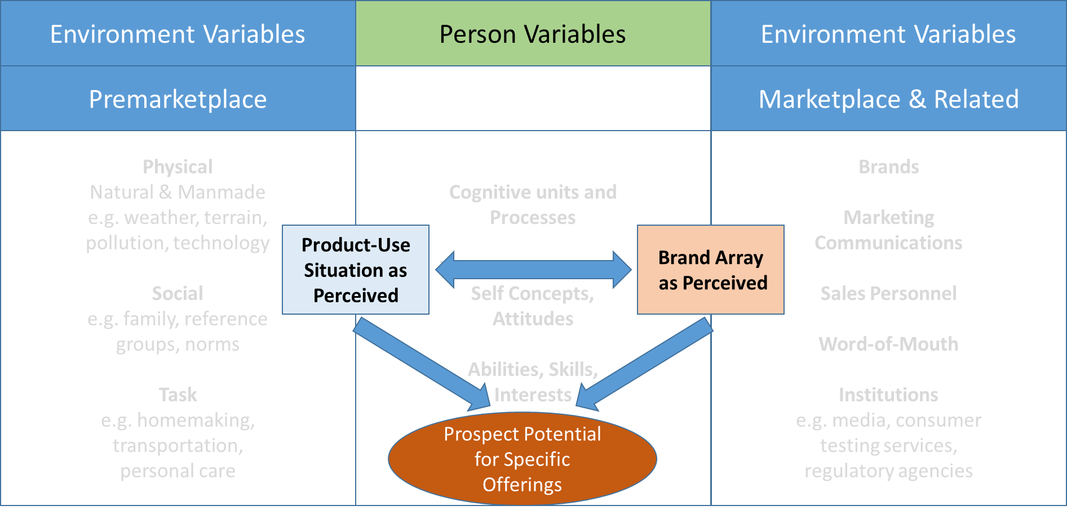
If we compare, or combine, this 2002 model with Fennell’s 1978 model, we can see that they are complementary and this 2002 models provides underlying support for Fennell’s overall concept of the person-activity occasion as the appropriate unit of study in consumer decision-making. Fennell’s 1978 model included perceptions of brands’ abilities relevant to the current motivating conditions as antecedent to the Outcomes in this 2002 model.
Adapted from Fennell, 1978
Outcomes, e.g.,
brand preferences

Slide 11
Extension and Application
In our current extensions of Fennell’s work, we are using the term ‘appetite’ for what this paper terms ‘motivating conditions.’ For instance, when visiting a mountain town, tourists may have an appetite for adventure, luxury, economy, or family recreation. When shopping for a new vehicle, drivers may care more about power, luxury, style, or technology. These all derive from the interaction between consumers’ personal conditions and the externl environment. Expressing these motivations as appetites allows us to develop appetite segments which can be served by differentiated offerings.

Slide 12
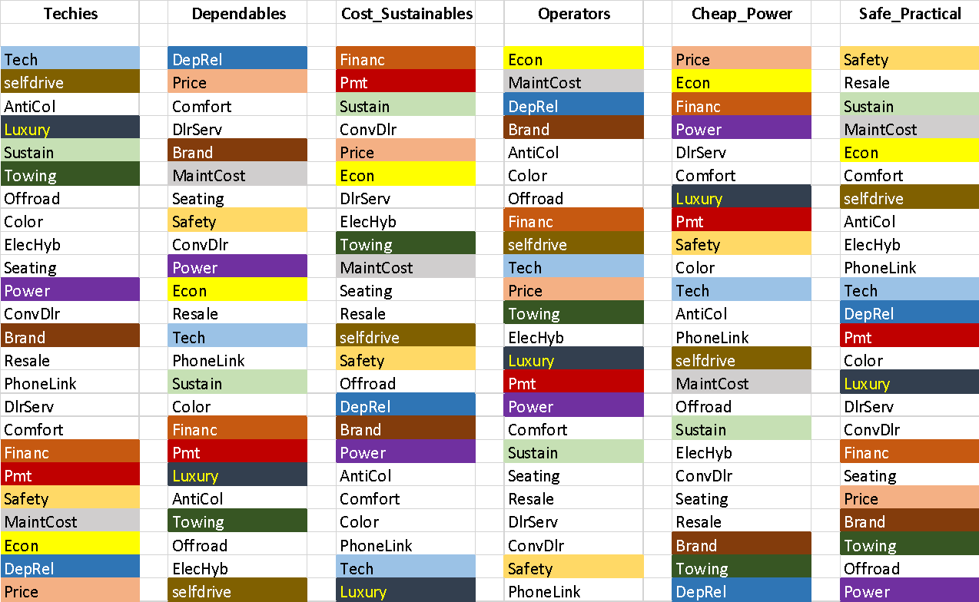
Appetite Example for Autos
In this example, drivers rated the importance of 24 attributes of a vehicle. Their ratings were used to construct seven appetite segments reflecting their primary elements of concern and interests.
Appetite Segments for Vehicle Buyers
Ranked Attribute Ratings

Slide 13
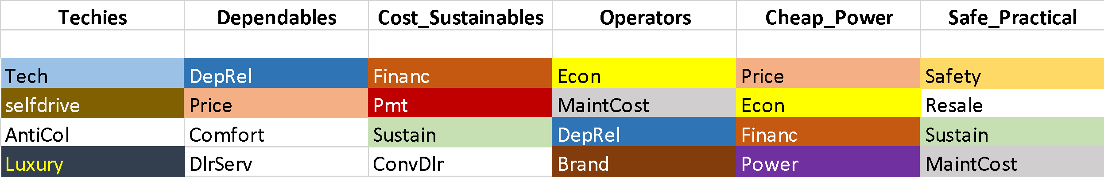
Appetite Example for Autos (continued)
Drivers’ top 4 most important attributes were used to develop a profile for the unique appetites of each segment. For instance, Techies care about technology and luxury, while Cheap Powers are most interested in price, fuel economy, financing options, and horsepower.
Appetite Segments for Vehicle Buyers
Most Important
Attributes

Slide 14
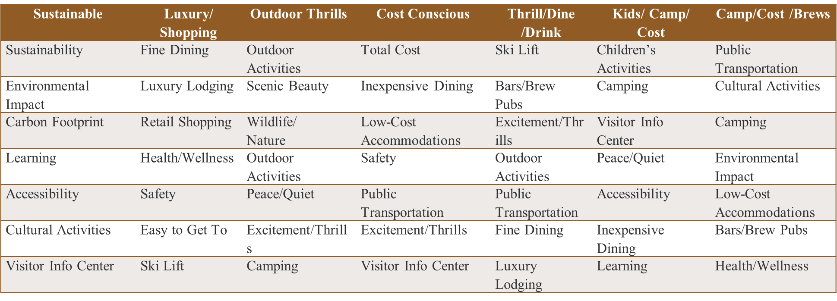
Appetite Example for Tourism
In this example, visitors to a mountain town rated the importance of 27 potential attributes of a visit. Their top 7 ratings were used to construct appetite segments reflecting their primary elements of concern and interests when selecting a destination.
Appetite Segments for Tourism

Slide 15
Applications
Fennell’s concepts highlight the importance of the occasion in defining a market and crafting an offering.
These extensions of Fennell’s model allow us to apply the framework in a variety of ways
  Comparing prospect potential across consumer groups
  Segmenting based on consumers’ appetites in unique occasions
  Better understanding consumer decision-making
  Designing marketing offerings to match specific consumer concerns and interests

