Slide 1
Revelation 13, Beast Out of The Earth
By,
Pastor Bob Rogers
Notes:
What are you doing in your life that will last forever? Stick around to the end and I will give you 5 things you can do that you don’t have to be rich to do.

Slide 2
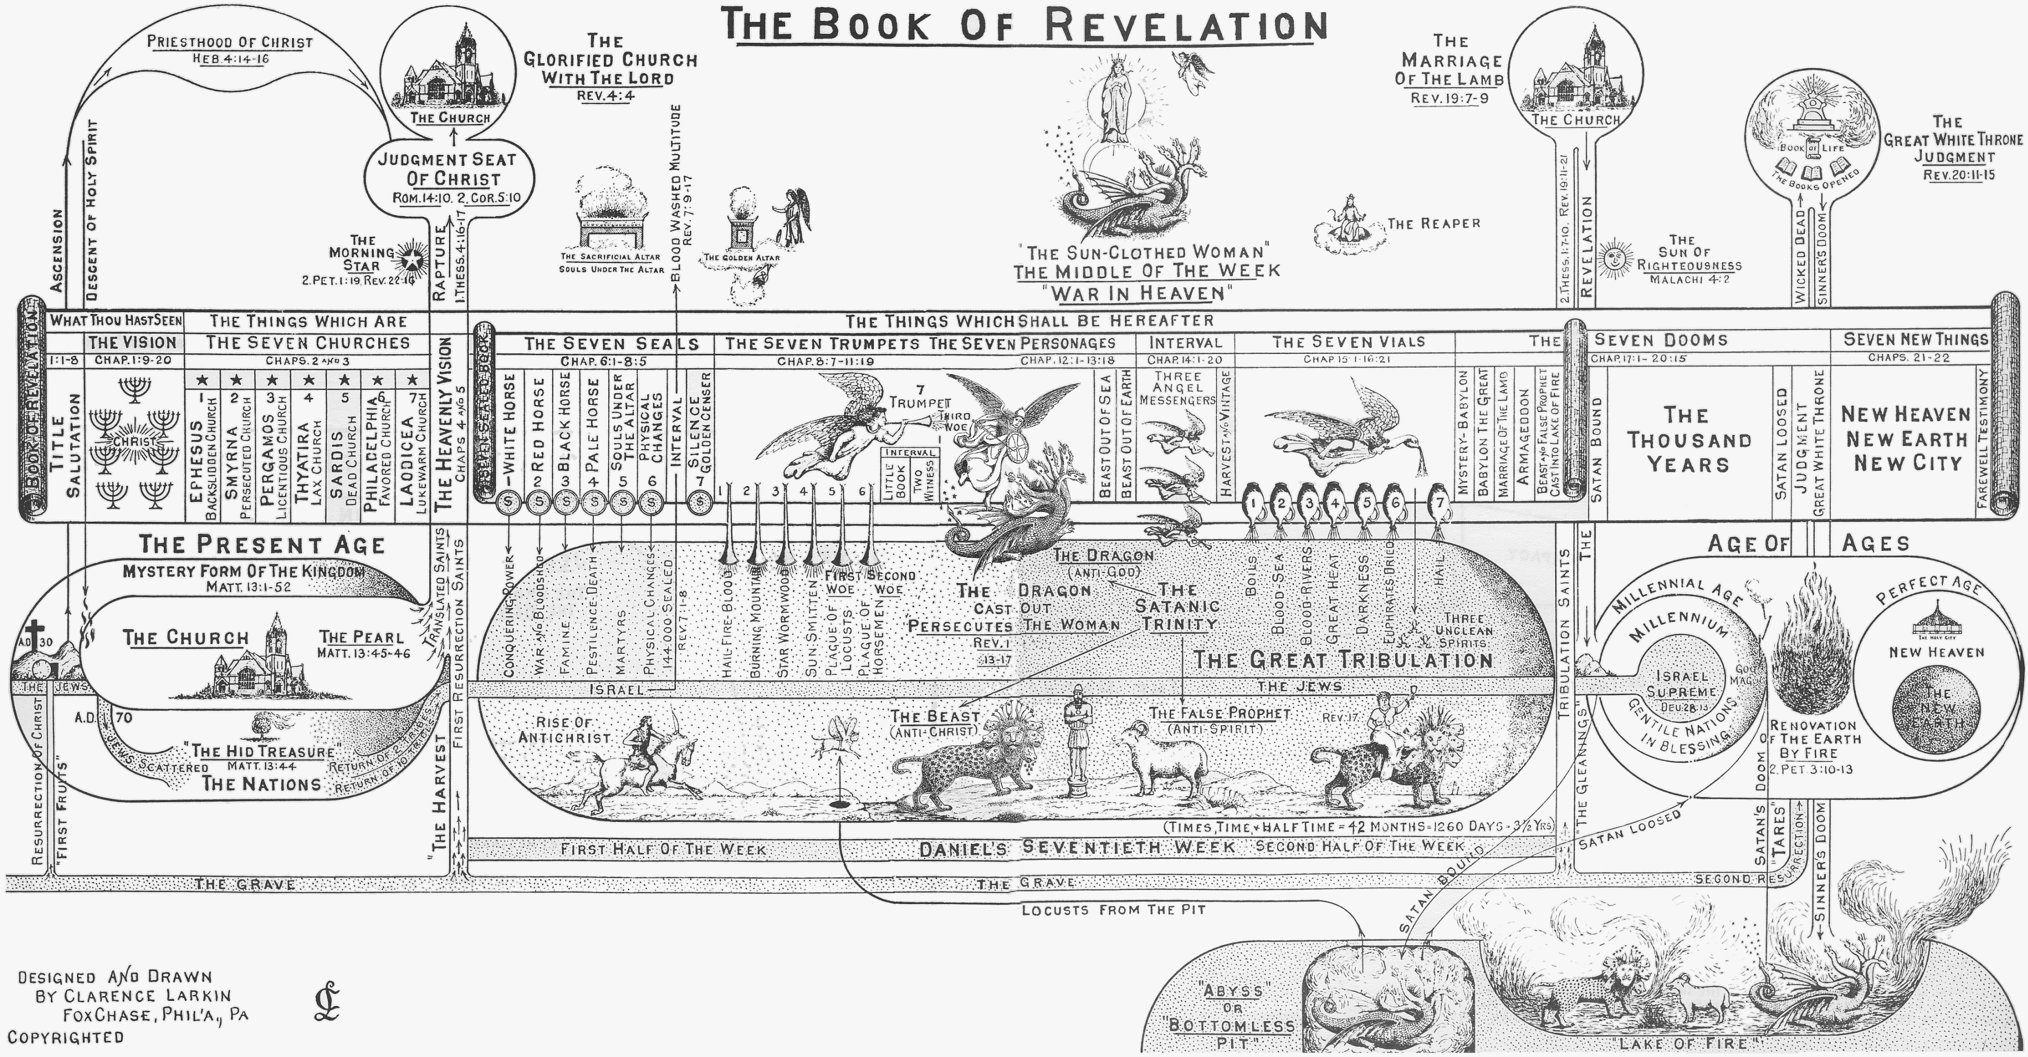

Slide 3
Comparison Revelation 13 & Daniel
Revelation 13 quoting from Daniel
Revelation 13:1 | Daniel 7:2-3 | “Beast” from “Sea”
Revelation 13:1 | Daniel 7:7-8, 20, 24 | “10 Horns”
Revelation 13:1 Revelation 13:5-6 | Daniel 7:8, 11, 20, 25 Daniel 11:36 | “Blasphemy” & “Speaking Great Things”
Revelation 13:2 | Daniel 7:4-6 | “Leopard” / “Bear” / “Lion”
Revelation 13:2 | Daniel 8:24 | “Great Power” (Source)
Revelation 13:5 | Daniel 7:25; 11:7 | “42 Months” or “3 ½ years”
Revelation 13:7 | Daniel 7:21, 25; 8:24 | “Conquer Saints”
Revelation 13:7 | Daniel 7:23 | Global Domination & Authority
Revelation 13:10 | Daniel 11:33 | “Captivity” “Sword” “Flame” “Plunder”
Revelation 13:15 | Daniel 3:6, 15 | Worship Image or Die

Slide 4
The Stratagems of Satan
Corruption of Adam’s line Genesis 6
Abraham’s seed Genesis 12, 20
Famine Genesis 50
Destruction of male line Exodus 1
Pharaoh’s pursuit Exodus 14
The populating of Canaan Genesis 12:6
Against David’s line 2 Samuel 7

Slide 5
Attacks on David’s Line
Jehoram kills his brothers 2 Chronicles 21
Arabians slew all but Ahazariah
Athaliah kills all but Joash 2 Chronicles 22
Hezekiah assaulted, etc. Isaiah 36, 38
Haman’s attempts Ester 3

Slide 6
Zechariah 11:16–17 (AV)
16 For, lo, I will raise up a shepherd in the land, which shall not visit those that be cut off, neither shall seek the young one, nor heal that that is broken, nor feed that that standeth still: but he shall eat the flesh of the fat, and tear their claws in pieces.
17 Woe to the idol shepherd that leaveth the flock! the sword shall be upon his arm, and upon his right eye: his arm shall be clean dried up, and his right eye shall be utterly darkened.
Notes:
This chapter explains the nation's rejection of the true Messiah and how they will accept a false messiah, the Antichrist, who will appear at the end of the age and deceive the whole world. The key image in the chapter is that of the shepherd, and three different shepherds are presented.
The wailing shepherds (vv. 1-3). These brief verses describe the invasion of the Holy Land by the Romans.
The true Shepherd (Zech. 11:4-14). God commanded Zechariah to play the role of the true Shepherd. He became a type of the Messiah at the time when our Lord was ministering on earth. The flock of Israel was destined for slaughter because of their wicked rulers, but he was to do his best to rescue them.
The false shepherd (Zech. 11:15-17). The prophet was then commanded to adopt the role of a "foolish shepherd." The word "foolish" doesn't mean "stupid" but "morally deficient, corrupt" because he doesn't receive God's truth. He's also called "a worthless (idle) shepherd," because he doesn't care for the sheep. Unlike the Good Shepherd, he doesn't seek the lost, care for the young, feed the flock, or heal the injured. All he does is slaughter the flock to feed himself! (See Ezek. 34.)
Because Israel rejected their true Shepherd, Jesus Christ, they will one day blindly accept and obey the false shepherd (Antichrist) who will lead them astray. Those who reject the light inevitably accept the darkness. "I have come in My Father's name," said Jesus, "and you do not receive Me; if another comes in his own name, him you will receive" (John 5:43).

Slide 7
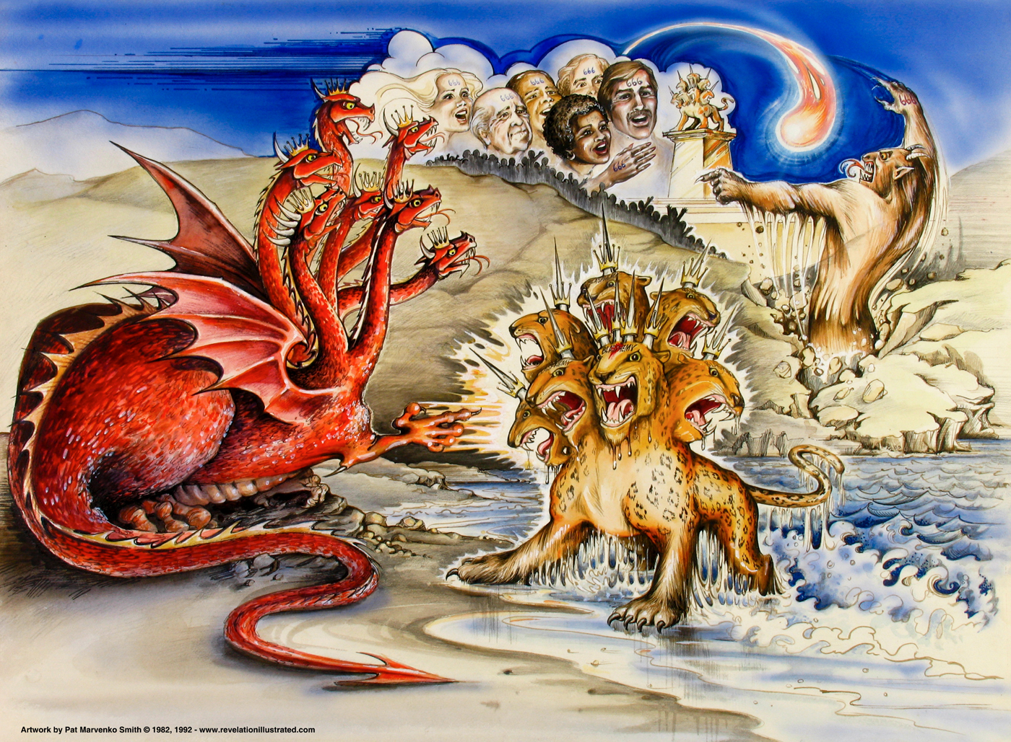
Notes:
Today, there is a movement caught up in signs and wonders. Most of these signs and wonders are not from God. Now, let me make it clear, God is still moving and things happen that can only be God doing them. However, there are other spirits at work today and it will be highly magnified in the Great Tribulation. Those signs will not be from God. Many of those stuck on signs and wonders of today may be the ones who sell completely out to the Antichrist in the Great Tribulation. Faith is more important that signs and wonders. Without Faith it is impossible to please God.

Slide 8
Revelation 13:11–12 (AV)
11 And I beheld another beast coming up out of the earth; and he had two horns like a lamb, and he spake as a dragon.
12 And he exerciseth all the power of the first beast before him, and causeth the earth and them which dwell therein to worship the first beast, whose deadly wound was healed.

Slide 9
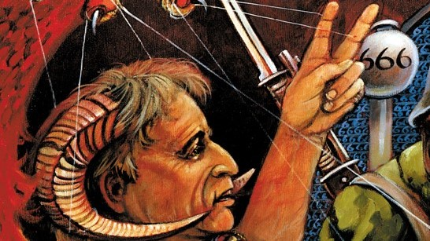

Slide 10
Beast Out of The Earth
After the Apostle John had seen and described the “Beast” that came up out of the SEA, he saw another “Beast” come up out of the EARTH.
This “Second Beast,” while John does not say it was a lamb, had “Two Horns” “like a lamb,” that is, it was LAMB-LIKE.
Because of this resemblance many claim that the “Second Beast” is the Antichrist, for Antichrist is supposed to imitate Christ.
While the LAMB (Christ) is mentioned in the Book of Revelation 22 times, the description given of Him in chapter 5:6, is that of a lamb having “SEVEN HORNS” and not “TWO.”
This differentiates Him from the “lamb-like Beast” that comes up out of the earth, who, though he is “lamb-like in appearance SPEAKS AS A DRAGON.”

Slide 11
Beast Out of The Earth
The “Second Beast” has a name. He is called the “FALSE PROPHET” three times.
First in chapter 16:13, then in chapter 19:20, and again in chapter 20:10.
Twice he is associated with the “First Beast” (Antichrist) and once with the “Dragon” (Satan) and the “First Beast,” and as they are PERSONS so must he be.
The fact that he is called the “False Prophet” is proof that he is not the “Antichrist.”
Jesus had a foreview of him when He said—“There shall arise ‘FALSE CHRISTS’ and ‘FALSE PROPHETS,’ and shall show GREAT SIGNS AND WONDERS: insomuch that, if it were possible they shall deceive the very elect.” Matt. 24:24.
Here Jesus differentiates between “FALSE CHRISTS” and “FALSE PROPHETS,” therefore the “ANTICHRIST” and the “FALSE PROPHET” cannot be the same.

Slide 12
Beast Out of The Earth
In the “Dragon,” the “Beast,” and the “False Prophet,” we have the “SATANIC TRINITY,” Satan’s imitation of the “Divine Trinity.”
In the unseen and invisible “Dragon” we have the FATHER (the ANTI-GOD).
In the “Beast” we have the “SON OF PERDITION” (the ANTI-CHRIST), begotten of the Dragon, who appears on the earth, dies, and is resurrected, and to whom is given a throne by his Father the Dragon.
In the “False Prophet” we have the “ANTI-SPIRIT,” who proceeds from the “Dragon Father” and “Dragon Son,” and whose speech is like the Dragon’s.
The “Dragon” then will be the “ANTI-GOD,” the “Beast” the “ANTI-CHRIST,” and the “False Prophet” the “ANTI-SPIRIT,” and the fact that all three are cast ALIVE into the “Lake of Fire” (Rev. 20:10) is proof that they together form a “Triumvirate” which we may well call—“THE SATANIC TRINITY.”

Slide 13
Beast Out of The Earth
Again the “Antichrist” is to be a KING and rule over a KINGDOM.
He will accept the “Kingdoms of this world” that Satan offered Christ, and that Christ refused. Matt. 4:8–10.
He will also EXALT himself, and claim to be God. 2 Thess. 2:4.
But the “False Prophet” is not a King, He does not exalt himself, he exalts the “First Beast” (Antichrist).
His relation to the “First Beast” is the same as the Holy Spirit’s relation to Christ.
He causeth the earth and them which dwell therein to worship the “First Beast.”
He also has power to give life, and in this he imitates the Holy Spirit.
And as the followers of Christ are sealed by the Holy Spirit until the “Day of Redemption” (Eph. 4:30); so, the followers of Antichrist shall be sealed by the False Prophet until the “Day of Perdition.” Rev. 13:16–17.

Slide 14
Revelation 13:13–14 (AV)
13 And he doeth great wonders, so that he maketh fire come down from heaven on the earth in the sight of men,
14 And deceiveth them that dwell on the earth by the means of those miracles which he had power to do in the sight of the beast; saying to them that dwell on the earth, that they should make an image to the beast, which had the wound by a sword, and did live.

Slide 15
The Miracle Worker
The False Prophet will be a “Miracle Worker.”
While Jesus was a “miracle worker,” He did all His mighty works in the “power” of the Holy Spirit. Acts 10:38.
Among the miracles that the False Prophet will perform he will bring down FIRE FROM HEAVEN.
As we have seen under the work of the “Two Witnesses,” chapter 11:1–14, there will probably be a “FIRE-TEST” between Elijah and the False Prophet, and the test as to who is God of Mt. Carmel will be repeated.
That Satan, who will then energize the False Prophet, can do this is clear from Job 1:16, where Satan, having secured permission from God to touch all that Job had, brought down “fire from heaven” and burned up Job’s sheep and servants.

Slide 16
The Miracle Worker
The False Prophet then commands the people to make an “IMAGE OF THE BEAST.”
This is further proof that the “First Beast” is the Antichrist.
It is a strange weakness of mankind that they must have some VISIBLE God to worship, and when the Children of Israel, who had been delivered from Egypt under Moses’ leadership, thought he had forsaken them because he did not come down from the Mount, they called Aaron to make them gods which should go before them, and Aaron made for them the “GOLDEN CALF.” Ex. 32:1–6.
So the False Prophet will have the people make for the purpose of worship an “IMAGE OF THE BEAST.” But the wonderful thing about the “IMAGE” is that the False Prophet will have power to give LIFE to it, and cause it to SPEAK, and to demand that all who will not worship it shall be put to death. In other words the “IMAGE” will be a living, speaking, AUTOMATON.

Slide 17
Revelation 13:15–16 (AV)
15 And he had power to give life unto the image of the beast, that the image of the beast should both speak, and cause that as many as would not worship the image of the beast should be killed.
16 And he causeth all, both small and great, rich and poor, free and bond, to receive a mark in their right hand, or in their foreheads:

Slide 18
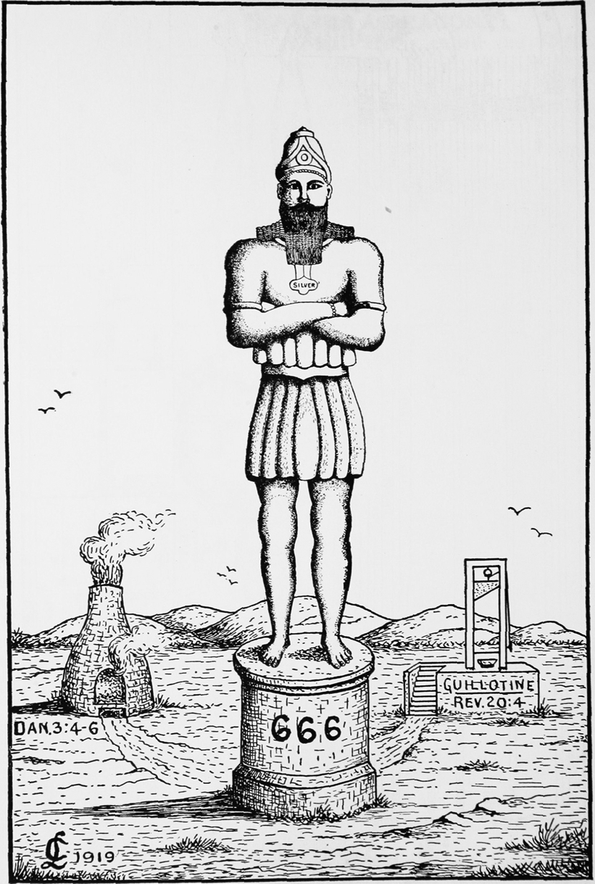

Slide 19
The Image
This “Image” reminds us of the “GOLDEN IMAGE” that Nebuchadnezzar commanded to be made and set up in the “Plain of Dura,” in the Province of Babylon (Dan. 3:1–30), before which, at the sounding of musical instruments, the people were commanded to bow down and worship under penalty, for those who disobeyed, of being cast into a “BURNING FIERY FURNACE.” Doubtless there will be many in the “Day of Antichrist” who will refuse to bow down and worship the “Image of the Beast,” and who will not escape as did the “Three Hebrew Children,” though God may interpose in a miraculous way to deliver some. And as if this was not enough the False Prophet shall cause—“ALL, both small and great, rich and poor, free and bond, to receive a ‘MARK’ in their RIGHT HAND, or in their FOREHEAD; and that no man might BUY or SELL, save he that has the ‘MARK’ or the ‘NAME OF THE BEAST,’ or the ‘NUMBER OF HIS NAME’.” This “MARK” will be known as the

Slide 20
Revelation 13:17–18 (AV)
17 And that no man might buy or sell, save he that had the mark, or the name of the beast, or the number of his name.
18 Here is wisdom. Let him that hath understanding count the number of the beast: for it is the number of a man; and his number is Six hundred threescore and six.

Slide 21
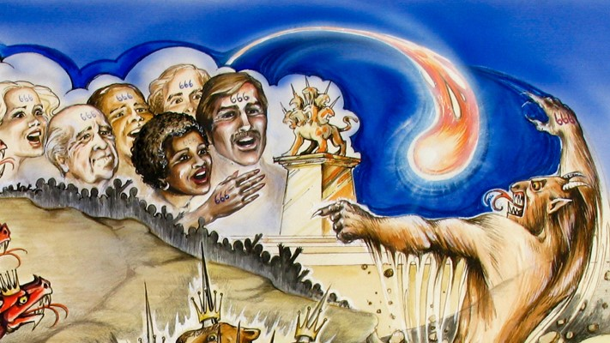

Slide 22
7 Personages of Revelation
Sun Clothed Woman Revelation 12:1-2
The Dragon Revelation 12:3-4
The Man Child Revelation 12:5-6
The Archangel Revelation 12:7-12
The Jewish Remanent Revelation 12:17
The Beast Out of The Sea Revelation 13:1-10
The Beast Out of The Land Revelation 13:11-18

Slide 23
Heaven

Slide 24
Sin
Romans 3:23 KJV For all have sinned, and come short of the glory of God;

Slide 25
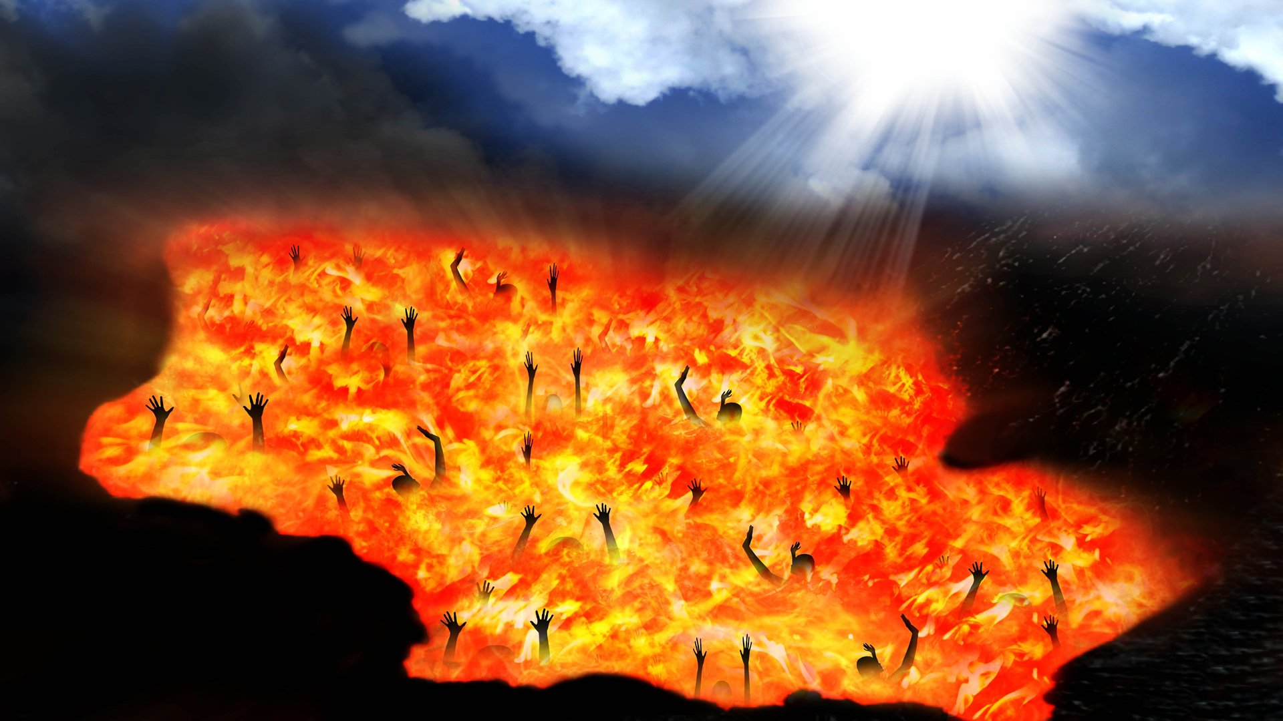
Revelation 20:15 KJV And whosoever was not found written in the book of life was cast into the lake of fire.

Slide 26
Jesus Died and Shed His Blood
Hebrews 9:22 KJV And almost all things are by the law purged with blood; and without shedding of blood is no remission.
Ephesians 1:7 KJV In whom we have redemption through his blood, the forgiveness of sins, according to the riches of his grace;
Jesus died for our sin, was buried, and rose again. He is the payment for our sin.

Slide 27
Jesus Died to make us Ready for Heaven
Psalm 51:7 (KJV)
7 Purge me with hyssop, and I shall be clean: wash me, and I shall be whiter than snow.

Slide 28
Heaven
Revelation 22:3-7 KJV And there shall be no more curse: but the throne of God and of the Lamb shall be in it; and his servants shall serve him: (4) And they shall see his face; and his name shall be in their foreheads. (5) And there shall be no night there; and they need no candle, neither light of the sun; for the Lord God giveth them light: and they shall reign for ever and ever. (6) And he said unto me, These sayings are faithful and true: and the Lord God of the holy prophets sent his angel to shew unto his servants the things which must shortly be done. (7) Behold, I come quickly: blessed is he that keepeth the sayings of the prophecy of this book.

Slide 29
Repentance
Acts 26:20
Change of Mind about Jesus Acts 10:43
A Gift of Holy Ghost Acts 11:18
Saved Person=Justified Person=Born Again Person
=Standing
James 2:24; 1:1; 5:7-9; Rev. 7:4; 14:12; Galatians 2:9
No Standing
Romans 4:5-8; 1:6
Spiritual Nature
Fleshy Nature, Carnal
=State
=State
Wicked Lost Sinner
Jeremiah 13:23
Worst kinds of sins
Carnal
Wicked at the end
Still in sin
Not sorry
Unbelief to Belief
Not surrendered
Works & Fruits
Spiritual
Spiritual at the end
Turn from sin (willing)
Sorry
Belief that grows
Surrender all
Worst kinds of Sin
Carnal
Wicked at the core
Still in sin
Not sorry
Good works
Not surrendered
1 Cor. 3:16-17; 5; 2 Cor. 2:6-8; 2 Cor. 7:10; Philippians 1:6
Easy Believeism Lordship Salvation
Saved person has two natures—Carnal/Spiritual
Notes:
Jeremiah 13:23 (NLT2) ²³ Can an Ethiopian change the color of his skin? Can a leopard take away its spots? Neither can you start doing good, for you have always done evil. Acts 11:18 (KJV) ¹⁸ When they heard these things, they held their peace, and glorified God, saying, Then hath God also to the Gentiles granted repentance unto life.
The question is then, do you believe? Do you believe Jesus is who He says He is?
Have you had that moment? That moment where you decided, you made the decision — you’re all in. You’re going to believe in faith that Jesus is who He says He is. That God is real. That He is your Father. That you are His son, His daughter.
And then it hits you. You realize… if you believe Jesus is exactly who He says He is, the risen Son of the Most High God… it changes everything.
So as Peter spoke the death, burial, and resurrection to the household of Cornielus he and his whole household believed on Jesus and they were filled with the Holy Spirit. Act 10:43 To him give all the prophets witness, that through his name whosoever believeth in him shall receive remission of sins.

Slide 30
What are you doing in your life that will last forever?
All of the magnificent buildings of Solomon, including the Temple, are gone. All of the wonderful buildings of Herod are rubble. The Pyramids are crumbling, the Tower of Pisa is leaning . . . Paul came to Thessalonica with an offer of something they could become a part of that never ends. Christ said here is something anyone in my family can do! Jesus said:
I collect all of your prayers - PRAY! Revelation 5:8 And when he had taken the book, the four beasts and four and twenty elders fell down before the Lamb, having every one of them harps, and golden vials full of odors, which are the prayers of saints. (KJV)

Slide 31
What are you doing in your life that will last forever?
I multiply sacrificial gifts - GIVE! Mark 12:42 And there came a certain poor widow, and she threw in two mites, which make a farthing. (KJV)
I count souls you lead to me - WIN! Daniel 12:3 And they that be wise shall shine as the brightness of the firmament, and they that turn many to righteousness as the stars forever and ever. Proverbs 11:30 The fruit of the righteous is a tree of life, and he that winneth souls is wise. 1 Corinthians 3:10 According to the grace of God which is given unto me, as a wise master builder, I have laid the foundation, and another buildeth thereon. But let every man take heed how he buildeth thereupon. (KJV)

Slide 32
What are you doing in your life that will last forever?
I remember humble service - SERVE! Mark 14:3 And being in Bethany in the house of Simon the leper, as he sat at meat, there came a woman having an alabaster box of ointment of spikenard very precious; and she broke the box, and poured it on his head. (KJV)
I love missionaries that do outreach - GO! Matthew 19:29 And every one that hath forsaken houses, or brethren, or sisters, or father, or mother, or wife, or children, or lands, for my name's sake, shall receive an hundredfold and shall inherit everlasting life. (KJV)
https://discoverthebook.org/

Slide 33
