Slide 1
Revelation 14, The Lamb and The 144,00
By,
Pastor Bob Rogers

Slide 2
Outline for Revelation
Revelation 1:19 (AV)
19 Write the things which thou hast seen, and the things which are, and the things which shall be hereafter;
Things Thou Hast Seen Chapter 1
Things Which Are Chapter 2-3
These are the 7 Churches
Most important part of Revelation
Things Which Shall Be Hereafter Chapter 4-22
The Church will be in Heaven

Slide 3
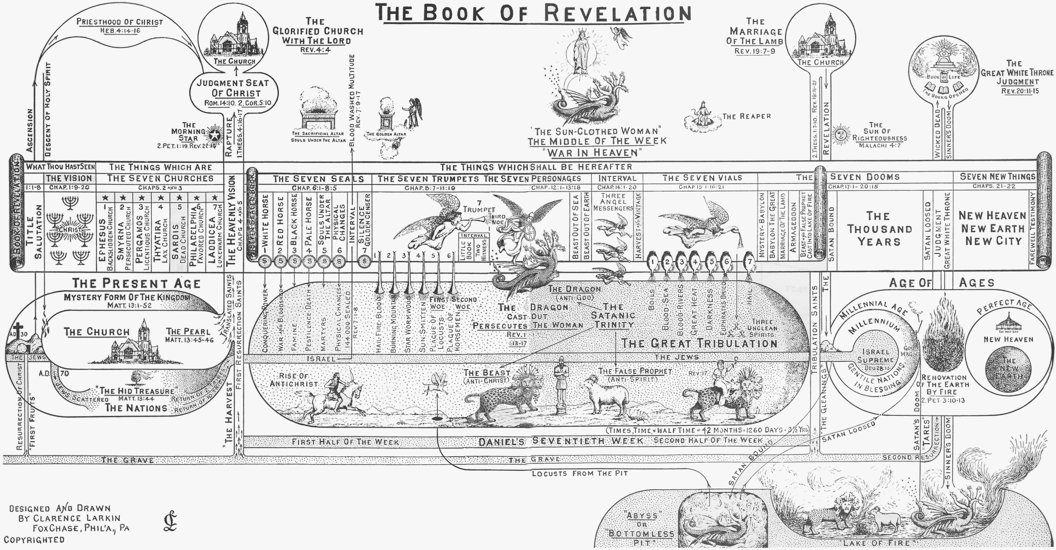

Slide 4
Parenthetical Chapters
Chapter 10
The Little Book
The Seven Thunders
Chapter 11
The Temple
The Two Witnesses
Chapter 12
The Woman, the Man Child, and the Dragon
Chapter 13
The Two Beasts
Chapter 14
The Lamb and The 144,000 all male choir
The Everlasting Gospel
Three angelic evangelists
Notes:
Chapter 14 brings to a conclusion the material found in the section of chapters 12 through 14. Chapter 12 deals with the important characters of the period, chapter 13 with the wicked rulers of the period, and chapter 14 with the ultimate triumph of Christ. All of this material is not chronological but prepares the way for the climax which begins in chapter 15. Chapter 14 consists of a series of pronouncements and visions assuring the reader of the ultimate triumph of Christ and the judgment of the wicked. Much of the chapter is prophetic of events that have not yet taken place, but which are now impending. The chapter begins with the assurance that the Lamb will ultimately stand in triumph on Mount Zion with his followers, and it concludes with a series of pronouncements of judgments upon the wicked.

Slide 5
Revelation 14:1–2 (AV)
1 And I looked, and, lo, a Lamb stood on the mount Sion, and with him an hundred forty and four thousand, having his Father’s name written in their foreheads.
2 And I heard a voice from heaven, as the voice of many waters, and as the voice of a great thunder: and I heard the voice of harpers harping with their harps:
Notes:
We have met this company before, only last time they were on earth. This is the illustrious company of the 144,000 who are sealed from twelve of Israel’s tribes (Rev. 7). These sealed ones have been preserved unharmed throughout the Great Tribulation, despite the rage of the dragon and the Beast. Unscathed, they have marched right down those dreadful years with horrors abounding on every hand and with every demon from the pit clutching at them in vain

Slide 6
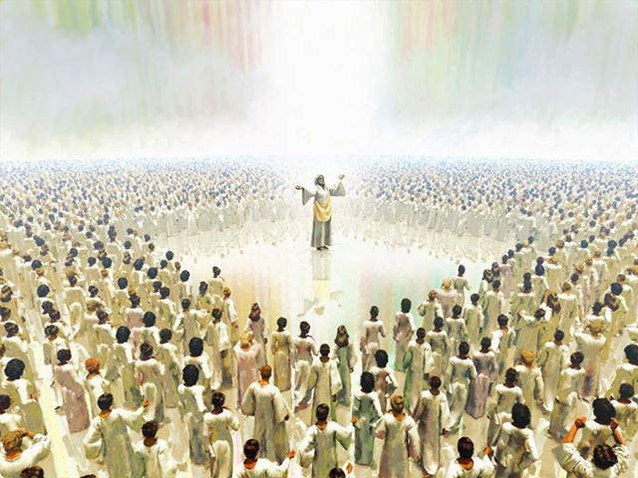
Notes:
Rev 7:4 And I heard the number of them which were sealed: and there were sealed an hundred and forty and four thousand of all the tribes of the children of Israel.

Slide 7
They Are an Exalted Company (14:1)
This is evident from what John says, And I looked, and lo, a Lamb stood on the mount Sion, and with him a hundred forty and four thousand, having his Father’s name written in their foreheads. Not one of the number is missing.
There were a 144,000 before the Tribulation began; all are safe now in heaven. The heavenly Zion is evidently in view, because the Lord has not yet descended to earth. Also, events in the immediate context seem clearly connected with the activity of heaven.
We are not told how or when these Jewish believers were caught up to heaven. But there they are, the firstfruits of the Tribulation harvest (14:5). standing now in the very location described by John in chapters 4 and 5; standing before God, before the living creatures, and before the twenty-four elders.

Slide 8
They Are an Exultant Company (14:2–3a)
John tells us what this exalted company is doing in heaven.
And I heard a voice from heaven as the voice of many waters, and as the voice of a great thunder: and I heard the voice of harpers harping with their harps: and they sung as it were a new song before the throne, and before the four beasts, and the elders.
The book of Revelation, so full of sorrow, strife, and tears, is also a book filled with song! Bring the Lamb into the picture, and immediately there is song!
The Lord has an amazing ability to make His people happy. One of the wonders of the God of the Bible is that He is a happy God!

Slide 9
They Are an Exultant Company (14:2–3a)
The gods of the pagans are fierce, wicked, and cruel, delighting in the tears and tremblings of men and feasting on human fear.
But our God is a happy God.
He picks us up from the horrible pit.
He plants our feet upon the rock.
He puts a new song into our mouth.
One of the greatest lessons we can learn in life is simply that there can be no real happiness apart from true holiness.
God is altogether holy; therefore He is altogether happy.
When we are filled with the Spirit, we sing! (Ps. 40:2–3; Eph. 5:18–19). This exalted company of God’s people is also an exultant company. They fill the courts of heaven with their song until the very hills thunder back the sound.
Notes:
Not only do the gods of the pagans delight in fear, the globalists delight in feasting on the fear of human sacrifice. There are horrors so terrible I can’t begin to comprehend them all. If this is how it is going to be then, let us understand we are but a hair’s breath from being there. Thank you Jesus that you pull us out of this terrible time. Let us understand the time of our departure is at hand. It could happen any time.

Slide 10
Revelation 14:3 (AV)
3 And they sung as it were a new song before the throne, and before the four beasts, and the elders: and no man could learn that song but the hundred and forty and four thousand, which were redeemed from the earth.

Slide 11
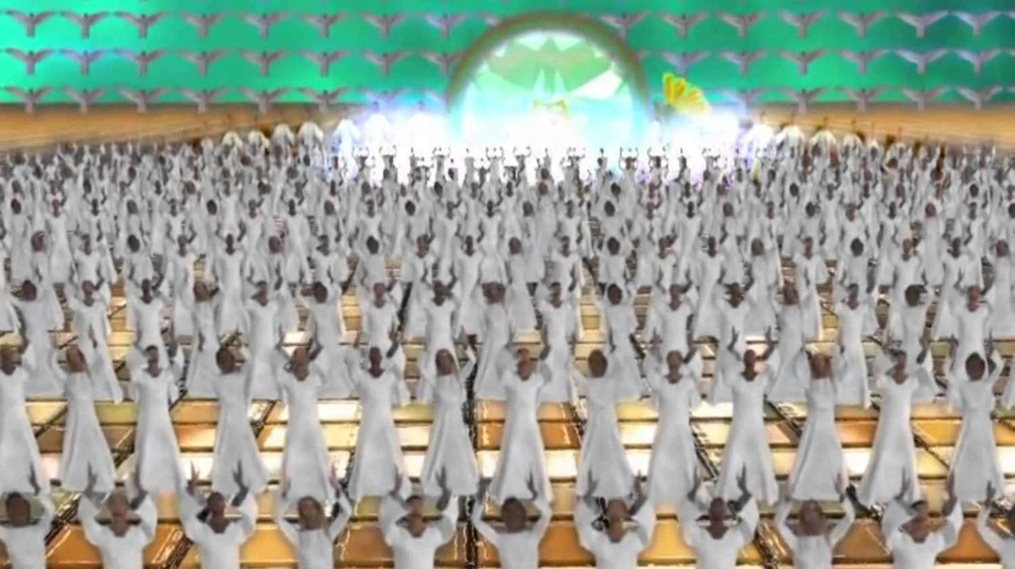
Notes:
14:1–5 History’s greatest all-male choir. The scene now shifted back to heaven (14–15), where John saw the 144,000 (see exposition on 7:1–8), now taken up to heaven, singing a song of redemption.

Slide 12
They Are an Exclusive Company (14:3b)
There are not many like them, even in heaven. John says, And no man could learn that song but the hundred and forty and four thousand, which were redeemed from the earth.
Their experiences are almost unique. Not many, even of God’s choicest saints, have walked through the flood and the flame as God’s untouchables.
There has been a Meshach, a Shadrach, an Abednego, perhaps, and a Daniel in the lions’ den, saints “who through faith subdued kingdoms, wrought righteousness, obtained promises, stopped the mouths of lions, quenched the violence of fire, escaped the edge of the sword, out of weakness were made strong, waxed valiant in fight, turned to flight the armies of the aliens” (Heb. 11:33–34).

Slide 13
They Are an Exclusive Company (14:3b)
There have been some, but their ranks are thin. No other age has produced a company like this, a veritable army of militant believers marching unscathed through every form of danger.
It has been theirs to defy the dragon, to bait the Beast, and to give the lie to the false prophet. Their calling has been to preach the gospel from the housetops when even to name the name of Christ called for the most dreadful penalties.
They have been surrounded, these latter-day Jobs, with impenetrable hedges, able to laugh to scorn all the grand inquisitors of hell.
They have walked the streets in broad daylight, careless of the teeth-gnashing rage of their would-be torturers and assassins, true witnesses of Jehovah in the most terrible era of the history of mankind.

Slide 14
They Are an Exclusive Company (14:3b)
The devil knows about this coming band of conquerors, and writhes already in an agony of anticipation.
By way of revenge he has built a cult already to parody these witnesses. It is a typical attempt of his to pour scorn on everything divine.
These saints are not sealed and set apart by God in this present age of grace, but they will appear on earth after the church has gone.
They will triumph gloriously while on earth, and then they will celebrate that triumph in a new song before the throne. The words of that song will be theirs alone to sing. No one else will be able to learn its words never having had their unique experience.

Slide 15
Revelation 14:4–5 (AV)
4 These are they which were not defiled with women; for they are virgins. These are they which follow the Lamb whithersoever he goeth. These were redeemed from among men, being the firstfruits unto God and to the Lamb.
5 And in their mouth was found no guile: for they are without fault before the throne of God.

Slide 16
They Are an Exemplary Company (14:4–5)
They are exemplary in five ways.
They are exemplary in their conduct.
John says, These are they which were not defiled with women; for they are virgins. This may be a figurative reference to their separated, sanctified spirituality, for no doubt these people will be marked by lofty standards of separation from the world and by spiritual sanctity.
However, there is more than a figurative reference to spirituality here. These witnesses have separated themselves absolutely, in a practical, purposeful way from the Babylonish, worldly religious system of the Beast.
The religion of the Beast, in common with so many pagan religions, will have at its base a vile immorality that will openly pander to every lust of the human heart. With the man of sin enthroned, lust will be applauded. It will be consecrated as an act of worship as it was by the ancient Canaanites and has been in fertility cults ever since. This company sets itself apart from all that.

Slide 17
They Are an Exemplary Company (14:4–5)
They are exemplary in their consecration.
We are told. These are they which follow the Lamb whithersoever he goeth. Their reward for such conduct while on earth will be to accompany Him as His constant companions in heaven. Absolute devotion to Christ is the driving force behind their godly lives on earth.
Like Caleb, their testimony is that they wholly follow the Lord. They allow no rivals, no refusals, and no restraint to mar their dedication to Him. Does He need someone to stand upon the steps of the Vatican and cry out against the marriage of Christendom to the Beast? There are 144,000 ready to go!
Does the Lord need someone to beard the Beast at some high function of state and roundly denounce him, his policy, his statecraft, his religion, his economic boycott, his mark, his ministers, his alliance with Satan? There are 144,000 eager to go!
Does the Lamb need evangelists to proclaim to the untold millions the gospel of the coming kingdom of God? to climb the highest Himalayas, to cross the desert sands, to blaze evangelistic trails through steaming jungles, or to mush huskies across wide arctic wastes? There are 144,000 ready to go!
And though the Beast’s gestapo dog their footsteps and wreak upon their converts his direst vengeance, yet on they go undaunted and undeterred. That was the very spirit of their consecration as they followed the Lamb whithersoever He led them on earth, and their reward is in kind.

Slide 18
They Are an Exemplary Company (14:4–5)
They are also exemplary in their calling.
John says, These were redeemed from among men, being the firstfruits unto God and to the Lamb. Israel kept an annual feast of firstfruits.
Each year the farmer went into his fields of swiftly ripening grain and cut out one sheaf. This sheaf was then presented to God. It was not the whole harvest, but it represented the whole.
It was a token of a work well done. This company make up the firstfruits of those who throughout the Tribulation will make their calling and election sure.

Slide 19
They Are an Exemplary Company (14:4–5)
They are exemplary in their conversation.
How simple is the statement.
And in their mouth was found no guile. When preaching the gospel, they do not conceal from their hearers that faith in Christ will be followed by swift retribution from the Beast.
They tell the truth, the whole truth, and nothing but the truth. “In their mouth was not found the lie” is the way some render it.
Others are mouthing the slogans of the Beast, chanting the vile creeds of his new world cult, and hailing him as the revealer of secrets, the savior of mankind, but these victorious believers refuse to pay lip service to him. They refuse to sing the praise of the Beast. In their mouth is not found the lie.

Slide 20
They Are an Exemplary Company (14:4–5)
They are, moreover, exemplary in their character.
John says, For they are without fault before the throne of God.
They have entered into the truth of Jude 24, “Now unto him that is able to keep you from falling, and to present you faultless before the presence of his glory with exceeding joy.”
They have entered fully into the righteousness of Christ of whom we read that He “offered himself without spot [faultless) unto God” (Heb. 9:14). The word implies that they are without blemish, just as the Old Testament sacrifices were without blemish. Animals offered on Jewish altars were scrutinized to make sure that they were perfect.
Here, then, is a company of God’s people who are saved, sealed, separated, sanctified, and spotless!
Yet we, in this age, members of the Body of Christ, are of a higher and holier order than they! What manner of people ought we to be!

Slide 21
Dispensations
God’s dealings with people in Old Testament times passed through various phases, often referred to as dispensations. He used different methods with the human race at different times and entered into various covenant relationships with men and nations.
The Old Testament ages passed through the age of innocence in the Garden of Eden before the Fall,
The age of conscience from Adam to the Flood,
The age of human government from Noah to Abraham,
The age of promise from Abraham to Moses, and
The age of law from Moses to the time of Christ.
All these ages have climaxed in the present age of Grace.
The Tribulation and 1000 year reign are future dispensatons
It is upon us that “the end of the ages are come.” When our age is over, events will move rapidly to a final fulfillment of all that was anticipated in the Old Testament. In the meantime, the experiences of the Hebrew people afford valuable lessons for us.

Slide 22
1 Corinthians 10:11 (AV)
11 Now all these things happened unto them for ensamples: and they are written for our admonition, upon whom the ends of the world are come.

Slide 23
Things Are Shaping Up Fast How God Wants Us To Live
1 Corinthians 10:11
Paul believed he was living in the last days.
He planned his days as if it were his last day.
He lives as if his next day will be spent in front of Jesus Christ.
Paul includes himself in the Rapture of the Church. 1 Thessalonians 4:15 (AV)
15 For this we say unto you by the word of the Lord, that we which are alive and remain unto the coming of the Lord shall not prevent them which are asleep.
Notes:
15 For this we declare to you by a word from the Lord, that we who are alive, who are left until the coming of the Lord, will not precede those who have fallen asleep.

Slide 24
Life in New Testament World
Deified Emperors wanting to be worshipped
Strong Religious deceptions
Multiplied false teachers
Physical & Mental persecutions
Looming imprisonments
Empire-wide unrest
Famines and pestilences
Notes:
15 For this we declare to you by a word from the Lord, that we who are alive, who are left until the coming of the Lord, will not precede those who have fallen asleep.

Slide 25
Life Today
Political leaders wanting to be worshipped and made rich
Covid-19 pandemic fear
Nuclear proliferation
Terrorism
Global religious deception
Financial uncertainty
Political uncertainty
Notes:
15 For this we declare to you by a word from the Lord, that we who are alive, who are left until the coming of the Lord, will not precede those who have fallen asleep.

Slide 26
Living for Jesus at the End of The Age Paul’s Life our Example
Justified (Saved) AD 33 approx. Acts 9:1-22
Arabia 33-35 AD Galatians 1:17-18
Tarsus 36-43 AD Acts 9:23-30
Antioch 43-46 AD Acts 11:25-30
First Mission Trip 47-49 AD Acts 13-14
Paul trained 14 Years to serve 10
Notes:
15 For this we declare to you by a word from the Lord, that we who are alive, who are left until the coming of the Lord, will not precede those who have fallen asleep.

Slide 27
Living for Jesus at the End of The Age Paul’s Life our Example
Second Mission Trip 50-52 AD Acts 15-18:22 –Ga. 1&2nd Thess.
Third Mission Trip 52-56 AD Acts 18:23-21:16 —1&2nd Cor., Romans
Caesarea 56-58 AD Acts 21:17-28:31
Rome 59-62 AD Luke&Acts, Eph. Philippians, Colossians, Philemon
Final 62-67 AD ?? Wrote 1 Timothy, Titus, 2nd Timothy
10 Years to serve then Hard suffering decade mostly alone
14 Years to train, 10 years alone waiting for ? Death comes
Notes:
15 For this we declare to you by a word from the Lord, that we who are alive, who are left until the coming of the Lord, will not precede those who have fallen asleep.

Slide 28
Living for Jesus at the End of The Age Paul’s Life our Example
Study all you can—Philippians 3:10, Galatians 1:12,17
preparation is vital
That I might know Him
Wait for God’s timing—Philippians 2:5
Spiritual growth takes time
Spent 7 years in Tarsus
Let this mind be in you
Listen to a Barnabas—Galatians 2:20
everyone needs discipled
3 plus years in Antioch
Christ liveth in me
Notes:
15 For this we declare to you by a word from the Lord, that we who are alive, who are left until the coming of the Lord, will not precede those who have fallen asleep.

Slide 29
Living for Jesus at the End of The Age Paul’s Life our Example
Run the race—Philippians 3:14
God can do so much in such a short time
Press toward the prize
Learn contentment—Philippians 4:11
God can use us anywhere
Think 6-10 years in prison
Love Jesus more than everything—2 Timothy 4:6-8
No one is indispensable
Think lonely and imprisoned, death impending
Finish your race
Notes:
15 For this we declare to you by a word from the Lord, that we who are alive, who are left until the coming of the Lord, will not precede those who have fallen asleep.

Slide 30
Paul Was
Waiting for Christ’s Return,
Trusting God’s Plan
And Serving Him each day.
That’s Paul’s Example
for each Christian

Slide 31
1 John 3:4 (AV)
4 Whosoever committeth sin transgresseth also the law: for sin is the transgression of the law.

Slide 32
Luke 16:19–24 (AV)
There was a certain rich man, which was clothed in purple and fine linen, and fared sumptuously every day: 20 And there was a certain beggar named Lazarus, which was laid at his gate, full of sores,
21 And desiring to be fed with the crumbs which fell from the rich man’s table: moreover the dogs came and licked his sores.
22 And it came to pass, that the beggar died, and was carried by the angels into Abraham’s bosom: the rich man also died, and was buried;
23 And in hell he lift up his eyes, being in torments, and seeth Abraham afar off, and Lazarus in his bosom.
24 And he cried and said, Father Abraham, have mercy on me, and send Lazarus, that he may dip the tip of his finger in water, and cool my tongue; for I am tormented in this flame.

Slide 33
Romans 6:23 (AV)
23 For the wages of sin is death; but the gift of God is eternal life through Jesus Christ our Lord.
John 3:15–16 (AV)
15 That whosoever believeth in him should not perish, but have eternal life.
16 For God so loved the world, that he gave his only begotten Son, that whosoever believeth in him should not perish, but have everlasting life.

Slide 34
John 3:17–18 (AV)
17 For God sent not his Son into the world to condemn the world; but that the world through him might be saved.
18 He that believeth on him is not condemned: but he that believeth not is condemned already, because he hath not believed in the name of the only begotten Son of God.

Slide 35
The Doctrine of Endless Punishment
Salvation supposes a prior damnation. In order to escape danger, one must believe in it.
No error is more fatal than that of Universalism. It blots out the attribute of retributive justice; transmutes sin into misfortune; turns all suffering into chastisement; relegates the sacrifice of Christ into simply moral influence; and, makes it a debt due to man, instead of an unmerited boon from God.
Throughout the Bible, we see God’s love and grace freely available to all who will accept it. The entire Bible is a record of the extremes He has gone to in order to allow us to avoid the destiny of our fallen state.

Slide 36
Repentance
Change of Mind about Jesus Acts 10:43
A Gift of Holy Ghost Acts 11:18
Saved Person=Justified Person=Born Again Person
=Standing
No Standing
Fleshy Nature, Carnal
Spiritual Nature
=State
=State
Wicked Lost Sinner
Jeremiah 13:23
Worst kinds of sins
Carnal
Wicked at the end
Still in sin
Not sorry
Unbelief to Belief
Not surrendered
Works & Fruits
Spiritual
Spiritual at the end
Turn from sin (willing)
Sorry
Belief that grows
Surrender all
Worst kinds of Sin
Carnal
Wicked at the core
Still in sin
Not sorry
Good works
Not surrendered
Notes:
Jeremiah 13:23 (NLT2) ²³ Can an Ethiopian change the color of his skin? Can a leopard take away its spots? Neither can you start doing good, for you have always done evil. Acts 11:18 (KJV) ¹⁸ When they heard these things, they held their peace, and glorified God, saying, Then hath God also to the Gentiles granted repentance unto life.
The question is then, do you believe? Do you believe Jesus is who He says He is?
Have you had that moment? That moment where you decided, you made the decision — you’re all in. You’re going to believe in faith that Jesus is who He says He is. That God is real. That He is your Father. That you are His son, His daughter.
And then it hits you. You realize… if you believe Jesus is exactly who He says He is, the risen Son of the Most High God… it changes everything.
So as Peter spoke the death, burial, and resurrection to the household of Cornielus he and his whole household believed on Jesus and they were filled with the Holy Spirit. Act 10:43 To him give all the prophets witness, that through his name whosoever believeth in him shall receive remission of sins.

