Slide 1
Revelation 14, The 6 Angels
By,
Pastor Bob Rogers
Notes:
In Revelation 1 we have the glorified Christ
In Revelation 2 & 3 we have seven letters to seven churches and these are the two most important chapters in Revelation.
In Revelation 4 the church is taken out of the world and there is a scene of worship in heaven.
In Revelation 5 we see the 7 sealed scroll.
In Revelation 6 the first 6 seals are opened.
In Revelation 7 we find the 144,000 of Israel and the souls of those out of Great Tribulation
In Revelation 8 we see the 7th seal opened and silence in heaven for ½ hour. The first 4 trumpets sound.
In Revelation 9 trumpets 5 & 6. Men who lived did not repent.
In Revelation 10 the angel comes from heaven with the little book.
In Revelation 11 the temple is measured and the two olive trees who are the two witnesses show up. Then there is rejoicing in heaven
In Revelation 12 there appeared two great wonders in heaven. Then there is war in heaven and satan is expelled.
In Revelation 13 there appears a beast out of the sea and a beast out of the earth. The anti-christ and the false prophet.
In Revelation 14 there are the 144,000 redeemed from earth and 6 angels and they start with the everlasting gospel.

Slide 2
Outline for Revelation
Revelation 1:19 (AV)
19 Write the things which thou hast seen, and the things which are, and the things which shall be hereafter;
Things Thou Hast Seen Chapter 1
Things Which Are Chapter 2-3
These are the 7 Churches
Most important part of Revelation
Things Which Shall Be Hereafter Chapter 4-22
The Church will be in Heaven

Slide 3
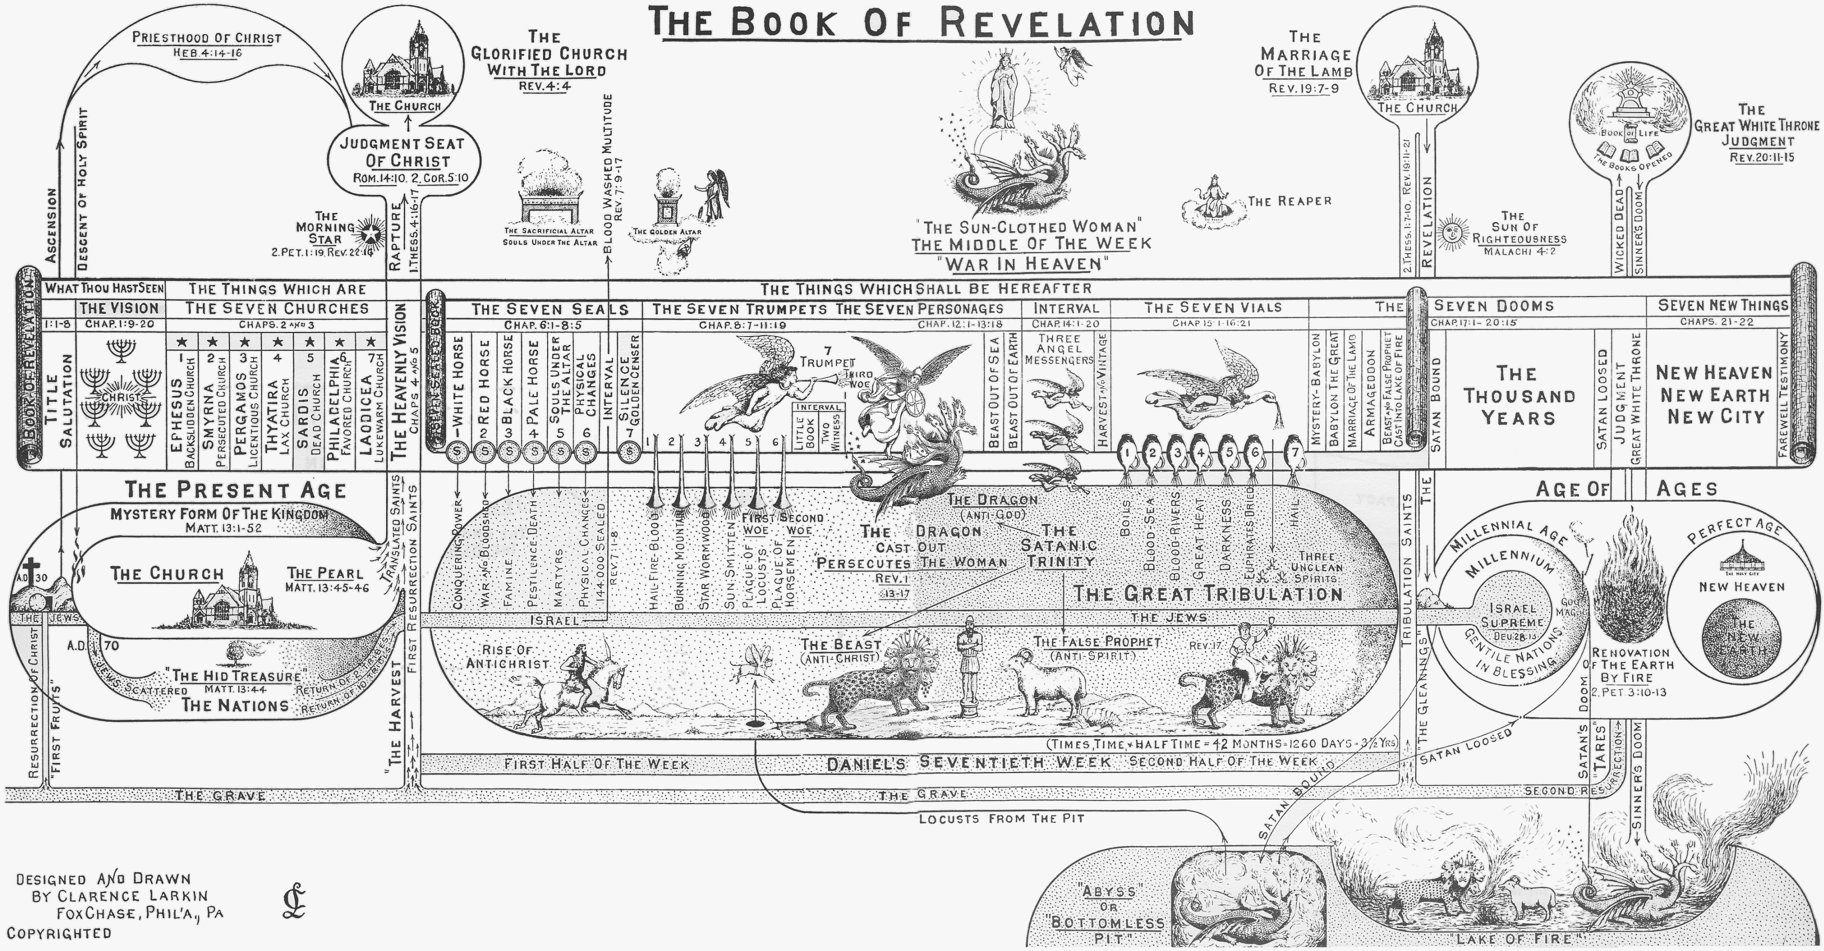

Slide 4
Parenthetical Chapters
Chapter 10
The Little Book
The Seven Thunders
Chapter 11
The Temple
The Two Witnesses
Chapter 12
The Woman, the Man Child, and the Dragon
Chapter 13
The Two Beasts
Chapter 14
The Lamb and The 144,000 all male choir
The Everlasting Gospel
Three angelic evangelists
Three angels of judgment
Notes:
Chapter 14 brings to a conclusion the material found in the section of chapters 12 through 14. Chapter 12 deals with the important characters of the period, chapter 13 with the wicked rulers of the period, and chapter 14 with the ultimate triumph of Christ. All of this material is not chronological but prepares the way for the climax which begins in chapter 15. Chapter 14 consists of a series of pronouncements and visions assuring the reader of the ultimate triumph of Christ and the judgment of the wicked. Much of the chapter is prophetic of events that have not yet taken place, but which are now impending. The chapter begins with the assurance that the Lamb will ultimately stand in triumph on Mount Zion with his followers, and it concludes with a series of pronouncements of judgments upon the wicked.

Slide 5
Revelation 14:6–7 (AV)
6 And I saw another angel fly in the midst of heaven, having the everlasting gospel to preach unto them that dwell on the earth, and to every nation, and kindred, and tongue, and people,
7 Saying with a loud voice, Fear God, and give glory to him; for the hour of his judgment is come: and worship him that made heaven, and earth, and the sea, and the fountains of waters.
Notes:
We have met this company before, only last time they were on earth. This is the illustrious company of the 144,000 who are sealed from twelve of Israel’s tribes (Rev. 7). These sealed ones have been preserved unharmed throughout the Great Tribulation, despite the rage of the dragon and the Beast. Unscathed, they have marched right down those dreadful years with horrors abounding on every hand and with every demon from the pit clutching at them in vain

Slide 6
Angel 1—The Everlasting Gospel
The expression “the everlasting gospel,” actually without the article (“everlasting gospel”) is an arresting phrase.
It is everlasting in the sense that it is ageless, not for any specific period.
Ordinarily, one would expect this to refer to the gospel of salvation.
In verse 7, however, the content of the message is quite otherwise, for it is an announcement of the hour of judgment of God and the command to worship Him.

Slide 7
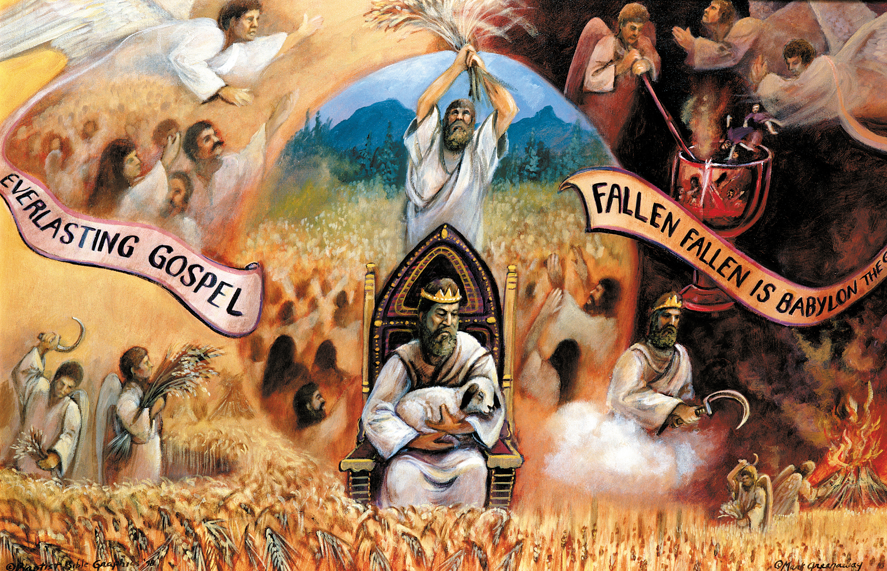

Slide 8
Angel 1—The Everlasting Gospel
The everlasting gospel seems to be neither the gospel of grace nor the gospel of the kingdom, but rather the good news that God at last is about to deal with the world in righteousness and establish His sovereignty over the world.
This is an ageless gospel in the sense that God’s righteousness is ageless.
Throughout eternity God will continue to manifest Himself in grace toward the saints and in punishment toward the wicked.
To refer to the gospel of grace as an everlasting gospel is to ignore the context and usage of the term.

Slide 9
Angel 1—The Everlasting Gospel
It is the good news of all the ages that God is sovereign, and man’s happiness consists in recognizing His authority.
In the present dispensation, the full truth of the gospel of the grace of God is added to this blessed fact. The gospel of the kingdom is but another aspect of this same news from Heaven, emphasizing particularly the lordship of Christ.
There can only be one gospel, for the apostle tells us, “ Though we, or an angel from heaven, preach any other gospel unto you than that which we have preached unto you, let him be accursed” (Gal_1:8). But that one gospel has different phases.
In the Epistle to the Galatians Paul speaks of “the gospel of the circumcision” and the “gospel of the uncircumcision”-the same gospel, but presented in one way to the Jews and another to the Gentiles.
When the Lord was here on earth ministering, as also was John the Baptist, they preached the gospel of the kingdom. But men rejected the kingdom, and so, for the time being, the kingdom is in abeyance. This is the day of the church we are in until the rapture.

Slide 10
Angel 1—The Everlasting Gospel
This message sends some mandates to people.
The respect of God. “Fear God, and give glory to him” (Revelation 14:7). Because God will triumph, we need to give Him honor and praise and respect. Our world is going to learn this truth the hard way it appears.
The retribution of God. “The hour of his judgment is come” (Revelation 14:7). Because God will win over evil, judgment upon evil is going to come. The announcement here is that judgment time has come for evil; God will judge evil.
The reverence for God. “Worship him” (Revelation 14:7). Satan wanted to be worshiped, but he is evil. The “everlasting gospel” says we must worship God, not Satan. God is holy and just and compassionate. He has the character to be worshiped.
The recognition of God. “Him that made heaven, and earth, and the sea, and the fountains of waters” (Revelation 14:7). As we have noted in previous chapters, there is no evolution talk in the book of Revelation. In this book we learn Who controls matters and Who created the universe. Wickedness does not want to recognize or submit to God’s supremeness.

Slide 11
Dispensations
God’s dealings with people in Old Testament times passed through various phases, often referred to as dispensations. He used different methods with the human race at different times and entered into various covenant relationships with men and nations.
The Old Testament ages passed through the dispensation of innocence in the Garden of Eden before the Fall,
The dispensation of conscience from Adam to the Flood,
The dispensation of human government from Noah to Abraham,
The dispensation of promise from Abraham to Moses, and
The dispensation of law from Moses to the time of Christ.
All these dispensations have climaxed in the present dispensation of Grace.
The Tribulation and 1000 year reign are future dispensations
It is upon us that “the end of the ages are come.” When our dispensation is over, events will move rapidly to a final fulfillment of all that was anticipated in the Old Testament.
In the meantime, the prophecy of Revelation affords valuable lessons for us.
Sir Isaac Newton (1643-1727): “Divine Presence” who set the universe in motion: “This most beautiful system of the Sun, planet and comets could only proceed from the counsel and dominion of the intelligent and powerful Being.”
(Newton also wrote over a million words of Biblical commentary, regarding it all literally.)
A key feature of Dispensationalism is to take the Bible literally.

Slide 12
Revelation 14:8 (AV)
8 And there followed another angel, saying, Babylon is fallen, is fallen, that great city, because she made all nations drink of the wine of the wrath of her fornication.

Slide 13
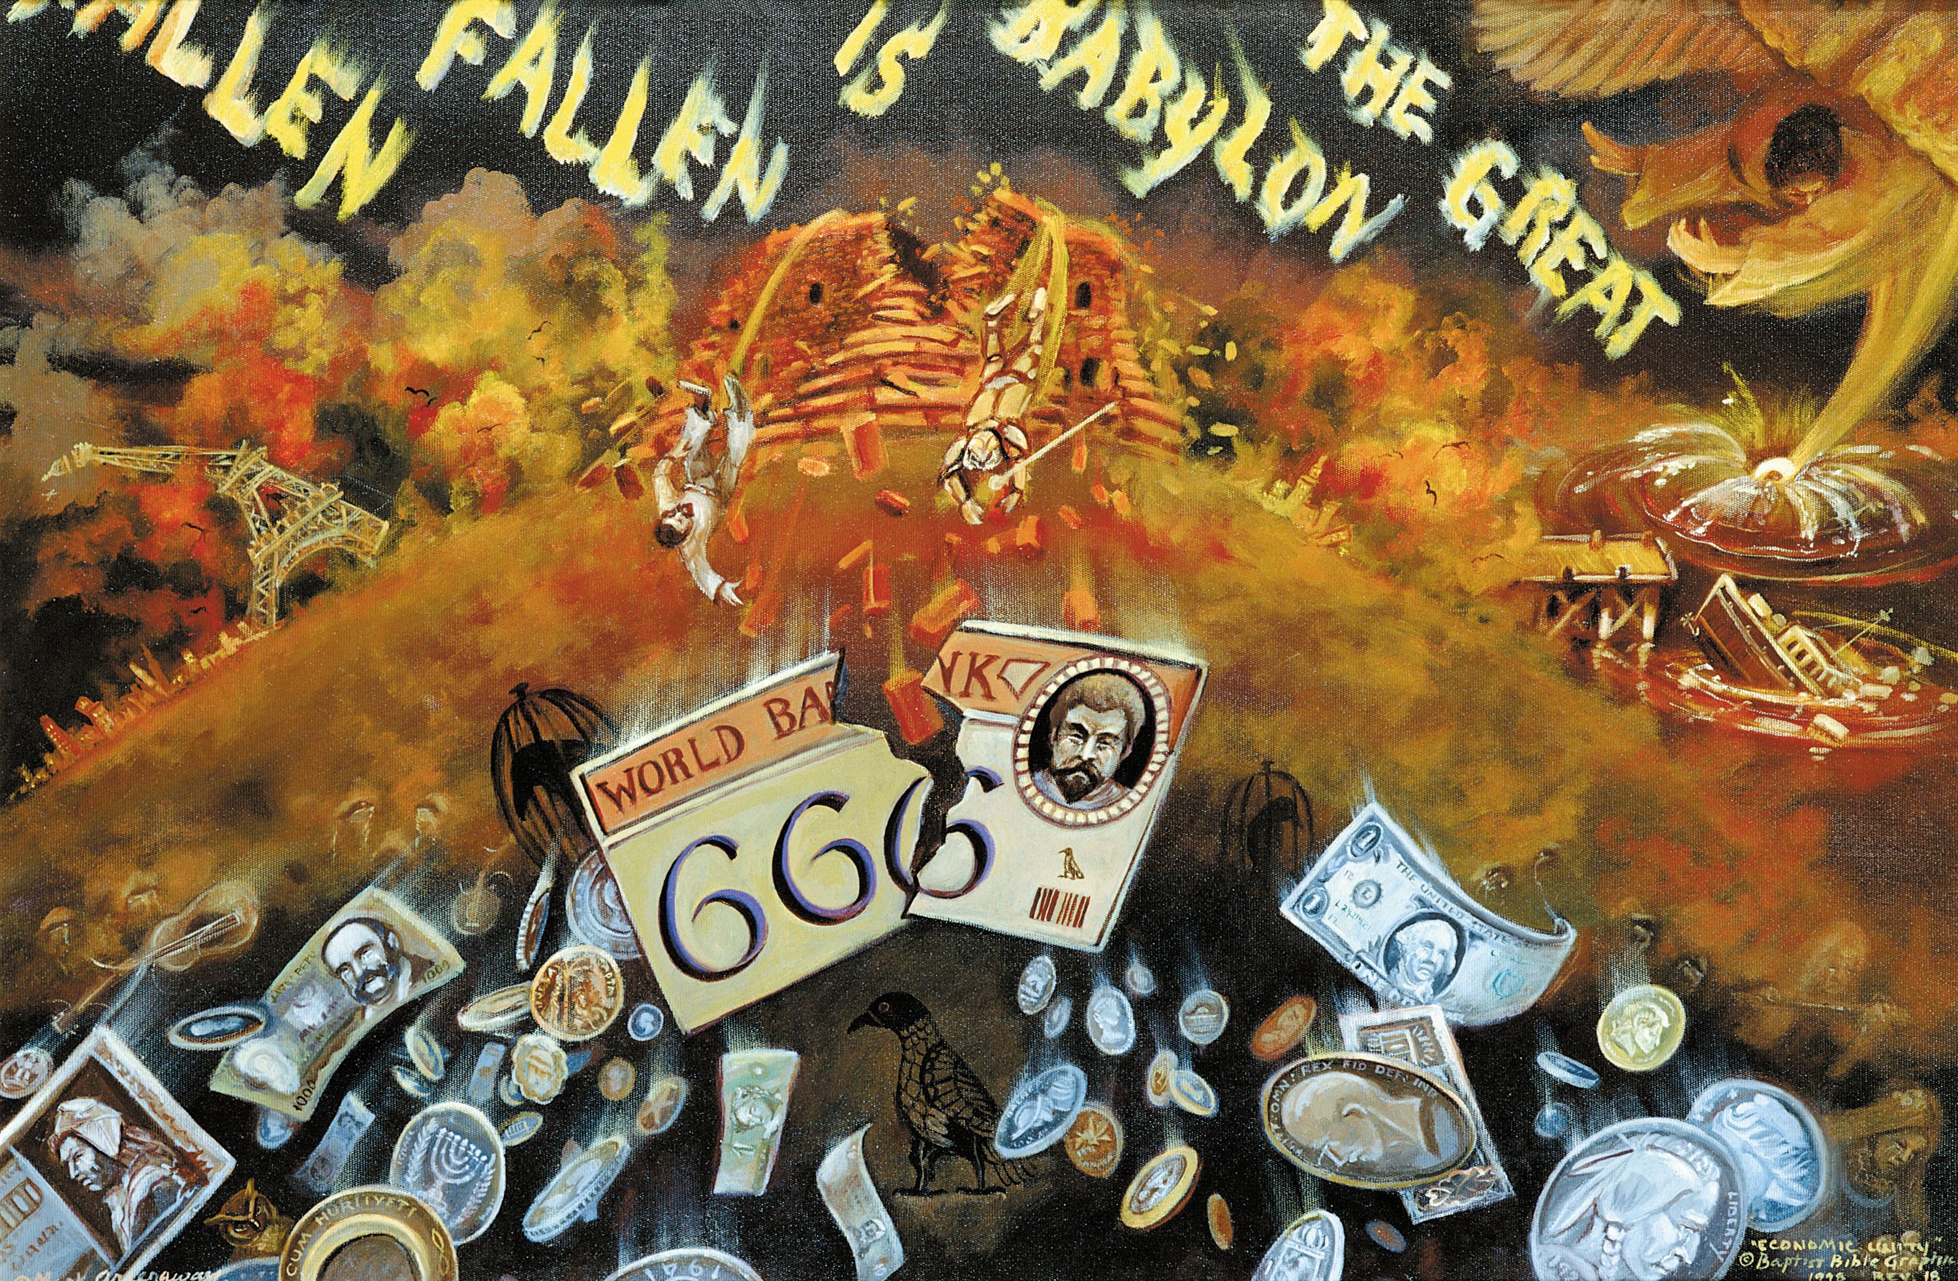

Slide 14
Angel 2—Babylon is Fallen
Babylon is more fully described for us in chapters 17-18, therefore, we have to defer any detailed exposition of this subject until a later chapter. I will say that just as Babylon of old was the fountainhead of idolatry, so is mystic Babylon today the mother of all false religious teaching in Christianity. That is Romanism and it is at the root of false religions.
In the time of the end it will be headed up in one great false church. That worldly church, which has proved so unworthy and false to her Lord, is to be utterly destroyed. I have no doubt that all over the world there will then be scenes with men crying, “No God; no church.”

Slide 15
Angel 2—Babylon is Fallen
Many religious leaders at the present time are very enthusiastic about what they call “the reunion of Christendom” but that reunion will simply be a great federation of Christless churches. Ecumenism. There is a cry today that churches should unite.
Modernists are drawing the Neo-evangelicals into their fold. Churches never drift toward fundamental views. They drift away from dispensational, Bible believing fundamental views into modernism. They tend to allegorize the Scripture instead of literal interpretation. They drift toward apostasy. One day all saved believers will be removed from these churches. Right now only Bible believing churches are holding the line.
They will form the most powerful religious association that has ever been known in this world-Catholic, Greek, Protestant, and all other systems united into one-after the true believers have gone.
For a time, this great institution will dominate everything until men will say at last, “What is the use of a church like this; why not destroy the whole thing and be done with it once and for all?” So they will destroy it throughout the world, as they once destroyed it in France and in Russia.

Slide 16
Revelation 14:9–10 (AV)
9 And the third angel followed them, saying with a loud voice, If any man worship the beast and his image, and receive his mark in his forehead, or in his hand,
10 The same shall drink of the wine of the wrath of God, which is poured out without mixture into the cup of his indignation; and he shall be tormented with fire and brimstone in the presence of the holy angels, and in the presence of the Lamb:

Slide 17
Tribulation Verses
Matthew 24:13–14 (AV)
13 But he that shall endure unto the end, the same shall be saved. 14 And this gospel of the kingdom shall be preached in all the world for a witness unto all nations; and then shall the end come.
Notes:
These verses are not written to the church.
I can make a verse taken out of context say anything I want it to say.

Slide 18
The Sin for the Suffering (Revelation 14:9)
God does not cause suffering without a reason. The reason for the suffering of damnation is twofold in our text.
The reverence of the beast and his image. “If any man worship the beast and his image” (Revelation 14:9). Worshiping the wrong entity can result in great judgment. If you did not worship the beast or its image you could be killed, but what is that to eternity in hellfire. Jesus gave perspective in this situation in Matthew 10:28.
Their reception of the mark of the beast. “And receive his mark” (Revelation 14:9). The mark of the beast will save your life (Revelation 13:16–18), but it will also curse your soul to eternal doom. Those who live for this life only will make the mistake of receiving the mark, but those who live for eternity will be willing to forfeit their life to be accepted by God.

Slide 19
The Severity of the Suffering (Revelation 14:10, 11)
Judgment brings great suffering to those who are damned. The severity of the suffering is characterized by drinking “the wine of the wrath of God” (Revelation 14:10).
The pain in the severity. “Shall be tormented with fire and brimstone” (Revelation 14:10). This is excruciating pain and it also comes with a really bad odor for the brimstone is sulphur which stinks to high heaven.
The permanency in the severity. “The smoke of their torment ascendeth up for ever and ever; and they have no rest day nor night” (Revelation 14:11). There is no let up in the punishment. Once it starts, it never stops. “For ever and ever” and “no rest day nor night” emphasize the severity and makes any gain by cooperating with Satan a delusion.
Just saw a post that said, “God’s word was meant to prepare you, not scare you.” If you are not “Born Again” I would suggest you become aware of judgment and “Believe” in what Jesus did for you. No one will get “saved” until they understand about “Hell.”

Slide 20
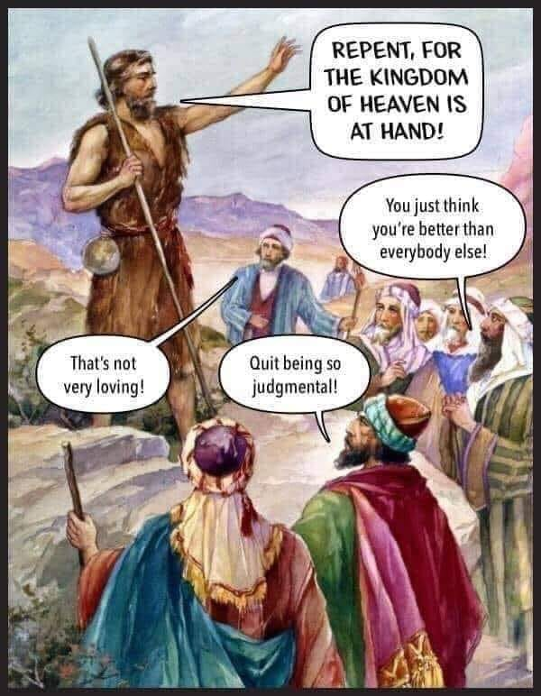
Notes:
In today’s society, the mere telling of truth makes the teller vicious, racist, homophobic, and xenophobic. Quoting the Bible will be considered a crime. In China the state has rewritten the Bible to say what the state wants. The true word of God will be criminal here on day. The state locked John the Baptist up because he took a stand on marriage. Then he lost his head because the king lusted after his stepdaughter.

Slide 21
The Site of the Suffering (Revelation 14:10)
“In the presence of holy angels, and in the presence of the Lamb” (Revelation 14:10).
The suffering will be done in the presence of those very personages the wicked ones despised. This is great vindication for righteousness but great shame for wickedness. Evil may rule the roost for a period of time but in the end righteousness comes out the winner. The saints will be vindicated before the very ones who mocked, scorned and persecuted them for their righteous life.

Slide 22
Revelation 14:11 (AV)
11 And the smoke of their torment ascendeth up for ever and ever: and they have no rest day nor night, who worship the beast and his image, and whosoever receiveth the mark of his name.

Slide 23
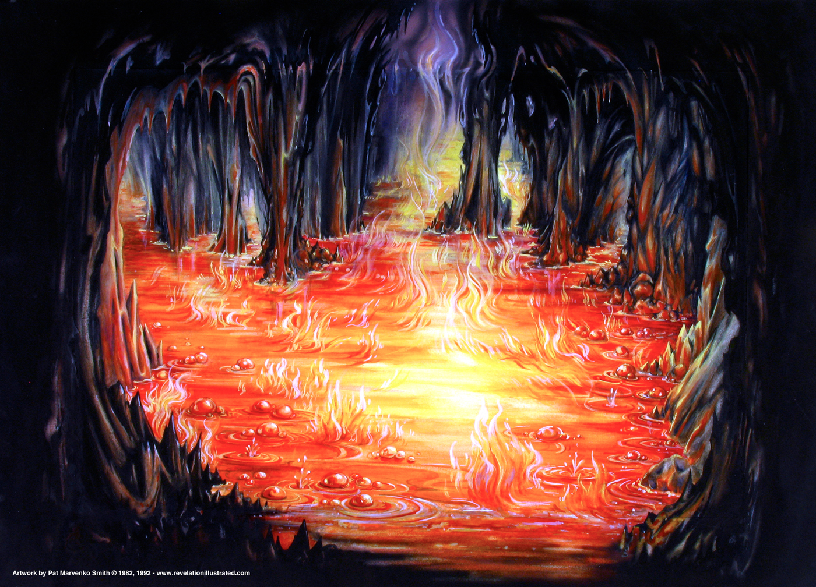

Slide 24
Angel 3—The Doom of the Worshipers of the Beast
The same Scripture which assures all Christians of the love of God and the grace of God as extended to those who trust in Christ is unequivocal in its absolute statements of judgment upon the wicked.
The righteousness of God is as unstoppable as the love of God is infinite. The love of God is not free to express itself to those who have spurned Jesus Christ. Their torment is not a momentary one, for it is described in verse 11 as continuing forever, literally “into the ages of ages,” the strongest expression of eternity of which the Greek is capable. To emphasize the idea of continued suffering, they are declared to have no rest day or night.

Slide 25
Revelation 14:12–13 (AV)
12 Here is the patience of the saints: here are they that keep the commandments of God, and the faith of Jesus.
13 And I heard a voice from heaven saying unto me, Write, Blessed are the dead which die in the Lord from henceforth: Yea, saith the Spirit, that they may rest from their labours; and their works do follow them.

Slide 26
The Patience for Steadfastness (Revelation 14:12)
“The patience of the saints” (Revelation 14:12). To be steadfast to the Lord requires much patience. The word “patience” in meaning is “generally meaning endurance, patience, perseverance or constancy under suffering in faith and duty” (Zodhiates). These saints had to endure a lot of affliction from the forces of evil to remain faithful to the Lord.

Slide 27
The Place of Steadfastness (Revelation 14:12)
“They that keep the commandments of God, and the faith of Jesus” (Revelation 14:12). The steadfastness was in the area of obeying Divine commands and in their faith in Jesus Christ.
The two beasts would harass and try everything they could to break this loyalty to the Lord, but those who abode faithful would not break.
This is to be understood in light of Dispensationalism. This was keeping of commandments and Faith in Jesus Christ.
Remember the Dispensationalist takes the Scripture literally.

Slide 28
The Prospects of Steadfastness (Revelation 14:13)
One who is steadfast for the Lord has good prospects.
The prospects in death. “Blessed are the dead which die in the Lord” (Revelation 14:13). The world will not agree. They will see the death of believers by the hand of the persecutors as a waste. But the waste is in the lives of the unbelievers.
The prospects in dividends. “They may rest from their labours; and their works do follow them” (Revelation 14:13). The prospects in dividends is twofold. First, the prospects of rest. “They may rest from their labours.” This is a great contrast to the wicked who in eternity “have no rest day nor night” (Revelation 14:11). The righteous will experience blissful conditions after they die unlike the wicked. Second, the prospects of rewards. “Their works do follow them.” This means their works will bring them due reward even if they have died. You sow and you will reap. Their deaths did not stop their rewards. Their works for the Lord will bring them much reward. It pays to serve Jesus, and death by persecution does not nullify the reward, for the works of the persecuted “do follow them.”
Notes:
Revelation 14:13 (AV)
13 And I heard a voice from heaven saying unto me, Write, Blessed are the dead which die in the Lord from henceforth: Yea, saith the Spirit, that they may rest from their labours; and their works do follow them.

Slide 29
Revelation 14:14–15 (AV)
14 And I looked, and behold a white cloud, and upon the cloud one sat like unto the Son of man, having on his head a golden crown, and in his hand a sharp sickle.
15 And another angel came out of the temple, crying with a loud voice to him that sat on the cloud, Thrust in thy sickle, and reap: for the time is come for thee to reap; for the harvest of the earth is ripe.

Slide 30
Preview of Armageddon
Revelation 14:14–20 The bloodiest battle of all time. John was then given a preview of Armageddon (compare Revelation16:12–16; 19:17–19).
Christ will return to earth triumphant (Revelation 14:14; Look back at (Dan. 7:13) and, joined by two angels, will begin “harvesting” the earth with sharp sickles, resulting in a river of human blood some 184 miles long and as high as a horse’s bridle. On the “grapes” of God’s “wrath” (Revelation 14:18–19 19:15; Isaiah 63:1–6; Joel 3:13).

Slide 31
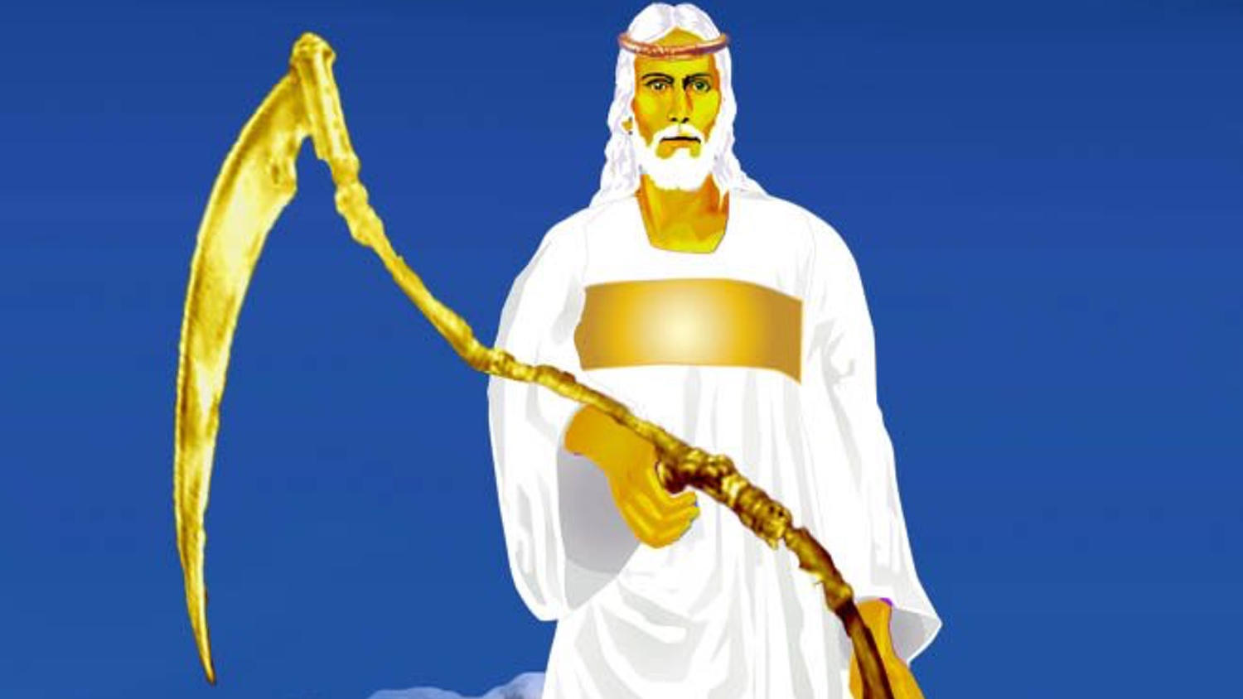

Slide 32
Angel 4—Encourages Judgment
As John beholds the vision of the Son of man having a sharp sickle, he sees another angel come out of the Temple crying to the Son of man to thrust in His sickle and reap, declaring that the harvest of the earth is ripe.
It is remarkable that an angel should thus address the Son of man, but it should be regarded as an entreaty of a holy angel to Christ as the Son of man in His position as judge of men (John 5:22, 27).

Slide 33
Revelation 14:16 (AV)
16 And he that sat on the cloud thrust in his sickle on the earth; and the earth was reaped.

Slide 34
THE SICKLES OF JUDGMENT (Revelation 14:14–20)
The last major part of this chapter is about sickles and judgment by God. Before the invention of harvesting machinery, sickles were used to harvest crops. So a sickle is a fit symbol of harvest. Our text speaks of Divine judgment as a harvest. The sickles judgments here are two. The first one speaks of the judgment of the world while the other is more limited to the judgment that fits the battle of Armaggedon. In both cases, the judgment of God upon wickedness is pictured as a harvesting.

Slide 35
The Sickle Judgment of the World (Revelation 14:14–16)
The “earth” is mentioned three times (Revelation 14:15, 16) in this judgment which indicates this judgment is for all the world.
The Person with the sickle. “I looked, and behold … the Son of man … and in his hand a sharp sickle” (Revelation 14:14). The One wielding the sickle is Jesus Christ. Scripture has some things to say about this Person with the sickle.
First, His position. “White cloud, and upon the cloud one sat … on his head a golden crown” (Revelation 14:14). The position of the Christ is an exalted position. Being on a white cloud speaks of exaltation and the golden crown emphasizes the same. Christ is honored in heaven. On earth He is despised, but in heaven He is exalted.
Second, His pseudonym. “Son of man” (Revelation 14:14). This is the last place in the Bible that Christ is called the “Son of man.” It is a name of humility and speaks of His Incarnation. It was as the “Son of man” that Christ was scorned, shamed and slain, Third, His power. “A sharp sickle” (Revelation 14:14). “Sharp” emphasizes the power of the sickle. A dull sickle is ineffective but a “sharp” one is powerful. Christ has power to bring great judgment upon the earth.

Slide 36
The Sickle Judgment of the World (Revelation 14:14–16)
The proclamation for the sickle. “Another angel came out of the temple, crying with a loud voice to him that sat on the cloud, Thrust in thy sickle, and reap … for the harvest of the earth is ripe” (Revelation 14:15). The “Son of man” is given orders to begin judgment upon the earth.
First, the command in the proclamation. “Thrust in thy sickle, and reap.” The symbolism of harvesting is used to show the end of the wicked world.
Second, the condition for the proclamation. “The harvest of the earth is ripe” (Revelation 14:15). You do not harvest until the field is ripe for harvest. The world is pictured in this symbolic way as ripe for judgment. Their wickedness is enough. God lets man go only so far then the sickle cuts them down in judgment. We are reaching that time when the world is becoming more and more ripe for Divine judgment.

Slide 37
The Sickle Judgment of the World (Revelation 14:14–16)
The people for the sickle. The people who were harvested by the sickle were people on the earth living in wickedness.
First, the condemnation of the people. “Thrust in his sickle on the earth.” (Revelation 14:16). The fact of the harvest condemned the people for their wickedness. The grim reaper in this case is Jesus Christ.
Second, the consummation of the people. “The earth was reaped” (Revelation 14:16). The reaping was the consummation or the end of matters for the wicked.
This chapter, as we noted earlier, is a brief summary of what is to come. Later chapters of Revelation describe in more detail the end of the world, the end of the life of the wicked and what their eternal destiny will be.

Slide 38
Revelation 14:17–18 (AV)
17 And another angel came out of the temple which is in heaven, he also having a sharp sickle.
18 And another angel came out from the altar, which had power over fire; and cried with a loud cry to him that had the sharp sickle, saying, Thrust in thy sharp sickle, and gather the clusters of the vine of the earth; for her grapes are fully ripe.

Slide 39
The Sickle Judgment of the War (Revelation 14:17–20)
This sickle judgment is limited to one locality on earth and is not worldwide as the previous sickle judgment. It corresponds to the battle of Armaggedon in its blood shed. The principle of the judgment here is that God will judge wickedness and all forces that wage war against Him.

Slide 40
Angel 5—Comes From Temple With Sickle
The repetition in the sickle. “Another angel came out of the temple which is in heaven, he also having a sharp sickle. And another angel came out from the altar, which had power over fire; and cried with a loud cry … Thrust in thy sharp sickle, and gather the clusters of the vine of the earth” (Revelation 14:17, 18).

Slide 41
Angel 6—Calls for Harvest
We have a repeat of the sickle judgment upon the earth but in different terms. In the previous sickle judgment the symbolism spoke of “harvest” (Revelation 14:15). Now this sickle judgment speaks of “clusters of the vine” (grapes)—a more bloody symbol that fits Armaggedon.

Slide 42
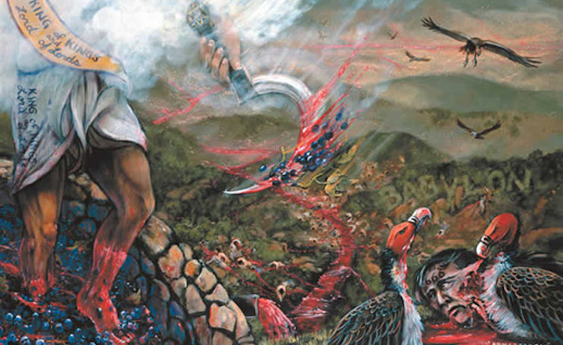

Slide 43
Revelation 14:19–20 (AV)
19 And the angel thrust in his sickle into the earth, and gathered the vine of the earth, and cast it into the great winepress of the wrath of God.
20 And the winepress was trodden without the city, and blood came out of the winepress, even unto the horse bridles, by the space of a thousand and six hundred furlongs.

Slide 44
The Sickle Judgment of the War (Revelation 14:17–20)
The ripeness for the sickle. “The clusters of the vine of the earth … her grapes are fully ripe” (Revelation 14:18). This repeats the previous sickle judgment in that the sickle is welded only when the crop is ripe. Judgment comes when the sinner is ripe for judgment. The end-time conditions are getting riper.

Slide 45
The Sickle Judgment of the War (Revelation 14:17–20)
The rage in the sickle. “The great winepress of the wrath of God” (Revelation 14:19). The wrath of God is pictured here as a winepress that will crush the grapes harvested by the sickle. The emphasis is on the “wrath of God.” People like to hear sermons on the love of God and the mercy and grace of God, but few sermons are heard about the “wrath of God” because people do not like such sermons. But people need to know that God has wrath and no wrath is greater than Divine wrath.

Slide 46
The Sickle Judgment of the War (Revelation 14:17–20)
The result of the sickle. The result of the work of this sickle judgment is a bloody one.
First, the symbolism in the result. “The winepress was trodden without the city” (Revelation 14:20). The grapes which were cut by the sickle were trodden under foot in the winepress. This practice is used as a symbol of the judgment of God upon mankind. God literally crushes wicked men under His feet.
Second, the slaughter in the result. “Blood came out of the winepress, even unto the horse bridles, by the space of a thousand and six hundred furlongs” (Revelation 14:20). The juice of the grape that comes from the winepress is pictured here as blood coming from the judgment of God.
It corresponds to the great slaughter at Armageddon which will be “the worst slaughter of human life in all history” (Strauss). That slaughter is so great, it will take seven months to bury the dead (Ezekiel 39:8–16). So one can easily imagine the great amount of blood that will be shed. Wickedness leaves a gory mess on the earth.

Slide 47
The Sickle Judgment of the War (Revelation 14:17–20)
These allusions seem to indicate that the angel is acting in response to the prayers of the saints for divine judgment on wickedness in the earthly scene, and the fact that he has power over fire indicates the purging judgment of which he is capable.
This passage speaks prophetically of that which will chronologically follow the return of Christ to the earth.

Slide 48
The Sickle Judgment of the War (Revelation 14:17–20)
The spurting of the grape juice from under the bare feet of those treading the grapes in the winepress is compared to the spurting of blood and speaks of the awful human carnage of Revelation 19:17–19, 21. The unusual expression that the blood spatters to “the horse bridles” for “a thousand six hundred furlongs” has intrigued expositors. The scene of this event is apparently the city of Jerusalem outside which the judgment takes place. It seems quite impossible that the blood will flow in depth as high as the horses’ bridles, and it is better to understand this simply as a liberal spattering of blood.

Slide 49
Repentance
Change of Mind about Jesus Acts 10:43
A Gift of Holy Ghost Acts 11:18
Saved Person=Justified Person=Born Again Person
=Standing
No Standing
Fleshy Nature, Carnal
Spiritual Nature
=State
=State
Wicked Lost Sinner
Jeremiah 13:23
Worst kinds of sins
Carnal
Wicked at the end
Still in sin
Not sorry
Unbelief to Belief
Not surrendered
Works & Fruits
Spiritual
Spiritual at the end
Turn from sin (willing)
Sorry
Belief that grows
Surrender all
Worst kinds of Sin
Carnal
Wicked at the core
Still in sin
Not sorry
Good works
Not surrendered
Notes:
Jeremiah 13:23 (NLT2) ²³ Can an Ethiopian change the color of his skin? Can a leopard take away its spots? Neither can you start doing good, for you have always done evil. Acts 11:18 (KJV) ¹⁸ When they heard these things, they held their peace, and glorified God, saying, Then hath God also to the Gentiles granted repentance unto life.
The question is then, do you believe? Do you believe Jesus is who He says He is?
Have you had that moment? That moment where you decided, you made the decision — you’re all in. You’re going to believe in faith that Jesus is who He says He is. That God is real. That He is your Father. That you are His son, His daughter.
And then it hits you. You realize… if you believe Jesus is exactly who He says He is, the risen Son of the Most High God… it changes everything.
So as Peter spoke the death, burial, and resurrection to the household of Cornielus he and his whole household believed on Jesus and they were filled with the Holy Spirit. Act 10:43 To him give all the prophets witness, that through his name whosoever believeth in him shall receive remission of sins.

Slide 50
Christians Not Under The Law
Galatians 3:23–26 (AV)
23 But before faith came, we were kept under the law, shut up unto the faith which should afterwards be revealed.
24 Wherefore the law was our schoolmaster to bring us unto Christ, that we might be justified by faith.
25 But after that faith is come, we are no longer under a schoolmaster.
26 For ye are all the children of God by faith in Christ Jesus.

Slide 51
Salvation Gives Us Freedom
Romans 6:5–7 (AV)
5 For if we have been planted together in the likeness of his death, we shall be also in the likeness of his resurrection:
6 Knowing this, that our old man is crucified with him, that the body of sin might be destroyed, that henceforth we should not serve sin.
7 For he that is dead is freed from sin.

Slide 52
Sin Does Not Have Dominion Over Believers
Romans 6:9–14 (AV)
9 Knowing that Christ being raised from the dead dieth no more; death hath no more dominion over him.
10 For in that he died, he died unto sin once: but in that he liveth, he liveth unto God.
11 Likewise reckon ye also yourselves to be dead indeed unto sin, but alive unto God through Jesus Christ our Lord.
12 Let not sin therefore reign in your mortal body, that ye should obey it in the lusts thereof.
13 Neither yield ye your members as instruments of unrighteousness unto sin: but yield yourselves unto God, as those that are alive from the dead, and your members as instruments of righteousness unto God.
14 For sin shall not have dominion over you: for ye are not under the law, but under grace.

Slide 53
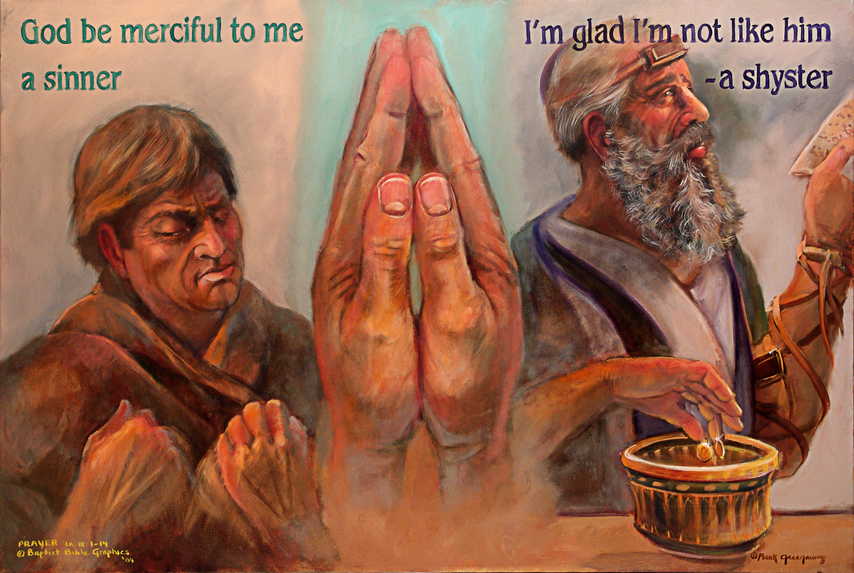
Notes:
Luke 18:10–14 (AV)
10 Two men went up into the temple to pray; the one a Pharisee, and the other a publican. 11 The Pharisee stood and prayed thus with himself, God, I thank thee, that I am not as other men are, extortioners, unjust, adulterers, or even as this publican. 12 I fast twice in the week, I give tithes of all that I possess. 13 And the publican, standing afar off, would not lift up so much as his eyes unto heaven, but smote upon his breast, saying, God be merciful to me a sinner. 14 I tell you, this man went down to his house justified rather than the other: for every one that exalteth himself shall be abased; and he that humbleth himself shall be exalted.

