Slide 1
Revelation 16, Seven Vials
By,
Pastor Bob Rogers
Notes:
"This is the record that God has given to us eternal life, and this life is in His Son. He who has the Son has the life; he who does not have the Son of God does not have the life," 1 John 5:11-12. "He who believes on Him is not condemned: but he who believeth not is condemned already, because he has not believed in the Name of the only begotten Son of God," John 3:18. "For there is no other Name under heaven given among men and whereby we must be saved," Acts 4:12. "For by grace you have been saved through faith; and not of yourselves it is the gift of God; not of works, lest any man should boast," Ephesians 2:8-9, "For I am persuaded that neither death, nor life, nor angels, nor principalities, nor powers, nor things present, nor things to come, nor height, nor depth, nor any other created thing is able to separate us from the love of God, which is in Christ Jesus our Lord," Romans 8:38-39. "For of Him and through Him and to Him are all things to Whom be the glory forever," Romans 11:26." Amen.

Slide 2
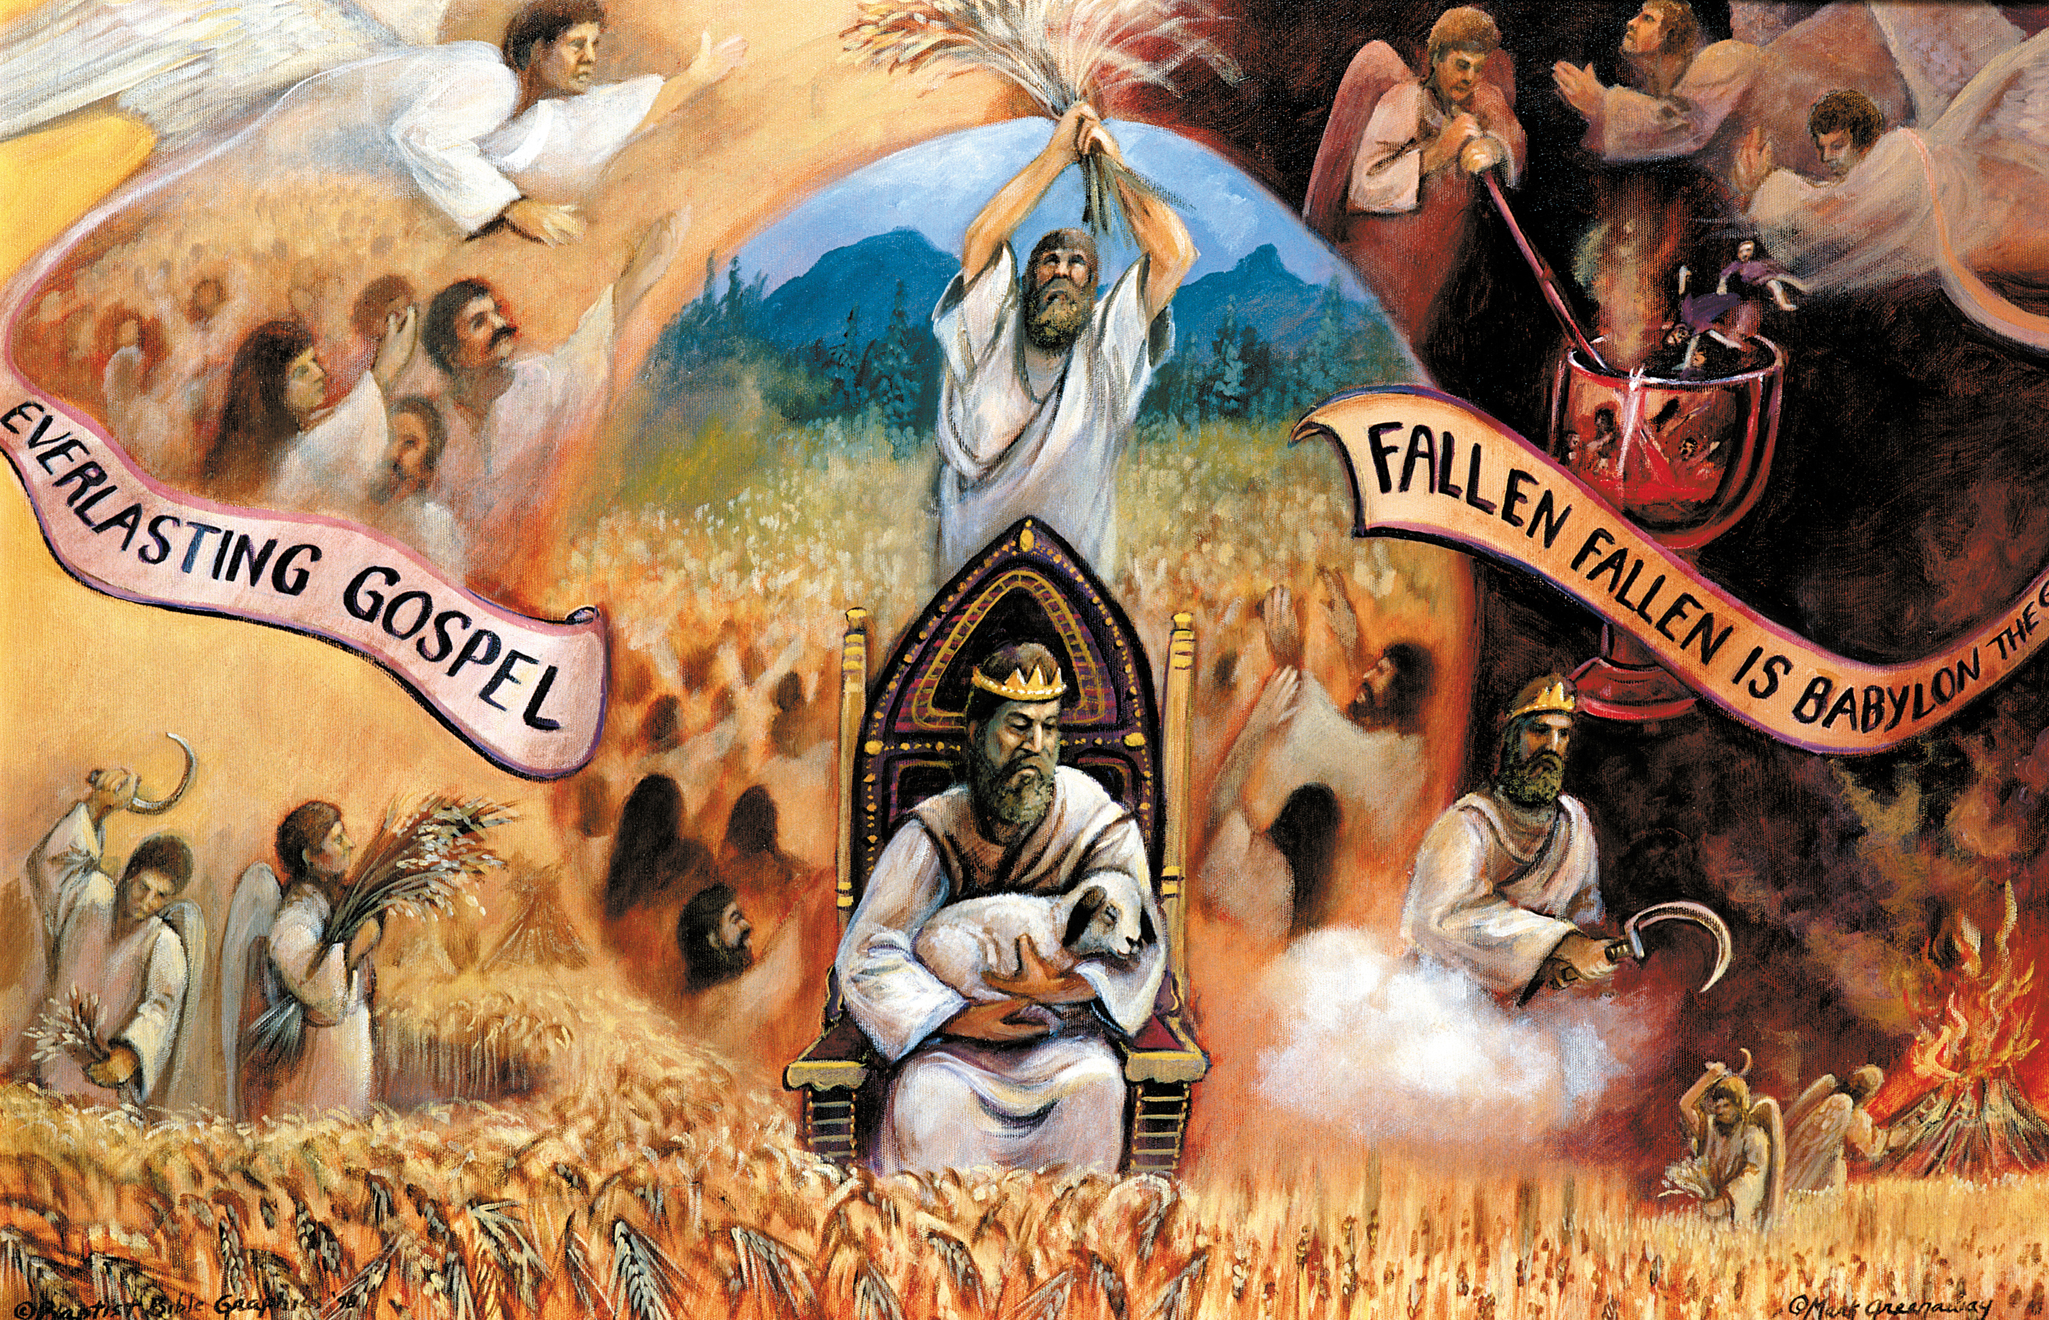
Notes:
In Revelation 14 there are the 144,000 redeemed from earth and 6 angels and they start with the everlasting gospel.

Slide 3
The Heptadic Structure (sevens)
Chapter 6
The 7 Sealed Scroll
Chapter 7
Parenthesis
1
2
3
4
5
6
7
Chapter 8,9 10-14
1
2
3
4
5
6
7
Parenthesis
Chapter 15 16
Parenthesis
1
1
1
1
2
3
1
1
1
1
4
5
6
7

Slide 4
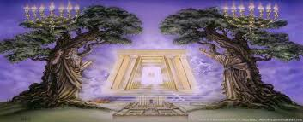
Harpazo (Rapture) 1 Thess 4:16-17
3 ½ yrs.
42 mos.
1260 days
3 ½ yrs.
42 mos.
1260 days
2nd Coming 2Thess 1:7-10 --Armageddon
Great Tribulation
Matt. 24:21-22
Rapture os Church
Rapture of OT Saints and Tribulation Saints And Judgment
Judgment of Israel Ezek. 20:32-38
144,000 Sealed
Angel Book Thunders Temple & 24 Elders
Abomination
Of
Desolation
Daniel 9:27; Matt. 24:15
Dragon, Beast, False Prophet, Evil Spirits, Frogs
1
3
5
7
2
4
6
1
3
5
7
2
4
6
1
1
1
1
3
5
1
1
1
1
7
2
4
6
1290 Days Image in Temple Dan. 12:11
1335 Days Dan. 12:12-13; 1Cor. 6:2-3
Two Witnesses

Slide 5
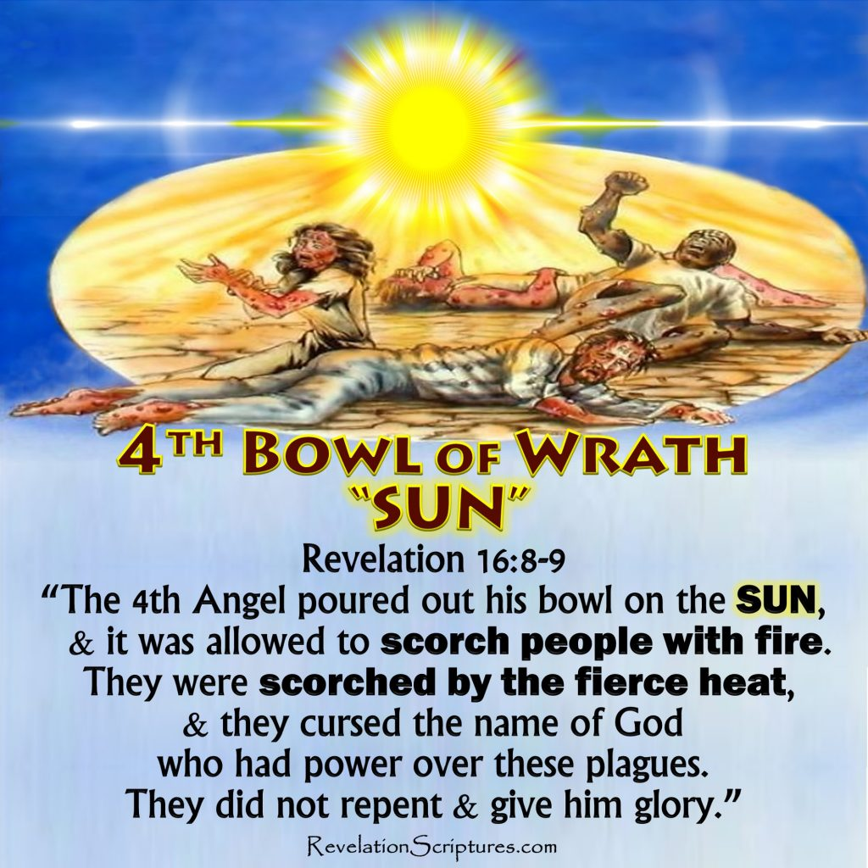
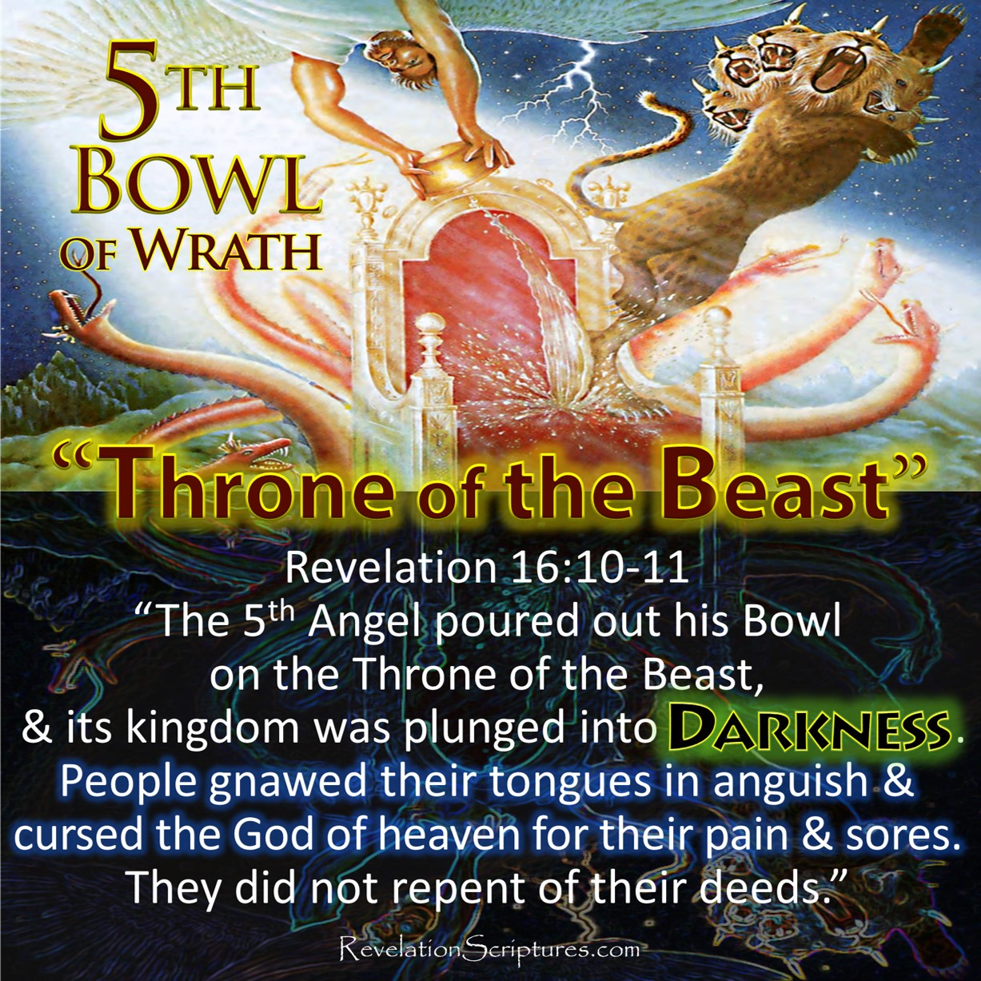
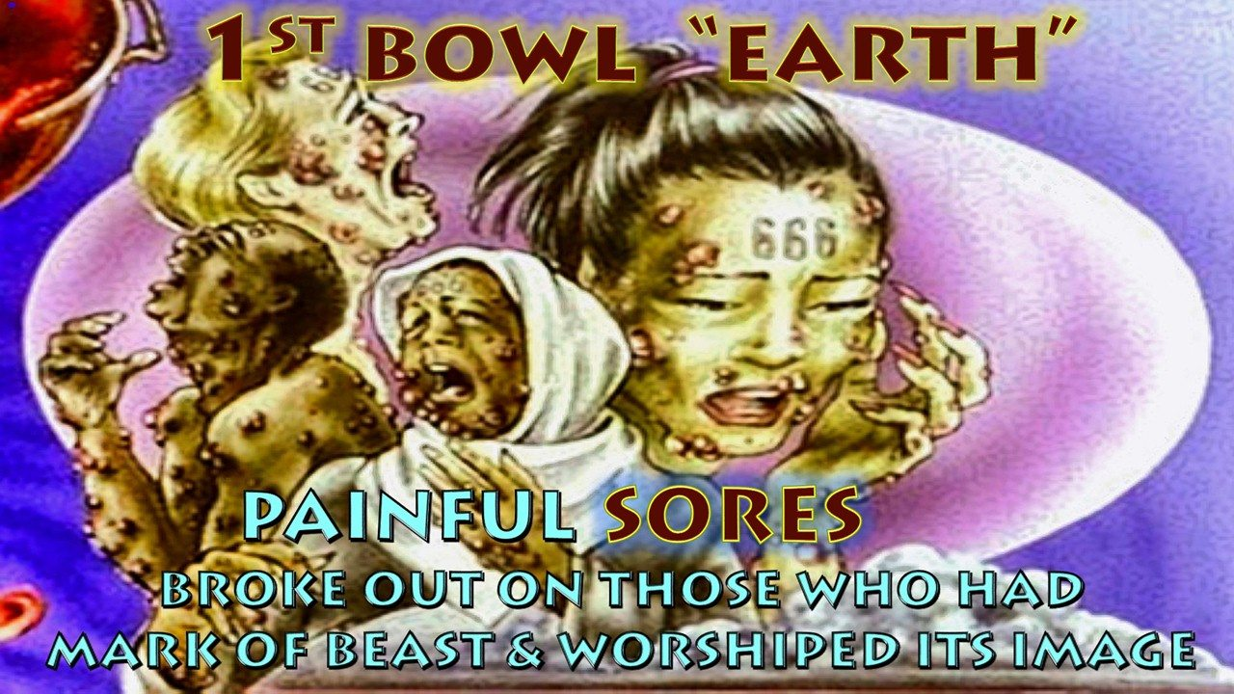
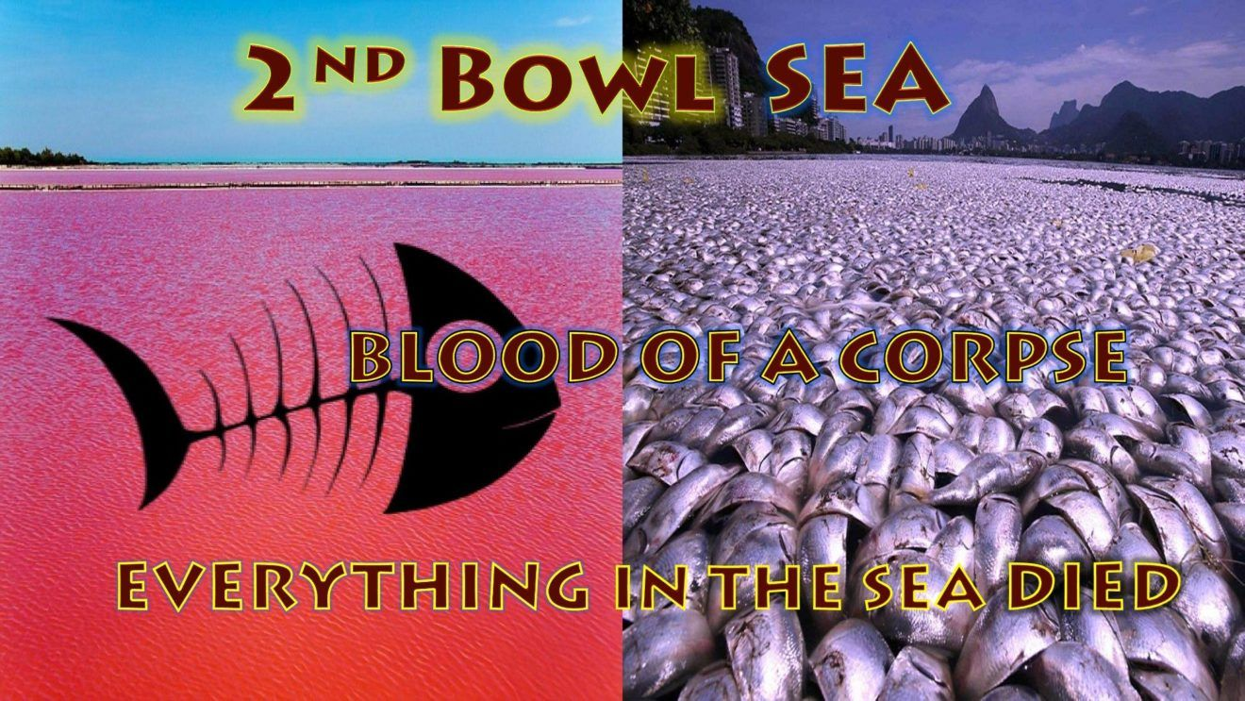
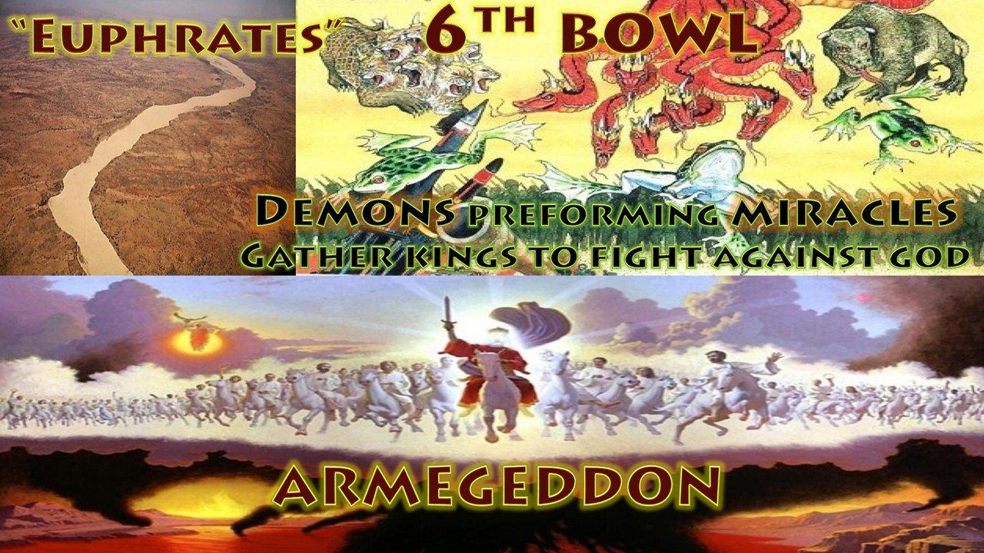
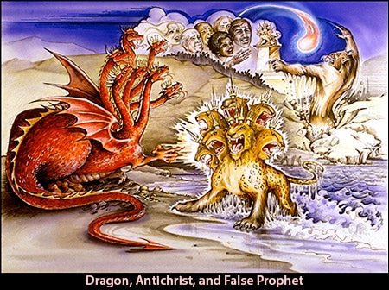
The Vials of Wrath
Dragon, Beast, False Prophet, Evil Spirits, Frogs
1
1
1
1
2
3
1
1
1
1
4
5
6
7
Rev. 16:2
Grievous Sore
Rev. 16:3
Sea of Blood
All in Sea Die
Rev. 16:4
Rivers to Blood
Rev. 16:10
Beast’s Kingdom full of Darkness
Rev. 16:12
Euphrates Dried Up
Rev. 16:8
Sun Scorched Men With Fire
Rev. 16:17-20 Earthquakes
Rev. 16:13-14

Slide 6
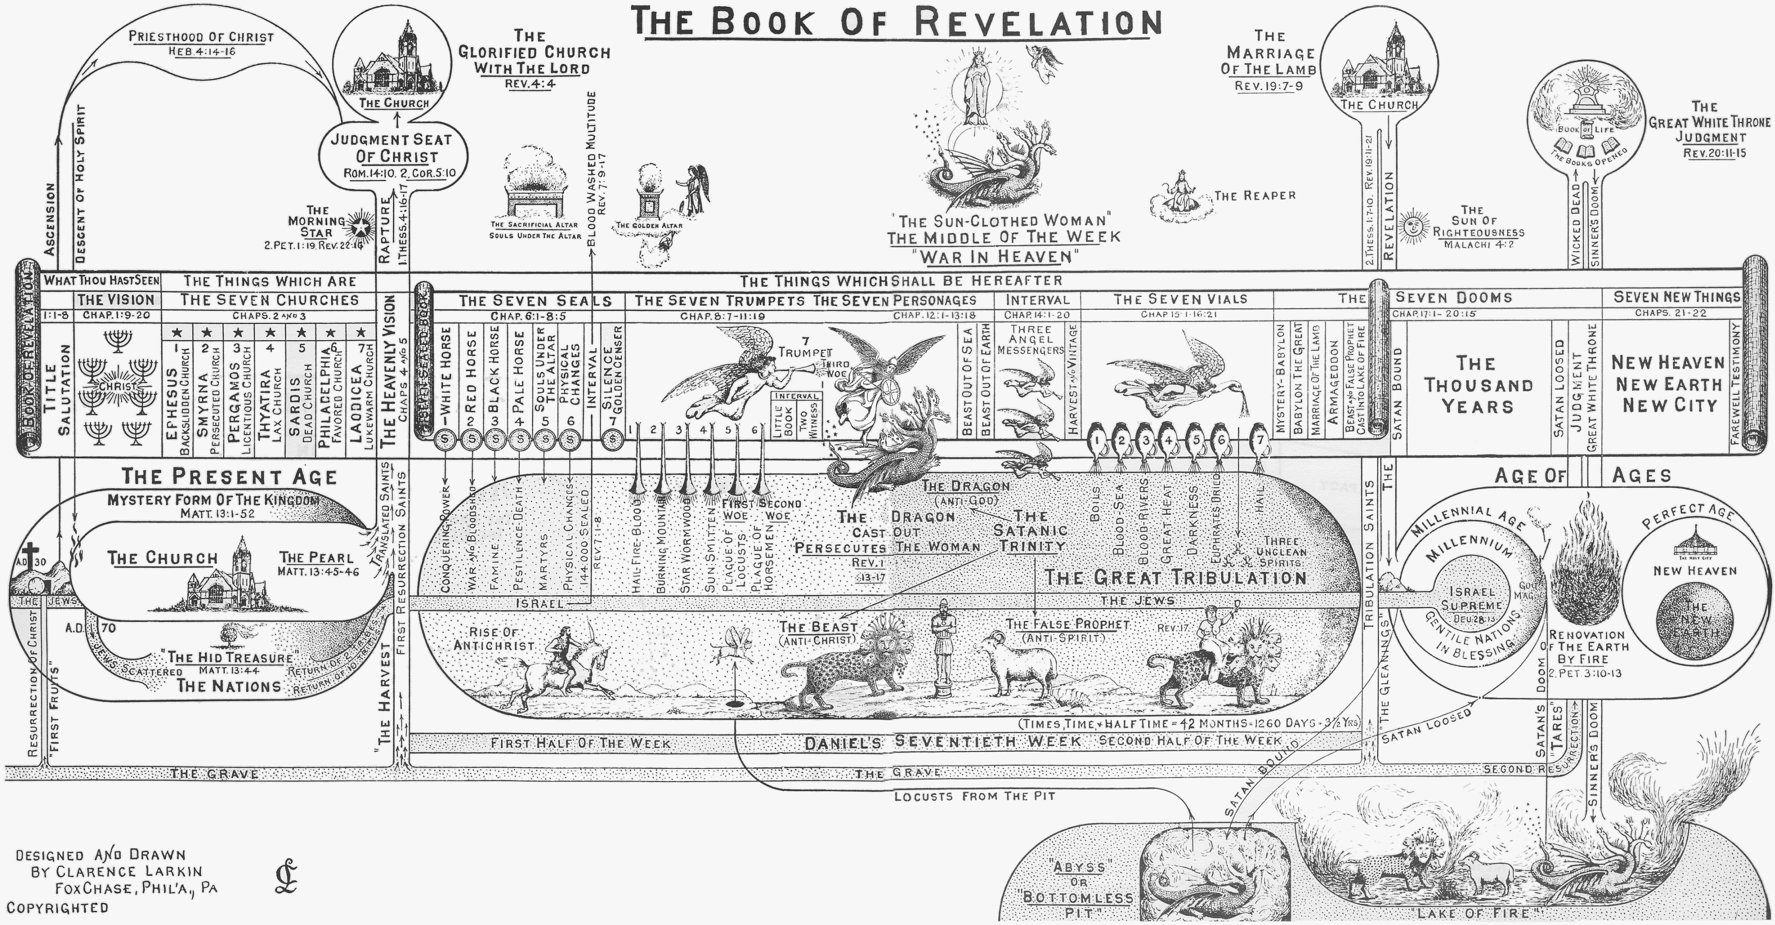

Slide 7
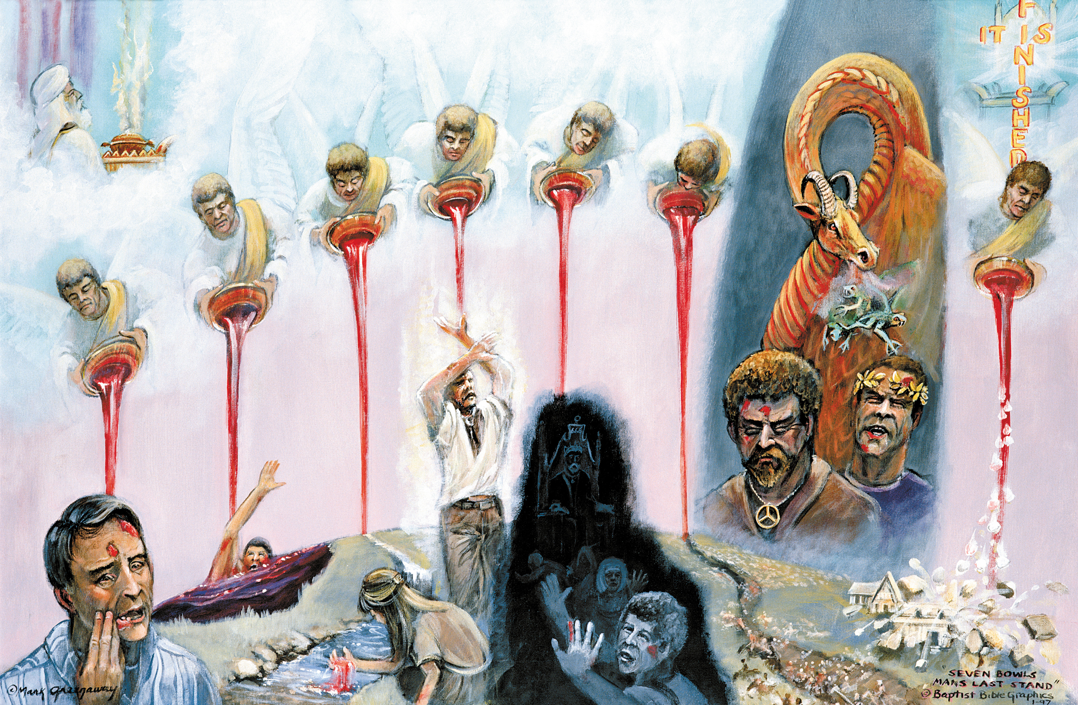
Notes:
These "VIALS" and their contents are LITERAL. One cannot imagine that such momentous things as are here described refer to historical events that are already past, as when some interpret the "First Vial" as the French Revolution in a.d. 17924, and the "sores" its infidelity; and the "Second Vial" as the naval wars of that Revolution; the "Third Vial" as the battles of Napoleon in Italy, and the rest of the Vials as historical events that happened in the Nineteenth Century. If this be true then we have been passing in the past 125 years through the period of the Great Tribulation without knowing it, and have been preaching "Grace" and not that "THE HOUR OF HIS JUDGMENT IS COME." This is supposition and not EXPOSITION, and requires the reader of the Book of Revelation to be versed in all the historical events of the Christian Era. No, these "Vial Judgments" are yet future, and will be literally fulfilled as here described, and this gives us the "KEY" to the LITERALNESS of the whole Book of Revelation. That these "Vial Judgments" are not figurative is clear from the fact that 4 of the 7 have actually happened before. They are simply repetitions of the "PLAGUES OF EGYPT." See the Chart on the "Seven Vials" and the "Egyptian Plagues" compared. This Plague of a "NOISOME AND GRIEVOUS SORE" that shall fall upon men, is a repetition of the "Plague of Boils" that fell upon the Egyptians at the time of the Exodus. Ex. 9:8-12. The "First Vial Judgment" then will be a repetition of the "Sixth Egyptian Plague." That that Plague actually happened no believer in the Bible doubts, then why should we try to explain away the literalness of the Plagues that shall follow the pouring out of each of these Vials. If you are not saved when the Rapture comes I would not give you a 50/50 chance of living until these vial judgments arrive.

Slide 8
7 Last Plagues
Revelation 16:1–2 (AV)
1 And I heard a great voice out of the temple saying to the seven angels, Go your ways, and pour out the vials of the wrath of God upon the earth.
2 And the first went, and poured out his vial upon the earth; and there fell a noisome and grievous sore upon the men which had the mark of the beast, and upon them which worshipped his image.
Notes:
I have his highlighted in each verse for these angels. Angels are male. The tendency of modern filmmakers and artists is to portray angels as women. We need to understand this as the Bible sees it.

Slide 9
The Prelude to the Sores
“I heard a great voice out of the temple saying to the seven angels, Go your ways, and pour out the vials of the wrath of God upon the earth” (Revelation 16:1). God has held back long enough. Sin sooner or later will incur the wrath of God.
The will of God in the prelude. “Go your ways, pour out the vials.” All service must be subject to the will of God.
The wrath of God in the prelude. “Vials of the wrath of God.” We much prefer to hear of Divine love and mercy but here it is Divine wrath. But the reason it is the wrath of God is because of the wickedness of the people.
The world of God in the prelude. “Upon the earth.” This is God’s world (Psalm 24:1), but men have rejected His ownership and corrupted God’s world by sin. Therefore His judgment comes upon the world’s inhabitants.

Slide 10
The Perniciousness of the Sores
“There fell a noisome and grievous sore” (Revelation 16:2).
The words translated “noisome” and “grievous” emphasize the harmful and painful effect of the sores on the physical body of people.
These were bad sores causing much physical distress, discomfort, distraction, and disablement.

Slide 11
The People for the Sores
“Upon the men which had the mark of the beast, and upon them which worshipped his image” (Revelation 16:2).
Those who thought they were avoiding harm by taking the mark of the beast and worshiping the image of the beast are learning otherwise.
God’s judgment is especially aimed at these people.

Slide 12
7 Last Plagues
Revelation 16:3 (AV)
3 And the second angel poured out his vial upon the sea; and it became as the blood of a dead man: and every living soul died in the sea.
Notes:
The second vial continued the judgment from heaven. This particular vial brought judgment to the seas/oceans of the earth.

Slide 13
The Defilement of the Seas
“The sea … became as the blood of a dead man” (Revelation 16:3).
This is not healthy blood, it is blood that is spoiled, rotten, dead, contaminated and contaminating.
One does not have to be a scientist to know that if the water of the oceans is turned to blood, the oceans will be overwhelmingly defiled, dirty, filthy, stinking.

Slide 14
The Death in the Seas
“Every living soul died in the sea” (Revelation 16:3).
Any person with a bit of intelligence in him would expect this consequence; but in case there are skeptics, the Scriptures makes it plain that every thing in the oceans died.
What a foul mess with dead creatures floating all over the defiled ocean. The stench would be intolerable.
All the luxurious, and expensive ocean-side homes will be forsaken and become nothing but worthless real estate. The farther inland one can move the better.

Slide 15
7 Last Plagues
Revelation 16:4–7 (AV)
4 And the third angel poured out his vial upon the rivers and fountains of waters; and they became blood.
5 And I heard the angel of the waters say, Thou art righteous, O Lord, which art, and wast, and shalt be, because thou hast judged thus.
6 For they have shed the blood of saints and prophets, and thou hast given them blood to drink; for they are worthy.
7 And I heard another out of the altar say, Even so, Lord God Almighty, true and righteous are thy judgments.
Notes:
The third angel “poured out his vial upon the rivers and fountains of waters; and they became blood” (Revelation 16:4). The third vial continued the bloody defilement of the waters that the second vial started. This time it was the inland streams and springs. One could not get away from the blood. This whole act of judgment was simply a reaping of evil by those who had sowed evil. They had sowed blood and now they reap blood. “They have shed the blood of saints and prophets, and [as a result] thou hast given them blood to drink” (Revelation 16:6).

Slide 16
The Foulness for the Sowers
“The rivers and fountains of waters … became blood” (Revelation 16:4).
This was like the first plague that came upon Egypt in Moses’ time (Exodus 7:17, 18).
That plague caused all the fish in the river to die and the river to stink and caused a real problem for drinking water.
This foulness of this vial would be no different and was like adding salt to the wound of the previous vial.

Slide 17
The Fairness for the Sowers
(Revelation 16:5–7)
People will criticize God for such judgments. But the critics are slow to criticize people for sinning. However, let God do something they do not like and they will accuse Him of injustice and lack of righteousness. So our text emphasizes the fairness and justice of this judgment.
The righteousness of the judgment. “I heard the angel of the waters say, Thou art righteous, O Lord … I heard another out of the altar say … true and righteous are thy judgments” (Revelation 16:5, 7). Heaven testifies to the righteousness of the judgment of God. Earth will fail to give such a testimony of God’s righteousness or anyone else’s righteousness. But it is not what the world says that matters, it is what heaven says.

Slide 18
The Fairness for the Sowers
The right to judge. “O Lord, which art, and wast, and shalt be … Lord God almighty” (Revelation 16:5, 7). In testifying of the righteousness of Divine judgment, the testimony of heaven also testified that God has a right to judge because of Who He is. Men often scorn others by saying, “Who gave you the right to judge?” But let them say that to God and they will get an answer that will silence their scorning. God is eternal (“which art, and wast, and shalt be”) and is “Lord God Almighty.” He has the rank to judge anyone.

Slide 19
The Fairness for the Sowers
The reciprocation in the judgment. “They have shed the blood of saints and prophets, and thou hast given them blood to drink; for they are worthy” (Revelation 16:6). Here the sowing is emphasized. Those being judged have sown evil deeds and now are reaping the same. “Worthy” means they are fitting for such a judgment. These folk cruelly shed the blood of good people. So God will give them some blood in their lives. God’s judgment is often in the same coin in which the sinners have sinned. Sinners sow evil acts and they will reap the same. They shed much blood, now blood will be their judgment.

Slide 20
7 Last Plagues
Revelation 16:8–9 (AV)
8 And the fourth angel poured out his vial upon the sun; and power was given unto him to scorch men with fire.
9 And men were scorched with great heat, and blasphemed the name of God, which hath power over these plagues: and they repented not to give him glory.
Notes:
Scorching heat came out of the fourth vial. The vials certainly are filled with horrific judgment. But this is the justified wrath of God upon the great wickedness of men.

Slide 21
The Retribution of Scorching
“Power was given unto him to scorch men with fire. And men were scorched with great heat” (Revelation 16:8, 9). This was literally hell on earth.
The sample in the retribution. This was a sample of some of the misery these wicked sinners will experience for eternity.
The suffering in the retribution. The scorching here is burning. People will suffer more than the discomfort of high temperatures but will experience burns. Burns are extremely painful. This judgment will be painful to experience and the pain and scars will last long after the judgment has stopped.

Slide 22
The Reaction to the Scorching
“Men … blasphemed the name of God, which hath power over these plagues; and they repented not to give him the glory” (Revelation 16:9).
The great searing, burning judgment did not cause this wicked sinners to repent.
Today people are being conditioned to reject any calamity as Divine judgment.
So when judgment comes in the end-time people will not repent but will blaspheme God.
That will only make matters worse. It will intensify and increase judgment.

Slide 23
Sun Worship
The earliest form of Paganism, originating on the plain of Shinar.
Nimrod (Gen 10:8-10). Hebrew, marad, “to rebel”; future tense, “we will rebel.” The final global dictator will be an Assyrian:\ (“Nimrod II”?) Micah 5:5,6; Isaiah 10.
The sun was first worshipped by Nimrod and his followers on the plains of Shinar and Bab-El was the site of the first temple to the sun. Gen 11:4. Mazzeroth corrupted to the zodiac. [See Signs in the Heavens and Monuments: Sacred or Profane?] All paganism is derived from this beginning. This also accounts for the parallelism in the pagan myths in all parts of the world.

Slide 24
Nimrod
Nimrod persuaded mankind not to ascribe their happiness to God, but to think that his own excellency was the source of it. And he soon changed things into a tyranny, thinking that there was no other way to wean men from the fear of God, than by making them rely upon his own power. Josephus, Antiquities of Jews, I.c.4.2
From the foundation of the world none was ever found like Nimrod, powerful in hunting, and in rebellions against the Lord.
Targum of Jonathan

Slide 25
Nimrod
He was powerful in hunting and in wickedness before the Lord for he was a hunter of the sons of men, and he said to them, ‘Depart from the judgment of the Lord, and adhere to the judgment of Nimrod!’ There is it said, ‘As Nimrod is the strong one, strong in hunting, and in wickedness before the Lord.’
Jerusalem Targum
Cush begat Nimrod, who began to prevail in wickedness, for he shed in- nocent blood, and rebelled against Jehovah.
The Chaldee paraphrase of 1 Chr 1:10

Slide 26
Global Dictator
Nimrod Genesis 10:8-10
Hebrew, marad, “to rebel”; future tense, “we will rebel.”
Nimrod II
The final global dictator will be an Assyrian: “Nimrod II”?
Micah 5:5-6; Isaiah 10

Slide 27
7 Last Plagues
Revelation 16:10–11 (AV)
10 And the fifth angel poured out his vial upon the seat of the beast; and his kingdom was full of darkness; and they gnawed their tongues for pain,
11 And blasphemed the God of heaven because of their pains and their sores, and repented not of their deeds.
Notes:
This vial was directed at the source of wickedness on the earth, namely, the old serpent, Satan. He who ruled the world gloriously for a short time is now targeted by God for some severe judgment.

Slide 28
The Site of the Judgment
“The seat of the beast” (Revelation 16:10). The “seat” speaks of the throne of the power of the earth at this time.
This judgment strikes hard at the reputation and prestige of the beast.
When the beast was in power, it was said of him, “Who is like unto the beast? who is able to make war with him?” (Revelation 13:4).
He advertised himself as invincible but now people learn that he is not invincible.
God is able to make war against him and soundly defeat him and condemn him to eternal judgment.
The glory time of evil is over.

Slide 29
The Suffering in the Judgment
“His kingdom was full of darkness; and they gnawed their tongues for pain” (Revelation 16:10).
This speaks of the suffering of the subjects of the kingdom.
They voted for the wrong person and are now experiencing terrible suffering as a result.
Hang your hopes on evil and you will hang with evil.

Slide 30
Darkness
Unexplained examples of darkness
May 19, 1780, New England, “The Dark Day.”
March 19 1886, Central Wisconsin (10 minutes)
December 1904, Memphis, Tennessee
March 1911, Louisville, Kentucky
Spiritual darkness: in a cultural way, truth is the first casualty.
Evolution Palestinian State
Legalism Government
Psychology Islam
Media Schools

Slide 31
The Scorning of the Judgment
“Blasphemed the God of heaven because of their pains and their sores, and repented not of their deeds” (Revelation 16:11). The folly of their scorning was great.
The blame in their scorning. “Blasphemed the God of heaven” (Revelation 16:11). The scorners never seemed to think their troubles were related to the beast, but they blamed God for their troubles. Much like men today. They scorn God’s commands and listen to the devil, and when they get in trouble, they cuss out God and blame Him for their troubles. Sin is so stupid!

Slide 32
The Scorning of the Judgment
• The battered doing the scorning. “Because of these pains and their sores” (Revelation 16:11). The previous vial judgments still pained the people, yet they did not learn from these judgments.
• The belligerency in their scorning. “Repented not of their deeds” (Revelation 16:11). Once again these wicked doers demonstrate their belligerency. No matter what calamity comes, they refuse to repent. They refuse to see themselves as the cause of any calamity. This only prolongs and increases judgment.

Slide 33
7 Last Plagues
Revelation 16:12 (AV)
12 And the sixth angel poured out his vial upon the great river Euphrates; and the water thereof was dried up, that the way of the kings of the east might be prepared.
Notes:
More is written of the sixth vial than of the other vials. It is a vial that prepares for the future judgment of Armaggedon.

Slide 34
The Work on the Stream
“The sixth angel poured out his vial upon the great river Euphrates” (Revelation 16:12). This is one of the oldest rivers in the Bible. It is first mentioned in Genesis 2 in connection with the Garden of Eden. It has been the eastern border of European empires for centuries. It is the eastern border of the future land of Israel.
The miracle in the work. “The water thereof was dried up” (Revelation 16:12). This was similar to the miracle at the Red Sea and Jordan only much more extensive. The entire river dried up. An astounding miracle that only God could do.
The motive in the work. “That the way of the kings of the east might be prepared” (Revelation 16:12). God is setting the stage for the great and final battle with Christ Who will defeat the nations of the world at Armageddon. With a river to cross, armies from the east of the Euphrates will be able to walk right across the river bed. Rivers are often major obstacles in war, but the last great war will not have to contend with the Euphrates.

Slide 35
The Parenthesis Amongst the 7 Vials
Revelation 16:13–14 (AV)
13 And I saw three unclean spirits like frogs come out of the mouth of the dragon, and out of the mouth of the beast, and out of the mouth of the false prophet.
14 For they are the spirits of devils, working miracles, which go forth unto the kings of the earth and of the whole world, to gather them to the battle of that great day of God Almighty.

Slide 36
The Doctrine of Endless Punishment
Salvation supposes a prior damnation. In order to escape danger, one must believe in it.
No error is more fatal than that of Universalism. It blots out the attribute of retributive justice; transmutes sin into misfortune; turns all suffering into chastisement; relegates the sacrifice of Christ into simply moral influence; and, makes it a debt due to man, instead of an unmerited boon from God.
Throughout the Bible, we see God’s love and grace freely available to all who will accept it. The entire Bible is a record of the extremes He has gone to in order to allow us to avoid the destiny of our fallen state.

Slide 37
God’s Three Alternatives
He can indulge it and allow it to go on forever, but in that case all the cruelty, injustice, hatred, pain, and death that now prevails on the earth will go on forever, too. God does not want that and neither does man.
He can force man into automata, However, removing our free will would also take away our capacity to give our love to God freely. Love cannot be forced. Or...
He can withdraw Himself from those who refuse His love. He must let them have their own way forever.
Since God is necessary for our existence, the decision to reject God is a decision to plunge ourselves into the most terrible sense of loneliness and isolation a human being can know—and to endure this eternally, without any hope.

Slide 38
Two Deaths
Physical death is the separation of the soul from the body
Spiritual death is the separation of the soul from the Spirit of God Himself (Jude 1:12; Rev 2:11; 20:6,14; 21:8).
Ultimately it is we ourselves who choose whether God will judge us. It is we ourselves who decide either to accept or refuse His grace, love, and forgiveness.
It is we ourselves who choose everlasting life—or everlasting death.

Slide 39
Revelation 12:1-6 (KJV)
1 And there appeared a great wonder in heaven; a woman clothed with the sun, and the moon under her feet, and upon her head a crown of twelve stars:
2 And she being with child cried, travailing in birth, and pained to be delivered.
3 And there appeared another wonder in heaven; and behold a great red dragon, having seven heads and ten horns, and seven crowns upon his heads.
4 And his tail drew the third part of the stars of heaven, and did cast them to the earth: and the dragon stood before the woman which was ready to be delivered, for to devour her child as soon as it was born.
5 And she brought forth a man child, who was to rule all nations with a rod of iron: and her child was caught up unto God, and to his throne.
6 And the woman fled into the wilderness, where she hath a place prepared of God, that they should feed her there a thousand two hundred and threescore days.

