Slide 1
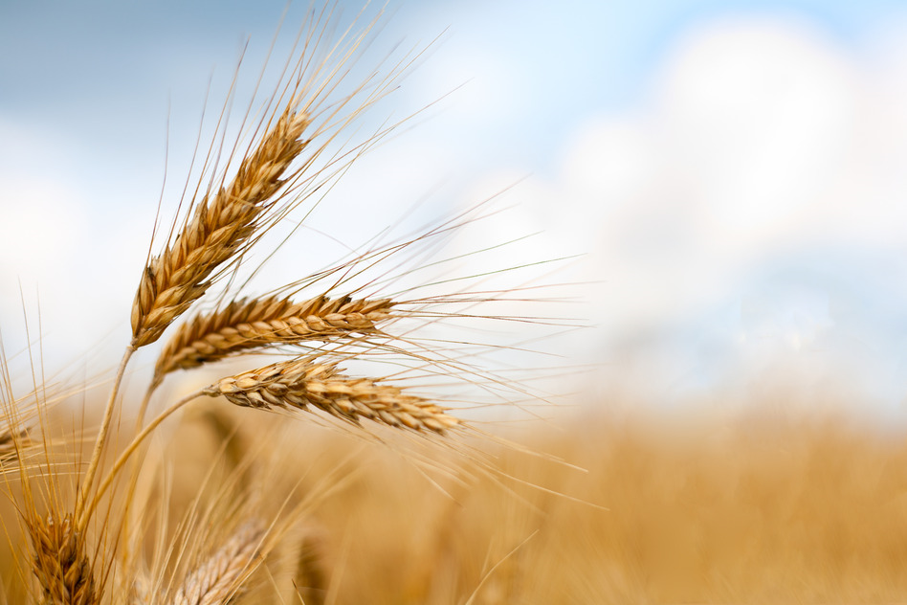
Passion Week
First Sabbath Day--Palm Sunday--Passion Week
Three Days & Three nights—Resurrection
By, Pastor Bob Rogers
Notes:
"This is the record that God has given to us eternal life, and this life is in His Son. He who has the Son has the life; he who does not have the Son of God does not have the life," 1 John 5:11-12. "He who believes on Him is not condemned: but he who believeth not is condemned already, because he has not believed in the Name of the only begotten Son of God," John 3:18. "For there is no other Name under heaven given among men and whereby we must be saved," Acts 4:12. "For by grace you have been saved through faith; and not of yourselves it is the gift of God; not of works, lest any man should boast," Ephesians 2:8-9, "For I am persuaded that neither death, nor life, nor angels, nor principalities, nor powers, nor things present, nor things to come, nor height, nor depth, nor any other created thing is able to separate us from the love of God, which is in Christ Jesus our Lord," Romans 8:38-39. "For of Him and through Him and to Him are all things to Whom be the glory forever," Romans 11:26." Amen.

Slide 2
The Spring Feasts of Israel
Nisan 14 Passover
Firstfruits
Feast of Pentecost
Counting the Omer 50 Days
Jesus’ Death
& Burial
Resurrection
Holy Spirit &
Birth
Of Church
Nisan 15-21 Feast of Unleavened Bread
Leavened Bread Feast
Un-leavened Bread

Slide 3
The Fall Feasts of Israel month of Tishrei
Feast of Trumpets
Feast of Tabernacles
5 Days
Days of Awe,
Judging our own sin
Head of the Year
Rapture
Scapegoat-Blood on Altar
Confession of Sin
Forgiveness of Sin
Tabernacle with God &
1000 Year Reign
Un-leavened Bread

Slide 4
Nisan 10 to Pentecost
Deuteronomy 29:29 (KJV)
29 The secret things belong unto the LORD our God: but those things which are revealed belong unto us and to our children for ever, that we may do all the words of this law.

Slide 6
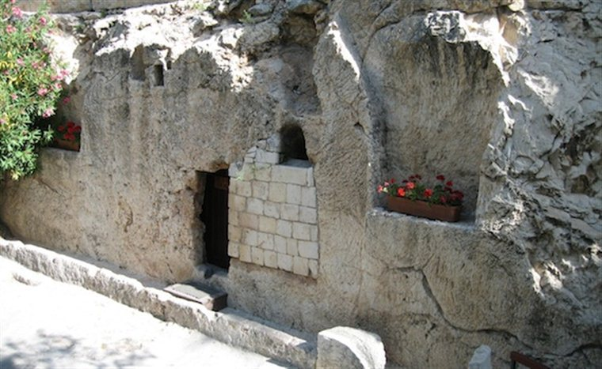

Slide 7
It is a good time in this presentation to state that we think it is important to study the Feasts of The Lord. They hold much significance for the Christian. However, we also must add that this knowledge is not required for a person to come to faith in Jesus Christ. It is my belief that these facts gives even more credibility to the Bible.
Keeping the Feasts will not save you. They are not a requirement for justification, salvation, being saved, or being born again; however you refer to it. This study is intended to clear up the misconceptions of Jesus dying on Friday and rising again on Sunday.
Along with this we present information that supports and informs us as to why Jesus did not die on Friday. Please come join us for this important study.
Notes:
How many of us have successfully worked a rubix cube? That is only a simple illustration to begin to understand the complexity and precision of the Word of God.

Slide 8
This study is tied to the Bible and to sound scholarship. Let’s get started.
This presentation seeks to provide Biblically based answers as to the timing of the Triumphal entry all the way through Passover, The Crucifixion, Firstfruits and to Pentecost.
Since the 14th of Nisan occurs on different days of the week over the years Messiah had to die in a year where the 14th of Nisan had to begin on a Tuesday evening and continue on Wednesday. He rose on the first day of the week.

Slide 9
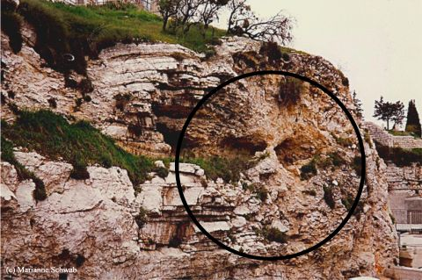

Slide 10
What criteria do we know has to be fulfilled for the Passion of Christ timeline and Pentecost?
The Passover lamb is selected Nisan 10.
Jesus has to rise on the First day of the Week.
Jesus has to celebrate Passover at beginning of Nisan 14. Of all people Jesus would know when to celebrate Passover.
Jesus has to die on Passover (Passover Lamb)
Jesus has to be in the grave for 3 days and 3 nights.
The counting of the Omer lasts for 50 days.

Slide 12
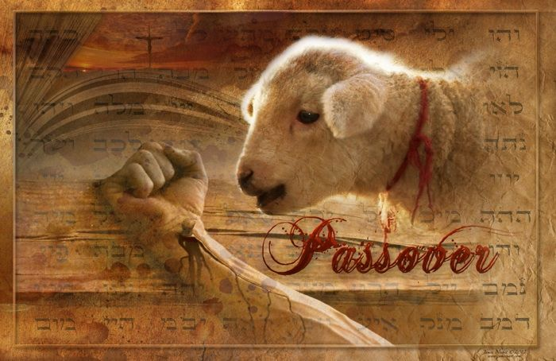
Instructions
for
Passover

Slide 13
Instructions for Passover
Exodus 12:1-7 (KJV)
1 And the LORD spake unto Moses and Aaron in the land of Egypt, saying,
2 This month shall be unto you the beginning of months: it shall be the first month of the year to you.
3 Speak ye unto all the congregation of Israel, saying, In the tenth day of this month they shall take to them every man a lamb, according to the house of their fathers, a lamb for an house:
4 And if the household be too little for the lamb, let him and his neighbour next unto his house take it according to the number of the souls; every man according to his eating shall make your count for the lamb.
5 Your lamb shall be without blemish, a male of the first year: ye shall take it out from the sheep, or from the goats:
6 And ye shall keep it up until the fourteenth day of the same month: and the whole assembly of the congregation of Israel shall kill it in the evening.
7 And they shall take of the blood, and strike it on the two side posts and on the upper door post of the houses, wherein they shall eat it.

Slide 14
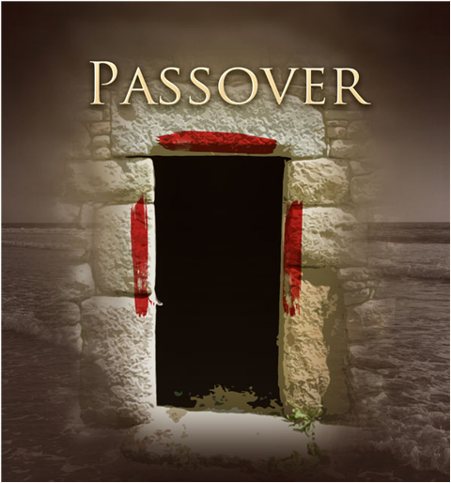
Exo 12:22-23 KJV
(22) And ye shall take a bunch of hyssop, and dip it in the blood that is in the bason, and strike the lintel and the two side posts with the blood that is in the bason; and none of you shall go out at the door of his house until the morning.
(23) For the LORD will pass through to smite the Egyptians; and when he seeth the blood upon the lintel, and on the two side posts, the LORD will pass over the door, and will not suffer the destroyer to come in unto your houses to smite you.
Exo 12:29 KJV
(29) And it came to pass, that at midnight the LORD smote all the firstborn in the land of Egypt, from the firstborn of Pharaoh that sat on his throne unto the firstborn of the captive that was in the dungeon; and all the firstborn of cattle.

Slide 15
Now Nisan 10
Nissan 10 is not just "famous" for being the date of the first Great Sabbath, it is also the date when Jesus rode into Israel on the back of a donkey and was hailed by some as King but ultimately rejected by Israel. Jesus went to Jerusalem, Israel's capital, on the very same day that the Jews were choosing their sacrificial lambs or kids and instead of deciding to take him, the Lamb of God, to heart and bring him into their lives they crucified him and received no benefit from his sacrifice at that time; all they had to do was look and believe on him yet they refused.

Slide 16
Nisan 10
Gabriel’s Zinger
Daniel, originally deported as a teenager (now near the end of the Babylonian captivity), was reading in the Book of Jeremiah (Jeremiah 25:11-12; 29:10). He understood that the seventy years of servitude were almost over and he began to pray for his people.
The Angel Gabriel interrupted Daniel’s prayer and gave him a four-verse prophecy that is unquestionably the most remarkable passage in the entire Bible: Daniel 9:24–27.
These four verses include the following segments:
9:24 – The Scope of the Entire Prophecy;
9:25 – The 69 Weeks;
9:26 – An Interval between the 69th and 70th Week;
9:27 – The 70th Week. Palm Sunday Surprise: by Chuck Missler

Slide 17
Nisan 10
The Scope
Seventy weeks are determined upon thy people and upon thy holy city, to finish the transgression, and to make an end of sins, and to make reconciliation for iniquity, and to bring in everlasting righteousness, and to seal up the vision and prophecy, and to anoint the most Holy Place .
— Daniel 9:24
The idiom of a “week” of years was common in Israel as a “sabbath for the land,” in which the land was to lie fallow every seventh year. It was their failure to obey these laws that led to God sending them into captivity under the Babylonians.
Note that the focus of this passage is upon “thy people and upon thy holy city,” that is, upon Israel and Jerusalem.
(It is not directed to the Church).
The scope of this prophecy includes a broad list of things which clearly have yet to be completed.

Slide 18
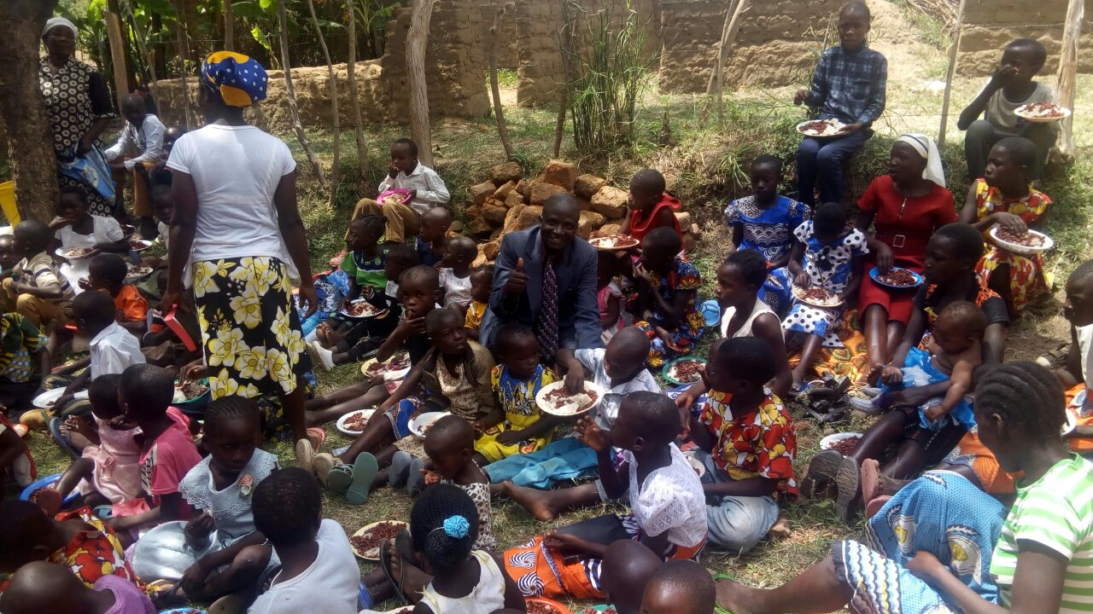

Slide 19
Nisan 10
The First 69 Weeks (Dan 9:25)
A very specific prediction occurs in verse 25:
Know therefore and understand, that from the going forth of the commandment to restore and to build Jerusalem unto the Messiah the Prince shall be seven weeks, and threescore and two weeks: the street shall be built again, and the wall, even in troublous times.
— Daniel 9:25
This includes a mathematical prophecy. The Jewish (and Babylonian) calendars used a 360-day year; 69 weeks of 360-day years totals 173,880 days. In effect, Gabriel told Daniel that the interval between the commandment to rebuild Jerusalem until the presentation of the Messiah as King would be 173,880 days.
The “Messiah the Prince” in the King James translation is actually the Meshiach Nagid, “The Messiah the King.” (Nagid is first used of King Saul.)

Slide 20
Nisan 10
Bull’s-Eye!
The commandment to restore and build Jerusalem was given by Artaxerxes Longimanus on March 14, 445 B.C. (The emphasis in the verse on “the street” and “the wall” was to avoid confusion with other earlier mandates confined to rebuilding the Temple.)
During the ministry of Jesus Christ there were several occasions in which the people attempted to promote Him as king, but He carefully avoided it: “Mine hour is not yet come”. Palm Sunday Surprise: by Chuck Missler • March 1, 1996 http://www.xwalk.ca/king2.html

Slide 21
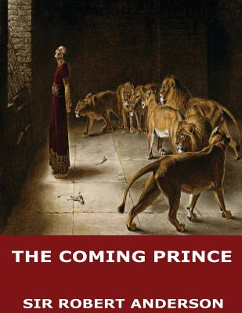

Slide 22
Nisan 10
Jesus went and presented himself in Jerusalem in fulfillment of part of Daniel's prophecy of the 70weeks. On the very day that the first 69 weeks were over, Jesus rode into Jerusalem and was rejected. Seeing Daniel's 70 weeks prophecy clock was stopped on 10 Nissan, another reason He should have been expected.
The clock has not restarted because the “times of the Gentiles is not complete. It will restart at the beginning of the Tribulation.
See Daniel 9:23-27

Slide 23
Nisan 10
The Triumphal Entry
Then, one day, He meticulously arranges it. On this particular day he rode into the city of Jerusalem riding on a donkey, deliberately fulfilling a prophecy by Zechariah that the Messiah would present Himself as king in just that way:
Rejoice greatly, O daughter of Zion; shout, O daughter of Jerusalem: behold, thy King cometh unto thee: he is just, and having salvation; lowly, and riding upon an ass, and upon a colt the foal of an ass.
— Zechariah 9:9
Whenever we might easily miss the significance of what was going on, the Pharisees come to our rescue. They felt that the overzealous crowd was blaspheming, proclaiming Jesus as the Messiah the King. However, Jesus endorsed it!
I tell you that, if these should hold their peace, the stones would immediately cry out.
— Luke 19:40
This is the only occasion that Jesus presented Himself as King. The date April 6, 32 A.D. according to Sir Robert Anderson's classic work, The Coming Prince, first published in 1894

Slide 24
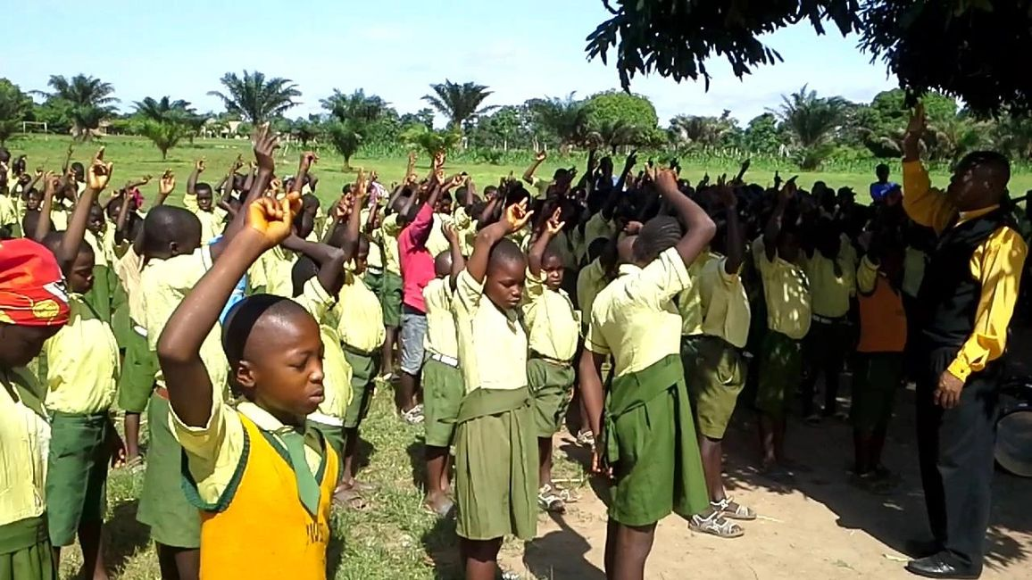

Slide 25
Nisan 10
Daniel 9:24-27 (KJV)
24 Seventy weeks are determined upon thy people and upon thy holy city, to finish the transgression, and to make an end of sins, and to make reconciliation for iniquity, and to bring in everlasting righteousness, and to seal up the vision and prophecy, and to anoint the most Holy.
25 Know therefore and understand, that from the going forth of the commandment to restore and to build Jerusalem unto the Messiah the Prince shall be seven weeks, and threescore and two weeks: the street shall be built again, and the wall, even in troublous times.
26 And after threescore and two weeks shall Messiah be cut off, but not for himself: and the people of the prince that shall come shall destroy the city and the sanctuary; and the end thereof shall be with a flood, and unto the end of the war desolations are determined.
27 And he shall confirm the covenant with many for one week: and in the midst of the week he shall cause the sacrifice and the oblation to cease, and for the overspreading of abominations he shall make it desolate, even until the consummation, and that determined shall be poured upon the desolate.

Slide 26
Nisan 10
The decree of Artaxerxes in the twentieth year of his reign (Neh_2:1-8) meets the requirements of verse Dan_9:25. The commandment to rebuild the city of Jerusalem was issued in the month Nisan 445 B.C. That, then, will be our starting point.
The first seven weeks of forty-nine years bring us to 397 B.C. and to Malachi and the end of the Old Testament. These were "troublous times," as witnessed by both Nehemiah and Malachi.

Slide 27
Nisan 10
Sixty-two weeks, or 434 years, bring us to the Messiah. Sir Robert Anderson in his book, The Coming Prince, has worked out the time schedule. From the first of the month Nisan to the tenth of Nisan (April 6) A.D. 32, is 173,880 days. Dividing them according to the Jewish year of 360 days, he arrives at 483 years (69 sevens). On this day Jesus rode into Jerusalem, offering Himself for the first time, publicly and officially, as the Messiah. J Vernon McGee

Slide 29
Nisan 10
But the language of the prophecy is clear: "From the going forth of the commandment to restore and to build Jerusalem unto Messiah the Prince shall be seven weeks and threescore and two weeks." An era therefore of sixty-nine "weeks," or 483 prophetic years reckoned from the 14th March, B.C. 445, should close with some event to satisfy the words, "unto the Messiah the Prince."

Slide 30
Nisan 10
The date of the nativity could not possibly have been the termination of Daniel 9:25, for then the sixty-nine weeks would have ended thirty-three years before Messiah's death.

Slide 31
Nisan 10
If we set the beginning of His ministry as the final date, difficulties of another kind present themselves. When the Lord began to preach, the kingdom was not presented as a fact accomplished in His advent, but as a hope the realization of which, though at the very door, was still to be fulfilled. Jesus took up John the Baptist's testimony, "The kingdom of heaven is at hand." His ministry was a preparation for the kingdom, leading up to the time when in fulfillment of the prophetic Scriptures He should publicly declare Himself as the Son of David (Matthew 1:1; 9:27; 21:9), the King of Israel, and claim the homage of the nation. It was the nation's rejection of the “Kingdom of Heaven,” and their guilt that made the cross and not the throne the climax of His life on earth.

Slide 33
Nisan 10
No student of the Gospel narrative can fail to see that the Lord's last visit to Jerusalem was the purpose of it, the crisis of His ministry, the goal towards which it had been directed. Up until now He had shunned all public Messianic claims. But now the twofold testimony of His words and His works are fully rendered. His entry into the Holy City was His proclamation of Messiahship and to die for our sin. Again and again His apostles had been charged that they should not make Him known. But now He accepted the acclamations of "the whole multitude of the disciples," and silenced the claims of the Pharisees with this rebuke, "I tell you if these should hold their peace, the stones would immediately cry out." (Luke 19:39, 40)

Slide 34
Nisan 10
The Precision of Prophecy
When we examine the period between March 14, 445 B.C. and April 6, 32 A.D., and correct for leap years, we discover that it is 173,880 days exactly, to the very day!
How could Daniel have known this in advance? How could anyone have contrived to have this detailed prediction documented over three centuries in advance?

Slide 35
Nisan 10
The Jews should have expected Jesus coming in Jerusalem Nisan 10 riding on a donkey.
Daniel 9:25-27
Zechariah 9:9 KJV Rejoice greatly, O daughter of Zion; shout, O daughter of Jerusalem: behold, thy King cometh unto thee: he is just, and having salvation; lowly, and riding upon an ass, and upon a colt the foal of an ass.
Now on to the Feasts of the Lord.

Slide 37
Leviticus 23:1-3 (KJV) 1 And the LORD spake unto Moses, saying, 2 Speak unto the children of Israel, and say unto them, Concerning the feasts of the LORD, which ye shall proclaim to be holy convocations, even these are my feasts. 3 Six days shall work be done: but the seventh day is the sabbath of rest, an holy convocation; ye shall do no work therein: it is the sabbath of the LORD in all your dwellings.
Levitical Law Concerning Passover, Unleavened Bread, Firstfruits and Pentecost

Slide 38
Leviticus 23:4 (KJV) 4 These are the feasts of the LORD, even holy convocations, which ye shall proclaim in their seasons.
Levitical Law Concerning Passover, Unleavened Bread, Firstfruits and Pentecost

Slide 39
When to count the omer: Leviticus 23:5-7 (KJV) 5 In the fourteenth day of the first month at even is the LORD'S passover. 6 And on the fifteenth day of the same month is the feast of unleavened bread unto the LORD: seven days ye must eat unleavened bread. 7 In the first day ye shall have an holy convocation: ye shall do no servile work therein.
Levitical Law Concerning Passover, Unleavened Bread, Firstfruits and Pentecost

Slide 41
Leviticus 23:8-11 (KJV) 8 But ye shall offer an offering made by fire unto the LORD seven days: in the seventh day is an holy convocation: ye shall do no servile work therein. 9 And the LORD spake unto Moses, saying, 10 Speak unto the children of Israel, and say unto them, When ye be come into the land which I give unto you, and shall reap the harvest thereof, then ye shall bring a sheaf of the firstfruits of your harvest unto the priest: 11 And he shall wave the sheaf before the LORD, to be accepted for you: on the morrow after the sabbath the priest shall wave it.
Levitical Law Concerning Passover, Unleavened Bread, Firstfruits and Pentecost

Slide 42
Leviticus 23:15-16 (KJV) 15 And ye shall count unto you from the morrow after the sabbath, from the day that ye brought the sheaf of the wave offering; seven sabbaths shall be complete: 16 Even unto the morrow after the seventh sabbath shall ye number fifty days; and ye shall offer a new meat offering unto the LORD.
Levitical Law Concerning Passover, Unleavened Bread, Firstfruits and Pentecost

Slide 43
Counting the Omer
The question is, does the count always begin on the 16th of Nisan, the day after the 15th, which is a Sabbath being the first day of the feast of Unleavened Bread or does it always begin on the first day of the week after the 7th day Sabbath of Passover week? If it always begins on Nisan 16 then Shavuot will always be on Sivan 6. If the feast of firstfruits always begins on the first day of the week, the day after the 7th day Sabbath then there will never be a set date for firstfruits or Shavuot. Amazingly, nowhere in the Scriptures does it ever give a date for firstfruits or Shavuot suggesting that there never was a set date like there is for every other feast given in Scripture. Mark Biltz

Slide 44
3 Days and 3 Nights
From a Messianic point of view you can never get 3 days and 3 nights from 3pm on 14th of Nisan to the morning of the 16th of Nisan. Since the 14th of Nisan moves during the days of the week over the years Messiah had to die in a year where the 14th of Nisan had to fall on a Wednesday. Therefore the counting of the Omer always begins on the first day of the week after Passover, after the Sabbath that falls on the 7th day of the week. Mark Biltz

Slide 46
3 Days and 3 Nights
Mark 8:31 (KJV)
31 And he began to teach them, that the Son of man must suffer many things, and be rejected of the elders, and of the chief priests, and scribes, and be killed, and after three days rise again.
Mark 9:31 (KJV)
31 For he taught his disciples, and said unto them, The Son of man is delivered into the hands of men, and they shall kill him; and after that he is killed, he shall rise the third day.

Slide 47
3 Days and 3 Nights
Matthew 12:38-40 (KJV)
38 Then certain of the scribes and of the Pharisees answered, saying, Master, we would see a sign from thee.
39 But he answered and said unto them, An evil and adulterous generation seeketh after a sign; and there shall no sign be given to it, but the sign of the prophet Jonas:
40 For as Jonas was three days and three nights in the whale's belly; so shall the Son of man be three days and three nights in the heart of the earth.

Slide 48
3 Days and 3 Nights
How many hours in a day?
John 11:9-10 (KJV)
9 Jesus answered, Are there not twelve hours in the day? If any man walk in the day, he stumbleth not, because he seeth the light of this world.
10 But if a man walk in the night, he stumbleth, because there is no light in him.
Matt. 20:3 And he went out about the third hour, and saw others standing idle in the marketplace,
Matt. 20:5 Again he went out about the sixth and ninth hour, and did likewise.
Matt. 20:6 And about the eleventh hour he went out, and found others standing idle, and saith unto them, Why stand ye here all the day idle?

Slide 49
Daytime Hours
12 Hours
1st Hour | 3rd Hour | 6th Hour | 9th Hour | 12th Hour
6 a.m. | 9 a.m. | Noon 12 p.m. | 3 p.m. | 6 p.m.

Slide 50
3 Days and 3 Nights
How many hours in a night?
Luke 12:38-40 (KJV)
38 And if he shall come in the second watch, or come in the third watch, and find them so, blessed are those servants.
39 And this know, that if the goodman of the house had known what hour the thief would come, he would have watched, and not have suffered his house to be broken through.
40 Be ye therefore ready also: for the Son of man cometh at an hour when ye think not.

Slide 51
Night Time Hours
12 Hours
1st Watch | 3rd Watch | 6th Watch | 9th Watch | 12th Watch
6 p.m. | 9 p.m. | Midnight 12 a.m. | 3 a.m. | 6 a.m.

Slide 52
3 Days and 3 Nights
1 Peter 3:18-20 (KJV)
18 For Christ also hath once suffered for sins, the just for the unjust, that he might bring us to God, being put to death in the flesh, but quickened by the Spirit:
19 By which also he went and preached unto the spirits in prison;
20 Which sometime were disobedient, when once the longsuffering of God waited in the days of Noah, while the ark was a preparing, wherein few, that is, eight souls were saved by water.

Slide 53
Passion Week
Nisan 4 Sunday Nisan 5 Begins 6:00 p.m. | Nisan 5 Monday Nisan 6 Begins 6:00 p.m. | Nisan 6 Tuesday Nisan 7 Begins 6:00 p.m. | Nisan 7 Wednesday Nisan 8 Begins 6:00 p.m. | Nisan 8 Thursday Nisan 9 Begins 6:00 p.m. | Nisan 9 Friday Nisan 10 Begins 6:00 p.m. | Nisan 10 Saturday Nisan 11 Begins 6:00 p.m.
 |  |  |  | Jesus travels to Bethany from Jericho John 12:1 | At Bethany John 12:1 | Triumphal Entry into Jerusalem Matt 21:5,12,17 Mark 11:7, 11 Luke 19:28 Visit to Temple Matt. 21:12

Slide 54
Passion Week
Nisan 11 Sunday Nisan 12 Begins 6:00 p.m. | Nisan 12 Monday Nisan 13 Begins 6:00 p.m. | Nisan 13 Tuesday Nisan 14 Begins 6:00 p.m. Passover | Nisan 14 Wednesday Nisan 15 Begins 6:00 p.m. Unleavened Bread | Nisan 15 Thursday Nisan 16 Begins 6:00 p.m. Unleavened Bread | Nisan 16 Friday Nisan 17 Begins 6:00 p.m. Unleavened Bread | Nisan 17 Saturday Nisan 18 Begins 6:00 p.m. Firstfruits
Jesus Cursed the fig tree Matthew 21:18-22—Matthew 26:2 |  | Matthew 26:1 Passover Lord’s Supper John 13:1-20

Slide 55
John 19:13-14 (KJV)
13 When Pilate therefore heard that saying, he brought Jesus forth, and sat down in the judgment seat in a place that is called the Pavement, but in the Hebrew, Gabbatha.
14 And it was the preparation of the passover, and about the sixth hour: and he saith unto the Jews, Behold your King!

Slide 56
Passion Week
Nisan 11 Sunday Nisan 12 Begins 6:00 p.m. | Nisan 12 Monday Nisan 13 Begins 6:00 p.m. | Nisan 13 Tuesday Nisan 14 Begins 6:00 p.m. Passover | Nisan 14 Wednesday Nisan 15 Begins 6:00 p.m. Unleavened Bread | Nisan 15 Thursday Nisan 16 Begins 6:00 p.m. Unleavened Bread | Nisan 16 Friday Nisan 17 Begins 6:00 p.m. Unleavened Bread | Nisan 17 Saturday Nisan 18 Begins 6:00 p.m. Firstfruits
Jesus Cursed the fig tree Matthew 21:18-22—Matthew 26:2 |  | Matthew 26:1 Passover Lord’s Supper John 13:1-20 | Jesus Crucified About 12 Noon

Slide 57
Passion Week
Nisan 11 Sunday Nisan 12 Begins 6:00 p.m. | Nisan 12 Monday Nisan 13 Begins 6:00 p.m. | Nisan 13 Tuesday Nisan 14 Begins 6:00 p.m. Passover | Nisan 14 Wednesday Nisan 15 Begins 6:00 p.m. Unleavened Bread | Nisan 15 Thursday Nisan 16 Begins 6:00 p.m. Unleavened Bread | Nisan 16 Friday Nisan 17 Begins 6:00 p.m. Unleavened Bread | Nisan 17 Saturday Nisan 18 Begins 6:00 p.m. Firstfruits
Jesus Cursed the fig tree Matthew 21:18-22—Matthew 26:2 |  | Matthew 26:1 Passover Lord’s Supper John 13:1-20 | Jesus Crucified About 12 Noon Darkness 12:00 p.m.

Slide 58
Passion Week
Nisan 11 Sunday Nisan 12 Begins 6:00 p.m. | Nisan 12 Monday Nisan 13 Begins 6:00 p.m. | Nisan 13 Tuesday Nisan 14 Begins 6:00 p.m. Passover | Nisan 14 Wednesday Nisan 15 Begins 6:00 p.m. Unleavened Bread | Nisan 15 Thursday Nisan 16 Begins 6:00 p.m. Unleavened Bread | Nisan 16 Friday Nisan 17 Begins 6:00 p.m. Unleavened Bread | Nisan 17 Saturday Nisan 18 Begins 6:00 p.m. Firstfruits
Jesus Cursed the fig tree Matthew 21:18-22—Matthew 26:2 |  | Matthew 26:1 Passover Lord’s Supper John 13:1-20 | Jesus Crucified About 12 Noon Darkness 12:00 p.m. Jesus Died 3:00 p.m.

Slide 59
Mark 15:34-37 (KJV)
34 And at the ninth hour Jesus cried with a loud voice, saying, Eloi, Eloi, lama sabachthani? which is, being interpreted, My God, my God, why hast thou forsaken me?
35 And some of them that stood by, when they heard it, said, Behold, he calleth Elias.
36 And one ran and filled a spunge full of vinegar, and put it on a reed, and gave him to drink, saying, Let alone; let us see whether Elias will come to take him down.
37 And Jesus cried with a loud voice, and gave up the ghost.

Slide 60
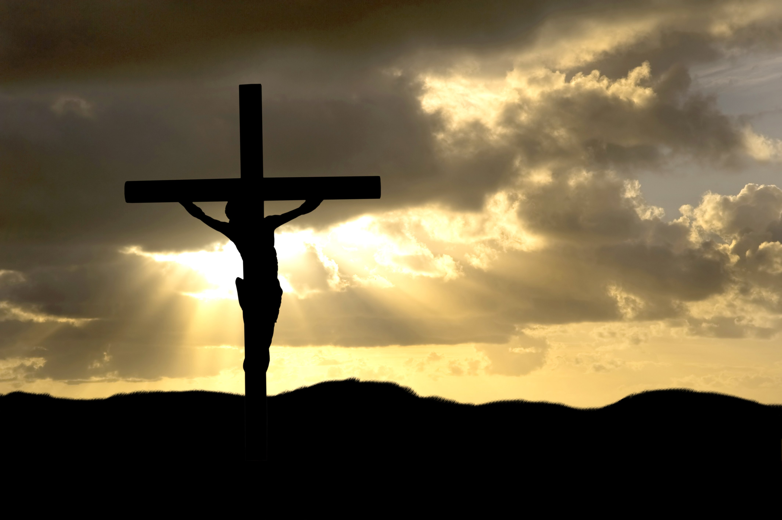

Slide 61
John 19:31 KJV The Jews therefore, because it was the preparation, that the bodies should not remain upon the cross on the sabbath day, (for that sabbath day was an high day,) besought Pilate that their legs might be broken, and that they might be taken away.

Slide 62
Luke 23:50-54 (KJV)
50 And, behold, there was a man named Joseph, a counsellor; and he was a good man, and a just:
51 (The same had not consented to the counsel and deed of them;) he was of Arimathaea, a city of the Jews: who also himself waited for the kingdom of God.
52 This man went unto Pilate, and begged the body of Jesus.
53 And he took it down, and wrapped it in linen, and laid it in a sepulchre that was hewn in stone, wherein never man before was laid.
54 And that day was the preparation, and the sabbath drew on.

Slide 63
Passion Week
Nisan 11 Sunday Nisan 12 Begins 6:00 p.m. | Nisan 12 Monday Nisan 13 Begins 6:00 p.m. | Nisan 13 Tuesday Nisan 14 Begins 6:00 p.m. Passover | Nisan 14 Wednesday Nisan 15 Begins 6:00 p.m. Unleavened Bread | Nisan 15 Thursday Nisan 16 Begins 6:00 p.m. Unleavened Bread | Nisan 16 Friday Nisan 17 Begins 6:00 p.m. Unleavened Bread | Nisan 17 Saturday Nisan 18 Begins 6:00 p.m. Firstfruits
Jesus Cursed the fig tree Matthew 21:18-22—Matthew 26:2 |  | Matthew 26:1 Passover Lord’s Supper John 13:1-20 | Jesus Crucified About 12 Noon Darkness 12:00 p.m. Jesus Died 3:00 p.m. Jesus in Tomb Before High Holy Day

Slide 64
Passion Week
Nisan 11 Sunday Nisan 12 Begins 6:00 p.m. | Nisan 12 Monday Nisan 13 Begins 6:00 p.m. | Nisan 13 Tuesday Nisan 14 Begins 6:00 p.m. Passover | Nisan 14 Wednesday Nisan 15 Begins 6:00 p.m. Unleavened Bread | Nisan 15 Thursday Nisan 16 Begins 6:00 p.m. Unleavened Bread | Nisan 16 Friday Nisan 17 Begins 6:00 p.m. Unleavened Bread | Nisan 17 Saturday Nisan 18 Begins 6:00 p.m. Firstfruits
Jesus Cursed the fig tree Matthew 21:18-22—Matthew 26:2 |  | Matthew 26:1 Passover Lord’s Supper John 13:1-20 | Jesus Crucified About 12 Noon Darkness 12:00 p.m. Jesus Died 3:00 p.m. Jesus in Tomb Before High Holy Day | Jesus in Tomb Matthew 27:62-63 Jewish leaders got the tomb sealed.

Slide 65
Passion Week
Nisan 11 Sunday Nisan 12 Begins 6:00 p.m. | Nisan 12 Monday Nisan 13 Begins 6:00 p.m. | Nisan 13 Tuesday Nisan 14 Begins 6:00 p.m. Passover | Nisan 14 Wednesday Nisan 15 Begins 6:00 p.m. Unleavened Bread | Nisan 15 Thursday Nisan 16 Begins 6:00 p.m. Unleavened Bread | Nisan 16 Friday Nisan 17 Begins 6:00 p.m. Unleavened Bread | Nisan 17 Saturday Nisan 18 Begins 6:00 p.m. Firstfruits
Jesus Cursed the fig tree Matthew 21:18-22—Matthew 26:2 |  | Matthew 26:1 Passover Lord’s Supper John 13:1-20 | Jesus Crucified About 12 Noon Darkness 12:00 p.m. Jesus Died 3:00 p.m. Jesus in Tomb Before High Holy Day | Jesus in Tomb Matthew 27:62-63 Jewish leaders got the tomb sealed. | Jesus in Tomb

Slide 66
Sign to Jewish Leaders
Matthew 27:62-63 (KJV)
62 Now the next day, that followed the day of the preparation, the chief priests and Pharisees came together unto Pilate,
63 Saying, Sir, we remember that that deceiver said, while he was yet alive, After three days I will rise again.
This Sabbath is Feast of Unleavened Bread

Slide 67
Sign to Jewish Leaders
John 2:18-19 (KJV) 18 Then answered the Jews and said unto him, What sign shewest thou unto us, seeing that thou doest these things?
19 Jesus answered and said unto them, Destroy this temple, and in three days I will raise it up.
To raise at the end of three complete days.
Matthew 12:39-40 (KJV) 39 But he answered and said unto them, An evil and adulterous generation seeketh after a sign; and there shall no sign be given to it, but the sign of the prophet Jonas:
40 For as Jonas was three days and three nights in the whale's belly; so shall the Son of man be three days and three nights in the heart of the earth.
At the completion of three full days.

Slide 68
Passion Week
Nisan 11 Sunday Nisan 12 Begins 6:00 p.m. | Nisan 12 Monday Nisan 13 Begins 6:00 p.m. | Nisan 13 Tuesday Nisan 14 Begins 6:00 p.m. Passover | Nisan 14 Wednesday Nisan 15 Begins 6:00 p.m. Unleavened Bread | Nisan 15 Thursday Nisan 16 Begins 6:00 p.m. Unleavened Bread | Nisan 16 Friday Nisan 17 Begins 6:00 p.m. Unleavened Bread | Nisan 17 Saturday Nisan 18 Begins 6:00 p.m. Firstfruits
Jesus Cursed the fig tree Matthew 21:18-22—Matthew 26:2 |  | Matthew 26:1 Passover Lord’s Supper John 13:1-20 | Jesus Crucified About 12 Noon Darkness 12:00 p.m. Jesus Died 3:00 p.m. Jesus in Tomb Before High Holy Day | Jesus in Tomb Matthew 27:62-63 Jewish leaders got the tomb sealed. | Jesus in Tomb | Jesus in Tomb Sabbath Strong’s (7676) Resurrection Occurs About Same Time of Day As Burial John 2:19 Luke 24:1-12

Slide 69
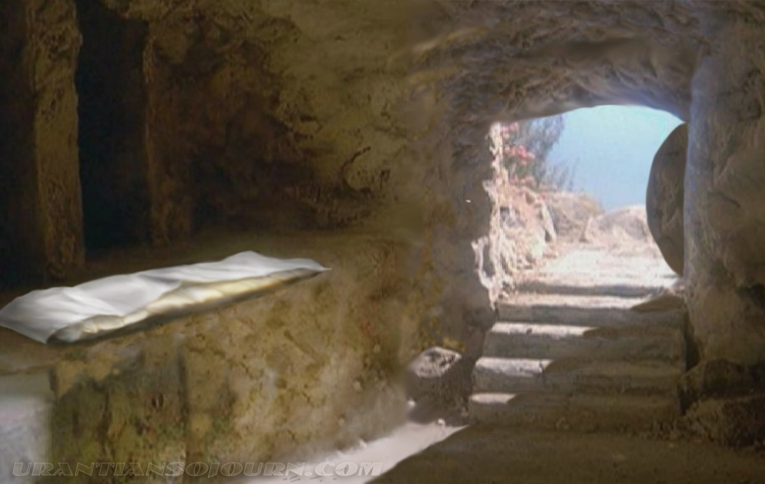

Slide 70
Leviticus 23:8-11 (KJV) 8 But ye shall offer an offering made by fire unto the LORD seven days: in the seventh day is an holy convocation: ye shall do no servile work therein. 9 And the LORD spake unto Moses, saying, 10 Speak unto the children of Israel, and say unto them, When ye be come into the land which I give unto you, and shall reap the harvest thereof, then ye shall bring a sheaf of the firstfruits of your harvest unto the priest: 11 And he shall wave the sheaf before the LORD, to be accepted for you: on the morrow after the sabbath the priest shall wave it.
Slide 42 Levitical Law Concerning Passover, Unleavened Bread, Firstfruits and Pentecost

Slide 71
Leviticus 23:15-16 (KJV) 15 And ye shall count unto you from the morrow after the sabbath, from the day that ye brought the sheaf of the wave offering; seven sabbaths shall be complete: 16 Even unto the morrow after the seventh sabbath shall ye number fifty days; and ye shall offer a new meat offering unto the LORD.
Slide 43 Levitical Law Concerning Passover, Unleavened Bread, Firstfruits and Pentecost

Slide 72
Passion Week
Nisan 18 Sunday Nisan 19 Begins 6:00 p.m. | Nisan 19 Monday Nisan 20 Begins 6:00 p.m. | Nisan 20 Tuesday Nisan 21 Begins 6:00 p.m. | Nisan 21 Wednesday Nisan 22 Begins 6:00 p.m. | Nisan 22 Thursday Nisan 23 Begins 6:00 p.m. | Nisan 23 Friday Nisan 24 Begins 6:00 p.m. | Nisan 24 Saturday Nisan 25 Begins 6:00 p.m.
Resurrection Morning Feast of Firstfruits Luke 24:1-12 Seven weeks to Pentecost

Slide 73
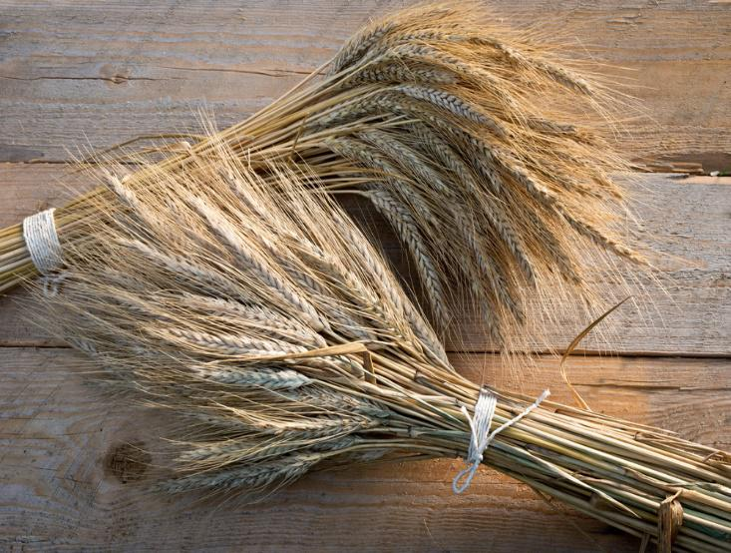
Jesus is The First Fruits

Slide 74
Passion Week
Nisan 4 Sunday Nisan 5 Begins 6:00 p.m. | Nisan 5 Monday Nisan 6 Begins 6:00 p.m. | Nisan 6 Tuesday Nisan 7 Begins 6:00 p.m. | Nisan 7 Wednesday Nisan 8 Begins 6:00 p.m. | Nisan 8 Thursday Nisan 9 Begins 6:00 p.m. | Nisan 9 Friday Nisan 10 Begins 6:00 p.m. | Nisan 10 Saturday Nisan 11 Begins 6:00 p.m.
 |  |  |  | Jesus travels to Bethany from Jericho John 12:1 | At Bethany John 12:1 | Triumphal Entry into Jerusalem Matt 21:5,12,17 Mark 11:7, 11 Luke 19:28 Visit to Temple Matt. 21:12

Slide 75
Passion Week
Nisan 11 Sunday Nisan 12 Begins 6:00 p.m. | Nisan 12 Monday Nisan 13 Begins 6:00 p.m. | Nisan 13 Tuesday Nisan 14 Begins 6:00 p.m. Passover | Nisan 14 Wednesday Nisan 15 Begins 6:00 p.m. Unleavened Bread | Nisan 15 Thursday Nisan 16 Begins 6:00 p.m. Unleavened Bread | Nisan 16 Friday Nisan 17 Begins 6:00 p.m. Unleavened Bread | Nisan 17 Saturday Nisan 18 Begins 6:00 p.m. Firstfruits
Jesus Cursed the fig tree Matthew 21:18-22—Matthew 26:2 |  | Matthew 26:1 Passover Lord’s Supper John 13:1-20 | Jesus Crucified About 12 Noon Darkness 12:00 p.m. Jesus Died 3:00 p.m. Jesus in Tomb Before High Holy Day | Jesus in Tomb | Jesus in Tomb | Jesus in Tomb Sabbath Strong’s (7676) Resurrection Occurs About Same Time of Day As Burial John 2:19 Luke 24:1-12

Slide 76
Counting The Omer
Nisan 18 Sunday Nisan 19 Begins 6:00 p.m. | Nisan 19 Monday Nisan 20 Begins 6:00 p.m. | Nisan 20 Tuesday Nisan 21 Begins 6:00 p.m. | Nisan 21 Wednesday Nisan 22 Begins 6:00 p.m. | Nisan 22 Thursday Nisan 23 Begins 6:00 p.m. | Nisan 23 Friday Nisan 24 Begins 6:00 p.m. | Nisan 24 Saturday Nisan 25 Begins 6:00 p.m.
Resurrection Morning Firstfruits 1st Day of Counting Omer | 2nd Day of Counting Omer | 3rd Day of Counting Omer | 4th Day of Counting Omer | 5th Day of Counting Omer | 6th Day of Counting Omer | 7th Day of Counting Omer

Slide 77
The Spring Feasts of Israel
Nisan 14 Passover
Firstfruits
Feast of Pentecost
Counting the Omer 50 Days
Jesus’ Death
& Burial
Resurrection
Holy Spirit &
Birth
Of Church
Nisan 15-21 Feast of Unleavened Bread
Leavened Bread Feast
Un-leavened Bread

Slide 78
Nisan 10 to Pentecost
Deuteronomy 29:29 (KJV)
29 The secret things belong unto the LORD our God: but those things which are revealed belong unto us and to our children for ever, that we may do all the words of this law.

