Slide 1
Revelation 12, War in Heaven
By,
Pastor Bob Rogers
Notes:
"This is the record that God has given to us eternal life, and this life is in His Son. He who has the Son has the life; he who does not have the Son of God does not have the life," 1 John 5:11-12. "He who believes on Him is not condemned: but he who believeth not is condemned already, because he has not believed in the Name of the only begotten Son of God," John 3:18. "For there is no other Name under heaven given among men and whereby we must be saved," Acts 4:12. "For by grace you have been saved through faith; and not of yourselves it is the gift of God; not of works, lest any man should boast," Ephesians 2:8-9, "For I am persuaded that neither death, nor life, nor angels, nor principalities, nor powers, nor things present, nor things to come, nor height, nor depth, nor any other created thing is able to separate us from the love of God, which is in Christ Jesus our Lord," Romans 8:38-39. "For of Him and through Him and to Him are all things to Whom be the glory forever," Romans 11:26." Amen.

Slide 2
The Design of the Gospels
 | Matthew | Mark | Luke | John
Presents as | Messiah | Servant | Son of Man | Son of God
Genealogy | Abraham (Legal) | -- | Adam (Bloodline) | Eternal (Preexistence)
What Jesus | Said | Did | Felt | Was (Diety)
Primarily To the: | Jew | Roman | Greek | Church
1st Miracle | Leper cleansed (Jew=sin) | Demon expelled | Demon expelled | Water to Wine
Ends with | Resurrection | Ascension | Promise of Spirit Acts | Promise of Return Revelation
Camp Side Ensign | East Judah | West Ephraim | South Ruben | North Dan
Face | Lion | Ox | Man | Eagle
Style | Groupings | Snapshots | Narrative | Mystical
Notes:
God has given us 66 books, by 40 authors, over 2200 years, in 3 languages, on 3 continents, with 1 divinely-inspired theme of love and redemption for all mankind. We should trust it. It is the Bible.

Slide 3
Two Men
Luke 9:30 (KJV)
30 And, behold, there talked with him two men, which were Moses and Elias:
Luke 24:4 (KJV)
4 And it came to pass, as they were much perplexed thereabout, behold, two men stood by them in shining garments:
Acts 1:10 (KJV)
10 And while they looked stedfastly toward heaven as he went up, behold, two men stood by them in white apparel;
Revelation 11:3 (KJV)
3 And I will give power unto my two witnesses, and they shall prophesy a thousand two hundred and threescore days, clothed in sackcloth.

Slide 4
Chronology
Daniel
LXX
Olivet Discourse
Return to
Jerusalem
Abomination of
Desolation
Abomination of
Desolation
Abomination of
Desolation
6th Century BC
5th Century BC
4th Century BC
3rd Century BC
2nd Century BC
1st Century BC
1st Century AD
Tribulation

Slide 5
The Heptadic Structure (sevens)
Chapter 6
The 7 Sealed Scroll
Chapter 7
Parenthesis
1
2
3
4
5
6
7
Chapter 8,9 10-14
1
2
3
4
5
6
7
Parenthesis
Chapter 15 16
Parenthesis
1
1
1
1
2
3
1
1
1
1
4
5
6
7
Notes:
We have had the 7 seals and the parenthesis between 6 & 7. We have looked at the first 6 trumpets and we have examined the parenthesis in the trumpets.

Slide 6
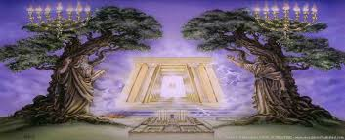
Harpazo (Rapture) 1 Thess 4:16-17
3 ½ yrs.
42 mos.
1260 days
3 ½ yrs.
42 mos.
1260 days
2nd Coming 2Thess 1:7-10 --Armageddon
Great Tribulation
Matt. 24:21-22
Rapture os Church
Rapture of OT Saints and Tribulation Saints And Judgment
Judgment of Israel Ezek. 20:32-38
144,000 Sealed
Angel Book Thunders Temple & 24 Elders
Abomination
Of
Desolation
Daniel 9:27; Matt. 24:15
Dragon, Beast, False Prophet, Evil Spirits, Frogs
1
3
5
7
2
4
6
1
3
5
7
2
4
6
1
1
1
1
3
5
1
1
1
1
7
2
4
6
1290 Days Image in Temple Dan. 12:11
1335 Days Dan. 12:12-13; 1Cor. 6:2-3
Two Witnesses

Slide 7
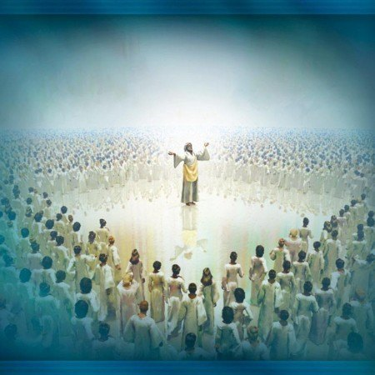
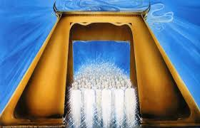
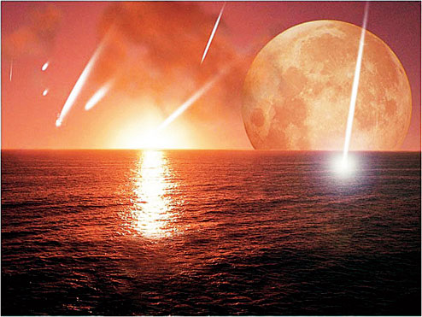
The Seals
The Four Horsemen
White
Red
Black
Pale
Cosmic
Changes
144,000
Witnesses
Silence in Heaven
Conquering
War
Famine
Death
Martyrs
144,000 Sealed
1
2
3
4
5
6
7

Slide 8
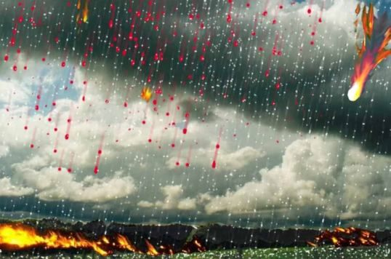
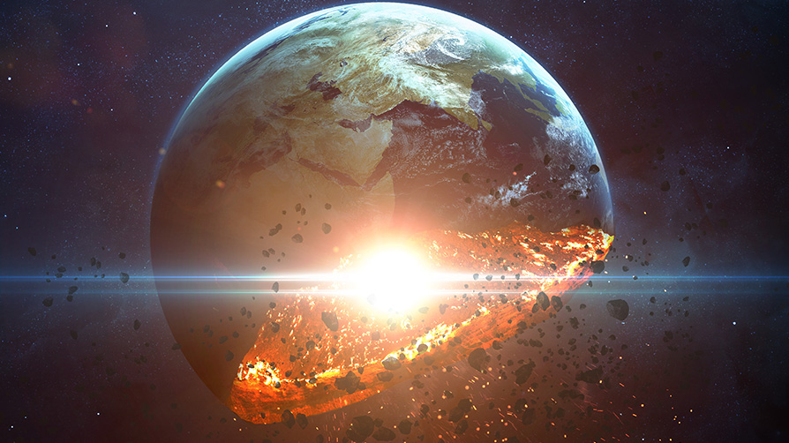
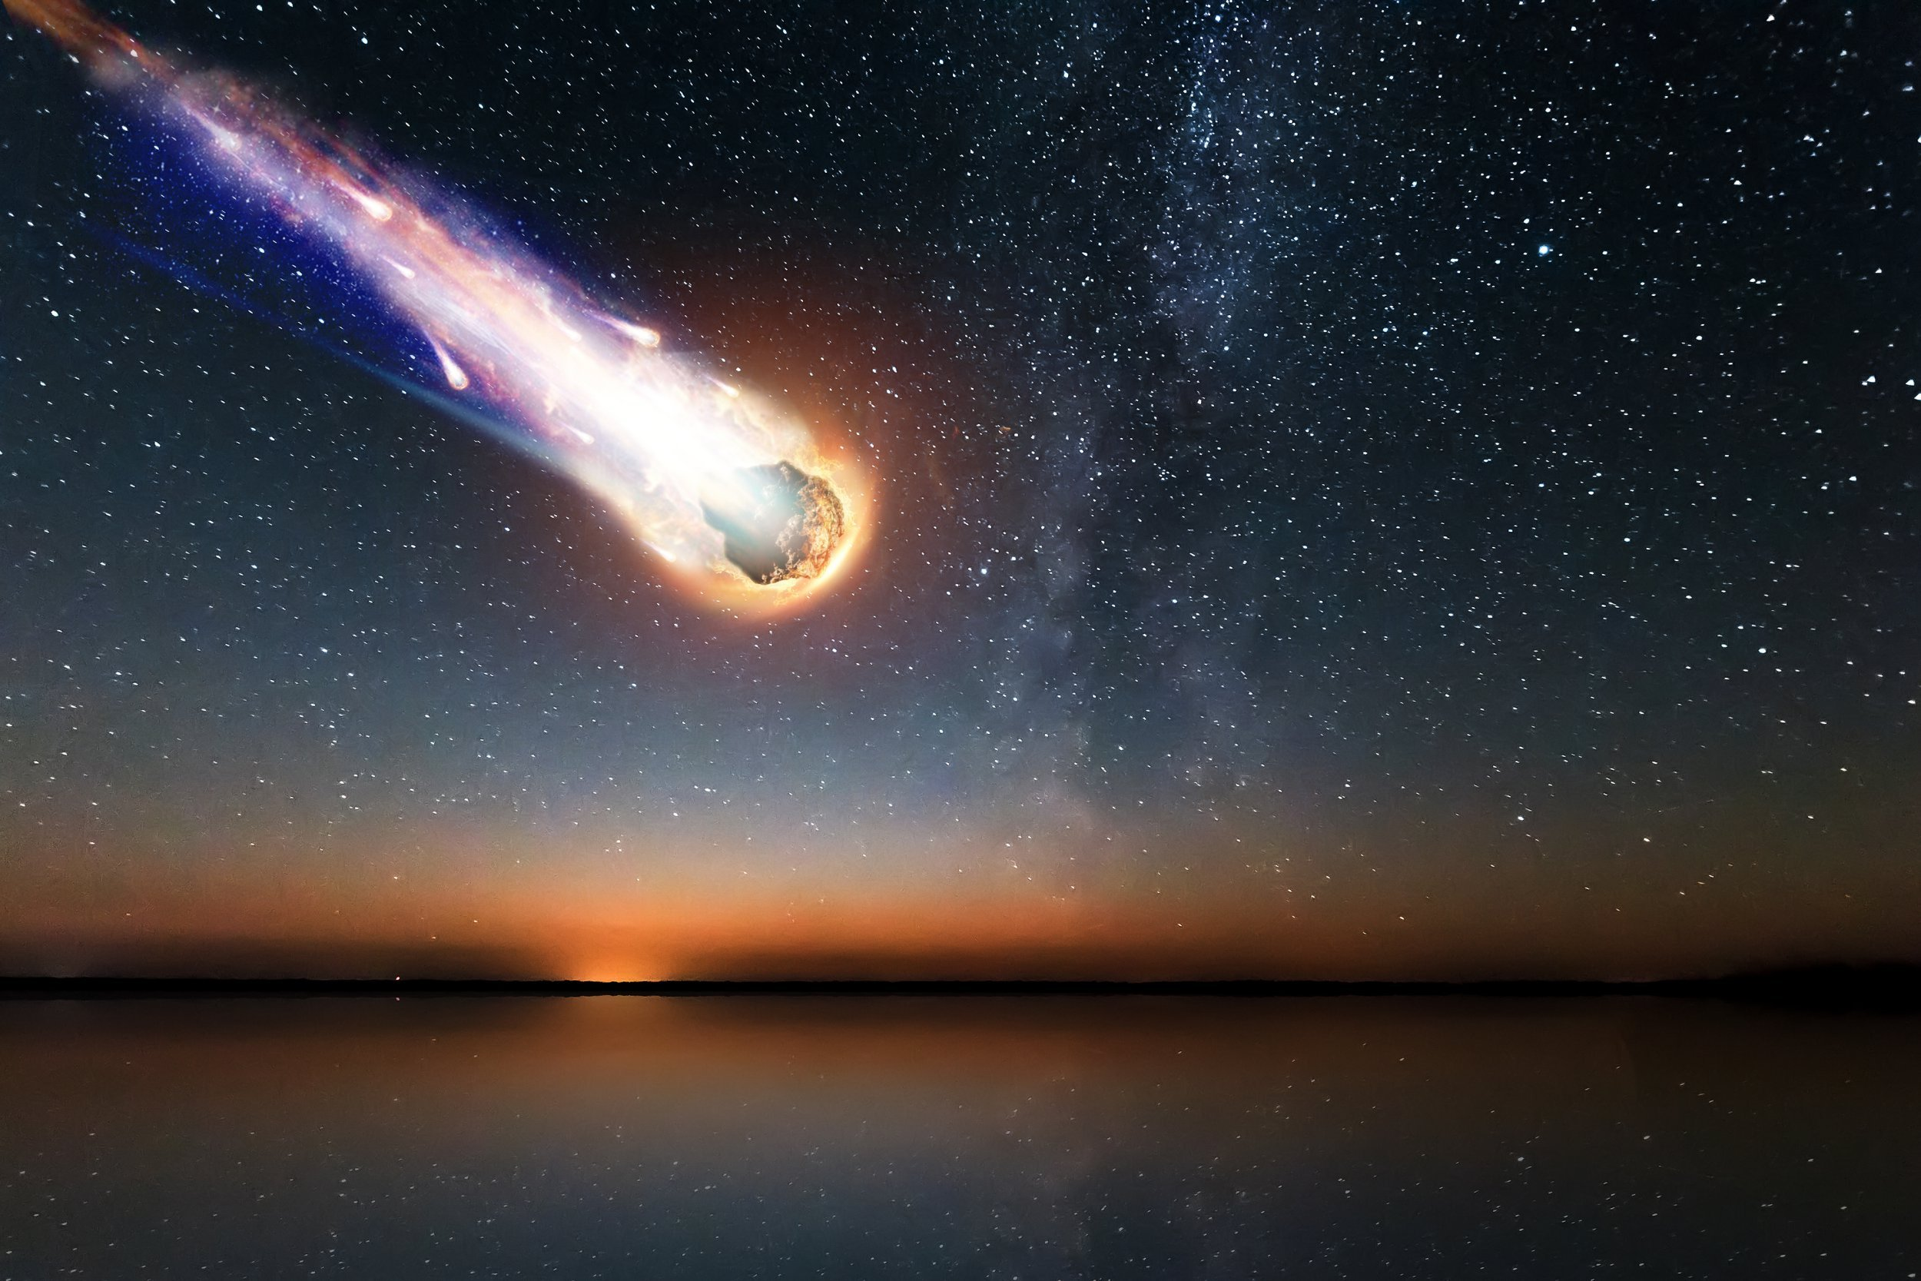
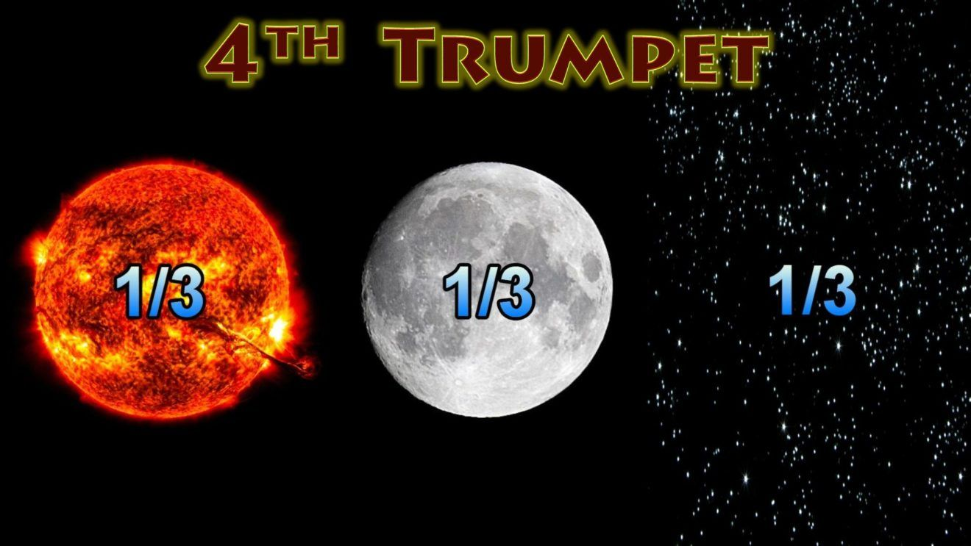
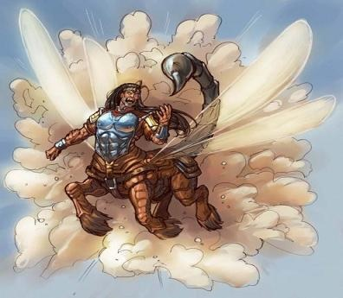
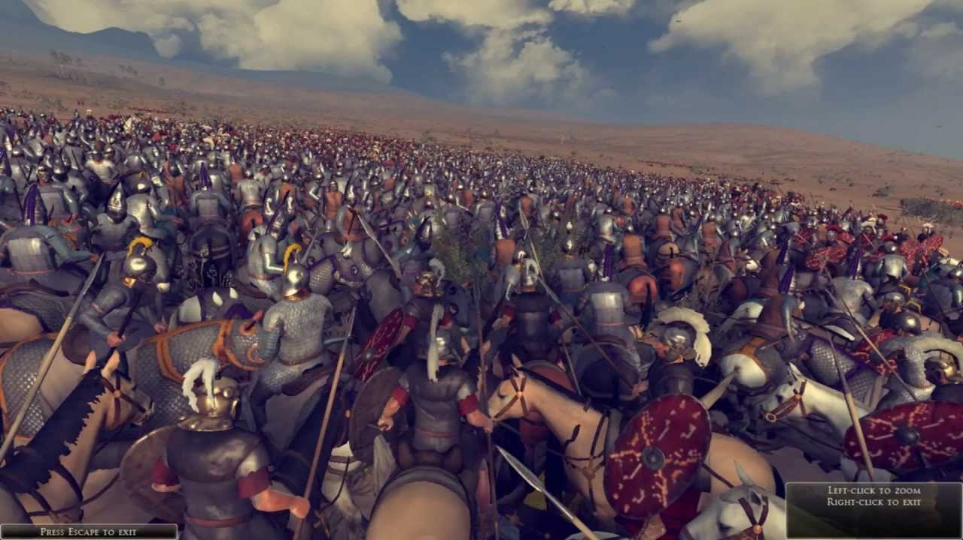
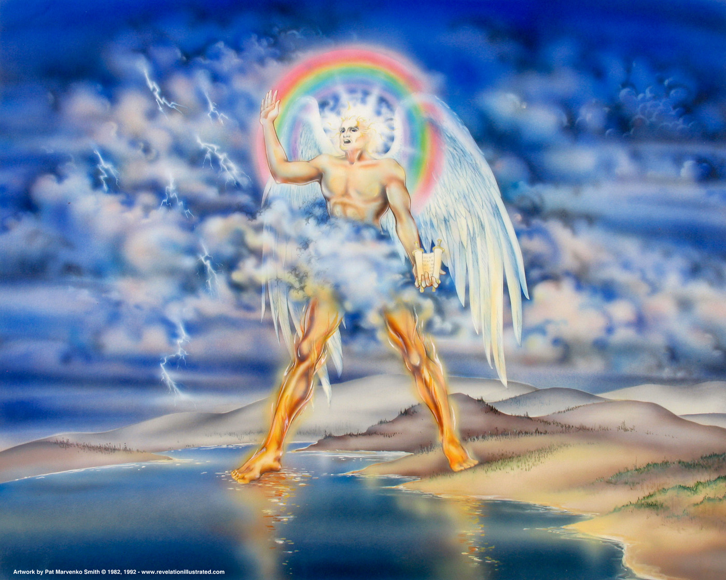
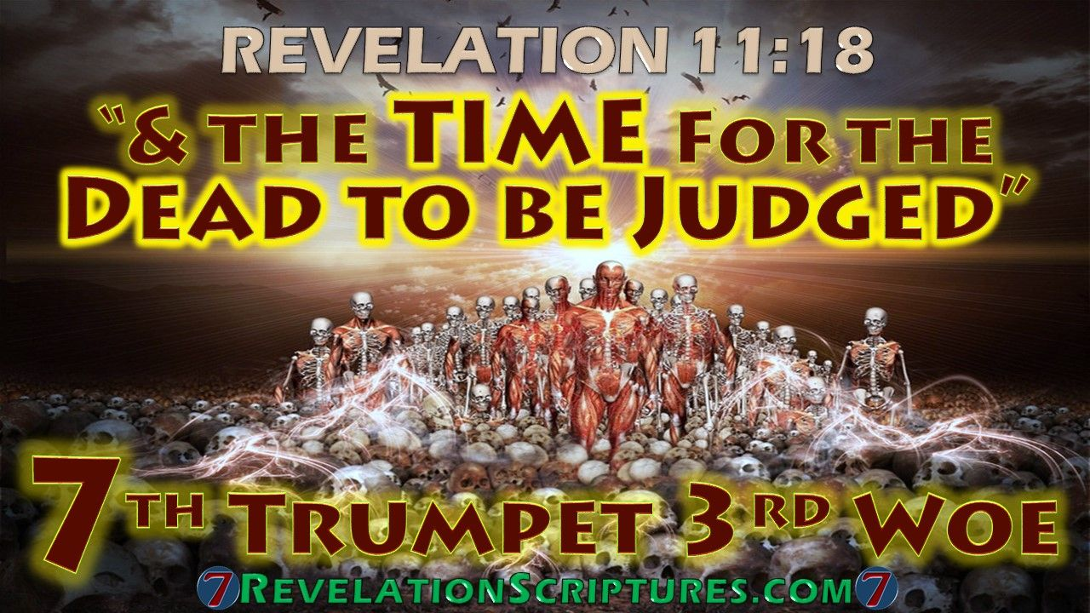
The Trumpet Judgments
1
2
3
4
5
6
7
Mighty Angel
Little Book Seven Thunders Temple & 24 Elders
Trees & Grass
Sea, Creatures &Ships
Rivers, Fountains & Waters
Sun, Moon, & Stars
Stinging locusts
1st Woe
Slay ⅓ of men
2nd Woe
Kingdoms become the LORDS
3rd Woe
Revelation 10-11:14
Judgment of the Thirds
Last 3 Trumpets = 3 “Woes”

Slide 9
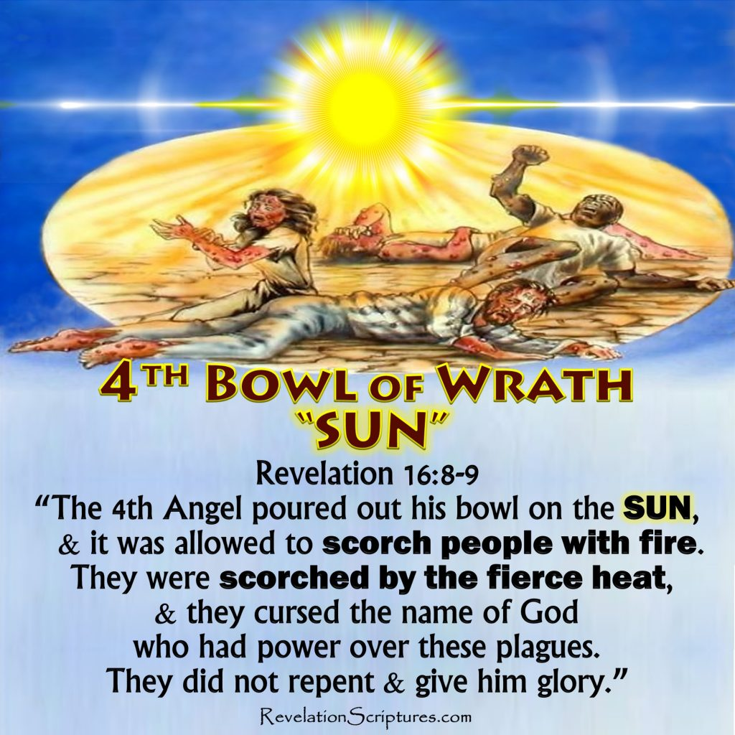
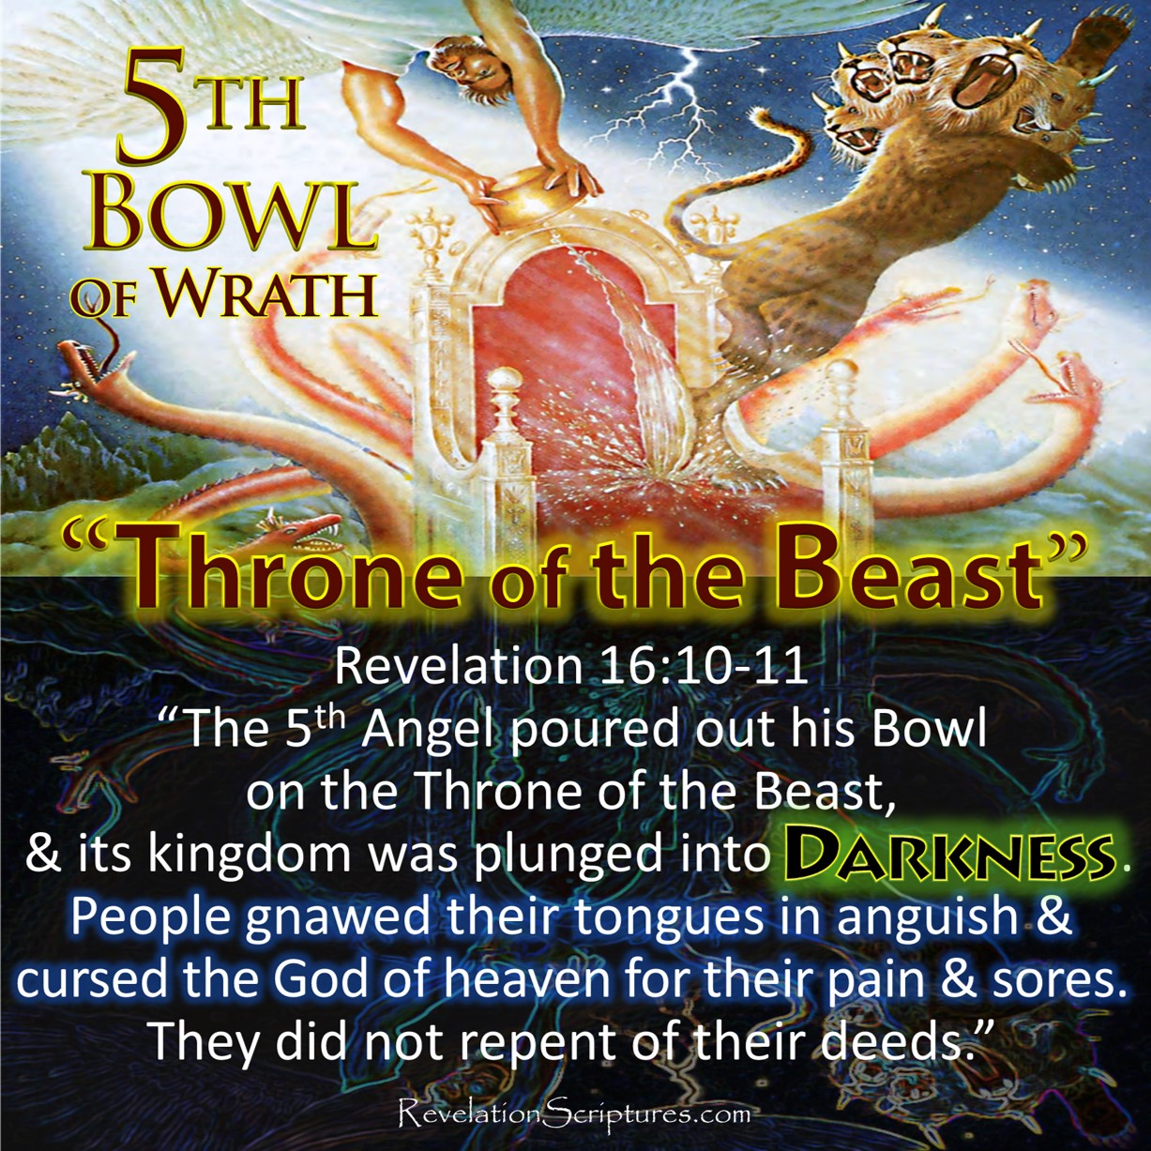
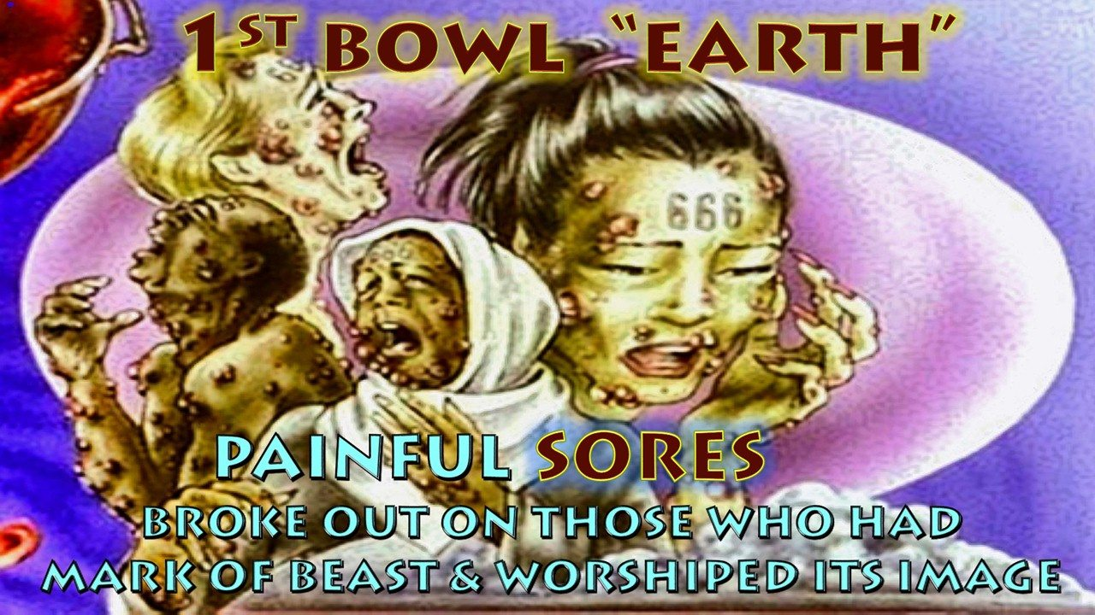
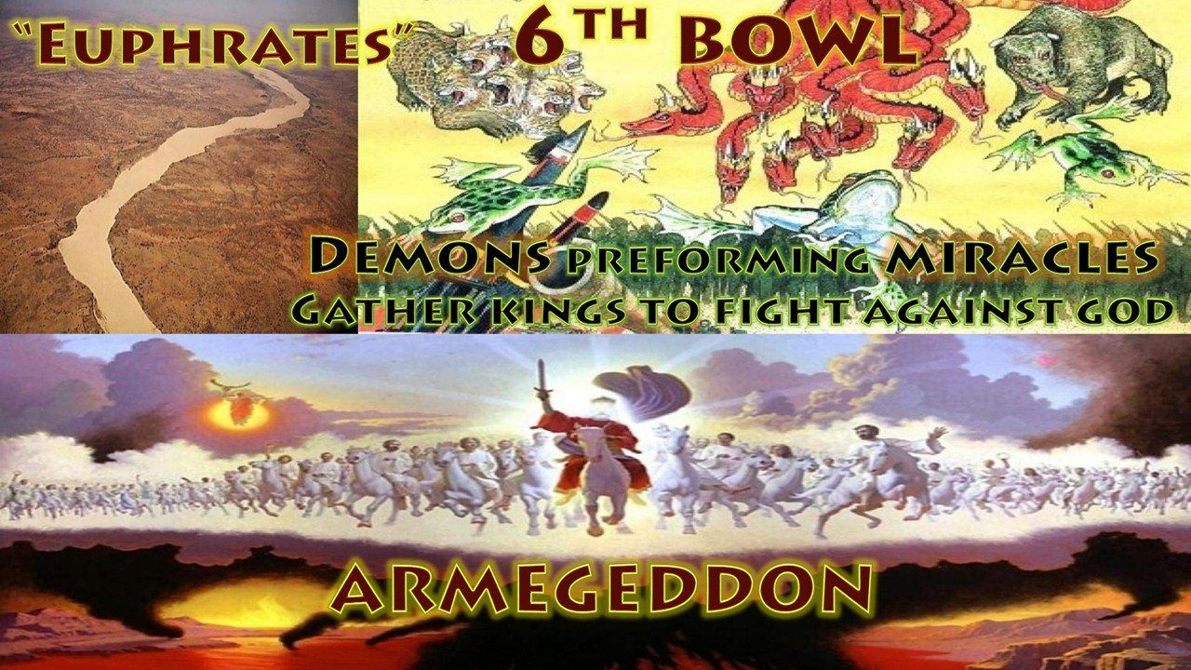
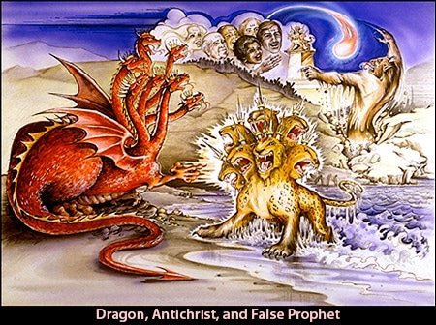
The Vials of Wrath
Dragon, Beast, False Prophet, Evil Spirits, Frogs
1
1
1
1
2
3
1
1
1
1
4
5
6
7
Rev. 16:2
Grievous Sore
Rev. 16:3
Sea of Blood
All in Sea Die
Rev. 16:4
Rivers to Blood
Rev. 16:10
Beast’s Kingdom full of Darkness
Rev. 16:12
Euphrates Dried Up
Rev. 16:8
Sun Scorched Men With Fire
Rev. 16:17-20 Earthquakes
Rev. 16:13-14

Slide 10
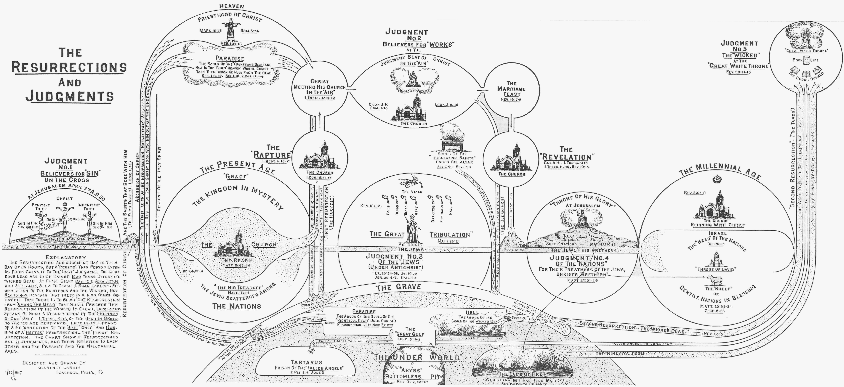

Slide 12
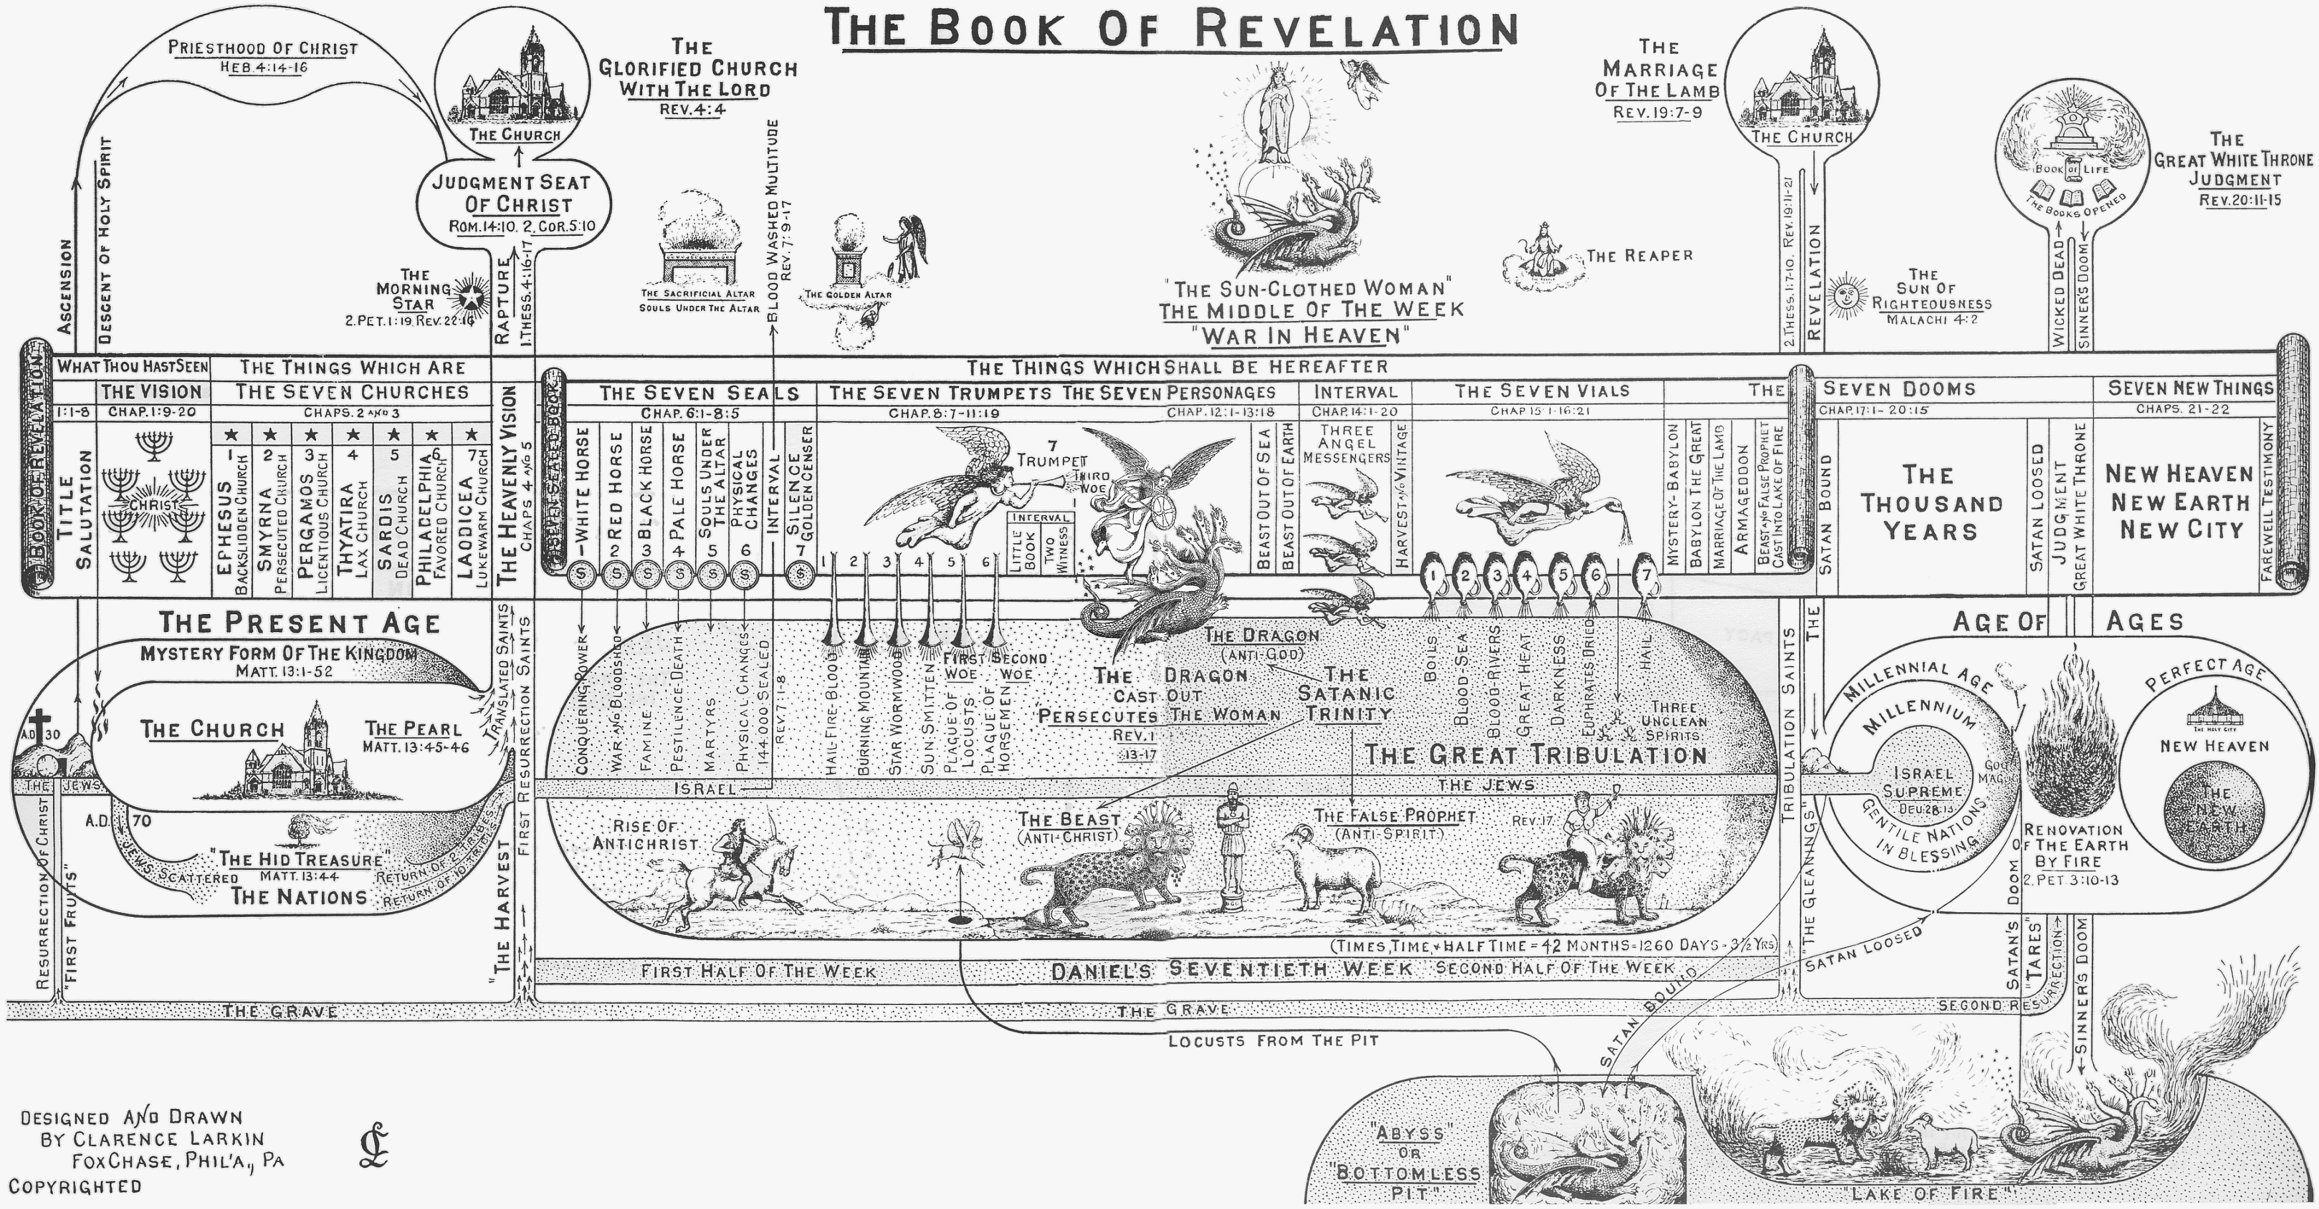

Slide 13
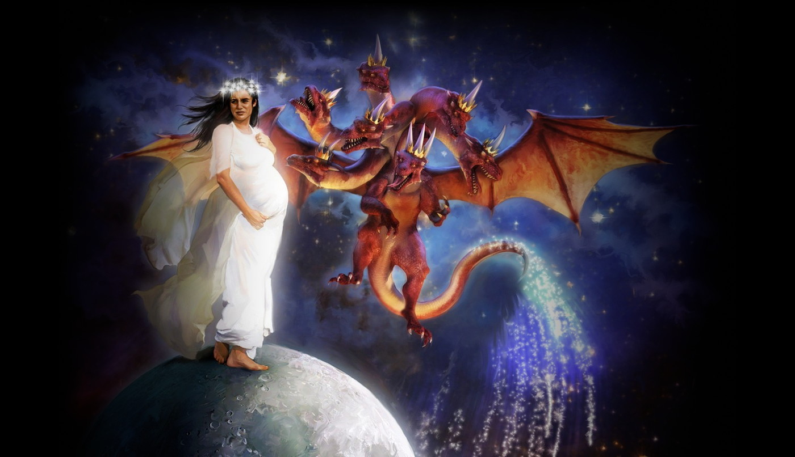

Slide 14
Satan’s Seven Super Kingdoms
Nimrod of Babylon Genesis 10:8-10, 11:1-2 in Shinar whole world was one Revelation 17:3-5 Babylon
Pharaoh of Egypt Ezekiel 29:3-4 Hooks in jaw Job 41:1-2
Sennacherib of Assyria Isaiah 10:12,19,20 connected to Satan Jeremiah 51:34 ;Luke 4:5-6 Satan gives kingdoms to whosoever he will. Jer. 50:17 Israel is a scattered sheep; the lions have driven him away: first the king of Assyria hath devoured him; and last this Nebuchadrezzar king of Babylon hath broken his bones.
Nebuchadnezzar of Babylon
Darius/Cyrus of Medeia/Persia Daniel 10:13 Spiritual kingdom Michael wars. Rev. 12:7, Jude 9 Michael spoken of as Archangel. Only 1 Archangel in Bible.
Alexander the Great of Greece. Daniel 10:20, Daniel 9:21, Man Gabriel caused to fly. Antichrist Daniel 8:21-25
Cesar Augustus of Rome. 2 Thess. 2:3,7-9,
One is yet to come Revelation 17:11.

Slide 15
War in Heaven
Revelation 12:7-9 (KJV)
7 And there was war in heaven: Michael and his angels fought against the dragon; and the dragon fought and his angels,
8 And prevailed not; neither was their place found any more in heaven.
9 And the great dragon was cast out, that old serpent, called the Devil, and Satan, which deceiveth the whole world: he was cast out into the earth, and his angels were cast out with him.

Slide 16
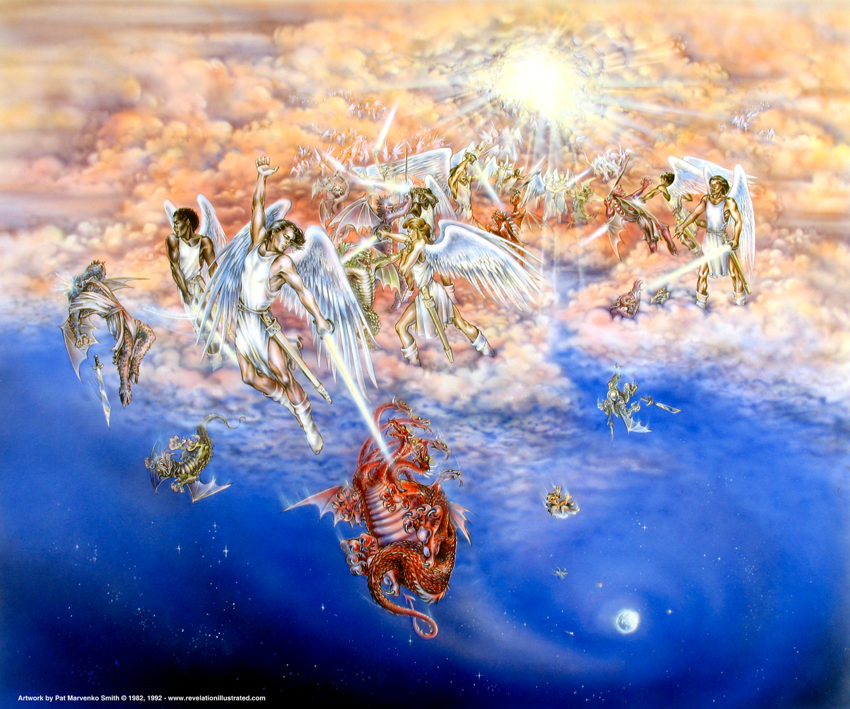

Slide 17
War in Heaven
The "WAR IN HEAVEN" is started by the attempt to expel the DRAGON and his angels From the Heavenlies.
That the DRAGON (Satan) and his angels were not cast out of Heaven at the time of his "Rebellion" (which antedates the present earth), and confined in some "prison house," is clear.
He was at liberty to visit the Garden of Eden and tempt Adam and Eve, and
He had access to God in Heaven in the days of Job, 2000 years before Christ (Job 1:1; 2:8),
He was free to visit the earth in Christ's day and tempt Him in the Wilderness, and later to sift Peter.
His origin is more or less shrouded in mystery, but one thing is certain, he is a "created being," and that of the most exalted type.

Slide 18
War in Heaven
He was before his rebellion "The Anointed Cherub That Covereth."
That is, he was the guardian or protector of the "Throne of God."
He was perfect in all his ways from the day that he was created until iniquity was found in him.
In him was the "fulness of wisdom," and the "perfection of beauty," but it was his "beauty" that caused the pride (1. Tim. 3:6) that was his downfall.
He was clothed in a garment that was covered with the most rare and precious gems, the sardius, topaz, diamond, beryl, onyx, jasper, sapphire, emerald, carbuncle, all woven in with gold.
He dwelt in Eden, the Garden of God. This probably refers not to the earthly Eden, but to the "Paradise of God" on high, for Satan dwelt on the "Holy Mount of God."

Slide 19
War in Heaven
The common notion is that Satan and his angels are imprisoned in Hell. This is not true.
The angels described in 2. Pet. 2:4, and Jude 6, as having left their "first estate," and being "reserved in everlasting chains under darkness," are not Satan's angels.
They are a special class of angels, spoken of as "Sons of God," whose sin of marrying the "Daughters of Men" caused the Flood. Gen. 6:1-8.
They are the "Spirits in Prison" of whom Peter speaks in 1. Pet. 3:18-20.
They are now confined in "Tartarus" awaiting the "Great White Throne" Judgment. Jude 6.
As this Book of Revelation that we are now studying is a prophecy of "Things To Come" that were future in the Apostle John's day, and it declares that Satan was still in the Heavenlies at that time, a.d. 96, as he has not been cast out since he must still be there.

Slide 20
War in Heaven
The opposing "Commanders in Chief" of the "War in Heaven" will be MICHAEL and the DRAGON (Satan).
We are first introduced to Michael in the Book of Daniel, and his appearance here is a confirmation that this part of the Book of Revelation is Jewish, and a continuation or supplement to the Book of Daniel.
Michael is called in the Book of Daniel
"one of the CHIEF PRINCES" (Dan. 10:13),
"YOUR PRINCE" (Dan. 10:21),
"GREAT PRINCE WHICH STANDETH FOR THY PEOPLE." Dan. 12:1.
That is, Michael has been chosen from among the "Chief Princes" that stand before God, to be the protector of Daniel's People, the Jews.
In Jude 9 he is called the "ARCHANGEL," and as there is but one "Archangel" spoken of in the Bible, Michael must be he.
He also has something to do with the resurrection of the dead, for he is associated with the "Resurrection" mentioned in Dan. 12:1-2
He contested with the Devil the resurrection of Moses (Jude 9),
The "Voice" of the Archangel that will be heard when the "Dead in Christ" shall rise (1 Thess. 4:16), will be the "voice" of MICHAEL.

Slide 21
War in Heaven
Revelation 12:10-11 (KJV)
10 And I heard a loud voice saying in heaven, Now is come salvation, and strength, and the kingdom of our God, and the power of his Christ: for the accuser of our brethren is cast down, which accused them before our God day and night.
11 And they overcame him by the blood of the Lamb, and by the word of their testimony; and they loved not their lives unto the death.

Slide 22
War in Heaven
When the "Dragon" is cast out of the "Heavenlies" there will be great rejoicing in Heaven.
The "Accuser" of Christ's "Brethren" (the Jews) is cast down, but there will be "woe" for the "inhabitants of the earth."
The "Dragon" will be filled with "great wrath" because he knows that he will have but a "short time" (31/2 years) to vent his wrath on the inhabitants of the earth before he is chained and cast into the Bottomless Pit.

Slide 23
War in Heaven
While Satan has been the "Accuser of the Brethren" in all Ages, the context shows that reference is here made to the "Jewish Remnant" (the brethren of Christ), who during the first 31/2 years of the "Tribulation Period" pass through great persecution, and die as "martyrs."
They are referred to in Rev. 6:9-11 as the "souls of them that were slain for the Word of God," and we are here told (Rev. 12:11) that they overcame by the "Blood of the Lamb," and the "Word of their Testimony," and died as "martyrs," for they "loved not their lives unto the death."
As they overcame by the "Blood Of The Lamb," then the "TIME" of their overcoming must be subsequent to the shedding of Christ's blood on Calvary, that is, Satan according to this account, could not have been cast out of the "Heavenlies" prior to the Crucifixion of Christ.

Slide 24
War in Heaven
When Jesus said—I beheld Satan as lightning fall from heaven" (Luke 10:18), He was not referring to some past fall of Satan, but it was a prophetic utterance, by way of anticipation, of his future fall, when he shall be hurled headfirst out of Heaven by Michael the Archangel.
As further evidence as to the time of Satan's casting out, Daniel the Prophet tells us that it will be at the "Time of Trouble" that is to come upon Daniel's People, the Jews, and that "Time of Trouble" is the "GREAT TRIBULATION." At that time Michael shall "stand up" to deliver Daniel's People, and the result will be "WAR IN HEAVEN" and Daniel's People shall be delivered, not from the "Great Tribulation," but out of it.

Slide 25
War in Heaven
When the Dragon and all the Principalities and Powers of evil that now occupy the "Middle Heaven" of the Heavenlies, that is, the Heaven between the atmosphere of our earth, and the "Third Heaven" where God dwells, are cast out and down, then the Heavens will be CLEAN, for they are not now clean in God's sight. Job 15:15. And as all these "Evil Powers" will doubtless be imprisoned during the Millennium, with Satan, the Heavens will be CLEAN during that period, and this will account for the universal rule of righteousness and peace of those days.

Slide 26
Woman Persecuted
Revelation 12:12-14 (KJV)
12 Therefore rejoice, ye heavens, and ye that dwell in them. Woe to the inhabiters of the earth and of the sea! for the devil is come down unto you, having great wrath, because he knoweth that he hath but a short time.
13 And when the dragon saw that he was cast unto the earth, he persecuted the woman which brought forth the man child.
14 And to the woman were given two wings of a great eagle, that she might fly into the wilderness, into her place, where she is nourished for a time, and times, and half a time, from the face of the serpent.

Slide 27
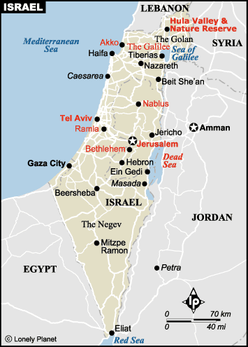

Slide 28
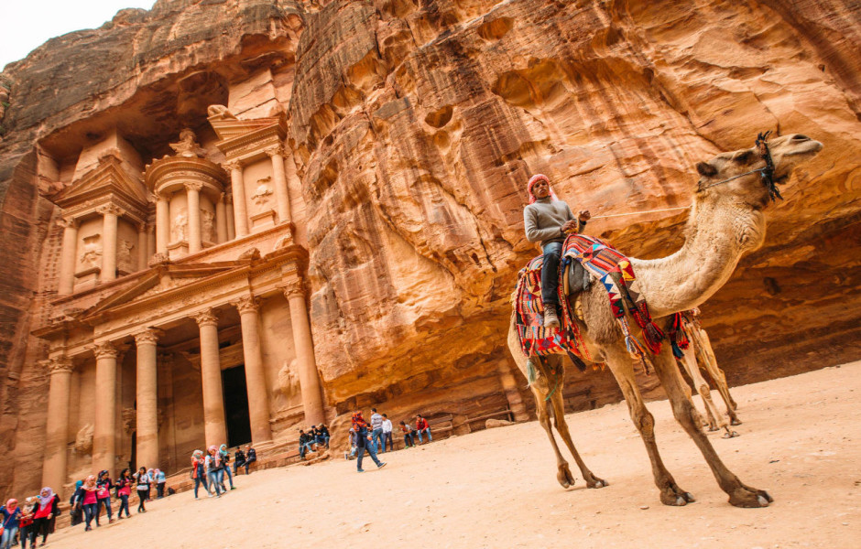

Slide 29
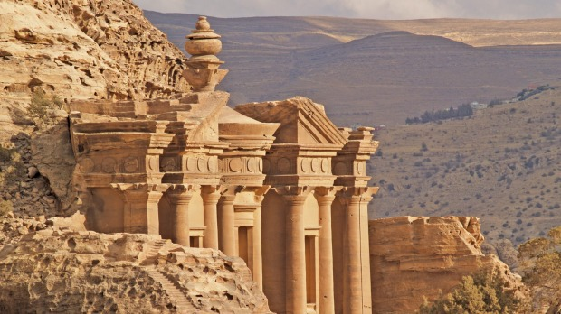

Slide 30
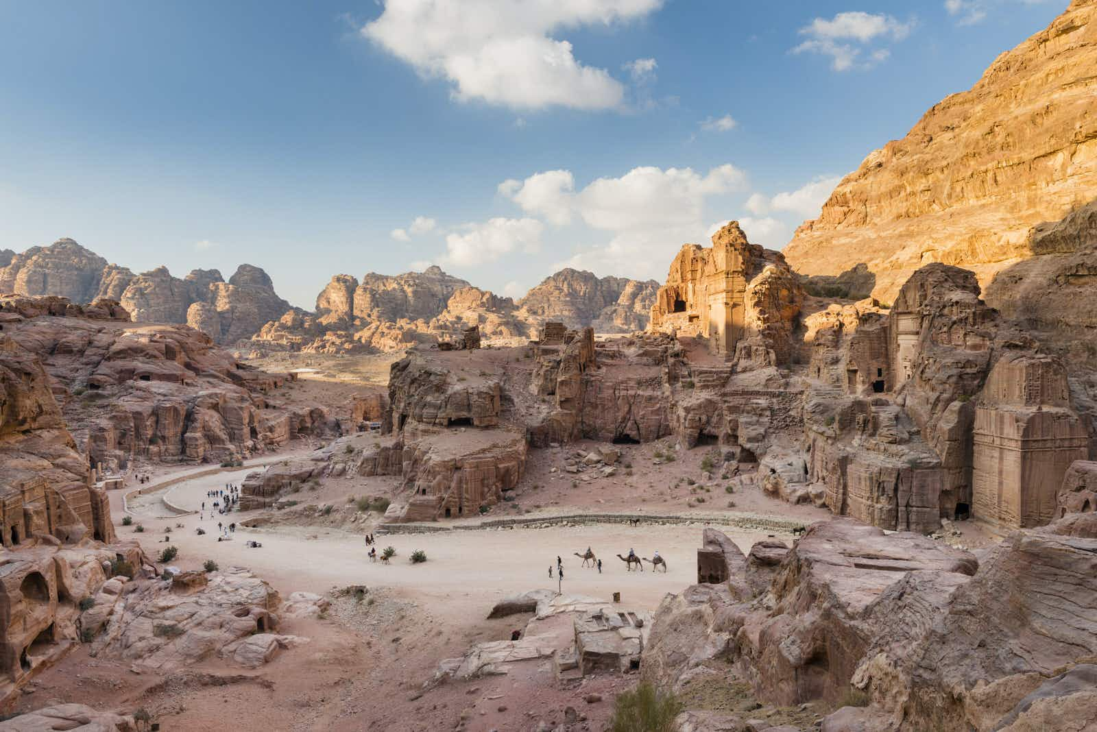

Slide 31
Woman Persecuted
Revelation 12:15-17 (KJV)
15 And the serpent cast out of his mouth water as a flood after the woman, that he might cause her to be carried away of the flood.
16 And the earth helped the woman, and the earth opened her mouth, and swallowed up the flood which the dragon cast out of his mouth.
17 And the dragon was wroth with the woman, and went to make war with the remnant of her seed, which keep the commandments of God, and have the testimony of Jesus Christ.
Notes:
“When the plain sense of Scripture makes common sense, seek no other sense; therefore, take every word at its primary, ordinary, usual, literal meaning unless the facts of the immediate context, studied in the light of related passages and axiomatic and fundamental truths, indicate clearly otherwise.”–Dr. David L. Cooper (1886-1965),

Slide 32
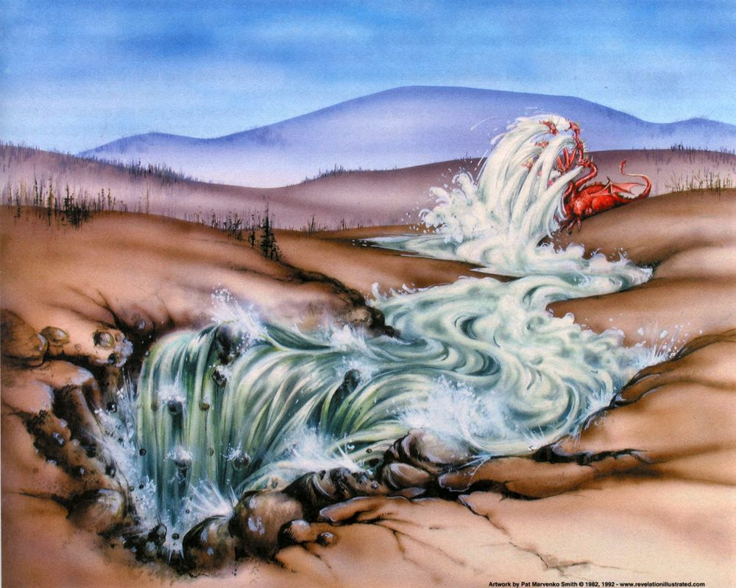

Slide 33
Woman Persecuted
Here again we have indirect evidence that the "Woman" is not the Church but ISRAEL.
When the Church is caught out no REMNANT is left behind, all that are "IN CHRIST" are taken away; but when the "Woman" (ISRAEL) flees into the wilderness a "REMNANT" is left behind.
This "Remnant" is composed of two classes.
Those who "keep the Commandments of God," that is, Orthodox Jews who observe the Old Testament Law,
Those who "accept the testimony of Jesus Christ," that is, accept Jesus as their promised Messiah.
The latter class will be converted by the preaching of the "Gospel of the Kingdom" by the "Two Witnesses." Those will be trying times for those Israelites who will not commit idolatry by bowing the knee to the "Image of the Beast," for it will be a remorseless war of persecution that Antichrist will wage against them, and thousands will die a martyr's death.

Slide 34
Repentance
Acts 26:20
Change of Mind about Jesus
A Gift of Holy Ghost Acts 11:18
Saved Person=Justified Person=Born Again Person
=Standing
James 2:24; 1:1; 5:7-9; Rev. 7:4; 14:12; Galatians 2:9
No Standing
Romans 4:5-8; 1:6
Spiritual Nature
Fleshy Nature, Carnal
=State
=State
Wicked Lost Sinner
Jeremiah 13:23
Worst kinds of sins
Carnal
Wicked at the end
Still in sin
Not sorry
Unbelief to Belief
Not surrendered
Works & Fruits
Spiritual
Spiritual at the end
Turn from sin (willing)
Sorry
Belief that grows
Surrender all
Worst kinds of Sin
Carnal
Wicked at the core
Still in sin
Not sorry
Good works
Not surrendered
1 Cor. 3:16-17; 5; 2 Cor. 2:6-8; 2 Cor. 7:10; Philippians 1:6
Easy Believeism Lordship Salvation
Saved person has two natures—

Slide 35
Revelation 12:1-6 (KJV)
1 And there appeared a great wonder in heaven; a woman clothed with the sun, and the moon under her feet, and upon her head a crown of twelve stars:
2 And she being with child cried, travailing in birth, and pained to be delivered.
3 And there appeared another wonder in heaven; and behold a great red dragon, having seven heads and ten horns, and seven crowns upon his heads.
4 And his tail drew the third part of the stars of heaven, and did cast them to the earth: and the dragon stood before the woman which was ready to be delivered, for to devour her child as soon as it was born.
5 And she brought forth a man child, who was to rule all nations with a rod of iron: and her child was caught up unto God, and to his throne.
6 And the woman fled into the wilderness, where she hath a place prepared of God, that they should feed her there a thousand two hundred and threescore days.

