Slide 1
Revelation 13, Beast From The Sea
By,
Pastor Bob Rogers

Slide 2
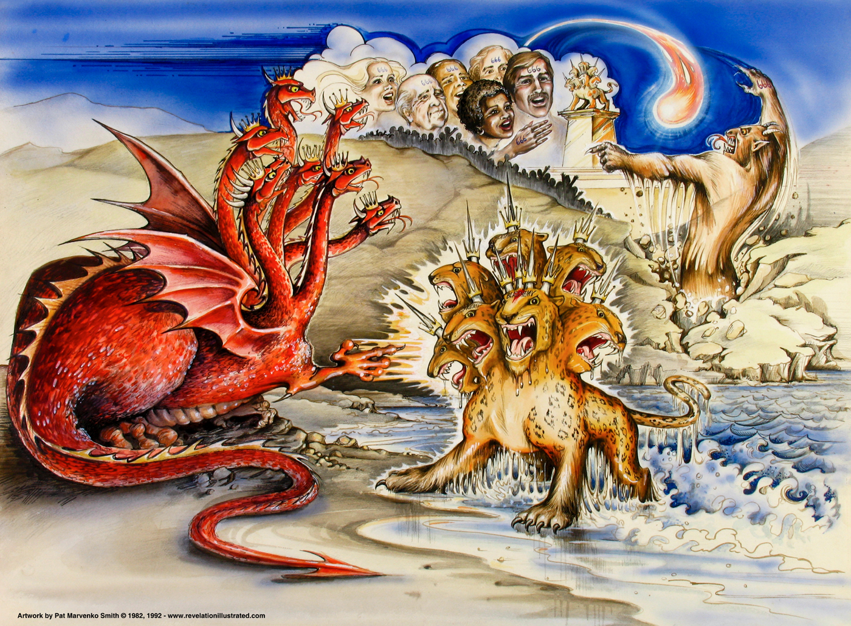
Notes:
Today, there is a movement caught up in signs and wonders. Most of these signs and wonders are not from God. Now, let me make it clear, God is still moving and things happen that can only be God doing them. However, there are other spirits at work today and it will be highly magnified in the Great Tribulation. Those signs will not be from God. Many of those stuck on signs and wonders of today may be the ones who sell completely out to the Antichrist in the Great Tribulation. Faith is more important that signs and wonders. Without Faith it is impossible to please God.

Slide 3
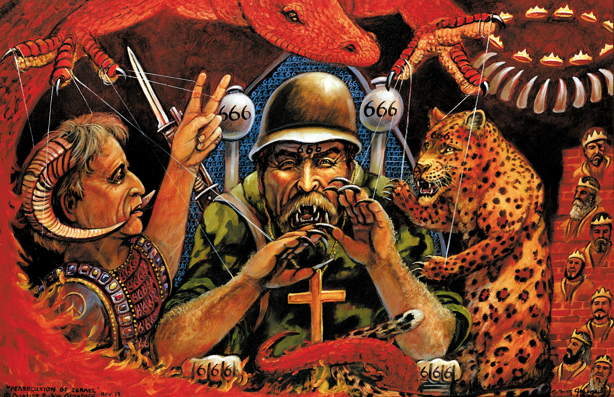

Slide 4
Revelation 13:1–2 (AV)
1 And I stood upon the sand of the sea, and saw a beast rise up out of the sea, having seven heads and ten horns, and upon his horns ten crowns, and upon his heads the name of blasphemy.
2 And the beast which I saw was like unto a leopard, and his feet were as the feet of a bear, and his mouth as the mouth of a lion: and the dragon gave him his power, and his seat, and great authority.

Slide 5
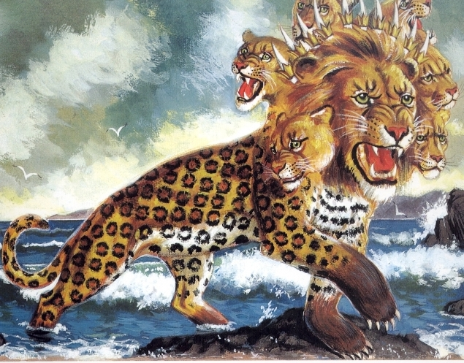

Slide 6
Revelation 13:3–4 (AV)
3 And I saw one of his heads as it were wounded to death; and his deadly wound was healed: and all the world wondered after the beast.
4 And they worshipped the dragon which gave power unto the beast: and they worshipped the beast, saying, Who is like unto the beast? who is able to make war with him?

Slide 7
Revelation 13:5–6 (AV)
5 And there was given unto him a mouth speaking great things and blasphemies; and power was given unto him to continue forty and two months.
6 And he opened his mouth in blasphemy against God, to blaspheme his name, and his tabernacle, and them that dwell in heaven.

Slide 8
Revelation 13:7–8 (AV)
7 And it was given unto him to make war with the saints, and to overcome them: and power was given him over all kindreds, and tongues, and nations.
8 And all that dwell upon the earth shall worship him, whose names are not written in the book of life of the Lamb slain from the foundation of the world.

Slide 9
Revelation 13:9–10 (AV)
9 If any man have an ear, let him hear.
10 He that leadeth into captivity shall go into captivity: he that killeth with the sword must be killed with the sword. Here is the patience and the faith of the saints.

Slide 10
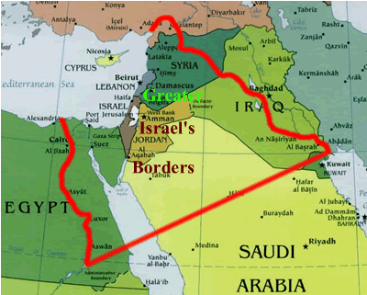

Slide 11
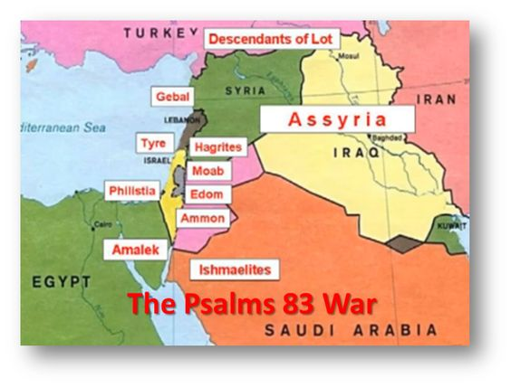

Slide 12
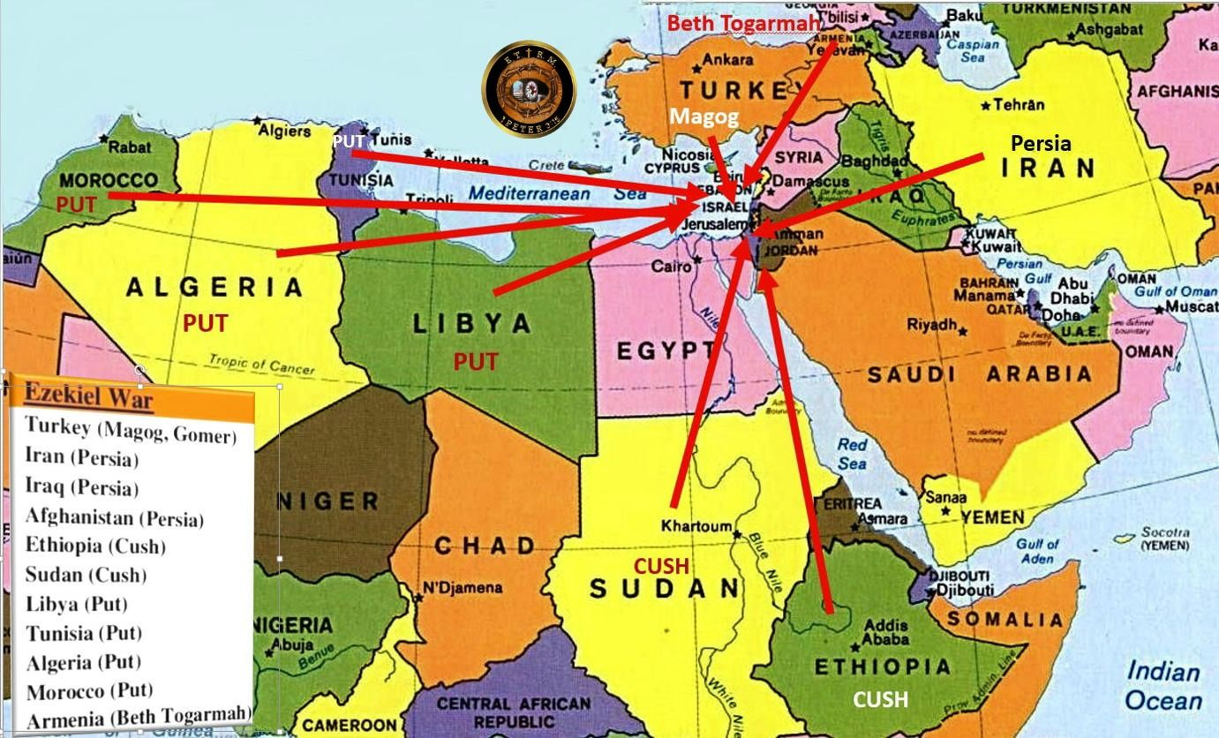

Slide 13
The Antichrist
Revelation 13:7–9 (AV)
⁷ And it was given unto him to make war with the saints, and to overcome them: and power was given him over all kindreds, and tongues, and nations. ⁸ And all that dwell upon the earth shall worship him, whose names are not written in the book of life of the Lamb slain from the foundation of the world. ⁹ If any man have an ear, let him hear.
You will remember that Antichrist began his career as a peacemaker (Rev. 6:2) and even "settled" the Arab-Israeli problem by making a covenant with the Jews to protect them for seven years (Dan. 9:27).
This protection would permit the nation to rebuild the temple and reinstitute religious rituals (Dan. 9:27; Rev. 11:1).
But in the middle of the seven-year period (the time we are studying now in Rev. 10-14) he will break that covenant, stop the ceremonies, and set up himself as god in the temple (Dan. 9:27; 2 Thess. 2:1-12).
Notes:
Rev 6:2 And I saw, and behold a white horse: and he that sat on him had a bow; and a crown was given unto him: and he went forth conquering, and to conquer.
Dan 9:27 And he shall confirm the covenant with many for one week: and in the midst of the week he shall cause the sacrifice and the oblation to cease, and for the overspreading of abominations he shall make it desolate, even until the consummation, and that determined shall be poured upon the desolate.
Rev 11:1 And there was given me a reed like unto a rod: and the angel stood, saying, Rise, and measure the temple of God, and the altar, and them that worship therein.
2Th 2:1 Now we beseech you, brethren, by the coming of our Lord Jesus Christ, and by our gathering together unto him,
2Th 2:2 That ye be not soon shaken in mind, or be troubled, neither by spirit, nor by word, nor by letter as from us, as that the day of Christ is at hand.
2Th 2:3 Let no man deceive you by any means: for that day shall not come, except there come a falling away first, and that man of sin be revealed, the son of perdition;
2Th 2:4 Who opposeth and exalteth himself above all that is called God, or that is worshipped; so that he as God sitteth in the temple of God, shewing himself that he is God.
2Th 2:5 Remember ye not, that, when I was yet with you, I told you these things?
2Th 2:6 And now ye know what withholdeth that he might be revealed in his time.
2Th 2:7 For the mystery of iniquity doth already work: only he who now letteth will let, until he be taken out of the way.
2Th 2:8 And then shall that Wicked be revealed, whom the Lord shall consume with the spirit of his mouth, and shall destroy with the brightness of his coming:
2Th 2:9 Even him, whose coming is after the working of Satan with all power and signs and lying wonders,
2Th 2:10 And with all deceivableness of unrighteousness in them that perish; because they received not the love of the truth, that they might be saved.
2Th 2:11 And for this cause God shall send them strong delusion, that they should believe a lie:
2Th 2:12 That they all might be damned who believed not the truth, but had pleasure in unrighteousness.

Slide 14
The Antichrist
Revelation 13:7–8 (AV)
⁷ And it was given unto him to make war with the saints, and to overcome them: and power was given him over all kindreds, and tongues, and nations. ⁸ And all that dwell upon the earth shall worship him, whose names are not written in the book of life of the Lamb slain from the foundation of the world.
The symbolic description of "the beast" enables us to learn something about his origin and character.
God does not see him as a man, made in the divine image, but as a wild animal, under the control of Satan.
He is a man (Rev. 13:18); but he is energized from hell, for he comes out of the pit (Rev. 11:7; 17:8).
Just as Jesus Christ is God in the flesh, so "the beast" will be Satan in a human body (see John 13:2, 27).
Revelation 13:7–8 (AV)
7 And it was given unto him to make war with the saints, and to overcome them: and power was given him over all kindreds, and tongues, and nations. 8 And all that dwell upon the earth shall worship him, whose names are not written in the book of life of the Lamb slain from the foundation of the world.
Revelation 13:7–8 (AV)
⁷ And it was given unto him to make war with the saints, and to overcome them: and power was given him over all kindreds, and tongues, and nations. ⁸ And all that dwell upon the earth shall worship him, whose names are not written in the book of life of the Lamb slain from the foundation of the world.

Slide 15
The Antichrist
Revelation 13:7–8 (AV)
⁷ And it was given unto him to make war with the saints, and to overcome them: and power was given him over all kindreds, and tongues, and nations. ⁸ And all that dwell upon the earth shall worship him, whose names are not written in the book of life of the Lamb slain from the foundation of the world.
The seven heads represent seven mountains (Rev. 17:9);
since Rome was built on seven hills, this must be a veiled reference to that powerful city (see Rev. 17:18).
It would be a most meaningful allusion in John’s day!
Revelation 13:7–8 (AV)
7 And it was given unto him to make war with the saints, and to overcome them: and power was given him over all kindreds, and tongues, and nations. 8 And all that dwell upon the earth shall worship him, whose names are not written in the book of life of the Lamb slain from the foundation of the world.
Revelation 13:7–8 (AV)
⁷ And it was given unto him to make war with the saints, and to overcome them: and power was given him over all kindreds, and tongues, and nations. ⁸ And all that dwell upon the earth shall worship him, whose names are not written in the book of life of the Lamb slain from the foundation of the world.

Slide 16
The Antichrist
Revelation 13:7–8 (AV)
⁷ And it was given unto him to make war with the saints, and to overcome them: and power was given him over all kindreds, and tongues, and nations. ⁸ And all that dwell upon the earth shall worship him, whose names are not written in the book of life of the Lamb slain from the foundation of the world.
The ten horns represent ten kingdoms (Dan. 7:24; Rev. 17:12). It appears that “the beast” will head a “United States of Europe,” a revived Roman Empire, before taking over as world dictator. All nations will no doubt admire and thank him for the “peace” he has achieved, little realizing the sorrow and destruction he will bring to the world.
Revelation 13:7–8 (AV)
7 And it was given unto him to make war with the saints, and to overcome them: and power was given him over all kindreds, and tongues, and nations. 8 And all that dwell upon the earth shall worship him, whose names are not written in the book of life of the Lamb slain from the foundation of the world.
Revelation 13:7–8 (AV)
⁷ And it was given unto him to make war with the saints, and to overcome them: and power was given him over all kindreds, and tongues, and nations. ⁸ And all that dwell upon the earth shall worship him, whose names are not written in the book of life of the Lamb slain from the foundation of the world.

Slide 17
The Antichrist
The three animals named in Revelation 13:2 remind us of the four beasts Daniel saw in his dream (Dan. 7): a lion (Babylon), a bear (Media-Persia), a leopard (Greece), and a “terrible beast” (the Antichrist). John saw these animals, or kingdoms, in reverse order since he was looking back, while Daniel was looking ahead. The final world empire will be rooted in all the previous empires and unite in one their evil and power. Added to the ferocity of these beasts will be Satan’s own power, throne, and authority!

Slide 18
The Antichrist
The three animals named in Revelation 13:2 remind us of the four beasts Daniel saw in his dream (Dan. 7): a lion (Babylon), a bear (Media-Persia), a leopard (Greece), and a “terrible beast” (the Antichrist). John saw these animals, or kingdoms, in reverse order since he was looking back, while Daniel was looking ahead. The final world empire will be rooted in all the previous empires and unite in one their evil and power. Added to the ferocity of these beasts will be Satan’s own power, throne, and authority!

Slide 19
Satan presents his great "masterpiece," the counterfeit Christ
First, there will be wonder (Rev. 13:3). Certainly a terrified world will wonder at Antichrist's power and his sudden rise to international fame and authority. But mankind will also wonder at the healing of his "wound." What is this "wound"? John does not explain it, but perhaps what he later wrote (Rev. 17:9-13) can help interpret the symbolism. This "wound" must be important, because John mentioned it three times (Rev. 13:3, 12, 14), including the fact that it was sword-inflicted.

Slide 20
Satan presents his great "masterpiece," the counterfeit Christ
The seven heads represent seven mountains, but also seven kings or kingdoms (Rev. 17:10). Antichrist or "the beast" is one of these seven kings (Rev. 17:11), but he is also the eighth.
Second, There will also be worship (Rev. 13:4). Worship is the one thing Satan has always wanted (Matt. 4:8-10), and he will receive it through "the beast." The second "beast," described in the last half of this chapter, will organize and promote the worship of Antichrist, making it the official religion of the world!

Slide 21
Satan presents his great "masterpiece," the counterfeit Christ
Third, There will also be words (Rev. 13:5-6). Almost all dictators have risen to power by controlling people with their words. Some of us can recall when Adolf Hitler was rising to power, and know now how he mesmerized huge crowds with his speeches. Satan will make "the beast" a great orator, whose addresses will blaspheme God, His name, His tabernacle (heaven), and the saints in heaven.
Since Satan will have recently been cast out of heaven, this blasphemy is to be expected.

Slide 22
Satan presents his great "masterpiece," the counterfeit Christ
Finally, there will be war (Rev. 13:7-10). God will permit Antichrist to war against His people ("wear out the saints," Dan. 7:25) and even to defeat some of them. John prophesied that some of the saints will be captured and some will be martyred. But because of their faith, they will have patience, or endurance (see Heb. 6:12; Rev. 1:9), and will not deny the Lord in spite of persecution and death.

Slide 23
Isaiah 24:19-21 (KJV)
19 The earth is utterly broken down, the earth is clean dissolved, the earth is moved exceedingly.
20 The earth shall reel to and fro like a drunkard, and shall be removed like a cottage; and the transgression thereof shall be heavy upon it; and it shall fall, and not rise again.
21 And it shall come to pass in that day, that the LORD shall punish the host of the high ones that are on high, and the kings of the earth upon the earth.

Slide 24
Isaiah 24:19-21 (KJV)
19 The earth is utterly broken down, the earth is clean dissolved, the earth is moved exceedingly.
20 The earth shall reel to and fro like a drunkard, and shall be removed like a cottage; and the transgression thereof shall be heavy upon it; and it shall fall, and not rise again.
21 And it shall come to pass in that day, that the LORD shall punish the host of the high ones that are on high, and the kings of the earth upon the earth.

Slide 25
Isaiah 24:19-21 (KJV)
19 The earth is utterly broken down, the earth is clean dissolved, the earth is moved exceedingly.
20 The earth shall reel to and fro like a drunkard, and shall be removed like a cottage; and the transgression thereof shall be heavy upon it; and it shall fall, and not rise again.
21 And it shall come to pass in that day, that the LORD shall punish the host of the high ones that are on high, and the kings of the earth upon the earth.

Slide 26
Heaven

Slide 27
Sin
Romans 3:23 KJV For all have sinned, and come short of the glory of God;

Slide 28
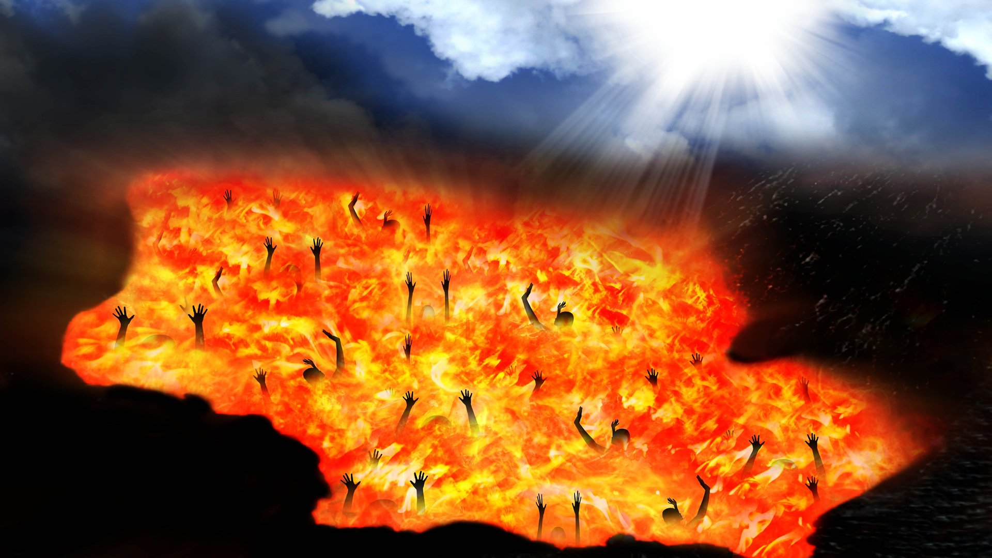
Revelation 20:15 KJV And whosoever was not found written in the book of life was cast into the lake of fire.

Slide 29
Jesus Died and Shed His Blood
Hebrews 9:22 KJV And almost all things are by the law purged with blood; and without shedding of blood is no remission.
Ephesians 1:7 KJV In whom we have redemption through his blood, the forgiveness of sins, according to the riches of his grace;
Jesus died for our sin, was buried, and rose again. He is the payment for our sin.

Slide 30
Jesus Died to make us Ready for Heaven
Psalm 51:7 (KJV)
7 Purge me with hyssop, and I shall be clean: wash me, and I shall be whiter than snow.

Slide 31
Heaven
Revelation 22:3-7 KJV And there shall be no more curse: but the throne of God and of the Lamb shall be in it; and his servants shall serve him: (4) And they shall see his face; and his name shall be in their foreheads. (5) And there shall be no night there; and they need no candle, neither light of the sun; for the Lord God giveth them light: and they shall reign for ever and ever. (6) And he said unto me, These sayings are faithful and true: and the Lord God of the holy prophets sent his angel to shew unto his servants the things which must shortly be done. (7) Behold, I come quickly: blessed is he that keepeth the sayings of the prophecy of this book.

Slide 32
Repentance
Acts 26:20
Change of Mind about Jesus Acts 10:43
A Gift of Holy Ghost Acts 11:18
Saved Person=Justified Person=Born Again Person
=Standing
James 2:24; 1:1; 5:7-9; Rev. 7:4; 14:12; Galatians 2:9
No Standing
Romans 4:5-8; 1:6
Spiritual Nature
Fleshy Nature, Carnal
=State
=State
Wicked Lost Sinner
Jeremiah 13:23
Worst kinds of sins
Carnal
Wicked at the end
Still in sin
Not sorry
Unbelief to Belief
Not surrendered
Works & Fruits
Spiritual
Spiritual at the end
Turn from sin (willing)
Sorry
Belief that grows
Surrender all
Worst kinds of Sin
Carnal
Wicked at the core
Still in sin
Not sorry
Good works
Not surrendered
1 Cor. 3:16-17; 5; 2 Cor. 2:6-8; 2 Cor. 7:10; Philippians 1:6
Easy Believeism Lordship Salvation
Saved person has two natures—Carnal/Spiritual
Notes:
Jeremiah 13:23 (NLT2) ²³ Can an Ethiopian change the color of his skin? Can a leopard take away its spots? Neither can you start doing good, for you have always done evil. Acts 11:18 (KJV) ¹⁸ When they heard these things, they held their peace, and glorified God, saying, Then hath God also to the Gentiles granted repentance unto life.
The question is then, do you believe? Do you believe Jesus is who He says He is?
Have you had that moment? That moment where you decided, you made the decision — you’re all in. You’re going to believe in faith that Jesus is who He says He is. That God is real. That He is your Father. That you are His son, His daughter.
And then it hits you. You realize… if you believe Jesus is exactly who He says He is, the risen Son of the Most High God… it changes everything.
So as Peter spoke the death, burial, and resurrection to the household of Cornielus he and his whole household believed on Jesus and they were filled with the Holy Spirit. Act 10:43 To him give all the prophets witness, that through his name whosoever believeth in him shall receive remission of sins.

Slide 33
