Slide 1

Brantford over-35 recreational soccer for fun, fitness and friendship
Annual General Meeting
September 13, 2019 at 8:00 pm
Brantford Harlequins

Slide 2
Introduction
Thanks to
Brantford Harlequins RFC
Dave McClean & Ken Courser

Slide 3
agenda
Membership update
Harlequins contract & facility upgrades
Financial update
  Approval with/without external audit
Code of conduct: Article 12
  Amendment to Article 12.1 in the constitution
Year-end social: Friday Oct. 18
Election of officers
Reviews
  Offside rule
  Picnic 2020
  Sponsors and jerseys for 2020
New business?

Slide 4
Membership update
Ninety-eight registered players
  Twenty-seven new players
Twenty-one social members
Receipts available upon request
..\Membership_2019\Member ship 2019_Aug 27_2019.xlsx
  ..\Membership_2019\Soccer Receipts_2019.pdf
Early registration would be helpful to move forward.
  Decide number of teams in 2020
  Order new jerseys for 2020

Slide 5
Harlequins update
..\Admin\BHRFC_Rec._Soccer_Contract 2019_2025_Signed.pdf
New contract
  Six years $xxxxxx for two fields (middle and far pitches)
    A third pitch, if needed, available for an additional $xxxxx per year
    Fifty percent paid on April 30, 2019
    Sundays are free unless there are full games and requires club house staff.
    Beer price might change. It is guaranteed to be the same as the one charged to Harlequins members.
    One Sunday for picnic is guaranteed
    Harlequins may pre-empt one Friday, every year, for their tournament.

Slide 6
facility upgrades
New roof for pergola
New picnic benches
New storage shed
New paint liner
New BBQ
New lighting

Slide 7
Financial update
In the Constitution (Article 4) there are built in mechanisms to prevent executive overreach.
  e.g., Invoking executive privilege by the President or Treasurer
Executive receives monthly update.
Members may receive a copy upon written request.
Members may also request an external/internal audit.
..\Financial statements\Receipts & Debits-2019_Sep 4__2019.xlsx
..\Tandia statements\Aug. 2019_Sep 6_2019.pdf

Slide 8
Financial update
This page is left intentionally blank

Slide 9
Financial update approval
Article 4.3.4 in the Constitution requires external audit if membership request.
Do we need external audit? Members unanimously agreed not to have internal or external audit.
Motion to accept treasurer’s report:
  Proposed by: Dave Lee
  Seconded by: Dennis Swackhammer
All in favour: Motion carried unanimously.
A copy of the minutes will be submitted to the Tandia Credit Union

Slide 10
Approval to transfer
Money from savings to chequing account
We have $xxxxx plus interest earned in the savings (facility) account.
Transfer money from savings to chequing account requires approval from membership and Credit Union should be notified.
No money was withdrawn from savings account for building pergola and storage shed although they were approved by the membership.
Current amount in the chequing account will not cover the cost for new jerseys and printing sponsors’ name.
Motion to approve transfer of necessary funding (maximum $xxxx) from savings to chequing
Proposed by: Raman Chirakal
Seconded by: Dave Lee
All in favour: Motion carried by a majority vote.

Slide 11
Article 12:
Code of conduct
Article 12.1
  The objective of the club is to provide recreational soccer through fun, fitness, and friendly competition. Physical or verbal abuse during a game, whether on the field of play or on the sidelines, will not be tolerated. Any questionable type of infraction will be dealt appropriately by the team captains or their deputies, who have witnessed the said infraction.
Amendment proposed by Dave Lee and seconded by Raman Chirakal
  The objective of the club is to provide recreational soccer through fun, fitness, and friendly competition. Physical or verbal abuse and racism in any form, on the field of play, on the sidelines or anywhere within the confines of the club will not be tolerated. Any questionable type of infraction will be dealt appropriately by the team captains or their deputies, who have witnessed the said infraction.
  Motion to approve the amendment: Tabled by Dave Lee and seconded by Raman Chirakal
  Motion was approved unanimously.

Slide 12
Upcoming events
Year-end social:
  October 18 after the game
  Pizza and chicken wings
  $10.00 per person for two beers and food
  **SPONSORED BY SUNDAY GROUP**
Advanced registration
  Sundays: $40.00 before October 27 ($50 after Oct. 27)
  Proposed by: Tomo Dancetovic Seconded by: Raman Chirakal
  Motion carried unanimously.
  ..\..\2020 Soccer\Administration\Adavanced Registration.docx

Slide 13
Election of officers
Dave Lee, President Retiring* (Effective January 1, 2020)
Dave Dodds Jr., VP Resigned** (Effective Sep. 13, 2019)
President:
  Name: Tomo Dancetovic
  Proposed by: Rick Mulvey and Seconded by: Caid Karim-Eddine
  Tomo was elected unanimously.
Vice-President: Jose Pagoada was acclaimed as the new VP
Treasurer: Raman Chirakal
Executive members: Justin Wentzil resigned
  Joe Maganja and Natalino Obili continues to be executives
  Dennis Swackhammer, Novak Kulina and Caid Karim-Eddine: New executives
Signing officers: Tomo, Joe, Jose and Raman

Slide 14
reviews
Review off-side rule:
  Proposed by Ed Wittek and seconded by Joe Maganja and Jose Pagoada
  ** This issue has been discussed and litigated several times.**
  No off-side means no off-side. There should be no wiggle room.
  Please refrain from shaming players who may be off-side.
    Leads to arguments and possibly fights.
Picnic 2020:
  Problems this year: No help!
  Solution for next year: Hire help.
Ticket price in 2020:
  $10.00 per ticket per person for food and two drinks

Slide 15
reviews
Sponsors for 2020
  McGonagall’s Pub, Lallo Mazda, ProQuip Internationals, EM Copper Products, Forest Hu and Vinces’s Hairstylists.
  JoseF Construction? (Jose), Aecon? (Dave Jr.)
New jerseys:
  Tomo Dancetovic is ordering new Jerseys from overseas.
Captains for 2020
  Novak Kulina Natalino Obili, Bill Mann and Grant Faiella.
  A fifth captain will be recruited if we have five teams (90 players minimum).
Any new business?
  Dave Dodds Sr. and Mike Callaghan suggested review of teams and players a few weeks into the season to equalize temas.

Slide 16
Acknowledgements
Team Sponsors:
  McGonagalls’ Pub (Dave) Pro-Quip International (Sam)
  Lallo Mazda (Gary) Vince’s Hairstylists (Vince)
  EM Copper (John) Aecon (Dave Jr.)
  Forrest Hu
Socials:
  Dave Lee, Natalino Obili, Novo Bubic, Tomo Dancetovic, Joe Sinkaric, Anna Bubic and Vera Dancetovic.
Facility upgrades:
  Novo Bubic, Tomo Dancetovic and Goran Valsenko
Club House Hospitality:
  Harlequins Senior Women, Ken Courser, John Hogarth and Dave McClean

Slide 17
Acknowledgements
  Thank you

Slide 18
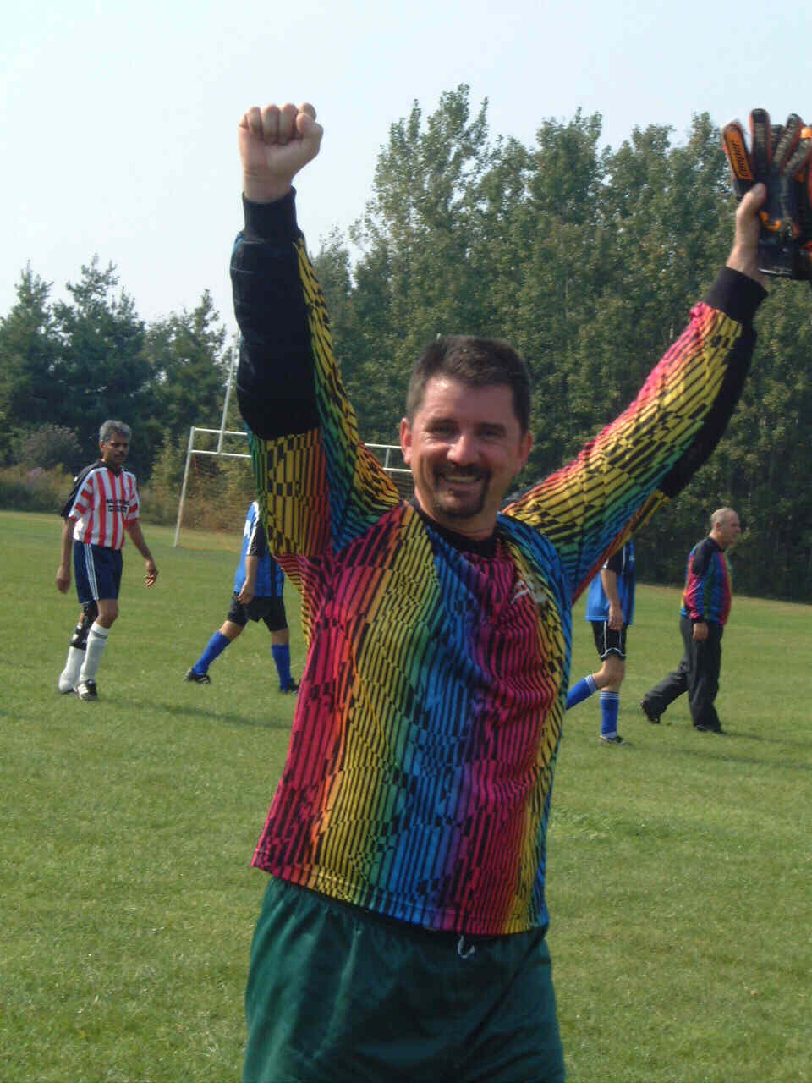
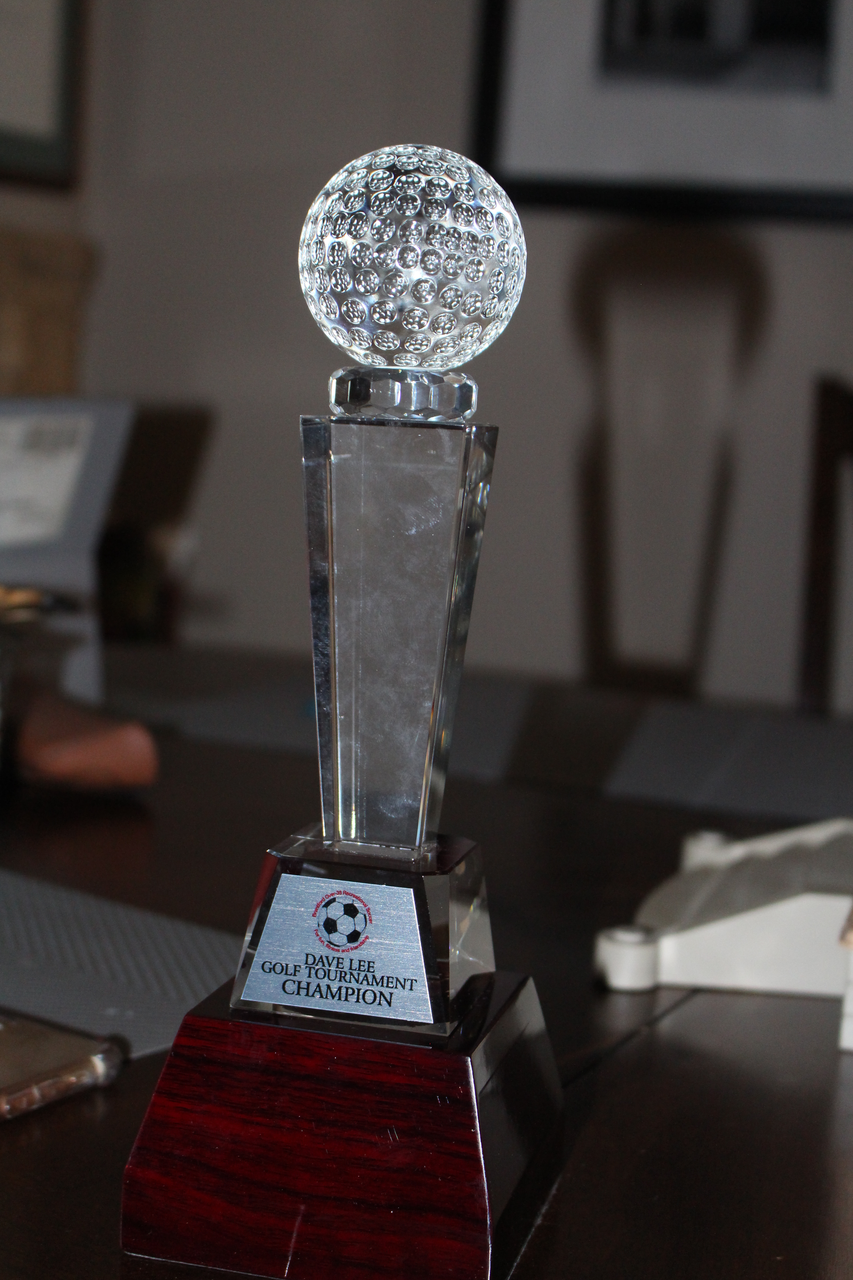
Acknowledgement
Dave Lee
FIRST LIFETIME MEMBER
Joined the League 1993
  “Dave Lee” Rule
Arguably the best keeper
Vice-President (1995–2010)
Convenor, Masters’ Division (2008-2013)
Facilitator, Annual family picnic (25 yrs)
President (second Avatara of the League)
Director, Dave Lee Golf Tournament

