Slide 1

Solutions for Coal Drying
Coking Coal Pre-treatment Process
-----History, Experience and Lessons of Nippon Steel's Development of Coking Coal Pretreatment Technology
戴尔塔干燥设备有限公司
Delta Drying Technologies Ltd

Slide 2
Solutions for Coal Drying
History, Experience and Lessons of Nippon Steel's Development of Coking Coal Pretreatment Technology
The purpose of coking coal pretreatment
The strength of coke depends largely on the viscosity of coking coal, while non-poor coking coals have poor coking performance (low viscosity) and cannot be used directly as coking coal.
The pretreatment process of non-poor coking coal, including pre-drying, briquetting and rapid preheating, has been proven to be an effective way to improve their performance (viscosity).
The pretreatment process can increase the viscosity of non-poor coking coal, thereby replacing part of the high-quality coking coal and reducing the production cost

Slide 3
Solutions for Coal Drying
History, Experience and Lessons of Nippon Steel's Development of Coking Coal Pretreatment Technology
Nippon Steel has been developing coking coal pretreatment technology since 1960. After 50 years of continuous efforts, it has become the global leader in coking coal pretreatment technology.
The coking coal pretreatment processes developed by Nippon Steel have all been industrialized.

Slide 4
Solutions for Coal Drying
History, Experience and Lessons of Nippon Steel's Development of Coking Coal Pretreatment Technology
Coking Coal Drying and Preheating process ( ProCarbon )
Process Description: The coking coal is dried to 0% moisture and preheated to 210ºC with two stage flash dryer, mixed with 0.5-1% coal tar, and then conveyed to coal tower through a chain conveyor
The blending ratio of non-poor coking coals was increased from 0% to 20%
Although 0.5-1% coal tar is added to the dried and preheated coal, the dust issue is still serious during the coal charging process
The dust content in the coal tar is 5 times higher than that in the wet coal charging process
Comment:
Fine coal cannot be separated from coarse coal with flash dryer, so dust issue is serious due to 0% coal charging moisture

Slide 5
Solutions for Coal Drying
History, Experience and Lessons of Nippon Steel's Development of Coking Coal Pretreatment Technology
Coking coal moisture control process ( CMC )
First generation: thermal oil rotary dryer (put into operation in 1983)
Second generation: steam rotary dryer (put into operation in 1991)
Third generation: coke oven flue gas fluidized bed dryer (put into operation in 1996)

Slide 6
Solutions for Coal Drying
History, Experience and Lessons of Nippon Steel's Development of Coking Coal Pretreatment Technology
Coking coal moisture control process ( CMC )
Process Description: The coking coal is dried to 6.5% or so of moisture with fluidized bed dryer, then the coarse coal and the fine coal collected by dust collector are charged to the coke oven

Slide 7
Solutions for Coal Drying
History, Experience and Lessons of Nippon Steel's Development of Coking Coal Pretreatment Technology
Coking coal moisture control process ( CMC )
As no fine coal briquetting process
If the coal charging moisture is below than 6%, certain percentage of non-poor coking coals can be blended to reduce production cost, but it will cause serious dust issue
If the coal charging moisture is higher than 7%, there is less dust issue, but the project benefits are negative as no non-poor coking coals can be blended

Slide 8
Solutions for Coal Drying
History, Experience and Lessons of Nippon Steel's Development of Coking Coal Pretreatment Technology
Coking coal moisture control process ( CMC )
Comment:
CMC process can be seen as a modification of ProCarbon process: since there is no fine coal briquetting process, the dust issue will be very serious if the coking coal is dried to 0% moisture, so it can only be dried moderately, that is, only dried to certain moisture that the dust issue caused is not serious / under acceptable degree. This may be the origin of the name of the coal moisture control process /CMC
CMC process cannot juggle dust issue and economic benefit, so it should be listed as an abandoned process (see technical and economic analysis)

Slide 9
Solutions for Coal Drying
History, Experience and Lessons of Nippon Steel's Development of Coking Coal Pretreatment Technology
Dry-cleaned and Agglomerated Precompaction System Process (DAPS)
Process Description: Wet coal is dried to 2% or so moisture with fluidized bed dryer; fine coal is collected and binderless briquetted and then conveyed to coke oven with dried coarse coal
The coal charging moisture can be dried to 2% or so due to fine coal briquetting process, and dust issues is not serious
The blending ratio of non-poor coking coals was increased from 10% to 40% due to lower coal charging moisture and fine coal briquetting

Slide 10
Solutions for Coal Drying
History, Experience and Lessons of Nippon Steel's Development of Coking Coal Pretreatment Technology
Dry-cleaned and Agglomerated Precompaction System Process (DAPS)
Comment:
Coking coal moisture should be dried to 0% as DAPS process is equipped with fine coal briquetting process
DAPS process has the problem of excessive briquetting of fine coal, because all fine coal collected from the dryer is briquetted.

Slide 11
Solutions for Coal Drying
History, Experience and Lessons of Nippon Steel's Development of Coking Coal Pretreatment Technology
Super Coke Oven for Productivity and Environmental enhancement toward the 21st century Process (SCOPE 21)
Process description: Coking coal is dried to 0% moisture using a fluidized bed dryer, then the coarse coal is heated to 350 to 400°C using a pneumatic rapid preheater, and the fine coal is briquetted using bitumen as a binder

Slide 12
Solutions for Coal Drying
History, Experience and Lessons of Nippon Steel's Development of Coking Coal Pretreatment Technology
Super Coke Oven for Productivity and Environmental enhancement toward the 21st century Process (SCOPE 21)
Comment:
SCOPE 21 also has the problem excessive briquetting of fine coal, this problem is even more serious than the DAPS process
The use of bitumen as a binder for fine coal briquetting eats up most of the profit from the increase in the blending ratio of non-poor coking coals
The pneumatic rapid preheater used in SCOPE 21 process can only preheat smaller particle size coal to the required temperature due to short residence time and larger particle size coal cannot be preheated to the required temperature

Slide 13
Solutions for Coal Drying
History, Experience and Lessons of Nippon Steel's Development of Coking Coal Pretreatment Technology
Achievements
Flash dryer, rotary dryer and fluidized bed dryer were used for coal drying, fluidized bed dryer was considered as the best process equipment for coking coal pre-treatment as
The fine coal can be separated from coarse coal and fine coal is briquetted to solve the dust issue
Fluidized bed dryer is also low in investment and maintenance cost

Slide 14
Solutions for Coal Drying
History, Experience and Lessons of Nippon Steel's Development of Coking Coal Pretreatment Technology
Achievements
Dust issue is the key to the success of coking coal pre-treatment process, and the solution is fine coal briquetting
Fine coal briquetting can also be beneficial to the increase of charging density of coking coal

Slide 15
Solutions for Coal Drying
History, Experience and Lessons of Nippon Steel's Development of Coking Coal Pretreatment Technology
Further improvements could be made
Avoiding the problem of excessive fine coal briquetting
All fine coal collected from the fluidized bed coal dryer is briquetted in both DAPS and SCOPE 21 processes
The fine coal size collected from the fluidized bed dryer is related to the design and operating parameters of the fluidized bed dryer
The fine coal size collected in the DAPS process is <0.3mm (its proportion is about 30% of the coking coal)
The fine coal size collected in the SCOPE 21 process is <0.5mm (its proportion is about 45% of the coking coal)

Slide 16
Solutions for Coal Drying
History, Experience and Lessons of Nippon Steel's Development of Coking Coal Pretreatment Technology
Further improvements could be made
Excessive fine coal briquetting should be avoided
According to the test, actual operation of the coke oven and calculation analysis, the fine coal size being carried over by coking oven gas is < 0.25mm during wet coal charging process; < 0.1mm during dried coal charging process and can even be reduced to <0.075mm if necessary
From the perspective of solving dust issue during coal charging, it is sufficient only to briquette the fine coal less < 0.1mm

Slide 17
Solutions for Coal Drying
History, Experience and Lessons of Nippon Steel's Development of Coking Coal Pretreatment Technology
Further improvements could be made
Excessive fine coal briquetting should be avoided
Excessive fine coal is harmful rather than beneficial
It reduces the strength of briquetted fine coal in binderless briquetting process
It increases the consumption of bitumen in the fine coal briquetting process using bitumen as binder
It always increase the equipment investment and power consumption
It also reduces the coal charging density according to Teck Resources’ test

Slide 18
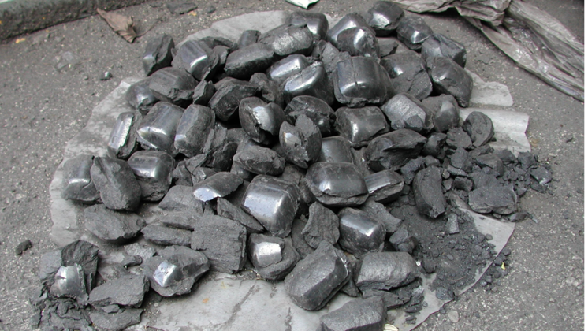
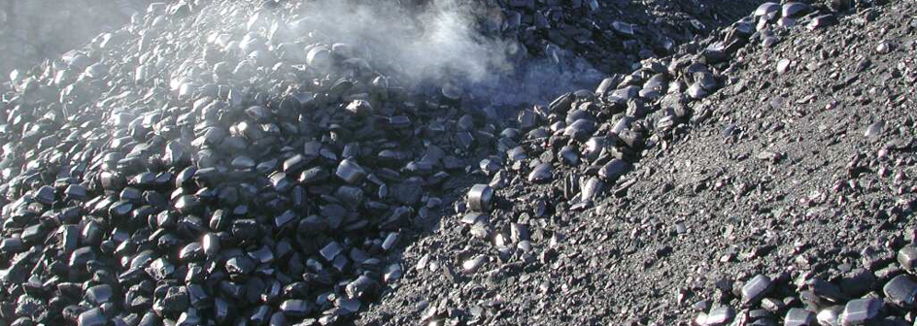
Solutions for Coal Drying
History, Experience and Lessons of Nippon Steel's Development of Coking Coal Pretreatment Technology
Further improvements could be made
Excessive fine coal briquetting should be avoided
The briquetted fine coal in Teck Resources’ test

Slide 19
Solutions for Coal Drying
History, Experience and Lessons of Nippon Steel's Development of Coking Coal Pretreatment Technology
Further improvements could be made
Using high temperature fluidized bed dryer
There were three high temperature fluid bed dryer manufacturers in the United States (ENI, McNally, and FMC), but these companies went out of business around 1985.
Since then, there have been no high temperature fluid bed dryer manufacturers on the market.
In 2018, DELTA designed a new gas distribution plate for Teck Resources' high temperature fluid bed dryer, and the improved high temperature fluid bed dryer returned to the market

Slide 20
Solutions for Coal Drying
History, Experience and Lessons of Nippon Steel's Development of Coking Coal Pretreatment Technology
Further improvements could be made
Replace pneumatic rapid preheater with recirculating pneumatic rapid preheater
The pneumatic rapid preheater used in SCOPE 21 process can only preheat smaller particle size coal to the required temperature due to short residence time and larger particle size coal cannot be preheated to the required temperature
Recirculating pneumatic rapid preheater can preheat smaller particle size coal one time and preheat large particle size coal more than one time in order to achieve all coarse coal to reach the uniform preheating temperature

Slide 22
Solutions for Coal Drying
Coking Coal Pre-treatment Process
-----DELTA process
戴尔塔干燥设备有限公司
Delta Drying Technologies Ltd

Slide 23
Solutions for Coal Drying
DELTA process
DELTA process was developed by using Delta's unique high-temperature fluidized bed drying technology and by absorbing the experience and lessons learned from the development of Nippon Steel's coking coal pretreatment technology
It can be seen as an improved version of the DAPS process and the SCOPE 21 process
Delta's unique high-temperature fluidized bed dryer can achieve flue gas temperatures of 1000-1100°C, which can significantly reduce equipment investment
Coking coal is dried to 0% moisture
If no need for production increase, the coking coal is preheated to 120-150°C
If need for production increase, it is preheated to 375°C
Fine coal carried over by dryer exhaust is collected according to its size
Only super fine coal (<0.1mmdryer exhaust and 8 to 10% of coking coal) is briquetted (or to PCI)

Slide 24
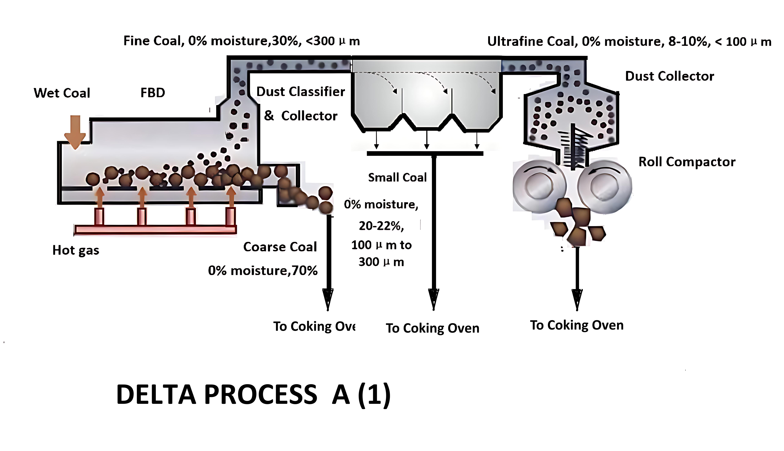
Solutions for Coal Drying
DELTA process
Process Flow ONE
8-10% superfine coal collected is briquetted without binder

Slide 25
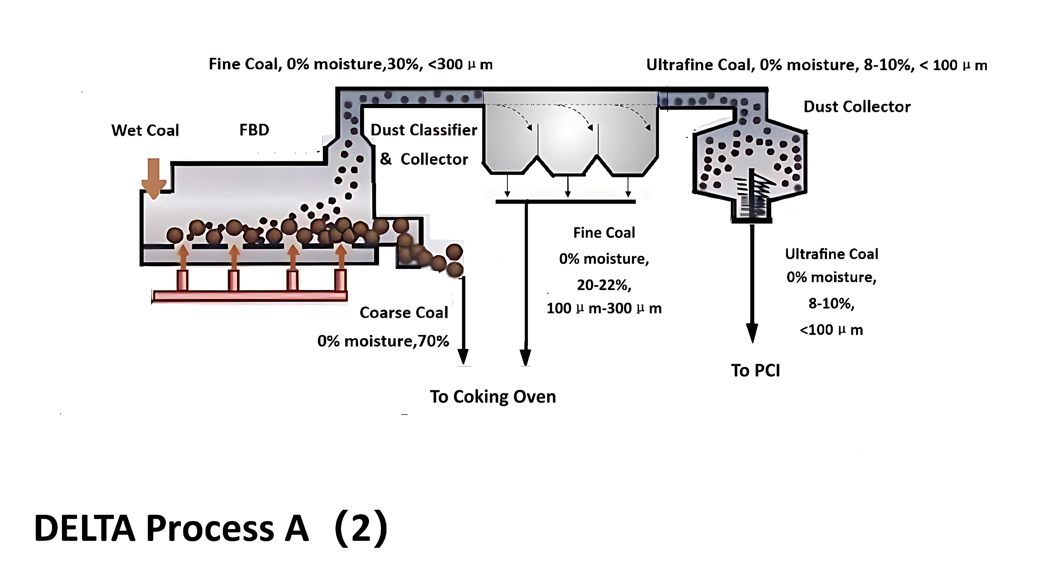
Solutions for Coal Drying
DELTA process
Process Flow TWO
8-10% superfine coal collected is sent to PCI
Lowest in equipment investment
The cleanest coal charging process

Slide 26
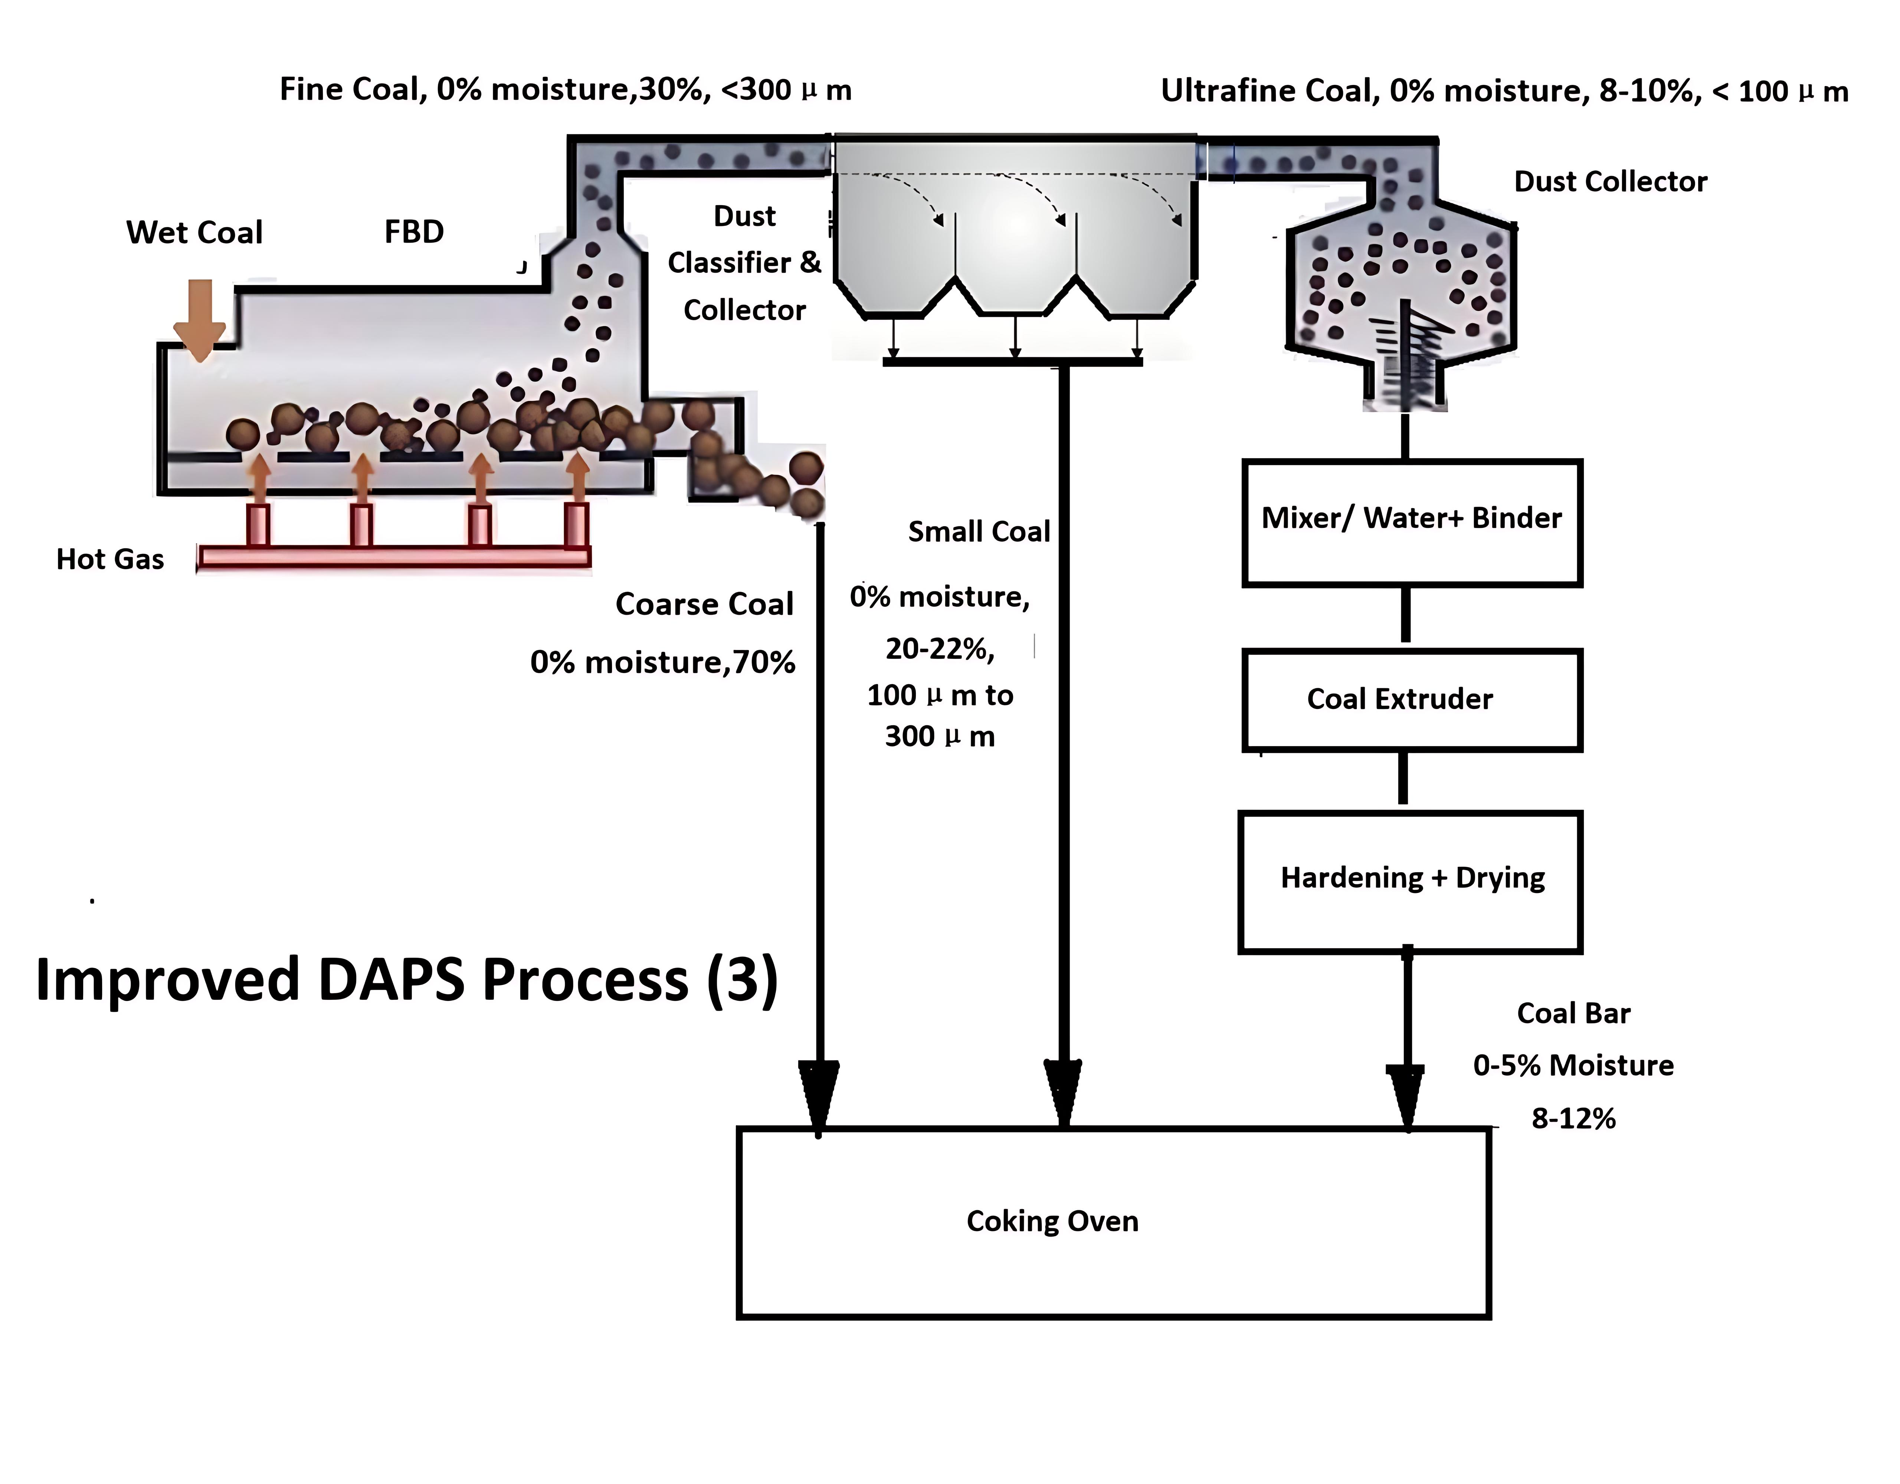
Solutions for Coal Drying
DELTA process
Process Flow THREE
8-10% ultra-fine coal is briquetted with water-soluble binder
Longest and most expensive process
Coal charging process is relatively clean

Slide 27
Solutions for Coal Drying
Delta Drying Technologies Ltd
305-3089 Bathurst St., Toronto, Ontario, M6A 2A4
Phone: +1.647.673.9832
E mail: long@deltadrying.ca
www.deltadrying.ca

