Slide 1

Solutions for Coal Drying
Low-Rank Coal Pyrolysis Process
戴尔塔干燥技术有限公司
Delta Drying Technologies Ltd

Slide 2
Solutions for Coal Drying
LRC (Low-Rank Coal) pyrolysis process
The utilization of LRC by quality is to convert LRC into three forms (three qualities) of gas (pyrolysis gas), liquid (coal tar), and solid (semi-coke) through processes such as drying, preheating, and pyrolysis, and then further convert pyrolysis gas, coal tar, and semi-coke into oil, gas, electricity, heat, and organic chemical products

Slide 3
Solutions for Coal Drying
LRC pyrolysis process

Slide 4
Solutions for Coal Drying
LRC pyrolysis process
The LRC pyrolysis process mainly produces three products: coal tar, pyrolysis gas and semi-coke
The quality of coal tar not only has a significant impact on the project revenue, but is also crucial to the smooth operation of the whole process equipment
Excessive dust content in pyrolysis gas will lead to high dust content in coal tar, low its selling price, and the pyrolysis gas treatment equipment cannot operate smoothly for a long time
The R&D of LRC pyrolysis process should meet the following requirements
The dust content in pyrolysis gas should be as low as possible
The output of a single machine should be as large as possible
The process consumption and investment should be as low as possible

Slide 5
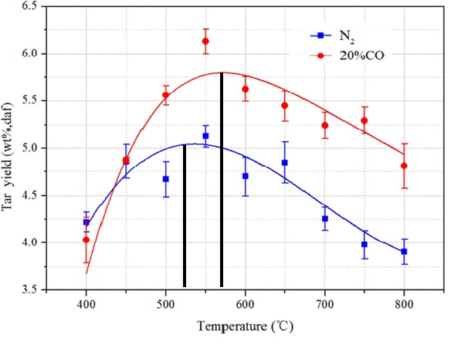
Solutions for Coal Drying
LRC pyrolysis process
The pyrolysis temperature
According to LRC pyrolysis experiments, the coal tar yield is the highest if the pyrolysis temperature is around 550℃
Therefore, the pyrolysis temperature of LRC should be set at around 550± 25℃

Slide 6
Solutions for Coal Drying
Delta LRC pyrolysis process
Delta LRC pyrolysis process is based on Delta's unique high-temperature fluidized bed drying technology, combined with its experience in lignite indirect heat exchange vertical moving bed dryers, to meet the following requirements to the greatest extent
The lowest dust content in pyrolysis gas
The highest processing capacity
The lowest investment and energy consumption

Slide 7
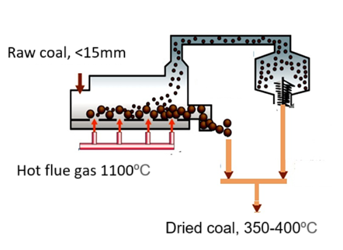
Solutions for Coal Drying
Delta LRC pyrolysis process
Process flow
It consists of three independent processes: LRC drying and preheating process, LRC pyrolysis process and hot semi-coke cooling process
LRC drying and preheating process
LRC is fed into a high-temperature fluidized bed dryer to dry to 0% moisture, and preheated to the initial pyrolysis temperature (150-350°C), and then transported to a vertical moving bed pyrolyzer

Slide 8
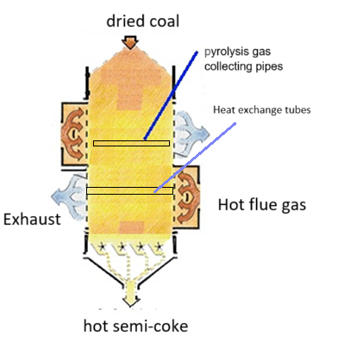
Solutions for Coal Drying
Delta l LRC pyrolysis process
Process flow
LRC pyrolysis process
The dried low-rank coal is sent to the top of the vertical moving bed pyrolyzer and flows downward under the action of gravity
The dried LRC is heated to the set pyrolysis temperature by the hot flue gas flowing in the horizontal heating tube
The high-temperature semi-coke is discharged from the bottom of the vertical moving bed pyrolyzer
The pyrolysis gas is collected by the pipeline in the vertical moving bed pyrolyzer and sent to the pyrolysis gas treatment equipment to separate the coal tar

Slide 9
Solutions for Coal Drying
Delta LRC pyrolysis process
Process flow
LRC pyrolysis process
The vertical moving bed pyrolyzer is a cubic structure with built-in horizontal heat exchange tubes
The dried LRC flows slowly from top to bottom through the horizontally arranged heat exchange tubes under the action of gravity, and is heated indirectly to 550℃ or so by the high-temperature flue gas in the tubes, and is discharged from the bottom to the hot semi-coke cooler
The shell structure of the vertical moving bed pyrolyzer adopts a refractory concrete lining structure and therefore only the horizontal heat exchange tubes are made of high-temperature resistant alloy, which greatly reduces the manufacturing cost

Slide 10
Solutions for Coal Drying
Delta LRC pyrolysis process
Process flow
LRC pyrolysis process
The dust content in the pyrolysis gas is very low due to the indirect heat excahnge between flue gas and lor-rank coal, and the movement of LRC inside the vertical moving bed pyrolyzer
The pyrolysis gas has high purity and high calorific value, which greatly reduces the investment in pyrolysis gas treatment equipment and pyrolysis gas treatment equipment can be operated smoothly for long term

Slide 11
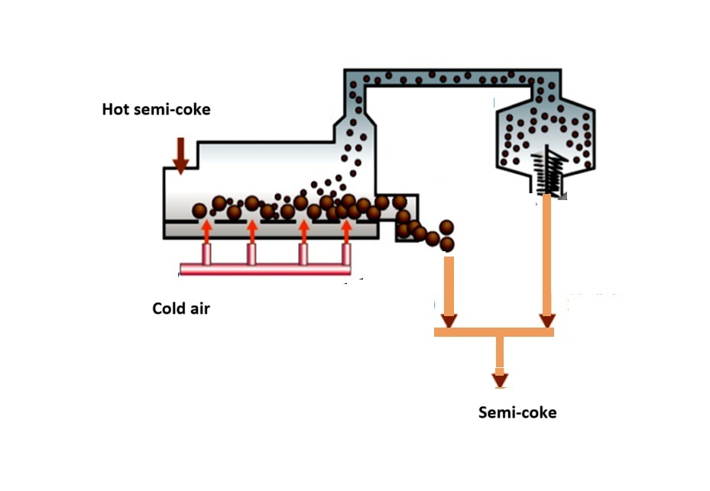
Solutions for Coal Drying
Delta LRC pyrolysis process
Process flow
Hot semi-coke cooling process
The hot semi-coke from the vertical moving bed pyrolyzer is fed to the fluidized bed cooler and is cooled to the required temperature by cold air/cooling water

Slide 12
Solutions for Coal Drying
Delta LRC pyrolysis process
Other Applications
Oil Shale Pyrolysis ( Oil Shale Retorting)
Oil shale pyrolysis is essentially the same as low-rank coal pyrolysis. It involves heating oil shale to a certain temperature in an airless environment, causing the organic matter to decompose and produce shale oil, combustible gas, and semi-coke. It is a key method for extracting shale oil and a non-conventional oil extraction technology.

