Slide 1

Key Information Officer Forum
Gus Verzosa,15/03/2018

Slide 2
Forum objectives
Sharing knowledge on new trends in information, data, and knowledge management among members.
Exposing members to technology offerings in the market relevant to information, data, and knowledge management.
Providing opportunities for collaboration on projects and resources industry wide to leverage cross-organisational strengths and address organisational gaps effectively and efficiently.
Promote innovation in information, data, and knowledge management.
Build a core group of experts which can be leveraged by the industry to lead new, emerging initiatives.

Slide 3
Coverage
Strategic ICT
Analytics, Big Data, business intelligence, artificial intelligence
Information, data management, knowledge management
Business process design/redesign
Digital transformation
Enterprise architecture
ERP (enterprise resource planning), CRM (customer relationship management), SCM (supply chain management), PLM (product lifecycle management), HCM (human capital management)
Cloud
Cybersecurity

Slide 4

Who is the key information officer (KIO)?

Slide 5

Characteristics of the KIO
Strategic vision
Passion: advocacy; credible; sustainable; acceptable
Position-blind
Integrity

Slide 6
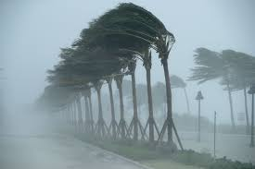
Emergence of the KIO - factors
A natural force of cybernature
Incompetent CIO
ICT complacency
Cybernatural selection

Slide 7
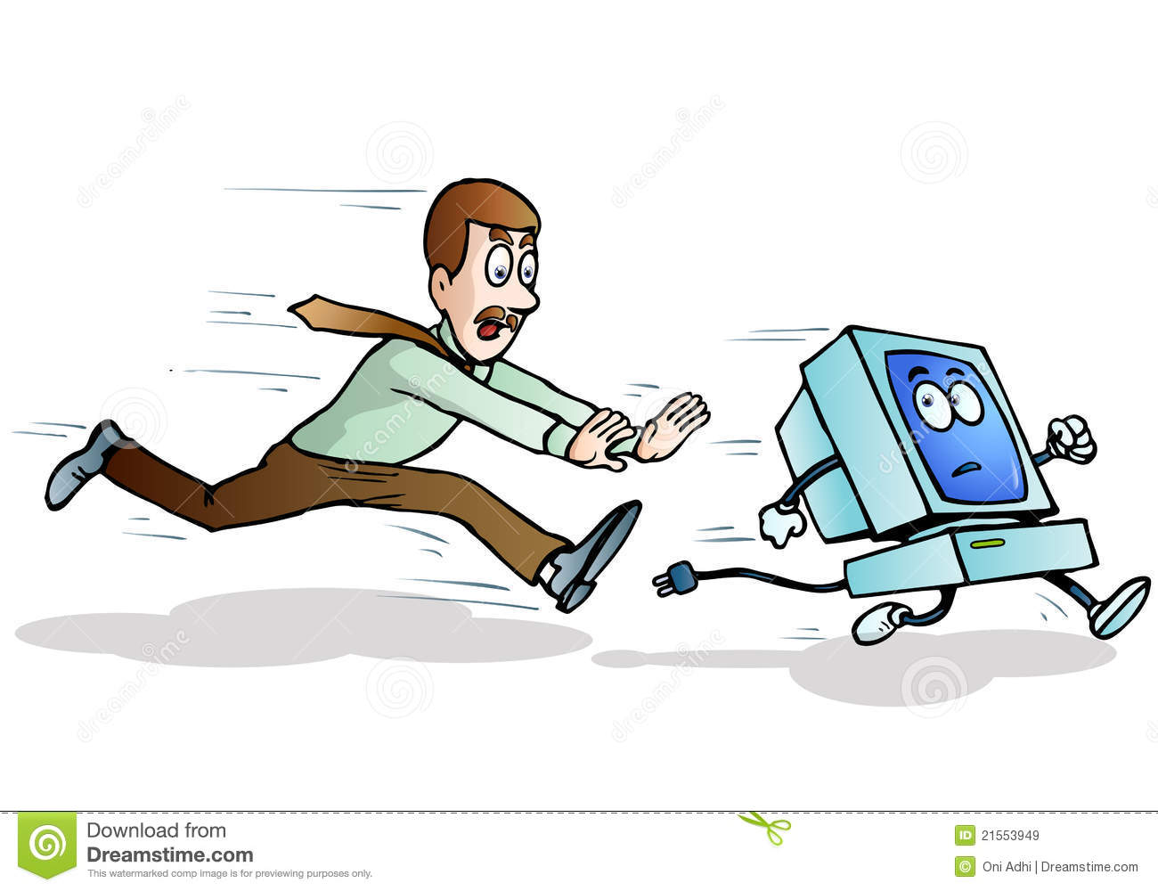
Signs of the emergence of the KIO
ICT losing control of projects to business areas
Business areas initiating ICT projects
Information advocacy from elsewhere
Key information functions move outside of ICT

Slide 8

What does the KIO do?
Leads information advocacy
Create vision for information management
Conceptualizes information projects
Drives information projects
Pushes CIO to work or exit
Assumes de facto leadership of ICT programs & projects
Completes & succeeds in ICT projects where CIO fails or does nothing
10plan90execute

Slide 9

Techniques of the KIO
Creative exploration
Simple strategy & planning
Fast execution
Value review and auto-cycling
AOTF – architecture on the fly
AT2M – agility to the max

Slide 10
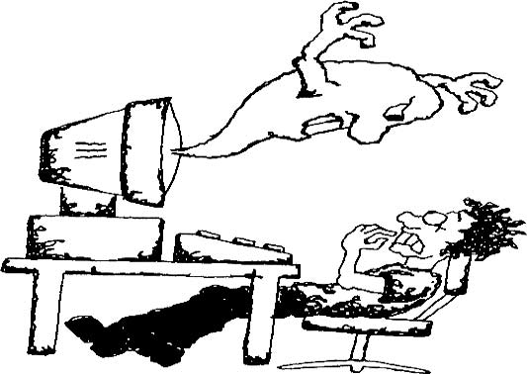
The KIO & the virtualization of ICT
Movement of traditional ICT functions to business areas
Dynamic, formal/informal disaggregation of traditional ICT
ICT becomes embedded in business areas

Slide 11

Impact of KIO on organization
Faster, more responsive to business information needs
Reinvention of information provisioning
Optimized information and ICT assets and staff
Accelerated information and ICT initiatives
Education of all areas on information and ICT processes

Slide 12
Thank you!

