Slide 1
ELECTRIC VEHICLE CHARGING STATIONS for Place du Village Square – Issues and Options

Slide 2
Why install chargers?
At least 20 per cent of all new passenger vehicles sold in Canada will be electric by 2026, 60 per cent by 2030, and 100 per cent by 2035.
Charging stations are quickly becoming a basic part of a home, much like a parking spot.
Installing CS in our parking garage would increase the value of the property, enhance its attractiveness to buyers and, of course, allow owners to charge their cars at home.
Is this the right time for Place du Village Square to proceed with installation?

Slide 3
The situation in our building
Research: Preliminary study by Lightenco and ongoing discussions with the Board.
Capacity: There are 48 units in our building. We don’t have sufficient electrical supply for one charger per unit without upgrading the power supply, which would be very expensive.
Configuration: We have the capacity for up to 24 stations, which could be mounted on walls or pillars. Two parking stalls would then share each charging station. This requires some cooperation but likely would be manageable.

Slide 4
The cost of installation
The Cost: Installation has two basic stages:
Installing the backbone: This must be done all at once and will cost about $40k. It would be funded with a Special Assessment.
Connecting individual charging stations: These can be added one at a time, at a cost of about $5k/station. CS will be organized in “pods” of four parking spots.

Slide 5
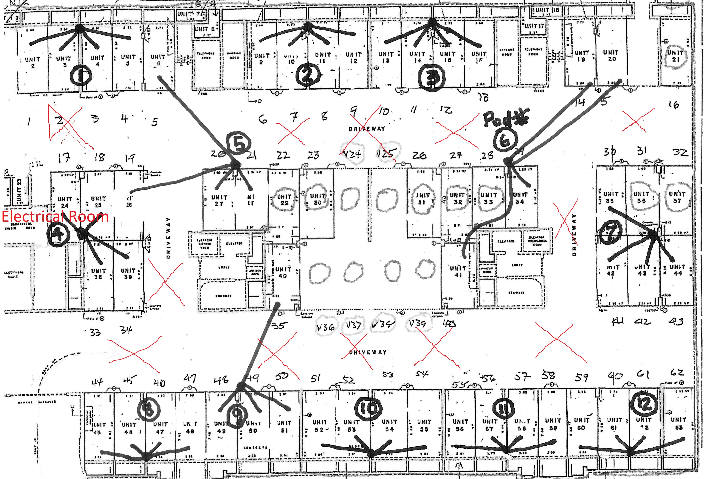

Slide 6
Interest from owners
While some owners may not be ready to invest in their own charging station, others want one now.
It seems unfair to require that everyone purchase a charging station immediately, but does that mean that those who want one now must wait…perhaps forever? The Board looked for middle ground.

Slide 7
Covering the costs
Opting-In to a Pod: The pods could be used as a system where people can “opt-in” to using a CS when they are ready and pay for their share of the cost at that time.
Starting a Pod: If someone wished to install a charging station ahead of the others, they would have to pay the full amount, and would be reimbursed as others opt-in.
Federal Subsidy: A federal subsidy would cover up to half the cost of installation, but this could be linked to installation of charging stations. If at the beginning we installed chargers in 8 pods, the condo could recover the full $40k investment.

