Slide 1
ELECTRIC VEHICLE CHARGING STATIONS for CCC 377 – is it time?

Slide 2
Why install chargers?
At least 20 per cent of all new passenger vehicles sold in Canada will be electric by 2026, 60 per cent by 2030, and 100 per cent by 2035
Charging stations are quickly becoming a basic part of a home, much like a parking spot.
Installing CS in our parking garage will increase the value of the property, enhance its attractiveness to buyers and, of course, allow owners to charge their cars at home.
Is this the right time for CCC 377 to proceed with installation?

Slide 3
The situation in our building
Research: Preliminary study by Lightenco and ongoing discussions with the Board.
Capacity: There are 48 units in our building. We don’t have sufficient electrical supply for one charger per unit, without upgrading the power supply, which would be very expensive.
Configuration: We have the capacity for up to 24 stations, which could be mounted on walls or pillars. Two parking stalls would then share each charging station. This requires some cooperation but should be manageable.

Slide 4
The cost of installation
The Cost: Installation has two basic stages:
Installing the backbone: This must be done all at once and will cost about $40k. It would be funded with a Special Assessment.
Connecting individual charging stations: these can be added one at a time, at a cost of about $5k/station. CS will be organized in “pods” of four parking spots.

Slide 5
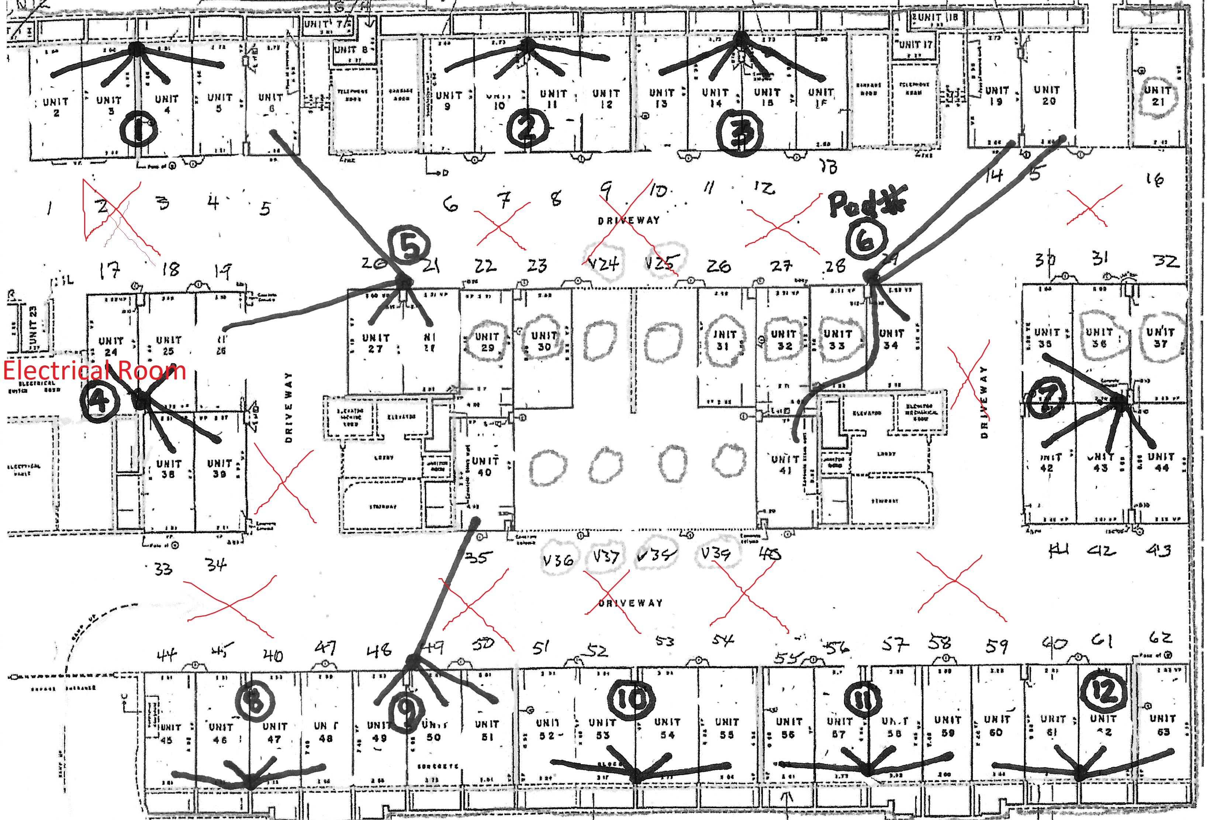

Slide 6
Interest from owners
While some owners may not be ready to invest in their own charging station, others want one now.
It seems unfair to require that everyone purchase a charging station immediately, but does that mean that those want one now must wait…perhaps forever? There is middle ground.

Slide 7
Covering the costs
Opting-In to a Pod: We propose to use the pods as a system where people can “opt-in” to using a CS when they are ready and pay for their share of the cost at that time.
Starting a Pod: If someone wishes to install a charging station ahead of the others, they must pay the full amount, and will be reimbursed as others opt-in.
Federal Subsidy: A federal subsidy will cover up to half the cost of installation, but this is linked to installation of charging stations. If we installed 8 chargers at the beginning, CCC 377 could recover the full $40k investment.

Slide 8
Two questions for owners
How many owners are willing to invest in charging stations now?
Are owners willing to use a Special Assessment to create the backbone?

Slide 9
Two questions for the Board
There is a scenario in which CCC 337 could proceed with installation even if less than eight pods were ready to launch.
Would we propose to move ahead even if there were less than eight? If so, what is the minimum number?

