Slide 1



Lake Therapies: Your Comprehensive Mental Health Resource Hub
Welcome to Lake Therapies, where we provide accessible, comprehensive mental health resources to support your wellbeing journey. Explore our extensive collection of videos, PDFs, interactive tools, and crisis support options.

Slide 2
Understanding Mental Health Today
90%
50%
Crisis Recognition
Young Adult Anxiety
Americans who acknowledge a mental health crisis exists nationwide
Young adults reporting frequent feelings of anxiety
60%
55%
Treatment Gap
Provider Shortage
Young people with major depression receiving no mental health treatment
U.S. counties lacking mental health professionals

Slide 3




Our Digital Resource Library
Remote Access
Video conferencing platforms providing flexible therapy sessions from the comfort of your home
Mobile Support
Smartphone applications delivering mental health resources anywhere, anytime
Targeted Interventions
Specialized resources for anxiety management, depression support, stress reduction, and trauma recovery
Community Connection
Virtual support groups fostering connection and shared healing

Slide 4
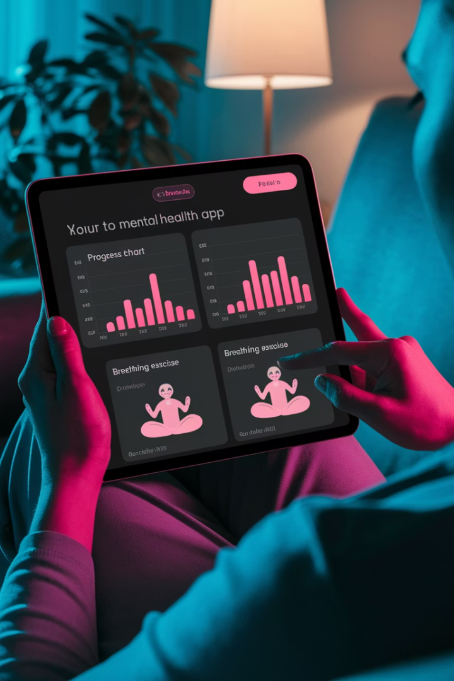
Video and Interactive Content
Smart Reminders
Medication management tools that send timely alerts and track adherence, helping maintain consistent treatment schedules.
Stress Management
Interactive breathing exercises, guided meditations, and mindfulness practices with visual and audio guidance for immediate relief.
Progress Tracking
Intuitive mood tracking and symptom monitoring tools that visualize your mental health journey over time with insightful analytics.
Biometric Integration
Advanced tools that monitor heart rate patterns, breathing rhythms, and sleep quality to provide personalized recommendations.

Slide 5








Specialized Support Collections
Depression Support
Anxiety Resources
Mood tracking applications
Panic attack management tools
Cognitive behavioral therapy exercises
Social anxiety support guides
LGBTQ+ Resources
Grief Counseling
Gender-affirming care guides
Loss navigation resources
Community-specific support networks
Virtual support groups

Slide 6
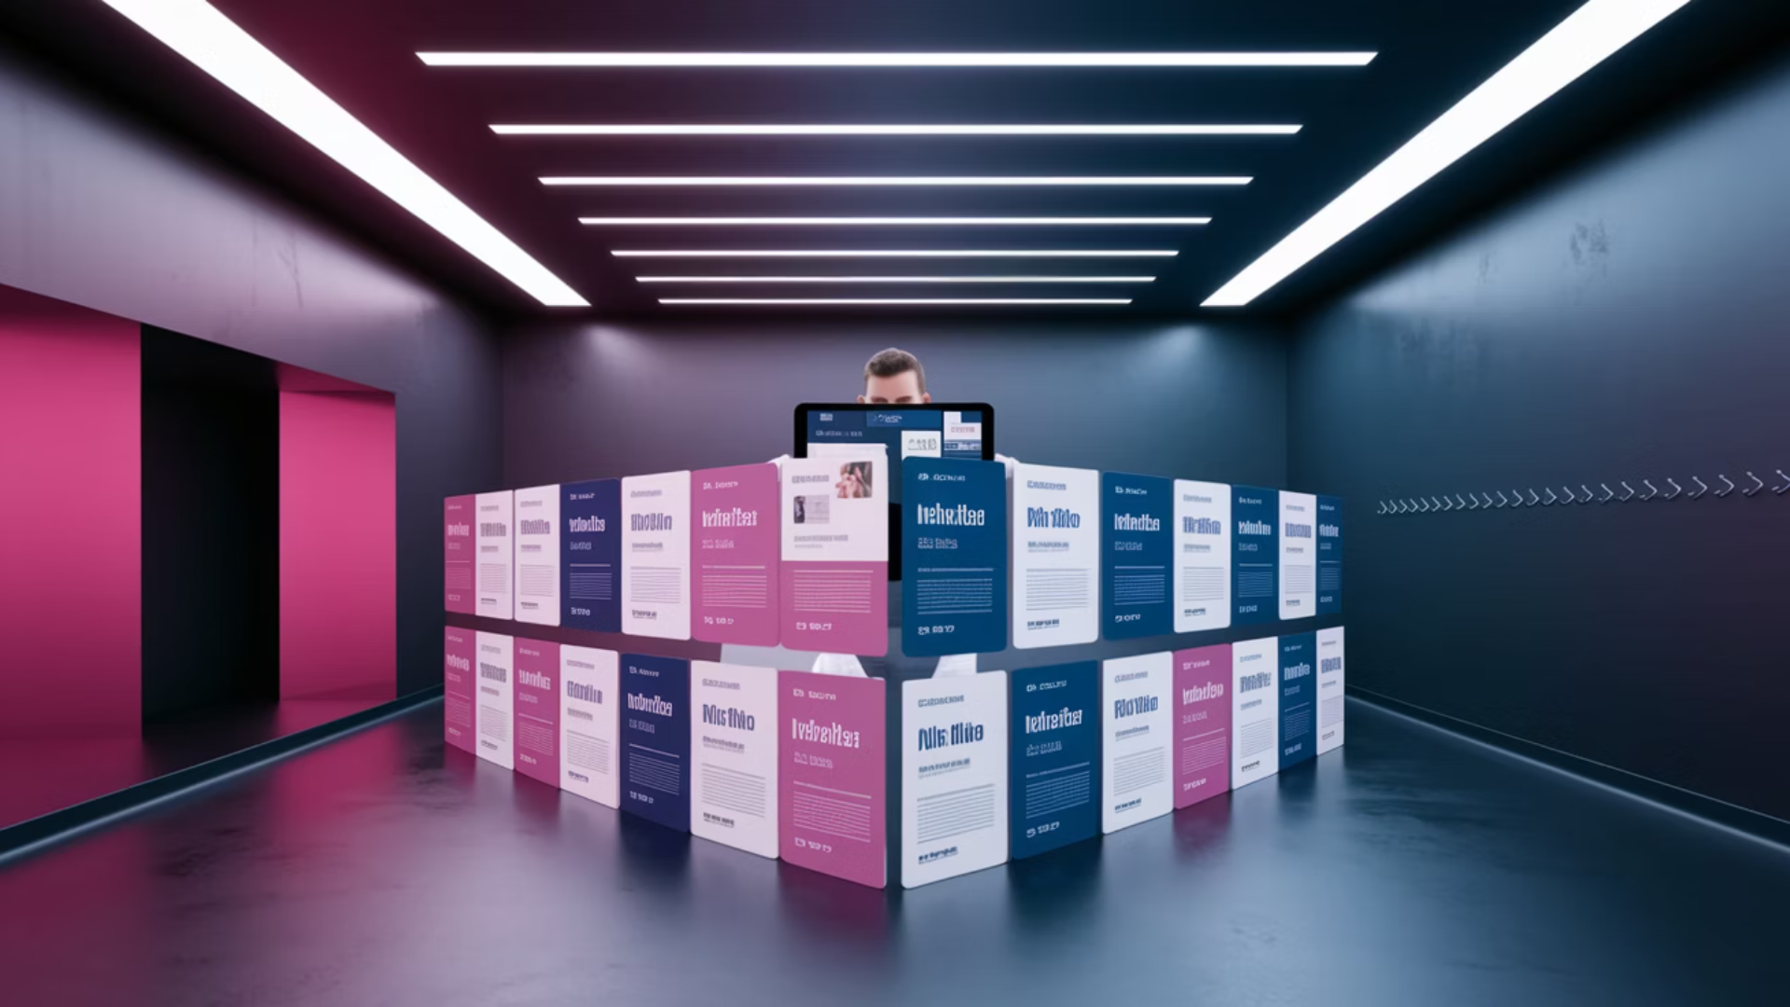




Professional Guidance PDFs
Therapy Options Guide
Comprehensive comparison of virtual and in-person therapy modalities, including CBT, DBT, and psychodynamic approaches with effectiveness research.
Medication Information
Evidence-based guides to common mental health medications, potential side effects, and questions to ask your healthcare provider.
Screening Resources
Primary care mental health screening tools and processes to help identify concerns early and facilitate appropriate referrals.
Federal Resources
Comprehensive directories for SAMHSA services and specialized veteran support programs with direct contact information.

Slide 7
Crisis and Immediate Support
988 Suicide & Crisis Lifeline
Veterans Crisis Support
Immediate, confidential support available 24/7 via phone, text, or chat. Connect with trained counselors who provide compassionate assistance during mental health emergencies.
Specialized 24-hour confidential crisis intervention specifically designed for veterans and their loved ones, addressing unique military-related concerns.
Press 1 after dialing 988
Call or text 988 anytime
No VA registration needed
Multi-language support available
Support for family members
No insurance required

Slide 8








Future of Mental Health Resources
AI-Driven Innovations
Personalized treatment recommendations and predictive analytics
Enhanced Accessibility
Breaking down geographic, financial, and cultural barriers
Ethical Implementation
Privacy protection and responsible technology development
Community Support
Creating stronger support networks through technology
Lake Therapies remains at the forefront of mental health innovation, continually expanding our resources to incorporate emerging technologies while maintaining our commitment to compassionate, accessible care for all.

