Slide 1

Challenging Histories
Guiding principles for good historical learning:
To be conscious that we each have a unique perspective based on our own circumstances, but that nobody has more, or less, importance in this class.
To let the facts inform you and lead your learning, rather than finding facts to support a prior viewpoint.
Avoid the use of terms like ‘we’ to refer to historical figures and peoples – as historians it is necessary to be impartial, so language is important.
i.e. refer to ‘the British’ rather than ‘we’. This helps to separate ourselves from the study and avoids unintentional othering or subconscious bias.
Accept that interpretations and feelings about what we study can and will differ. This is ok!
Discussion should be based on the facts. Use evidence to support your points to avoid making unfair or inaccurate assertions.
Notes:
Ask for an explanation of what we mean by ‘othering’ and ‘subconscious bias’.

Slide 2
A shared space for learning
To make the class respectful, fair, inclusive, kind and supportive, we will:
Listen to one another without interrupting
Ensure that everyone in the class has a chance to have their say
Avoid using language which might hurt other people
Ask questions and give our views, knowing that others won’t judge

Slide 3


Starter: The Turing Test
Can YOU tell the difference between a human being and AI?
Choose one of these two Turing Tests and have a go!
playturing.com
humanornot.ai
Notes:
This slide and the following slide are hidden.
If the class is going to play the Turing Test online, unhide the slide and let the students decide which test they want to play. The tests are slightly different in style, so it can be pointed out that the Turing Test can be applied to a range of AI.

Slide 4
Starter: How did you get on?
Were you able to tell the difference between a human and AI?
Is it important to be able to distinguish between AI and humans?
Why?
Does the inventor of the test deserve some sort of recognition, or would that person need to do more than just devise such a test in order to gain national recognition?

Slide 5
Starter: Think | Pair | Share
We all have heroes. People we look up to in some way and for different reasons. But what makes a hero?
With the person sitting next to you, spend two minutes making a list of what you think makes a hero – you do not have to agree!
In your list, include the names of two of your heroes.
When time is up, join with another pair and share your ideas – you have two minutes then we will collect class responses on the board.
Notice where you have agreed and where you disagree.

Slide 6
Starter: Think | Pair | Share
• What (if anything) do these heroes have in common?
• How many are not men?
• How many are fictional?
• Why might people not agree that someone is a hero?

Slide 7

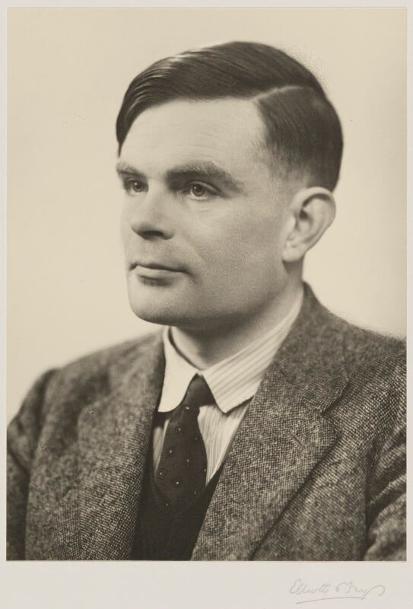
Enquiry Question: Who was Alan Turing and why should we care?
Lesson Title: Who was Alan Turing and why is he important to Britain?

Slide 8
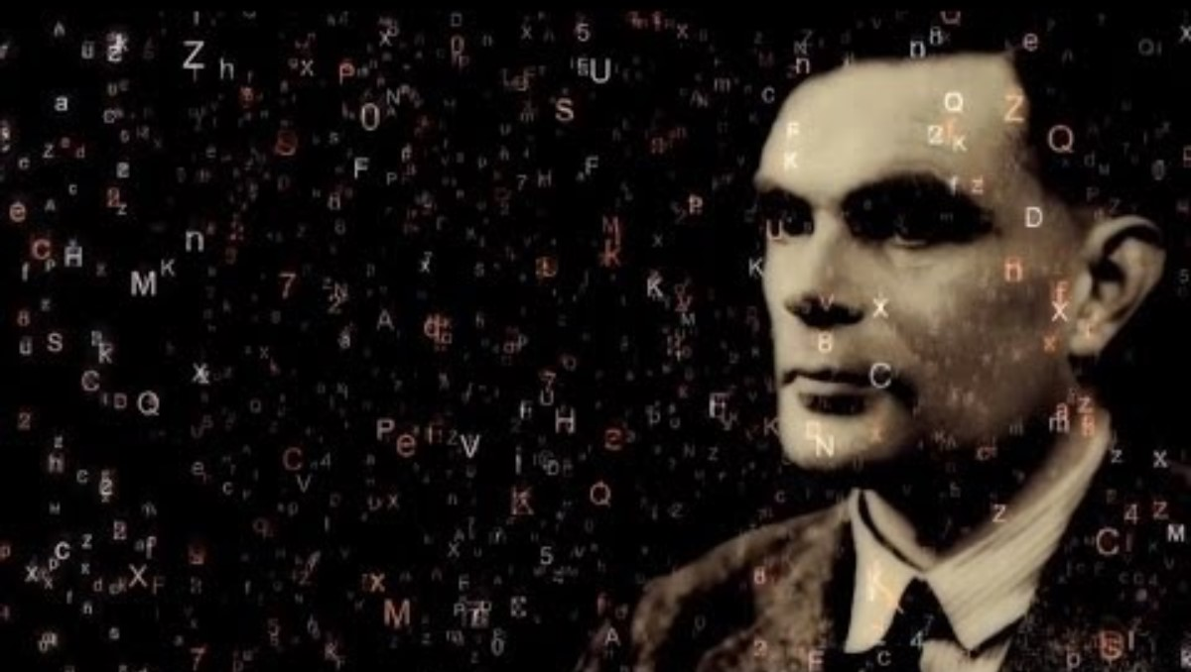
Who was Alan Turing?
Watch this short video about Turing’s life and work:
Alan Turing - Celebrating the life of a genius

Slide 9
Now use what you have learnt from the video, and the Information Cards you have been given, to complete the ‘Who was Alan Turing? worksheet.
We will then share our knowledge as a class.

Slide 11
Who was Alan Turing? Information Cards
23 June 1912 - 7 June 1954
Alan Turing was very interested in science and mathematics and was far ahead of other children in these subjects.
After boarding at Sherborne School, he went to King's College, Cambridge where he studied mathematics. He got his degree in 1934 and was made a Fellow of the college in recognition of the brilliant research into probability theory.

Slide 12
Who was Alan Turing? Information Cards
Turing made many important contributions to mathematics. In 1936, he published a paper called On Computable Numbers, which put forward the idea of a machine that could solve mathematical problems using a set of rules. This idea is the basis of today's computer science. The idea was called the Turing machine. He also worked on several other important areas of mathematics, including work which later became a big influence on artificial intelligence and on the way computers process information today.

Slide 13
Who was Alan Turing? Information Cards
During World War II, Turing worked at the top-secret codebreaking centre at Bletchley Park in Milton Keynes. He was part of a team whose task it was to crack the German's Enigma code. This complex code changed every day, but was cracked with the use of a machine called the Bombe, which Turing helped to design. Now the Allies could understand the German military's secret messages, were able to know the German plans and won important battles, such as the Battle of the Atlantic.
Historians estimate that Turing’s codebreaking shortened the war by two years, saving millions of lives. He is one of the most important figures in the history of British military intelligence.

Slide 14
Who was Alan Turing? Information Cards
Other people were also involved in the work at Bletchley Park:
Joan Clarke – a cryptanalyst and close friend of Turing, known for her work on breaking German naval codes.
Hugh Alexander – a chess champion and cryptanalyst who led the team working on Enigma decryption. Gordon Welchman – a mathematician who helped improve the Bombe machine used to crack the Enigma code.
Tommy Flowers – an engineer who designed the world’s first programmable electronic computer, which was named Colossus.

Slide 15
Who was Alan Turing? Information Cards
Turing worked in the field of abstract mathematics and something called 'morphogenesis', which is a type of mathematical biology. Turing developed new ideas about the mathematics of pattern formation.
This meant he was able to show, that animals with stripes and spots - such as leopards - will only ever have striped tails and spots on the body, not the other way around.

Slide 16
Who was Alan Turing? Information Cards
Turing was a keen runner (he was very close to being on the 1948 Olympic Games running team) and cyclist. He used to avoid hay fever in the summer by cycling to Bletchley wearing his gas mask!
His mathematical ability made him so good at playing Monopoly that William, the son of codebreaker Max Newman, designed a board that had some squares diagonally across the board. This was meant to make Turing’s mathematical tactics ineffective. William and Turing only played this version once – Turing lost! There is now a modern version of William’s game.
One of Turing's favourite stories was 'Snow White'.

Slide 17
Who was Alan Turing? Information Cards
Turing was gay, which was then illegal in Britain. In 1952, he reported a burglary at his home, but whilst investigating the burglary, the police discovered Turing was in a relationship with a man. He was charged with gross indecency and given a choice, but rather than be sent to prison he agreed to be chemically castrated, a brutal treatment which made him ill.
The criminal record meant he could no longer work for the government because of the Official Secrets Act, so he lost the job he loved.
In 1954, he died from cyanide poisoning, possibly by eating a poisoned apple.

Slide 18
Who was Alan Turing? Information Cards
Turing was persecuted – as well as legally prosecuted – during his lifetime for being gay. Britain officially pardoned him in 2013, and his face now appears on the £50 banknote.
His legacy is honoured through statues, academic awards, and institutions such as the Alan Turing Institute, ensuring his impact is never forgotten.

Slide 19
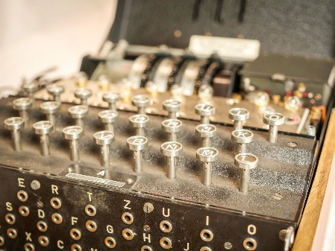
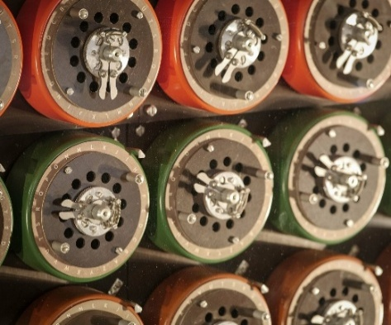
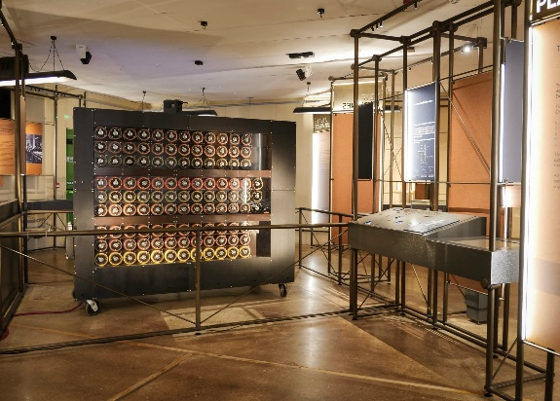
Who was Alan Turing? Information Cards
Notes:
L-R: an Enigma machine; the Bombe machine; close-up of the Bombe machine drums

Slide 20
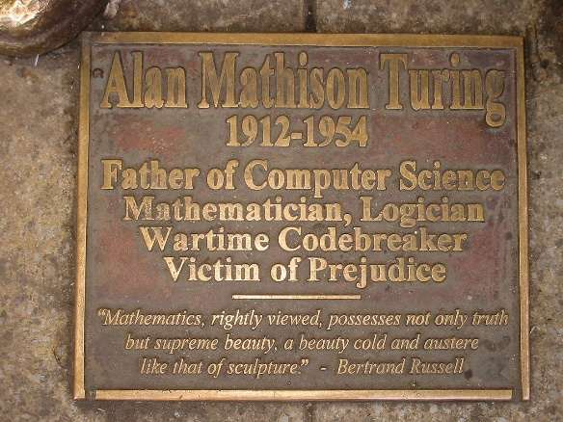
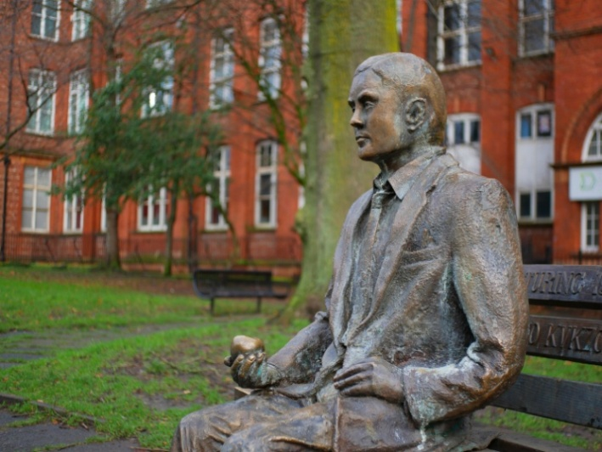
Who was Alan Turing? Information Cards
Notes:
A statue of Alan Turing, with plaque. He is depicted holding an apple. The memorial is in Sackville Gardens Manchester.

Slide 21
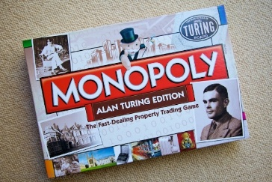
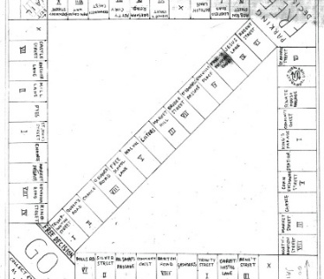
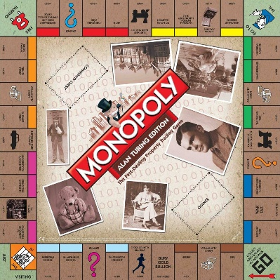
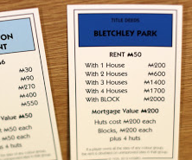
Who was Alan Turing? Information Cards
Notes:
L-R: a copy of the Monopoly board designed by William Newman; a modern version of Turing Monopoly.

Slide 22
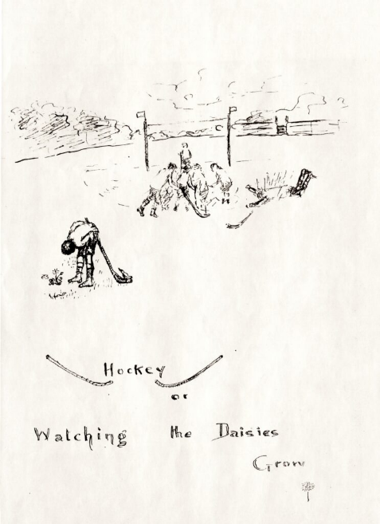
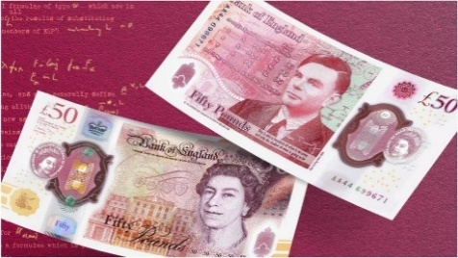
Who was Alan Turing? Information Cards
Notes:
A drawing of Alan Turing at Sherborne School, drawn by his mother; the £50 note depicting Turing.

Slide 23
What have we learnt about Alan Turing?
What contributions did Turing make to Britain?
What significant contributions did Turing make to science; mathematics; computing?
Did Turing make any other contributions?
How and why was Turing persecuted? What does it mean to be persecuted?
How has Turing been recognised by the country?
Is Turing a hero? Why/why not?

Slide 24
Timeline
Each group has been given a card with a date and event on it.
When called by the teacher, one of your group should read the card out loud and then place it in the appropriate place on the washing line.
The washing line will be left up for the remainder of our study of Alan Turing.

Slide 25

Summary: What have we learned and why does it matter?
Discuss the following questions with your partner and be ready to share your thoughts (use evidence to support your answers):
In what ways did Turing contribute to Britain?
How did he contribute to maths and science?
Why was he persecuted?
How has he been recognised and is that enough?
Concluding question: Would you say that Turing is a hero? Be ready to give reasons for your answer.

