Slide 1

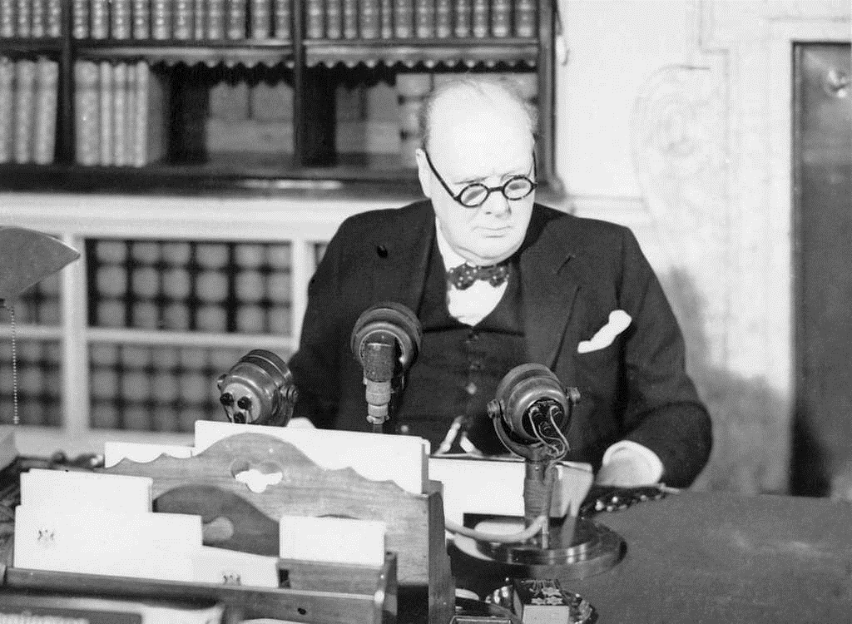
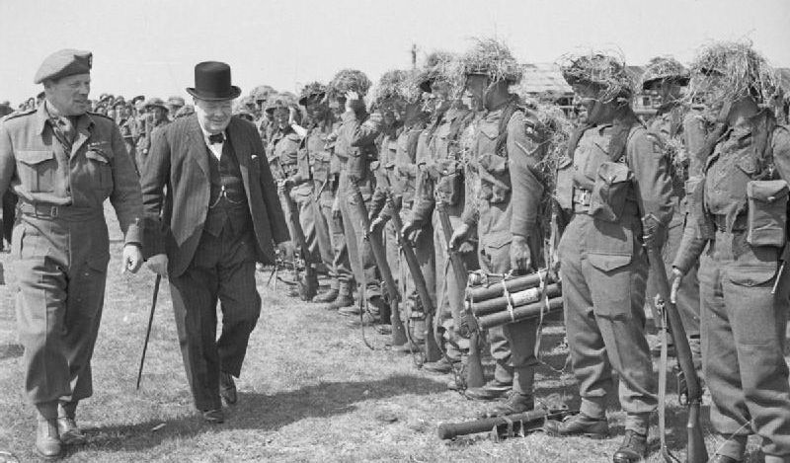
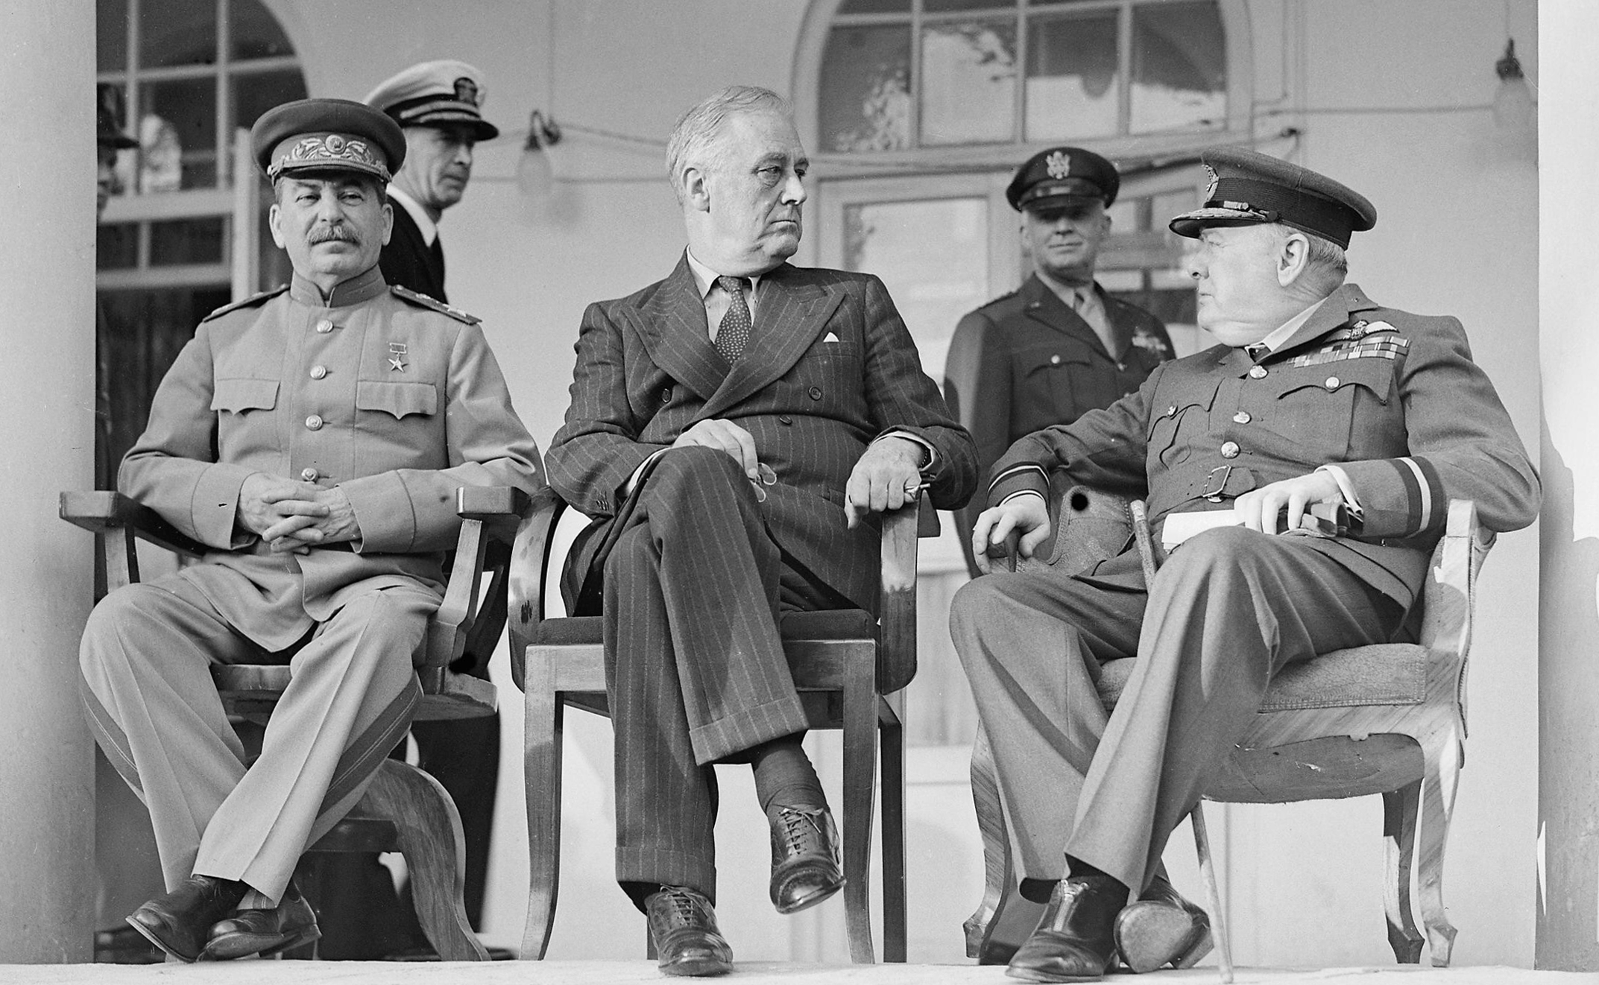


Starter: The power of words?
Listen to the following clip of Churchill speaking to civil authorities in London on July 14th, 1941.
What is his message?
How do you think he wants the listener to feel after hearing his words?
What impact might this speech have on the people who hear it?
What impression does it give about the British people?

Slide 2
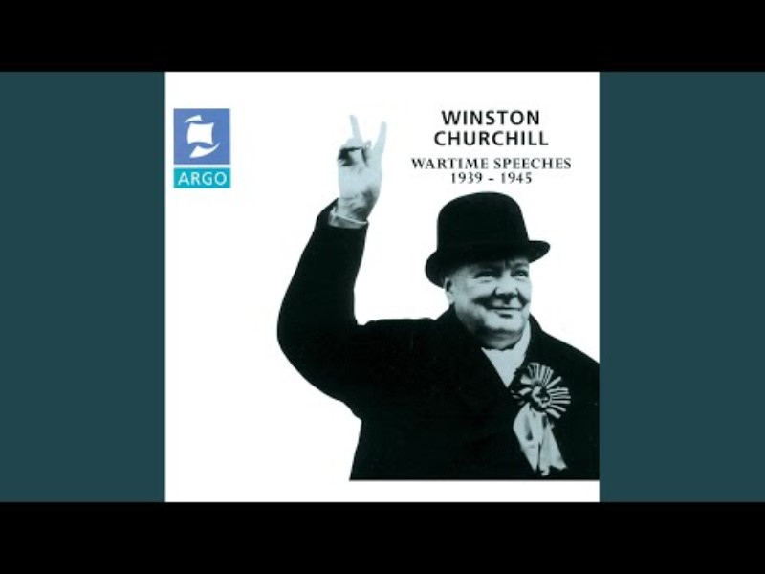

Slide 3

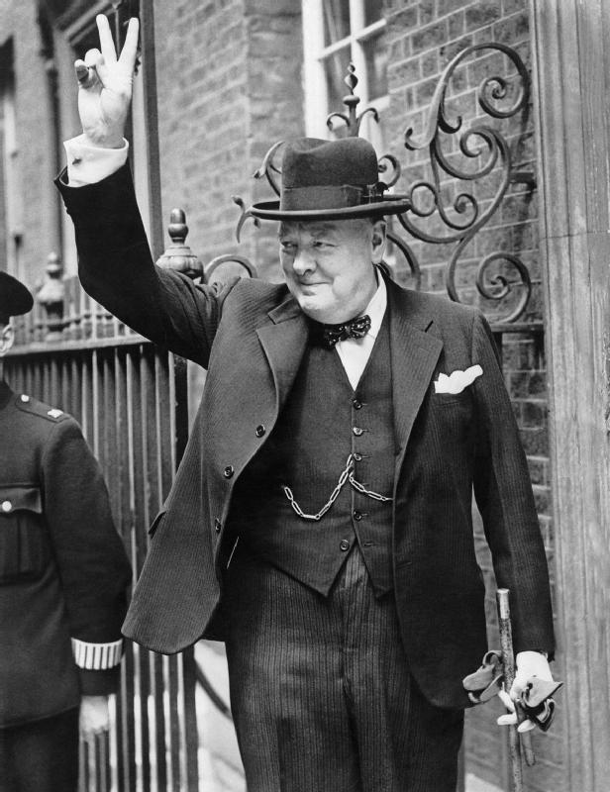
Enquiry Question:
How did Churchill shape modern Britain?
Lesson Title:
How did World War II change Britain?

Slide 4
World War II overview
Watch the film on the next slide.
As you watch, answer as many of the questions on your handout as you can. We’ll go through them together at the end of the film.
Challenge Question: What does the film suggest about Britain’s role in WWII?

Slide 5
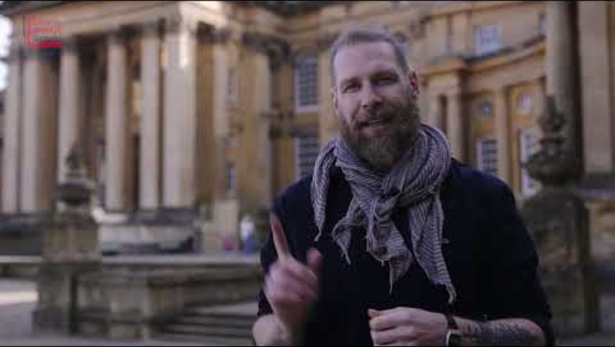

Slide 6
World War II overview
When did World War II happen?
Who were the Axis Powers?
Who led the Allied Powers?
How many people died in the conflict?
What was the name of the battle that prevented Nazi Germany from being able to Invade Britain?
Where did Squadron 303 come from? Why are they significant?
Which colonies fought alongside Britain?
Why was the Soviet Union seen as an ‘unlikely ally’ to Britain when they joined forces in 1941?
What did Churchill feel when the USA joined the war?
Where did the Allies counter offensive begin?
Were the Allies always in agreement about the war and its aftermath?

Slide 7
Churchill’s wartime leadership
In groups, look at the information sheet you have been given and complete the relevant section of your handout.
Consider if/how Churchill’s leadership and Britain’s influence and status changed over the course of the war.
You will look at one of three factors, then feedback to the group.
The People’s Prime Minister
Military Campaigns
Building Alliances

Slide 8
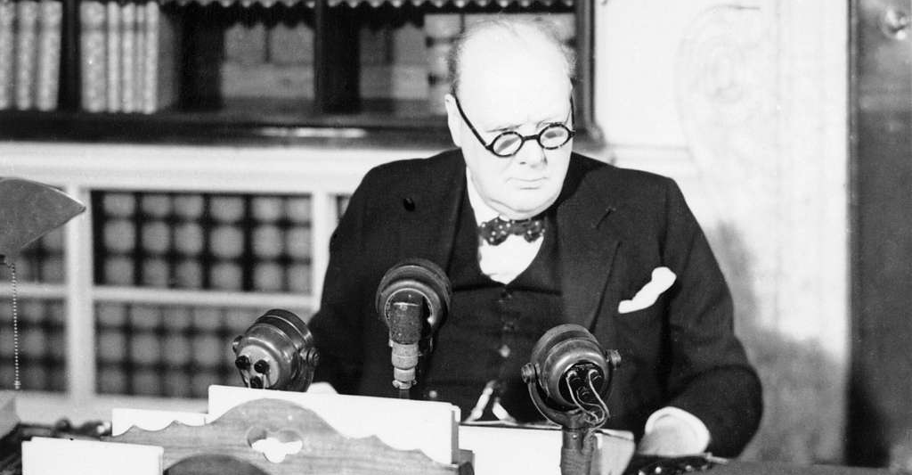
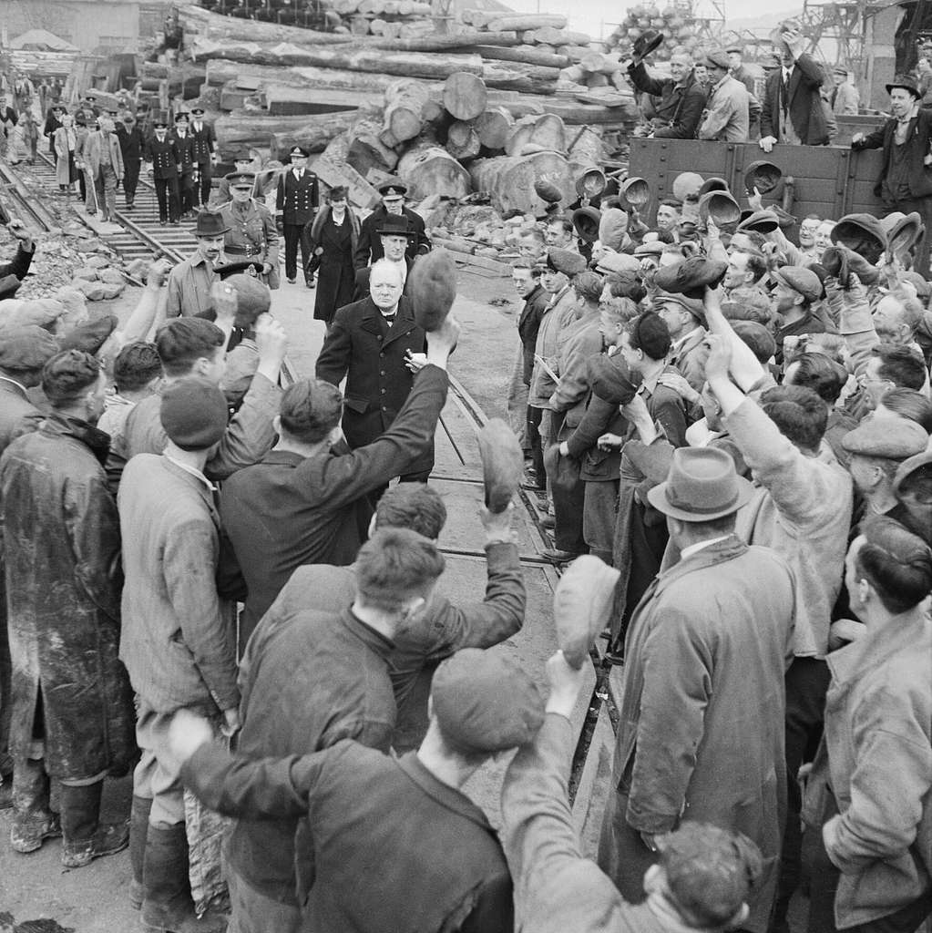
The People’s Prime Minister
(B) First Speech as Prime Minister to the House of Commons
‘I would say to the House, as I said to those who have joined this Government: "I have nothing to offer but blood, toil, tears and sweat."
We have before us an ordeal of the most grievous kind. We have before us many, many long months of struggle and of suffering. You ask, what is our policy? I can say: It is to wage war, by sea, land and air, with all our might and with all the strength that God can give us; to wage war against a monstrous tyranny, never surpassed in the dark, lamentable catalogue of human crime. That is our policy. You ask, what is our aim? I can answer in one word: It is victory, victory at all costs, victory in spite of all terror, victory, however long and hard the road may be; for without victory, there is no survival… and I say, "Come then, let us go forward together with our united strength.“’
May 13, 1940
As well as being heard by the people, Churchill was keen to be seen. He made visits to towns and cities across the country to show his support for their work, give emphatic and witty morale boosting speeches, and sharing in their grief over bomb damage and lost ones.
Churchill’s successor as Prime Minister, Clement Atlee said, following Churchill’s death in 1965, ‘If somebody asked me what exactly Winston did to win the war, I would say “Talk about it”.’
Look at the following examples of how Churchill fostered support during the war and add to your note taking sheet.
(D) Public opinion
Churchill’s personal popularity was clear to see. Opinion polls showed his approval rating (how much of the population thought he was doing a good job) never below 78% during the war and reaching 93% in 1942 and 1943. (making him Britain's most popular Prime Minister ever!).
Churchill preparing to address the nation
(A) We Shall Fight on the Beaches, 1940
‘We shall go on to the end, we shall fight in France, we shall fight on the seas and oceans, we shall fight with growing confidence and growing strength in the air, we shall defend our Island, whatever the cost may be, we shall fight on the beaches, we shall fight on the landing grounds, we shall fight in the fields and in the streets, we shall fight in the hills; we shall never surrender.’
Delivered at the House of Commons, June 4, 1940
(C) Broadcast following the Nazi invasion of the Soviet Union
‘We have but one aim and one single irrevocable purpose. We are resolved to destroy Hitler and every vestige of the Nazi regime. From this nothing will turn us. Nothing. We will never parley; we will never negotiate with Hitler or any of his gang.’
London, June 1941
(E) Visiting bomb damaged cities
In 1941 Churchill toured some of the worst bombed cities across the country. His visits included the southern port city of Plymouth, which had suffered large bombing raids attacking strategic targets such as oil depots, but also civilian targets including houses, the Town Hall and Hospital. Despite the destruction and clear up work that had to be done, Churchill was greeted by cheering crowds. Churchill saw the bomb damage across the city as he drove through in an open top car. Speaking to the public, Churchill said ‘Your homes are low, but your hearts are high.’
Cheered by workers during a visit to bomb-damaged Plymouth, 2 May 1941.

Slide 9
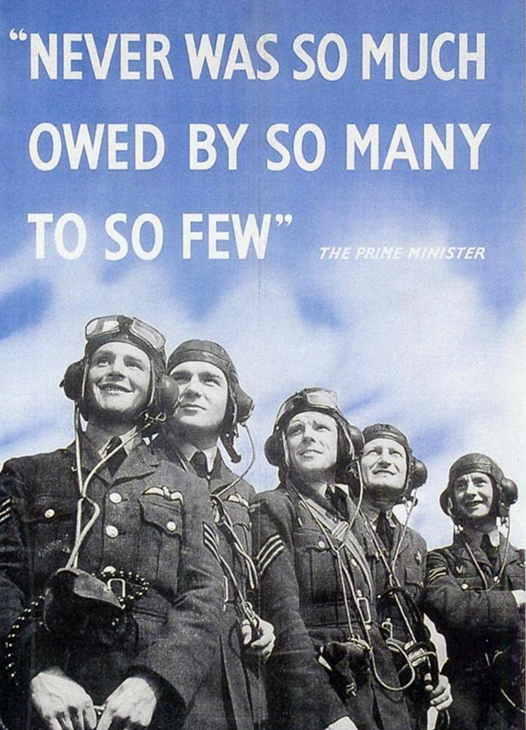
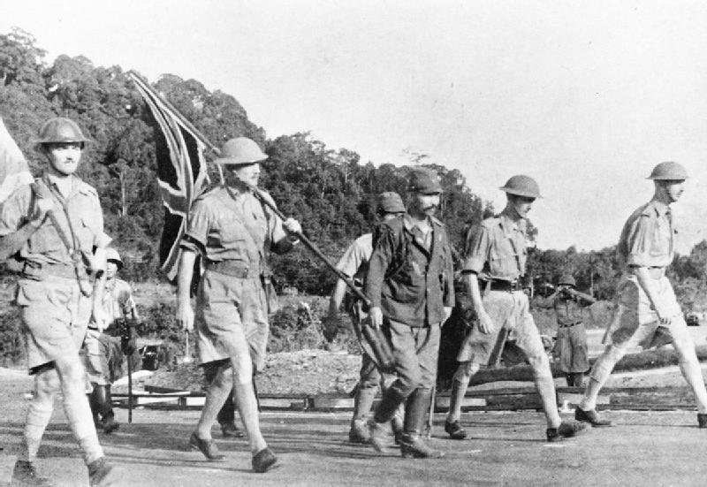
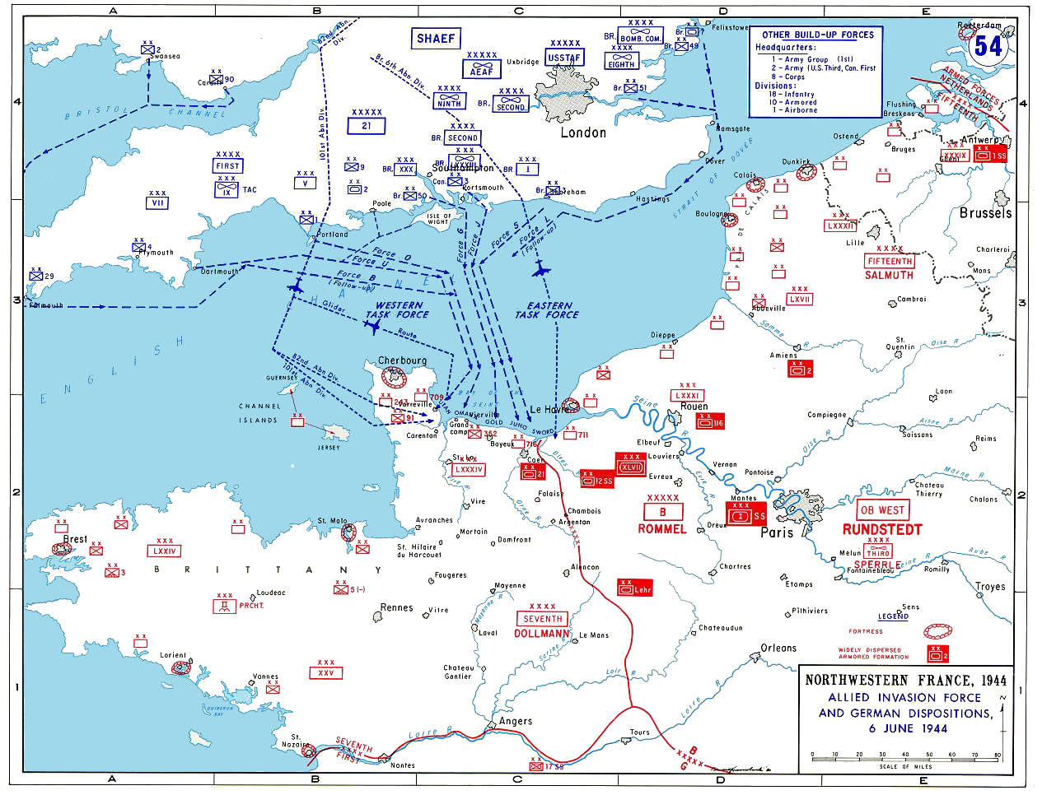
Military Campaigns
The North African Front
The North African campaign was fought in the countries of Egypt, Morrocco, Tunisia, Algeria, and Libya. Italian and German troops stood against Allied forces from Britain, India, Australia, New Zealand, South Africa, Poland, Greece, Czechoslovakia and others, with American troops joining the effort in 1942. Between June 1940 and May 1943 both sides launched offensives and counter-offensives until the eventual Allied victory, which forced the Italians out of the war altogether and the Germans out of Africa, turning the tide of the war in the Allies favour.
British command of the Allied forces in Africa was challenged when America joined the war in December 1941 as U.S. commanders opposed British strategy. However, American President, Roosevelt gave orders to accept the British plan and work with them. When troops arrived in May 1942 the reinforcements were essential in aiding the overall Allied victory.
Victory in North Africa gave the allies a secure base from which to launch a counter-invasion against Nazi Germany into Southern Europe.
D- Day, 6th June 1944
The counter-invasion of Western Europe was the largest seaborne invasion in history. It began the process of liberating France and pushing the German forces back to their homeland, and eventual surrender. More than 300,000 soldiers and naval troops were involved in a coordinated attack of artillery, airstrikes and ground forces across five beeches along the Normandy coast of France. 160,000 troops crossed the channel on D-Day itself.
As the senior partner in the Western Alliance, American President, Roosevelt put Major General Eisenhower in overall command of the Allied forces, with Britain’s General Montgomery in charge of the land forces involved. Planning of the landings was meticulous and time consuming, taking over a year to be finalised and agreed. American, British and Canadian troops were dropped behind enemy lines to help secure positions and break German defences. The Normandy landings gave the Allies a foothold on continental Europe for the first time in three years and a platform from which to push the Germans back. Costing the lives of some 10,000 Allied soldiers and 1,000 German troops.
It has been said that World War II was won with American money and Soviet blood. But when the war broke out, Britain was the only major power standing against Hitler. How Churchill led the country during this early period and following the Japanese attack on America and Hitler’s subsequent declaration of war, then his invasion of the USSR, when these two superpowers joined the war helps us understand Britain’s changing position in the world.
Look at the examples to see how this affected allied strategy and leadership and add to your note taking sheet.
The Battle of Britain, 10th July – 31st October 1940
As the sole major European power standing against Hitler Britain was at risk of invasion. Control of the skies over the English Channel would be essential for German forces to be able to land on British shores. Britain and her allies resisted German attacks and defeated their Airforce in fierce aerial fighting, marking the first major defeat of Hitler’s armed forces. Britain’s strategy worked and Churchill thanked the armed forces stating “never in the field of human conflict has so much been owed by so many to so few” in response to their efforts and the fact that through winning this battle Britain had prevented Hitler from winning the war.
The Far East
With Britain’s main military focus on Europe, being stretched so thinly meant its colonies in the far east were under threat from Japanese forces. Singapore was an important colony – Britain’s foremost military base and economic port in the region. It’s fall to Japan in February 1942 was Britain’s largest military surrender ever, devastating Churchill who said who called it ‘the worst disaster… in British history.’ This changed the power balance of the region and damaging Britain’s prestige hugely, demonstrating the inability of Britain to maintain its empire in the long term.

Slide 10
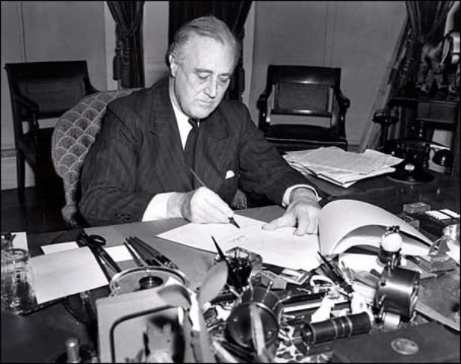
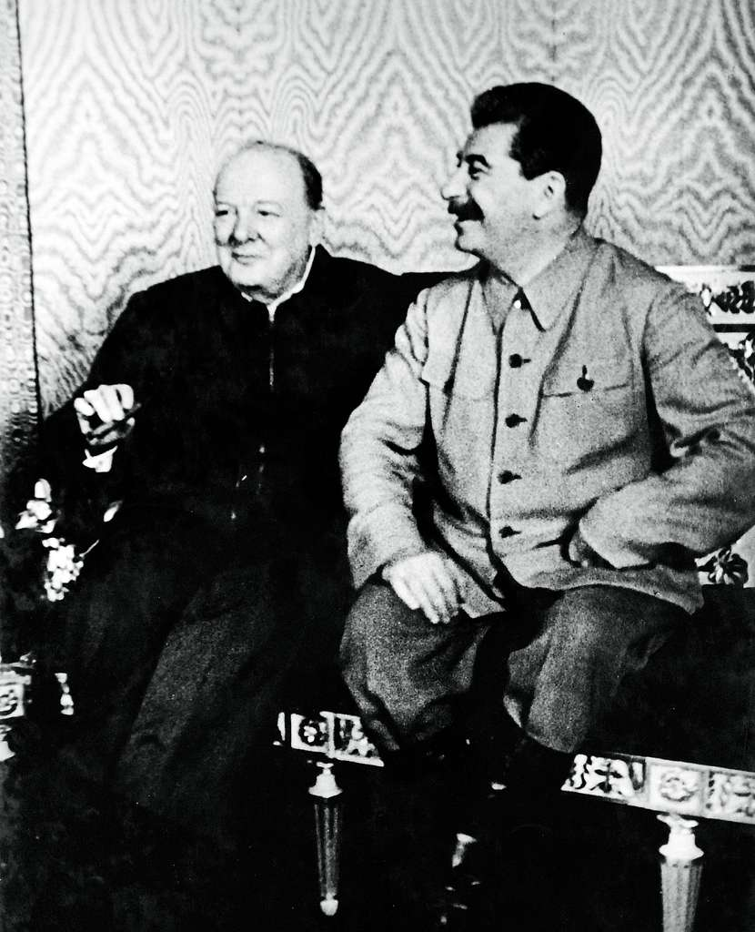
Building Alliances
USSR: Unlikely Alliance
When Germany invaded the Soviet Union in June 1941, Britain gained an unlikely ally. The Soviet union, led by the dictator Joseph Stalin, was a communist dictatorship ideologically opposed to Britain and with entirely different ideas of how to organise and run their own country. Despite these differences the fact that they shared an enemy brought the two countries together as they needed to cooperate to be able to defeat Hitler.
Churchill showed his opinion of Stalin and forming the alliance with him by stating “If Hitler invaded Hell, I would at least make a favourable reference to the Devil.”
In August 1942 Churchill flew to Moscow to visit Stalin. Whilst they could not fully agree on all aspects of war strategy, Churchill was able to maintain his plans (made with America) to invade Europe first from North Africa, rather than France. Stalin would have to accept this, and whilst he pressed for a western front and even accused Churchill and the British of being afraid to fight, he ultimately found common ground with Churchill in his passion and intent, if not his strategy, saying “Your words are not important, what is vital is the spirit.”
Whilst there were questions of trust and clear differences of opinion between the two leaders, they agreed on the priority of defeating Hitler. The importance of the face–to–face visit enabled the two leaders to build a relationship that would be essential for maintaining their military alliance.
Churchill understood that Britain needed allies and alliances to win the war. For this reason, he engaged in a campaign of diplomacy with leaders of countries he wished to gain support from. His priority was to gain support from America. As Historian and Churchill biographer Martin Gilbert said, ‘From the first to the last days of his premiership… he spent more time and energy seeking to obtain help from the United States than in any other endeavour.’
He also met with leaders of other countries to persuade them to support Britain. He met the leaders of Poland, France, Turkey, China, Croatia and Yugoslavia. He mostly travelled to meet leaders face-to-face as he believed his personality could win them over. However, there were two allies more important to Churchill than any others.
USA: Lend Lease, Atlantic Charter and the ‘special relationship’
Britain’s capacity to produce the materials needed for war could not equal to the huge demands put on it and the country was fast running out of money and equipment. While America was not a part of the war, Churchill worked on forming a trade agreement that would allow Britain to get supplies without paying up front. Under the Lend-Lease agreement of March 1941 America agreed to loan supplies to Allied countries. Over $50billion worth of supplies were loaned, which allowed Britain and her allies to carry on fighting. The debt would not be fully repaid until 2006, and this indicated a clear shift in global power, with America’s wealth, resources, and therefore influence, outstripping all others, including Britain.
Later that year Britain and America signed the Atlantic charter, outlining the aims of the two countries for the postwar world. This included free elections for liberated countries, better economic and social conditions for all, disarming aggressive nations and working together on trade. Later in 1944, Churchill described Britain and America as being tied together through a ‘special relationship’, a phrase and alliance which has been maintained into the 21st Century. It was clear who the senior partner in the relationship would be from the outset though.
‘Big Three’ conferences, 1943-1945
With Germany losing the war the leaders of the ‘Big Three’ countries, Roosevelt, Stalin and Churchill, met three times to discuss and plan for the post war world. These meetings were held in Tehran, Iran in December 1943, Yalta, Russia in February 1945 and, following Germany’s surrender, at Potsdam, Germany in July 1945.
The three leaders discussed such issues as what to do with the defeated Germany, how to treat liberated countries and how countries could be compensated for their losses. Whilst they came to agreement, the leaders had differing levels of influence. Stalin’s position was strong due to his military. Soviet troops had liberated countries in Eastern Europe, and Stalin wanted control over these countries. Roosevelt’s influence also was strong due to his economic position. America had grown in wealth as it supplied the allies and had not suffered major damage at home. Churchill’s influence was limited as Britain had been severely weakened both militarily and economically after five years of fighting. Churchill and Stalin disagreed on Poland. Churchill wanted it to be a free, democratic country, but Stalin wanted to keep his soldiers and influence there. Churchill was forced to compromise - to maintain Britain’s interests in Greece, and prevent a communist revolution there, he had to concede to Stalin on Poland. Britain’s power and influence was clearly not what it once had been.
Left: President Roosevelt signs the Lend-Lease agreement
Right: Churchill and Stalin at the Moscow Conference
Left to right: Stalin, President Roosevelt, and Churchill gather for a photo at the Tehran Conference

Slide 11
Churchill’s wartime leadership
 | Outline Events | Churchill’s role and Britain’s actions | Impact on Britain’s status?
The People’s Prime Minister
Military Campaigns
Building Alliances

Slide 12
How did World War II change Britain?
Discuss:
To what extent was Britain ‘alone’ in WWII?
How did Britain’s role change during WWII?
What was the significance of British leadership in WWII?
What was the impact of Churchill during WWII?
Now write a paragraph to answer the question:
How did World War II change Britain?
  Include evidence and examples from the different factors.

Slide 13
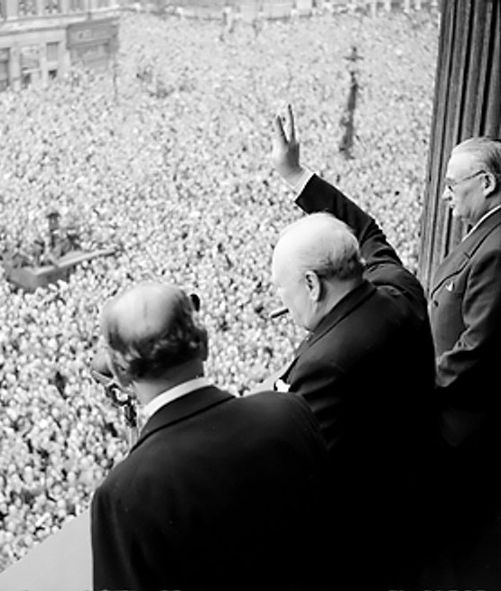
How did Churchill shape Modern Britian in WWII?
Use what we have studied today and your own knowledge to discuss this question with your partner.
Be ready to feedback your thoughts.
You may wish to consider:
How can you connect the examples we have looked at in this lesson to the present day?

