Slide 1

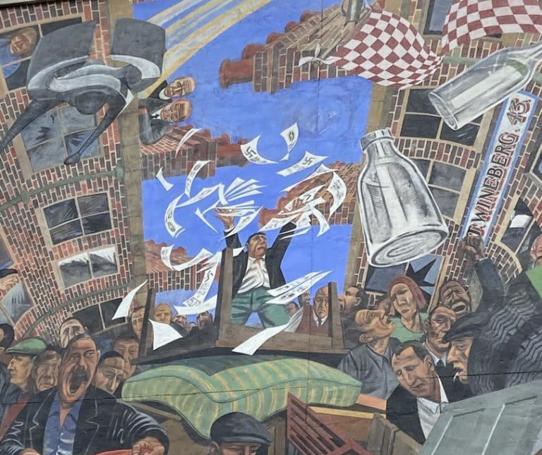
The Battle of Cable Street: Antisemitism & Extremism in the UK
Who Were the British Union of Fascists?
Why Did They Have Support?

Slide 2
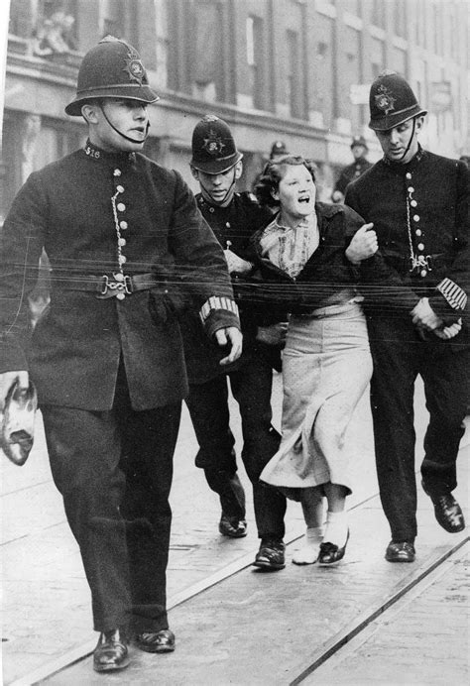
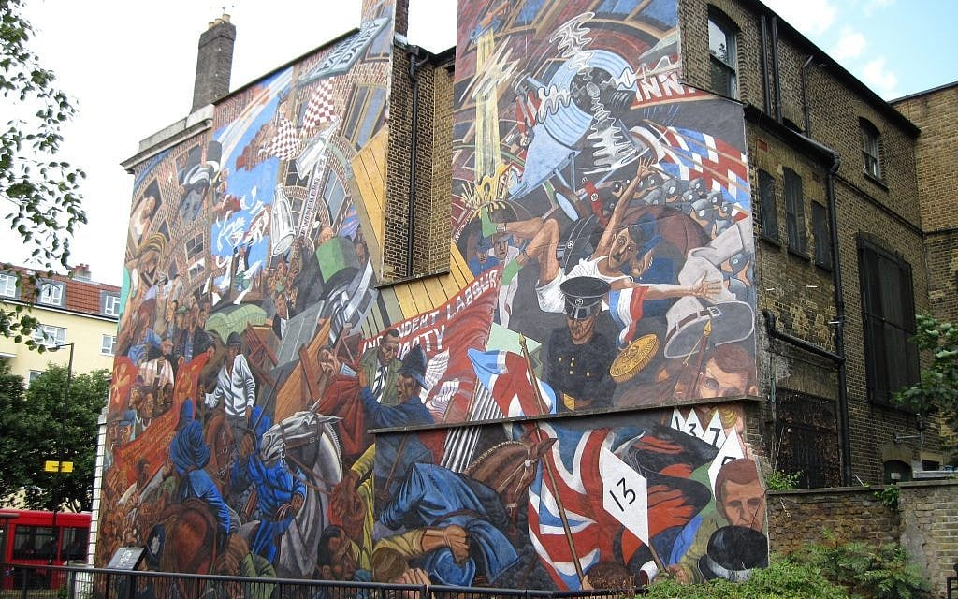


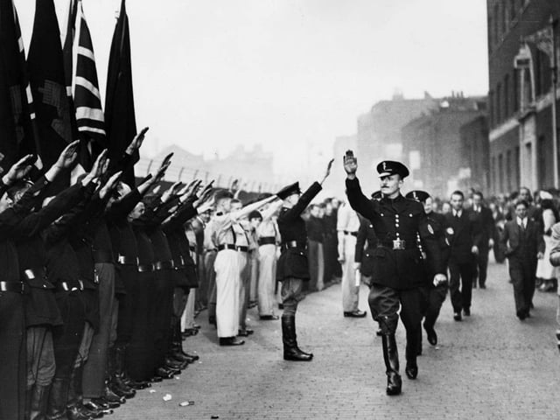
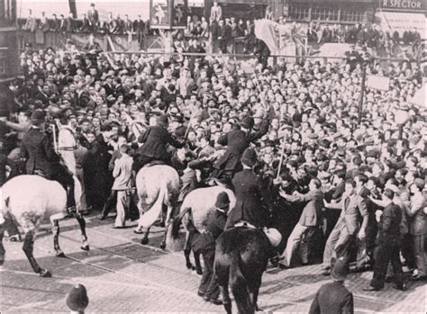
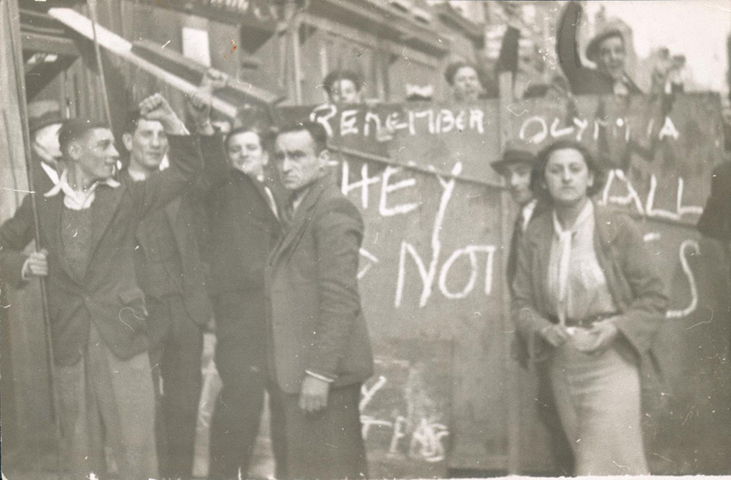
2
3
1
4
6
5
What are your immediate reactions to these images?
Are they connected in any way? In what ways?
7

Slide 3
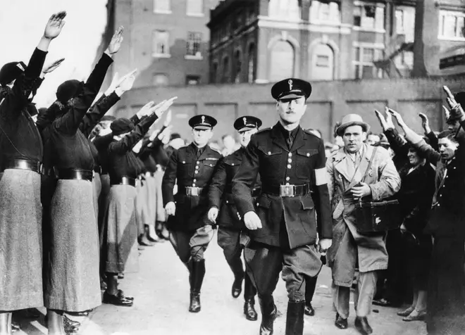
Who were the BUF? Why did they have support?
What conditions might make people support extreme political movements?

Slide 4
Challenging Histories
Guiding principles for good historical learning:
  To be conscious that we each have a unique perspective based on our own circumstances, but that nobody has more, or less, importance in this class.
  To let the facts inform you and lead your learning, rather than finding facts to support a prior viewpoint.
  Avoid the use of terms like ‘we’ to refer to historical figures and peoples – as historians it is necessary to be impartial, so language is important.
    i.e. refer to ‘the British’ rather than ‘we’. This helps to separate ourselves from the study and avoids unintentional othering or subconscious bias.
  Accept that interpretations and feelings about what we study can and will differ. This is ok!
  Discussion should be based on the facts. Use evidence to support your points to avoid making unfair or inaccurate assertions.
Notes:
Ask for an explanation of what we mean by ‘othering’ and ‘subconscious bias’.

Slide 5
A shared space for learning
To make the class respectful, fair, inclusive, kind and supportive, we will:
Listen to one another without interrupting
Ensure that everyone in the class has a chance to have their say
Avoid using language which might hurt other people
Ask questions and give our views, knowing that others won’t judge

Slide 6
Classroom Expectations
We are studying racism, antisemitism and fascism and these can be controversial topics.
  Nobody is expected to defend discriminatory views.
  We study historical beliefs to understand the past.
  Challenge ideas respectfully.
Terminology:
Fascism - Extreme political system with strong authoritarian control.
Antisemitism - Prejudice, hostility, or discrimination against Jewish people.
Democracy - Government where people choose their leaders.
Propaganda - Information used to influence people's beliefs.
Extremism - Holding or promoting extreme political views.

Slide 7
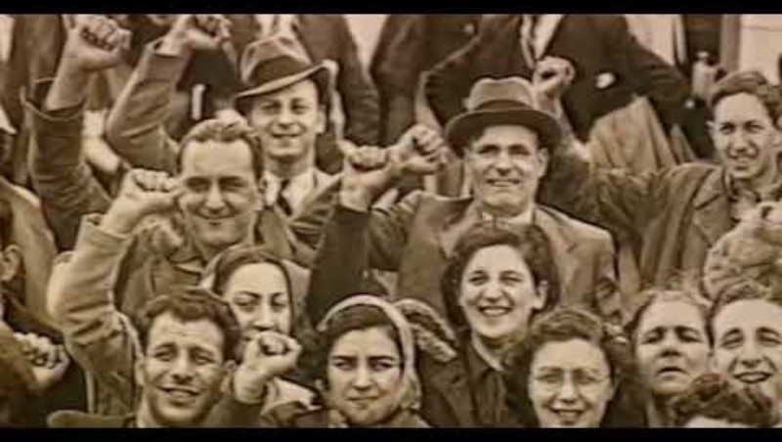
EMBEDDED VIDEO (5 minutes)

Slide 8
Think-Pair-Share
Question:
How might unemployment and poverty affect people's political choices?
Think individually
Discuss with partner
Share with class
Complete Task 1 on your worksheet

Slide 9
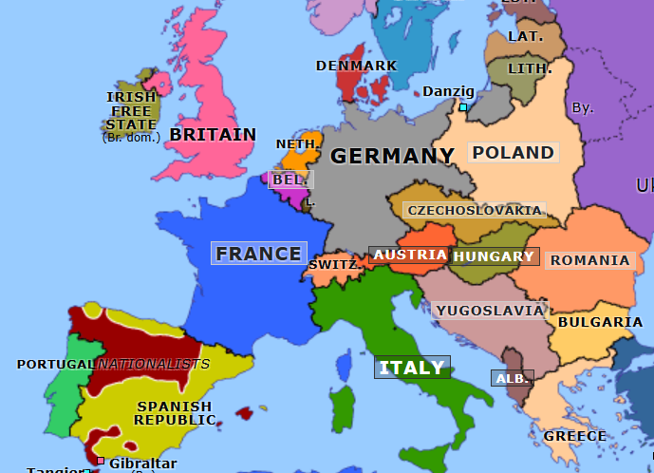
Fascist Governments

Slide 10
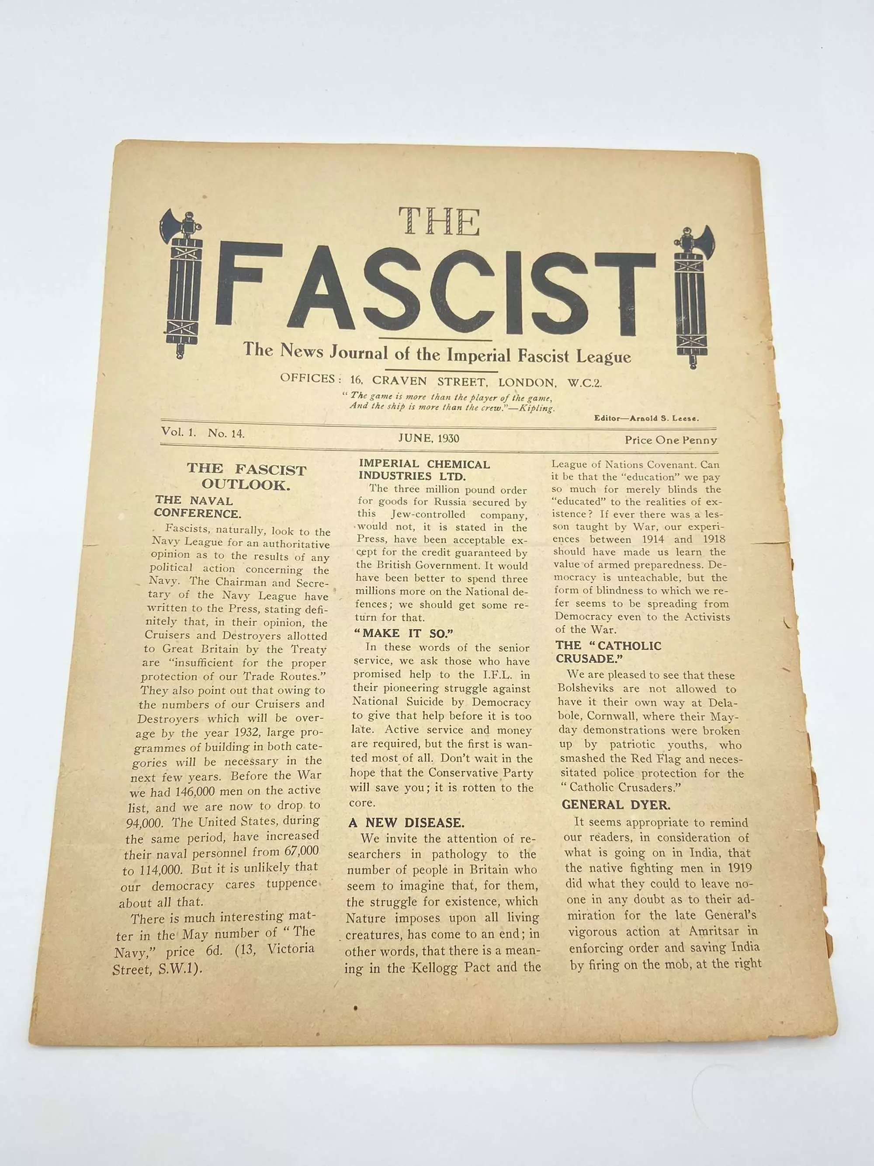
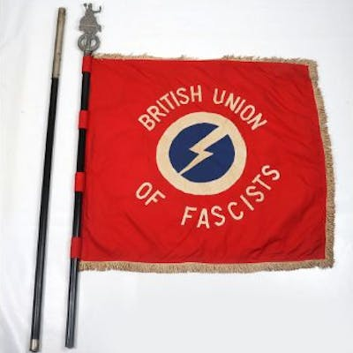
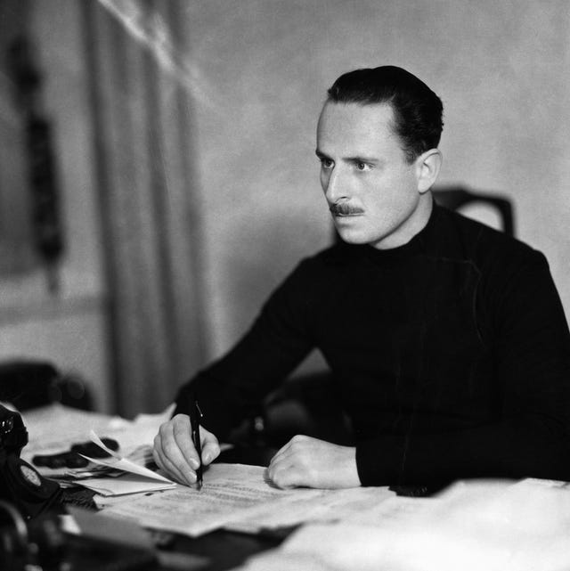
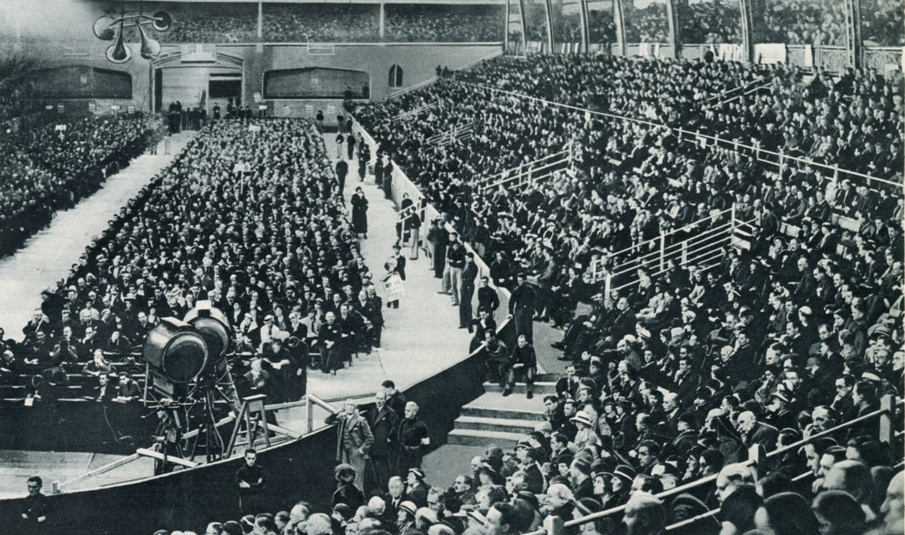
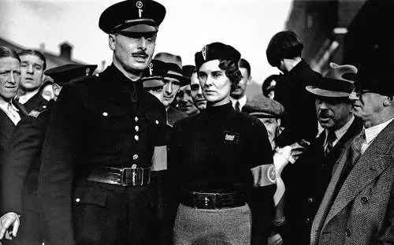
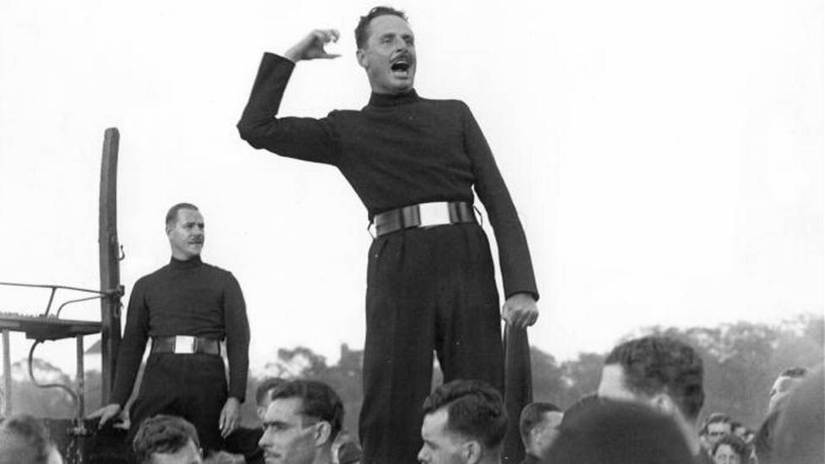
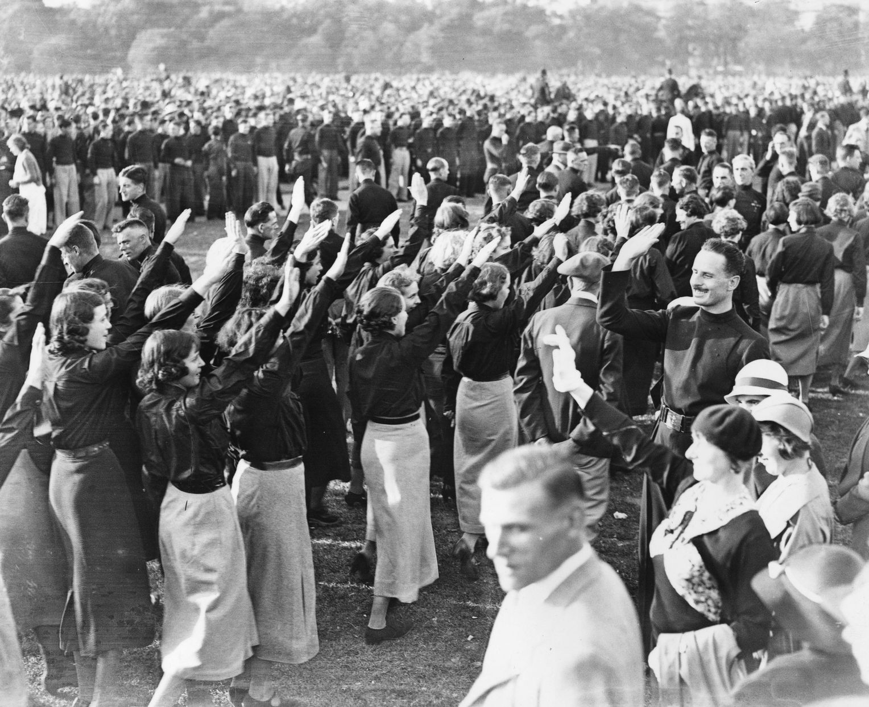
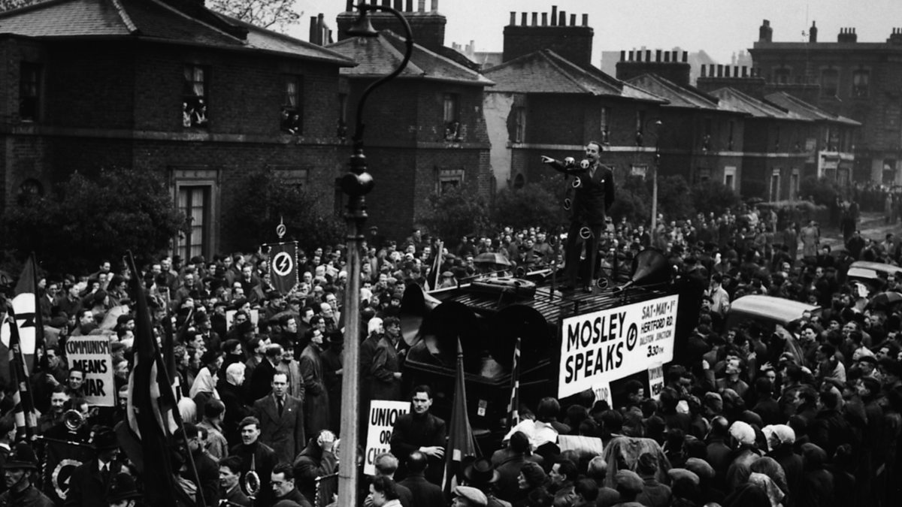
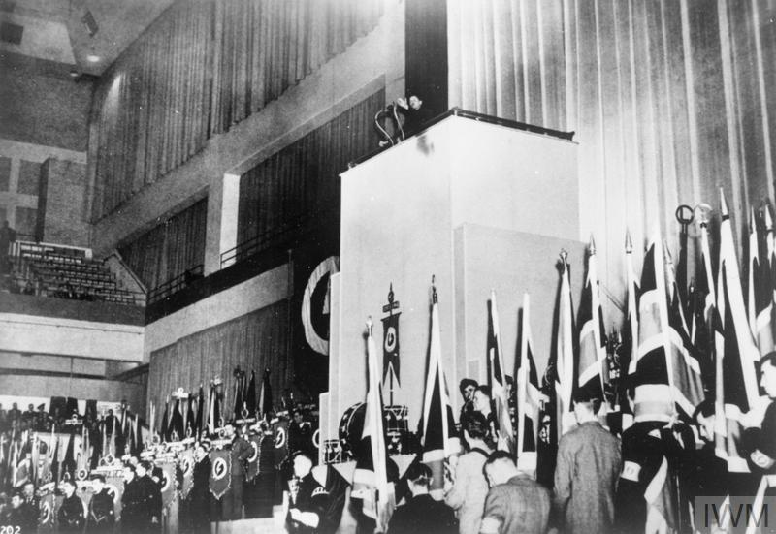

Slide 11
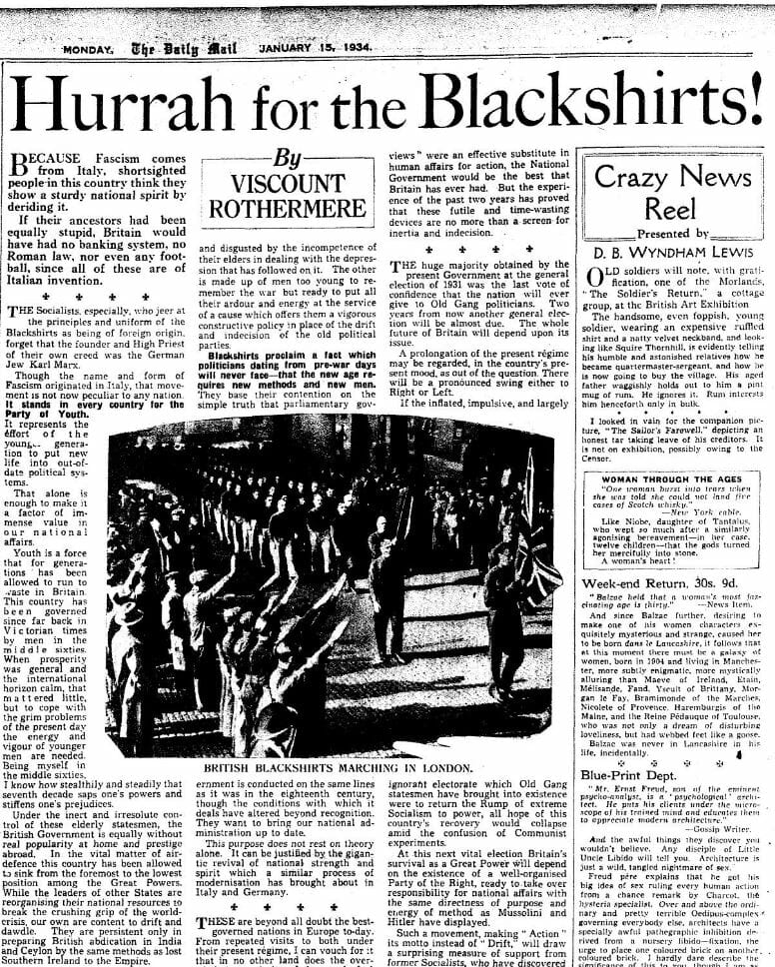
Source Investigation
Source A (Primary)
"Hurrah for the Blackshirts" (Daily Mail January 15th, 1934)
Questions
What message does this headline send?
Why might newspaper support matter?
Does this surprise you?
Complete Tasks 2 & 3 on your worksheet

Slide 12
Source Investigation
Sources B – F (Primary)
Questions
What are the reasons given for joining the BUF?
Why might these sources from ordinary members be more useful in explaining why people joined the BUF than a source from Mosley would be?

Slide 13
Why did some people support the British Union of Fascists in 1930s Britain?
Give:
One economic reason
One political reason
One social reason
Which factor do you think is the most important? Explain

