Slide 1

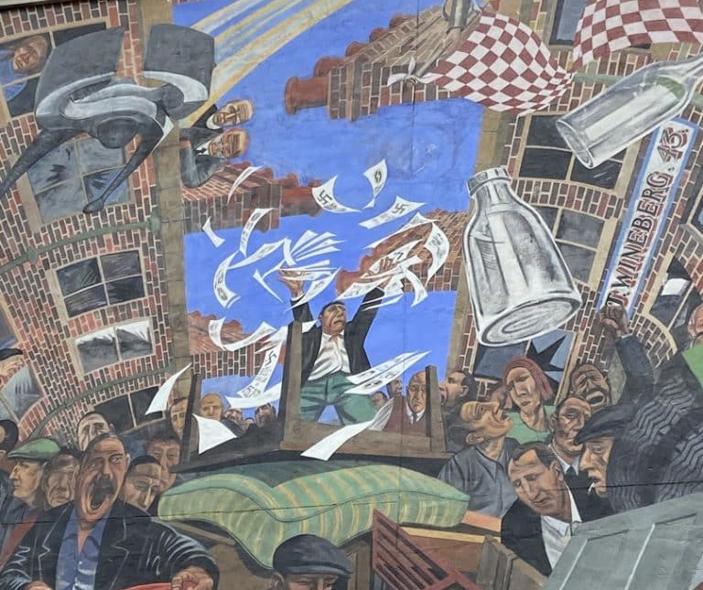
The Battle of Cable Street: Antisemitism & Extremism in the UK
Why did the British Union of Fascists choose to march through the East End?
Why did people disagree so strongly about how to respond?

Slide 2
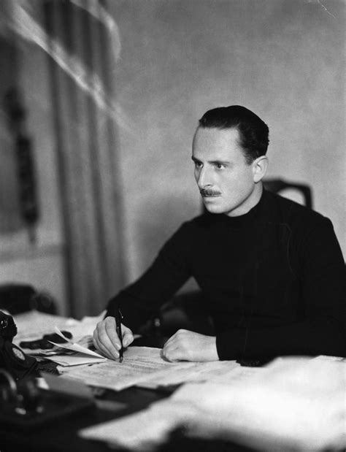
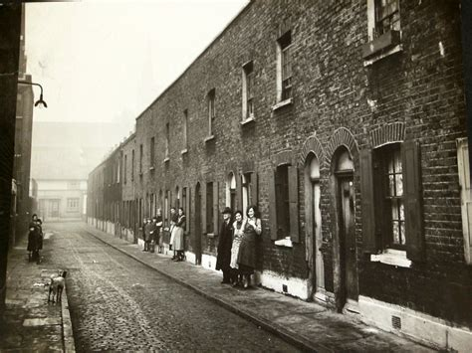
What Do You Remember?
Who founded the BUF?
Why did people support the BUF?
What was fascism?
Why was East London important to the BUF?

Slide 3
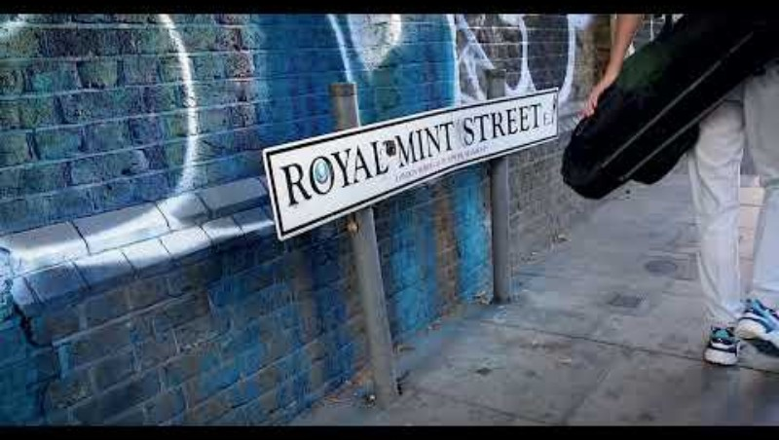
EMBEDDED VIDEO (5 minutes)

Slide 4
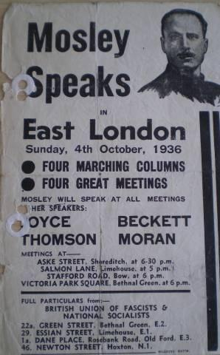
Source Analysis
Sources A & B: BUF March Announcement
Questions:
Where was the march due to begin?
Which areas would it pass through?
The BUF was founded in Chelsea (West London) and its headquarters was in Westminster (Central London). Is there anything in these sources which suggest why the march was planned for East London?

Slide 5
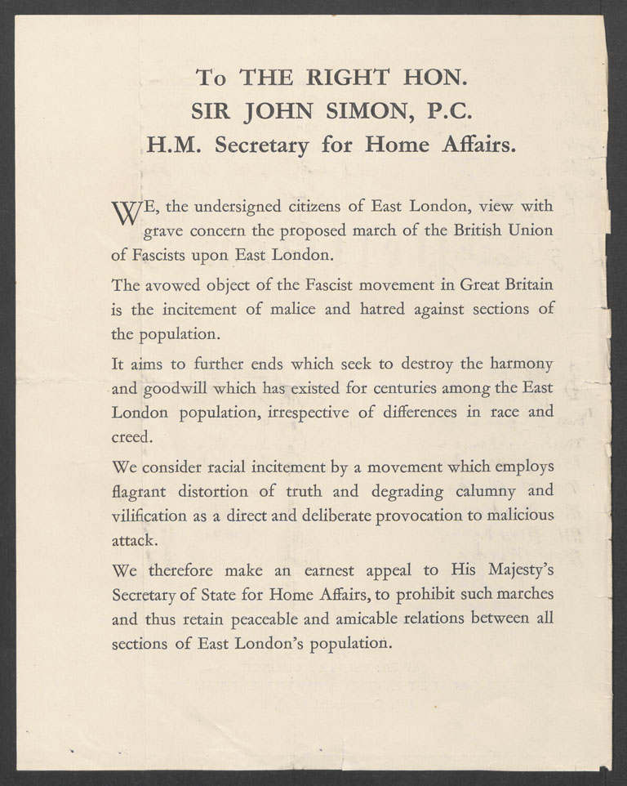
“grave concern”
Source Investigation
Source C (Primary)
Petition organised by the Jewish People’s Council against the BUF march, signed by 100,000 East Londoners in two days
“The avowed object of the Fascist movement in Great Britain is the incitement of malice and hatred against sections of the population.”
Questions
Who produced this source?
Why was it written?
What concerns did local people have?
What does this source tell us about support for the BUF?

Slide 6
Everyone Agreed the BUF Were Dangerous... Right?
What were the different responses?
Although most people and organisations opposed the British Union of Fascists there was considerable disagreement over what should be done.
As we talk through the following slides, you may wish to add notes to the table on Task 3 of your worksheet. You will add more using Sources D – G.

Slide 7
Everyone Agreed the BUF Were Dangerous... Right?
People often assume everyone opposed the BUF in the same way, but responses varied significantly.
Board of Deputies of British Jews
Labour Party
Independent Labour Party (ILP)
Believed Jews should stay away from direct confrontation. Feared violence. Wanted legal solutions.
Opposed fascism and antisemitism. Discouraged participation in direct confrontation. Preferred political campaigning and democratic methods. Believed large street clashes could help Mosley gain attention.
Strongly opposed fascism. More willing than the Labour Party to support direct anti-fascist action. Many members joined demonstrations and local campaigns against the BUF. Believed fascism had to be actively resisted.

Slide 8
Everyone Agreed the BUF Were Dangerous... Right?
People often assume everyone opposed the BUF in the same way, but responses varied significantly.
Communist Party (& Young Communist League)
Home Office &
Home Secretary
Metropolitan Police
Advocated mass mobilisation against the BUF. Organised demonstrations, leafleting, protests and the opposition at Cable Street. Argued that fascism should be confronted directly in the streets.
Primary concern was maintaining public order and to avoid major disturbances and political violence. Refused demands to ban Mosley's march. Preferred policing and legal regulation rather than supporting either side.
Had to maintain order and protect the BUF's legal right to march. Clashed repeatedly with anti-fascist protesters. Saw their role as enforcing the law rather than taking sides.

Slide 9
Plenary: Diamond 9
Antisemitism
East End poverty
BUF publicity strategy
Fear of violence
Government decisions
Press coverage
Jewish community concerns
Anti-fascist organising
Location of the route
Task
Rank the reasons the march became controversial, placing them in a diamond shape, with the most important reason at the top, down to the least important at the bottom.

