Slide 1

Challenging Histories
Guiding principles for good historical learning:
  To be conscious that we each have a unique perspective based on our own circumstances, but that nobody has more or less importance in this class.
  To let the facts inform you and lead your learning, rather than finding facts to support a prior viewpoint.
  Avoid the use terms like ‘we’ to refer to historical figures, peoples – as historians it is necessary to be impartial, so language is important.
    i.e. refer to ‘the British’ rather than ‘we’. This helps to separate ourselves from the study and avoids unintentional othering or subconscious bias.
  Accept that interpretations and feelings about what we study can and will differ. This is ok!
  Discussion should be based on the facts. Use evidence to support your points to avoid making unfair or inaccurate assertions.

Slide 2
A shared space for learning
To make the class respectful, fair, inclusive, kind and supportive, we will:
Listen to one another without interrupting
Ensure that everyone in the class has a chance to have their say
Avoid using language which might hurt other people
Ask questions and give our views, knowing that others won’t judge

Slide 3
Starter: Think | Pair | Share
Listen to the pen portrait of an historical world leader.
Consider the following questions and add notes to your handout:
  How would you describe this person?
  Is this a leader a country should be proud of?
  How do you think they might be remembered?
  Would you support this person?

Slide 4


Pen Portrait A
  How would you describe this person?
  Is this a leader a country should be proud of?
  How do you think they might be remembered?
  Would you support this person?
This person was born into a wealthy family and attended private schools as a child, before going on to Officer training school. He became a soldier before working as a journalist and writing many books. He became an MP at age 26 and would serve for over 60 years in parliament. He criticised British forces behaviour in the colonies, where he had fought. He championed the rights of prisoners at home and reformed prisons to be more humane. He helped create what we call the modern welfare state, through supporting unemployment and sickness insurance, labour exchanges (early job centres) and support for a fairer society for workers. He married age 23 and had five children. He was supportive of women’s suffrage. He was a keen amateur painter and also enjoyed horse riding and brick laying. He believed in democracy and that people should be free. He vocally opposed Britain’s approach to tyrannical leaders abroad when others did not. He led his country to victory in war. He was a very popular war leader, particularly known for rousing speeches which inspired support. He developed strong diplomatic relationships with key allies. He believed that Europe needed to be united in order to secure peace for the future. He was known for being confident in his ability to lead.

Slide 5
Pen Portrait B
  How would you describe this person?
  Is this a leader a country should be proud of?
  How do you think they might be remembered?
  Would you support this person?
This person was born into a wealthy family and attended private schools as a child, before going on to Officer training school. By age 26 he had fought in three wars , worked as a war correspondent for British newspapers, and written five books. He became an MP and would serve for over 60 years in parliament, despite switching parties several times – a move for which he suffered a lot of criticism. He believed that Britain's colonies should not gain independence to rule themselves, they should be ruled over by Britain despite huge cost to local populations. He took up flying, and was an advocate of this new technology for national defence. He believed people of colour were less able than white and English-speaking people and has since been referred to as a white-supremacist. He voted against women’s suffrage in parliament, going against his wife’s own wishes. He called in the army to break miners strikes and edited a national newspaper which condemned workers claims for better rights. As a war leader he depended on the support of other countries. He was considered by some to be arrogant and self-serving. His numerous books have chronicled significant aspects of British history, many of which he lived through, with some suggesting he wrote his books in order to present himself as more important that he might have actually been.

Slide 6
Pen Portrait reflections
Pen Portrait A | Pen Portrait B
Does this sound like a good leader to you? Why? | Does this sound like a good leader to you? Why?

Slide 7
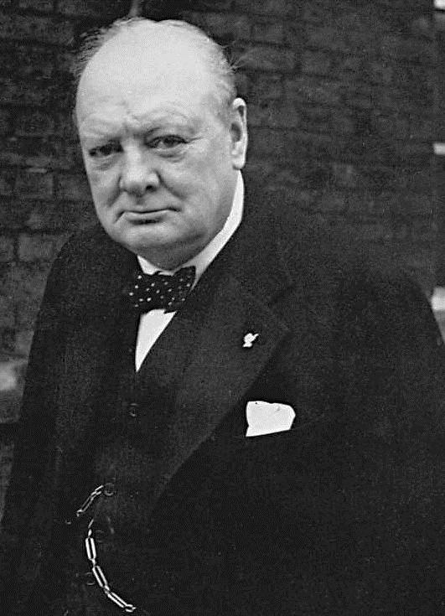
Enquiry Question:
How did Churchill shape modern Britain?
Lesson Title:
How should we characterise Sir Winston Churchill?

Slide 8

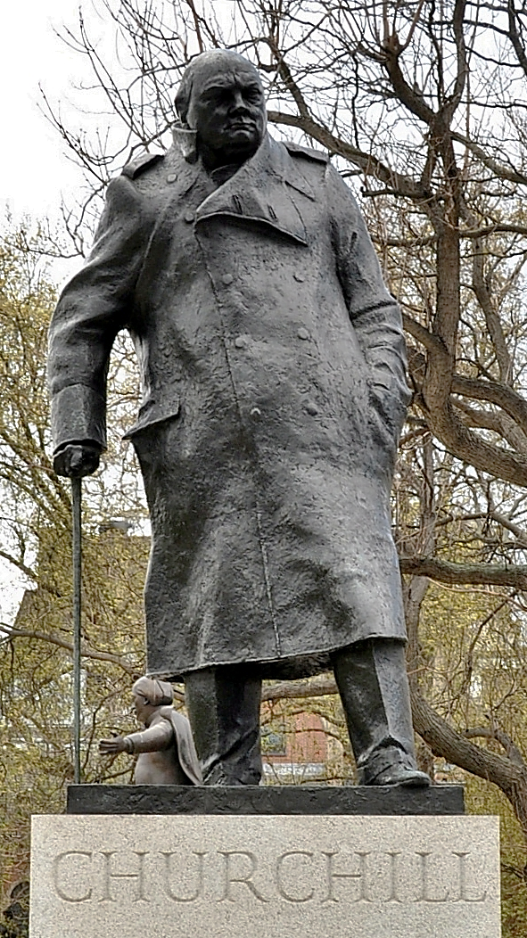
What do you know about Churchill?
What do you know about him?
Why is there a statue of him in front of the House of Parliament?
What does this mean for our understanding of Britain and Britishness?

Slide 9
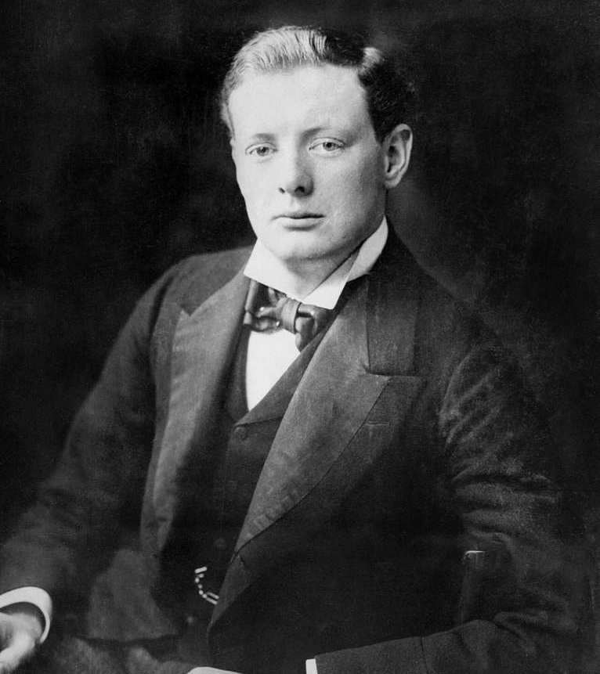
Churchill’s Early Life
Watch the following video about Churchill’s early life.
Add to your mind map as you listen, writing down anything you can about how you think Churchill’s upbringing might have shaped his life and the way he thought about the world.
Consider questions such as:
  What kind of family did he come from?
  Was he a good student?
  What jobs/careers had Churchill had by 1900?
  Who were the major influences in his upbringing?
  What key ideas about the world were being formed at this time?
  What were his main interests?
Why do you think Churchill’s early life could be considered unusual?

Slide 10
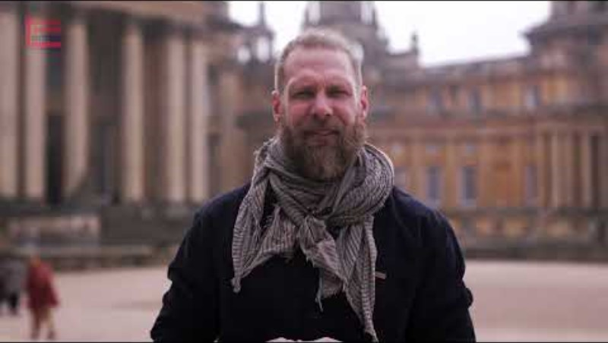

Slide 11
Churchill’s Early Life
  What kind of family did he come from?
  Was he a good student?
  What jobs/careers had Churchill had by 1900?
  Who were the major influences in his upbringing?
  What key ideas about the world were being formed at this time?
  What were his main interests?

Slide 12
How should we characterise Churchill?
In the Starter activity we heard two descriptions of Churchill.
Why do you think they might be so different?
Now look at the following evidence. Each piece of evidence links to one of the following themes:
  Empire
  Women
  Workers
  War
  Leadership
Can you identify the theme of each piece of evidence?
For each of the following statements write on your mini white board which theme it links to.
Challenge Question: What does the evidence this tell us about Churchill?

Slide 13

Women
Empire
In 1906, when criticizing the ‘chronic bloodshed’ caused by British punitive raids in West Africa, it was he who sarcastically wrote: “the whole enterprise is liable to be misrepresented by persons unacquainted with Imperial terminology as the murdering of natives and stealing of their lands”.
Richard Toye, Churchill’s Empire.
Workers
Leadership
War

Slide 14
Women
Empire
His 1953 statement, “Wherever it had grown, British imperialism had meant steady progress for the masses of the people and the establishment and enforcement of just laws.”
Richard Toye, Churchill’s Empire.
Workers
Leadership
War

Slide 15
Women
Empire
“…what is the general cause in society of poverty among able-bodied persons?... Why should such a noble creature as man live under injustice …?”
Churchill
Churchill: His Radical Decade, Malcolm Hill
Workers
Leadership
War

Slide 16
Women
Empire
The bitterness towards Churchill, which has been passed down the years, stems from the fact that the troops’ presence made picketing impossible, and effectively broke the strike. It stuck in the craw of the miners that a Liberal government would use the army to side with pit owners over the workers.
Churchill as Home Secretary, Charles Stevenson
Workers
Leadership
War

Slide 17
Women
Empire
I am, however, anxious to see women relieved in principle from a disability which is injurious [harmful] to them whilst it is based on grounds of sex.” - Churchill
Churchill as Home Secretary, Charles Stevenson
Workers
Leadership
War

Slide 18
Women
Empire
Clementine (Churchill’s wife) was in favour of female suffrage and.. she was ‘very angry and disappointed in her husband’s attitude’
Churchill as Home Secretary, Charles Stevenson
Workers
Leadership
War

Slide 19
Women
Empire
Clement Attlee, the Prime Minister from 1945-51 said that “Churchill was the greatest leader in War this country has ever known.”
Professor Sir Vernon Bogdanor
Workers
Leadership
War

Slide 20
Women
Empire
From the first to the last days of his premiership, the link to the United States was central to Churchill’s war policy. He spent more time and energy in seeking to obtain help from the United States than in any other endeavour.
As WWII progressed Britain’s position as a global power weakened.
Continue to Pester, Nag and Bite: Churchill’s War Leadership. Martin Gilbert
Workers
Leadership
War

Slide 21
Women
Empire
"He was the greatest Briton because he showed the determination and courage to protect Britain from invasion and without his inspiring leadership the outcome of World War II may have been very different. He was the choice of the people."
Mo Mowlam MP (2002)
Workers
Leadership
War

Slide 22
Women
Empire
A commentator in 1907 had opined that: ‘He… has never pretended to be animated by any motive beyond a desire for his own advancement. He has no principles and no enthusiasm except egoism. ’
‘History will be kind to me , for I intend to write it’ - Churchill
Churchill as Home Secretary, Charles Stevenson
Workers
Leadership
War

Slide 23
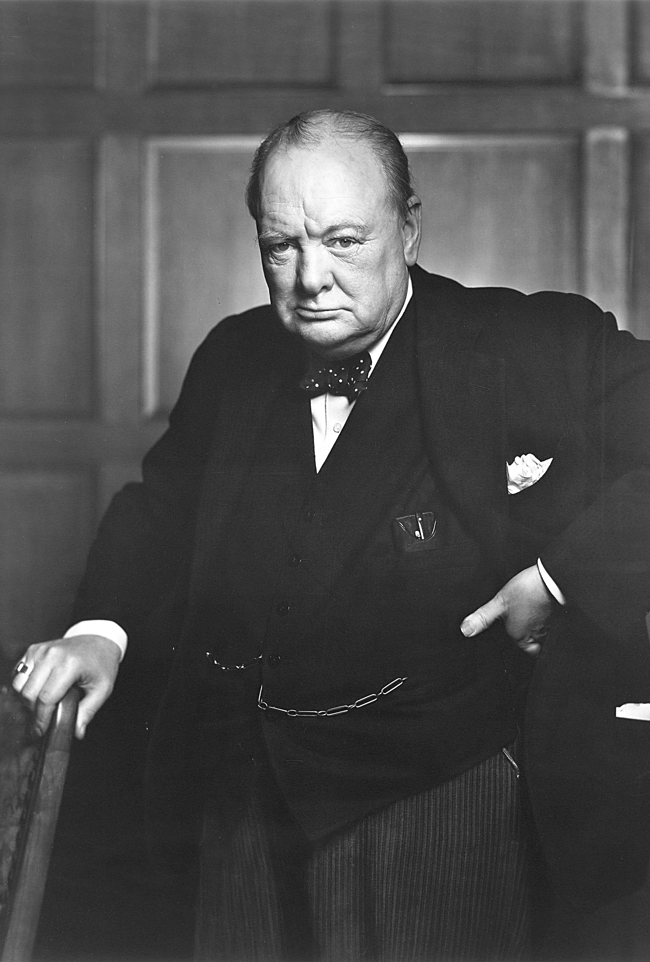
Summary: How should we characterise Churchill?
Discuss the following questions with your partner and be ready to share your thoughts (use evidence to support your answers):
  Having looked at some evidence, how would you characterise Churchill?
  How has your knowledge developed during this lesson?
  Has this changed since the start of the lesson?
  Is it possible to describe Churchill in a simple way?
Concluding question: Is it useful to describe Churchill as a hero or a villain? Be ready to give reasons for your answer.

