Slide 1


Starter: Connecting thinking
‘There were so many Winston Churchills. This baffled his contemporaries and often inspired their mistrust; it has caused historians and his biographers' comparable problems… some of these multiple, and overlapping, identities: ‘politician, sportsman, artist, orator, historian, parliamentarian, journalist, essayist, gambler, soldier, war correspondent, adventurer, patriot, internationalist, dreamer, pragmatist, strategist, Zionist, Imperialist, monarchist, democrat, egocentric, hedonist, romantic… the list seems endless.’
  Churchill as Home Secretary, Charles Stephenson
Does this seem like an accurate summary to you?
What other words might you use to describe him?
What does a statement like this add to your understanding?
What questions would you like to ask?

Slide 2

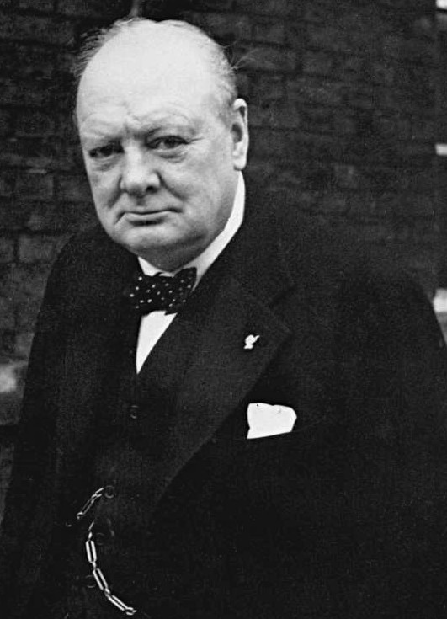
Enquiry Question:
How did Churchill shape modern Britain?
Lesson Title:
What was Churchill’s role in British History?

Slide 3
What stands out in Churchill’s career?
In groups, look at the timeline of Churchill’s life from 1900.
What are your initial impressions?
Now read the timeline again. This time each member of the group will look for a specific theme as you read together.
  Political roles and offices
  Social issues
  War and diplomacy
  Empire
Highlight the timeline with a different colour for each theme. You may want to highlight some entries with more than one colour.

Slide 4
What stands out in Churchill’s Career?
Group feedback
Look at the highlighting on your timeline.
What do you notice?
  Are there periods where one issue is more important than others?
  What does the timeline suggest were Churchill’s main priorities?
  How does what the timeline portray Churchill?

Slide 5
Putting it all together
Based on what we have looked at today and last lesson, how would you summarise Churchill?
  His upbringing
  His career
  His priorities and beliefs
What can we hypothesise about Churchill’s impact on British history from looking over his whole career?
Challenge: How did Churchill shape modern Britain?

Slide 6
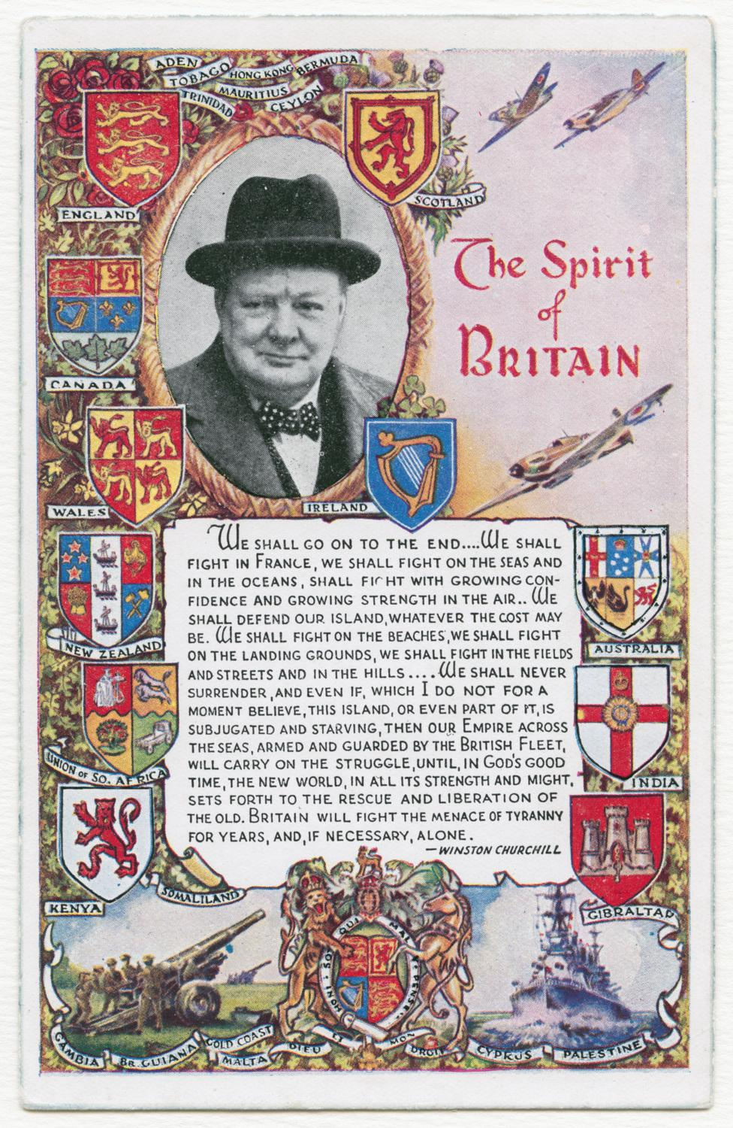
How did Churchill shape modern Britain?
In 2020 Churchill College, Cambridge hosted a panel discussion to discuss the legacy of Churchill in the 21st century. They said:
  ‘Sir Winston is often presented as the embodiment of WWII and the UK’s identity, and so to some extent, to critically reassess Churchill is to critically reassess a nation’s identity.’
  Churchill College, Cambridge, 2020

Slide 7
How did Churchill shape modern Britain?
By looking at key events in the life of Churchill, we are looking at key events in British history, so how we reflect on how the two can be similar.
At the end of the unit, we will consider how this history helps us to understand our present, and how we might want to respond to what we have learned.
As we work through the next few lessons consider how we can see the echoes of the past in the world in the present to see how Churchill and the events he was connected to shaped the country we live in today.
Which aspects of today’s learning do you think are relevant today and why?

