Slide 1

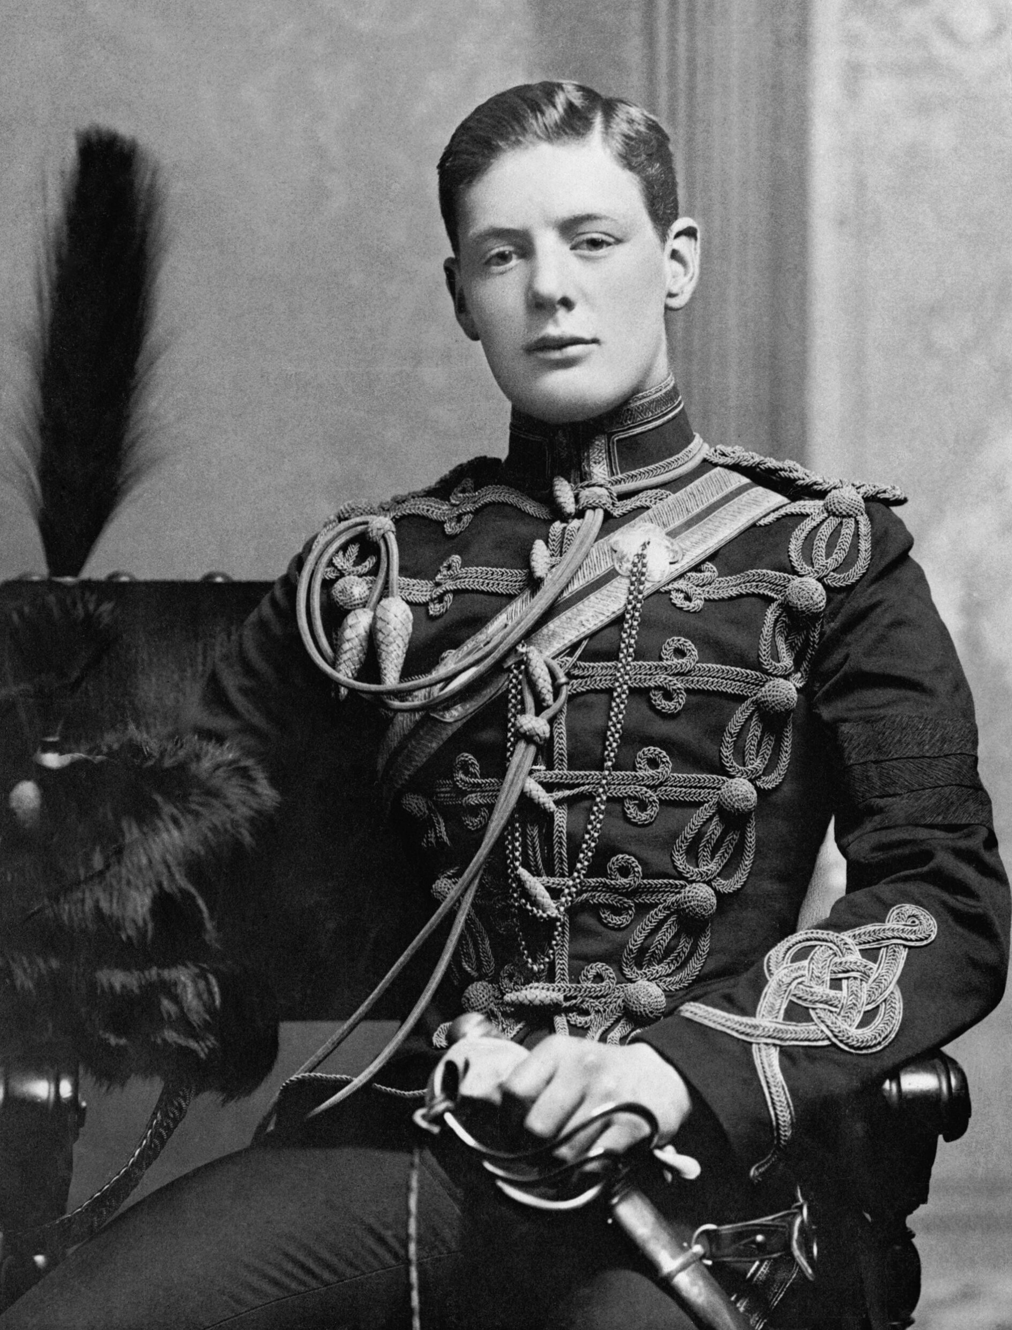
The British Empire: Think | Pair | Share
What can you infer from this song about British attitudes to its empire?
Does it surprise you that Churchill sung this song whilst he was on military duty in India in 1896?
Great White Mother,
far across the sea,
Ruler of the empire,
may ever she be,
Long may she reign,
glorious and free
In the Great White
Motherland
Military officer’s song, late 19th century.

Slide 2

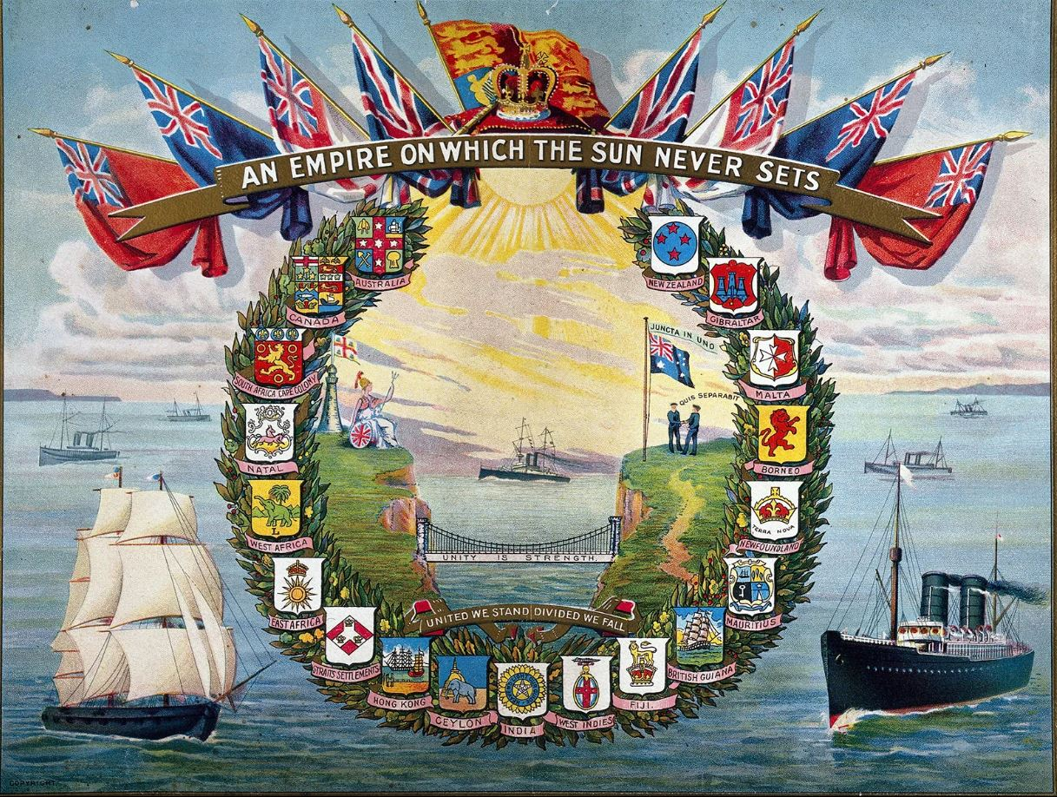
Enquiry Question:
How did Churchill shape modern Britain?
Lesson Title:
Churchill, Britain, and the empire
Could the Bengal Famine have been avoided?

Slide 3


Slide 4
The British Empire
Size and scale
Why was it important for Britain?
What was Churchill’s view?
Why did the Empire come to an end?

Slide 5
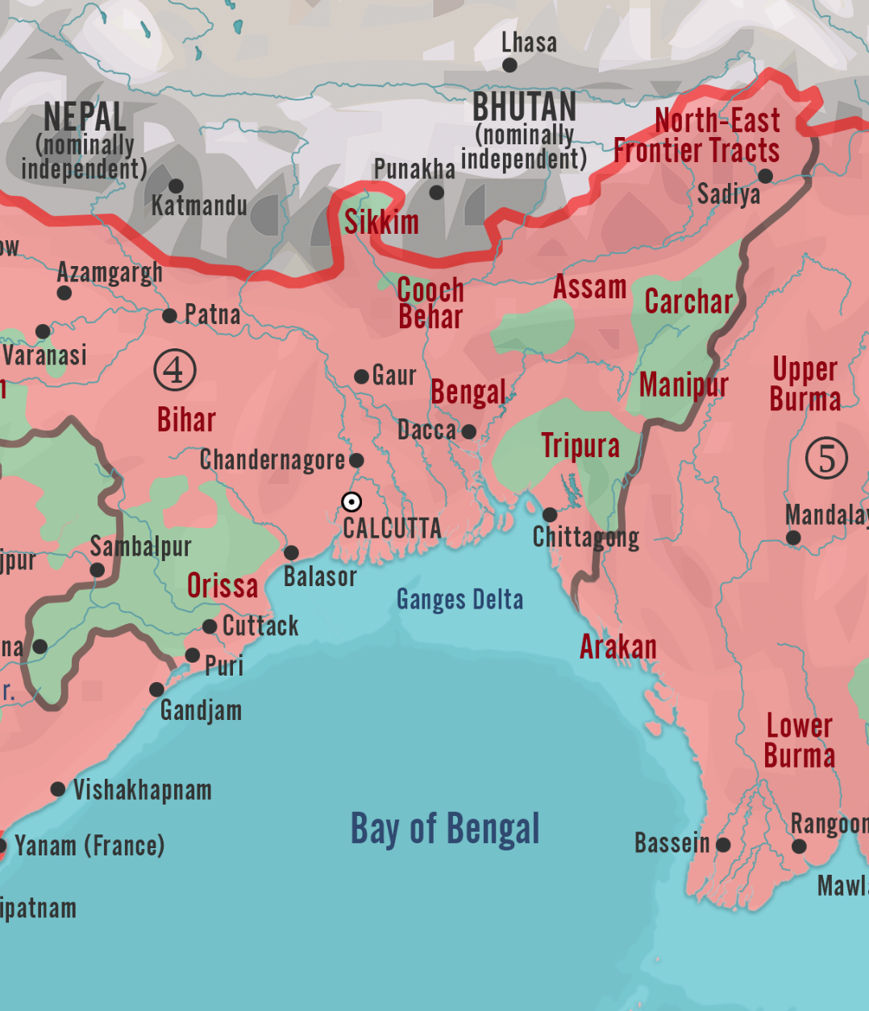
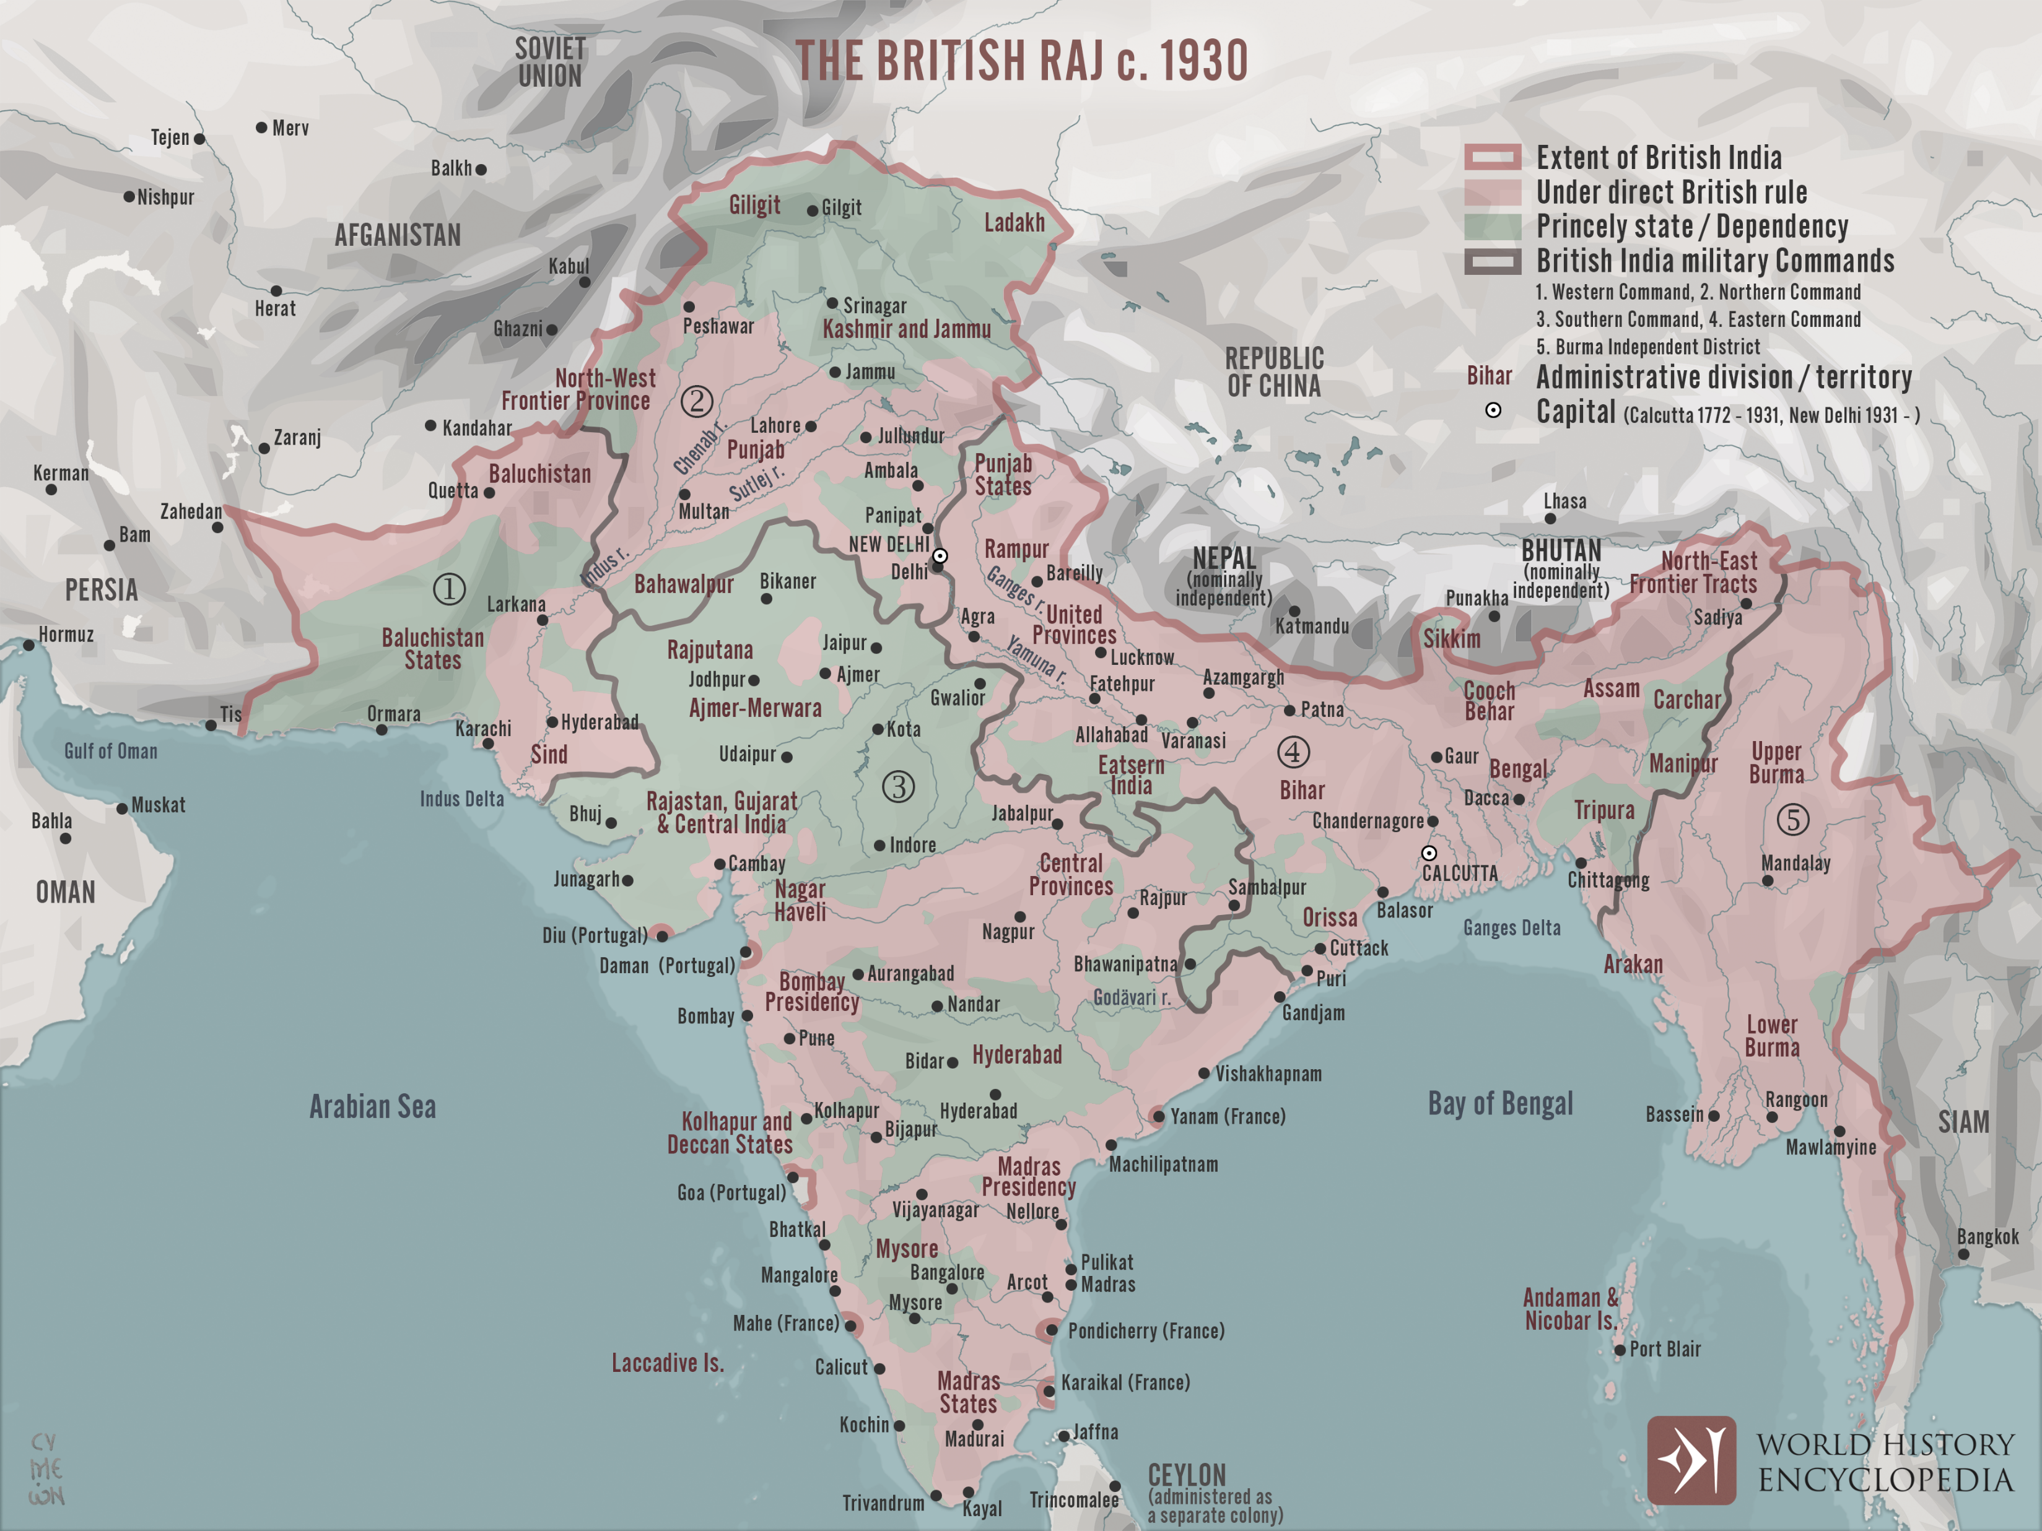
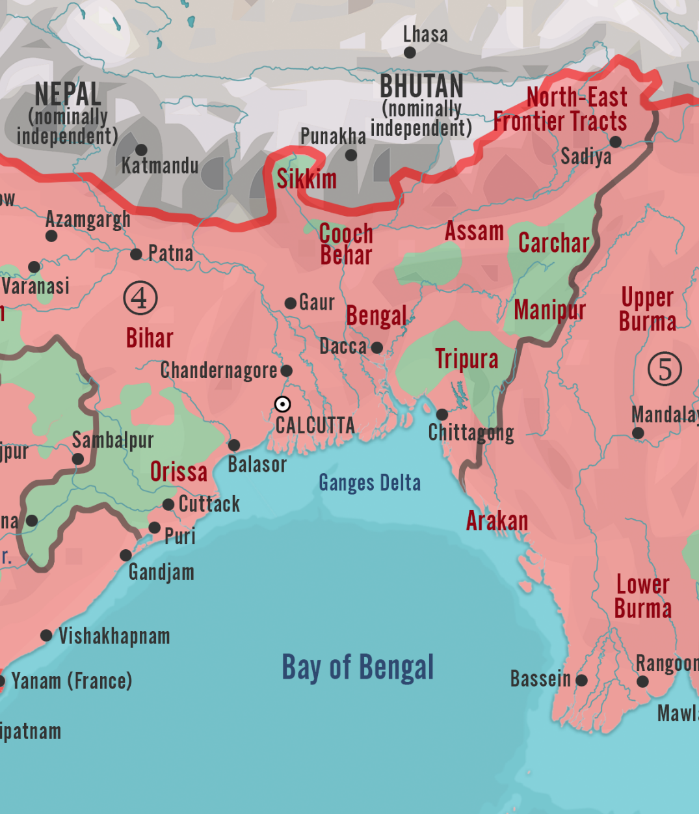
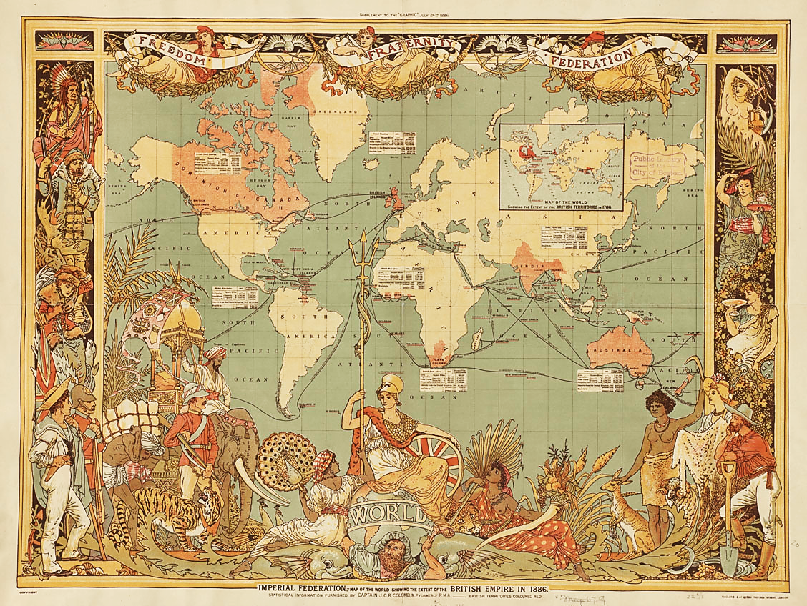
Bengal Region
The British Raj c.1930

Slide 6
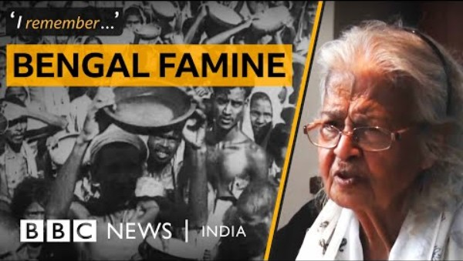
Activity
Watch the following video
Add answers to your sheet as you watch
Notes:
https://www.youtube.com/watch?v=amV_XKaiTKE

Slide 7
The Bengal Famine
How old was Zebunnessa when the famine happened? | How does Zebunnessa describe the famine? | How does Zebunnessa describe the famine? | Did all people experience the famine the same way? Why not?
When did the Bengal Famine Happen?
Did British soldiers in India suffer from the famine? | Why did some people respond by going on anti-British marches? | What did Zebunnessa’s granddaughter say she knew about the Bengal Famine? | What did Zebunnessa’s granddaughter say she knew about the Bengal Famine? Why might this be significant?

Slide 8
What was the Bengal Famine?
Key Facts
A famine in the Bengal Province of the British Raj (present-day Bangladesh, West Bengal and eastern India) during World War II.
It is estimated that over 3 million people died, from starvation, malaria and other diseases aggravated by malnutrition, population displacement, unsanitary conditions and lack of health care.
Millions were impoverished as the crisis overwhelmed large segments of the economy and catastrophically disrupted the social fabric.

Slide 9
Causes of the Bengal Famine
Bengal Famine
Trade Barriers
Denial Policies
Refusal of imports
Japanese Invasion of Burma
Natural Disasters
Activity:
Read the information sheet about each cause and complete your table.
Once you have completed the table, consider the relative importance of each factor.
  1=not important, 5=very important
  Think about the ‘when’ as well as the ‘what’!
  Weight of evidence – what are the most important pieces of evidence?

Slide 10
Causes of the Bengal Famine
Event | When? | What happened? | How did it help to cause the famine? | Rating 1 - 5
Japanese invasion of Burma
Internal Trade Barriers
Denial Policies
Natural Disasters
Refusal of Imports

Slide 11
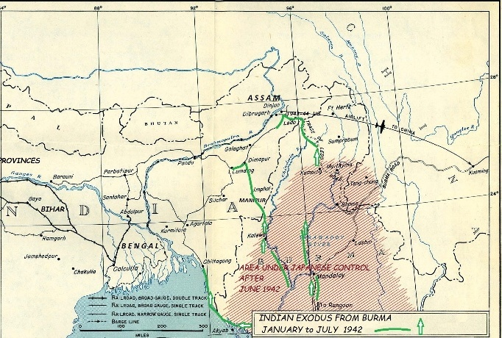
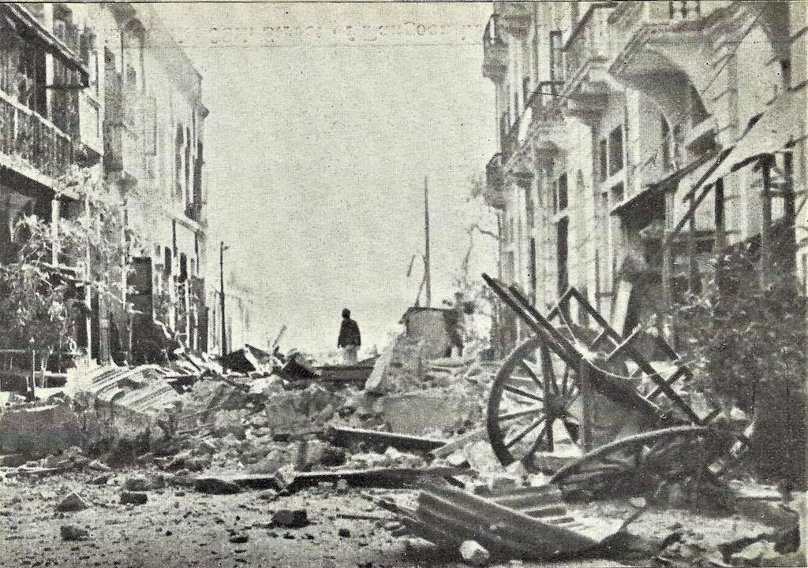
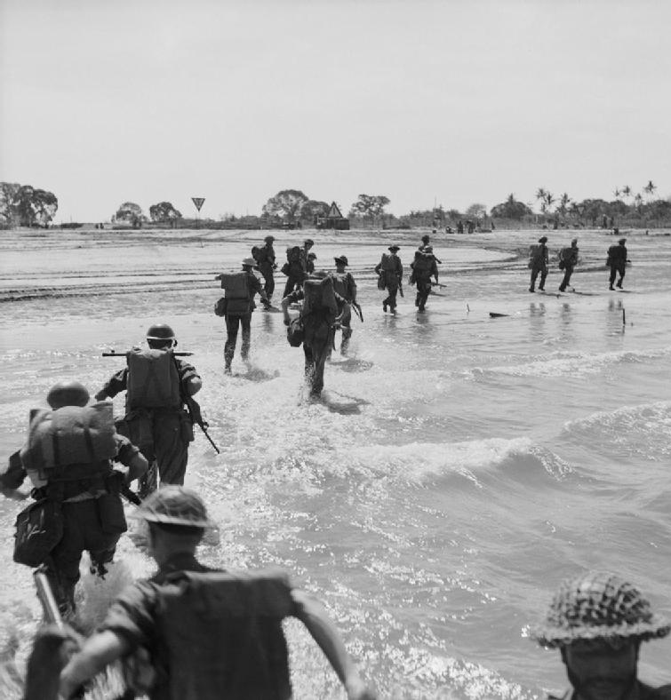
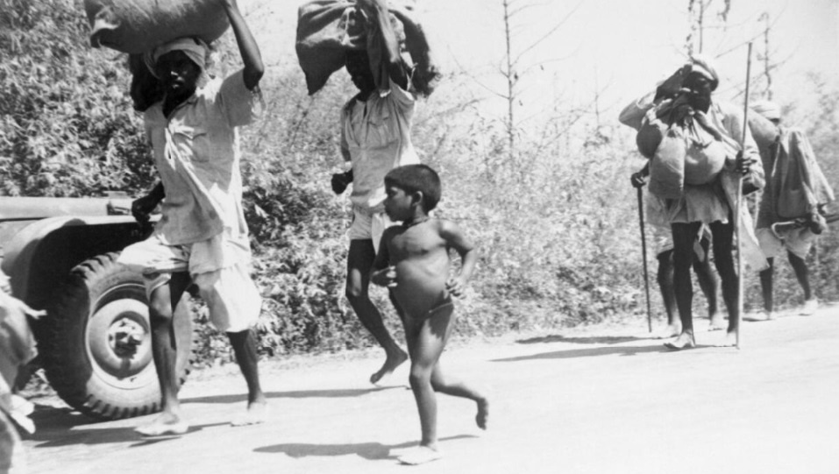
Japanese Invasion of Burma
In early 1942 Japan invaded Burma, India’s eastern neighbour.
½ million Indians who fled for their lives. This meant that there was a greater demand for food, clothing and medical aid in the Bengal region.
Living conditions were already poor for the locals.
Tens of thousands of those who had fled Burma would suffer disease and death as a result of the lack of food and hygiene.
With Japanese troops on India’s eastern doorstep, Bengal was now close to the battlefront. This meant more allied troops arriving and setting up bases. Supplies would have to be stretched even thinner, with the allied forces getting priority over the local civilian population.
India was struggling to feed its own people and could no longer import foods from the east.
Exports of rice continued to supply other parts of the British Empire.
In the first half of 1941 Bengal had imported 296,000 tons of rice, but in the same period of 1942 it would export 185,000 tons. This left a huge shortfall in stocks.
As well as limiting access to supplies for locals, prices for goods skyrocketed.
Bengal's people could not afford to eat!
As part of their invasion Japan:
sunk ships
prevented goods and food from entering Bengal that were necessary for the locals.

Slide 12
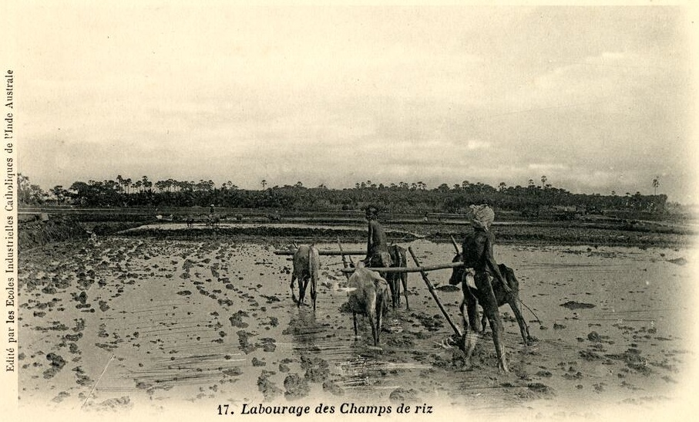
Internal Trade Barriers
Trade barriers implemented in mid-1942 restricted the movement of goods around the country.
Provinces wanted to ensure their own populations were fed, so trading of rice between regions was strictly limited.
Bengali people would have to rely on imports from abroad to feed its population.
Priority was given to the armed services, so civilians had to go without food, clothing and other essentials.
Goods became harder to get hold of.
People could not afford to buy enough food to sustain themselves and their families.
The Famine Inquiry Commission of 1945 characterised the policy of trade barriers as a failure as it prevented areas of need from being able to trade with areas of plenty. One submission to the commission stated that:
"Every province, every district, every [administrative division] in the east of India had become a food republic unto itself. The trade machinery for the distribution of food [between provinces] throughout the east of India was slowly strangled, and by the spring of 1943 was dead."
With trade stifled and very limited stockpiles of rice and grains Bengal the policy of trade barriers arguably created the conditions for famine in Bengal.

Slide 13
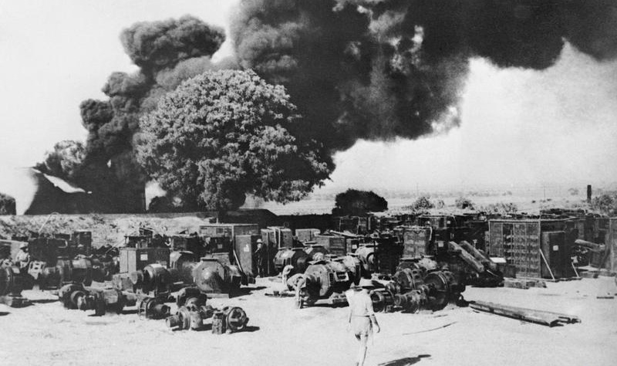
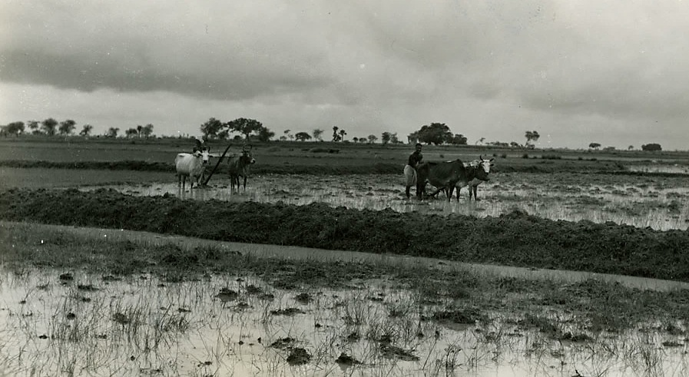
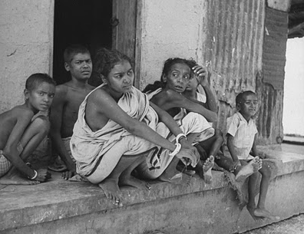
Denial Policies
Scorched Earth
In March 1942, the British military began a policy to prevent Japan from being able to benefit from India’s resources should an invasion be successful.
It denied the Japanese invaders access to any useful materials including:
  Food supplies,
  transport
  infrastructure such as boats,
  other resources
Electrical equipment at the Yenangyaung oilfields being destroyed as part of the "scorched earth" policy pursued by the British.
Rice stocks in the region were to be seized by the government, then either removed or destroyed. Furthermore, corruption amongst those in control of the buying and selling of rice meant that even more was removed than necessary. This caused unrest amongst the population as they saw their primary means of survival taken away from them and led some to hoard rice while others went without entirely.
Ploughing in a rice field
Boat Denial
The army was authorised to confiscate, relocate, or destroy any boat that could hold more than ten people, as well as bikes, bullock carts, and even elephants.
Approximately 45,000 boats were removed from Bengal.
The fishing industry was decimated
equipment could not be moved to the fields
produce could not be moved from farm to market.
Farmers, labourers, sellers and others were unable to travel and couldn’t make a living.
This angered the local population further and led to protests against the government.

Slide 14
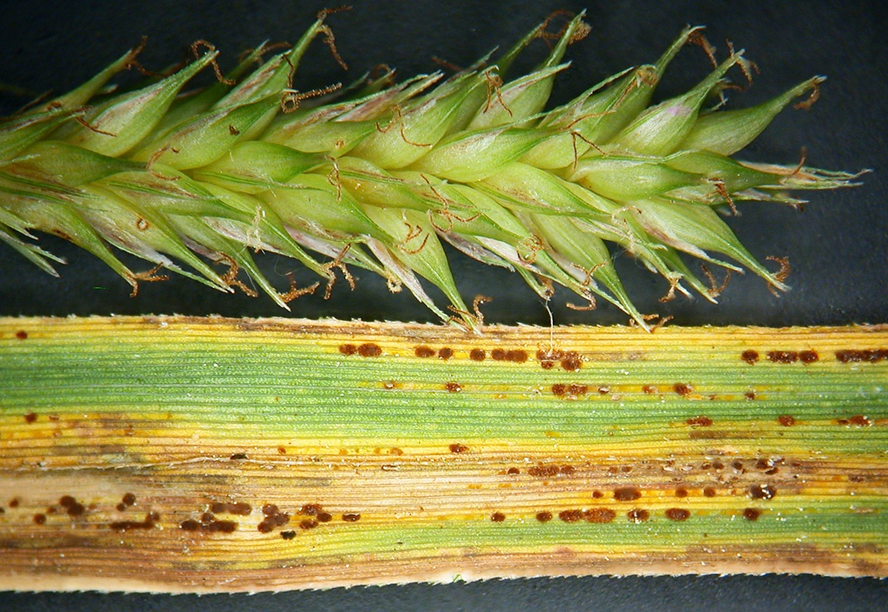
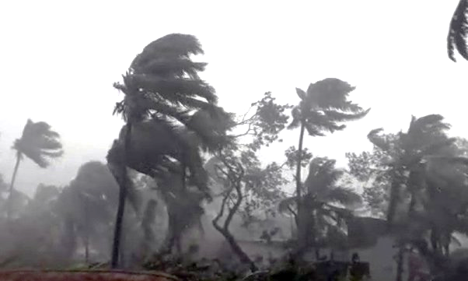
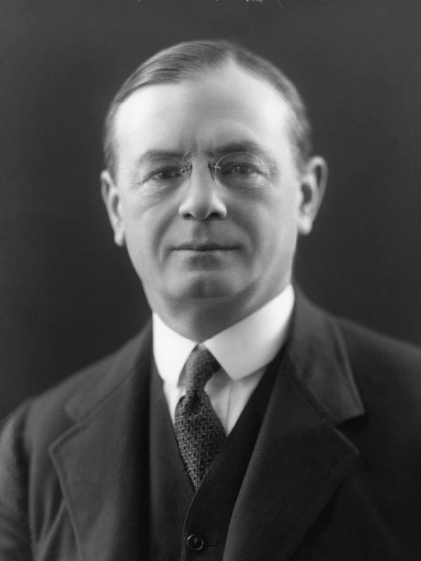
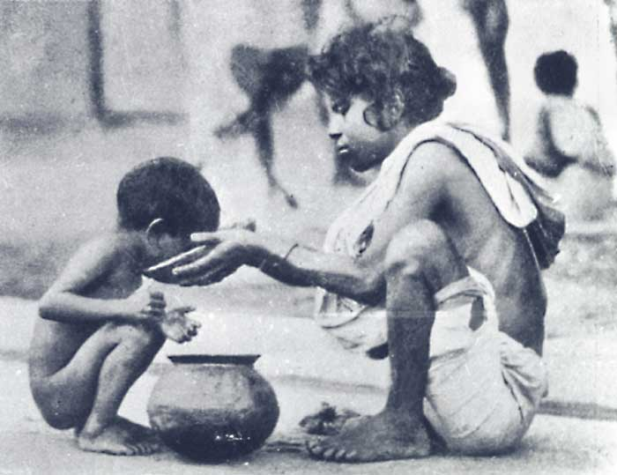
Natural Disasters
In October 1942, a series of natural disasters ravaged Bengal. A severe fungal outbreak known as Brown spot disease killed rice crops, before cyclones and storms destroyed rice fields, houses, killing around 15,000 people and over 190,000 cattle. Rice stocks were also destroyed meaning farmers, distributers, and consumers had nothing, and would be reliant on imports of food to avoid starvation conditions.
The effects of Brown Spot Disease on rice
The strong winds dispersed the crop disease causing it to affect rice fields across the region, meaning an even lower harvest.
flood defences on the coast were wiped out.
Torrential rain and flooding would damage over 3,000 square miles of land.
the rice crop of 1942 failed leaving millions without food or income
diseases such as Malaria spread more widely than usual, with deadly effect. This had a crippling effect on Bengals economy and left people jobless, homeless, and starving.
As a result of these disasters, The Government of India warned Leo Amery (Secretary of State for India) that the food shortfall was so large that:
“it will be physically impossible to bridge the gaps entirely with India’s own resources.”
Leo Amery

Slide 15
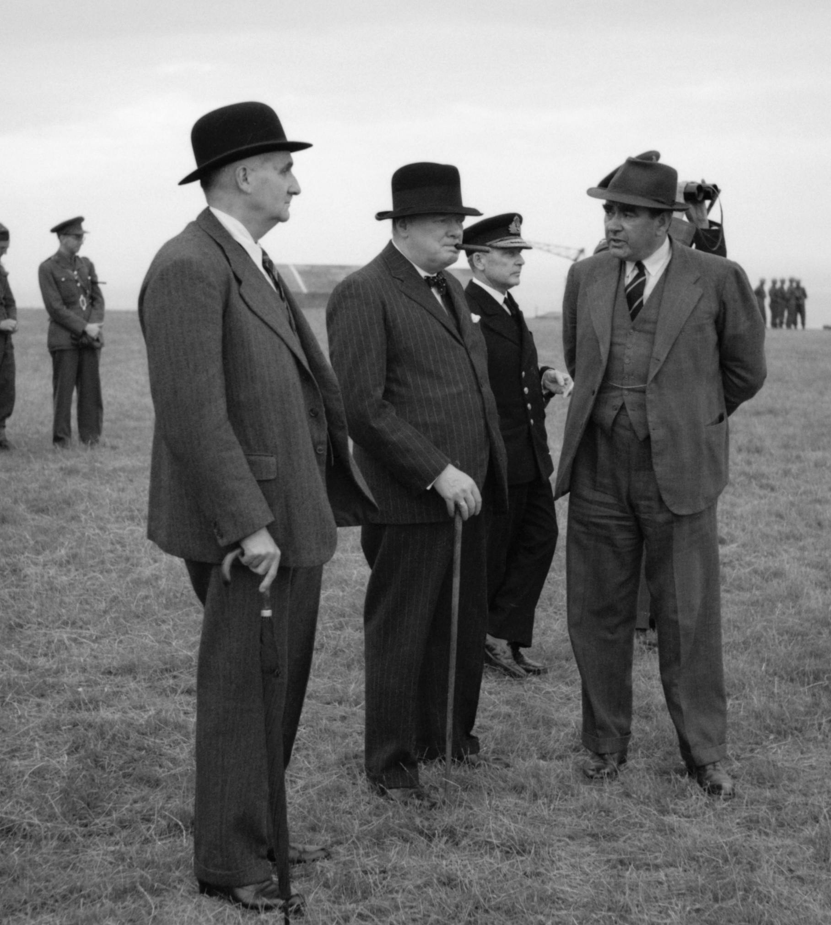
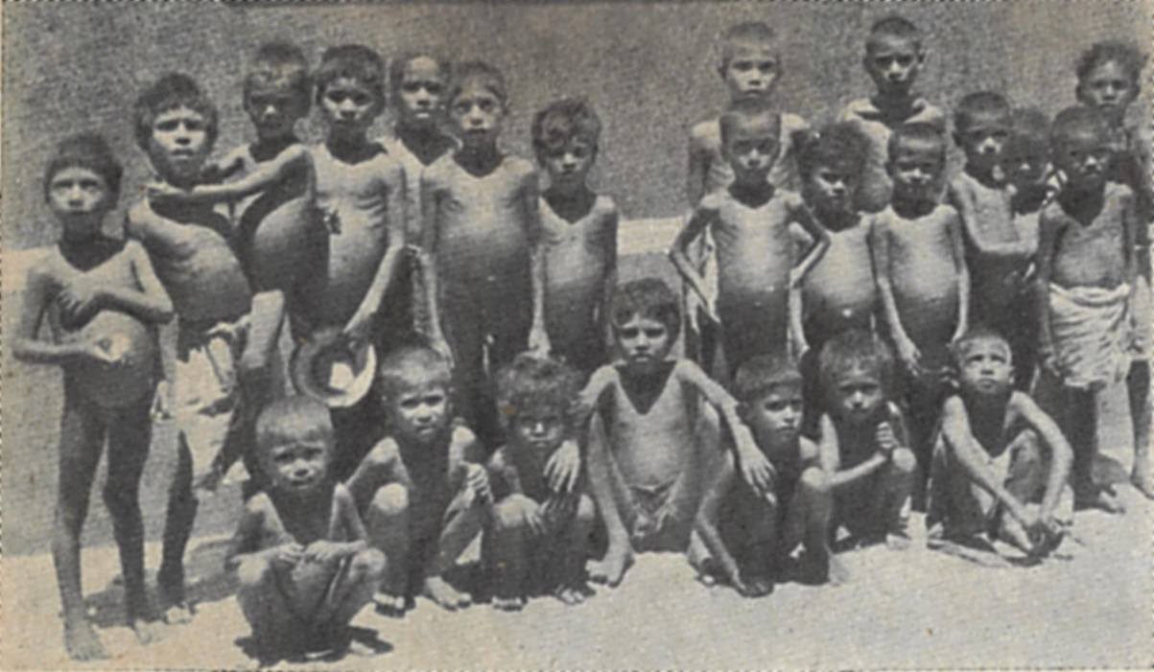
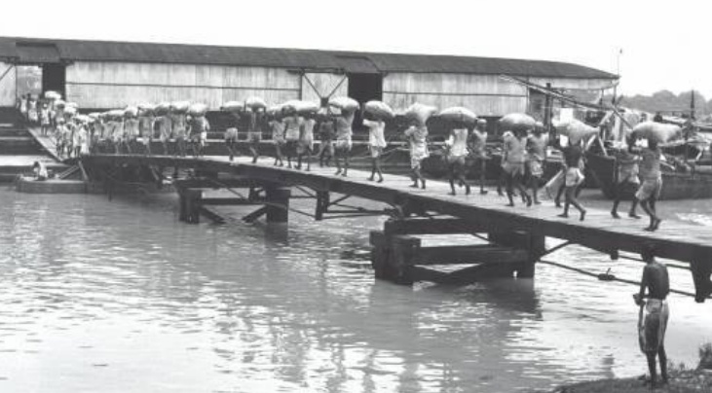
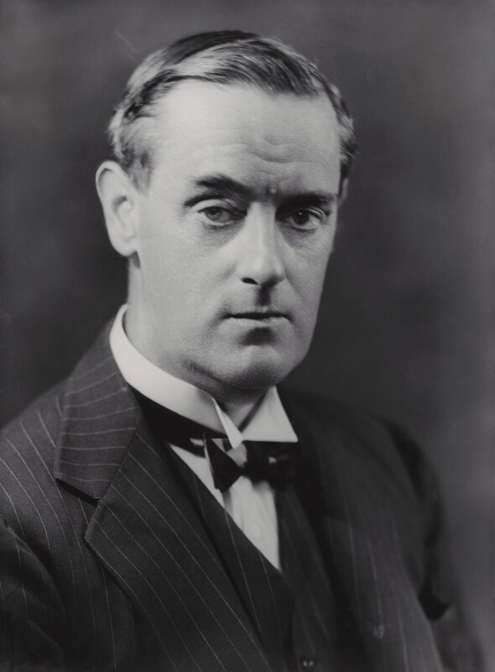
Refusal of Imports
In August, a further request of 500,000 tons of wheat was refused
no additional relief for India was planned.
Meanwhile Australia , South Africa , New Zealand , and Canada all offered help. A minister in Canberra, Australia stated:
Whilst Australia did send aid, it was not as much as they had offered due to shipping restrictions.
Britain was also concerned with the allies' position in the Indian Ocean having lost their important strategic base and colony of Singapore.
The British government also had to balance its use of limited shipping, meaning shipments to India could reduce essential war related supplies coming to Britain itself.
From late 1942 onwards a series of requests were made to the British government to send food-aid to India. With increasing urgency high ranking officials including the Governor of Bengal, the Viceroy, the Secretary of State and the Commander-in-Chief of the British forces asked for assistance, but with little success. The British government, led by Churchill, was seemingly reluctant to divert any shipments to India as he felt that the Allies could not afford to use their limited shipping for India when other areas also needed supplies.
“Australia could supply all the wheat needed for the starving in India provided the United Kingdom could provide the ships,”
Churchill’s principal advisor on the logistical matters of shipping and allocation of supplies was Lord Cherwell. Cherwell, a scientist was known to be racist to the extent that the presence of any black person evoked ‘physical revulsion which he was unable to control.’ How far this influenced his advice is impossible to say, however we do know that Churchill held him in high regard and his recommendations were almost always carried out. Churchill himself had also made some highly derogatory comments regarding Indian people. Referring to them based on their majority religion of Hinduism, Churchill had said in March 1943 “the Hindus were a foul race protected by their mere pullulation from the doom that is their due.” (Pullulation means rapid breeding).
Lord Cherwell (left) with Churchill and others
In late 1942 Viceroy Linlithgow requested the import of 600,000 tons of wheat.
The British Government allowed 30,000 tons of aid by June 1943.
By March of that year starvation deaths had begun in Bengal.
Churchill insisted on the continuation of rice exports.
Between January and July 1943, 71,000 tons of rice were exported out of India.
Famine raged in Bengal.
Unloading supplies
A group of orphans who survived the Bengal Famine
That autumn, The United Kingdom began to build stockpiles of food in preparation for post war need.
The shipments of Australian wheat offered to relieve the famine in India were directed to Europe, destined not for consumption but for storage to support Britain and aid liberated countries in Europe who lacked food supplies.
Eventually 80,000 tons of wheat did arrive on Indian shores. Still a fraction of that which was required.
Viceroy Linlithgow

Slide 16
Could the Bengal Famine have been avoided?
Using what you have learned about the causes of the Bengal famine, write a summary paragraph to answer the question above.
Consider:
  Which factors were the most important in causing the famine?
  What, if anything, could have been done differently?
  Can you categorise the factors into long term and short term, or avoidable problems and unavoidable problems? How might this help you form your own judgement?
  Was the role played by the British Government helpful or unhelpful to the Indian people?

Slide 17
Enduring Questions
How did Churchill shape Modern Britian and attitudes to its former empire?
Use what we have studied today and your own knowledge to discuss this question with your partner.
Be ready to feedback your thoughts.
You may wish to consider:
What can we learn about the relationship between Britain and India from the case of the Bengal Famine?
What might this suggest about Britain’s attitude towards its colonies more broadly?
How might this impact Britain today?

