Slide 1

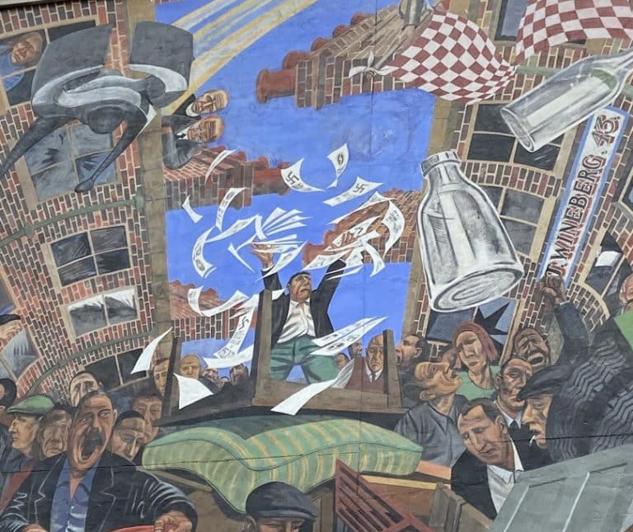
The Battle of Cable Street: Antisemitism & Extremism in the UK
Did the Battle of Cable Street defeat fascism in Britain?

Slide 2
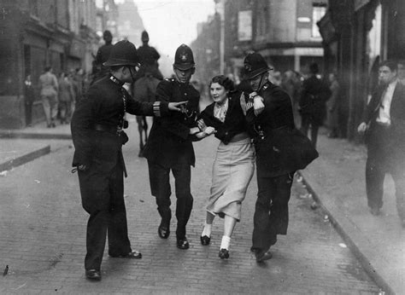
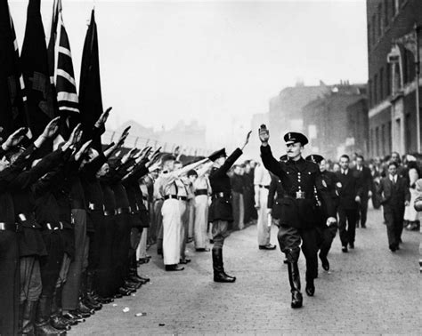
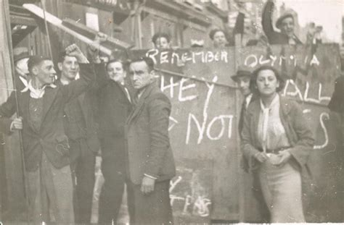
What can you remember?
What Happened at Cable Street?
When was the Battle of Cable Street?
Who planned the march?
Why was the East End chosen?
Who did the protestors consist of?
What role did the police play?
Why was the march abandoned?

Slide 3
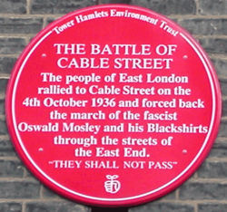
The Aftermath of the Battle:
Fascism (Un)Defeated?
If you stop a march, have you defeated an ideology?
Plaque erected on February 1st, 2008, at 3-5 Dock Street

Slide 4
What Would You Expect?
After Cable Street I would expect:
□ Fascism to disappear
□ Fascism to become stronger
□ Violence to decrease
□ Antisemitism to decline
□ Government action
□ Something else

Slide 5
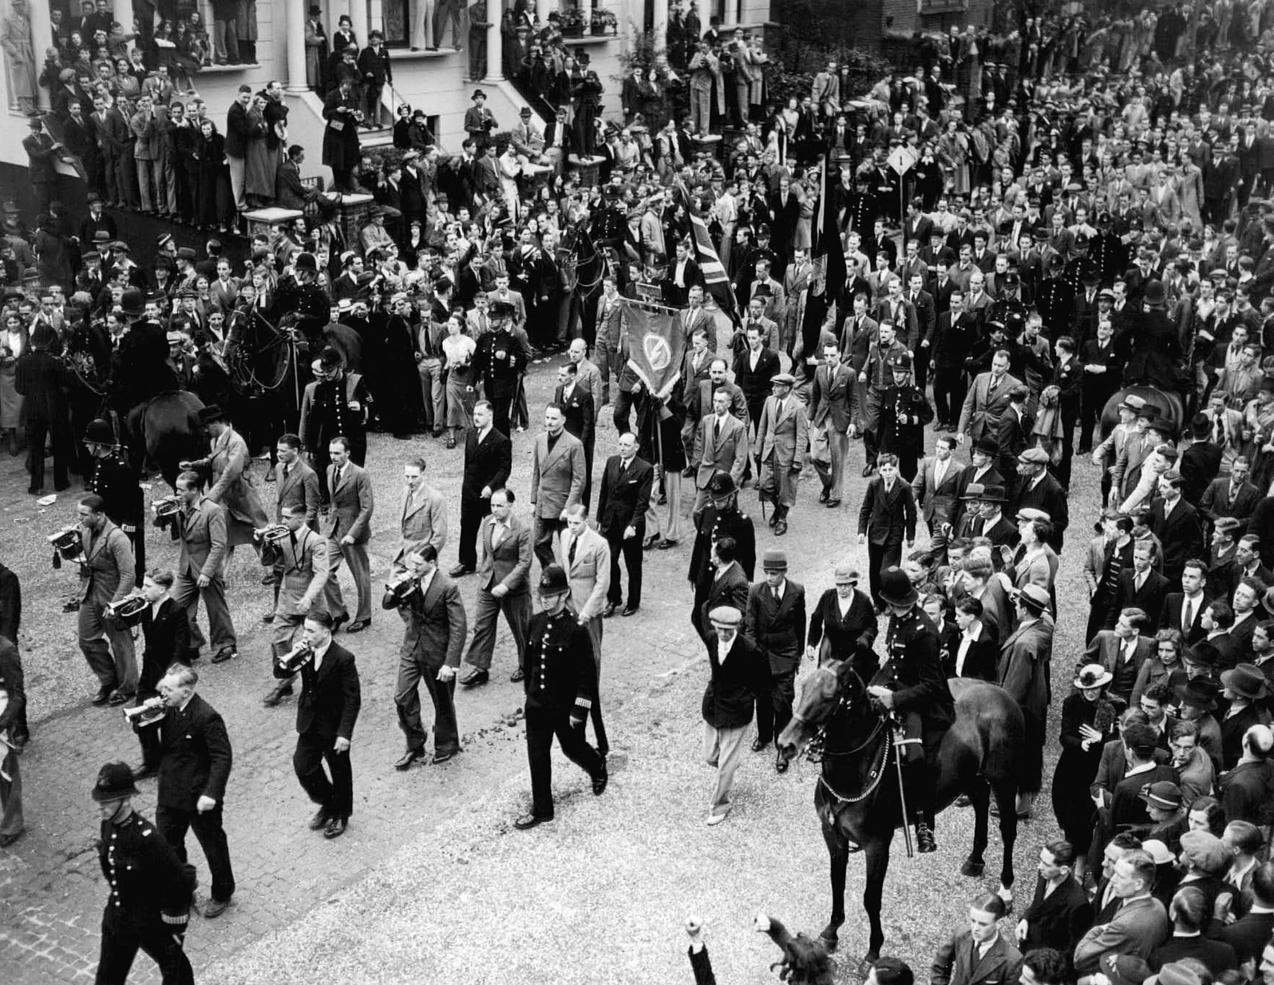
The Aftermath of the Battle:
Fascism (Un)Defeated?
If you stop a march, have you defeated an ideology?
The start of a BUF march to Trafalgar Square, July 4th, 1937 (Mosley is circled)
Plaque erected on February 1st, 2008, at 3-5 Dock Street

Slide 6
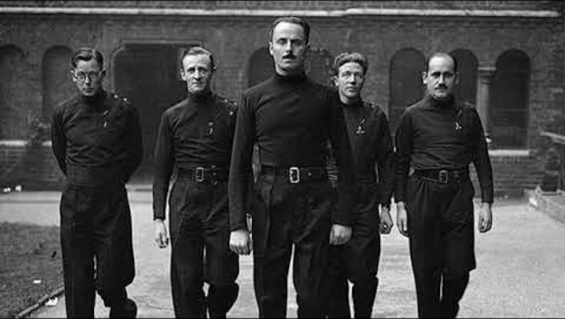
Embedded Video

Slide 7
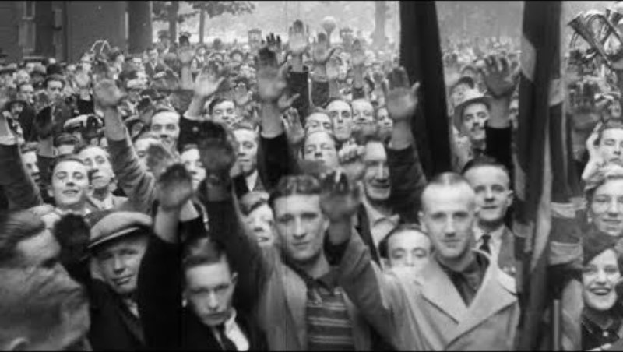
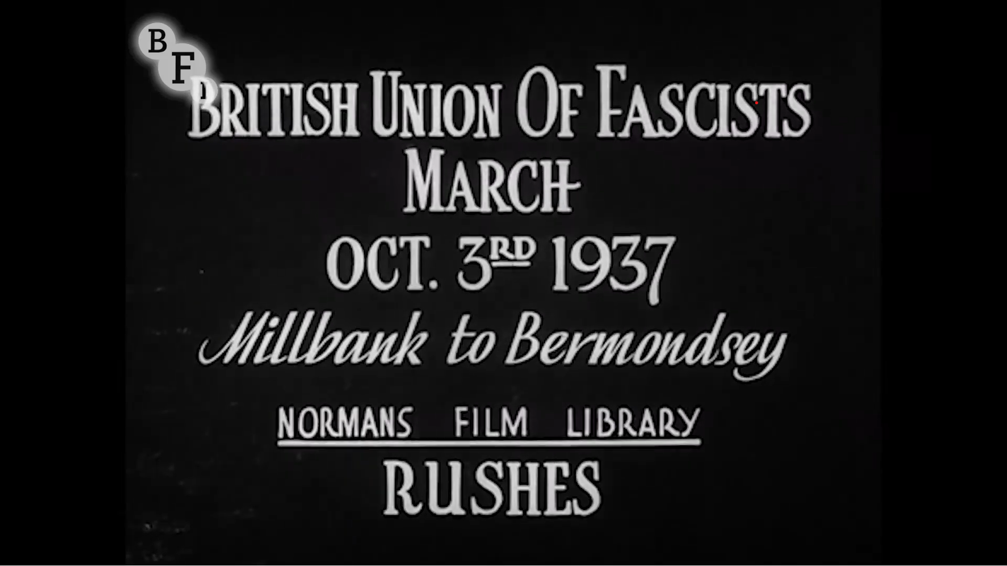
Source A
Source A: Unedited film rushes

Slide 8
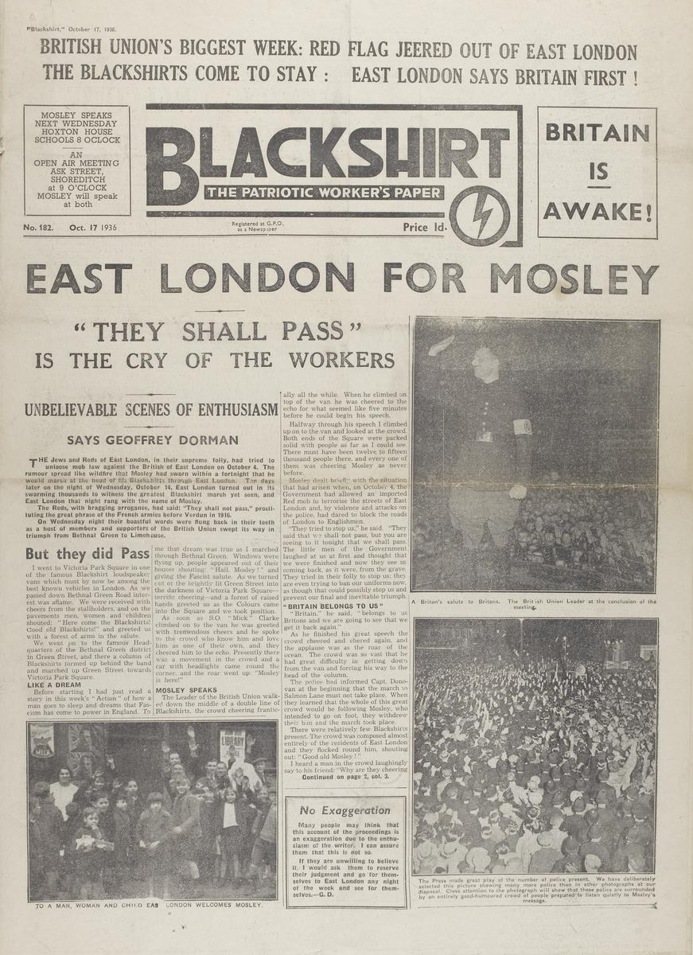
THE BUF AFTER CABLE STREET
Source Investigation
Source B: Blackshirt (October 17th, 1936)
Task 2
Look carefully at Source B, which describes a BUF march in East London on Wednesday October 14th, 1936. Use the source to answer the questions on your worksheet.
Does this sound like a defeated movement?
Why might the BUF present events this way?
What audience is being targeted?

Slide 9
ANTISEMITISM AFTER CABLE STREET
The Pogrom of Mile End
One week after Cable Street, violent anti-Jewish attacks occurred in parts of East London. Jewish businesses and homes were targeted.
Sources C-F
What sorts of things happened?
Who was affected? How?
What does this suggest about the consequences of Cable Street?
Discussion
Why might tensions actually increase after a major confrontation?

Slide 10
BRITAIN AND THE HOLOCAUST
Britain Before the War
Many British politicians preferred accommodation and appeasement before the war
Public attitudes towards Nazi Germany were often more complex than students assume
Antisemitism in Britain
Britain was not Nazi Germany.
However:
Antisemitic attitudes existed
Refugees sometimes faced hostility
Jewish immigration was controversial
Prejudice persisted throughout the 1930s
Refugees and Rescue
Many Jewish children were admitted to Britain.
However:
Adult refugees faced greater restrictions
Immigration remained limited
The war against Germany was not fought to “save the Jews”
Discussion: Why might countries know about persecution but still hesitate to accept refugees?

Slide 11
Historical Interpretations: Interpretation A
Cable Street was a great anti-fascist victory.
Evidence:
March prevented
Huge mobilisation
Symbol of solidarity
WHO WON?
Historical Interpretations: Interpretation B
Cable Street has been exaggerated.
Evidence:
BUF activity continued
Antisemitism remained
Other factors weakened fascism later

Slide 12
Historical Interpretations of Cable Street
Claim | Evidence | Your Conclusion
Cable Street stopped Mosley
Fascism survived
Antisemitism continued
Cable Street is an important symbol

Slide 13
Plenary: What Really Stopped British Fascism From Succeeding?
Possible factors:
Cable Street
Public hostility to violence
Public Order Act
Democratic politics
Failure in elections
Second World War

