Slide 1


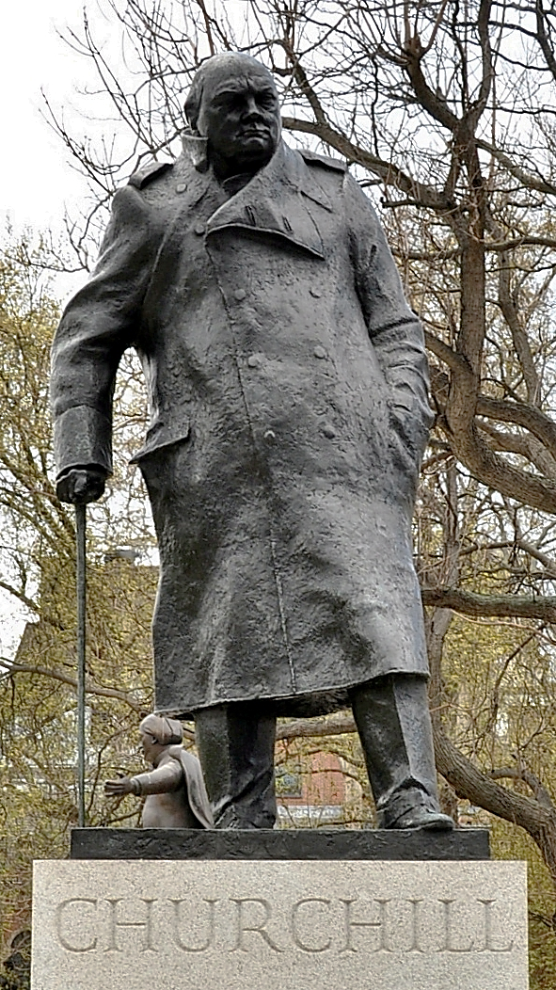
Enquiry Question:
How did Churchill shape modern Britain?
Lesson Title:
Reflections, Echoes and responses

Slide 2
Reflections and Echoes
Watch the following video
As you watch note:
  Key events, achievements, and issues Churchill was involved in.
  Present day issues that you can identify

Slide 3
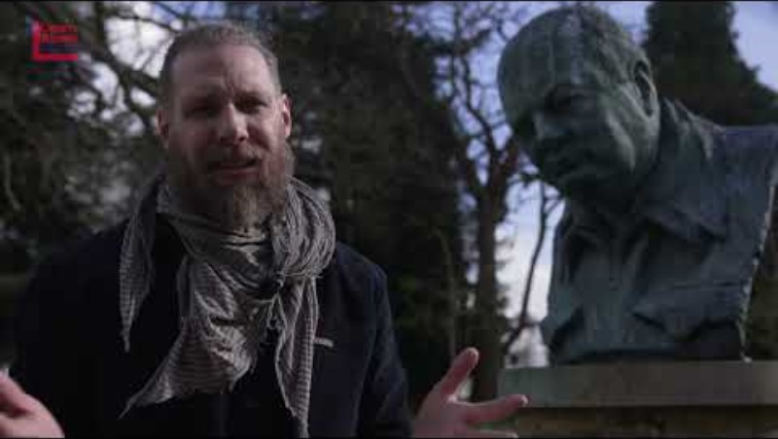

Slide 4
Key events, achievements, and issues Churchill was involved in | Present day issues

Slide 5
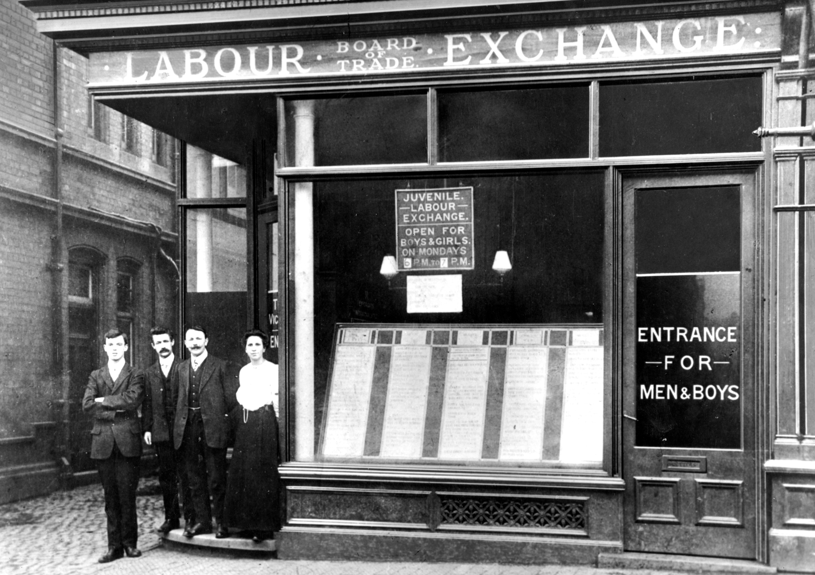
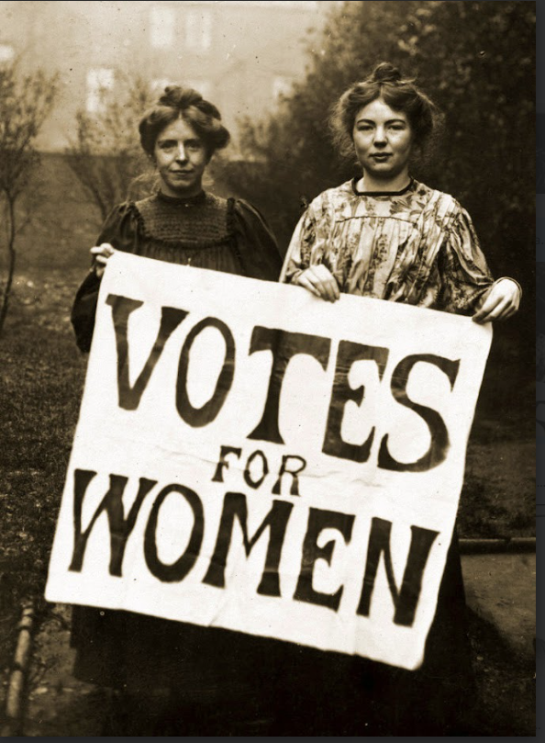
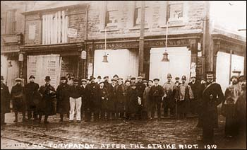
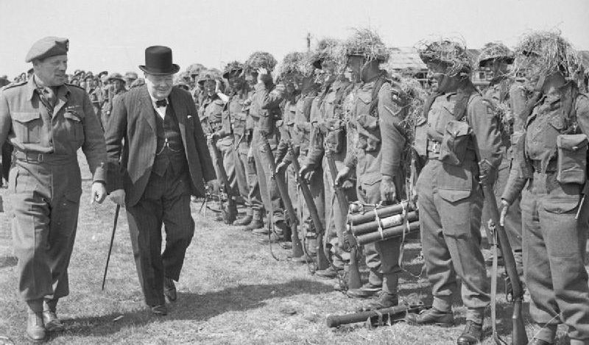
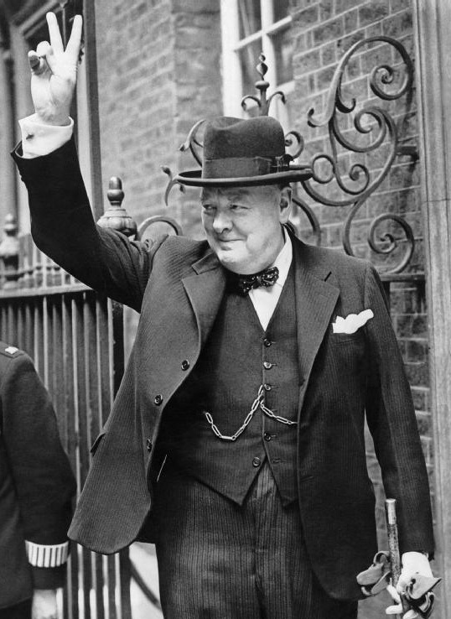
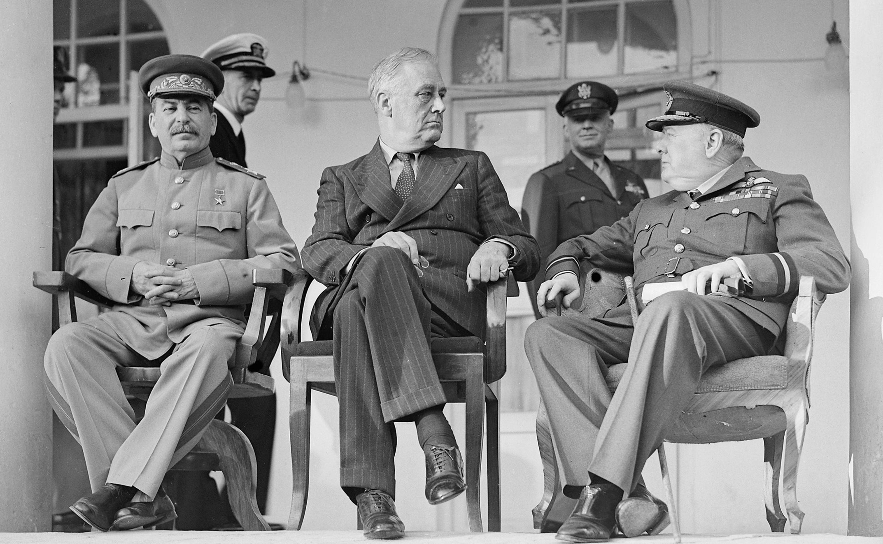
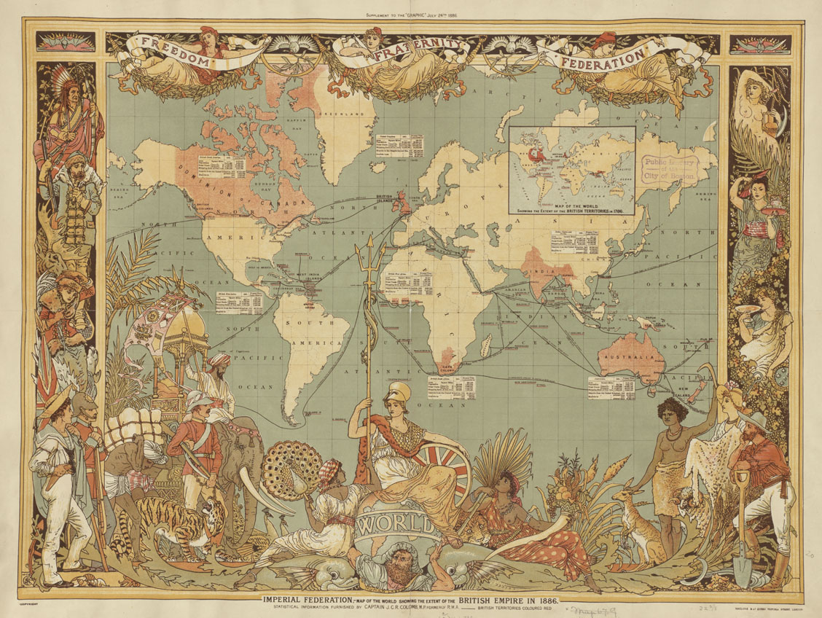
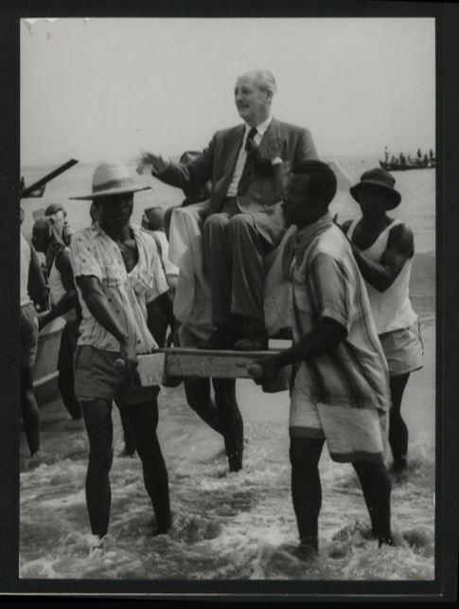
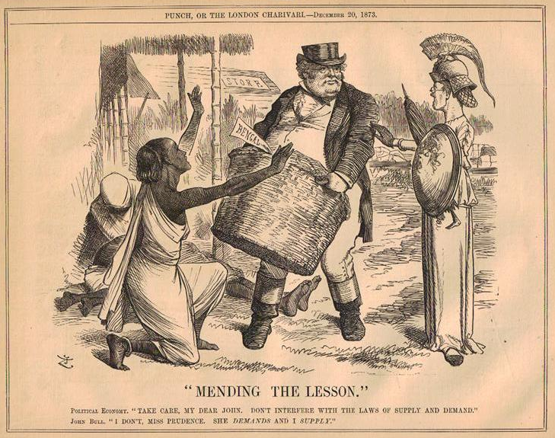
Reflections: How did Churchill shape modern Britain?
How did Churchill shape Britain in the early 20th Century?
How did Churchill shape Modern Britain in WWII?
How did Churchill shape Modern Britain and attitudes to its former empire?

Slide 6
Reflections and Echoes
 | Reflections on the past | Echoes in the present
Domestic
War and Diplomacy
Empire and Commonwealth
Response: Which area do you think is most significant to you and why?

Slide 7
Echoes of the past in the present
What similarities and differences can we see between the Britain Churchill lived in and the Britain of today?

Slide 8
Echoes of the past in the present
Look at the contemporary case study information cards around the room.
What do they suggest about Britain today?
Can you identify the themes within the case studies?
Add notes to your handout as you move around the room.
  Aim to visit and analyse at least 1 case study for each theme.
Challenge question: How can we connect the issues that exist in the present with those that we have studied from the past?

Slide 9
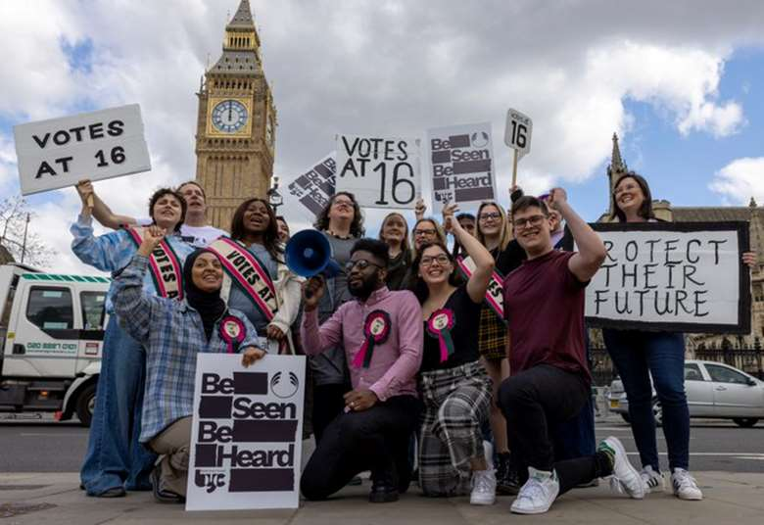
Some young people in Britain are calling for a reduction in the voting age from 18 to 16. They argue that young people should be allowed to vote as they can be employed and pay tax, they should have the right to vote in elections too. They argue that young people can be just as informed (or uninformed) as adults and giving them the vote younger would encourage greater participation in politics and democracy. However, others have argued that young people do not have the life experience or maturity to be trusted with such an important privilege as the ability to vote in elections. Critics argue that voting should align with these other age-based legal thresholds, such as drinking alcohol or serving on a jury, to maintain consistency in defining adulthood. Some are also concerned that younger voters might be more susceptible to populist ideas or short-term promises that may not align with the long-term needs of the country.

Slide 10

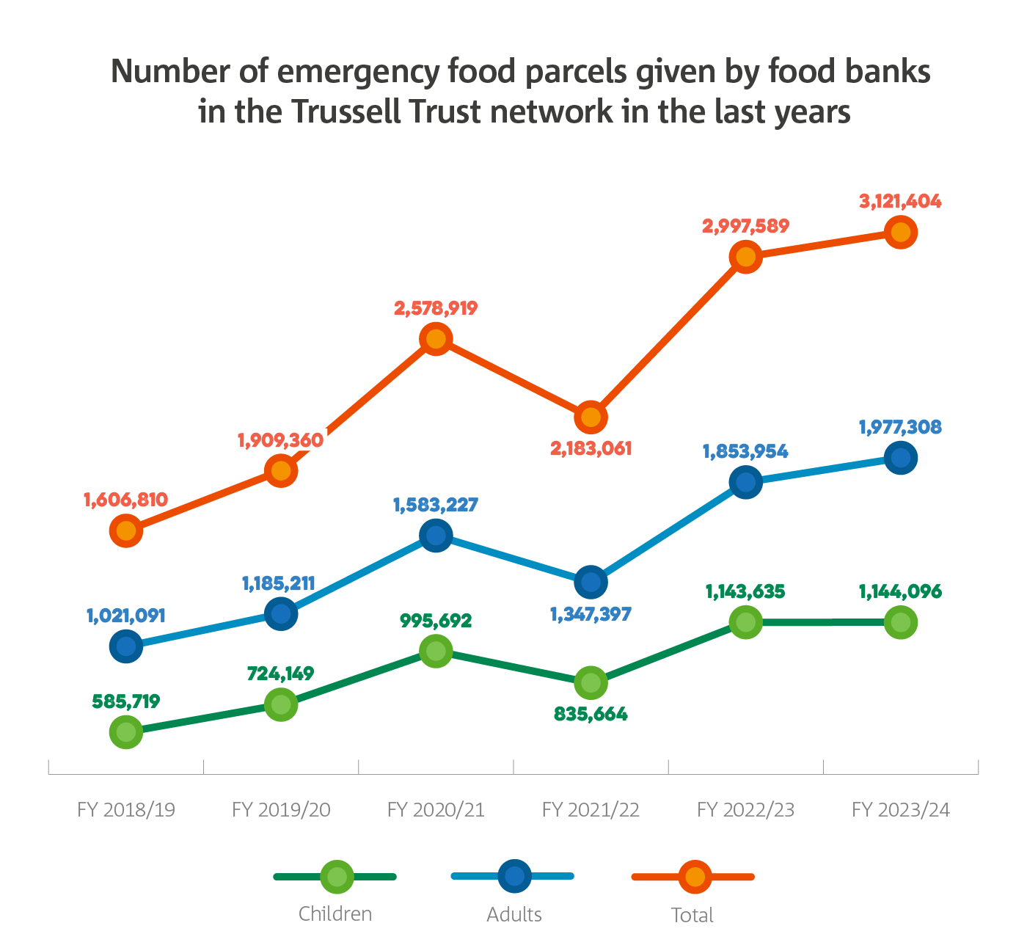
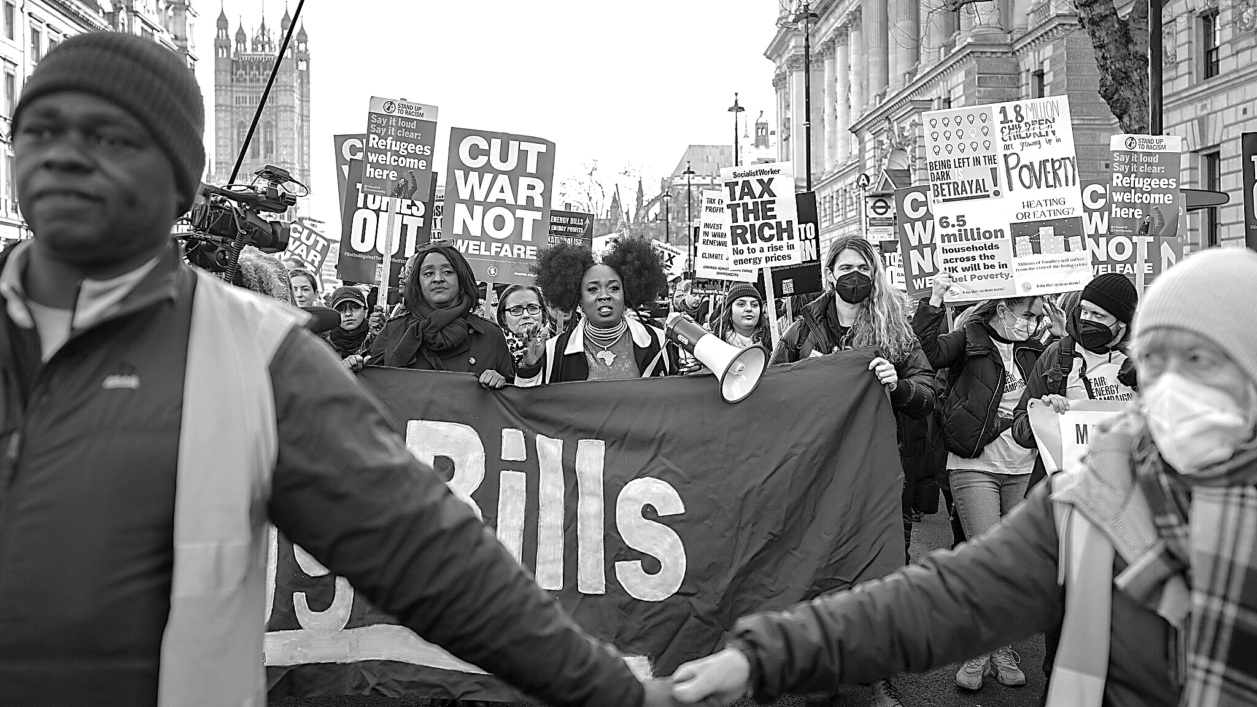
People in Britain have faced difficult economic times over the past decade. Limits on spending on public services and welfare have led to some people's needs not being met. The cost of energy and basics like food have escalated, leading to the increased need for and use of food banks by the general population. Some people have used marches and social media campaigns to demand the government changes policies to support working people more.
Notes:
https://www.trusselltrust.org/news-and-blog/latest-stats/end-year-stats/

Slide 11
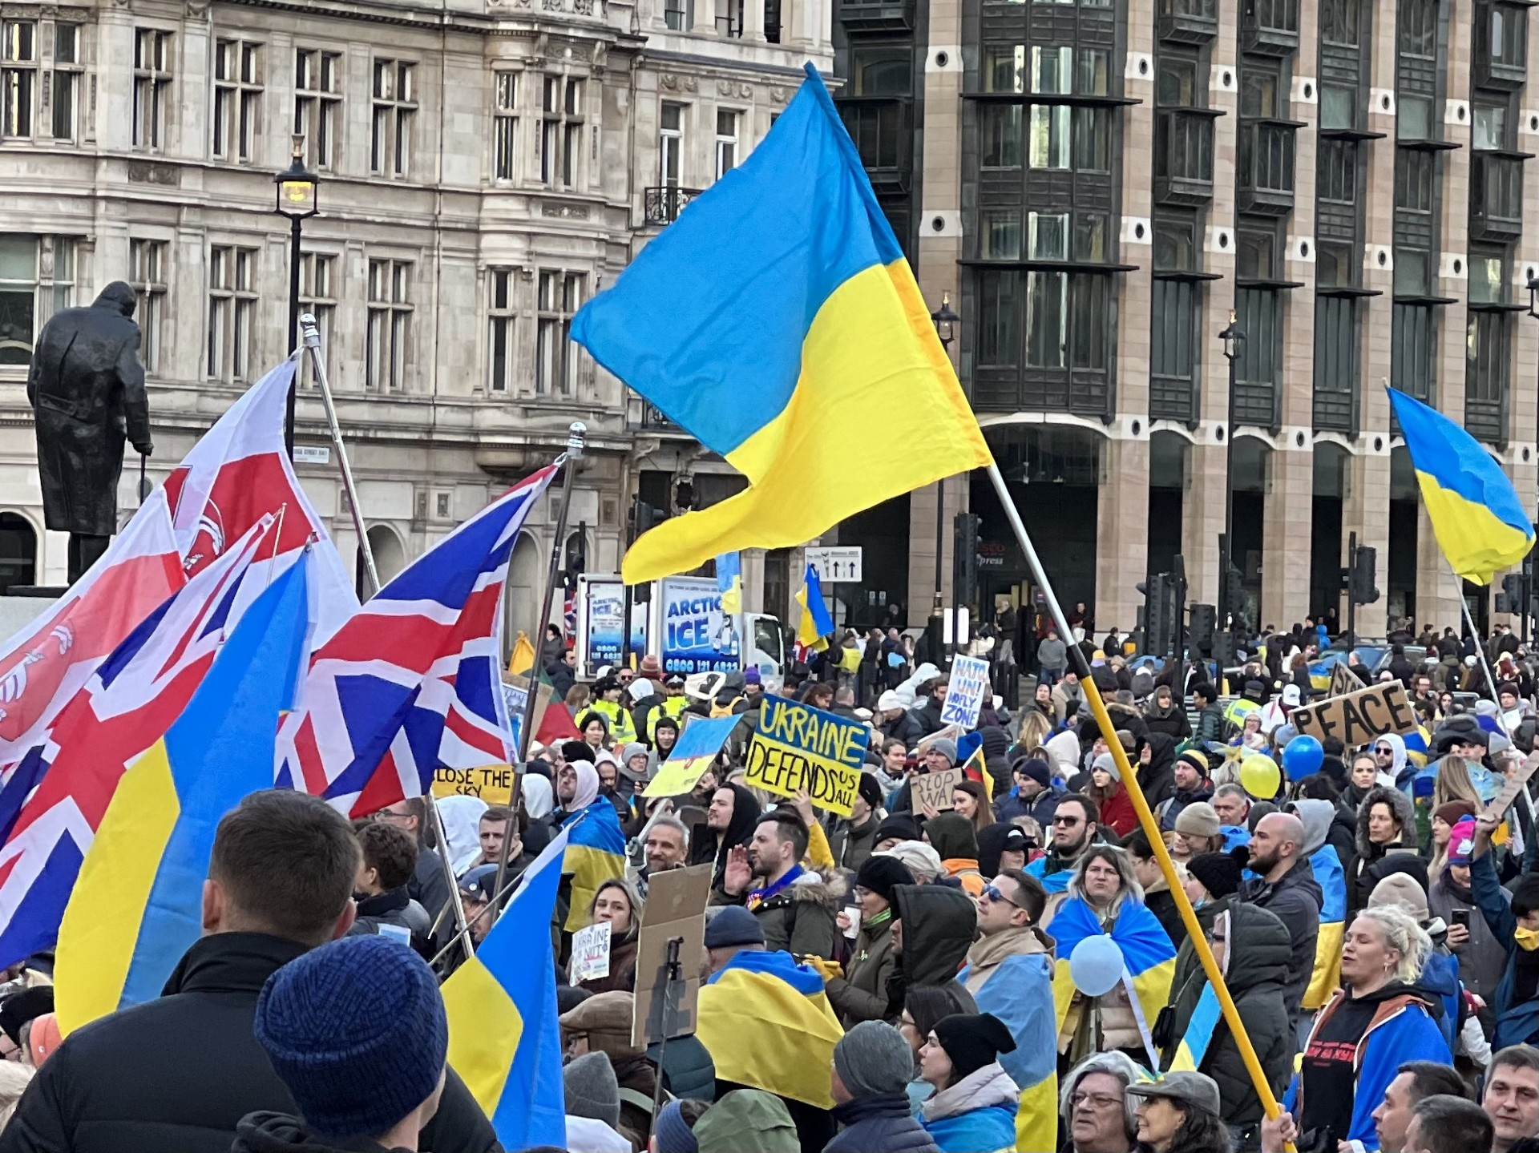
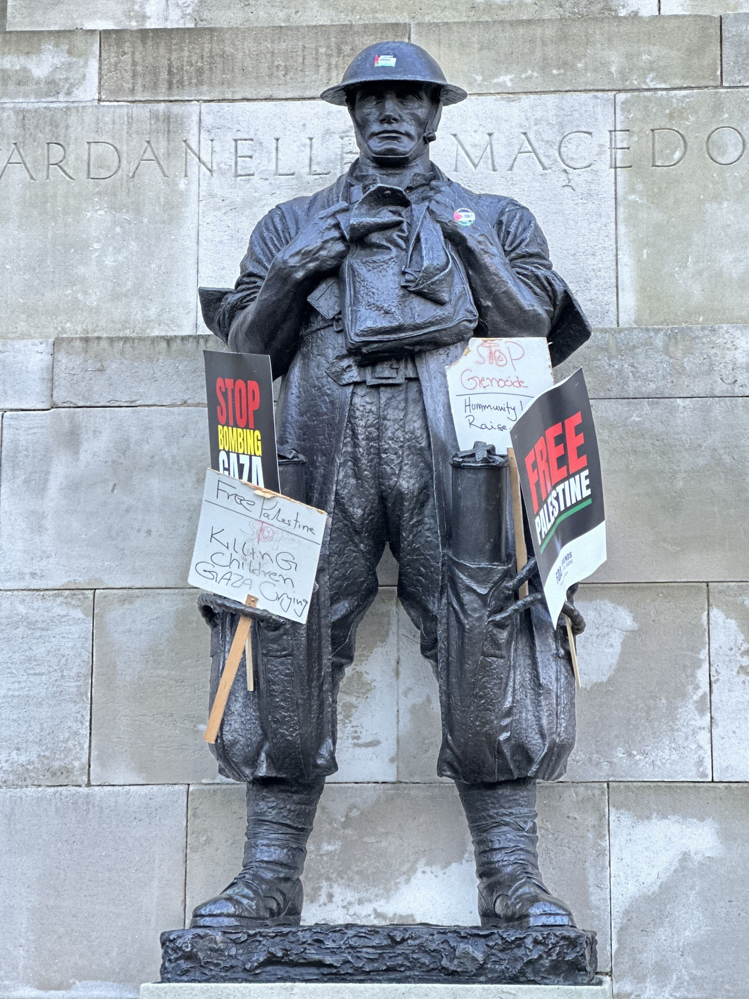
Whilst British soldiers are not actively involved in military conflicts in the way they were in Churchill's era, wars continue around the world. Who Britain supports in wars, through selling weapons or through military and diplomatic support, continues to be debated.

Slide 12
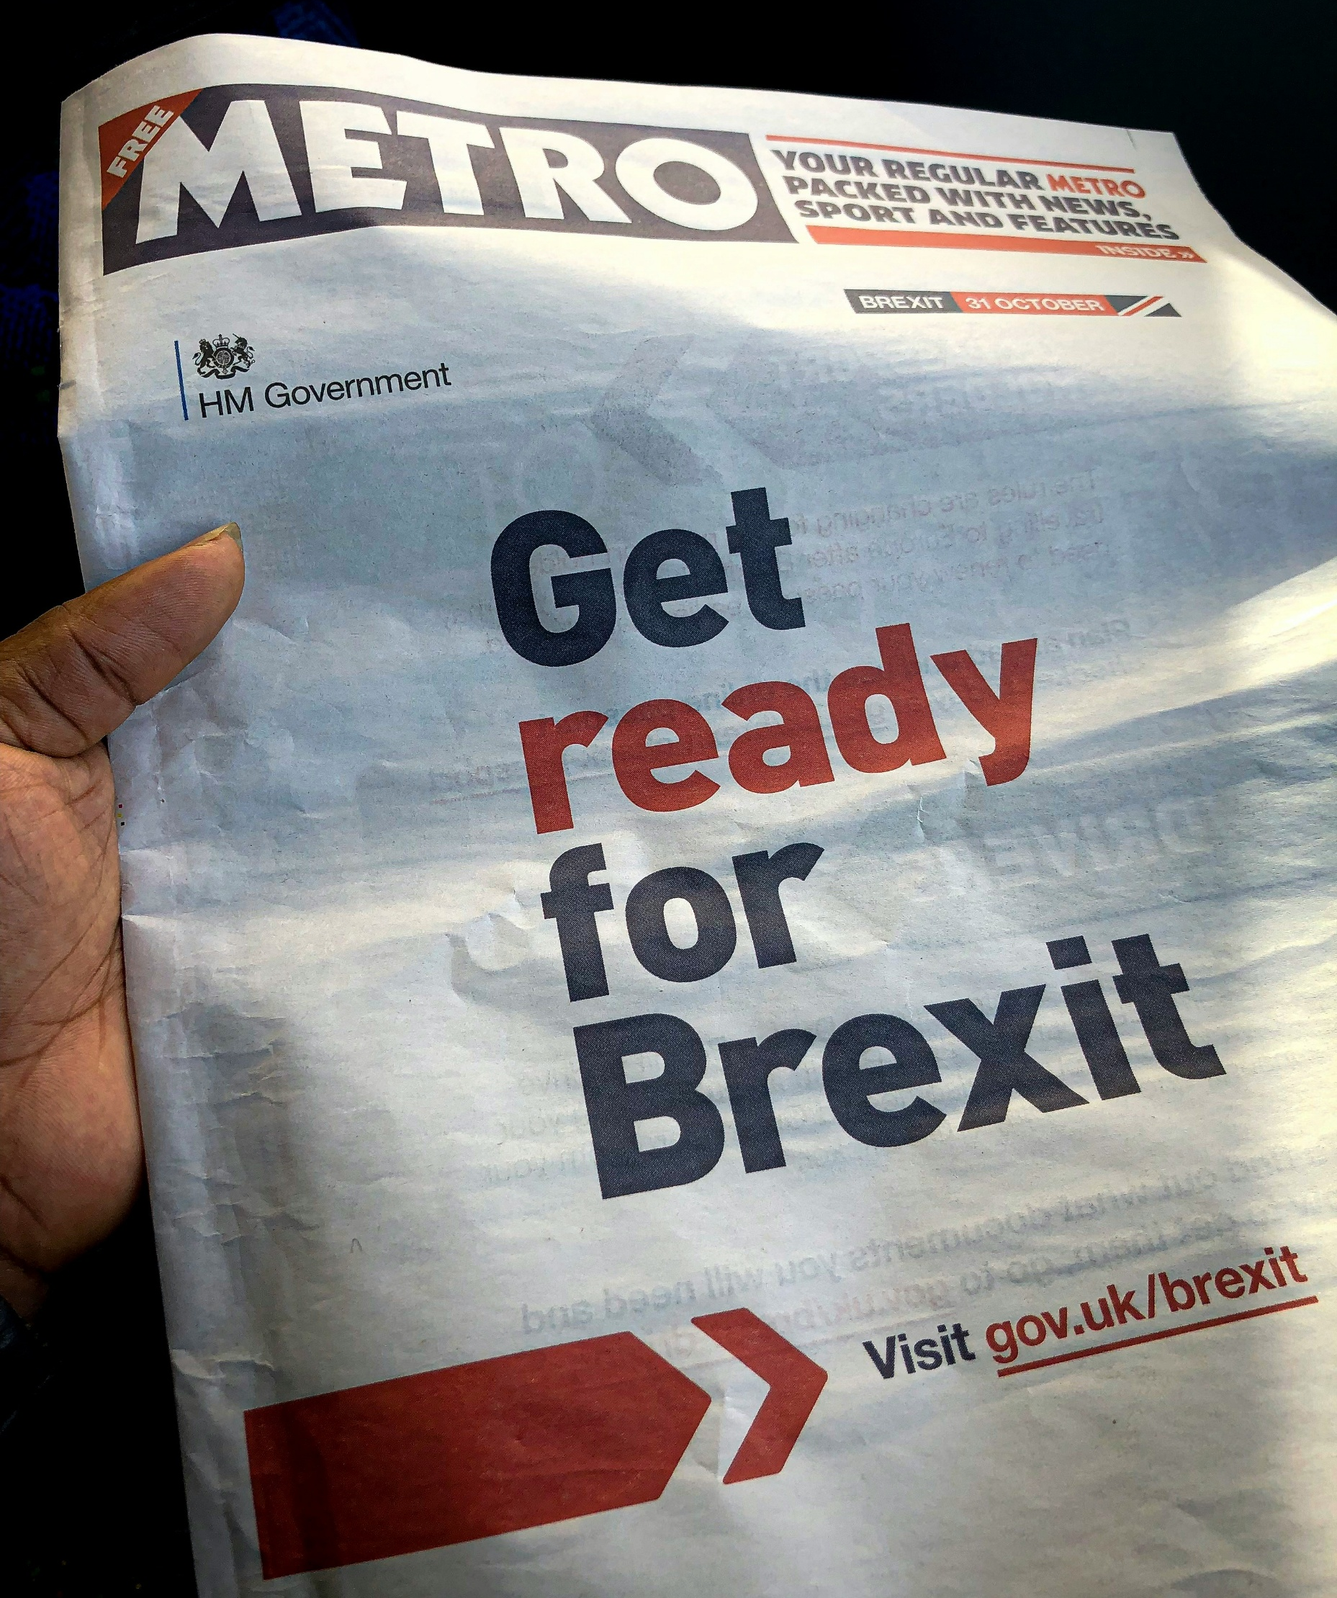
In 2016 a referendum was held to decide if Britain should remain a part of the European Union. The public voted to leave the European Union by 51.9% to 48.1%.
This has changed Britain’s relationship with European countries significantly and even now continues to divide the country, with Britain's future relationship with Europe still the subject of debate

Slide 13
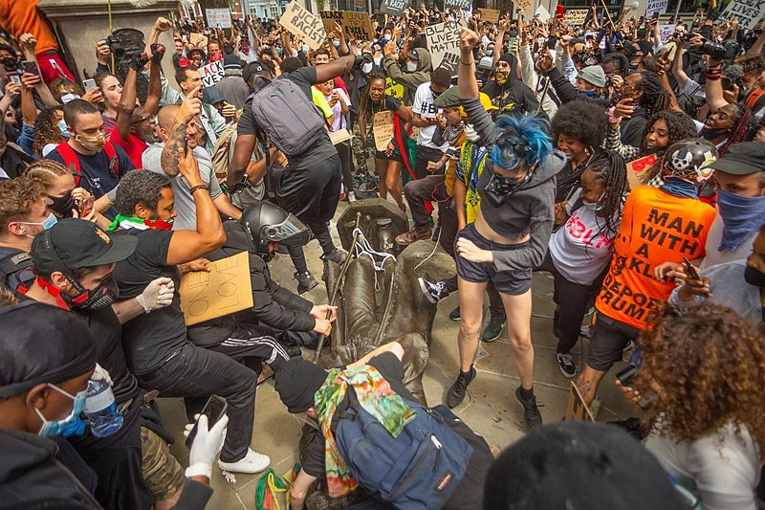
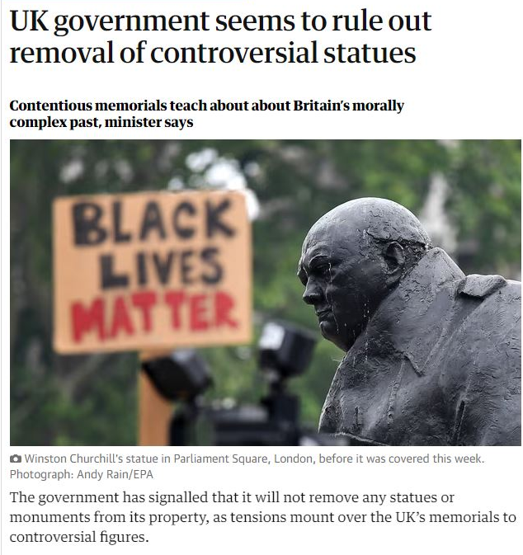
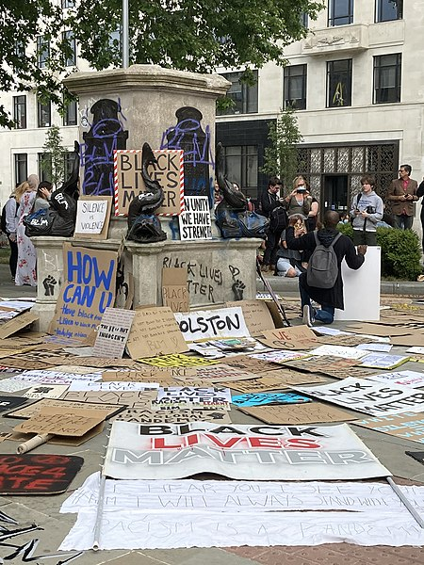
The campaign for racial justice has grown over recent years. Following the murder, by white Police, of African American, George Floyd in Minnesota, USA in 2020 protests were held around the UK with a focus on the country’s history of slave trading and treatment of black people in the UK today.
In Bristol, a statue of Edward Colston was torn down and thrown into the river. Colston was an English merchant and MP who made a fortune through transporting and selling some 80,000 African men women and children to America during the 1600s. As he spent much of his money on public buildings, schools and charitable causes he was recognised with a statue in the city centre. However, protesters argue that this statue doesn’t mention how he gained his wealth, and that to celebrate a slave trader no longer fits with British values. The protestors who rolled the statue into the river were cleared by a court of causing criminal damage.

Slide 14
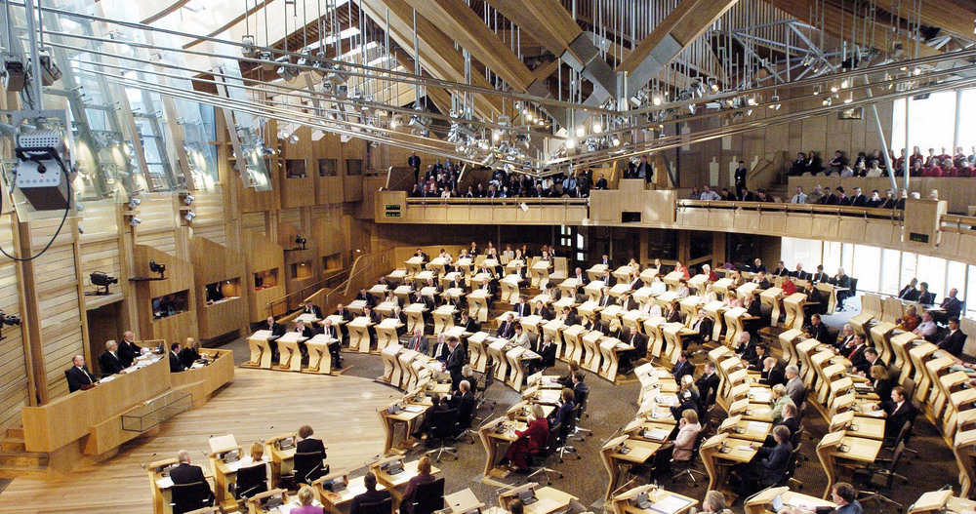
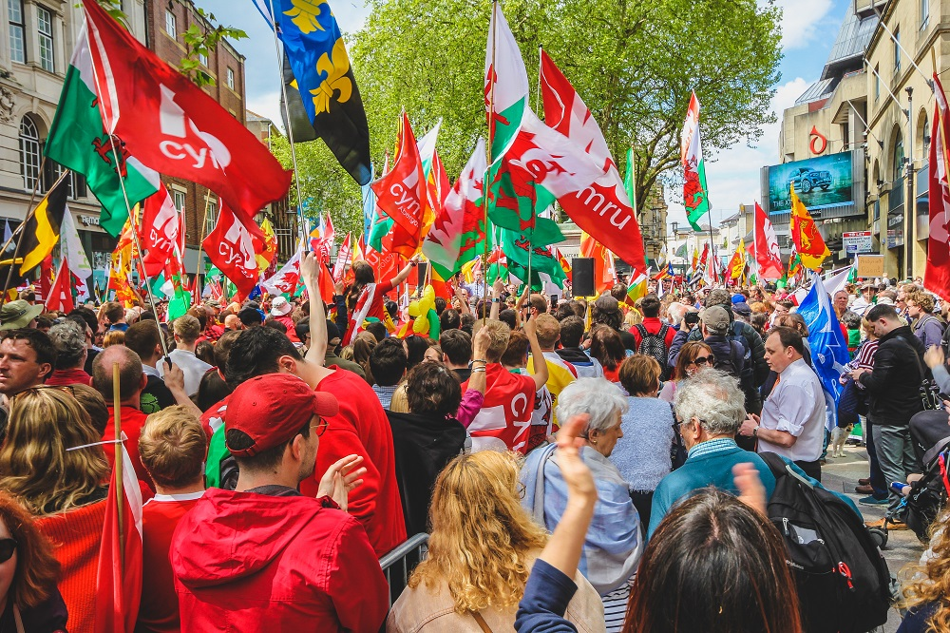
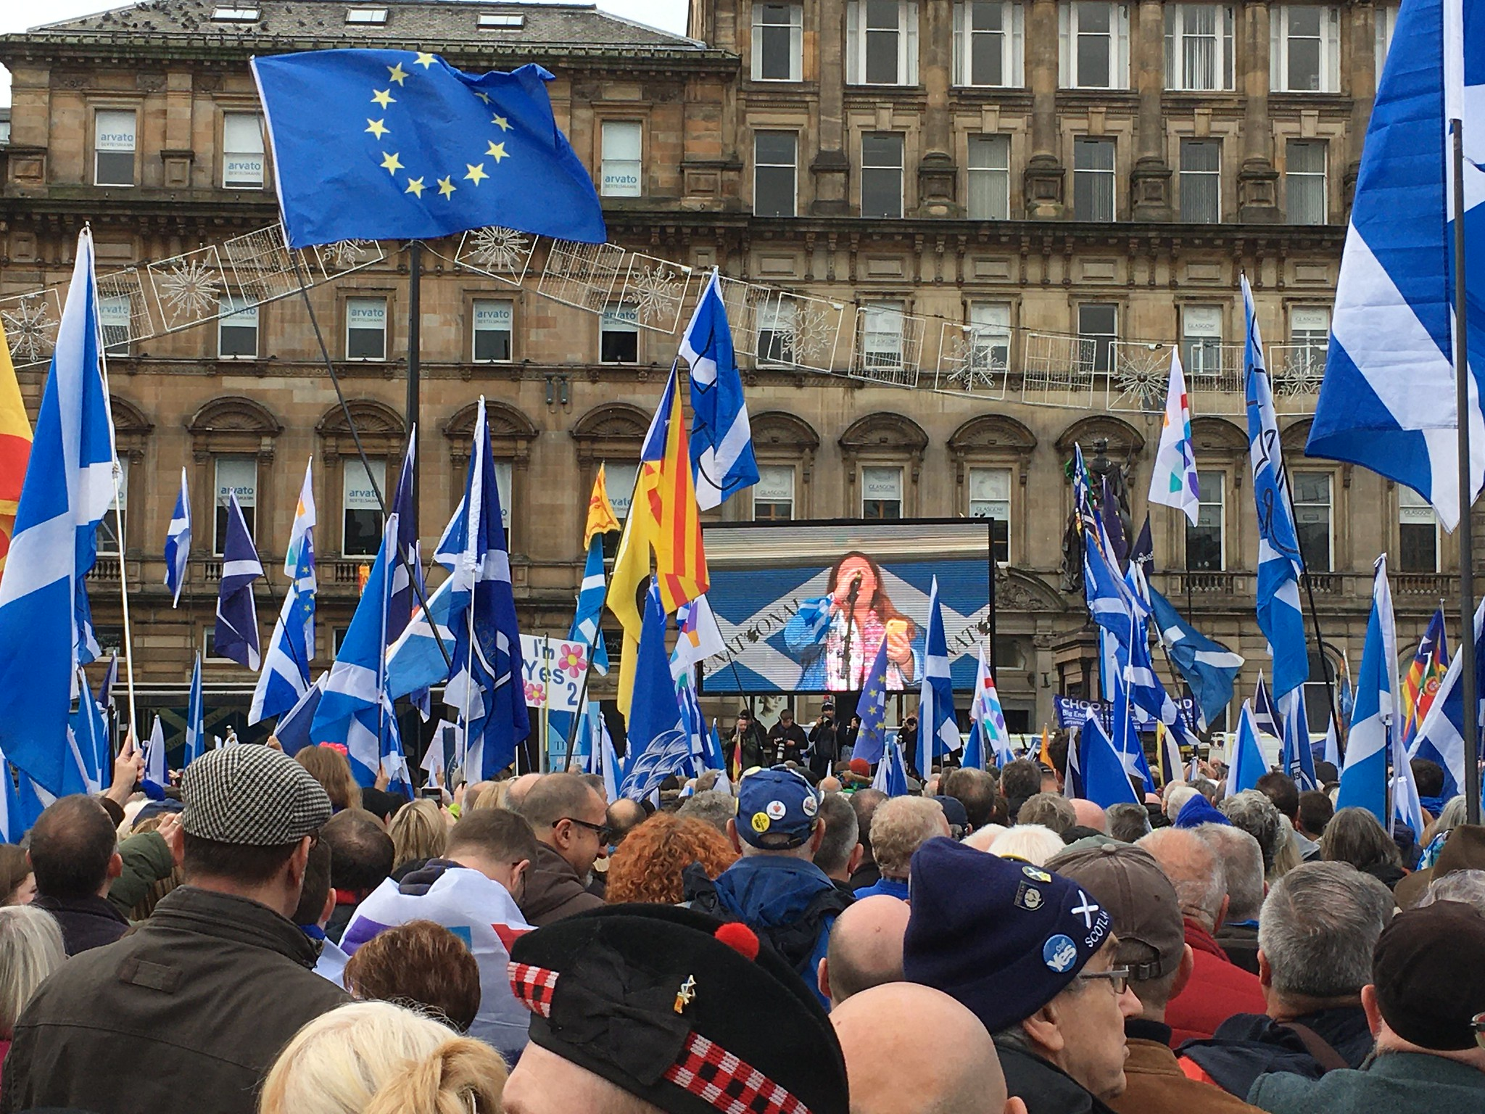
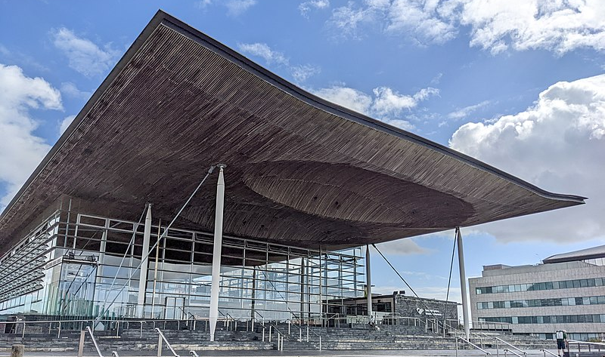
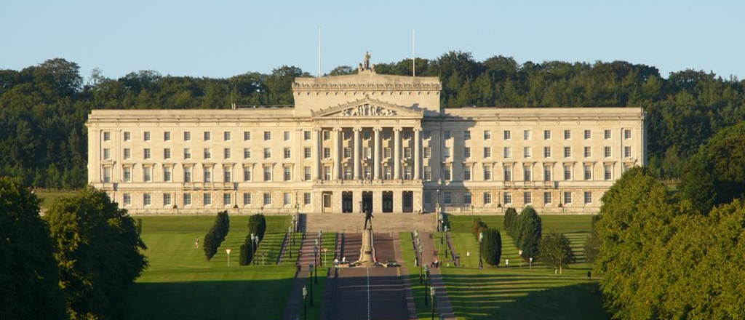
Britain has seen significant devolution (the transfer of power and authority from a central government to regional or local governments, allowing them greater self-governance.) over recent decades with the creation of governments in Scotland, Wales and Northern Ireland. Some in those nations seek full independence from Britain while others want to stay part of the United Kingdom
Inside the Scottish National Assembly, Edinburgh
Welsh independence march in Cardiff
A rally for Scottish independence, Edinburgh
The Welsh National Assembly, the Senedd, Cardiff
The Northern Ireland National Assembly, Belfast

Slide 15
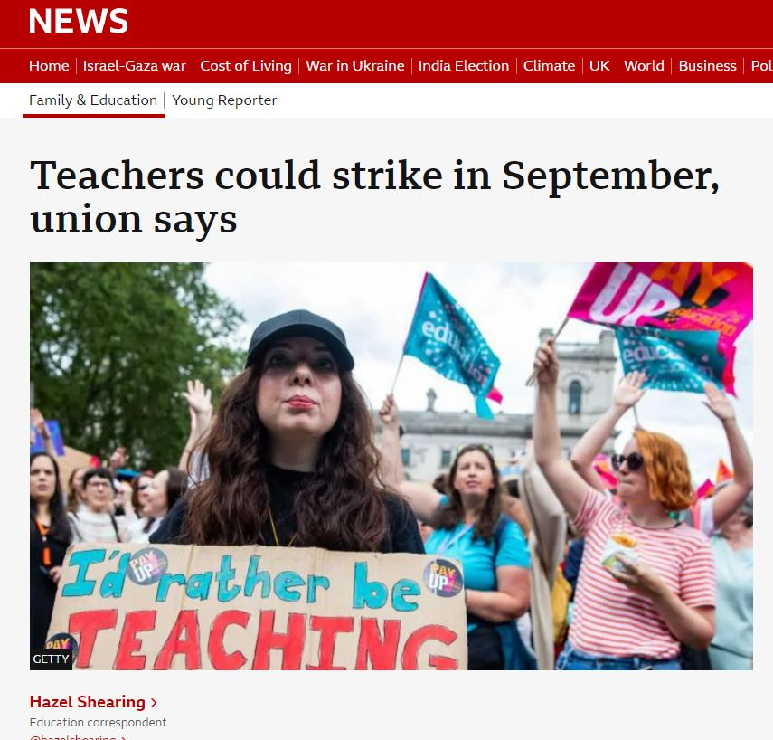
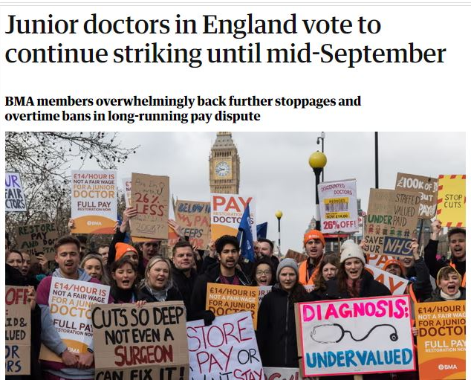
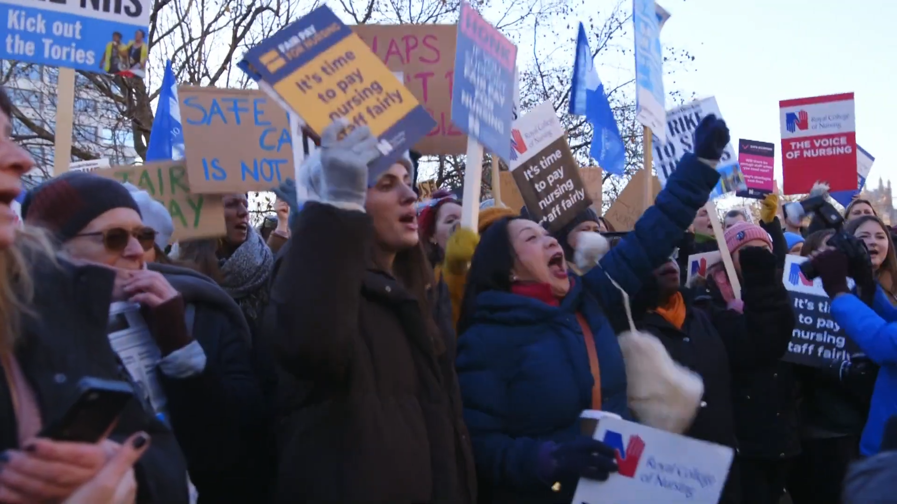
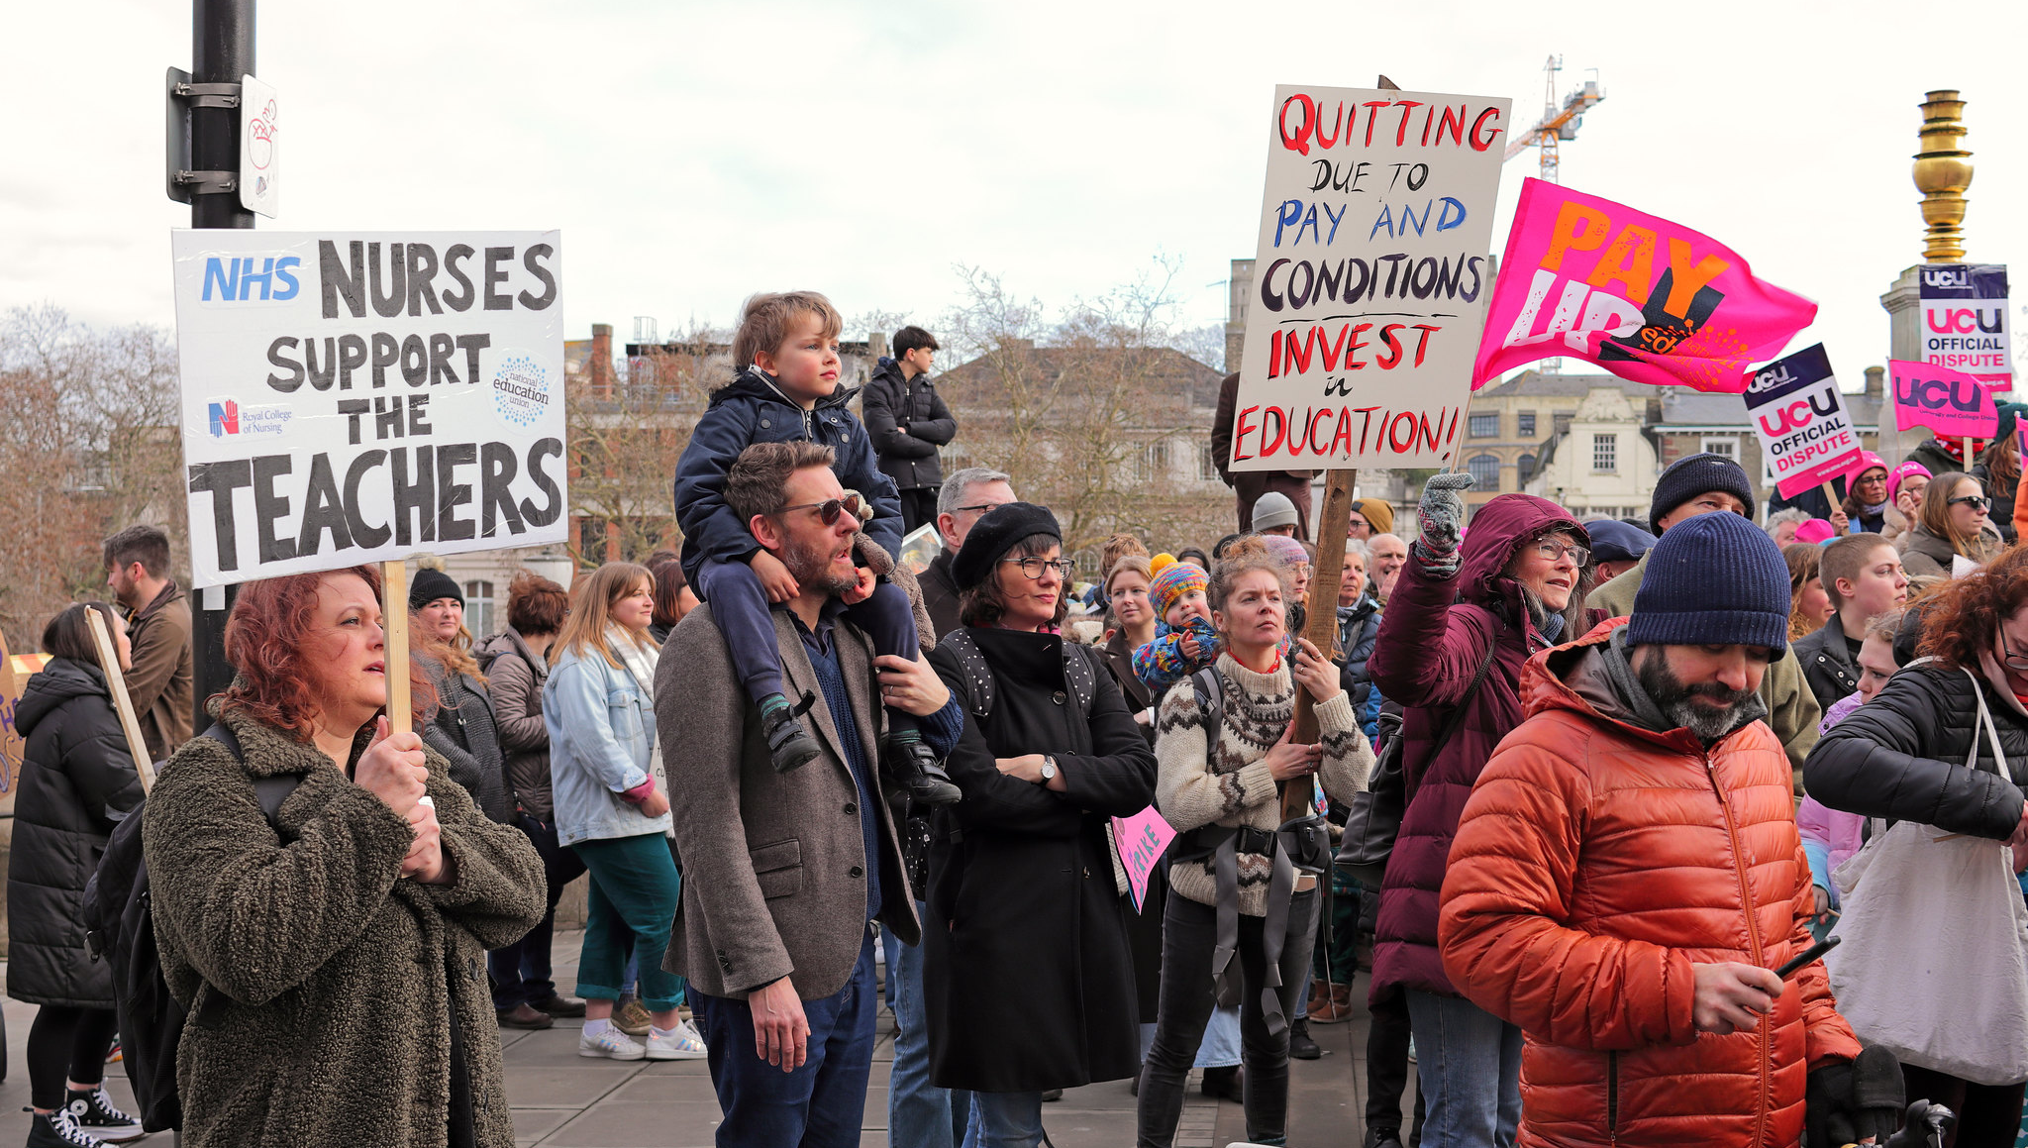
Workers across the public sector, including doctors, nurses and teachers, have been on strike in recent years, raising concerns about workload and pay not keeping up with the increasing cost of living.

Slide 16
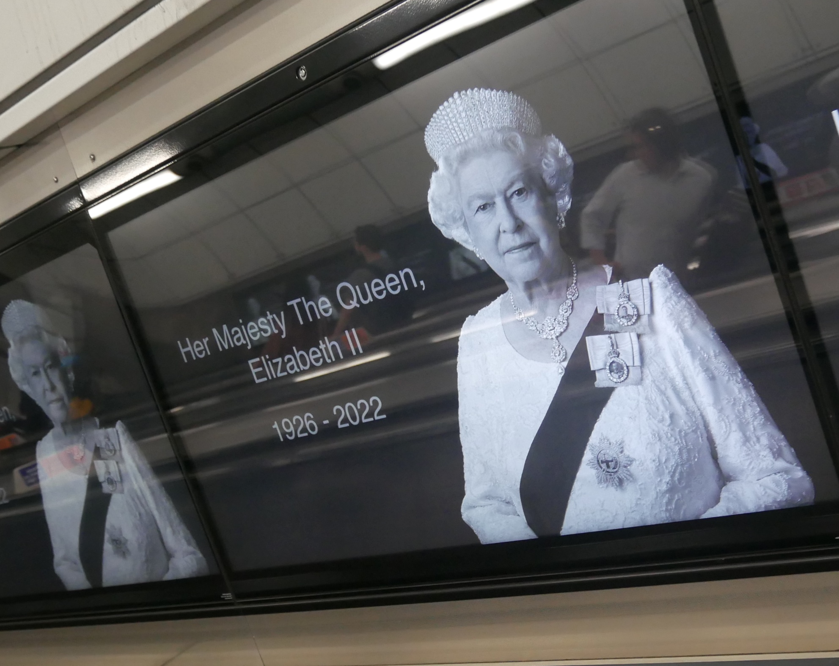
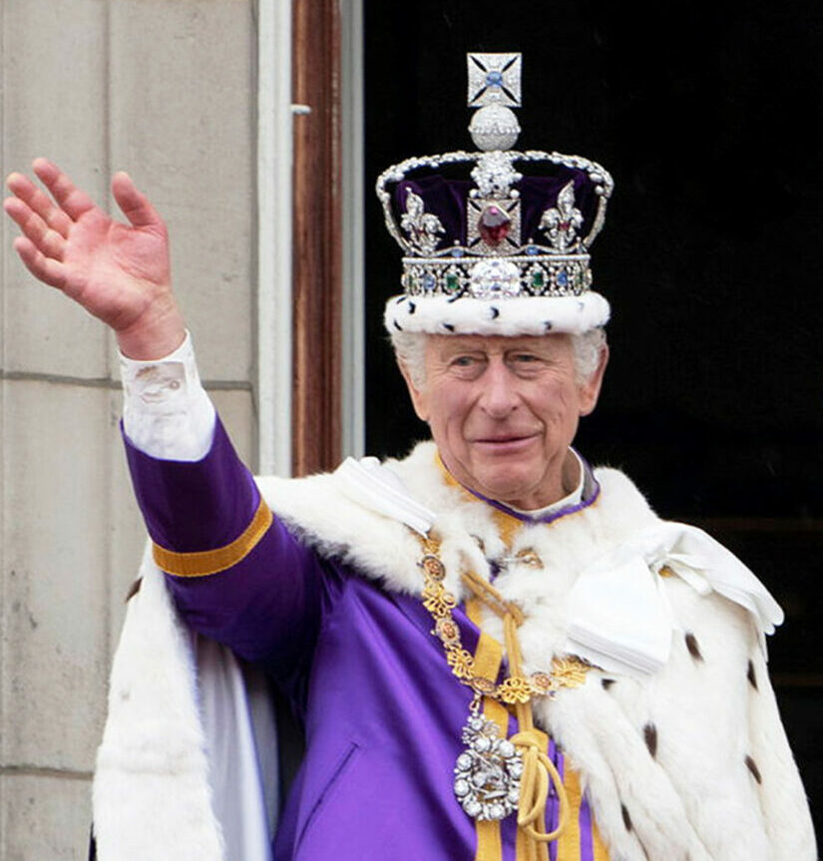
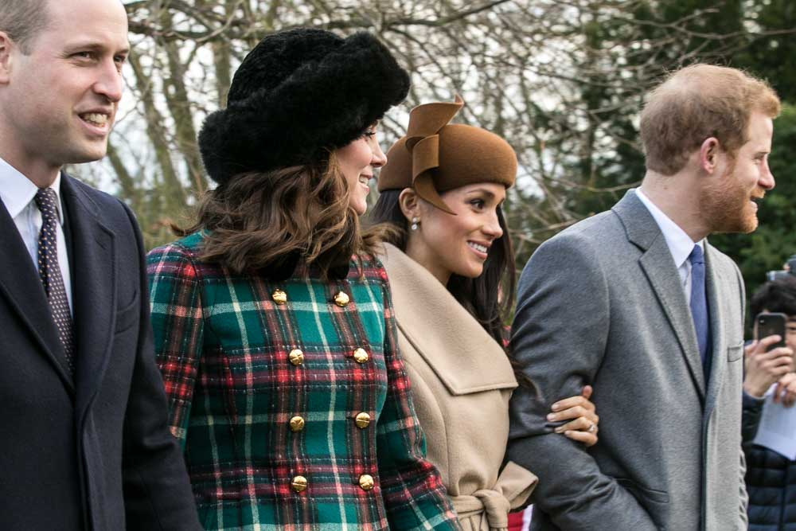
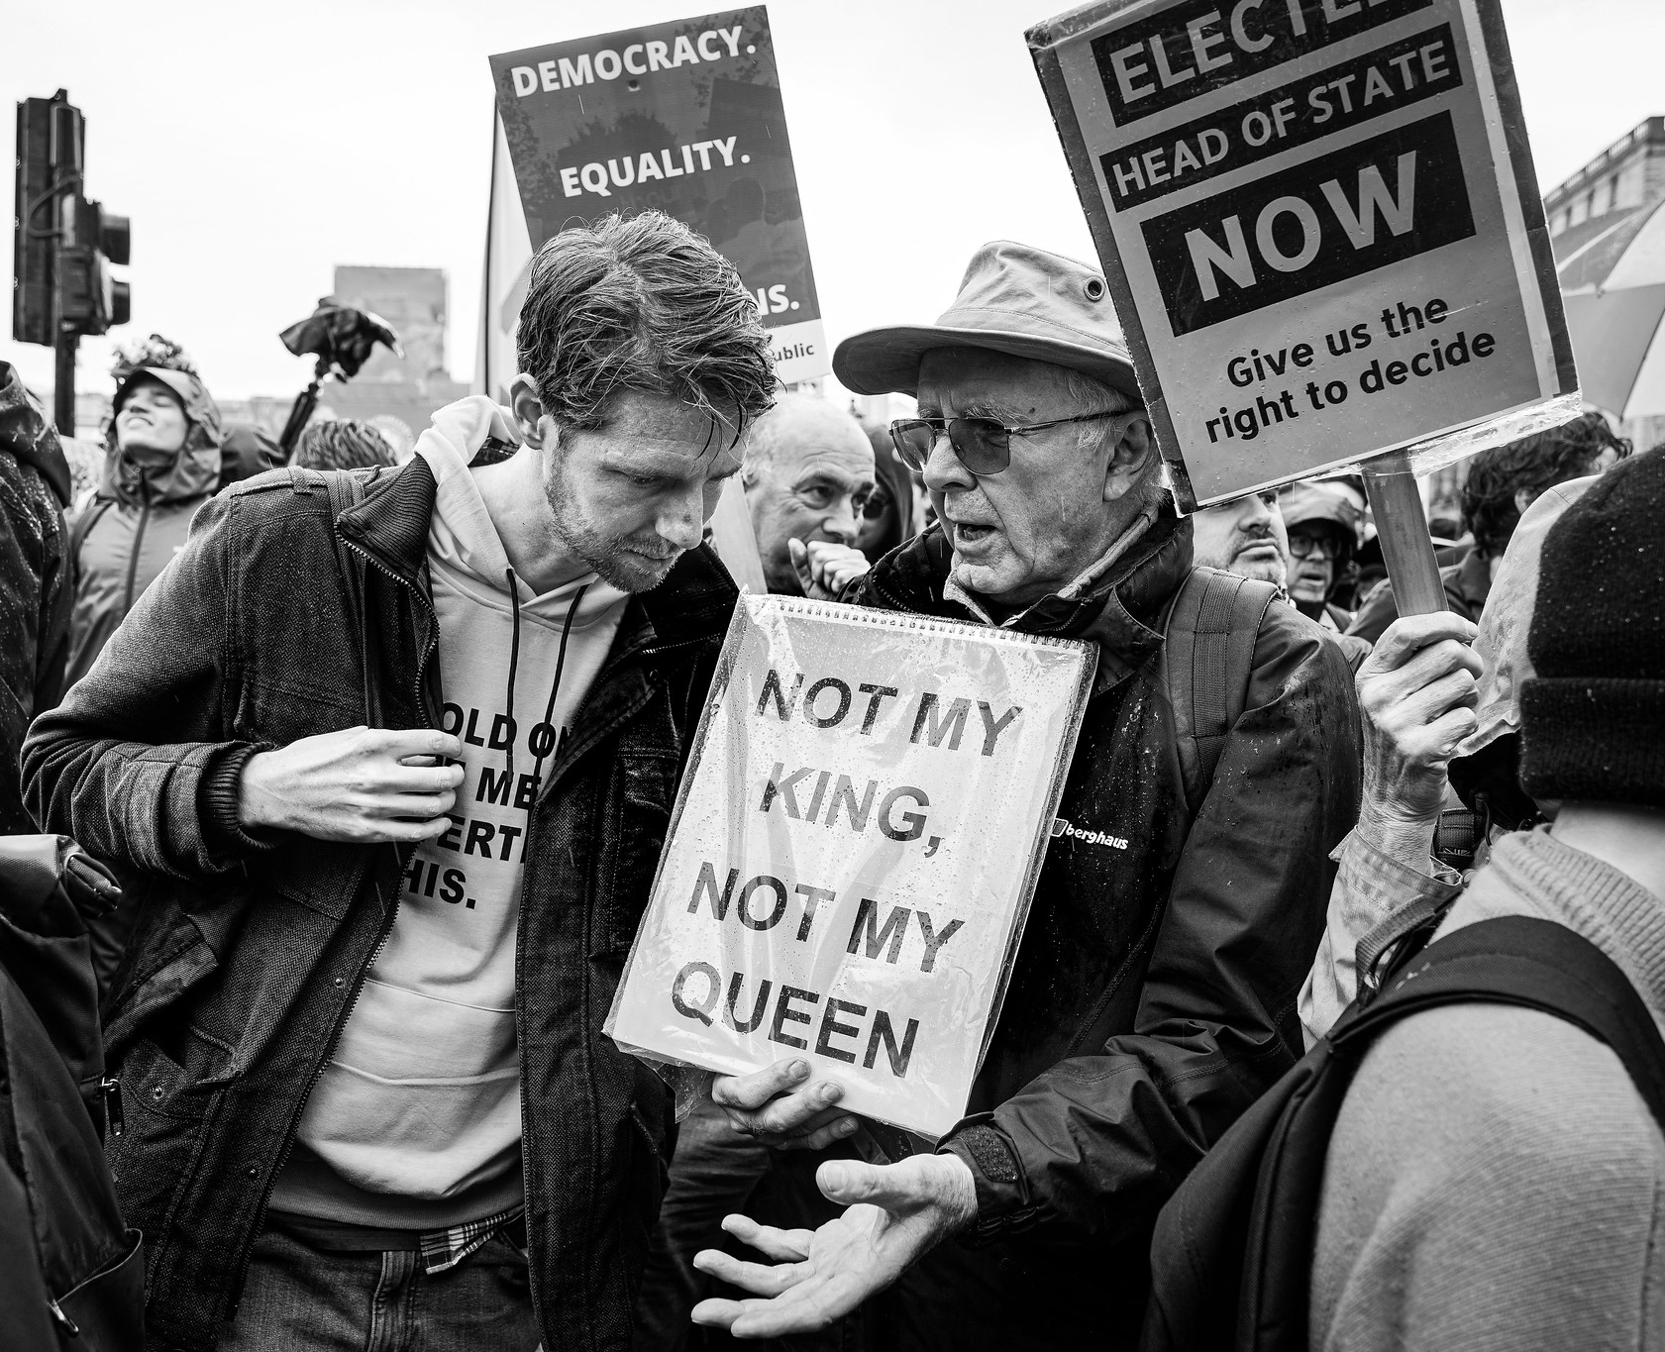
There are a broad range of views about the Royal Family, with many around the country and the world feeling a deep love and affection and others believing the Monarchy is old fashioned and outdated and should be abolished. In 2022 Queen Elizabeth II, who became monarch when Churchill became Prime Minister, died and her son Charles became King; Two years earlier, Prince Harry had stepped back from official royal duties and left the UK with his wife, Meghan Markle. There are a broad range of views about the royal family, with the majority of Britons supporting its continuation and others believing the Monarchy is old fashioned and outdated and that Britain should have an elected head of state.

Slide 17
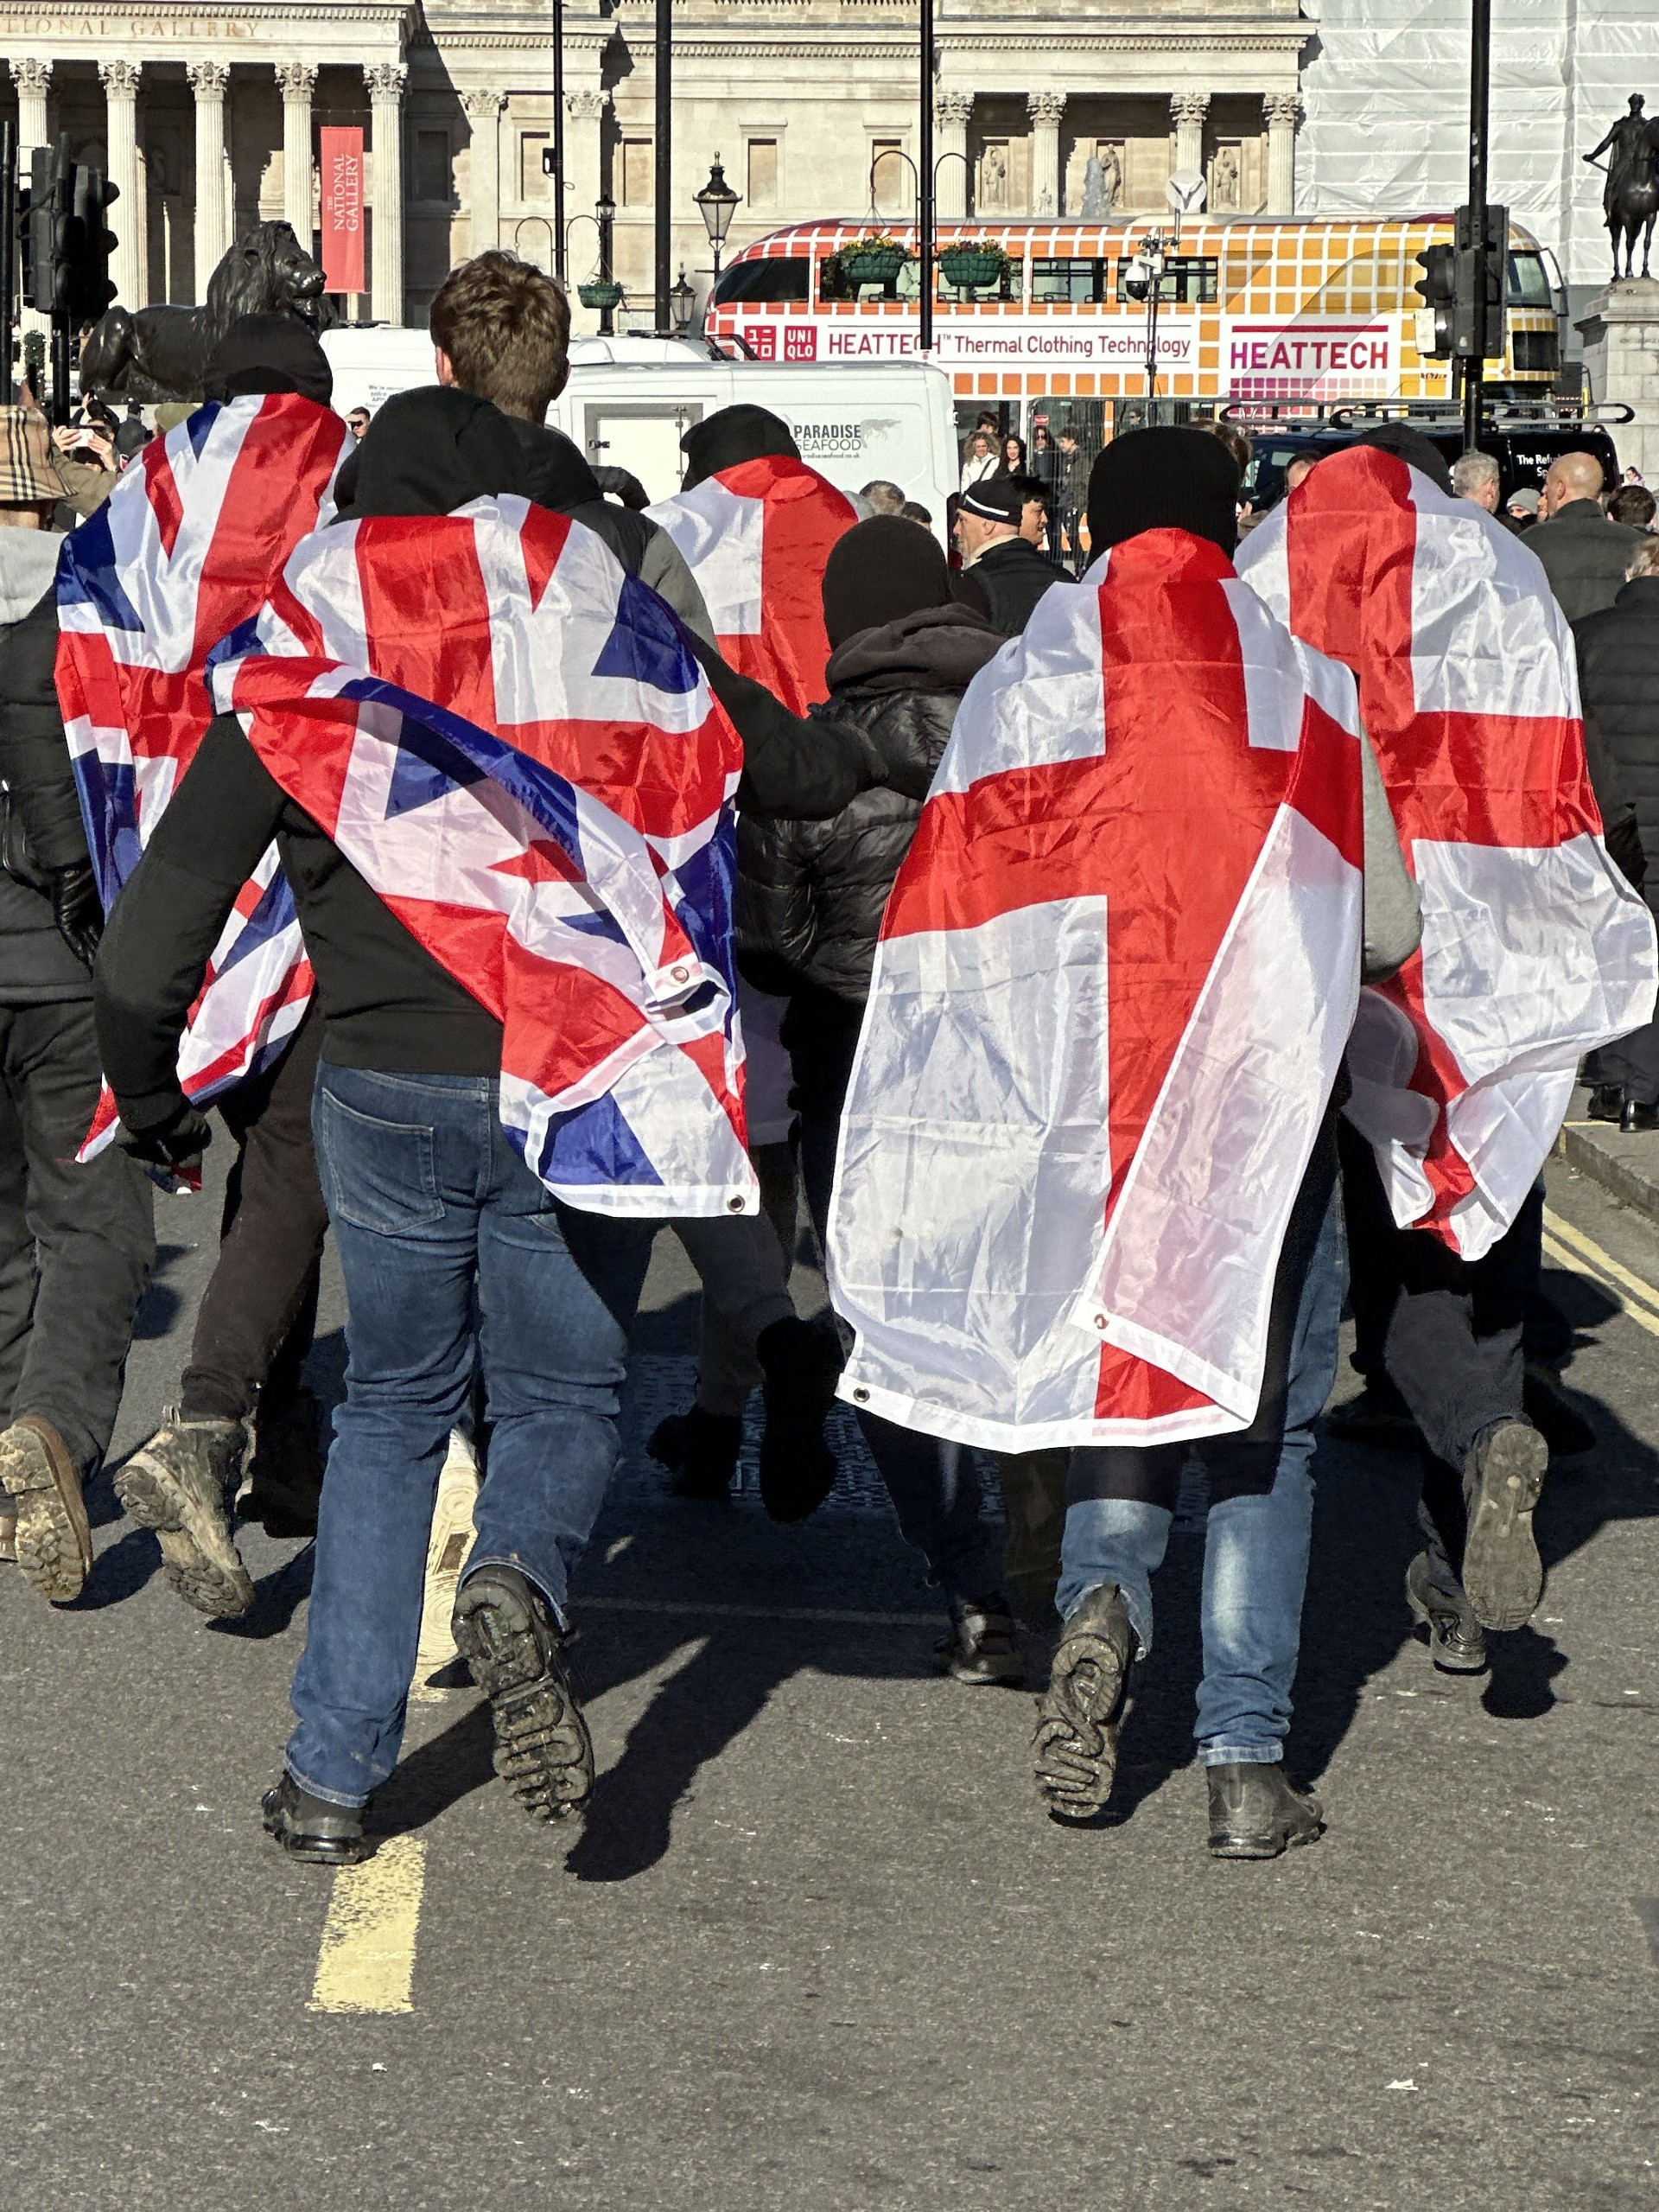
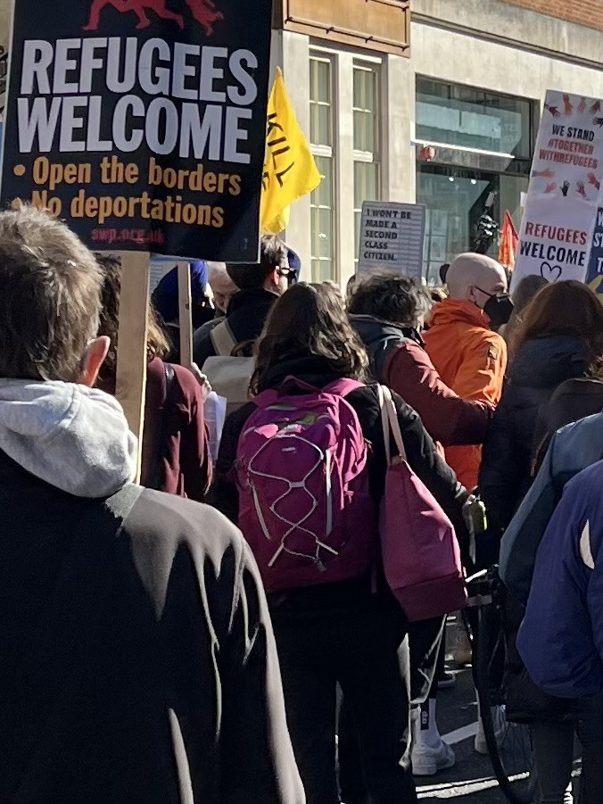
There are a range of feelings about people who come to the UK from other countries, from those who believe that refugees, asylum seekers and economic migrants should be welcomed to the UK, to those who believe that Britain should not accept people from other countries and reject ideas of multiculturalism (the coexistence and interaction of diverse cultures within a society, where cultural differences are recognised, respected, and valued).
These feelings have led to violent demonstrations from far-right groups and members of the public, whilst large numbers of others have mounted counter-demonstrations expressing a desire for a more welcoming and open society.

Slide 18
Responses
Thinking about the historical events you have studied and the present-day issues you have identified, consider which area you feel most connected to.
  Social issues
  War and diplomacy
  Empire, immigration and their aftermath
Why is this issue important to you?
What would you like to say about it?
Who do you think needs to hear the views you have?

Slide 19
Responses Task
You are going to complete an activity based on your chosen area of interest.
You should use your historical learning as well as knowledge of Britain today to create a piece of work that shows your knowledge, understanding and personal perspective.
You will use this task to demonstrate your knowledge and viewpoint, either to a specific person or group, to other students, to adults, or to the general public.
  Think who you want your audience to be
This activity is an opportunity for you to respond to your learning in a way that suits you.
  You can be as creative as you want!
On the next slide are a range of options for how you can present your work…

Slide 20
Responses Task – menu
Create a piece of Art, Music or Poetry Using either sources from within lessons or of your own research as a basis for your creation. Demonstrate understanding of your key theme. Explain why you have chosen your sources, and what the message of your exhibition is with a short, written commentary. | Write Letter to your MP or a relevant organisation What issue do you want to talk about? How will use past and present events to support your case? What would you like them to do to make a positive change for British people?
Create an Exhibition on your chosen issue Using either sources from within lessons or of your own research. Demonstrate understanding of your key theme. Explain why you have chosen your sources, and what the message of your exhibition is through the descriptions. | Design a Social Media Campaign Using either sources from within lessons or of your own research. Demonstrate understanding of your key theme. Explain why you have chosen your sources, and what the message of your exhibition is through the descriptions. * Do not post anything online before your teacher has seen your work.
Newspaper Article Through your own research tell the story of individuals or groups in the present and analyse their experience of life in Britain using evidence from the past to show how things have or have not changed. This could be based on a relevant local or national news story or event or your own experience. | Essay How did Churchill shape modern Britain? How have your ideas about Britain changed? What does it mean to be British? Choose your own title – check with your teacher first. Build your argument based on evidence from the past and contemporary evidence.
Success criteria: No matter which task you choose you must: Overarching title: How did Churchill shape modern Britain? Make sure you include specific details from your learning in lessons. Use a range of sources of information. Analyse and compare the history to the present as well as describing it.

Slide 21
Churchill 150 competition [1]
Learn About Britain is running a competition for students looking at Churchill’s life and legacy
If you want to enter, you need to prepare an essay of up to 1000 words, a short film of no more than 3 minutes or a piece of artwork giving your response to the following question:
  150 years after he was born, what are your reflections on Churchill’s life and legacy?
This project will need to complete by 14 February 2025 and successful entrants can win prizes in the form of vouchers and the chance to join an expenses paid educational day in London in spring 2025. Winners and runners up will have their work showcased on the Learn About Britain website and at a Parliamentary event on the evening of the educational day in London.

Slide 22
Churchill 150 competition [2]
As you prepare your entry, you may want to think about the following questions:
  How did Britain change under Churchill’s leadership?
  What would our lives look like today if Churchill hadn’t become Prime Minister?
  In leading a war against an enemy like Nazi Germany as Churchill did, is it justified to sacrifice people’s lives in order to defeat your enemy?
  What is the legacy of the British Empire, which Churchill loved so much?
  Should we judge historical figures by today’s moral standards? Can we still consider people who hold attitudes or do things we condemn to be heroes?
You do not need to answer all of these questions or to go up to the word limit – we are looking for honesty, nuance and balance rather than a precise number of words.

