Slide 1
Starter: How much do you remember about Alan Turing?
You have three minutes to complete the fill-in-the-blanks worksheet on your table… GO!​
​
Alan Turing was a brilliant who helped create the first ideas for
. ​
During World War II, he helped break the code, which the army used to send secret messages, helping the Allies win important battles.​
After the war, he worked on and artificial , shaping the future of technology.​
In 1952, he was arrested because being was illegal at the time, and he was treated unfairly, leading to his in 1954.​
Today, he is recognized as a , and his face is on the banknote to honour his achievements.
mathematician
computing
Enigma
German
computers
intelligence
gay
death
hero
50-pound

Slide 2


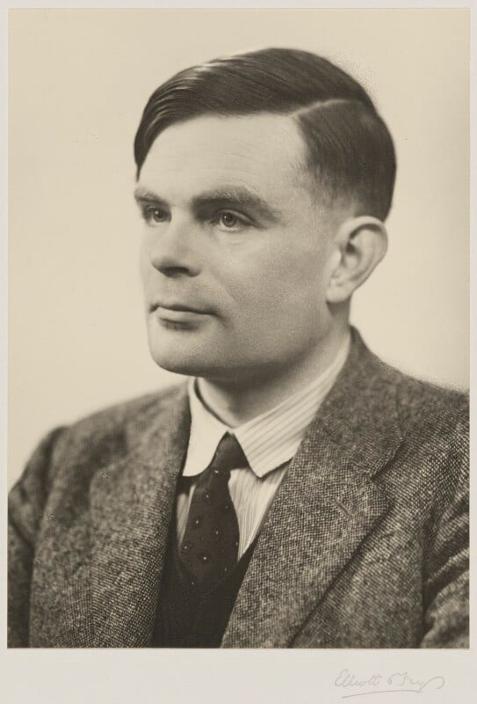
Enquiry Question: Who was Alan Turing and why should we care?
Lesson Title: Being Gay in Britain in the 1950s

Slide 3
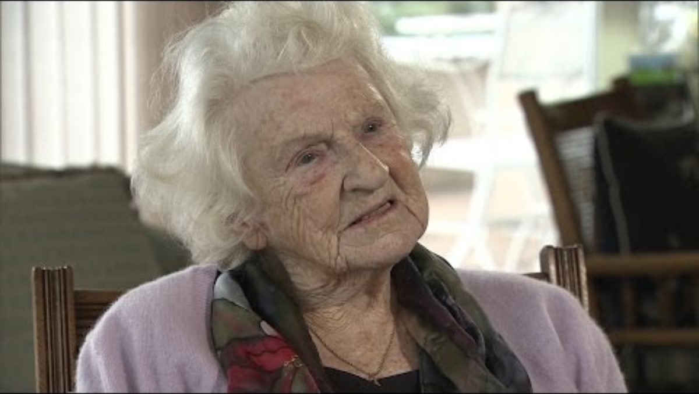
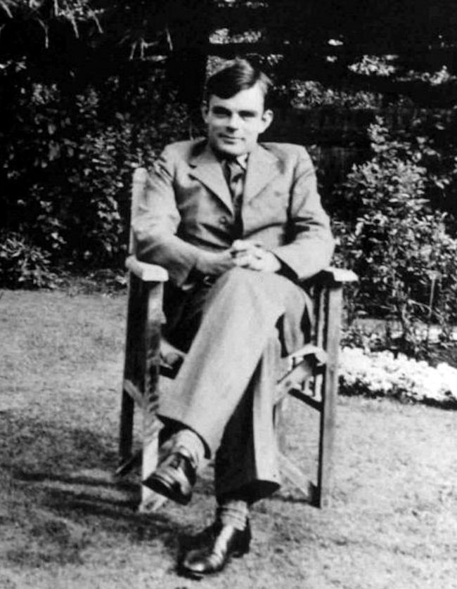
Alan Turing at Bletchley Park
We are going to watch three short film extracts in which two people who worked with Alan Turing at Bletchley Park talk about working with him and what he was like. We will discuss what we can learn from each of the film extracts afterwards.
Nazi code-breaker on Imitation Game hero Alan Turing
The Turing Test was originally called the Imitation Game by Turing in his 1949 paper. It was used as the title of a film starring Benedict Cumberbatch as Turing.

Slide 4
Discussion Questions
What was Alan Turing’s role at Bletchley Park, and why was his work so important during the Second World War?
Olive Bailey describes Turing as having a "lovely sense of humour" but also being
misunderstood. Why do you think some people found him difficult to understand?
The film The Imitation Game portrays Turing as eccentric. Do you think films sometimes
exaggerate real people’s personalities? Why might they do this?
Turing chained his coffee mug to a radiator to avoid losing it. What does this tell us about
his personality and the way he worked?

Slide 5
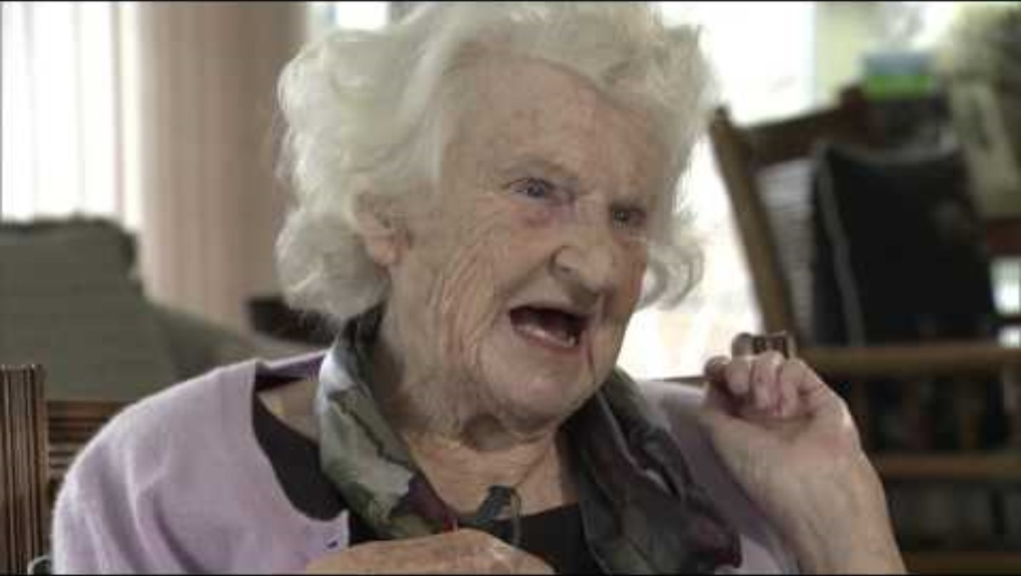
Alan Turing at Bletchley Park
Real "Imitation Game" code-breaker Olive Bailey describes Alan Turing - YouTube

Slide 6
Discussion Questions
What does Olive Bailey say about Turing’s intelligence and personality?
Bailey describes Turing’s sense of humour. Why do you think humour might
have been important for people working in high-pressure environments like
Bletchley Park?
Bailey mentions Turing’s personal struggles, including the fact that being gay was illegal at the time. How do you think this affected his life and career?
Bailey reflects on how Turing’s legacy has been misunderstood. Why do you think it took so long for his contributions to be fully recognised?

Slide 7
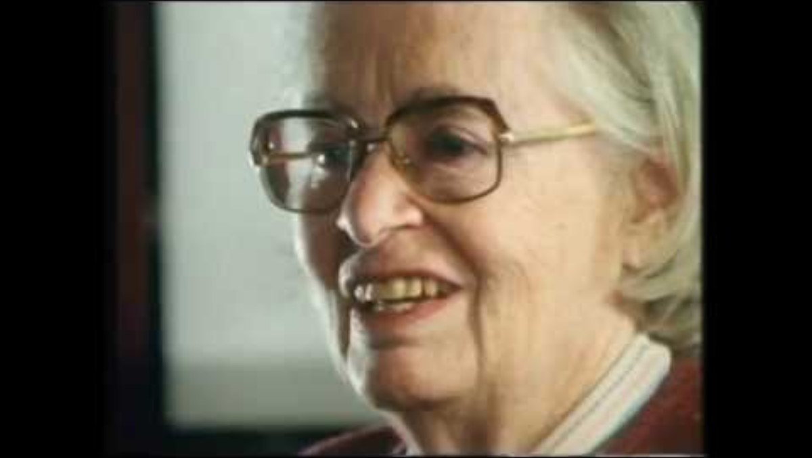
Alan Turing at Bletchley Park
My Engagement to Alan Turing by Joan Clarke (later Joan Murray)

Slide 8
Discussion Questions
Joan Clarke describes Alan Turing’s proposal as unexpected. Why do you think Turing wanted to marry her, despite knowing he was gay?
Clarke describes their relationship as "sweet" and says she wasn’t upset when the engagement ended. What does this tell us about their friendship?
At the time, being gay was illegal in Britain. How might this have influenced Turing’s decision to propose marriage?
Joan Clarke was one of the few women working as a codebreaker at Bletchley Park. What challenges do you think she might have faced in a male-dominated field?

Slide 9
Being gay in Britain in the 1950s
You have been given a worksheet, and your group a set of Information Cards which set out the legal context for gay men in Britain in the 1950s, how this affected Turing and the beginning of changes which eventually led to Turing being given a royal pardon.
Read and discuss the Information Cards in your group and write down answers on the worksheet. Remember to support your answers.

Slide 10
Being gay in Britain in the 1950s
Section 1: Recording Key Information
What were the three main laws used to criminalise LGBTQ+ people in Britain in the 1950s, and how did they work?
How did entrapment (police pretending to be interested in a same-sex relationship to trick someone into breaking the law) contribute to arrests and prosecutions?
Why was Alan Turing arrested in 1952? How did the law at the time justify his prosecution?
What punishment was Turing given by the court? How did it affect his health and career?
What was the Wolfenden Report (1957)? What recommendations did it make about homosexuality?
Give two ways that Turing’s legacy has been recognised in Britain in recent years.

Slide 11
Being gay in Britain in the 1950s
Section 2: Demonstrating Understanding
Why do you think the UK government criminalised homosexuality in the 1950s?
How might entrapment have made life more difficult for LGBTQ+ people at the time?
How do you think Cold War fears affected how the government treated LGBTQ+ individuals?
Why was the Wolfenden Report important, even though it didn’t immediately change the law?
What do you think was the purpose of Turing’s Law, and why was it introduced decades later?
In what ways do you think Turing’s legacy has helped people understand LGBTQ+ history?

Slide 12
Summary
Add your answers to these summary questions to your worksheet.
Alan Turing helped save millions of lives by breaking the Enigma code, yet in 1952, he was arrested for being gay – a crime under British law at the time. His conviction was part of a larger crackdown on male homosexuality, led by people like Home Secretary Sir David Maxwell-Fyfe. Thousands of men were prosecuted, and the enforcement of these laws grew harsher.
The legal system, social attitudes, and government fears in the 1950s were all biased against gay men. Do you think that therefore Turing’s arrest and sentencing were acceptable for the time they happened, even if you believe it would be wrong today?
Do you think Turing was prosecuted only because he broke the law? In which case, why was Arnold Murray not given the same sentence?

