Slide 1

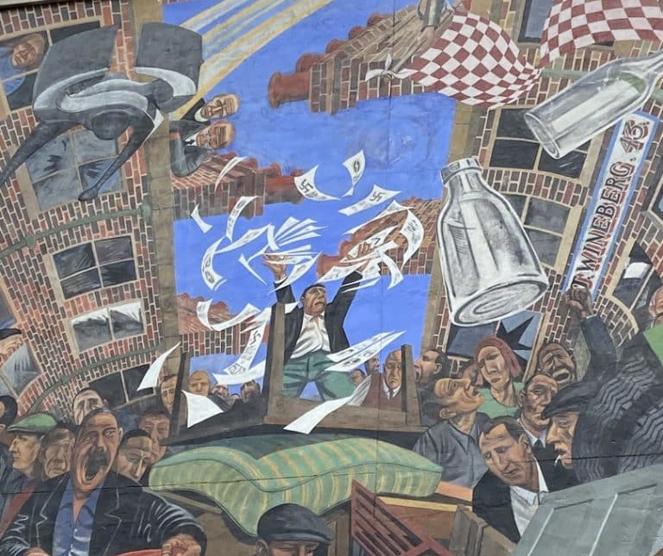
The Battle of Cable Street: Antisemitism & Extremism in the UK
What can the history of antisemitism in Britain since Cable Street teach us about responding to prejudice today?

Slide 2
Problem Solved?
A The Holocaust ended antisemitism YES / NO
B Cable Street ended antisemitism YES / NO
C Antisemitism changed, but did not disappear YES / NO

Slide 3
Whilst watching this short video, make notes on the questions in Task 1 in your worksheet.

Slide 4
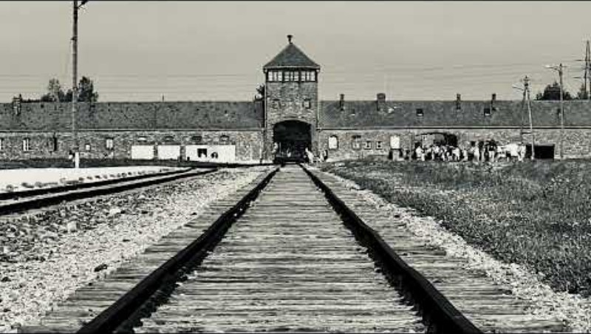

Slide 5
From Cable Street to Today - Checking Your Understanding
How did antisemitism change after the Second World War?
In what ways did antisemitism stay the same after the war?
What was the 43 Group and why was it created?
How did the 43 Group respond to fascism? How was this different to responses to fascism before the war?
How much support did the 43 Group have?
Can you identify any patterns in antisemitism in modern day Britain?
What, if anything, surprises you about the statistics on antisemitism since 2014?

Slide 6
Carousel Group Work
Workstation 1: Post-war antisemitism in Britain
Workstation 2: The 43 Group
Workstation 3: Modern day antisemitism
Task: Your small group has five minutes at each workstation. Discuss the information at each workstation and use it to answer the questions in your worksheet.

Slide 7
Post-war antisemitism in Britain
How did antisemitism change after the Second World War?
In what ways did antisemitism stay the same after the war?
Date | Event | What Changed? | What Stayed the Same?
1947 | Anti-Jewish riots in Britain | Britain no longer has a mass fascist movement | Jewish communities still targeted
1960s-80s | Growth of anti-racist campaigns | Overt antisemitism less socially acceptable | Stereotypes and prejudice remain
1984 | CST begins systematic recording of incidents | Better monitoring of hate incidents | Antisemitism still occurs

Slide 8
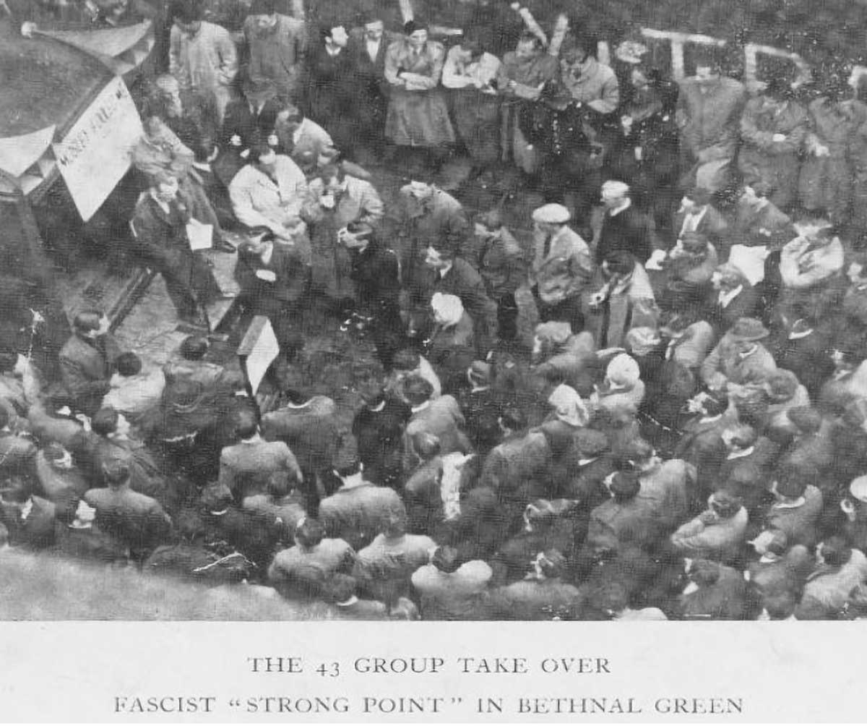
The 43 Group
What was the 43 Group and why was it created?
How did the 43 Group respond to fascism? How was this different to responses to fascism before the war?
How much support did the 43 Group have?

Slide 9
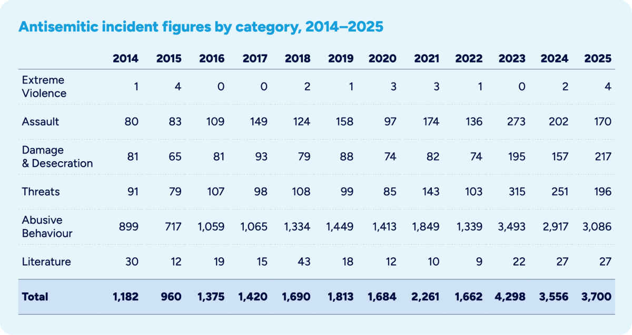
Modern day antisemitism
Can you identify any patterns in antisemitism in modern day Britain?
What, if anything, surprises you about the statistics on antisemitism since 2014?

Slide 10
What responses to prejudice have we come across in this Unit?
Petitions
Community organising
Demonstrations
Education
Art / Murals
Newspapers
Theatre
Campaigning

Slide 11
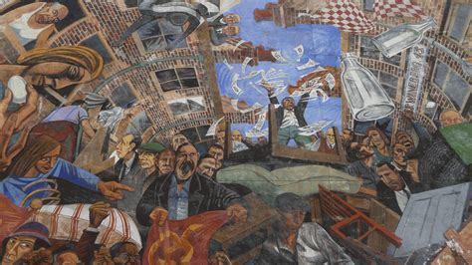
Britain has come a long way since before the Second World War and is a much more tolerant country than in the 1960s, 70s and 80s.
How can we ensure that “the spirit of Cable Street” lives on in the face of intolerance and prejudice?

Slide 12
End of Unit Project: “The Spirit of Cable Street”
Why is the spirit of Cable Street still relevant in modern Britain?
You are going to work in small groups to show how “the spirit of Cable Street” is still alive, with you.
You have a Planning Sheet with guidance and instructions for your task. There are three things you will need to do.
In your small group, DISCUSS examples of prejudice and intolerance, then agree on one of these to respond to. It could be something big, such as racism or antisemitism, or it could be something local – even in your school.
Next, DECIDE on a suitable method for tackling the issue you have chosen. It should be something achievable.
Then, DO IT – create a plan of how you will tackle the issue you have chosen.

Slide 13
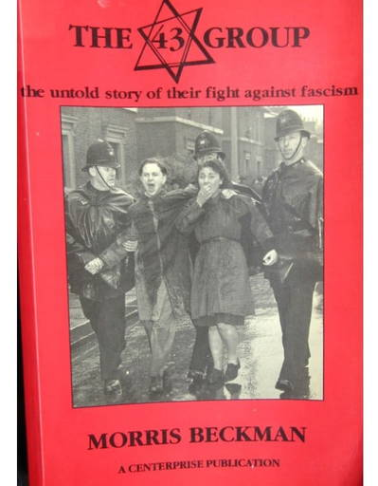
The motto of the 43 Group was known as the ‘3Ds’:
Discuss:
The problem
Decide:
The action
Do it:
The potential impact
Use this approach to help you identify and respond to prejudice and intolerance.

Slide 14
The Battle of Cable Street: Antisemitism & Extremism in the UK
What have you understood?
In the 90 years since the Battle of Cable Street, have intolerance and prejudice become less acceptable? How do we know this?
Give an example of how prejudice and intolerance have been challenged since the Battle of Cable Street.
Why is the “spirit of Cable Street” still important?
Why is it important to remember historical struggles for equality and fights against prejudice and intolerance?

