Slide 1

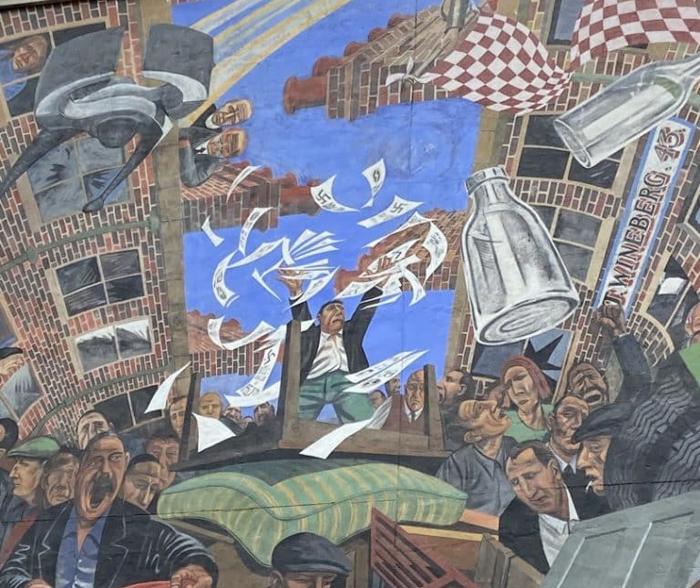
The Battle of Cable Street: Antisemitism & Extremism in the UK
How can we use historical sources to reconstruct what happened at Cable Street?

Slide 2
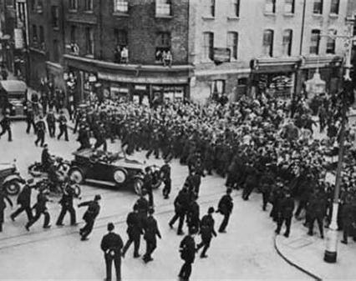
What Did People See at Cable Street?
If 100,000 people witnessed the same event, would they all tell the same story?”

Slide 3
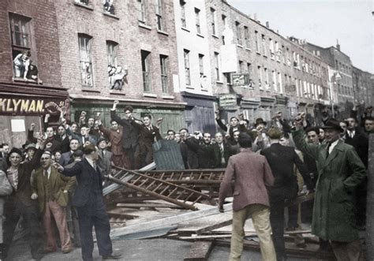
Recapping what we know
Who led the BUF?
Why did they want to march through the East End?
Why did many residents oppose the march?
Why did the Home Office initially allow it to go ahead?

Slide 4
Recapping what we know
Oswald Mosely led the BUF
The BUF want to march through the East End to threaten and intimidate the local Jewish population
Many residents opposed the march because they despised the BUF and were worried about the threat of violence in their community against their Jewish neighbours.
The Home Office initially allowed it to go ahead because it said it didn’t want to stop free assembly or be seen to be ‘taking sides’

Slide 5
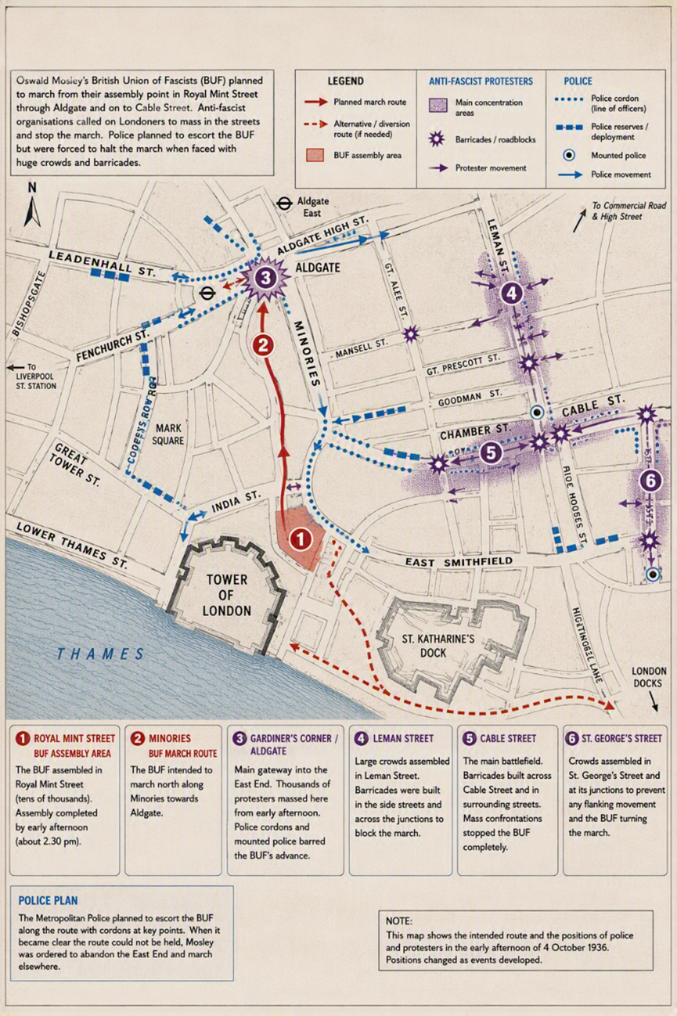
Mapping the Protest
Highlight the following places on your map:
  Tower Hill
  Aldgate
  Gardiner's Corner
  Cable Street
  Leman Street
  St George’s Street
Then answer the questions in Tasks 1 and 2 on your worksheet.

Slide 6
Questions:
Why was Aldgate important?
Why was Cable Street easy to block?
How did geography help protesters?

Slide 7
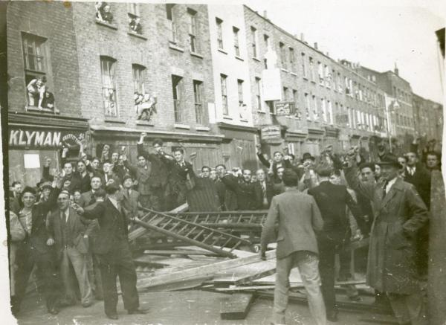
Eyewitness Testimony
Source A: Reg Weston
Highlight:
What people were feeling.
Evidence of organisation.
Evidence of community involvement.
Questions:
Why do you think people came onto the streets?
What emotions are described?
What can an eyewitness tell us that a textbook cannot?

Slide 8
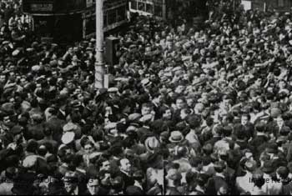
Is seeing the same as knowing?
Reg Weston describes:
Crowds
Rumours
Confusion
Question:
Does being present automatically make someone reliable?

Slide 9
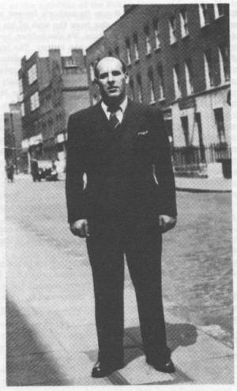
Eyewitness Testimony
Source B: Joe Jacobs
What evidence is there that the Communist Party seems to be organised?
What actions are described?
What emotions are evident?
Summarize how Joe Jacobs portrays events?

Slide 10
Eyewitness Comparison
Discussion:
Do both witnesses remember events in the same way?
Memory is valuable.
Memory can also be selective

Slide 11
Source Investigation – Other Voices
In your pairs, complete Task 5 using Sources C – G
What was the atmosphere like on the day? Did people expect violence?
Is there evidence that young people were politically active, even though they could not vote?
Who were protestors mainly in conflict with? Does this surprise you?
What can we learn about the range of people involved in the protests?
What does the building of barricades tell us about the involvement of the local community?

Slide 12
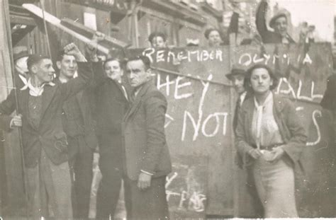
Eyewitness Testimony
Source C: Pathé News
Questions (Task 6):
Are there any details that appear in the newsreel which were not in the written accounts you have seen?
Which source seems most convincing? Why?
Any other points of interest?

Slide 13
Source Investigation: The BUF Perspective
In your pairs, complete Task 7 using Sources H – K
What was the atmosphere like amongst the BUF?
How would you describe the fascists attitude to violence?
According to the sources, what did the fascists think about the day of the march?
What other points of interest can you take from these sources?

Slide 14
Source Investigation: The Police Perspective
In your pairs, complete Task 8 using the report from Sir Phillip Game and the information about Bill Fishman on your Information Sheet.
  What were police trying to achieve?
  Why did protesters become angry with police?
  Why might police officers describe the day differently from protesters?
  What do you notice about the number of arrests and who was arrested?
  Do the numbers of arrests show whose side the police might have been on?

Slide 15
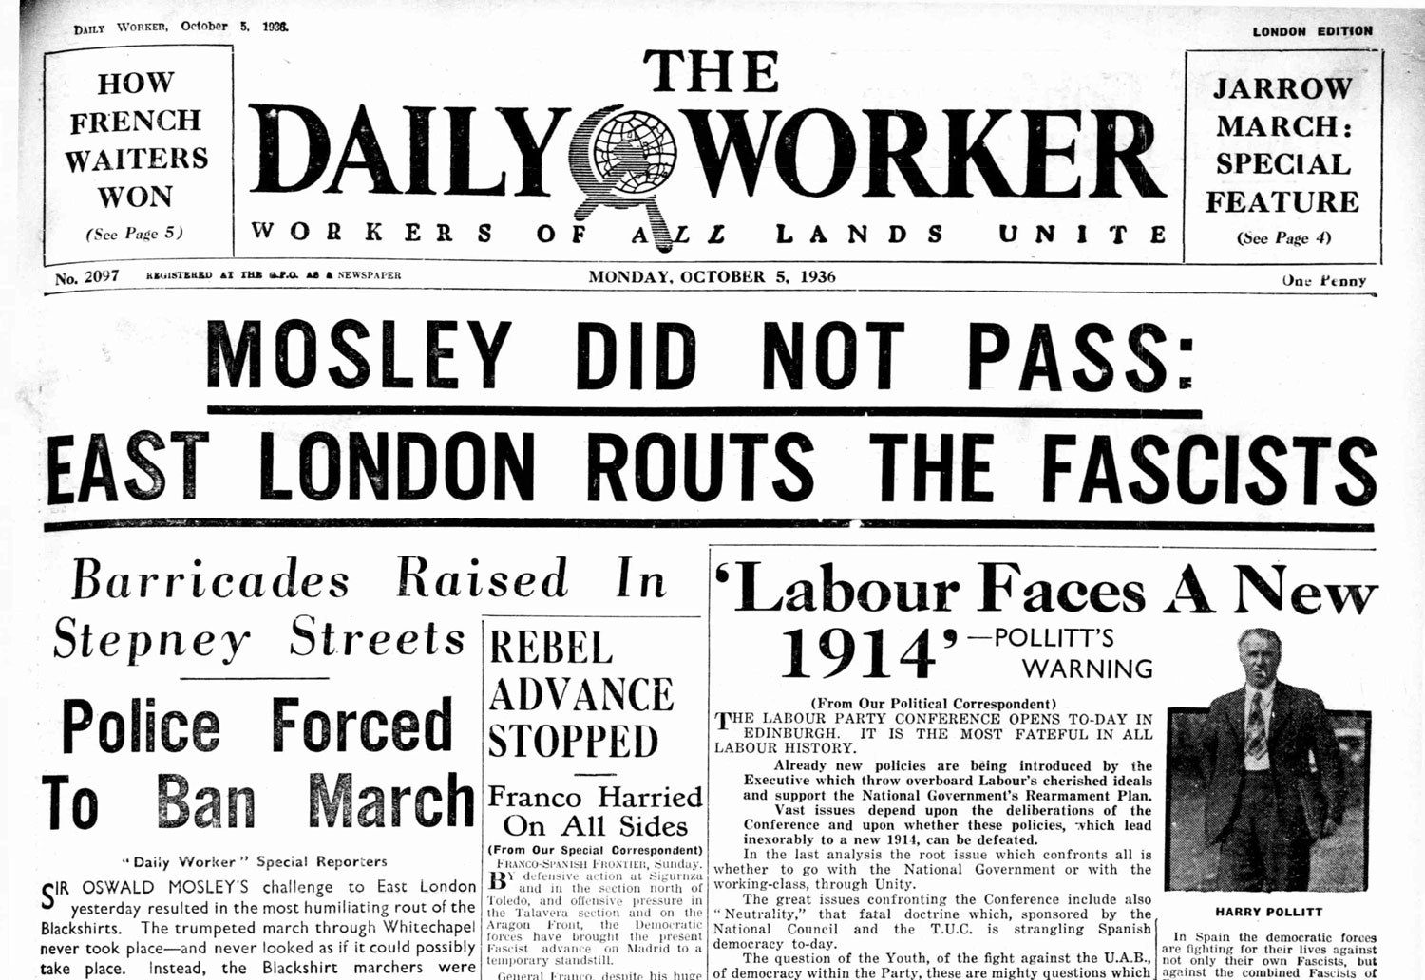
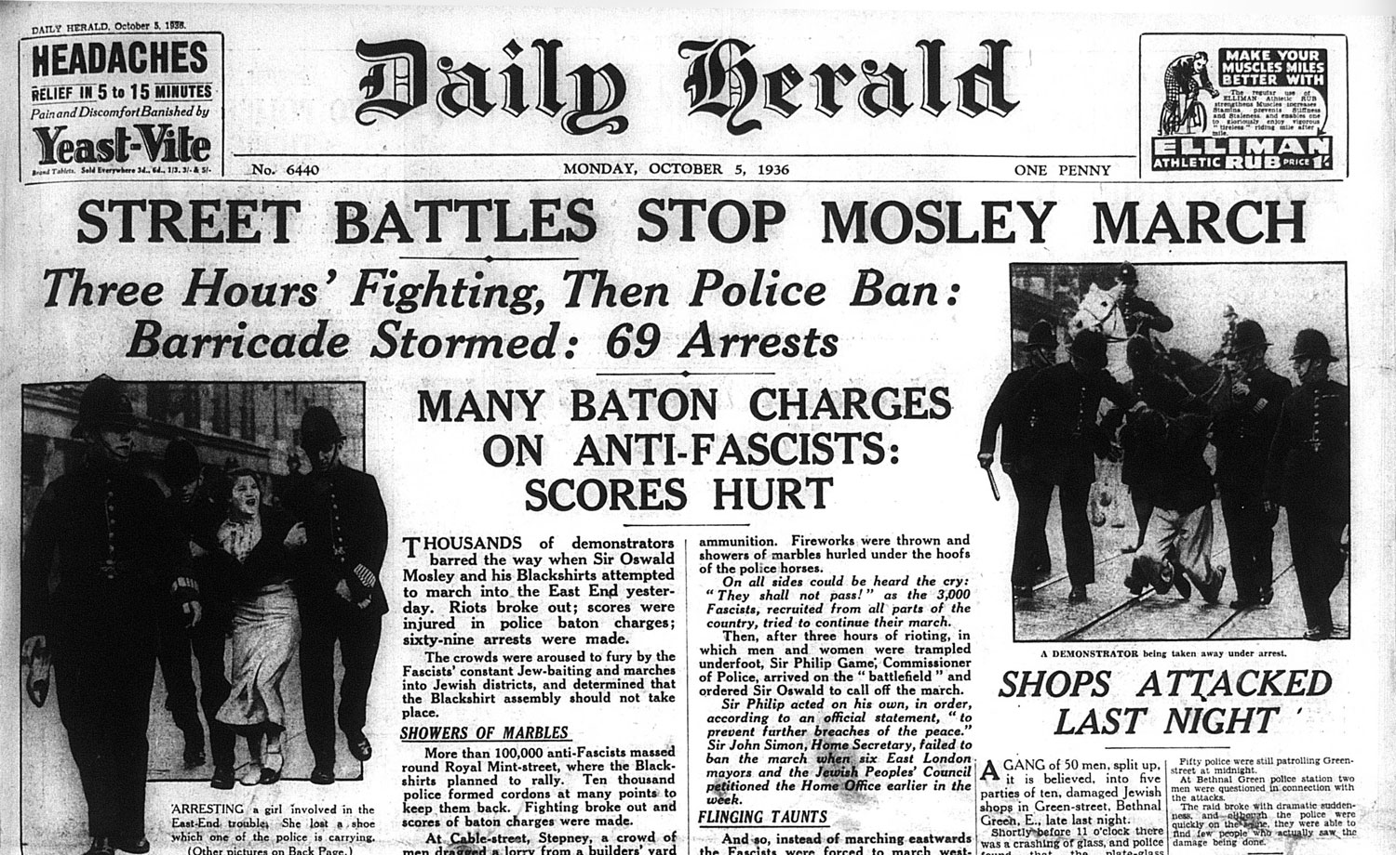
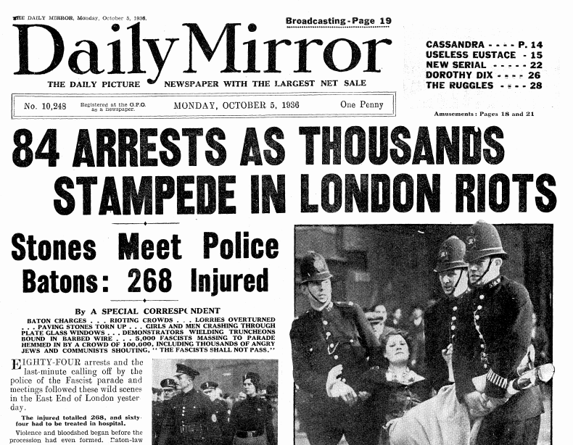
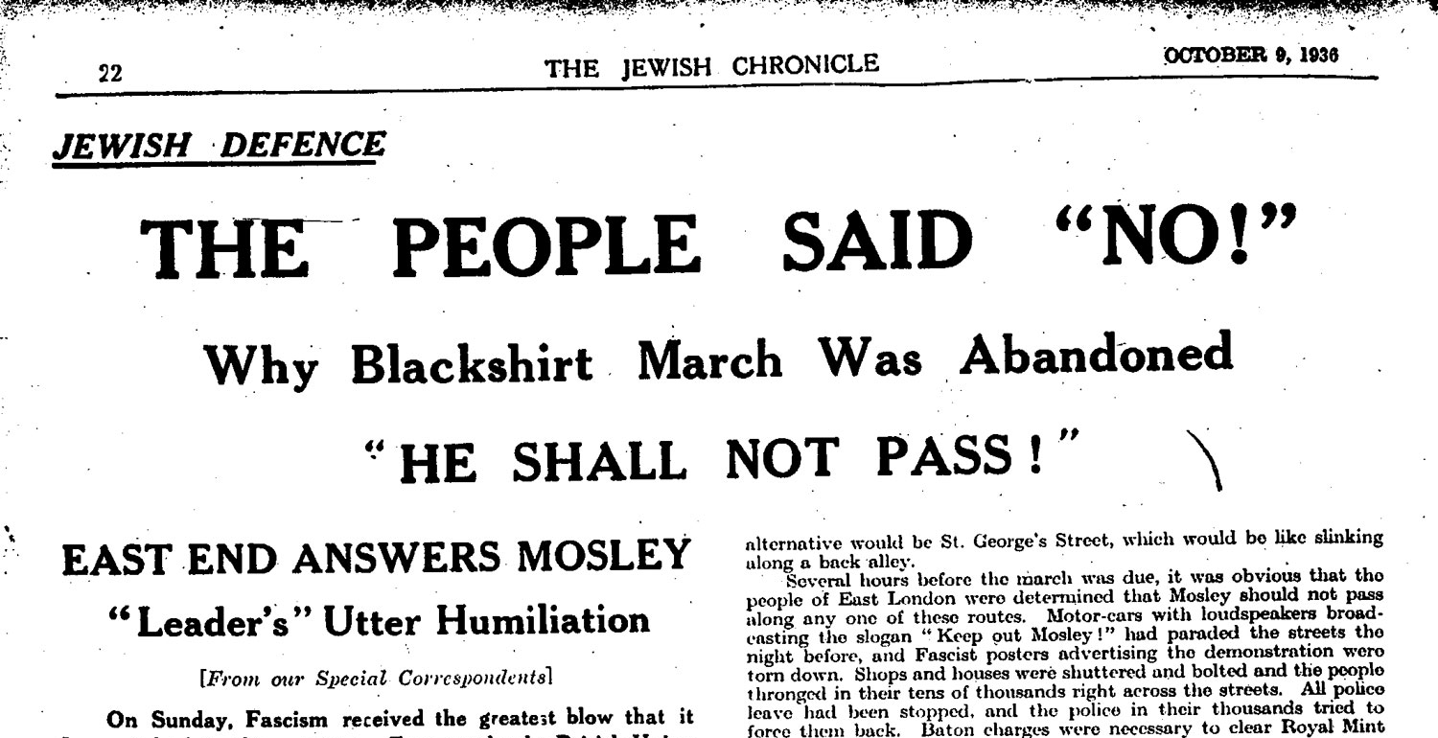
Source M
Source L
Source N
Source O

Slide 16
Which headline sounds victorious?
Which sounds defensive?
Did everybody interpret the day in the same way?
Source L
Source M
Source O
Source N

Slide 17
Arrange these source types from Most Useful to Least Useful for finding out about the Battle of Cable Street.
Source Types
Most Useful Least Useful
Maps Reg Weston Newsreels
Joe Jacobs Newspapers BUF Members
Police Reports Petition Jewish Protestors

Slide 18
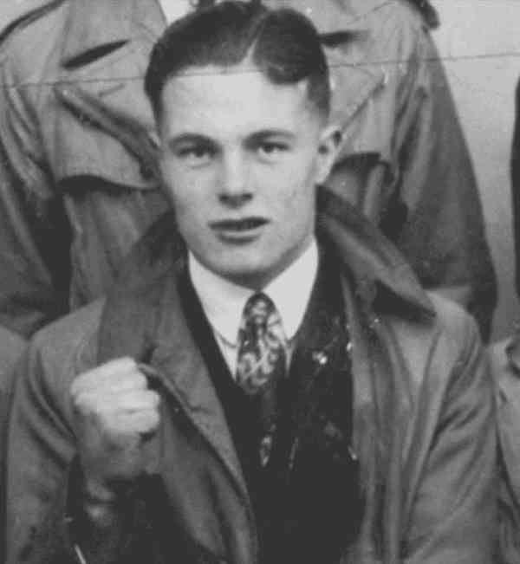
Johnny Longstaff – photograph taken the day before he went to fight fascists in Spain, aged just 17.

