Slide 1


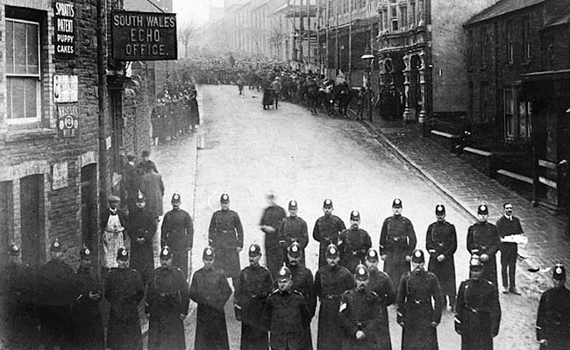
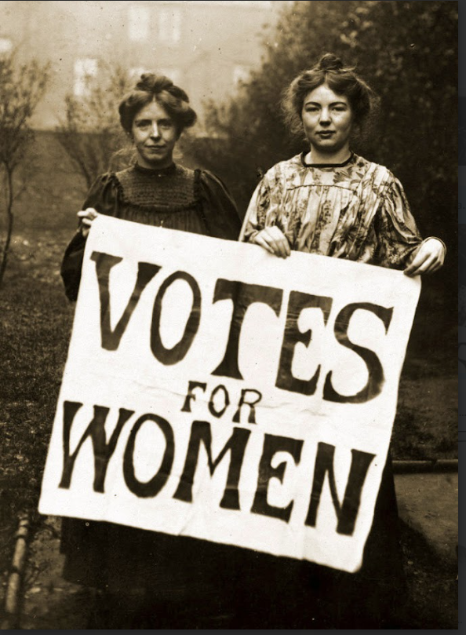
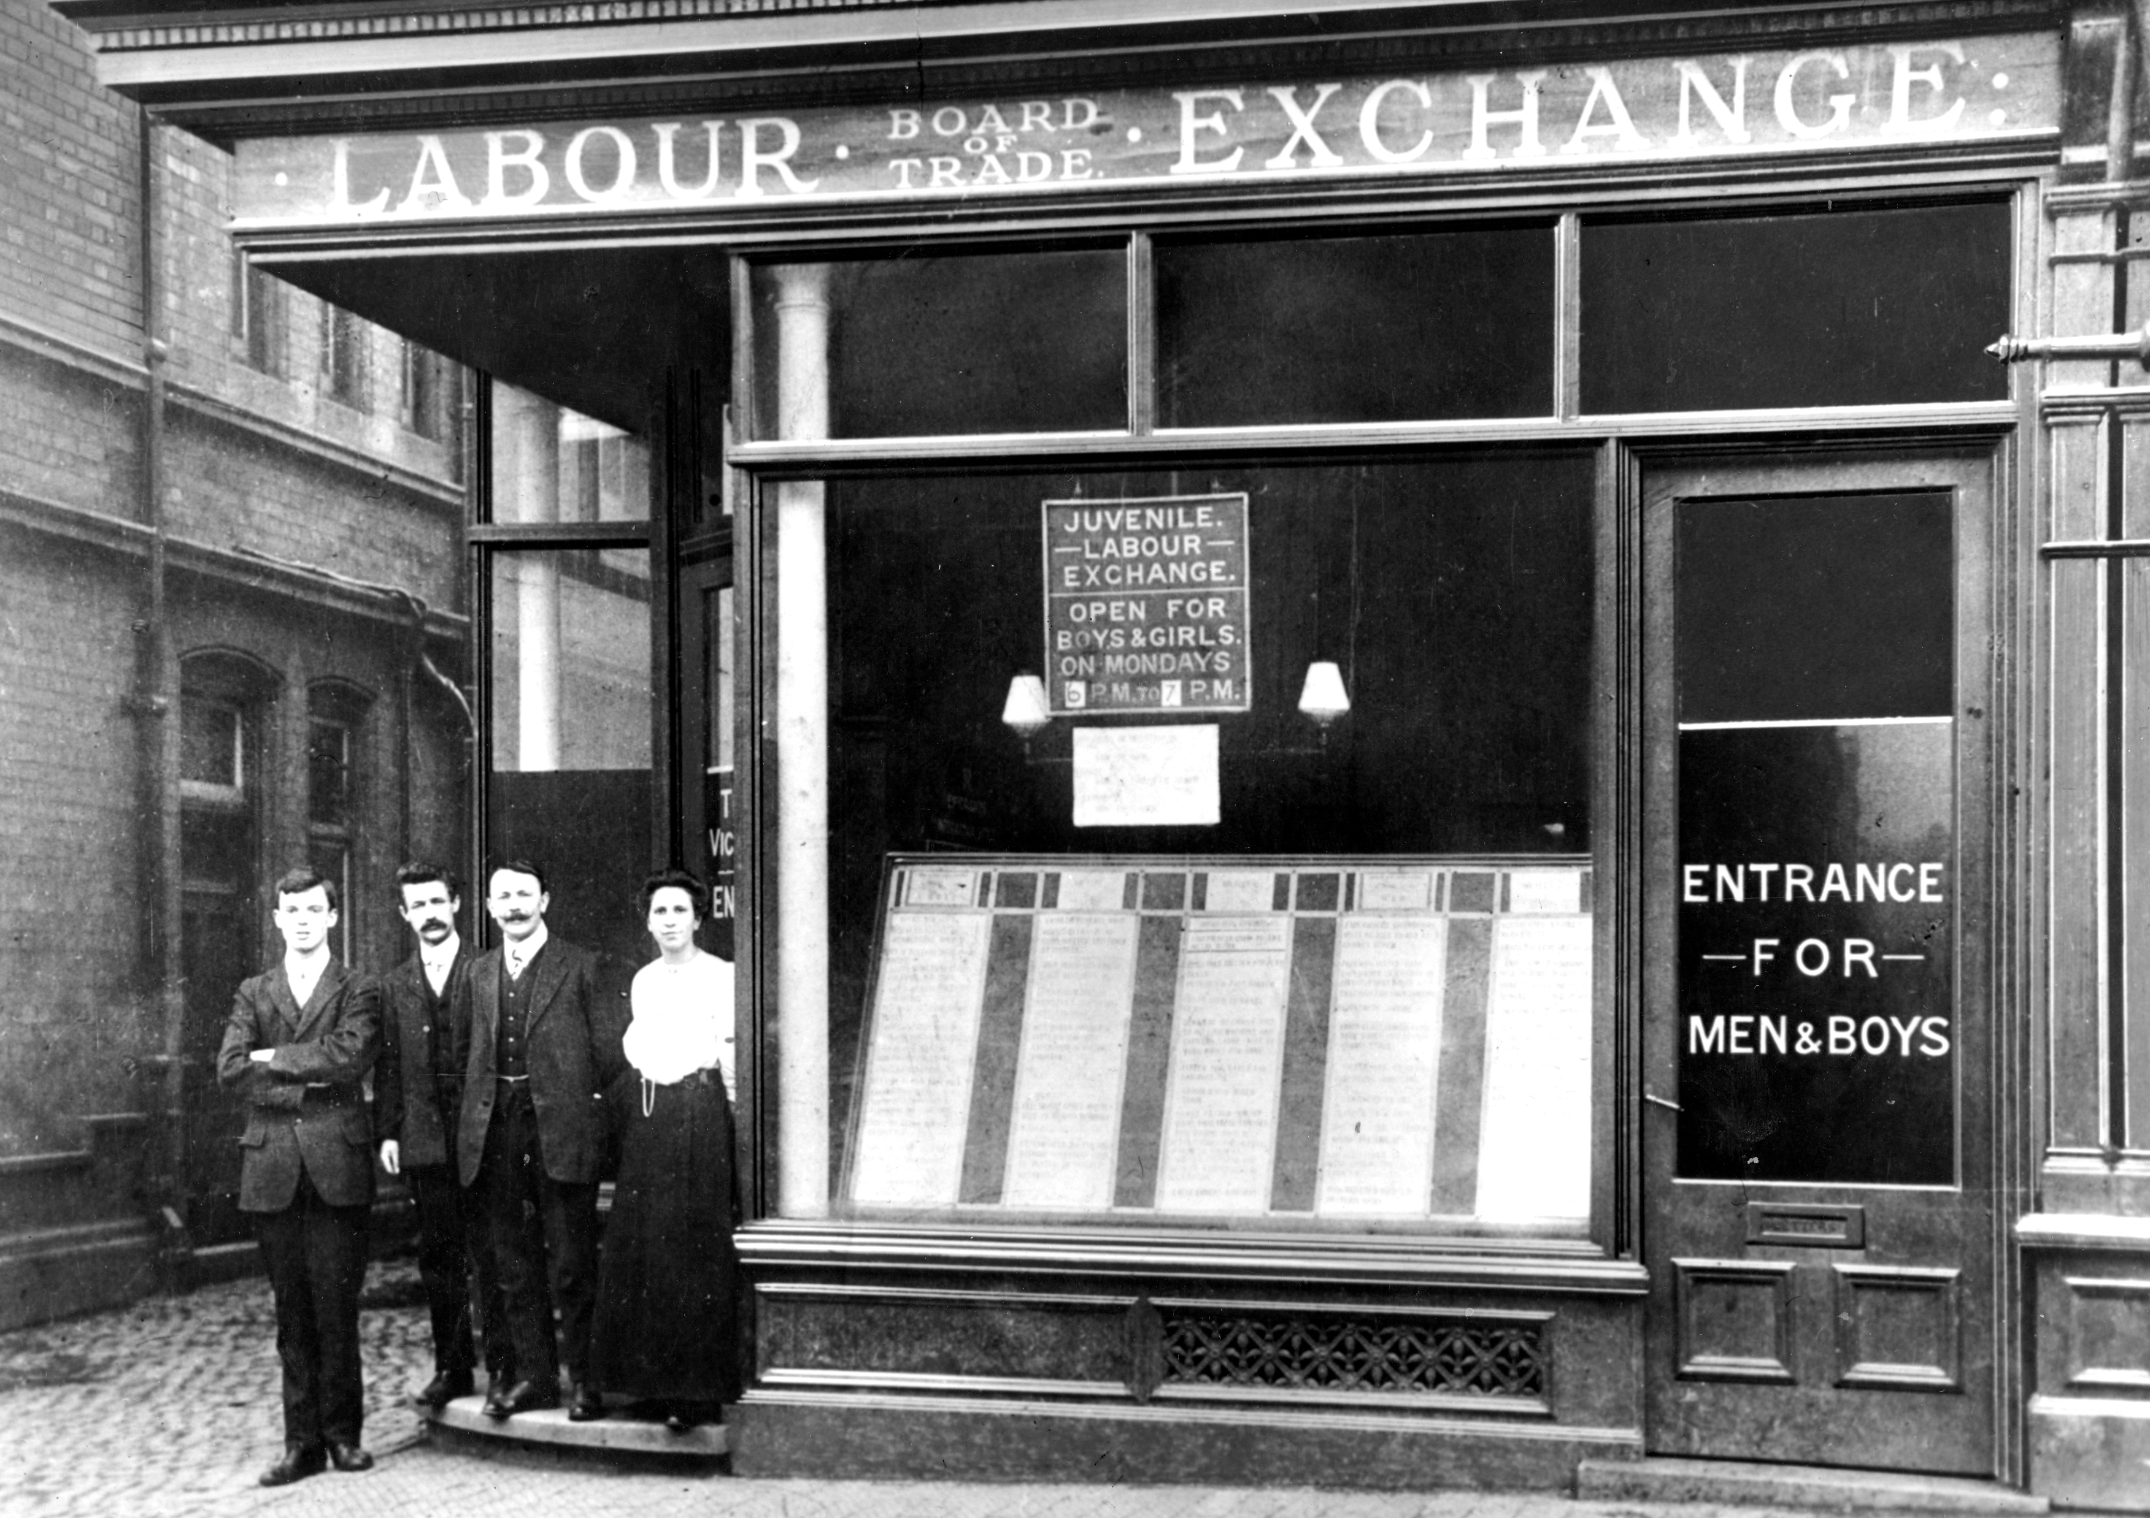
Enquiry Question:
How did Churchill shape modern Britain?
Lesson Title:
What did Churchill do for British people in the early 20th century?

Slide 2
Britain in the late 19th Century
Britain in the late 19th Century
Watch our film about Britain in the late 19th century.
As you watch, add details to the prompts on your handout
Watch the following video about Britain in the late 19th century.
As you watch, add details to the prompts on your handout

Slide 3
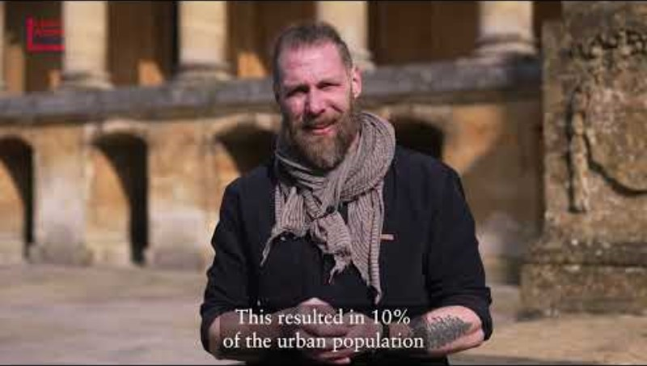
Britain in the late 19th Century

Slide 4
Britain in the late 19th century
Industrial Revolution | Empire | Sea Power | Population
Urban/Rural | Factories | Housing | Working conditions
Life expectancy | Wages | Voting | Men and Women

Slide 5
What did Churchill do for British people in the early 20th century?
As a political figure of growing significance, Churchill was involved in various policies and events which affected British people and how they lived.
In groups read through the info pack on one of the following three case studies:
  Social reforms
  Women's suffrage
  Workers' rights
Complete the relevant section of your handout and consider the following questions:
  What does the case study tell us about attitudes and values at the time?
    What were the priorities for the people and the government?
    Were they always the same?
  What can we learn from Churchill and the governments responses?

Slide 6

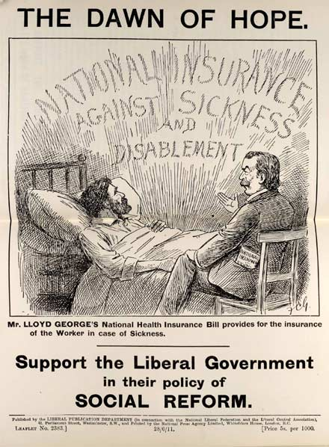
Social Reforms
Trade Board Act, 1909
Workers in trades such as tailoring, lace making and chain making earned very low wages. The Trade Boards Act created a means of negotiating higher minimum wages for these industries. As a result, 200,000 workers benefited, giving them more money for essentials like food and rent.
Most workers were not covered by this Act though, so the impact was limited. Negotiations often took months with the outcomes regularly being only small increases in wages.
Old Age Pensions Act, 1908
For many people, the wages they earned were not enough to save for retirement, therefore some would ‘work till they dropped’, live off charity, or face living in extreme poverty in old age.
The Old Age Pensions Act gave people aged 70 and over a weekly income. By 1914 nearly a million people were provided with a pension (money to support them), meaning they didn’t have to work into old age until they died.
However, the average life expectancy of 49 for men and 50 for women meant many people never benefitted, and others had to work through their 60’s even if they were less able. Furthermore, whilst the pension gave 25p a week, studies showed 35p was needed to lift a person out of poverty.
In 1905 The Liberal Party took over the Government with an agenda of social reform to improve the living standards of ordinary people. Between 1906 and 1914 the aimed to tackle poverty in British society. Winston Churchill had joined the Liberal Party from the Conservatives in 1904 and was given the cabinet position of President of the Board of Trade in 1908 before becoming Home Secretary in 1910. Alongside Chancellor, David Lloyd George, Churchill contributed to various Acts which were designed to improve the lives of ordinary people.
‘It’s not much unless you haven’t got it.’ Winston Churchill
Labour Exchanges Act, 1909
Labour exchanges were the first Job Centres in the UK. They gave unemployed people a place to go to find new jobs, making searching for work much easier. This help both the unemployed and businesses fill positions quicker.
62 Labour Exchanges were opened in 1910 and by 1914 there were 430, providing an average of 3000 jobs per day.
However, Trade Unions and many employers did not like the idea, and often did not advertise their jobs through Labour Exchanges. Only around 25% of people found work through Labour Exchanges.
National Insurance Act, 1911
At the start of the 20th century unemployment of sickness could quickly lead to destitution, so the government introduced the National Insurance Act. This provided people with money to survive if they were unemployed or too sick to work. Workers, employers and the government all contributed to this fund meaning people could survive even if they were unable to work.
National Insurance was only available in certain industries like construction and shipbuilding, so many people, particularly women, could not benefit from it. Workers also complained that their wages were so low contributing to the scheme was impossible.
‘It is a serious national evil that any class of His Majesty’s subjects should receive less than a living wage in return for their utmost exertions.’ Winston Churchill, 1909

Slide 7
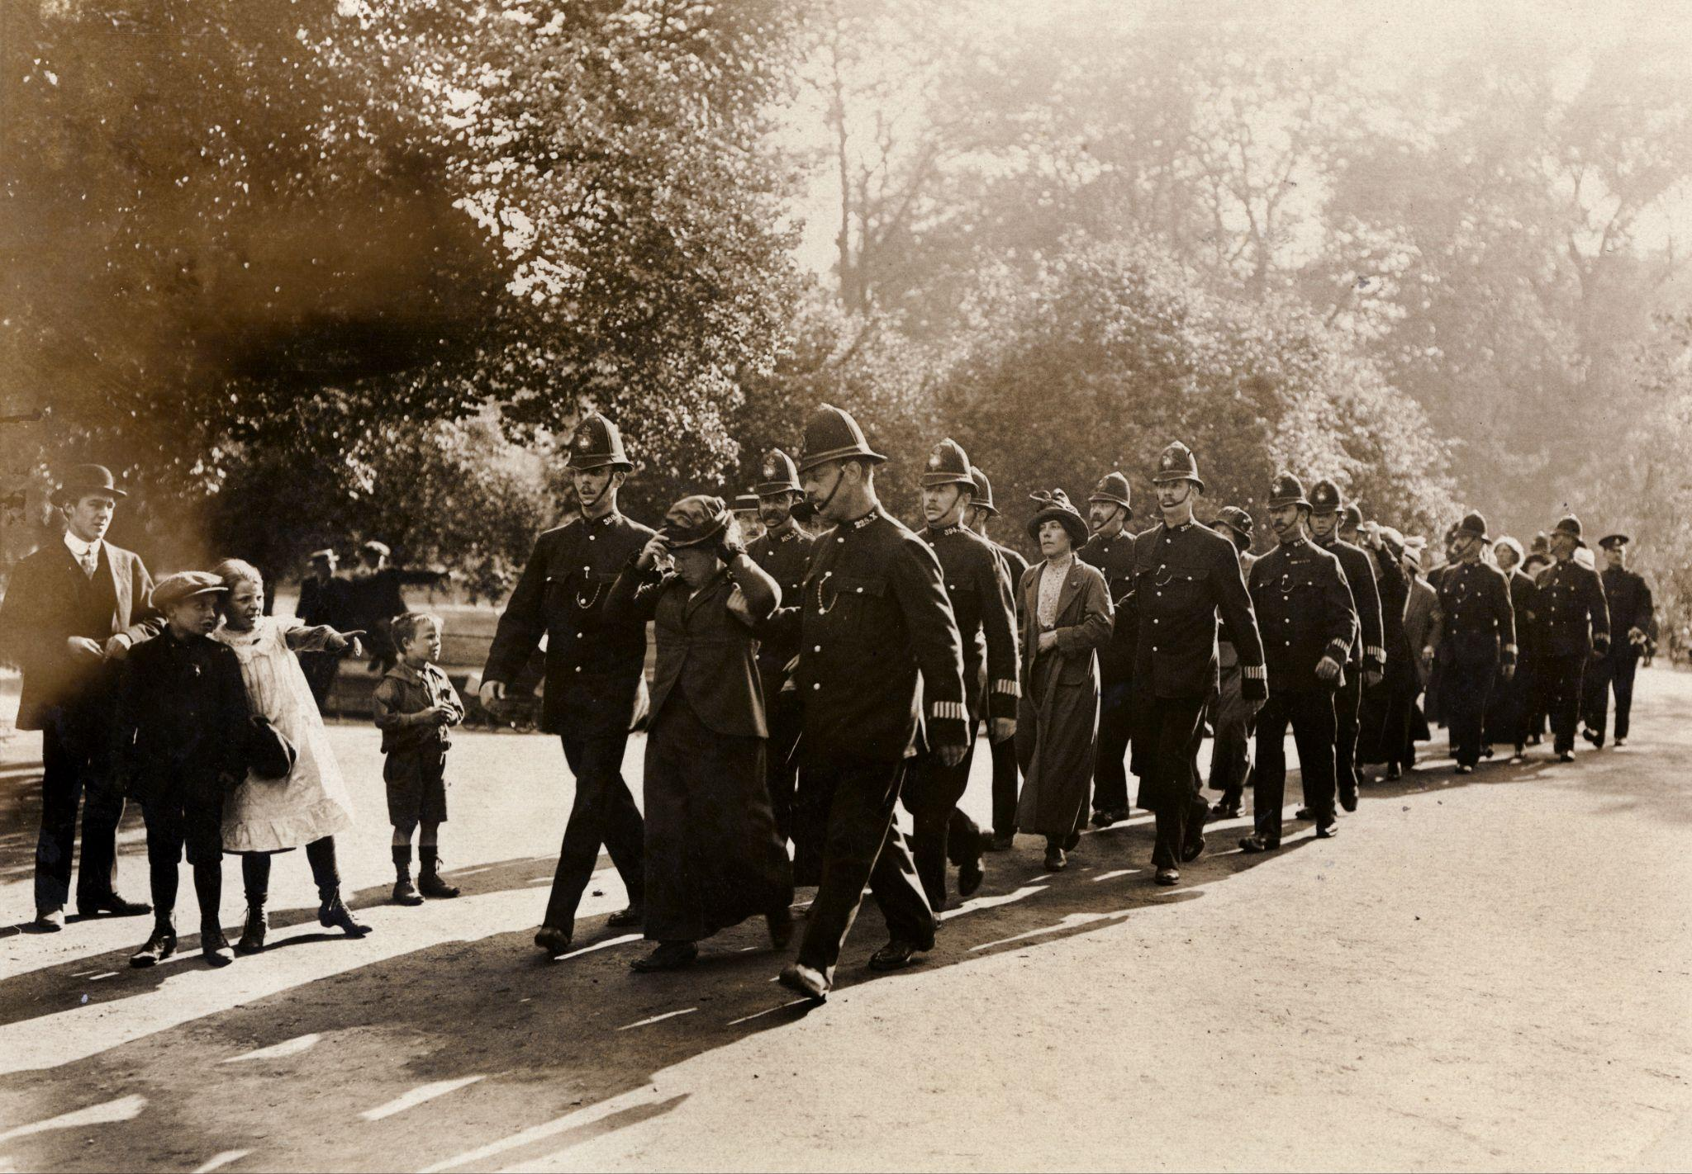
The Women’s Suffrage Movement
Black Friday, 18 November 1910
Black Friday was a suffragette demonstration in London on 18 November 1910, in which 300 women marched to the Houses of Parliament as part of their campaign to secure voting rights for women after Prime Minister Asquith refused to offer a parliamentary vote on women’s suffrage. For six hours women were attacked by police as they protested, with many accounts complaining about the sexual nature of the violence. Police arrested 115 women and 4 men but dropped all charges the following day.
The events were considered a low point in the relationship between the women’s suffrage movement and the government.
At the end of the 19th century not all adults had the right to vote. Most men had gained the right to vote by 1900 but no women could vote. In 1897 the National Union of Women’s Suffrage Societies was formed by Millicent Fawcett to bring campaigning groups together and build a movement. They were known as the Suffragists, and they campaigned through petitions, meetings, marches and pamphlets. However, many male MPs did not think women should be allowed to vote and by 1900 15 attempts to change the law in parliament had failed.
In 1903 the Women’s Social and Political Union was formed by Emmeline Pankhurst. Known as the Suffragettes, they employed militant tactics to raise awareness of their cause including marches, damaging property, chaining themselves to fences and, famously, Emily Davison was killed attempting to pin a badge onto the Kings horse at the Epsom Derby, a major horse racing event, in 1913.
Some women would finally be granted the vote in 1918, and all adult women gained the vote equally with men in 1928.
Churchill and Women’s suffrage
Whilst Churchill was in favour of women having the right to vote in principle. However, when it came to voting on this in Parliament, he chose not to support women’s suffrage and voted against a change in the voting laws. As Home Secretary at the time, this made him very unpopular with the suffrage movement.
‘I am ,however , anxious to see women relieved in principle from a disability which is injurious to them whilst it is based on grounds of sex.’ Winston Churchill, 1910
Hugh Franklin was a member of the recently founded militant ‘Men’s Political Union for Women’s Enfranchisement’. On 26 November 1910 he found himself on the same London-bound train as the Home Secretary. Franklin attempted to attack Churchill, using a dog whip from his pocket and shouting ‘‘Winston Churchill, take that, you dirty cur’’.’ Franklin was jailed for six weeks. In response, he said: ‘When a man is responsible for having women knocked about and physically injured by others – when, in addition, he insults them to their face and slanders them behind their back – he deserves a whipping. It was because I held Mr Churchill guilty on every one of these counts that I determined to punish him in the only way which was open to me.’
‘Already something of a target for proponents of female suffrage … Churchill was now held directly responsible by the suffragettes and their supporters for the behaviour of the Metropolitan Police.’ Charles Stevenson
The census of 1911
Total UK population: 45,221,000.191
25 per cent adult males (11,900,000)
1910 , 7,250,000 men could vote
4,665,000 men could not vote
No women could vote whatsoever .

Slide 8
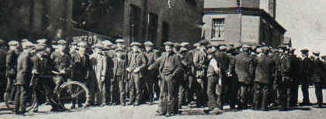
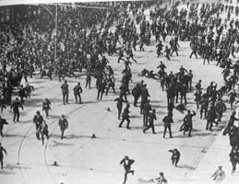
Workers' Rights
In 1911 , 9 per cent of the total industrial population was involved in strikes of various length , compared with 2.6 per cent for 1902.
As the twentieth century began, working class people in Britain were gaining rights. More men than ever could vote, but working conditions were often dangerous, pay was low and hours were long. Meanwhile the cost of living was increasing, meaning working class people were becoming poorer. People who worked in industry used strike action (refusing to work), as a way of bargaining for better pay and conditions. In 1912 a national coal miners' strike lasted 37 days and resulted in new laws guaranteeing a minimum wage. Not all strikes saw such positive outcomes though, and they sometimes became violent as the government was accused of being heavy handed in their response.
Liverpool general transport strike 1911
When the National Sailors’ and Firemen’s Union announced a national strike in June 1911, dockers, railway workers, and other tradesmen in Liverpool joined the strike in solidarity and to protest for better pay and conditions. On August 13th 85,000 people gathered in the centre of the city when the police batton charged the crowd to disperse it. Unrest and violence continued for several days. Over 350 people were injured and two killed after the army opened fire on a crowd.
General Strike 1926
Following a dispute about pay and working hours for coal miners a general strike was announced in May 1926. This meant workers from all industries, including transport workers, dockers, printers and steel and iron industry workers joined in, bringing some 1.7million people out on strike. The government had been prepared for this strike and used the armed forces and volunteer workers to maintain services.
The general strike lasted for 9 days, from May 4th – 12th and whilst there were skirmishes with police and strikers it was largely peaceful. The strike ended in failure for the workers to secure the pay and work hours they wanted and in 1927 a new law was passed making sympathy strikes illegal.
Churchill was the Chancellor at this time, but also edited a pro-government newspaper British Gazette whilst cutting the supply of paper to a worker's newspaper and encouraging the use of armed forces to suppress the strikers.
Tonypandy Riots 1910-1911
In the Rhondda Valley region of south Wales coal mining was the main industry. In 1910, a dispute between miners and the Naval Colliery Company who ran the mines took place over rates of pay and working conditions. When the mine owners closed a mine in response to the workers' demands, a strike of 12,000 miners began across the valley closing all but one mine. ‘Strike-breakers’ (workers from other parts of the country) were called in to keep the mine working. Local strikers surrounded the colliery to prevent work taking place. Violence ensued. As police pushed the strikers back towards the town of Tonypandy, charging the mine workers with truncheons, the miners began smashing shop windows and looting. On Churchill’s orders, the Met Police were sent to break up the riot whilst the army were sent and placed on standby nearby. Amidst the strike and riots one man, Samuel Rhys, was killed, whilst 13 miners were arrested, and hundreds of citizens and police were injured.
David Maddox , an author of a book on the Tonypandy Riots, stated ‘The bitterness towards Churchill , which has been passed down the years, stems from the fact that the troops presence made picketing impossible, and effectively broke the strike. It stuck in the craw of the miners that a Liberal government would use the army to side with pit owners over the workers.’
The riots ‘ should be seen as evidence of social fracture as much as of industrial dispute.’ Dai Smith

Slide 9
What did Churchill do for British people in the early 20th century?
 | What happened? | Churchill and government responses | What does this suggest about life in Britain in the early twentieth century?
Social Reforms
The Women’s Suffrage Movement
Workers' Rights

Slide 10
How did Churchill shape Modern Britian in the early 20th Century?
Use what we have studied today and your own knowledge to discuss this question with your partner. Consider:
What do the case studies tell us about Britain in the early 20th century?
What did Churchill do for the British people in the early 20th century?
Be ready to feedback your thoughts.
…And today?
Can you connect the examples and themes we have looked at in this lesson to the present day?

