Slide 1
Town of Glasgow
TOWN MANAGER’S
FISCAL YEAR 2021
RECOMMENDED BUDGET
February 25, 2020

Slide 2
My Premises
Zero based budgeting from the ground up
A Budget is More than $s and ₵
It’s the single biggest policy decision of the year setting
1.) The services you will deliver;
2.) How you will do so; and
3.) The resources you will allocated for it.

Slide 3
Glasgow Funds Overview
The Town of Glasgow has 3 funds for operations
The General Fund, Water Fund, and Sewer Fund
Each fund provides unique services to residents, business owners, and visitors

Slide 4
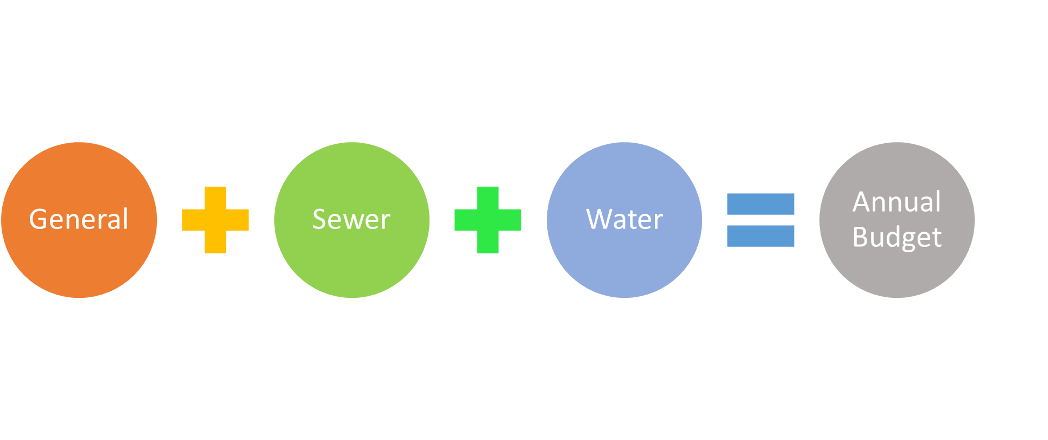
Glasgow Funds Overview

Slide 5
Glasgow Funds Overview
General Fund
General Fund operates primarily based on taxing authority granted from its charter.
The Towns 4 largest sources of revenue make up over 55% of our revenue in FY 2021’s Budget:
  Real Estate Taxes;
  Personal Property / Machine & Tools (M&T) Taxes;
  Sales Taxes;
  Meals Taxes.
Glasgow has certain obligations we must meet that residents pay for through their Town taxes such as: public property, streets, parks, trash pickup, and law & code enforcement.

Slide 6
Glasgow Funds Overview
Water Fund
The Water Fund operates based on its charges for services to customers as a Business-Type-Activity.
Almost 75% of its revenue comes from in-town residents.
There are 4 categories of expenditures: Personnel, Operations, Debt Service, and Capital Expenses.
The largest cost driver by far for the Water Fund is its debt obligations at 56% to the Virginia Resource Authority.
The Water Fund pays a little more than $162,500 a year in debt obligations.

Slide 7
Glasgow Funds Overview
Sewer Fund
Like the Water Fund where a vast majority of its revenue comes from residents at 65%.
The other primary source of revenue is waste from sources outside the wastewater collection system, known as septage. This stream of revenue makes up 22% of the Sewer Funds’ sources of revenue.
Over 80% of the costs for the Sewer Fund are from its Personnel at 39% and Operations at 42%. This is a little more than $225,500 a year.
The remaining costs are as follows: Debt Service 12% and Capital Expenses 7%.

Slide 8
Method of Budget Development
Revenue Projections
At the end of November, I took the average of 5 periods (July - November) and multiplied it out for 12 periods.
I did this for last year FY19 and this year FY20 to compare how close this projection model was to the actuals for FY19.
Many were very close or higher, so I applied the same principal to FY20’s actuals.
This is how I developed our monthly streams of revenue such as sales tax, meals tax, sewer residential, septage, and water residential.

Slide 9
Method of Budget Development
Revenue Projections
For Real and Personal Property Taxes, I took the amount we billed out for each set of taxes and projected:
  87% collection rate for Real Property
  90% collection for Personal / M&T taxes.
In FY18 we collected 84% of our Real Property taxes, and this year we are at 87% so far for collections.
In FY20, we have collected 88% of Personal / M&T Taxes so far. I have us collecting 90% of our Personal / M&T Taxes.
  Mohawk pays roughly $54,000 out of roughly $80,000.
Water and Sewer numbers are based off of Jeff’s recommendations and my projections, with the goal to be realistic of what amount of money coming in next year and not grossly over or under estimate.

Slide 10
Method of Budget Development
Department Head Requests
Department templates were sent out to staff for the following budgets: Police, Trash, Buildings & Grounds, Parks & Rec., Water, and Sewer.
Staff was instructed to request what they needed in the Blue Baseline column and what they wanted next year if I could provide it in the Red Baseline + column.
I sat down and reviewed their recommendations with them one-on-one.

Slide 11

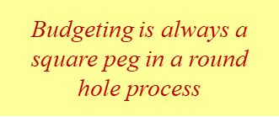
Method of Budget Development
Town Manager Recommendations
I did my best to build this budget from the ground up with the zero based budget approach.
The recommendations are based on what is realistic for what we have spent so far in FY20 and what was spent in FY19 and FY18.
Recommendations are to meet our operational and contractual needs while improving efficiency.
The detail costs column helps explain what the line item is used for in a department.

Slide 12
Method of Budget Development
2 by 2s with Council & Mayor
Once the recommendations were developed, I met with the Mayor & Council members either individually or in groups of 2 and reviewed my recommendations for feedback.
Minor tweaks were made based on feedback from Council.

Slide 13
General Fund Changes From Last Year
From 84% to 87% collection of Real Property
From 88% to 90% collection for Personal / M&T
$6,000 more in sales tax revenue
$2,000 more in meals tax revenue.

Slide 14
General Fund Changes From Last Year
Meeting our fundraising goal of $7,500 for our first annual concert series ‘Rockin the Gorge’
Council set aside roughly $4,000 for the new Town Attorney at $150 an hour billing hourly instead of a flat monthly rate.
Council contingency went down from $26,774 to $7,500 which still meets our financial policy recommendations.
A majority of contingency funds went to starting a Capital Reserve Maintenance Fund (CRMF) program for the General Fund.

Slide 15
Water and Sewer Fund Changes From Last Year
Tweaked allocated costs for employees who are associated to both funds in a manner which balances the funds fairly.
We still have enough money to operate efficiently, meet our debt obligations, while putting money aside for capital replacement and future projects.
The Sewer Fund is now paying the Town’s Water Fund $40,235 next year for its water consumption which is used to meet its DEQ requirements.

Slide 16
Major Policy Initiatives and Projects
i. New Town Attorney with a new perspective on updating ordinances and approaches to legal matters;
ii. Starting a Capital Reserve Maintenance Fund (CRMF) program for the General Fund
iii. Contracting of services with our regional planning district for staff support in updating our Comprehensive Plan which is in line with Council Retreat Goals;
iv. Farmer’s Market Manager and money in the budget for one big event for the market;
v. Canceling the continuance of picking up and hauling off large trash items not included in weekly pick up, with the exception of brush.
  If Council wants to continue to pay for this service, it will need to increase the trash rate from $4.50 a month to $9.00;

Slide 17
Major Policy Initiatives and Projects
vi. Reduction of equipment & vehicle repair costs with creation of Public Works and Utilities Committee;
vii. Hosting first ever concert series ‘Rockin the Gorge’ from May until October estimating $7,500 total or $1,500 per event;
viii. Reducing redundant aid to the regional library system since residents pay for the system through County taxes,
  Eliminating electrical costs and an annual donation
  No other Town of our size provides these to their regional library;
ix. Annually evaluating the personnel cost allocation of employees between the 3 funds;
x. The Sewer Fund paying the Town’s Water Fund for its water consumption.

Slide 18
CIP Recommendations
Make the $7,500 annual contribution to the Capital Reserve Maintenance Fund meeting Town’s financial policies
Multi-purpose vehicle replacing Explorer before putting more money into it vehicle repairs
Treatment plant study which could be refunded through grant
ADA accessible bathrooms at the Farmer’s Market
ADA accessible bathroom and enclosed shower at Hiker’s Shelter
Rehab of basketball court installing a new backboard & rim, new hoop, and resealing of court with Town logo

Slide 19
Goals & Challenges for
FY 2021 & Beyond
Continuing CDBG Planning Grant
Implementation of Delinquent Collection Tax Programs
VDOT Multi-Purpose Trail Project
Updating of Charter, Ordinances, and Comp. Plan
Explore Possibilities of new Town Hall

Slide 20
Items Subject to Change
Health Insurance Premium
VACORP Insurance Policies
VRS Contribution Rates
Council’s recommended Capital Improvement Plan

Slide 21
And Now…
Thanks for your Attention and Patience
I look forward to working with you
Budget Season Starts Now:
Questions Council?

Slide 22
Future Meeting Schedule
Day
Tues | Mar 10 | Council Budget Work Session | 6:00 pm; Library
Tues | Mar 10 | Council Regular Meeting | 7:00 pm; Library
Tues | Mar 24 | Council Budget Work Session | 6:00 pm; Library
Mon | Mar 30 | Council Budget Work Session | 6:00 pm; Library
Tues | Apr 14 | Council Budget Work Session | 6:00 pm; Library
 | Apr 14 | Council Regular Meeting - Budget Adoption | 7:00 pm; Library

