Slide 1

BUDGETING SEMINAR
FOR TOWN AND CITY GOVERNMENTS
Basic Information for Writing a Budget
Notes:
Transition when he mentions movies.

Slide 2
A Budget Tells a Story
STRASBURG
BERRYVILLE
TOMS BROOK
PURCELLVILLE
MOUNT JACKSON
HAYMARKET
MIDDLEBURG
VIENNA
FALLS CHURCH
DUMFRIES
FAIRFAX
STANLEY
OCCOQUAN
BRIDGEWATER
REMINGTON
GROTTOES
FREDERICKSBURG
WAYNESBORO
CHARLOTTESVILLE
CHINCOTEAGUE
WARSAW
AMHERST
ASHLAND
IRVINGTON
LYNCHBURG
VINTON
FARMVILLE
HOPEWELL
CAPE CHARLES
RADFORD
ALTAVISTA
COLONIAL HEIGHTS
WILLIAMSBURG
ROCKY MOUNT
CREWE
HAMPTON
COEBURN
PULASKI
ALBERTA
WAVERLY
NEWPORT NEWS
MARION
SOUTH HILL
WAKEFIELD
NORFOLK
ABINGDON
GALAX
DANVILLE
LAWRENCEVILLE
FRANKLIN
CLARKSVILLE

Slide 3

Notes:
Budget plans your course for the coming year - charts your course

Slide 4
Budget Essentials
Revenues
Expenditures
Capital vs. Operating Budget
Debt Capacity
Taxes
Fraud
Public expectations
The danger of the majority
Communication

Slide 5
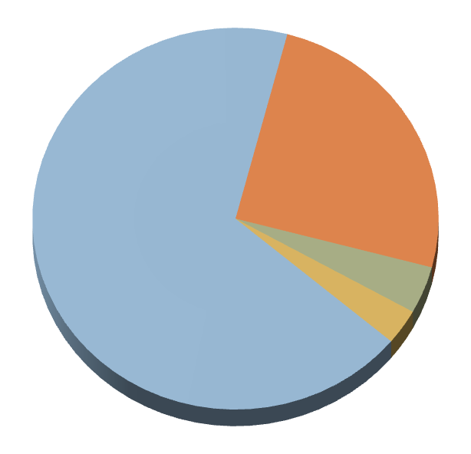
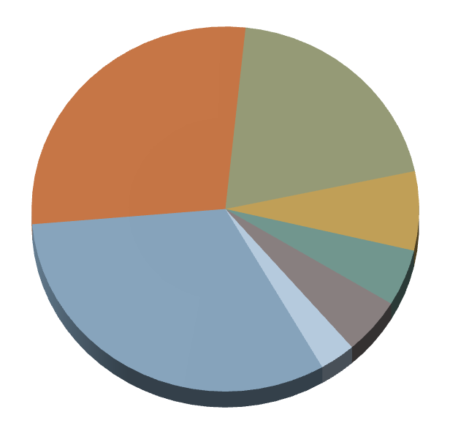

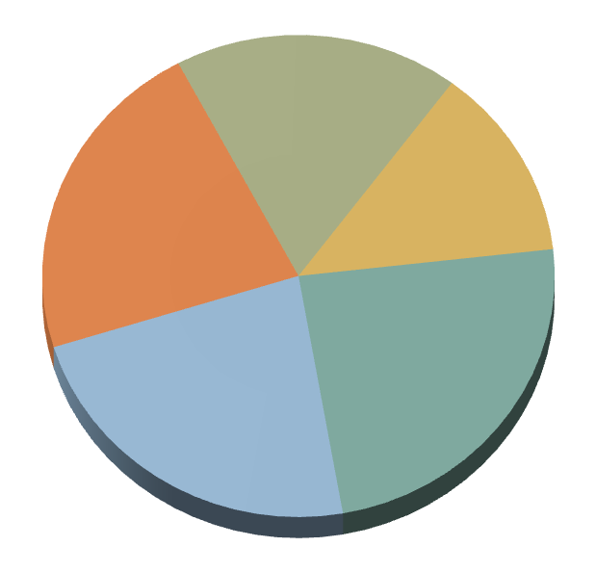
Revenues
Intergovernmental Transfers/Grants 18%
General Property Taxes
13%
General Property Taxes
25%
Sewer Revenue
22%
Intergovernmental Transfers/Grants
68%
Other Local Taxes
24%
Other Local Taxes 4%
Water Revenue
23%
Water/Sewer Revenue 3%
ROCKINGHAM COUNTY
TOWN OF BRIDGEWATER
General Property Taxes
20%
Other Local Taxes
28%
Sanitation Revenue 7%
Intergovernmental Transfers/Grants 32%
Water Revenue 5%
CITY OF HARRISONBURG
Sewer Revenue 5%
Public Transportation 3%
Notes:
Longer discussion

Slide 6
Fiscal Year 2017 Recapitulation
Budget Category | Revenues | Expenditures | Surplus or Deficit
General Fund | 4,044,300 | 4,575,230 | ($530,930)
Sanitation Department | 492,700 | 495,000 | ($2,300)
Sewer Department | 1,795,500 | 1,158,650 | $636,850
Water Department | 1,081,600 | 1,073,670 | $7,930
Stormwater Management | 90,600 | 202,150 | ($111,550)
Total | $7,504,700 | $7,504,700 | $0

Slide 7
Revenues
GENERAL FUND
General Property Taxes | FY 2016 | FY 2017
Real Property Tax | 365,000 | 365,000
Public Service Corporations | 5,000 | 6,400
Personal Property Tax | 174,000 | 201,100
Personal Property Tax (State Portion) | 101,000 | 102,000
Penalties and Interest | 3,000 | 3,000
Total | $648,000 | $677,500
Other Local Taxes/Fees
Local Sales and Use Tax | 185,000 | 187,000
Consumption Tax | 25,000 | 23,000
Communication’s Tax | 95,000 | 88,000
Consumer’s Utility Tax | 386,000 | 397,600
Cigarette Tax | 20,000 | 22,100
Business License Tax | 217,000 | 209,100
Bank Stock Tax | 107,000 | 148,000
Meals Tax | 470,000 | 541,500
Motor Vehicle License Fee | 87,000 | 84,000
Right-of-way Fees | 14,000 | 13,200
Total | $1,606,000 | $1,713,500

Slide 8
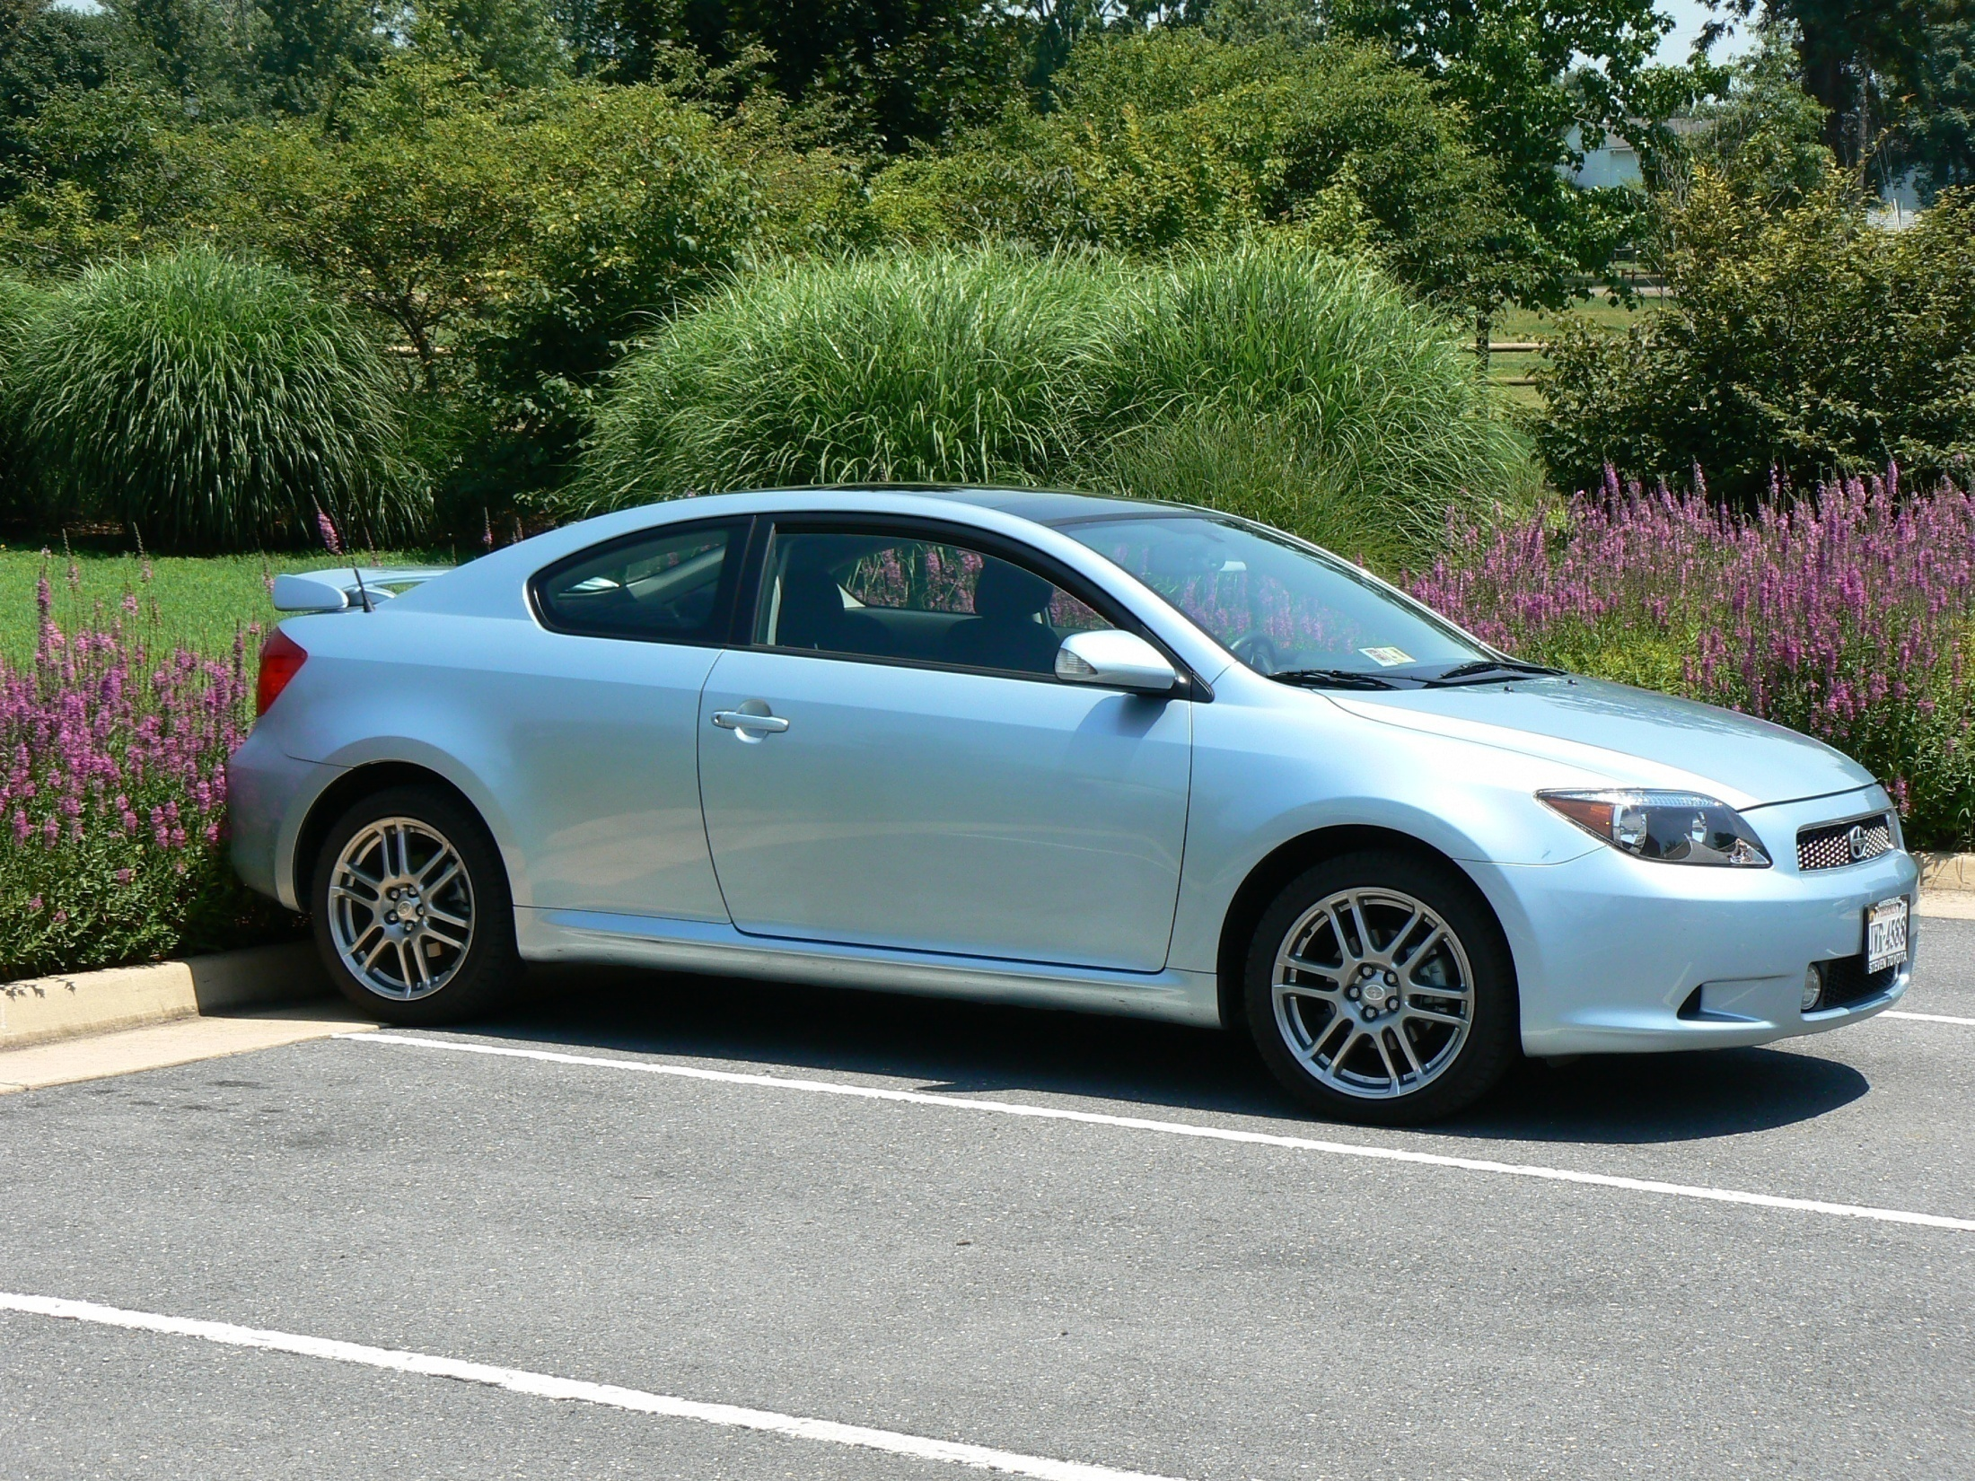
Personal Property Tax Relief
ORIGINAL PLAN OF IMPLEMENTATION
TAX YEAR

Slide 9
Personal Property Tax Relief
EXAMPLE NUMBERS FROM THE TOWN OF BRIDGEWATER
Tax Year | % Relief | $ Relief
1998 | 12.5% | DIRECT RELIEF
1999 | 27.5% | $ 32,693.82
2000 | 47.5% | $ 58,230.06
2001 | 70.0% | $ 92,164.41
2002 | 70.0% | $ 93,366.27
2003 | 70.0% | $ 93,908.08
2004 | 70.0% | $ 92,776.46
2005 | 70.0% | $ 104,183.77
2006 | 61.0% | $ 102,034.14
2007 | 61.0% | $ 102,034.14
2008 | 65.0% | $ 102,034.14
2009 | 65.0% | $ 102,034.14
2013 | 60.0% | $ 102,034.14
2014 | 60.0% | $ 102,034.14
2015 | 56.0% | $ 102,034.14

Slide 10
Revenues
GENERAL FUND
General Property Taxes | FY 2016 | FY 2017
Real Property Tax | 365,000 | 365,000
Public Service Corporations | 5,000 | 6,400
Personal Property Tax | 174,000 | 201,100
Personal Property Tax (State Portion) | 101,000 | 102,000
Penalties and Interest | 3,000 | 3,000
Total | $648,000 | $677,500
Other Local Taxes/Fees
Local Sales and Use Tax | 185,000 | 187,000
Consumption Tax | 25,000 | 23,000
Communication’s Tax | 95,000 | 88,000
Consumer’s Utility Tax | 386,000 | 397,600
Cigarette Tax | 20,000 | 22,100
Business License Tax | 217,000 | 209,100
Bank Stock Tax | 107,000 | 148,000
Meals Tax | 470,000 | 541,500
Motor Vehicle License Fee | 87,000 | 84,000
Right-of-way Fees | 14,000 | 13,200
Total | $1,606,000 | $1,713,500

Slide 11
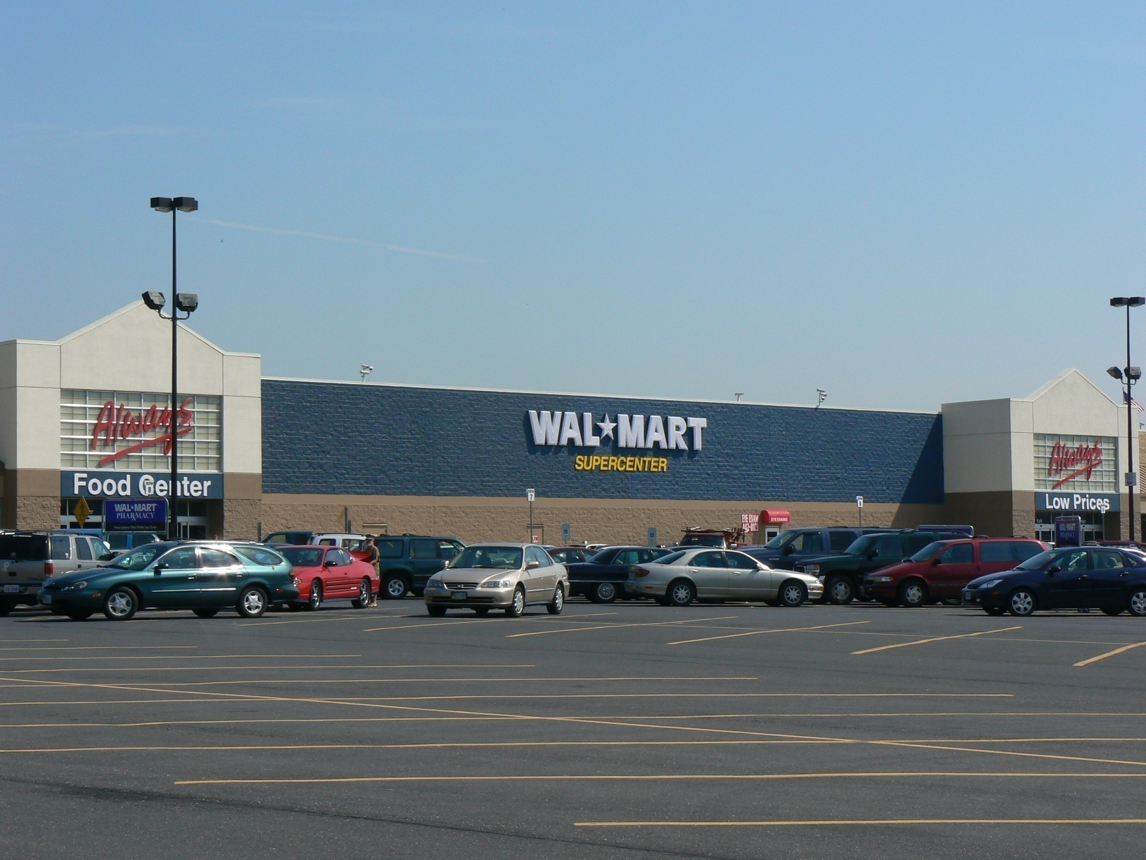

Slide 12
Revenues
GENERAL FUND
General Property Taxes | FY 2016 | FY 2017
Real Property Tax | 365,000 | 365,000
Public Service Corporations | 5,000 | 6,400
Personal Property Tax | 174,000 | 201,100
Personal Property Tax (State Portion) | 101,000 | 102,000
Penalties and Interest | 3,000 | 3,000
Total | $648,000 | $677,500
Other Local Taxes/Fees
Local Sales and Use Tax | 185,000 | 187,000
Consumption Tax | 25,000 | 23,000
Communication’s Tax | 95,000 | 88,000
Consumer’s Utility Tax | 386,000 | 397,600
Cigarette Tax | 20,000 | 22,100
Business License Tax | 217,000 | 209,100
Bank Stock Tax | 107,000 | 148,000
Meals Tax | 470,000 | 541,500
Motor Vehicle License Fee | 87,000 | 84,000
Right-of-way Fees | 14,000 | 13,200
Total | $1,606,000 | $1,713,500

Slide 13
Budget Essentials
Revenues
Expenditures
Capital vs. Operating Budget
Debt Capacity
Taxes
Fraud
Public expectations
The danger of the majority
Communication

Slide 14
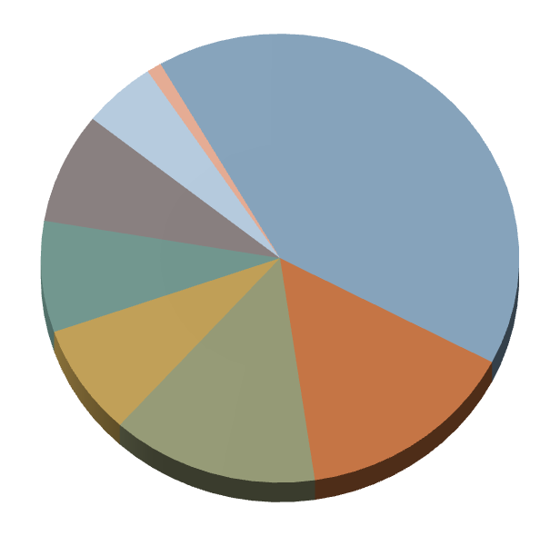
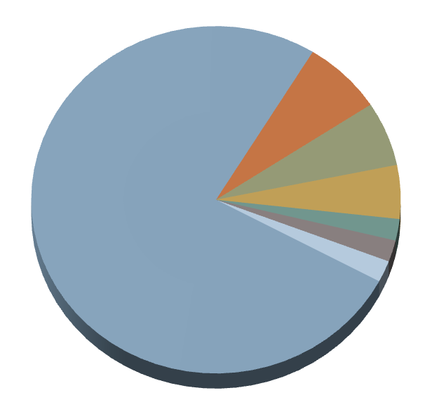
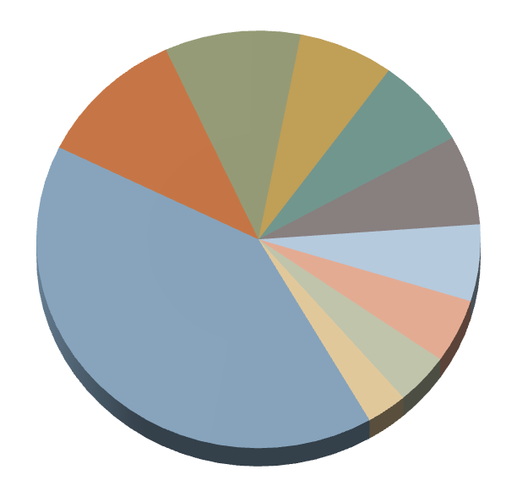
Expenditures
Public Safety 7%
Community Development 1%
Sanitation Department 5%
General Governmental
Administration
6%
General Governmental Administration
8%
Public Works 41%
Education 76%
Human Services 5%
Debt Services 8%
Public Works 2%
Parks & Recreation 2%
Sewer Department 8%
Community Development 2%
Public Safety 15%
Water Department 14%
Water Department 7%
Sanitation Department 10%
ROCKINGHAM COUNTY
TOWN OF BRIDGEWATER
Public Safety 11%
Public Works 7%
Community Development 7%
Sewer Department 6%
Education 41%
Public Transportation 5%
CITY OF HARRISONBURG
Parks & Recreation 4%
General Governmental Administration 3%
Notes:
longer

Slide 15
Fiscal Year 2017 Recapitulation
Budget Category | Revenues | Expenditures | Surplus or Deficit
General Fund | 4,044,300 | 4,575,230 | ($530,930)
Sanitation Department | 492,700 | 495,000 | ($2,300)
Sewer Department | 1,795,500 | 1,158,650 | $636,850
Water Department | 1,081,600 | 1,073,670 | $7,930
Stormwater Management | 90,600 | 202,150 | ($111,550)
Total | $7,504,700 | $7,504,700 | $0

Slide 16
Expenditures
GENERAL FUND
Police Department | FY 2016 |  | FY 2017
Personal Services | 516,000 |  | 547,200
Fringe Benefits | 167,000 |  | 169,050
Administrative Costs | 60,000 |  | 0,000
Contractual Services | 0 |  | 30,000
Auto Repair | 5,000 |  | 2,000
Gas, Oil and Tires | 28,000 |  | 22,900
Other Charges | 76,000 |  | 30,000
Capital Outlay | 133,000 |  | 0
Donations to Volunteer Fire & Rescue Squads | $30,000 |  | $30,000
Total | $955,000 |  | $831,150
Public Works Department
Personal Services |  | 186,000 | 206,700
Fringe Benefits |  | 49,000 | 62,160
Contractual Services |  | 0 | 2,000
Other Charges |  | 24,000 | 13,000
Capital Outlay |  | 3,000 | 0
Total |  | $262,000 | $283,860

Slide 17
Budget Essentials
Revenues
Expenditures
Capital vs. Operating Budget
Debt Capacity
Taxes
Fraud
Public expectations
The danger of the majority
Communication

Slide 18

Notes:
Budget plans your course for the coming year - charts your course

Slide 19
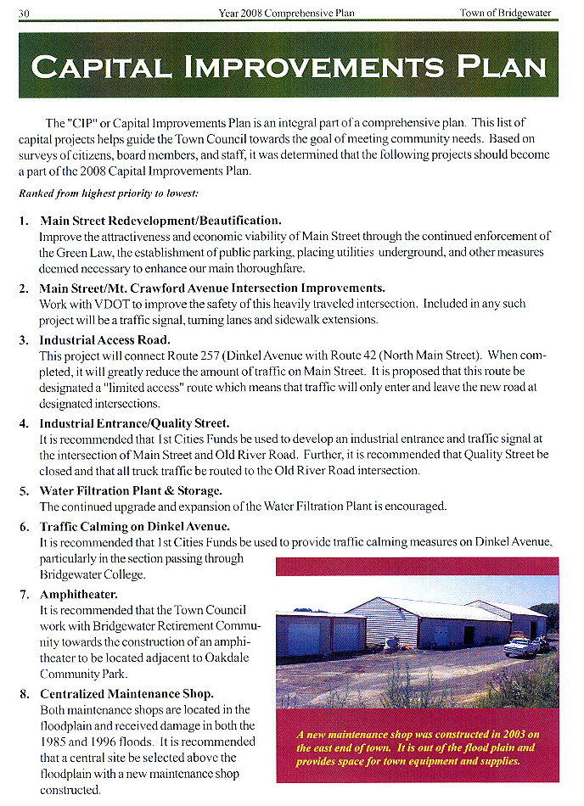

Slide 20
Budget Essentials
Revenues
Expenditures
Capital vs. Operating Budget
Debt Capacity
Taxes
Fraud
Public expectations
The danger of the majority
Communication

Slide 21
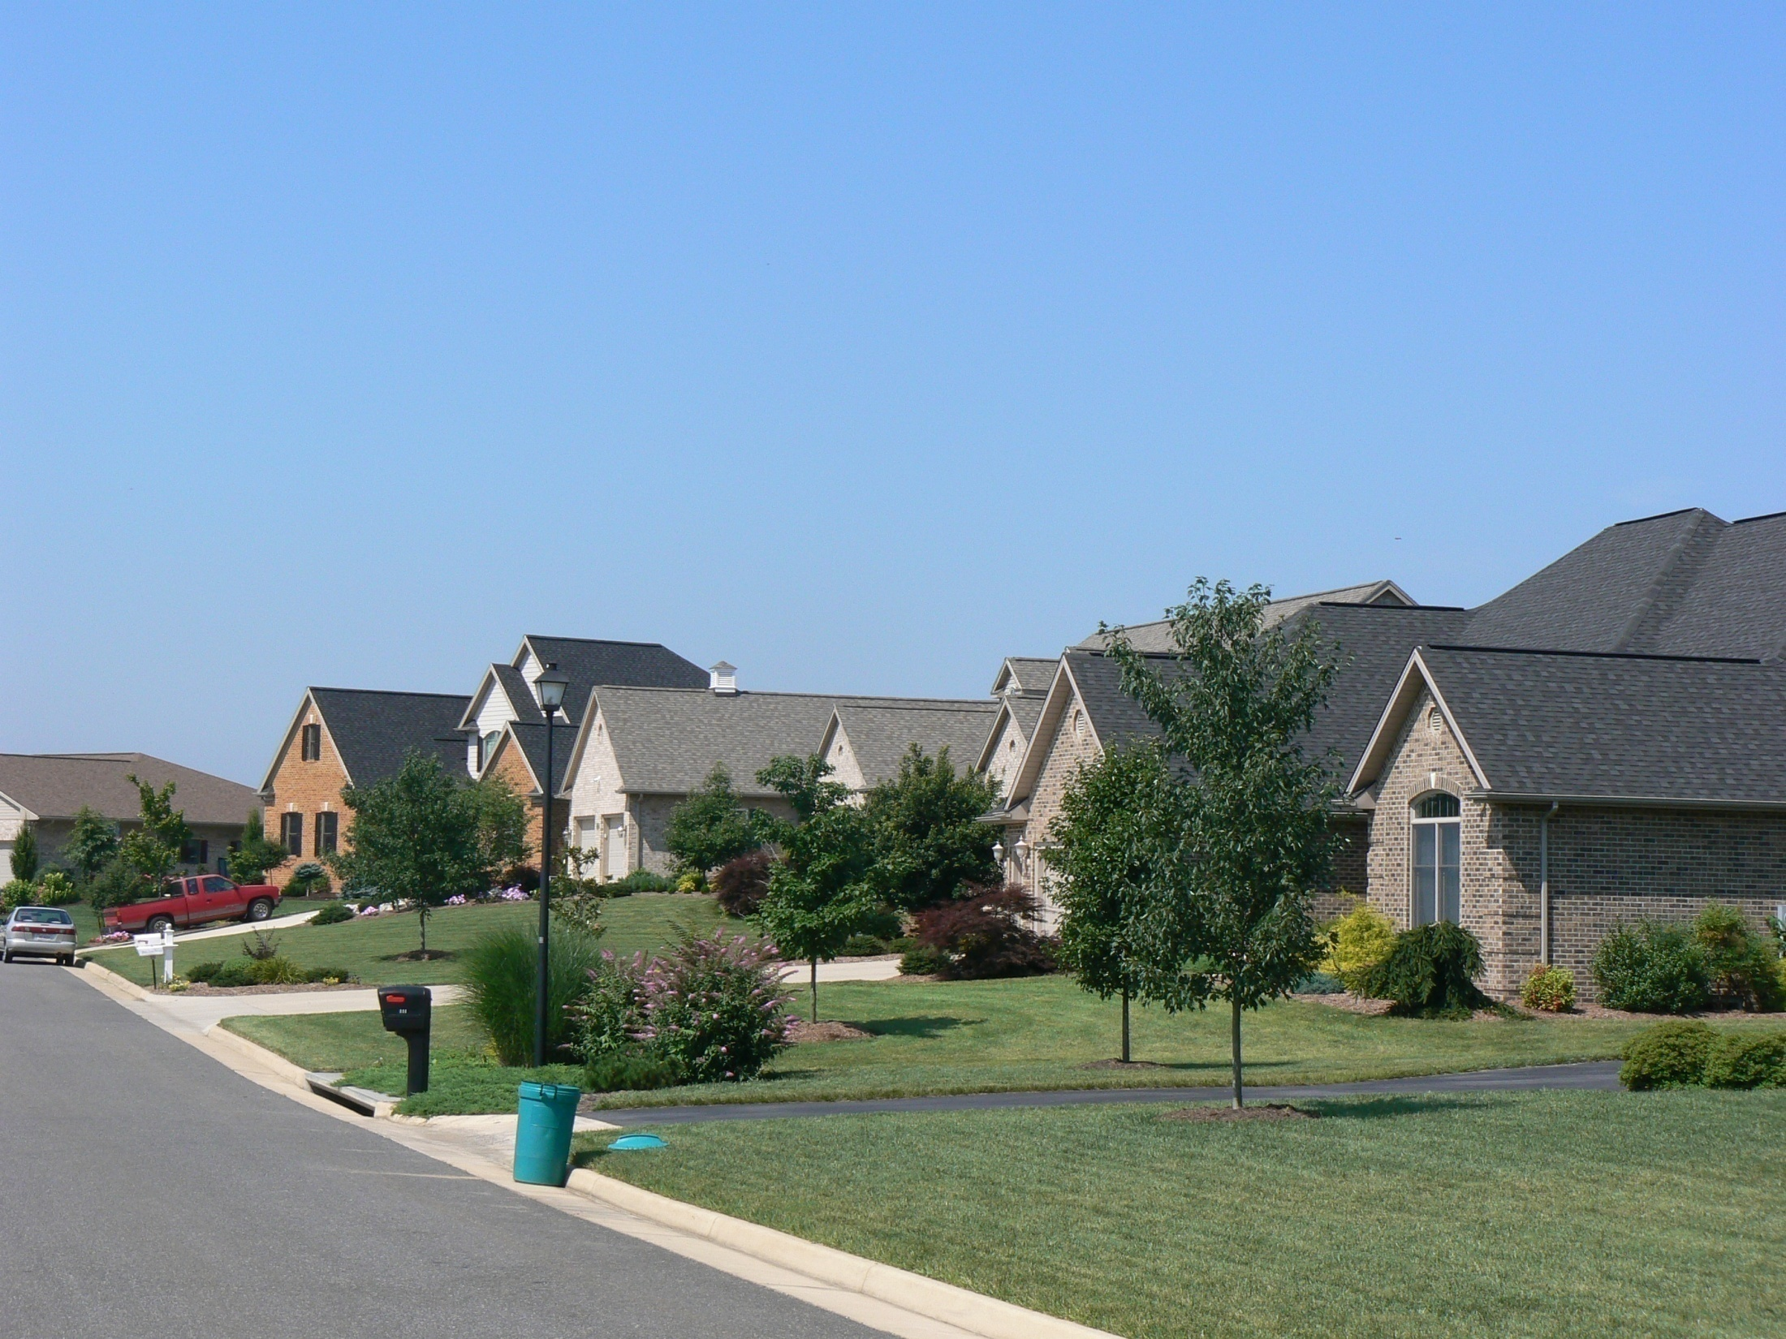
10%
Debt Capacity

Slide 22
Budget Essentials
Revenues
Expenditures
Capital vs. Operating Budget
Debt Capacity
Taxes
Fraud
Public expectations
The danger of the majority
Communication

Slide 23
I’ve paid double for my groceries
FRUIT
VEGETABLES
DRY GOODS
EGGS
BUTTER
MEAT

Slide 24
WATER
SEWER
STREETS
PARKS
POLICE
EDUCATION
WELFARE
LANDFILL
COURT
SYSTEM JAIL
TOWN
COUNTY

Slide 25
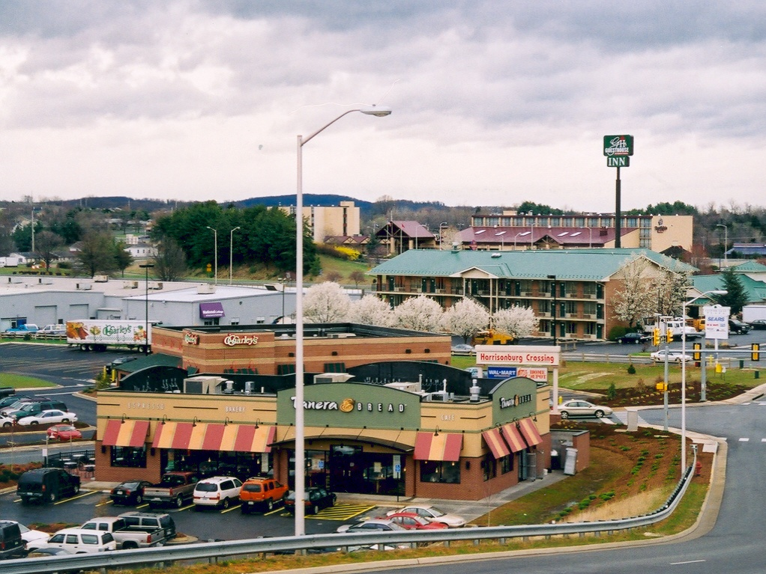
Cities & Towns

Slide 26
Budget Essentials
Revenues
Expenditures
Capital vs. Operating Budget
Debt Capacity
Taxes
Fraud
Public expectations
The danger of the majority
Communication

Slide 27

2014

Slide 28
Cost of Fraud & Abuse
$652 billion annually
5% of revenues
42% recover nothing after fraud is discovered

Slide 29

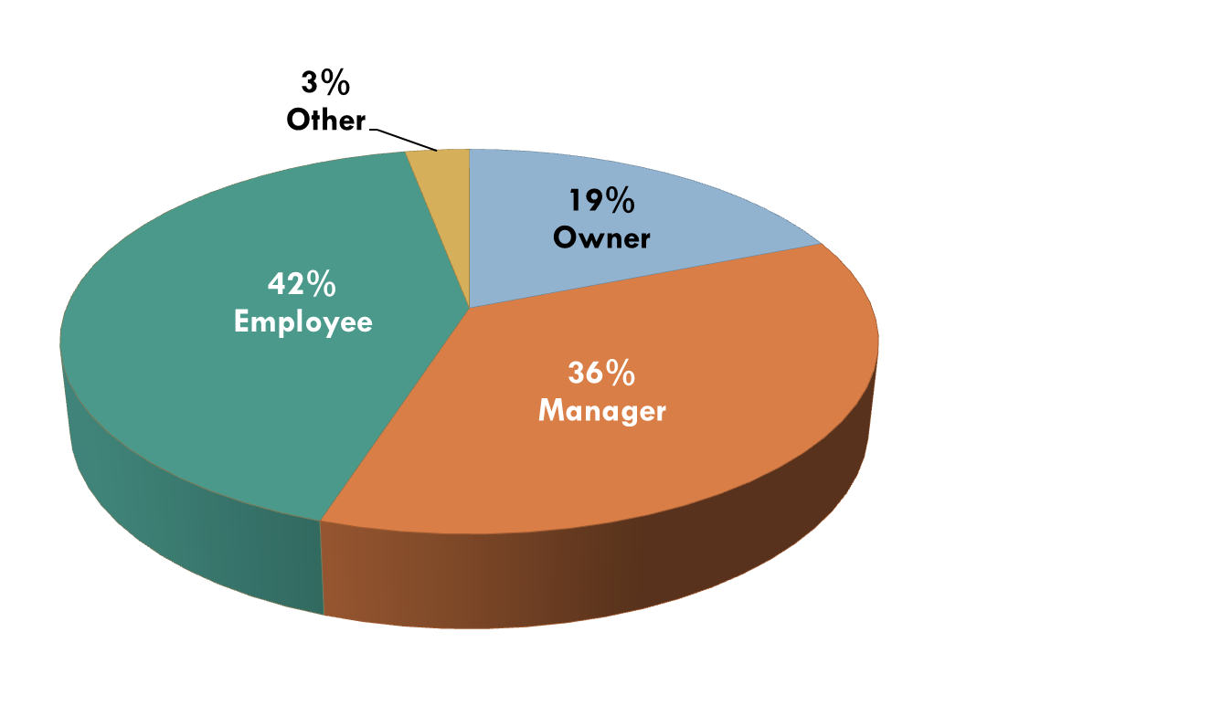
2014
Position of Perpetrator

Slide 30
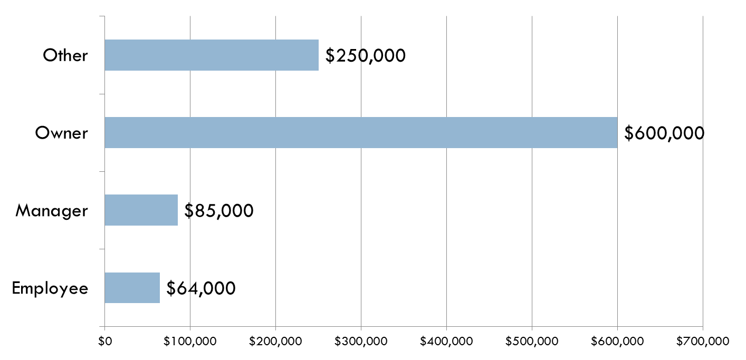
2014
Perpetrator – Median Loss

Slide 31

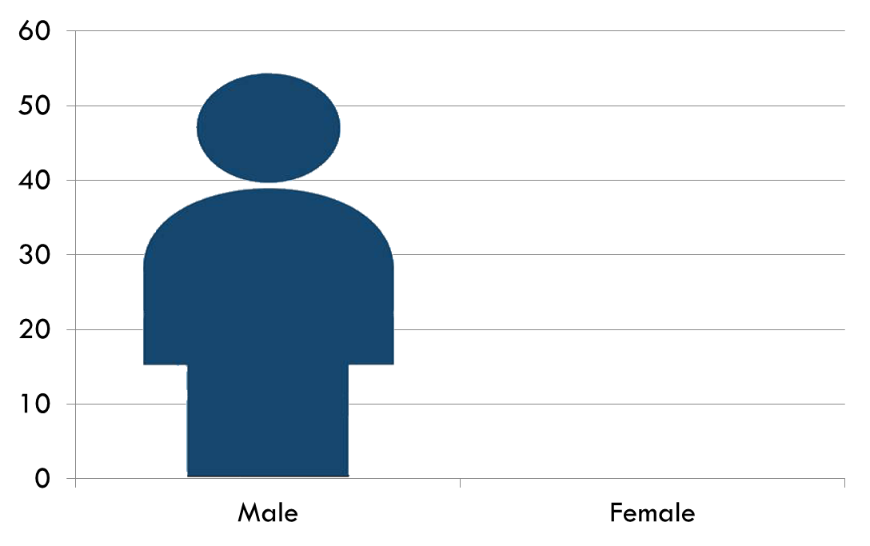

2014
Perpetrator – Gender and Median Loss
$185,000
$83,000
53%
46%

Slide 32
Damages to Victims go Beyond Dollars & Cents
Reputation
Loss of public confidence
Damage to relationships
Sagging staff morale
Distraction from the mission

Slide 33
The Fraud Triangle
Perceived pressure facing individual
Perceived opportunity to commit fraud
Person’s rationalization or integrity

Slide 34
Research -- The Typical Perpetrator
White male
College-educated
Intelligent
Married
Most loyal employee
No prior criminal history (<8%)
Well liked by co-workers

Slide 35
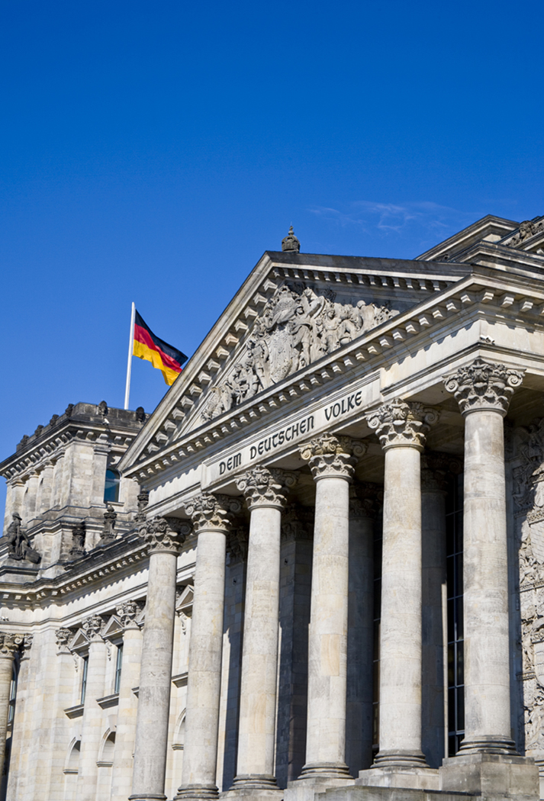
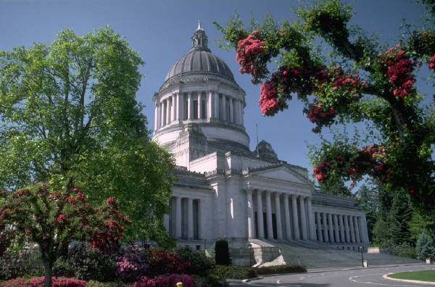
2014
The second highest incidence of fraud occurs in government and public administration, superseded only by banking and financial services.
$185,00

Slide 36
Cash Schemes
Stealing cash funds processed or on hand
Not recording & stealing the cash receipts
Underringing & stealing the difference in cash receipts
Altering bank deposits

Slide 37
Accounts Receivable Schemes
Forging checks received
Altering credit card receipts
Granting bogus credits
Bogus bad debt write-offs or account adjustments

Slide 38
Inventory & Fixed Assets
Theft of business assets
Selling the assets

Slide 39
Accounts Payable & Purchasing
Personal bills
Fictitious suppliers
Kickbacks
Ordering personal items
Petty cash funds
Employee expense accounts
Credit cards

Slide 40
Symptoms of Fraud
Unusual bank statement items
Increases in refunds or write-offs
Missing documents
Things that don’t make sense
Complaints
Employee tips
Out-of-balance conditions
Large adjustments

Slide 41
If You Suspect Fraud
Follow up immediately
Keep it quiet (don’t tip off suspect)
Contact your attorney
Possibly hire a fraud specialist
Interview the suspect
Report to regulatory authorities
Terminate employee
Potentially make a deal
File fidelity bond claims
Civil action

Slide 42
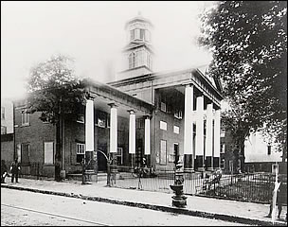
Staunton, Virginia circa 1900

Slide 43
Budget Essentials
Revenues
Expenditures
Capital vs. Operating Budget
Debt Capacity
Taxes
Fraud
Public expectations
The danger of the majority
Communication

Slide 44
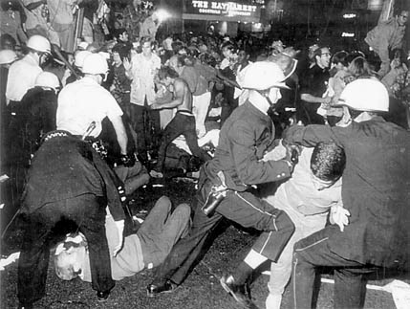

Slide 45
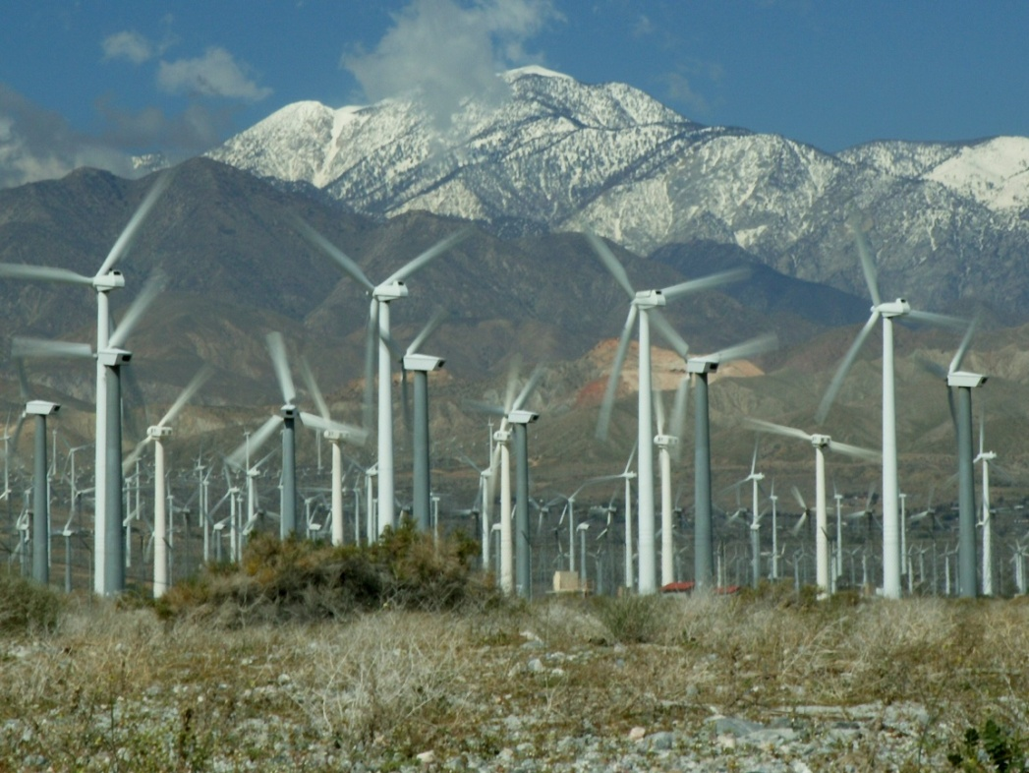
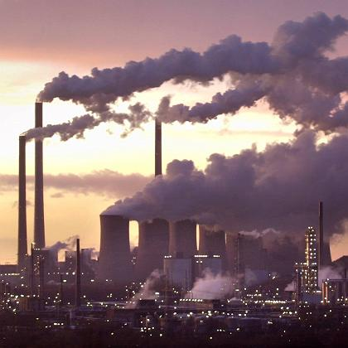
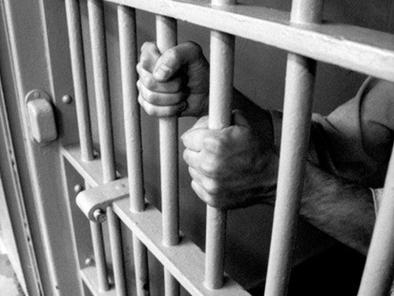
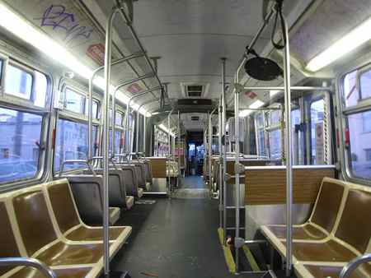
N.I.M.B.Y.
(Not in my backyard)

Slide 46
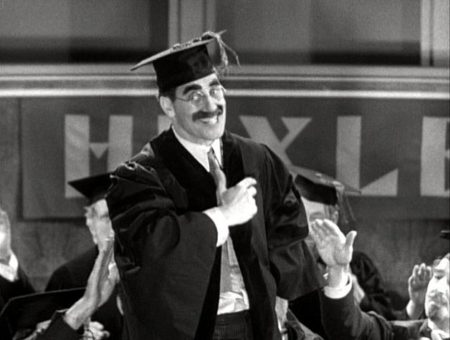
“Whatever it is…I’m against it!”

Slide 47
Budget Essentials
Revenues
Expenditures
Capital vs. Operating Budget
Debt Capacity
Taxes
Fraud
Public expectations
The danger of the majority
Communication

Slide 48
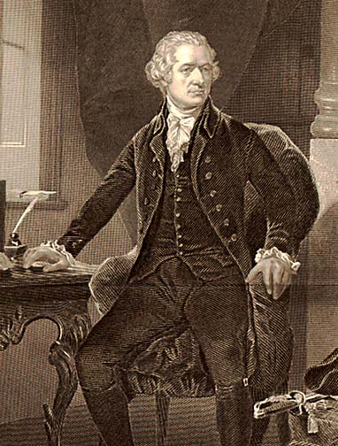
“I’ve learned to hold popular opinion of no value.”
Alexander Hamilton

Slide 49
At One Time, The Majority…
…Favored Slavery.
…Denied Women the Right to Vote.
…Supported Segregation of Schools, Churches, Graveyards etc.

Slide 50
Budget Essentials
Revenues
Expenditures
Capital vs. Operating Budget
Debt Capacity
Taxes
Fraud
Public expectations
The danger of the majority
Communication

Slide 51
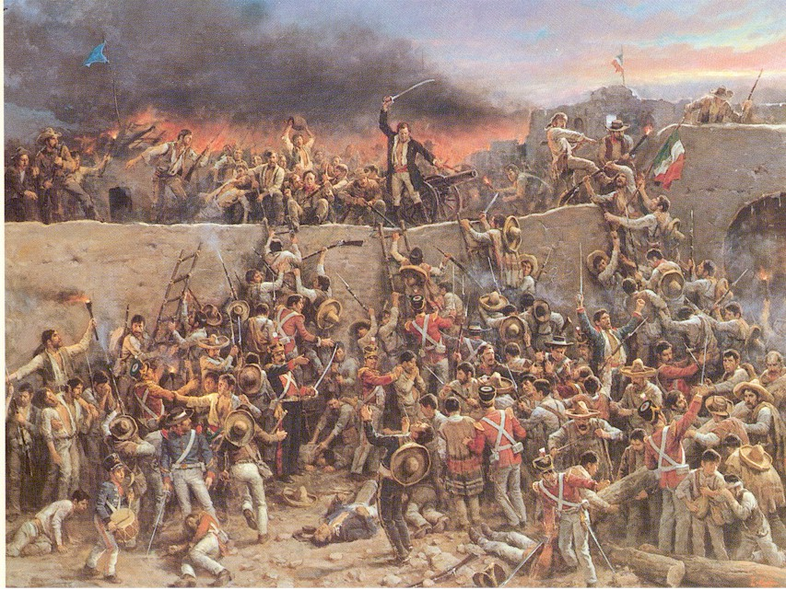
Picture of an Actual Budget Hearing

Slide 52
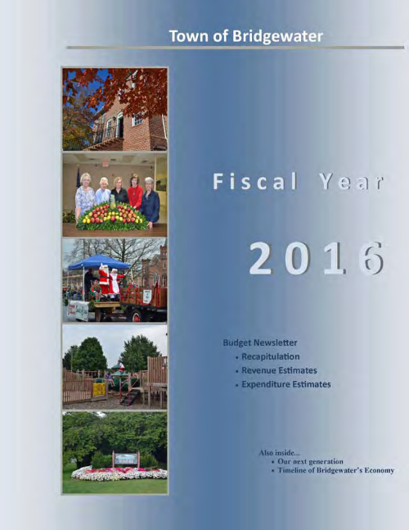
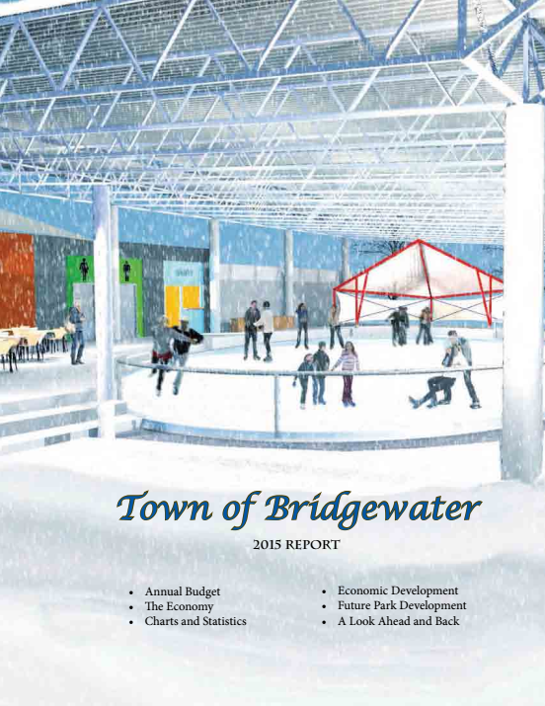
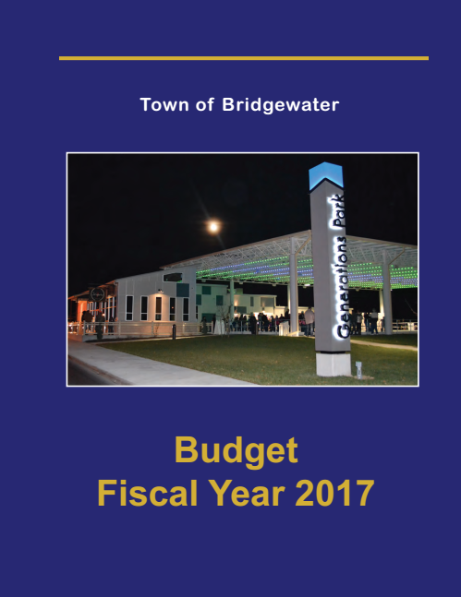

Slide 53
A Budget Tells a Story
STRASBURG
BERRYVILLE
TOMS BROOK
PURCELLVILLE
MOUNT JACKSON
HAYMARKET
MIDDLEBURG
VIENNA
FALLS CHURCH
DUMFRIES
FAIRFAX
STANLEY
OCCOQUAN
BRIDGEWATER
REMINGTON
GROTTOES
FREDERICKSBURG
WAYNESBORO
CHARLOTTESVILLE
CHINCOTEAGUE
WARSAW
AMHERST
ASHLAND
IRVINGTON
LYNCHBURG
VINTON
FARMVILLE
HOPEWELL
CAPE CHARLES
RADFORD
ALTAVISTA
COLONIAL HEIGHTS
WILLIAMSBURG
ROCKY MOUNT
CREWE
HAMPTON
COEBURN
PULASKI
ALBERTA
WAVERLY
NEWPORT NEWS
MARION
SOUTH HILL
WAKEFIELD
NORFOLK
ABINGDON
GALAX
DANVILLE
LAWRENCEVILLE
FRANKLIN
CLARKSVILLE

