Slide 1
Virginia Municipal League
Newly Elected Officials’ Conference
October 4, 2015

Slide 2
Politics
“Politics is what we invented because we have no analytical way to distinguish among values” Dr. Nalbandian
The Mayor and Council establish the value sorting of the locality
“A leader is best when people barely know he exists, when his work is done, his aim fulfilled, they will say: we did it ourselves” —Lao Tzu
The Manager strives to create an amazing organization that can fulfill the value preferences chosen by the elected body.

Slide 3
Town of Rocky Mount
The Honorable Steven C. Angle
-Council Member 1990 to 2006
-Mayor from 2006-Present
-Chairman of the West Piedmont Planning District Commission 1996-2004
-Appointed by the Governor to the Virginia Economic Commission 1998-2002
sangle@rockymountva.org

Slide 4
Town of Rocky Mount
C. James Ervin, ICMA-CM
-Town Manager of Rocky Mount since 2007
-25 years in local government
-Active in ICMA and VLGMA
jervin@rockymountva.org

Slide 5
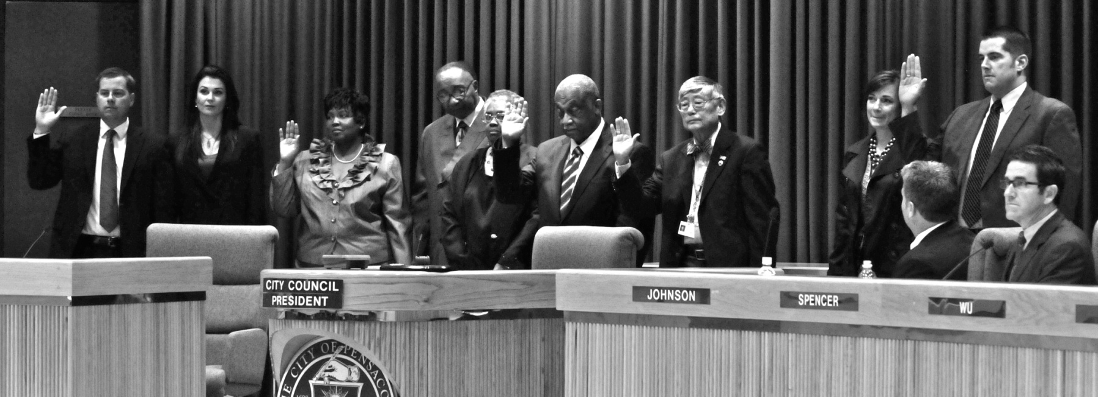
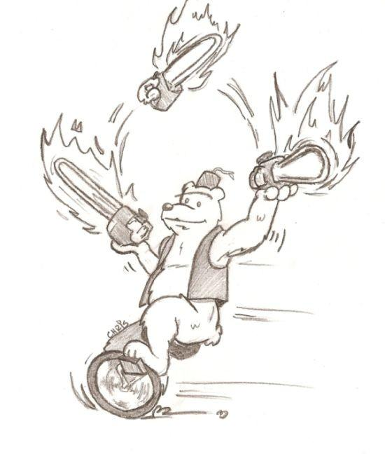
Perception:
Reality!!!

Slide 6
Mayor-Council
Some of the Commonwealth’s communities utilize this form of government where the Mayor serves as the chief administrative officer (VA Code § 15.2-1423)
Council Committee Structure oversees daily administration above and beyond policy implementation and planning responsibilities

Slide 7
Council-Manager
Council-manager government combines the strong political leadership (values) of elected officials with the strong professional managerial experience of an appointed manager.
All power and authority to set policy rests with an elected governing body, which includes a mayor or chairperson and members of the council, commission, or board. The governing body in turn hires a nonpartisan professional manager who has very broad authority to run the organization.

Slide 8
Council-Manager
Typically, the mayor/chair serves as presiding officer at meetings and as the ceremonial head of the locality. Often called the “Chief Elected Official”.
The Manager is hired to enable the political process (goals, vision and values as set by Council), create an effective organization and receive and give information to the citizens. Often called the “Chief Administrative Official”.

Slide 9
Working with your Manager
VA Code §15.2-1541 details the required duties for a city or town manager.
ICMA Code of Ethics www.icma.org (hand out)
An effective manager should be able to implement and communicate council’s vision for the community and help Council formulate that vision during times when there is a less than perfect consensus among the elected body

Slide 10
Working with your manager
The manager should be capable of projecting the desired image of the community. Public perception of the manager is a direct reflection of council.
Conduct a fair and comprehensive evaluation of the manager annually.
Communicate clear expectations to the manager, and through the manager, to employees, so that they take responsibility and ownership of their work.

Slide 11
Expect your Manager to…
Treat council with respect and to share the same information with all members of the elected body
Stay out of individual council disagreements or politics
Give advice when sought and to ask for it often
Be disciplined in follow-up on council issues
Provide clear policy alternatives that are thoughtful, well researched, and doable. Your manager should give you credible information and detailed advice to allow you to make the best decisions for the community

Slide 12
Expect your Manager to…
Provide clear policy alternatives that are thoughtful, well researched, and doable. Your manager should give you credible information and detailed advice to allow you to make the best decisions for the community
Present an agenda that is essential for the vision of the community and for the functional needs of the organization. Pacing is critical.
Meet with Council members regularly in a one-on-one setting
Notify you of important issues before reading about it in the paper

Slide 13
Manager expectations of Council
Be good at politics i.e. be able to engage in debate and reach, if not a consensus, a definitive action point.
Govern with passion, swing for the fences! Try and do the things that are worth doing.
Function as a legislative body, knowing that staff are working diligently on the decisions of the body even though some members may oppose the action or decision.
Don’t surprise the manager in public.
Don’t criticize the manager (or staff) in public meetings. Private individual meetings and/or closed sessions allow for appropriate handling of personnel issues.
Be sensitive to your manager’s time on weekends and evenings.

Slide 14
Manager expects of Council
Share information with the Manager just as you would expect it to be shared with you.
Win and lose with equal grace.
Allow the Manager to adhere to the ICMA code of ethics.
Do not let problems between the council and the manager fester. Reach an understanding through clear expectations on both ends.
Read manager/staff reports before the council meetings and call with questions.
Conduct a fair and comprehensive evaluation of the manager annually and compensate them fairly.
Support the professional development and continuing education needs of your manager.

Slide 15
Questions?

