Slide 1
Elevating Learning & Development: A 30-60-90 Day Plan
Michelle Pacheco

Slide 2


Purpose
Join me in reviewing a
30-60-90 Day Plan to assess, develop and evaluate your organization’s learning capabilities as we kick-off our journey toward success!

Slide 3
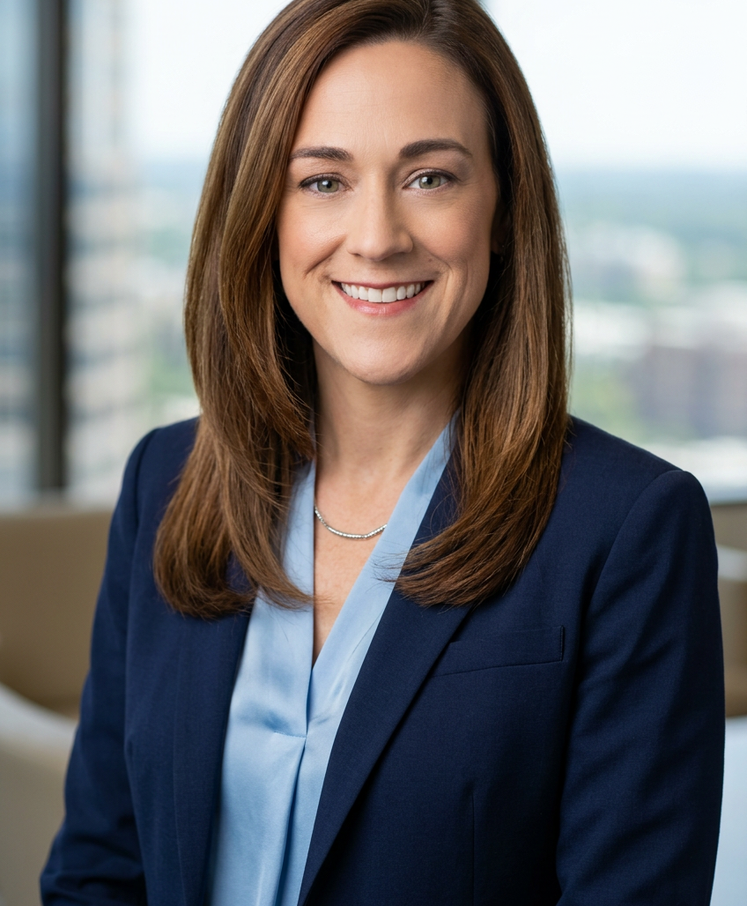
The role of Organizational Development Leader
My role is to help diagnose systemic barriers, influence senior leaders, and and translate business strategy into scalable people solutions.
Notes:
My role is to diagnose systemic barriers, influence senior leaders, and translate business strategy into scalable people solutions.

Slide 4
Timeline
30 days - Assessment & Setup
Familiarize myself with the organizational culture, current learning and development frameworks, data analysis and team dynamics.
60 Days – Development & Implementation
Start creating targeted learning solutions based on the initial assessments to align enterprise learning initiatives with strategic business objectives.
90 Days - Evaluation & Optimization
Measure the effectiveness of enterprise learning programs with strategic objectives and optimize accordingly.

Slide 5
30 Days – Assessment and Setup
Conduct initial stakeholder meetings with department heads to gather data and insights to understand expectations and needs.
Analyze current training programs impacts to strategic goals and gather feedback to identify gaps.
Conduct comprehensive needs assessments across departments to align learning initiatives with measurable business goals.
Collaborate with business leaders, HRBPs, and Executives to customize learning interventions that align with strategic business objectives.
Familiarize myself with the organizational culture, current learning and development frameworks, data analysis, and team dynamics
Notes:
At Healthfirst, I conducted annual needs assessments that resulted in a 30% increase in targeted leadership development offerings on my 2nd year.
Facilitate feedback sessions with users and stakeholders to gather insights on program impact to business goals.

Slide 6
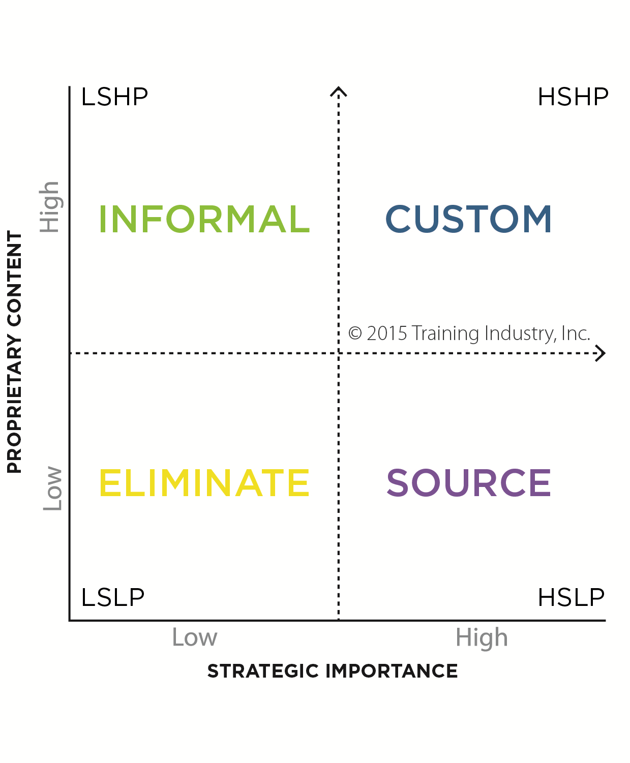
30-Days: Portfolio Rationalization
Dual-Axis Scoring Table
A scoring table uses two axes: custom content and strategic objective alignment, both ranging from 1 to 10.
Visual Asset Comparison
Assets are plotted on the table, allowing for easy visual comparison based on their scores.
Assessment and Prioritization
This method enables clear assessment and prioritization by connecting customization with strategic fit.
CPTM Model used to assist w/ quickly assessing existing learning programs or catalogs

Slide 7
60 Days – Development & Implementation
Develop innovative blended learning experiences using the data collected in first 30 days and attempt to shift programs to 70-20-10 Model as appropriate
Collaborate with leaders to implement ‘workflow learning’ methodologies that integrate technology with user platforms to provide just-in-time accessible learning resources.
Launch and promote scalable digital learning platforms and resources to increase learning material accessibility of business and performance learning.
Transition to Content Development Model(s) for development of learning assets to align with technical teams to deliver timely learning aligning to technology release
Start creating targeted learning solutions based on the initial assessments.
Notes:
Focus on program development and delivery ensures systems and processes….
Transition to Rapid Content Development (RCD) Model for development of assets to align with organization’s technical teams often building in Agile models. This model of development follows a similar cycle so we can work in parallel. Getting us to a “ready” learning that can be leveraged aligning to technology release

Slide 8
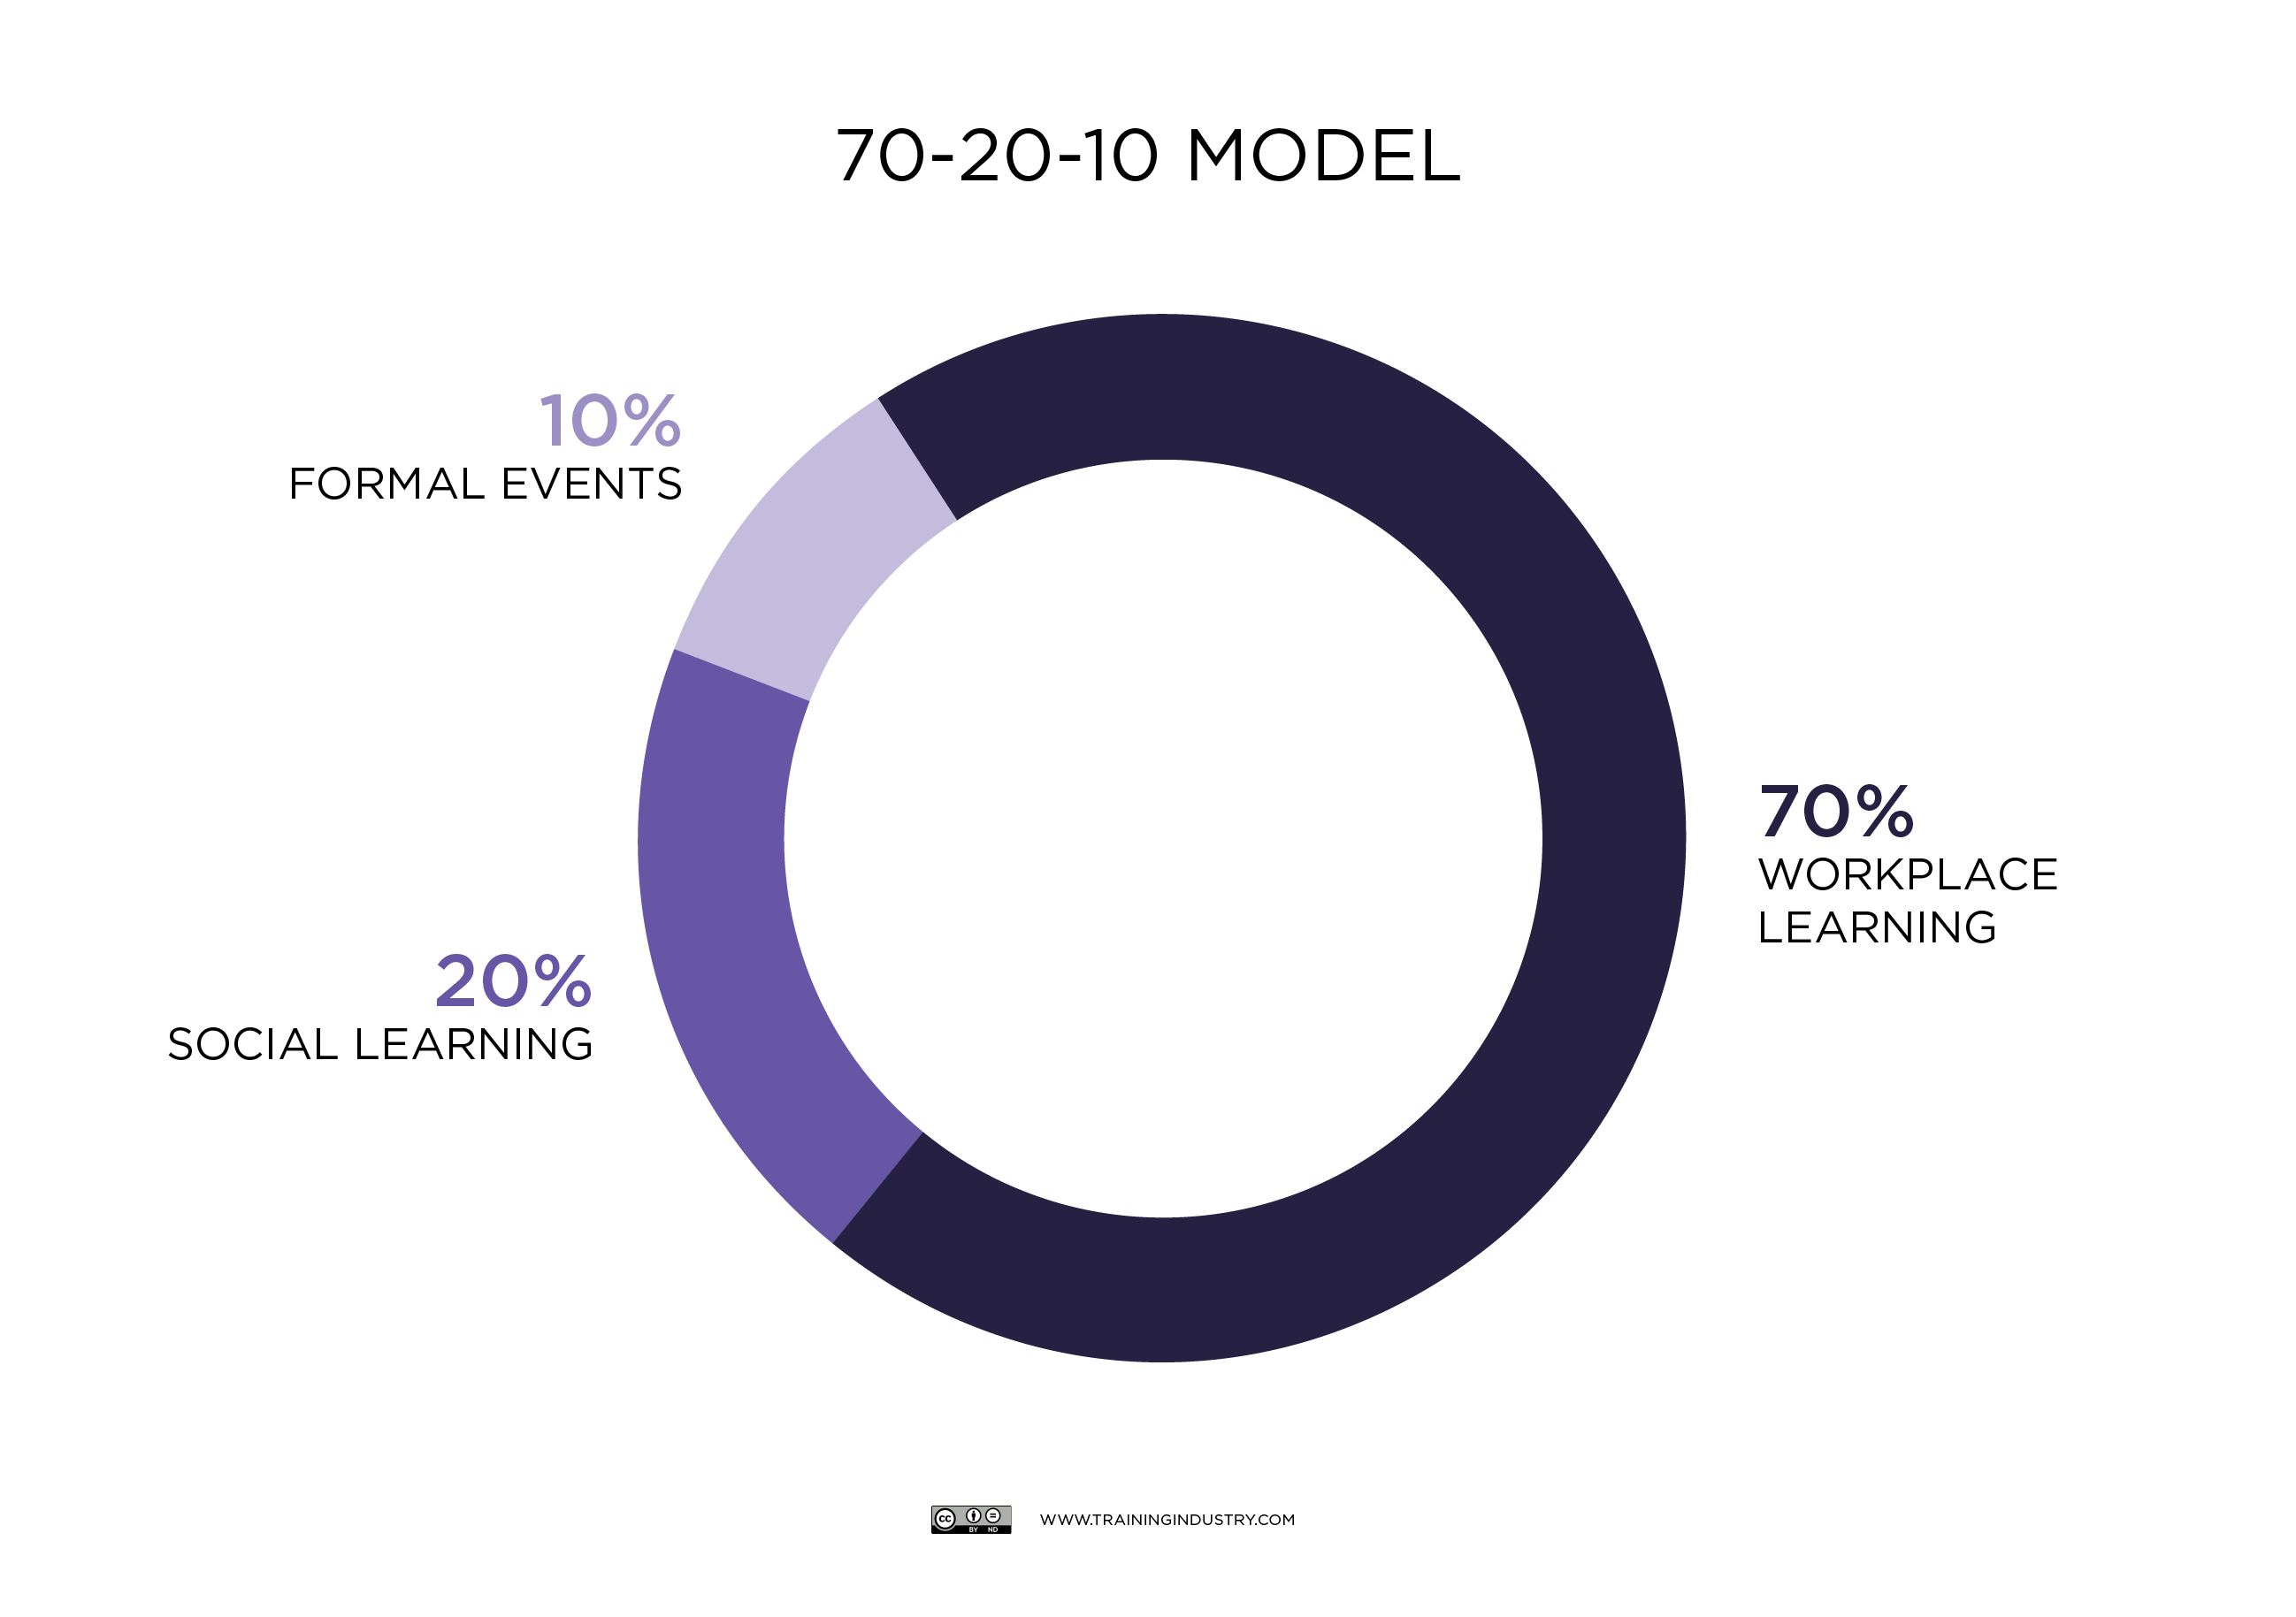
60-Days: 70-20-10 Model
What it is
A CPTM best practice for the suggested blended-learning model that balances how to optimize experience for adult learners:
70% Experience — apply skills in real work
20% Exposure — coaching, mentoring, peer learning
10% Education — courses, certifications, curated content
Click icon for Example Role Based Learning Program previously designed with 70-20-10 in mind.
Notes:
Example learning path — Call center agent
70% Experience — shadow 2 calls; handle 5 guided calls using a QA checklist
20% Exposure — daily huddle; weekly recorded‑call coaching + peer buddy 10% Education — micro‑modules (systems, compliance, de‑escalation) + product digest
How to leverage it in an enterprise
• Align role-based skill maps to a 70/20/10 learning plan
• Design experience pathways (projects, rotations, simulations) tied to outcomes
• Enable the 20% with manager toolkits, mentors, and communities of practice

Slide 9
90 Days – Evaluation & Optimization
Lead the implementation of robust learning analytics systems to track key performance metrics and outcomes to measure ROI of learning programs .
Develop and implement a comprehensive program evaluation framework for real-time data tracking, fostering continuous improvement.
Implement changes based on real-time tracking and evaluation frameworks, aiming for continuous improvement and a 35% increase in actionable insights.
Execute initiatives addressing critical business challenges revealed during assessments, securing executive buy-in for program funding and support.
Measure the effectiveness of existing and newly implemented programs and optimize accordingly.

Slide 10
90 Days: Kirkpatrick Model
Level 1: Reaction
Measures how participants respond to the training, including satisfaction and engagement.
Level 2: Learning
Assesses the increase in knowledge or skills resulting from the training.
Level 3: Behavior
Evaluates the extent to which participants apply what they've learned in their work environment.
Level 4: Results
Determines the impact of the training on organizational goals and outcomes.
Level 5: ROI
Calculate the ROI by comparing training costs against productivity gains and other financial indicators.
The Kirkpatrick Model is a robust framework for evaluating the effectiveness of training programs within learning organizations. this model encompasses four key levels of assessment: Reaction, Learning, Behavior, and Results, with a fifth level—Return on Investment (ROI)—added later to quantify the financial impact of training initiatives.

Slide 11



Unique Value Proposition
Experienced with Business-Centric Learning
Redesigned Compliance and Role Based onboarding programs, halving duration while improving performance
Managed multi-million dollar budgets with 98% on-time and on-budget delivery rate.
Successfully introduced workflow learning methods that reduced front-line onboarding time by 40% with decreased Average Call Handling time and enhancing quality scores by 12%
Developed and deployed data-analytics systems resulting in 80% improvement of reporting accuracy, tracking ROI and increased ability to influence support of learning funding initiatives
Notes:
I position data as the entry point, not the conclusion. Data earns credibility and opens the door, but behavior change happens through trust and meaning. With executives, I’m very explicit about trade-offs. Speed without adoption creates rework.
I use data to frame the risk of moving too fast, then co-create milestones that deliver visible wins while allowing time for leaders to model the change. That balance keeps momentum without sacrificing sustainability.
I measure OD success through business outcomes first, then people indicators
I also look at capability maturity. If leaders are independently using OD tools and frameworks without my team facilitating, that tells me the work has scaled.

Slide 12
Future-Focused Strategic Milestones
Establish a comprehensive framework to enable L&D to be viewed as a strategic partner in organizational growth and engagement.
Create a resilient organization that anticipates and responds to future challenges through innovation in learning.
1-Year Milestone: Foundation for Learning Excellence
3-Year Milestone: Driving Performance and Engagement
5-Year Vision: Transformational Learning Organization
Foster a culture of feedback and continuous improvement through regular assessment and adaptation of training programs.
Establish cross-functional learning opportunities to drive collaboration and knowledge sharing across departments.

Slide 13

Thank you
Michelle Pacheco
michelle.pacheco426@gmail.com
LinkedIn Page
Website
discovermichelle.com
13

