Slide 1
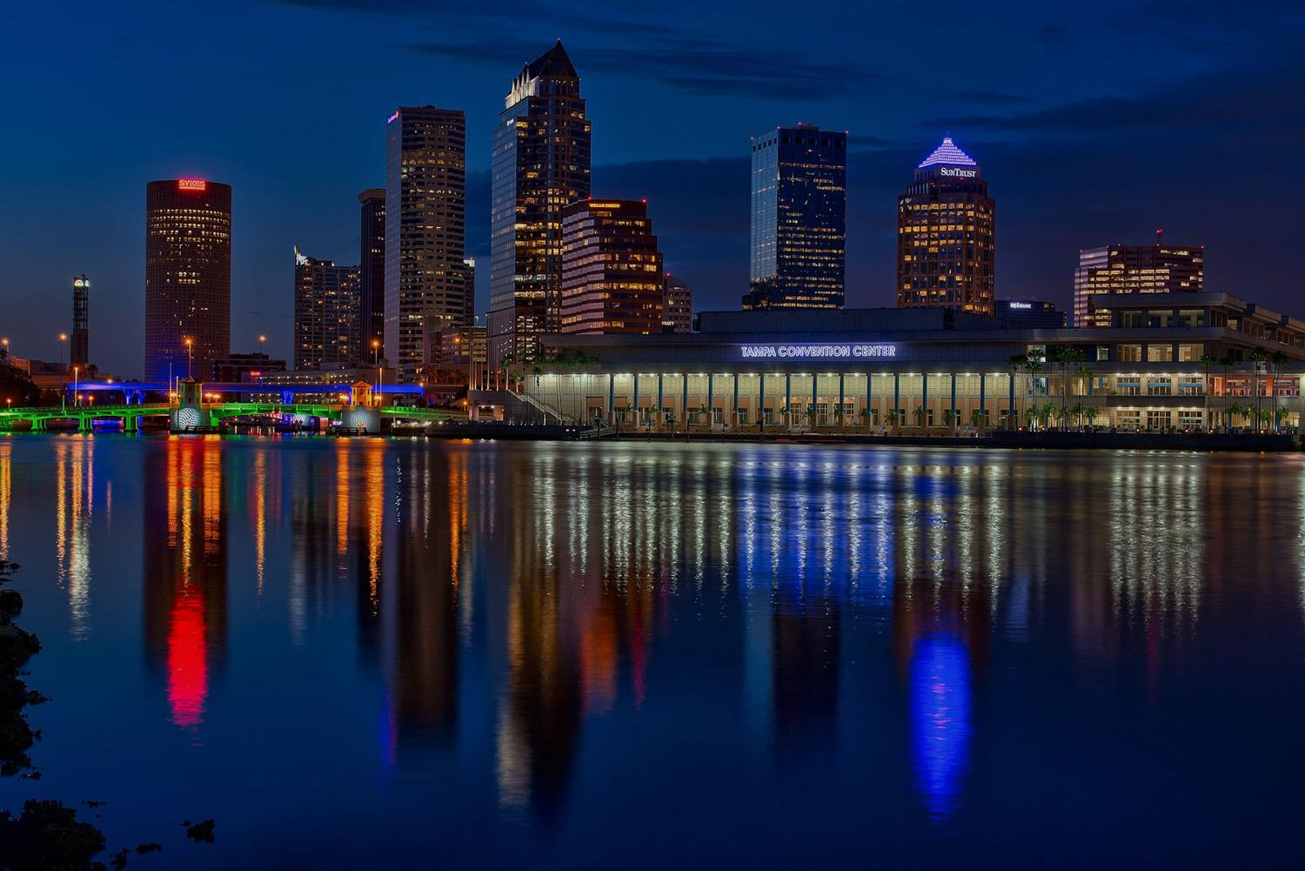
Tampa Bay, FL, USA
FOND LLC / The Fond Organization / Fond Development Group
Development
14391 Spring Hill Dr., Ste. 147, Spring Hill, FL 34609 | (813) 957-1515 | fondllc.com | fonddevgroup.com | info@fondllc.com
Construction
“Our mission is to deliver solution-based inventions, resilience-focused designs, and strategic implementation to The FOND Standard”
Construction Management
Project Management
Property Management
Actively seeking Contractors and Subcontractors to join the FOND team!
Disaster Management
Infrastructure Rehabilitation
“Integrity, Loyalty, Honesty, and Ethically-based Principles…The Footprints of the legacy we leave for future generations." --Belinda A Bentley, Ph.D.

Slide 2
Why Work with FOND?
FOND is committed to a team atmosphere as we build partnerships with our Contractors, Subcontractors, Vendors, and Manufacturers.
Significant growth in 2017, leads the way to a diversely successful 2018. At FOND, we believe in Diversity Programs that create additional opportunities for our team.
A winning partnership with MRS LLC not only brings years of boots-on-the-ground experience to the FOND team but also a wealth of new opportunity.
Technological advancements, a fractured critical infrastructure, and an increase in the frequency and severity of natural and man-made disasters are the driving force of growth in our industry.
Join us on our path to:
Developing stronger industry unity
Building safer, more resilient communities
Re-building Critical Infrastructure
Preventing Catastrophic Storm Damage
Leaving a legacy of a better tomorrow
14391 Spring Hill Dr., Ste. 147, Spring Hill, FL 34609 | (813) 957-1515 | fondllc.com | fonddevgroup.com | info@fondllc.com

Slide 3
FOND SERVI CES
Construction Project Management
Contract Document Development
Contract Bidding, Negotiation, and Award
CPM Schedule Development and Monitoring
Contract Administration and Cost Control
Budget Management and Change Control
Quality and Safety Monitoring
Owner’s Representation
Project Cost Estimating
Constructability Reviews
Schedule and Narrative Development
On-site inspections and Monthly Reporting
LEED Registration and Certification
Contract Close-Out
Claims Management and Resolution
Alternative Dispute Resolution
Schedule Development and Time-Impact Analysis
Claim Entitlement and Cost Impact Analysis
Claim Preparation and Evaluation
Factual and Technical Investigation
Litigation Support and Expert Testimony
Commercial Service Solutions
Property Management
Inspection/Maintenance Program
Risk Management Program
Mitigation Assessments
Grant Management Program
Forensic Accounting
Benefit Cost Analysis
Energy Efficient Product Solutions
14391 Spring Hill Dr., Ste. 147, Spring Hill, FL 34609 | (813) 957-1515 | fondllc.com | fonddevgroup.com | info@fondllc.com

Slide 4
ADD I T I O N A L SERV I CES
♦ Project Management
♦ Construction Management
♦ Disaster Management
♦ Claims Management/Resolution
♦ Program Management
♦ Design & Build
♦ Owner’s Representation
♦ Estimating Services
♦ Forensic Accounting
♦ Benefit-Cost Analysis
♦ ADA Consulting
♦ Energy-Eff. Product Solutions
♦ Executive Leasing Program: (Disaster Recovery Personnel Only)
14391 Spring Hill Dr., Ste. 147, Spring Hill, FL 34609 | (813) 957-1515 | fondllc.com | fonddevgroup.com | info@fondllc.com

Slide 5
To start the Pre-Qualification Process, visit
www.fonddevgroup.com
For more detailed information, email your request to:
bella@fondllc.com
14391 Spring Hill Dr., Ste. 147, Spring Hill, FL 34609 | (813) 957-1515 | fondllc.com | fonddevgroup.com | info@fondllc.com

