Slide 1
JOC Container Shipping Outlook
Global Shakeup: Turbulent Times in the Shipping Market
Presented by
Hugh Morley
Senior Editor, JOC.com /The Journal of Commerce
Notes:
IHS Markit - one of leading global sources of information and bus

Slide 2

Staying ahead in a fast-changing industry
Through mergers, acquisitions and one collapse, the number of major container lines will have fallen from 20 to eight in a period of three years.
Alliances are a boon for carriers but less so for shippers.
Transloading soars, helping importers and carriers but causing pain for inland exporters.
Will carriers be able to mitigate higher fuel prices with “emergency surcharges,” and what will happen to carriers that don’t push new fees?
Volume growth, coupled with some capacity discipline, pushed container shipping into the black in 2017, but capacity injections and higher fuel rates in 2018 could tip industry back into the red.

Slide 3
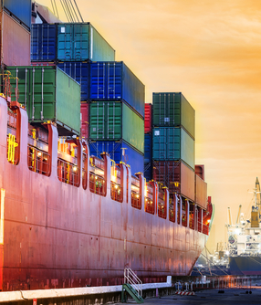
Staying ahead in a fast-changing industry
The gap between spot rates to the East and Gulf coasts and the West Coast from Asia is narrowing, a move that could accelerate the shift of cargo to the East Coast.
When talking “capacity,” shippers too often focus on drivers, facilities and assets. Time, however, is a key element in transportation capacity, and one that needs to be addressed if shippers hope to find freight space at reasonable prices and ship “more with less” in 2018
The ELD mandate may affect drayage drivers even more than over-the-road truckload drivers, making it more difficult for them to make turns at ocean ports and inland railyards.

Slide 4
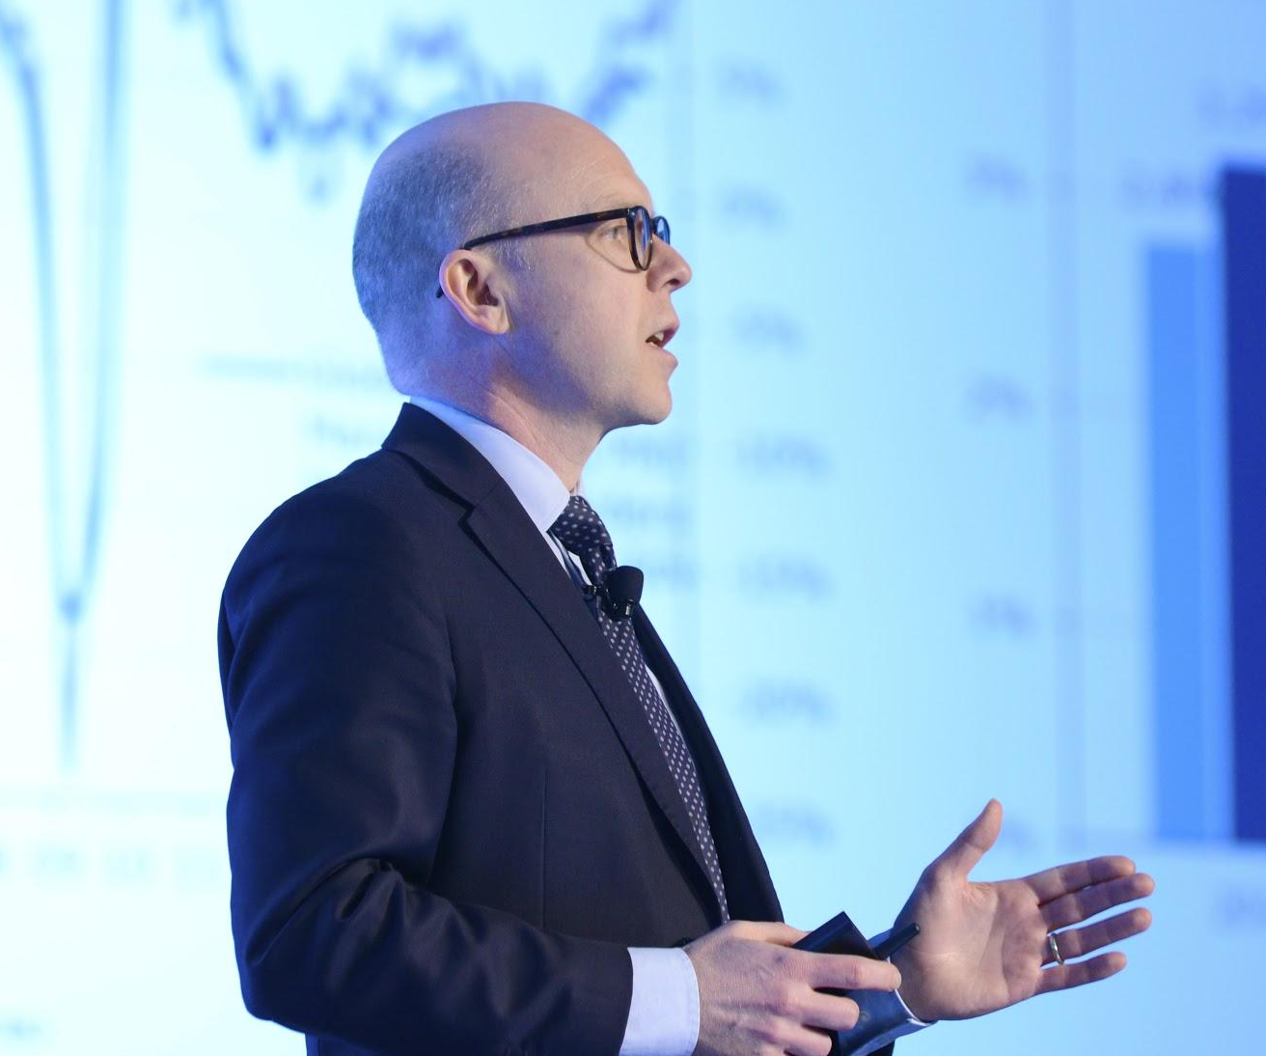
Heard at TPM
“Back in 2016 we saw the worst market for container shipping ever ... improvements came along last year, and improvements are expected to come along this year."
Peter Sand, chief shipping analyst, BIMCO

Slide 5
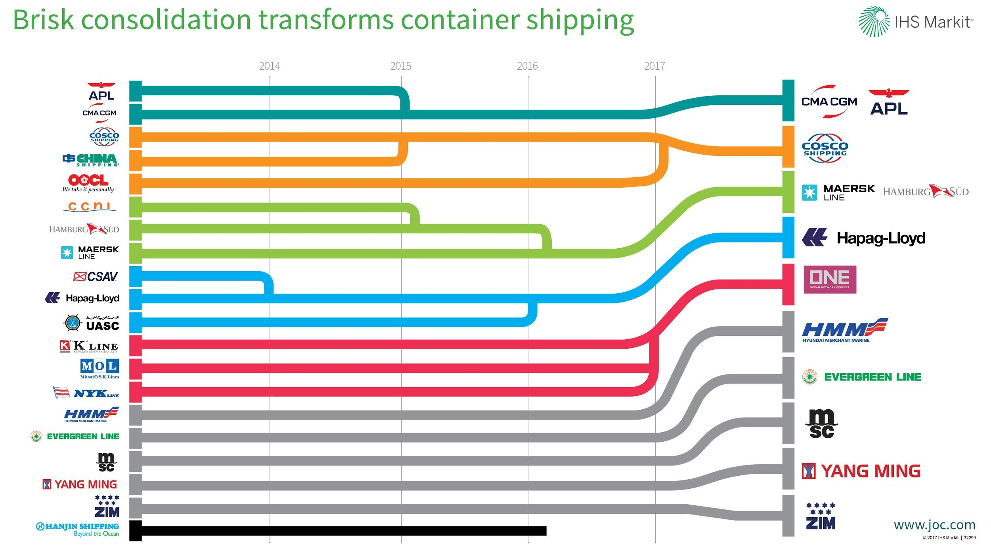
Rapid consolidation transforms container shipping

Slide 6
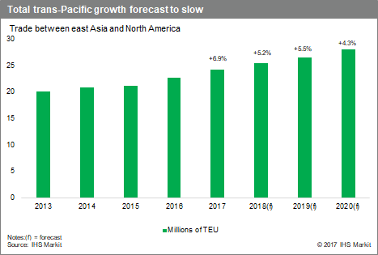
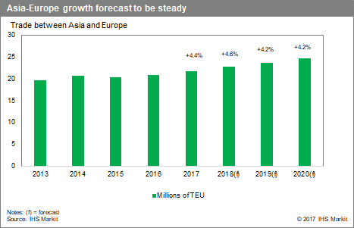
Global containerized volume rebounding
IHS Markit predicts global container trade expanded 5% in 2017 and 5.3% in 2018
Global container trade will expand 5.3% in 2019, with annual growth of around 5% through 2025.
IHS Markit expects average annual world GDP growth in 2018 of 3.4%, while growth will come in at 3.1% for 2017, well above the 2.5% in 2016.
The current forecast assumes the expansion will continue over at least the medium term thanks to the prevailing low world inflation and interest rates, along with modest wage growth.

Slide 7
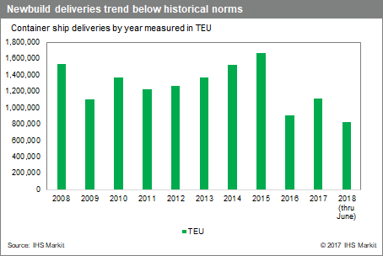
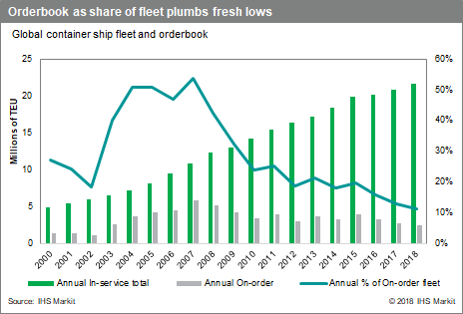
Fundamentals are starting to change, but is it enough?
About 7% overcapacity in 2017 as fleet expands 2.4%.
The carriers had a $7 billion operating profit in 2017, after six straight years of industry losses.
Industry profitability far from certain for 2018 as so much hinges on capacity discipline and recouping higher bunker prices.
Leading carriers reported losses in Q1 but said they would still turn profit for full year.
Shippers face rising spot market rates in the second half of 2018 as the supply-demand balance improves.

Slide 8
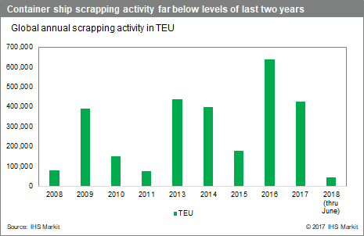
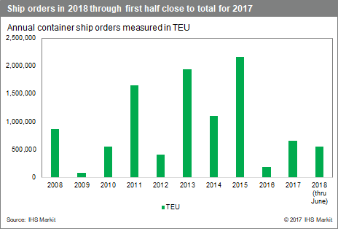
Signs of some capacity discipline
Container ship scrappings were way up in 2016 and 2017, but have fallen off in 2018.
The industry scrapped more than 650,000 TEU in 2016 and scrapped more than 400,000 TEU in 2017, but only 44,000 TEU scrapped through June of this year.
Extrapolated over the full year, the number of box ships sold for scrap this year could be the lowest since 2011.
Average ship age is 11 years, so carriers are running of candidates for the scrap heap.
New orders way down, but lines still scheduled to take possession of 150 ships of 10,000-22,000 TEUs in two years.

Slide 9
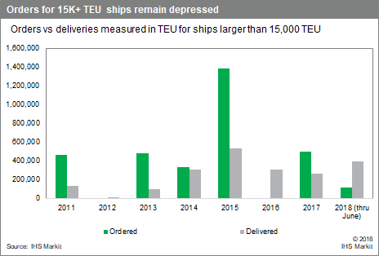
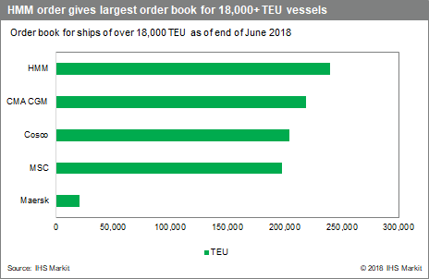
Container capacity growth restarts
CMA CGM has ordered nine 22,000- TEU ships, and Mediterranean Shipping Co. has placed 11.
Hyundai Merchant Marine now has the industry’s largest orderbook of 18K+ TEU ships after ordering 12 units in the 20,000-TEU class.

Slide 10
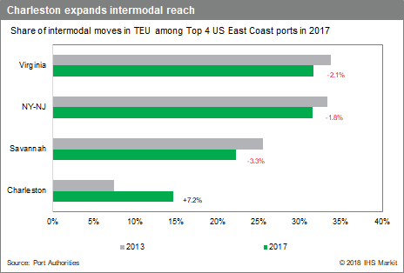
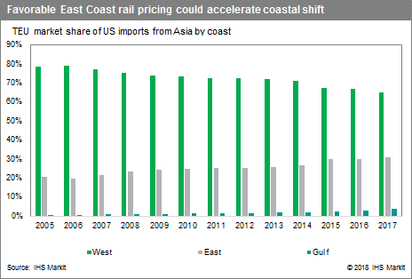
Shift in cargo to the East and Gulf coast continues
West Coast share of Asian imports down to 65.7 percent from 78.4 percent in 2005.
Mega-ships give BCOs low-cost options to East & Gulf Coast ports.
Increased transloading at LA-LB and Savannah show the pull of both gateways for e-commerce.
Savannah, Charleston, Jacksonville expanding intermodal reach.
BCOs with high-value shipments favor West Coast transloading to Ohio Valley/mid-South for time-sensitive merchandise.

Slide 11
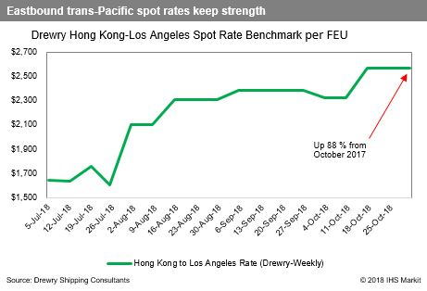
Trans-Pac spot rates and service contracting
Carriers began 2018 expecting modest growth and excess capacity. Signed service contracts with less-than compensatory rates.
Trans-Pacific capacity projected to increase 8-9 percent while imports projected to increase 5-6 percent, according to Alphaliner.
Service contracts about $100/FEU lower than 2017-2018 contract rates
Then tremendous uncertainty due to tariffs on imports from China. Retailers fast-forwarded holiday merchandise. Vessel space tight in Asia since July. Spot rates soared.
Carriers say they need rates of $1,600 to $1,700 to the West Coast, when accounting total loop costs of repositioning containers to Asia. Some analysts put the break-even costs at $1,200 to $1,300.
Takeaway: Carriers in second half of 2018 on track to return to profitability.
Carriers preparing for $100 per FEU rate increase due to shippers moving foods before Jan. tarriffs.
Spot rate $2,571 to West Coast and $3,288 to East coast.
1/2

Slide 12
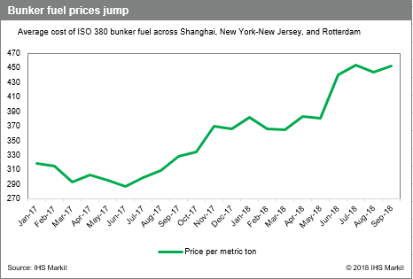
Bunker fuel prices rising
Average bunker fuel prices through August up 43.7 percent from June 2017 to $444 per metric ton across Rotterdam, New York-New Jersey, and Shanghai.
Prices spiked in May, rising 21.4 percent from the start of April.
Maersk, MSC, and CMA CGM, are seeking “emergency bunker recovery measures,” while Hapag-Lloyd imposed a bunker surcharge on Asia-EU/Med and Oceania trades.
Q3 will reveal how successful carriers have been in pricing in the fuel increases.

Slide 13
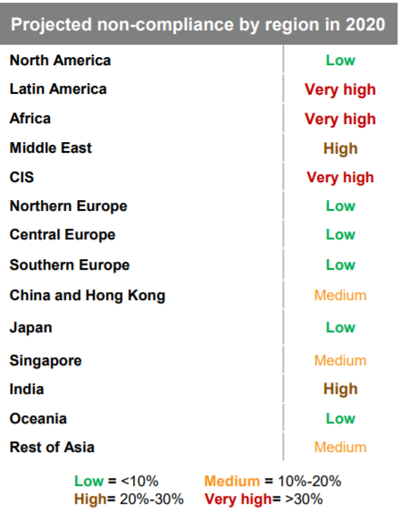
IMO’s low-sulfur fuel mandate looms
IMO low-sulfur fuel requirement takes effect in 2020, requiring marine fuel oil’s sulfur content fall from 3.5 percent to 0.5 percent.
Forecast to cost $5 billion to $100 billion. Maersk alone plans to spend $2B billion to meet annually. Whatever the cost, shippers will eat most of it.
Major carriers worry smaller players will ignore rule because of lax enforcement. IHS Markit expects 12% non-compliance globally.
Carriers must already burn low-sulfur fuel when calling at ports in China, Europe, and North America.

Slide 14
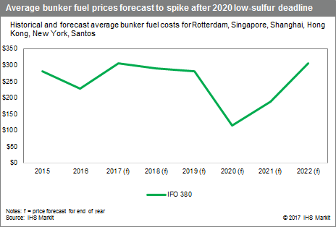
IMO low-sulfur fuel mandate
Concerns that neither carriers nor oil refiners are prepared for the jump in demand come 2020.
Shippers fear dramatic jump in costs if those shortages occur. IHS Markit still expects price volatility in the first six months of implementation, but has reduced its expectations.
Carriers can comply by using scrubbers on smokestacks to capture sulfur, or converting vessels to run on liquefied natural gas.
Demand and prices for standard IFO 380 seen rebounding after 2020 as carriers adopt scrubbers for their fleets.

Slide 15
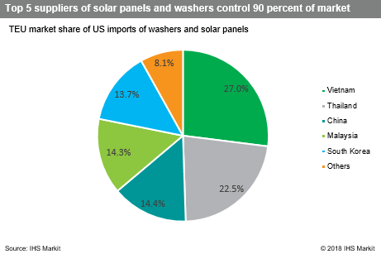
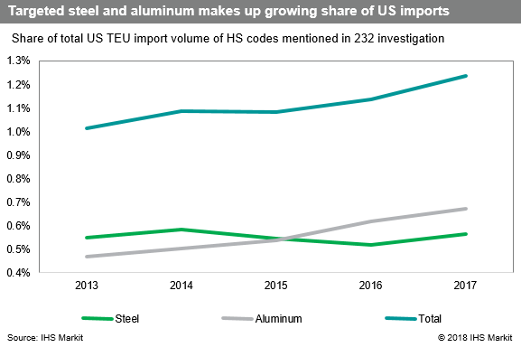
US trade policy generates uncertainty
Started small with washer and solar tariffs on just 195,000 TEU.
Grew to steel and aluminum tariffs, which even without exemptions for EU and other allies amounted to only 1.2 percent of US imports.
China was first to retaliate to steel and aluminum tariffs, hitting pork, fruits, and nuts.
EU, India, Turkey retaliated. Japan and Russia have submitted dollar figures and HS code list is expected to follow.
Trump and European Commission President Jean-claude Juncker reportedly reached a deal last week to work to zero tariffs, but tariffs in place will remain in effect during talks.

Slide 16
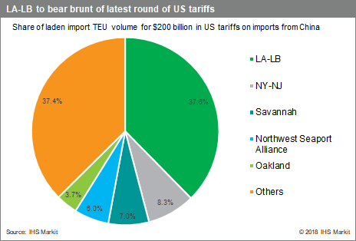
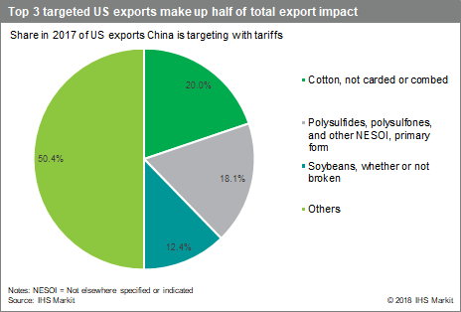
US trade policy generates uncertainty
First set of $50 billion in tariffs unveiled put 7 percent of the US-China container trade at risk.
Updates and revision before splitting list in to $34 and $16 billion increased risk to 8.5 percent.
The $200 billion announced in July combined with the earlier announced tariffs bring total exposure to 47.5 percent of US import trade with China.
Ag sector to be hardest hit. Retaliation by China and others focused on ag, while US tariffs on China include wide range of ag equipment.
China has yet to retaliate to $200 billion in tariffs.

Slide 17
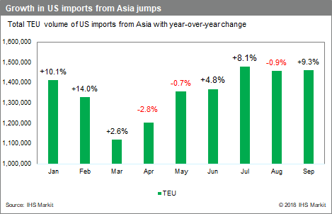
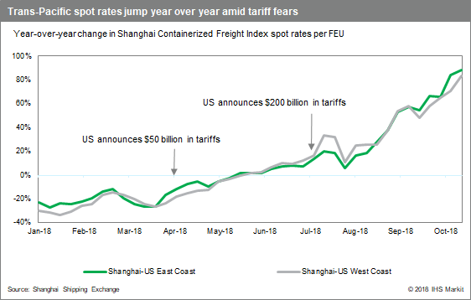
Tariffs warp typical shipping patterns
Market surprised by announcement that tariffs would jump to 25 percent Jan. 1.
Shippers were already front-loading shipments, and jump to 25 percent led to a bigger jolt in rates and volume.
Rush made July this year’s biggest month for peak-season volume, when historically August is.
Rates up more than 50 percent year over year despite relatively strong comparisons to 2017, when carriers were profitable.
Will pattern of pre Lunar New Year rush and rise in rates of years’ past repeat?
Or does the peak month being July indicate a larger, more profound shift in market dynamics?

Slide 18
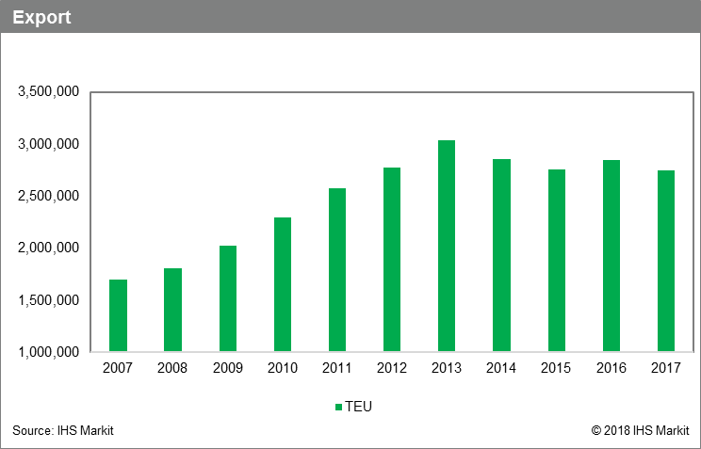
Chemical trade with China
Exports to China fell by 21 percent in the first eight months of 2018 over the same period in 2017.
In every month of 2018, exports were at least 11 percent down on same month in 2017. Largest decline was 34 percent fall in August over the 2017 month.
Exports fell by 3.7 percent in 2017, after 3.4 percent increase in 2016.
2018 exports for January to August = 1.5 million TEU
2018 imports for January to August 2018 = 7.35 million TEU, up 4.4 percent on the same period in 2017.

Slide 19
Tariff Impact on China Chemical Trade
Initially
  Us placed 25 percent tariff on $2.2 billion of chemicals and plastics from China
  China retaliated with tariffs on $2 billion of US chemicals and plastics
Then
  US put tariffs on another $16.4 billion Chinese chemicals and plastics
  China retaliation expected to be on $8.8 billion
Total- about $11 billion in US chemicals and plastics to China face tariff.
Other Countries
Canada, EU, Turkey etc, - tariffs on $3.3 billion goods
“The direction of trade policy and imposition of tariffs is introducing a significant amount of uncertainty. This is the biggest downside risk to the US chemicals industry right now.”
American Chemistry Council
Best case scenario
15 percent reduction in exports.
Worst case – 56 percent reduction
Source: American Chemistry Council

Slide 20
Tariff Impact on China Trade - Imports
  “Because chemicals are used to add value in nearly every step of manufacturing, there is really no way for our industry to escape the negative impacts of the tariffs on imports.
  American Chemistry Council
  “Devastating” effect on autos and parts.
  Chemicals contribute to about 19 percent of the weight of a new vehicle. 332 pounds of plastic in every vehicle.
  Average value of chemistry in a vehicle is about $3,000
Then
  US put tariffs on another $16.4 billion Chinese chemicals and plastics
  China retaliation expected to be on $8.8 billion
Total- about $11 billion in US chemicals and plastics to China face tariff.
Source: American Chemistry Council

Slide 21
Is Tech the big Game Changer?
Only two of the world’s top dozen container lines — Maersk Line and Hapag-Lloyd — offer shippers the capability to get instant quotes via an online booking engine
Development of port-wide portal by Port of Los Angeles and GE Transportation will enhance information sharing and sets stage for predictive analytics. Other US ports are set to join the program.
BCOs are benefitting incrementally from the use of technology in various sectors of the supply chain, but true end-to-end cargo visibility remains elusive.
Terminal operators and equipment providers could better use predictive analytics to ensure sufficient chassis for BCOs if only BCOs would be more forthcoming in alerting IEPs and terminals when they will return the chassis to the terminals.

Slide 22
Most Impactful Technology Today
Load-Matching
Convoy
Transfix
Loadsmart
Uber Freight
    Collaborative platforms
          Haven (ocean side)
          Cloud Logistics (domestic side; recently bought by E2open)
    Enhanced Visibility
    (focus on predictive ETAs as opposed to where's my stuff)
      FourKites
      project44s
      Dynamic Pricing / Marketplaces
          Freightos
          XPO Logistics (AI-driven demand-based pricing system)

Slide 23
Tomorrow’s Tech
Artificial Intelligence / machine learning
ClearMetal – uses artificial intelligence to help to predict booking behavior, such as customer cancellations, modifications and withdrawals (eg Panalpina)
ManWo Ng (Old Dominion University) mathermatical model to project a port terminal’s future chassis requirements
Loadsmart
Blockchain
          Maersk Lines/IBM – TradeLens
          Zim -
          Internet of Things

