Slide 1
Bromine ISO Fleet Management

Slide 2
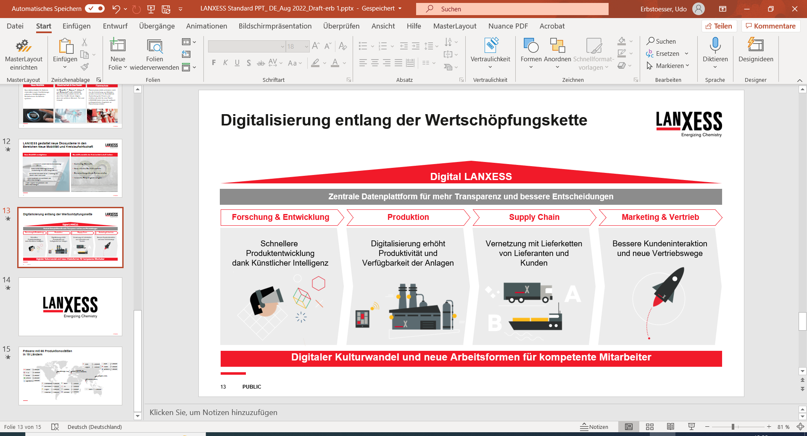


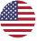


Presence with 58 production sites in 17 countries
China
5 Sites
Singapore
1 Site
Japan
1 Site
Corporate HQ Cologne (Germany)
Taiwan
1 Site
Pittsburgh (USA)
Canada
2 Sites
Australia
1 Site
Shanghai (China)
U.S.A.
18 Sites
Brazil
3 Sites
Mumbai (India)
Argentina
2 Sites
Germany
8 Sites
India
2 Sites
Italy
1 Site
Netherlands
1 Site
UK
7 Sites
Belgium
1 Site
South Africa
1 Site
France
2 Sites
* Status 09/2023
PUBLIC

Slide 3
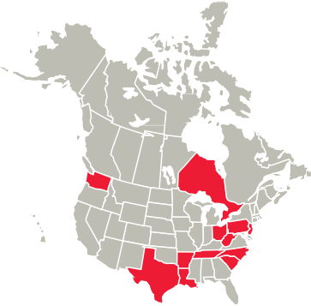
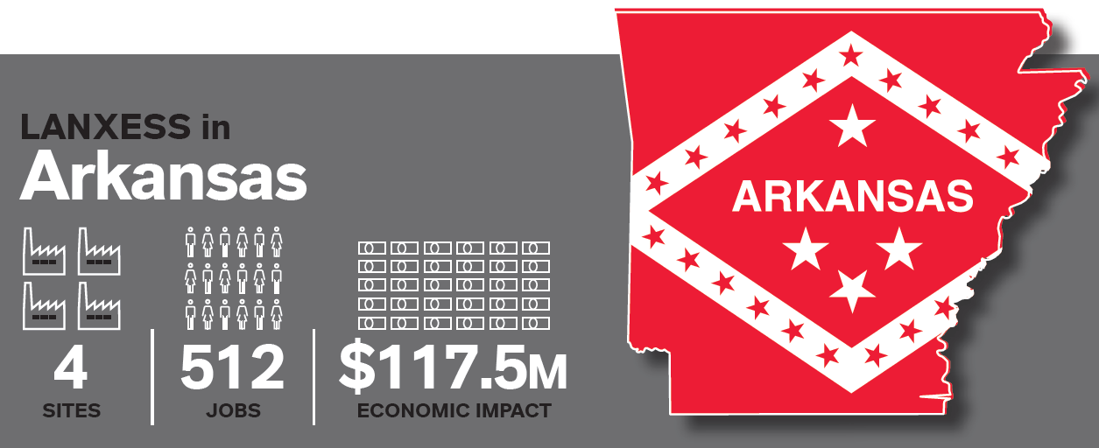
Lanxess North America
$3.1 B
2023 SALES
2,300 EMPLOYEES
14 STATES
20 PRODUCTION SITES
Arkansas
Delaware
Louisiana
New Jersey
North Carolina
Ohio
Pennsylvania
South Carolina
Tennessee
Texas
Washington
West Virginia
Elmira, Ontario
West Hill, Ontario

Slide 4
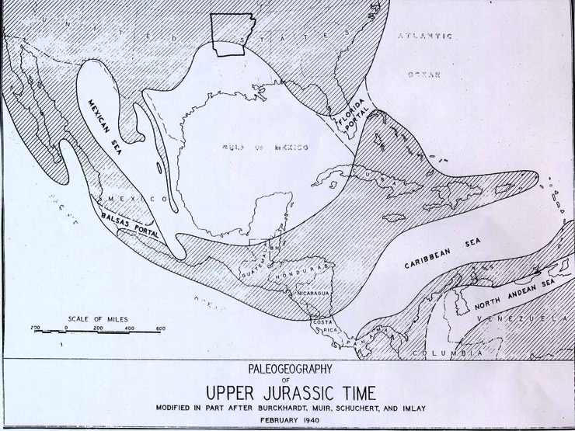
Bromine Solutions - South Arkansas
South Arkansas
Why we are here:
Natural Resource (salt water) with high bromide concentration.
Discovered in 1921 during the oil boom.
1.3-1.5-mile-deep (2.1-2.5 km) rock formation called the Smackover Limestone Formation; second largest brine reserve in the world (Dead Sea is the largest).
The Smackover was created by the ancient Gulf of Mexico over lower portions of south Arkansas. As the Gulf receded, the remaining layers of organic matter, salt water and various geological factors formed the reservoir.
Brine is extracted from the porous rock formation and sent through pipelines to our plants.
Bromine is freed from brine using chlorine and then the bromine is used in the manufacture of brominated products.
Salt water is returned to the formation.

Slide 5
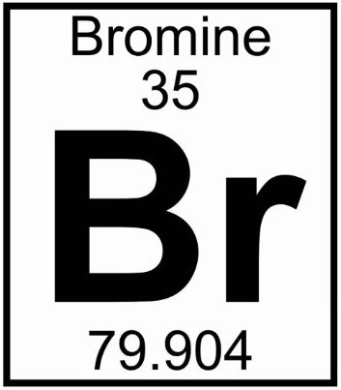
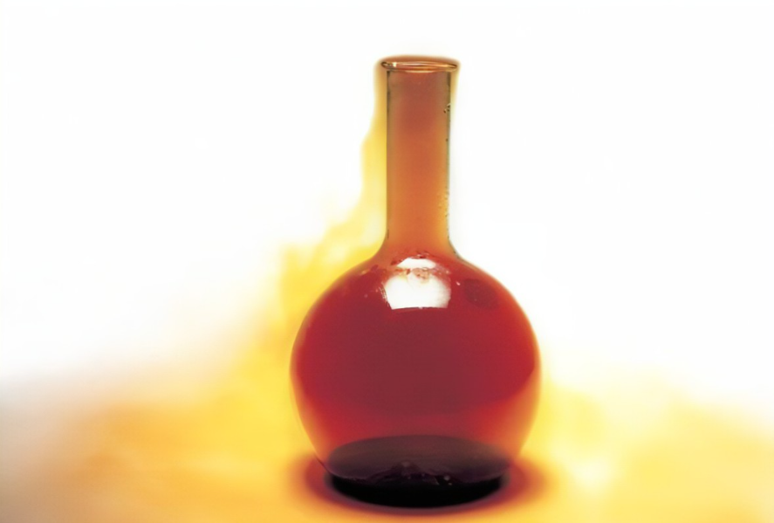
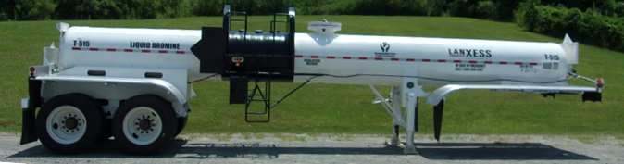
What is Bromine?
A reddish-brown liquid at room temperature, first isolated in 1825.
Weighs 26 lb/gallon (density 3.1)
25th chemical element in order of abundance in nature
Strong oxidizing agent, corrosive
Irritating odor and is named from the ancient Greek word βρῶμος (bromos) meaning stench

Slide 6
South Arkansas Operations
Three manufacturing sites – Central, South, West, and Brine operations
Support functions include EHS&S, Human Resources, Finance, Procurement & Logistics
~500 employees
Largest site in Lanxess North America
Third largest site in Lanxess globally.
Central
West
South

Slide 7
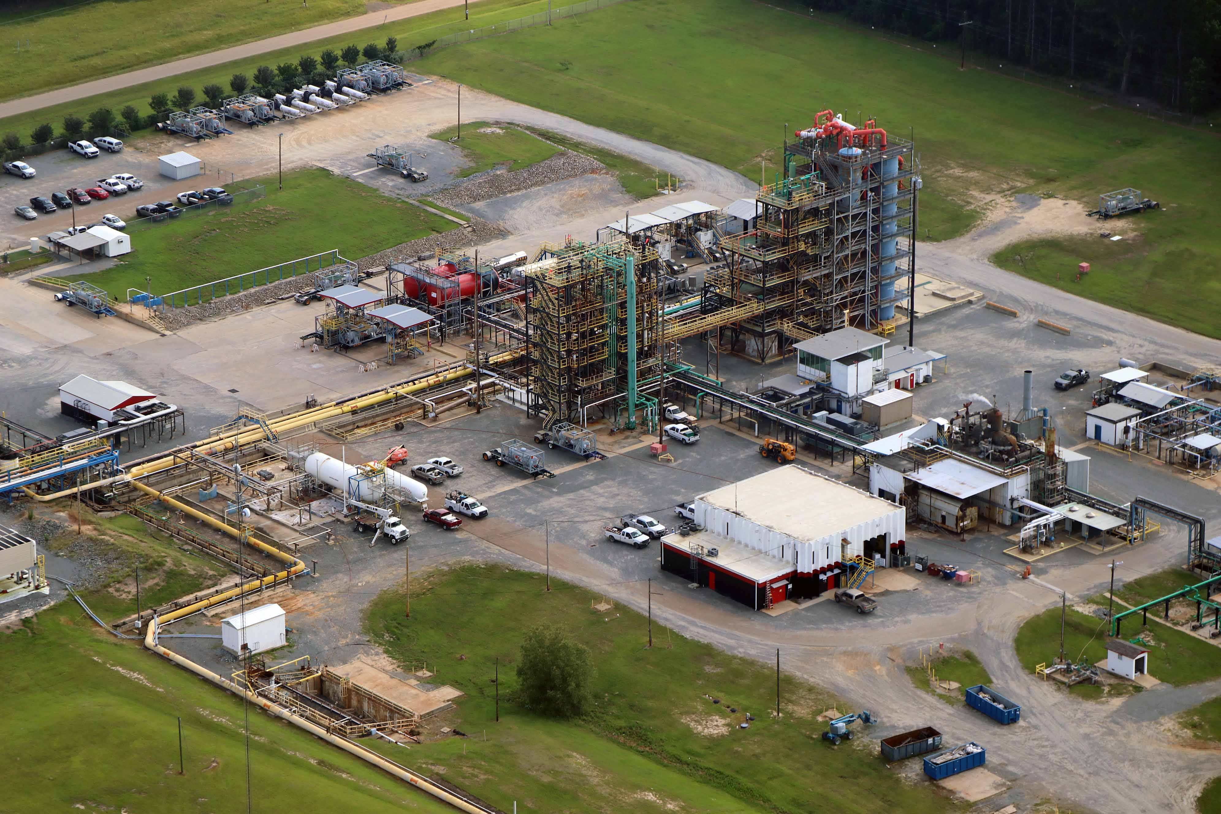
Bromine Production Unit (West Plant)
Main Bromine production facility
Fill all Bromine ISOs
Fill Bromine Trailers
also filled at central and south

Slide 8
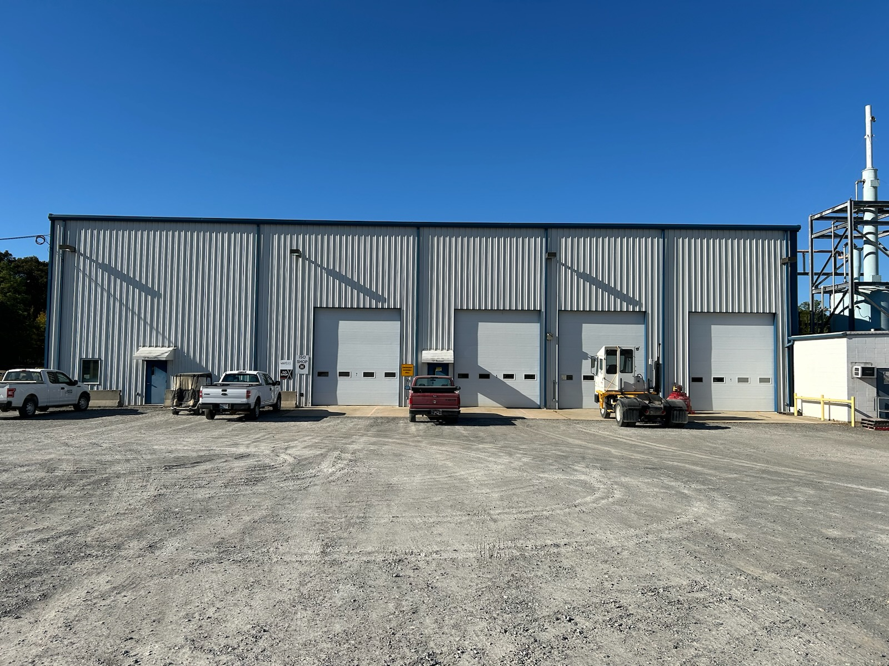
El Dorado ISO Maintenance Shop
8 Bay shop with washing, venting, and scrubbing capabilities
Tank Fleets Maintained
Bromine ISO
small Bromine cylinders
Bromine Road Trailers
Chlorine ISO
MeBr ISO

Slide 9
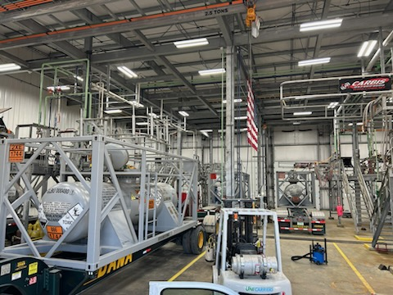
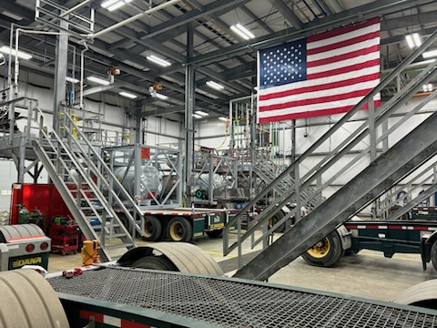
ISO Maintenance Operations
12,000 sq ft shop
DOT CT licensed shop
Built in 2013
Caustic scrubber system with vacuum
3 Waste Water tanks
High Pressure and Low Pressure Air Compressors
-40F Dew point dryer system

Slide 10
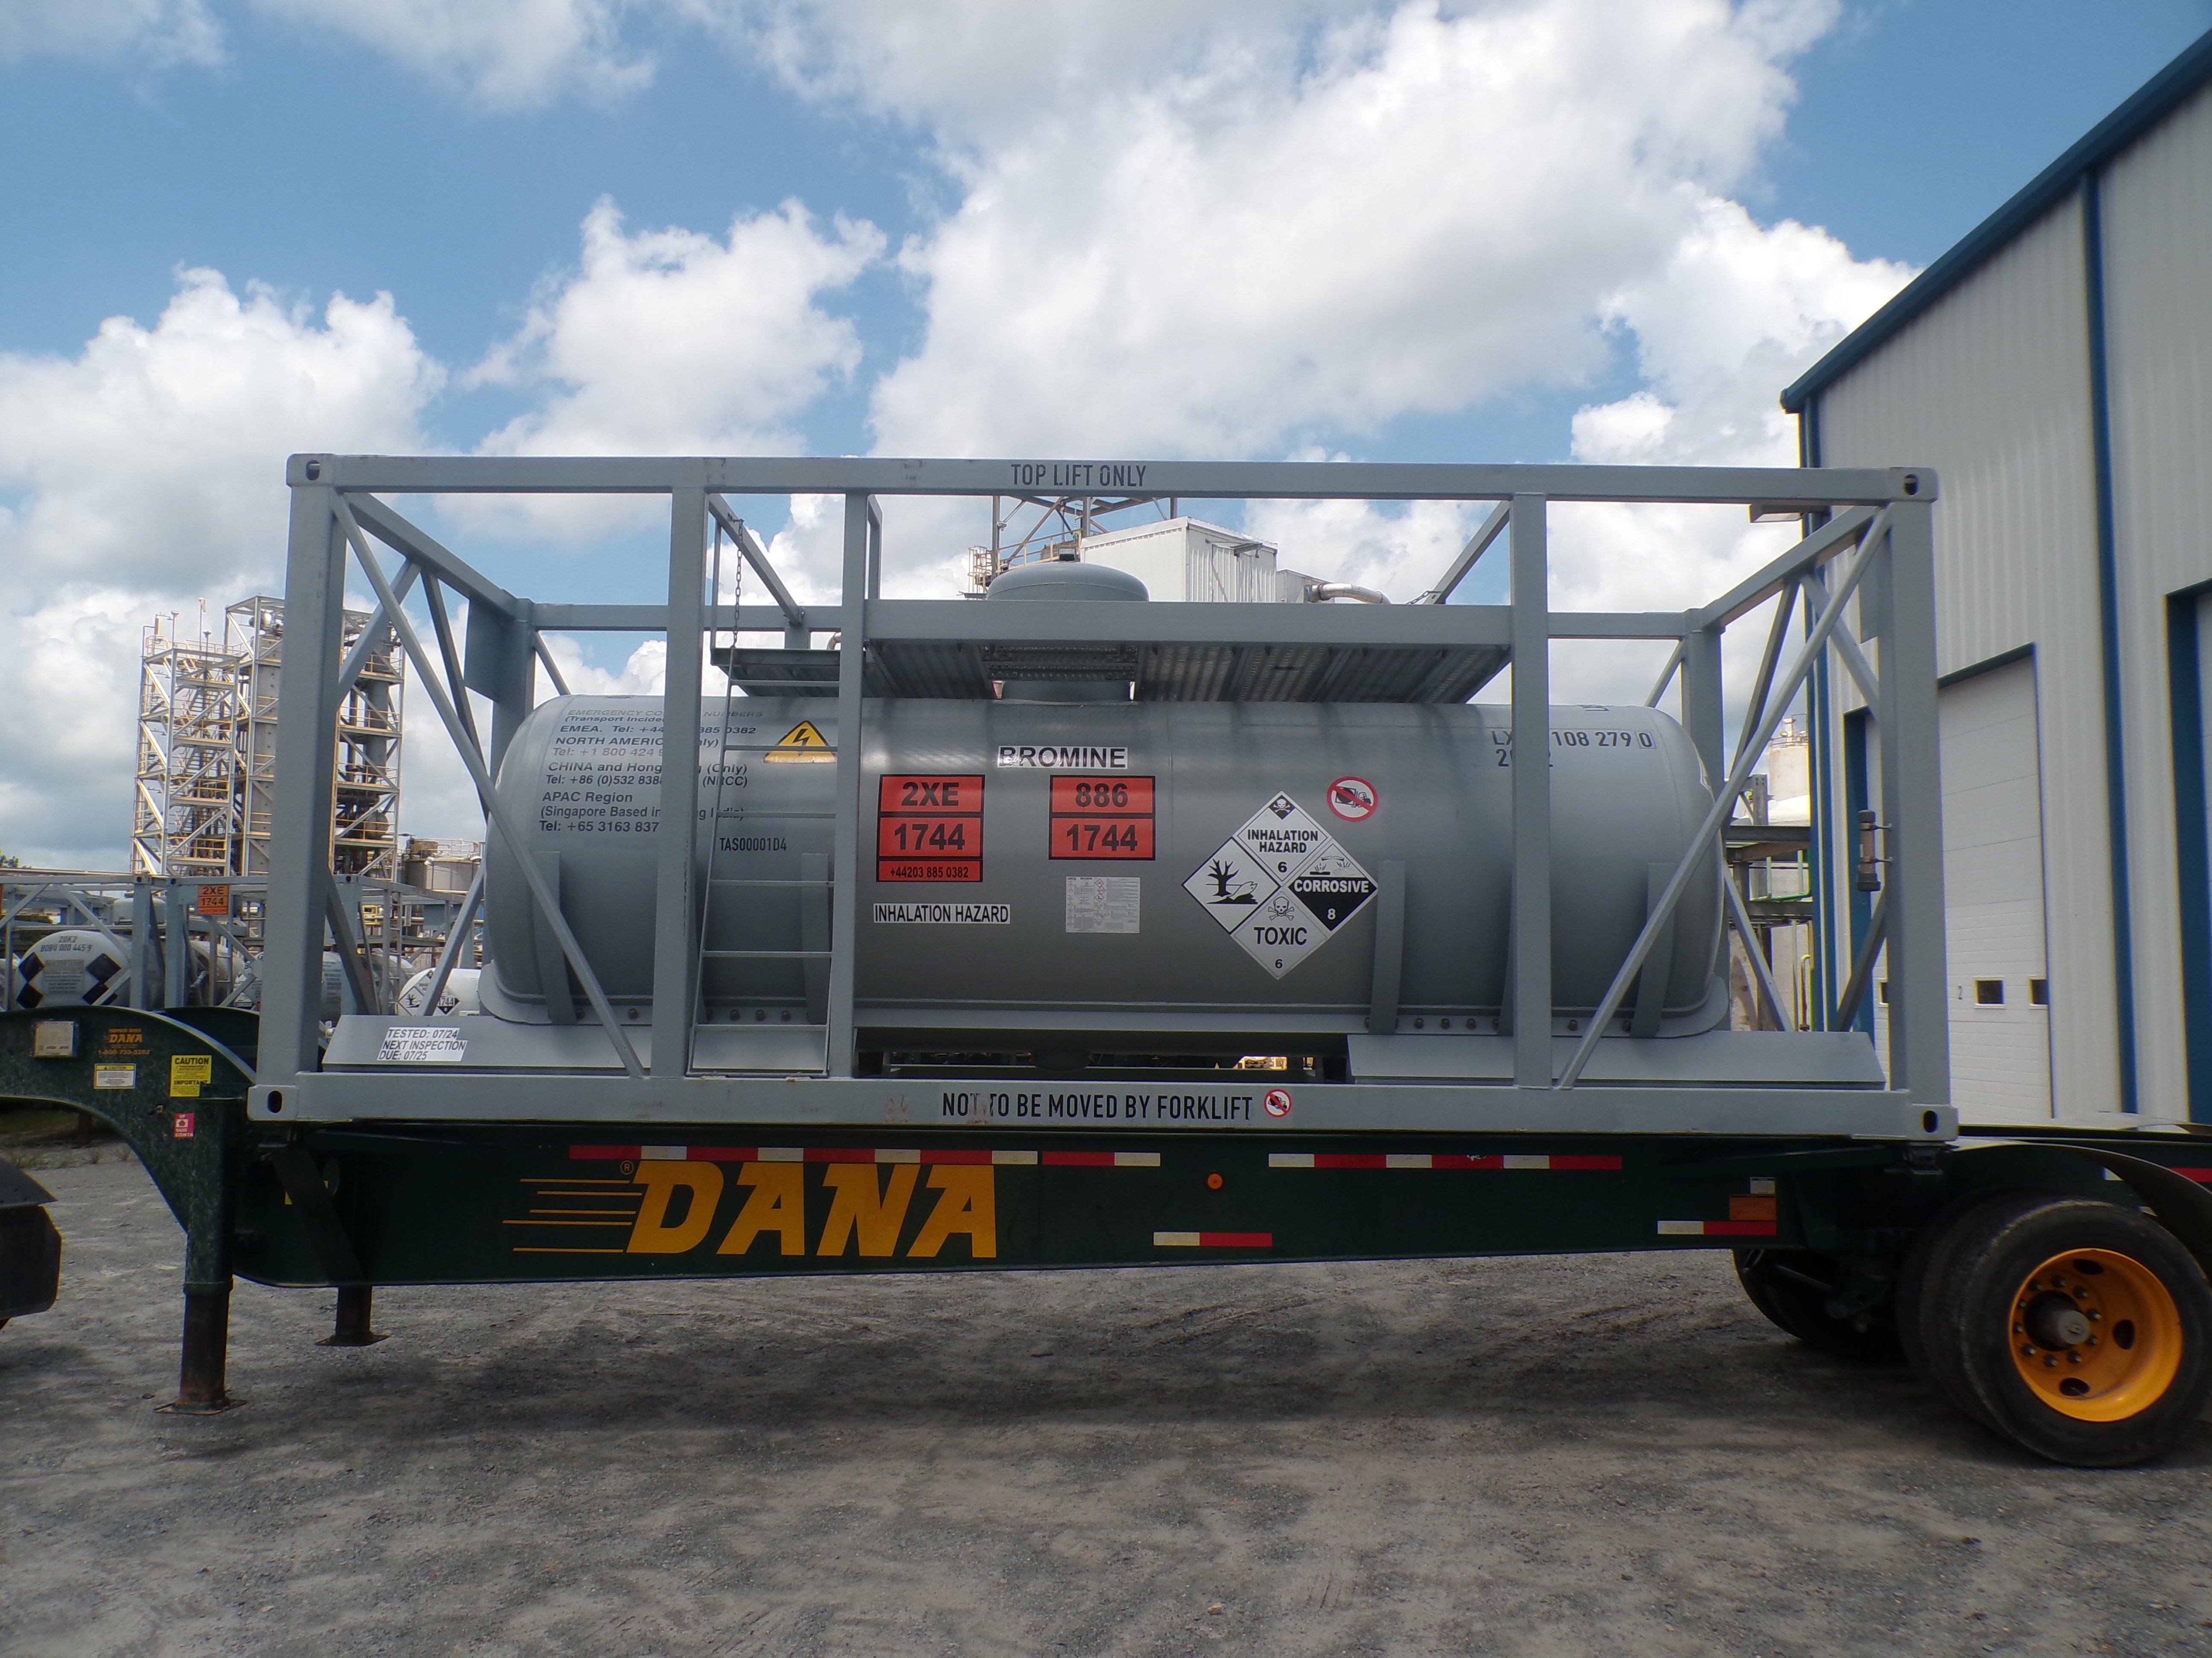
Lead lined Bromine ISO
Bromine ISO Maintenance
Steel tanks with lead liner
Annual internal inspection
Liner thickness check
TP10 provision (49 cfr, 172.102)
Inspection authority (BV) require 2.5-year inspection, 5 year hydrotest
Annual replacement of hardware, gasket, valves
Annual replacement of relief device

Slide 11
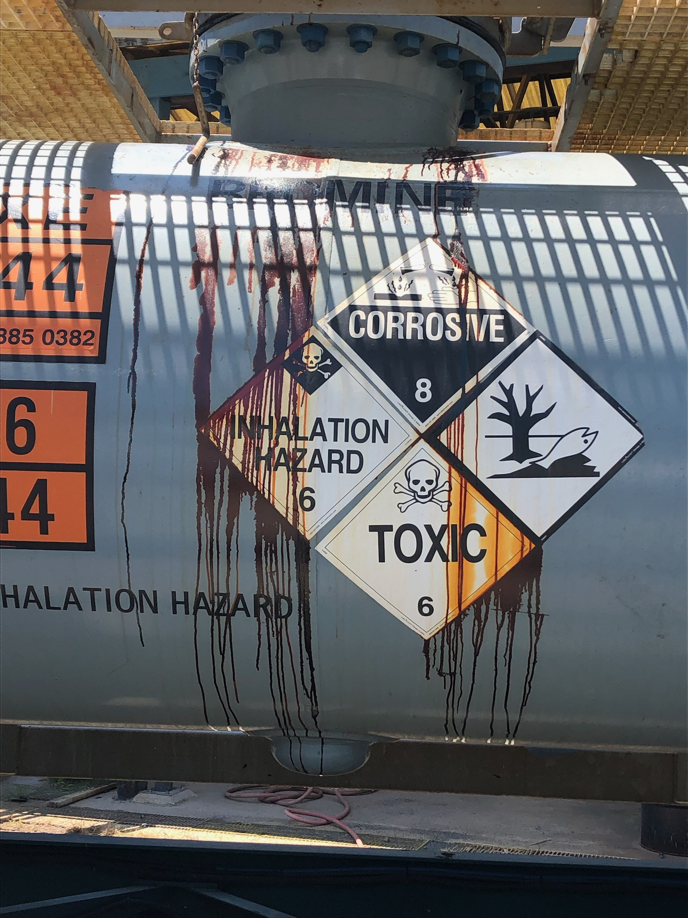
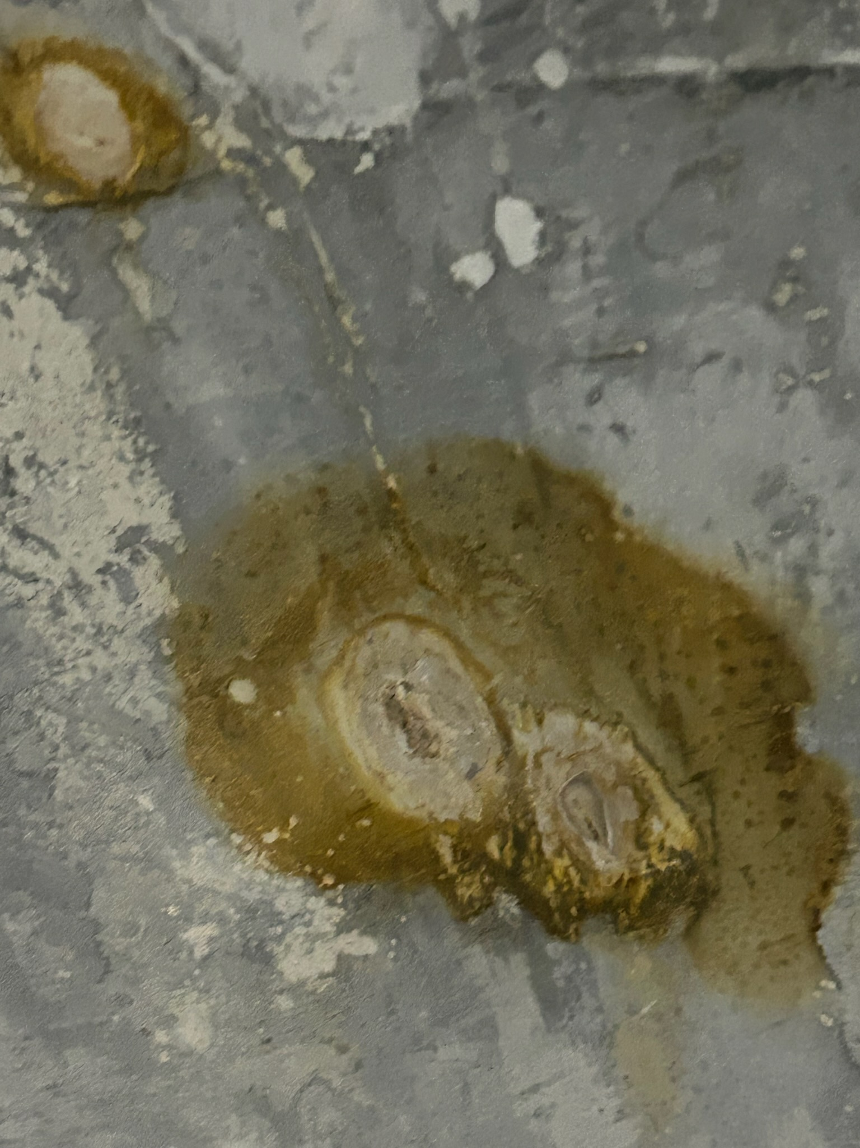
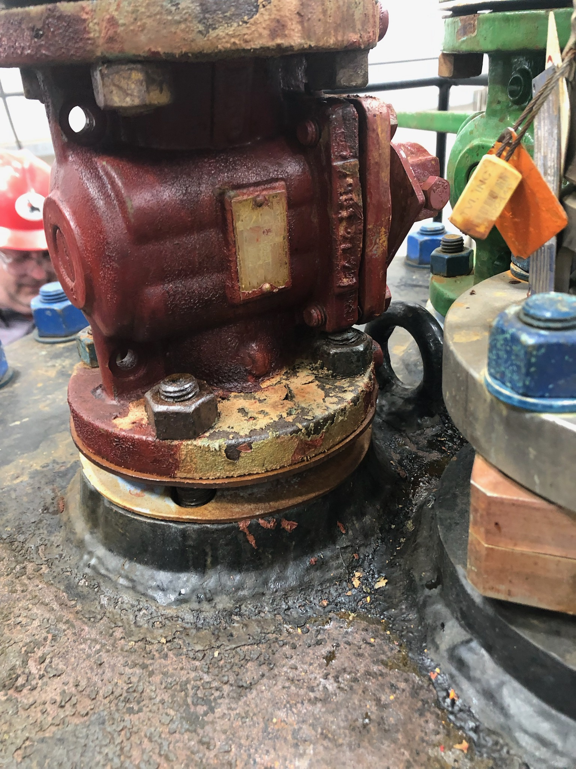
Bromine ISO Maintenance
Typical damage mechanisms
Bleeds
Low spots
Sealing surface deformation
Gasket material degradation
Corrosion to valve body and hardware

Slide 12
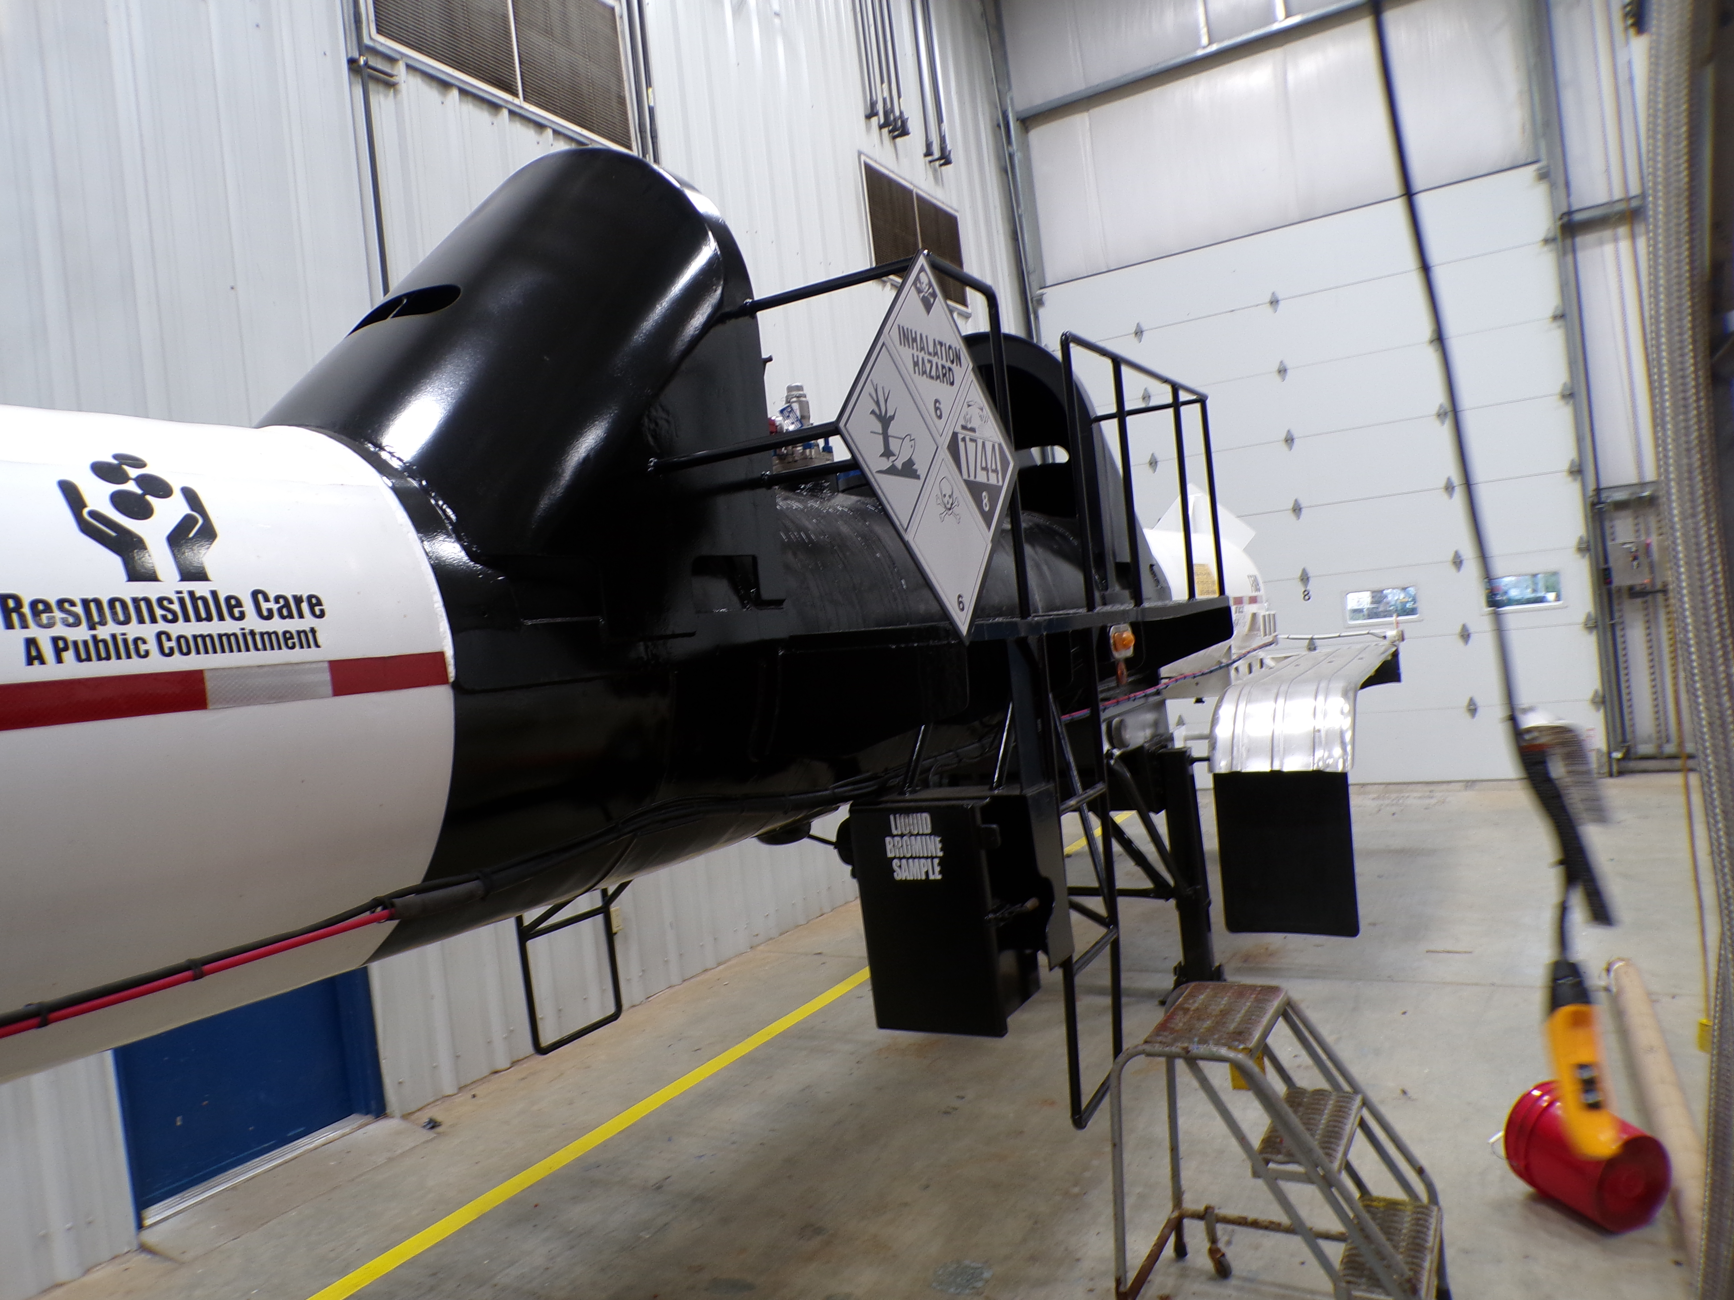
Bromine Road Trailer
Domestic Fleet
Steel tanks with Nickel liner
Annual internal inspection
Annual replacement of hardware, gasket, valves
Annual replacement of relief device
5 year hydrostatic pressure test

Slide 13
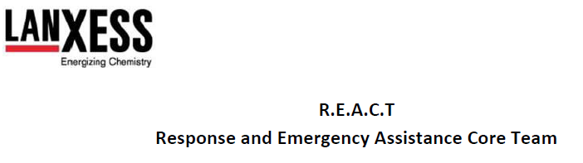
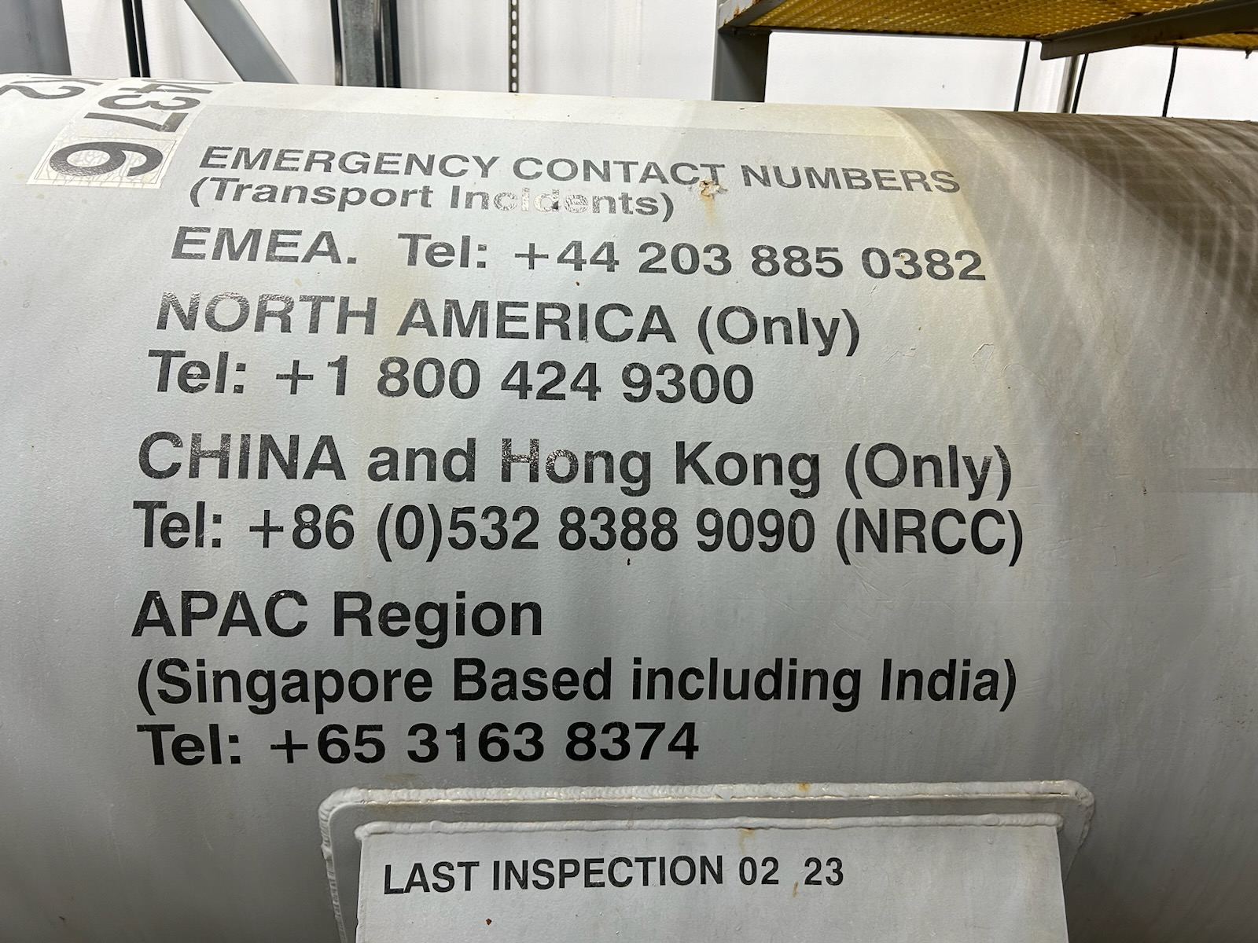
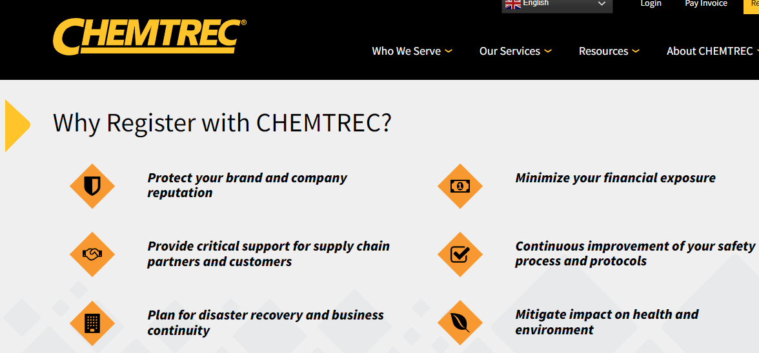
Emergency Response Management
Chemtrec emergency contact number on all containers
Chemtrec notifies us
Responsible Care member

Slide 14
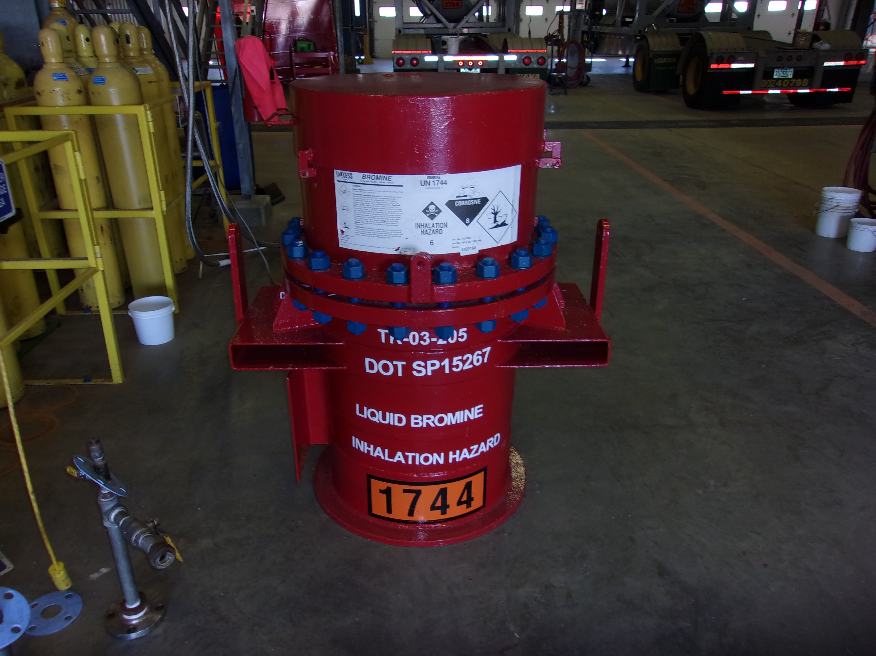
Bromine Cylinder Incident
Customer safety system detected leak 02/20/24 10:09
Plant personnel on call with customer at 11:15
Leak contained and safe
Dispatched plant personnel to customer 02/21/24 03:00
On-site at 14:00 2/21/24
Received replacement cylinder 2/22/24

Slide 15
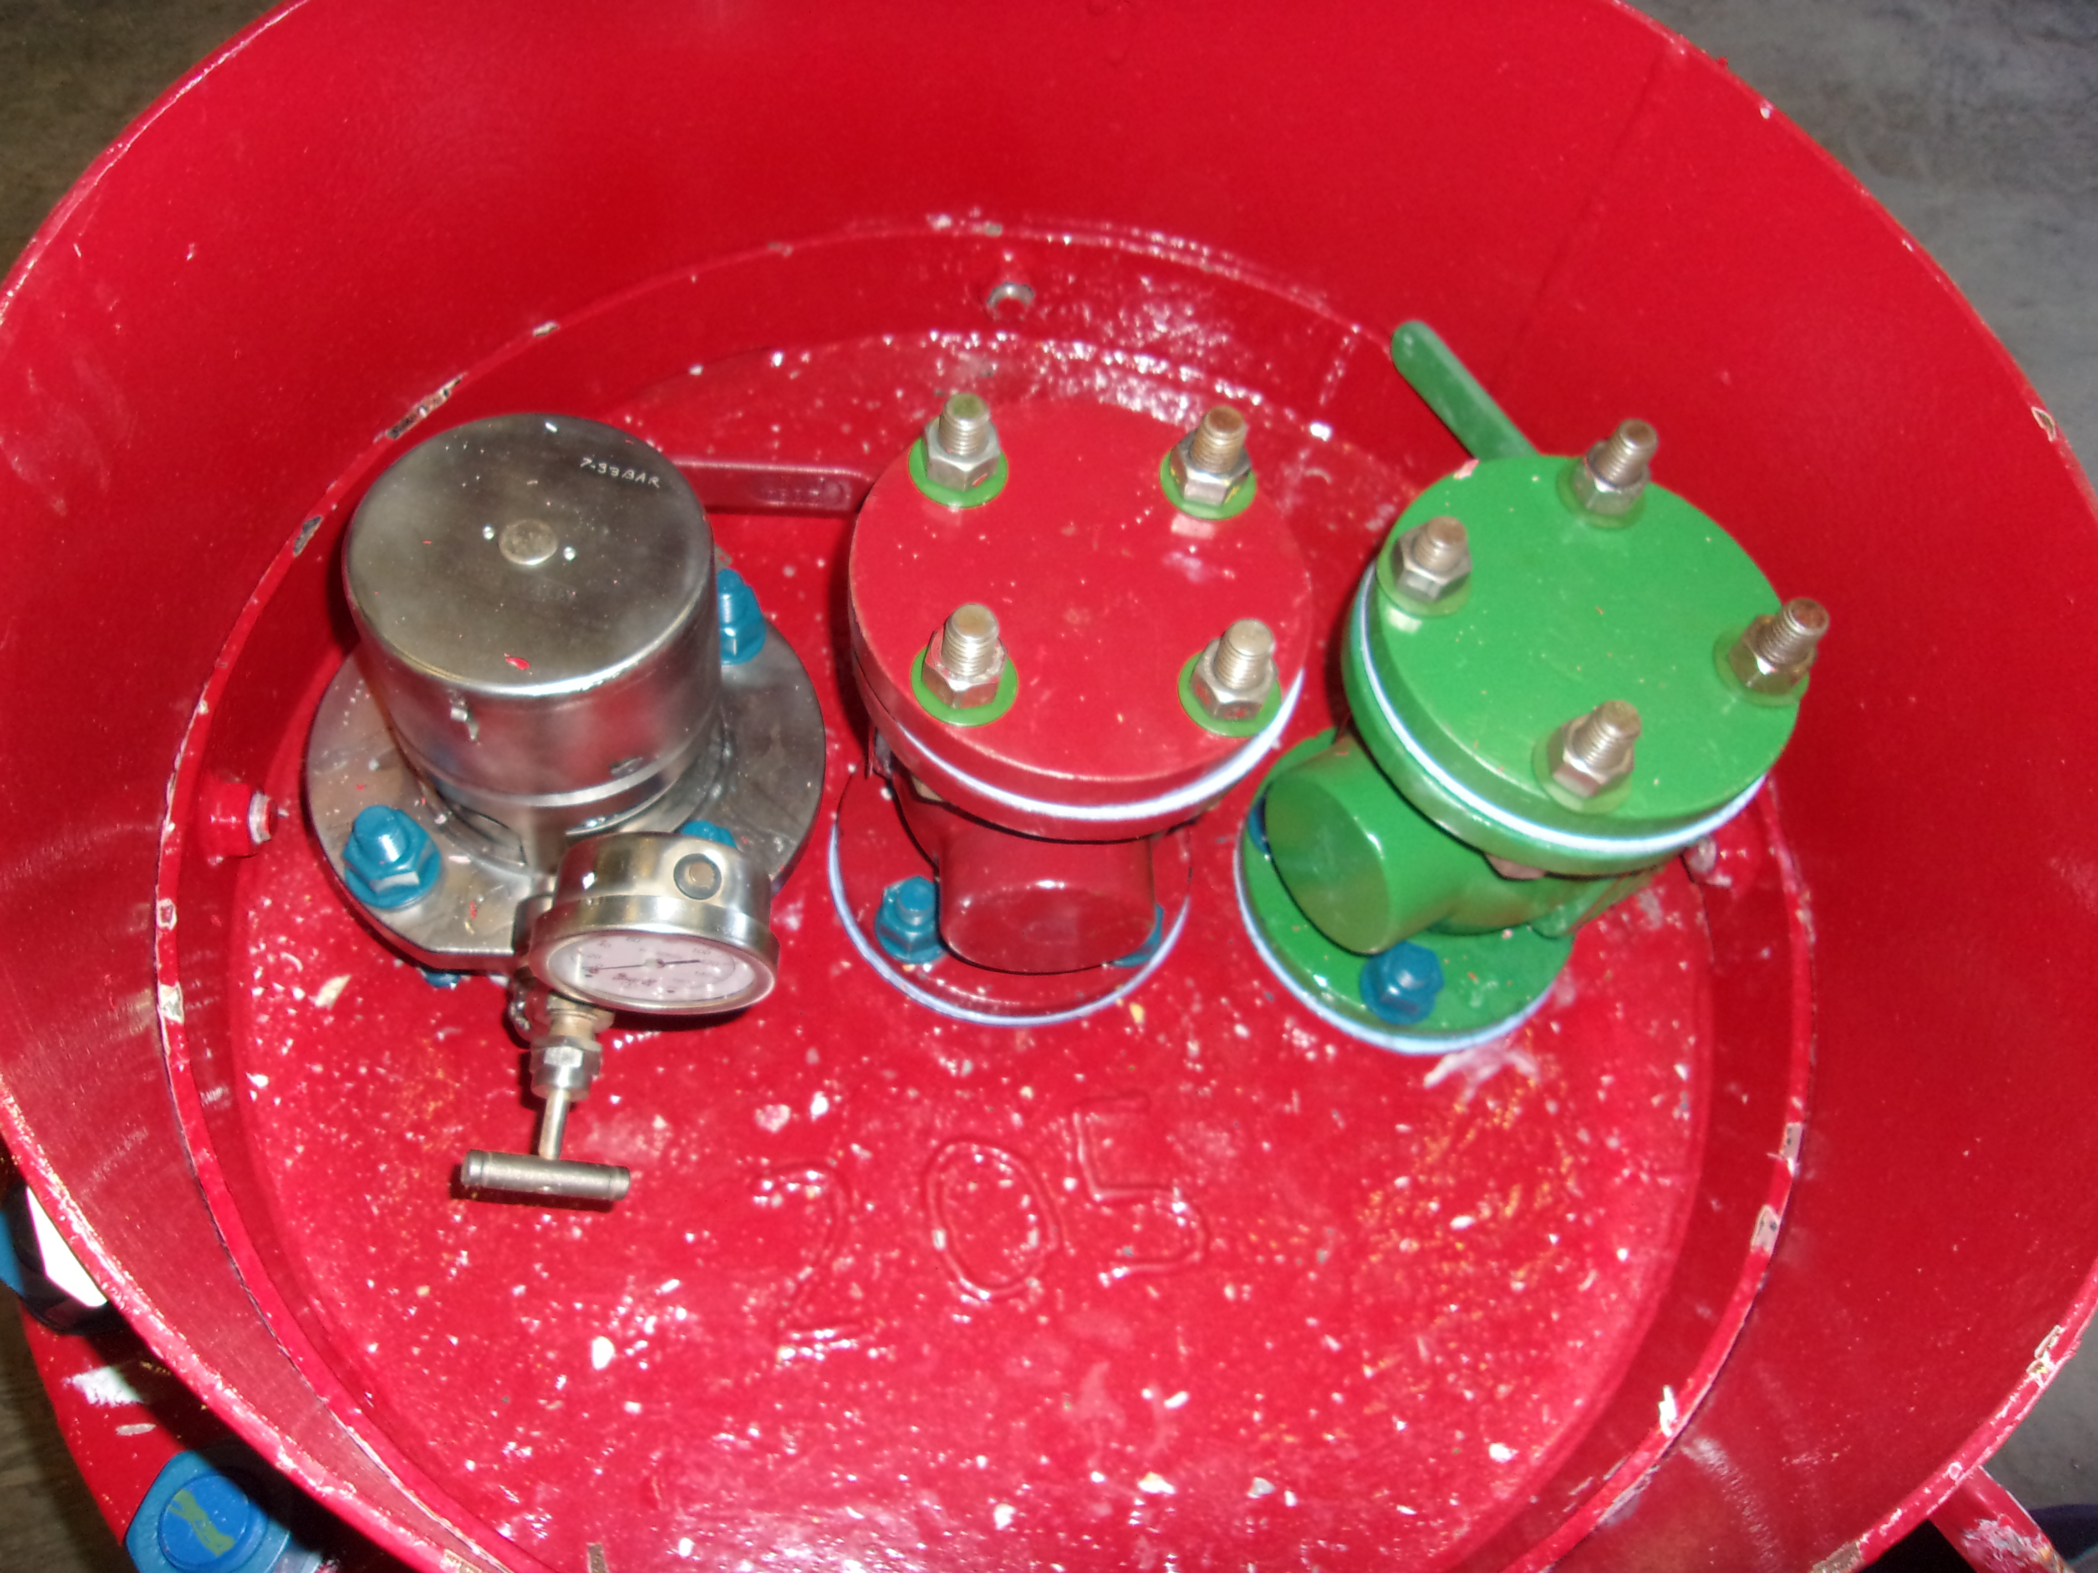
Bromine Cylinder Leak Root Cause
Root Cause
Green valve lost gasket load
Gylon 3504 gasket
Lead creep resulted in loss of bolt torque
Corrective Action
Change Gasket material to Viton
Softer gasket material
Requires less bolt stress
More memory to fill void
Results in less lead creep
Implemented specification change for all lead lined cylinders

