Slide 1
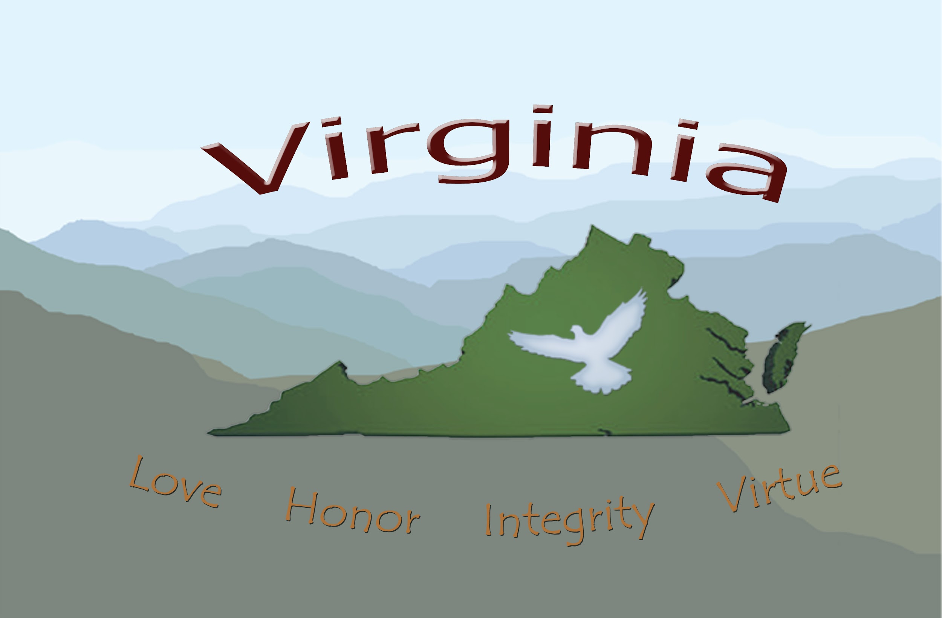
Foundations of Self-Governance
Last published 3/5/26

Slide 2
Virginia Self-Governance
“That to secure these Rights, Governments are instituted among Men, deriving their just Powers from the Consent of the Governed, that whenever any Form of Government becomes destructive of these Ends, it is the Right of the People to alter or to abolish it, and to institute new Government, laying its Foundation on such Principles, and organizing its Powers in such Form, as to them shall seem most likely to effect their Safety and Happiness.” (Declaration of Independence)
“The job of American governance begins around the kitchen table, which is the focus of power, because the ultimate source of political power in a republican state is vested in the living people and extends outward from the family to the community to the county to the state to the country as a whole.”

Slide 3
Why should Self-Governance lead to Self-Government?
Our Land and Soil jurisdiction governance is only as good as its people. When all men and women agree to Do No Harm, Be in Honor, Act in Kindness, and Leave Life Better, Self-Governance is possible. BUT, is it enough to protect our rights ‘collectively’ to live freely on its own?
Without Self-Government “of the people”, developed “by the people, for the people” it is not possible to protect our individual freedoms granted by our creator.

Slide 4
To ascend to a higher level of awareness and self-governance and self-knowledge, to face the world as it is, not as we want it to be, and at the same time----to see what it could be, and to fearlessly accept our responsibility for it all.
Each one of us are a micro government within ourselves that we are to govern.

Slide 5
Personality traits that we need to be aware of to make change to Self Governance.
-Clear your conscious and be unbiased.
-What’s driving you to being an American? Common Law, freedom, your rights, etc
-Leave ego and desires at the door. It’s about service to others, not “what about me”?
-Our memory is our storehouse of past histories. Create NEW memories?
-Be aware of our reasoning. Lay out your “pro’s and Con’s”
-Our senses: Look, listen, feel, understand the new life with your Freedom
-Will power: drives us to understand our feelings and make change

Slide 6
Self Governance/Government to Consider…….
All the hard lessons you learned climbing the corporate ladder need to be left behind in favor of service, self-respect, self-determination, and self-responsibility, freedom, equality, brotherhood, and freewill ---- all of which are the hallmarks of self-governance.
Self-mastery is the ability to be one's own master, it means being able to control one's own impulses and desires, rather than being controlled by them.
The need to discipline yourself and to discover the truth about yourself will become obvious with time; self-governance will cease to be a foreign concept. As you learn to govern yourselves and know your own nature, you will learn to govern your nations and your world as well.

Slide 7
Self Governance/Government to Consider…….
“Take action to preserve your own protections and exemptions and property rights and pay attention and get involved in assembling your local county and state units of government. Those things operating "as" counties and "as" States of States aren't your government. You are your government. That is what "self-governance" means.”

Slide 8
Self Governance/Government to Consider…….
John Locke believed that freedom is not a possession but an action, that is, it is not something that you have, but something you do. (Wikipedia)
Self governance requires a higher degree of knowledge, a higher degree of proactive participation, and a more determined attitude toward administering your own life, taking care of your own property, and exercising your own responsibilities and your own rights go with those responsibilities.

Slide 9
Self Governance/Government to Consider…….
-The Mayflower Compact-
…..a voyage to plant the first colony in the northern parts of Virginia, do by these presents solemnly and mutually in the presence of God and one of another, covenant, and combine ourselves together into a civil body politic, for our better ordering and preservation, and furtherance of the ends aforesaid; and by virtue hereof to enact, constitute, and frame such just and equal laws, ordinances, acts, constitutions, offices from time to time, as shall be thought most meet and convenient for the general good of the colony:......

Slide 10
Self Governance/Government to Consider…….
If you have seen the government fraud and waste, discovered racketeering within multinational corporations, learned of falsities within religious and political organizations, YOU have the necessary wisdom to not only demand change, but to be a part of this change!
As an American YOU are uniquely responsible for creating, staffing, and supporting the Body Politic that actually owns and should be operating the land jurisdiction of the United States. It's a job that only you can do and a vision that only you are heir to: it is called "self-governance".

Slide 11
Self Governance/Government to Consider…….
We shall conduct our own business, create our own banks and currencies, plan our own lives, accept our own responsibilities, we shall keep our assets and our armies, our treaties and our contracts, our credit and our prerogatives, our right to self-governance.

Slide 12
Self Governance/Government to Consider…….
The process of "incorporating" everything has been used to promote a de facto takeover of our government has led to the rampant criminality with which we now contend. You can see how important it is for each one of us to do the work of restoration of our Land jurisdiction governance.
Actually participating in self-governance—which is what government of, for, and by the people requires.

Slide 13
Self Governance/Government to Consider…….
We must awaken our sleeping friends, families, and neighbors and ring the alarm. We must organize our Jural Assemblies and operate our States and Counties and re-enter all the Offices that have been secretly vacated. They have to exercise and enforce all that for themselves. That is what "American Self-Governance" is about. It all begins at the local level.
Your State of the Union is yours, but you have to own up to the job of claiming, caring for, and running it. You have to bear the responsibility of self-governance to have the right of independence.

Slide 14
Self Governance/Government to Consider…….
As Americans we have our own jurisdiction and form of law (Common Law) that is a higher form of law than what the Federal and State of State courts practice, but until you correct your status and operate your own government --- that is, self-govern- you are presumed to be a federal employee or dependent and to be subject to their foreign forms of law.
Remember that the primary obligation of self-governance is being able to govern yourself.

Slide 15
Self Governance/Government to Consider…….
“Self-governance integrates self-reliance and moderation. It means to show self-control, avoid extremes, and not to be influenced or controlled by others.” (Bill of Rights Institute)
Self-governance, self-government, self-sovereignty, or self-rule is the ability of a person or group to exercise all necessary functions of regulation without intervention from an external authority.

Slide 16
Self Governance/Government to Consider…….
In the context of nation states, self-governance is called national sovereignty which is an important concept in international law. A population or demographic becomes independent from any government that they perceive does not adequately represent them.
Self-governance is not just a philosophical concept but also a practical one. It can be seen in various forms such as self-regulation, control, management and leadership.

Slide 17
Self Governance/Government to Consider…….
Self-governance can also be seen in the context of community and society, where it refers to the ability of individuals to take responsibility for their own actions and the actions of their community.
To see the full Self-Governance document click the link below:
Thevirginiaassembly.land
Go to the Jural Assembly tab and Find the Common Law handbook

Slide 18
The bottomline?
Self-governance is also closely related to the concept of self-determination which refers to the idea that individuals and groups have the right to govern themselves and to make decisions about their own lives and to determine their own future and political status without outside interference. Self-governance emphasizes the importance of individuals and groups being able to take control of their own lives and to make decisions about their own future, communities, state and American government.
Please consider getting involved today!

Slide 19
The bottomline for Virginia?
Recognize that unless you get involved in your Land and Soil Virginia State Assembly, County, and Common Law Court system and/or government we (you) have little chance of living freely as a Self-Governing man or woman.
PROTECT YOUR FREEDOMS AND THE FREEDOMS OF FUTURE GENERATIONS!

