Slide 1
Gestalt Therapy: Fritz Perls.
After WWII he worked in a Psychiatric hospital for brain damaged soldiers and began to publish his works on mental health.
The Gestalt institute was established in 1952 and became popular in the nineteen sixties. Fritz Perls became a Guru for the Cultural Revolution in America.
Gestalt Therapy is a process based wellness model : The Here and Now.
The foundation of Gestalt is grounded in two major ideas.
1. The past did happen but it is not happening NOW.
2. Reality is subjective and that the individual assigns meaning to reality.
The word ‘should’, is a societal imposition onto the individual

Slide 2
Gestalt: It’s what’s inside that counts.
The goal of Gestalt Therapy is to peel away the layers of the inauthentic self.. the pretend-self that the client has actually constructed to avoid awareness of one’s real authentic self : See Freud’s Iceberg model. 1.Consious 2.Sub-conscious 3.Unconscious
Fritz Perls believed that human beings have a predictable manner in which a person unravels his world to achieve authenticity. (not the pretend-self)
Human beings are naturally ‘whole and complete’…..but we get lost and we no longer know how to live with ourselves. We lose the connection to ourselves and an unexpressed life can result in anxiety.
Choosing freedom: We all have the keys to the kingdom….but you must be willing and courageous to afford the price of admission.

Slide 3
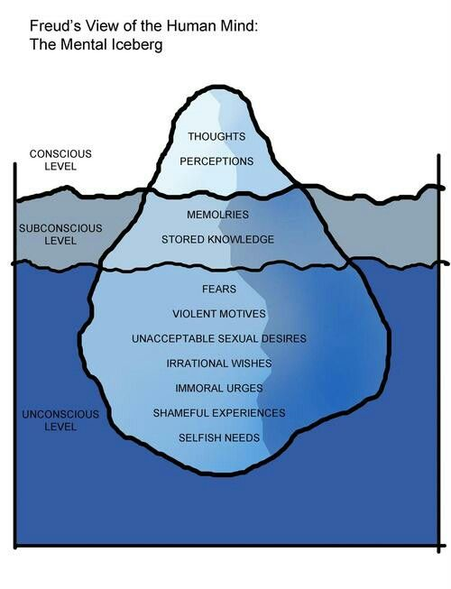

Slide 4
Peeling away the layers
The cliché layer is our first line of defense. Our authentic self is protected most profoundly at this layer. It is superficial.
The phony layer is our next line of defense when we find ourselves engaged socially but we choose to pretend and present only ‘the face’ that hides our authentic self from others and usually ourselves as well.
The Impasse layer is present once we gain awareness that we have been living a pretend life. At this point we don’t know what to do about it. BUT we have no idea how to access our authentic self. We are blocked
Implosive Layer is the point at which we are faced with the reality of ‘what is blocking us’. We can’t go back to being phony and we are keenly aware that if our authentic self is exposed we could be unacceptable and unloved. The pressure can cause us to implode or shut down. Until we are willing to take this risk, we will be stuck in this layer.
Explosive Layer is the place when we finally decide let go of the false self and embrace our authentic self. We accept who we are and who we are not. We will have achieved the ability to feel the full range of our human experience. We are real and committed to expressing ourselves directly and honestly with others.

Slide 5
The Gestalt Cycle
Continuous Cycling in waking state
Sensation : Physical body/emotion sensing a NEED
Awareness: the realization that something has to be done
Mobilization: Commit to taking care of the need by taking an action
Action: Taking action to get it done
Final Contact: The action itself
Satisfaction: Experience of completing the action
Withdrawal : Letting go to allow for a new sensation

Slide 6
Blocks stop the fulfillment of a need
Multiple Sensations can cause one cycle to interrupt another (prioritization)
Desensitization occurs to block a sensation from awareness. The Need never reaches awareness. The need can be caused by past abuse. Sensation of abuse ‘in the now’ is blocked out
Deflection: Occurs in awareness to block any further experience. Nervous laughter to block shame which is identified with the need.
Introjection: Blocks using Shoulds or Shouldn’ts to dominate fulfillment of need
Projection: Projection of fears or apprehensions onto the intentions (thoughts and feelings) of others. Blocking final contact with the need.
Retroflection: fear of failure blocks and works against need to succeed.
Confluence: Someone else’s need blocks and dominates one’s own need
Egotism: Blocks satisfaction with self-recriminations for the need itself.

