Slide 1
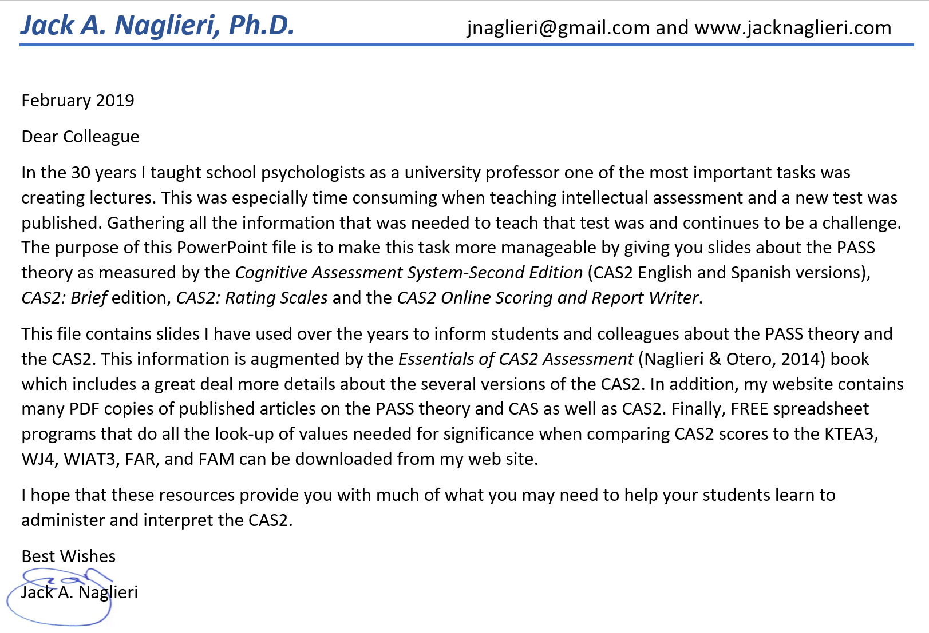

Slide 2
PASS Comprehensive System Using the CAS2
GOAL: Create a set of tools to measure PASS Theory for use across multiple settings
and multiple tiers

Slide 3
Topical Outline
PASS Comprehensive System using CAS2
PASS Theory
  A Brief Look at Validity of the PASS Theory
Interpretation of CAS2, CAS2: Brief, and CAS2: Rating Scale
  Using PASS Theory and CAS2 Tests for Eligibility Determination
  Using CAS2 for Academic Intervention
  Case Studies
Conclusions

Slide 4
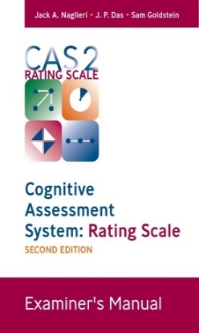
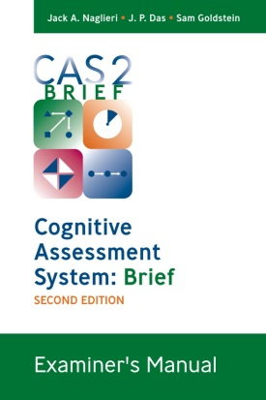
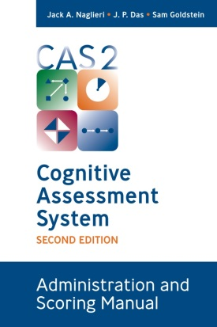

PASS Comprehensive System
(Naglieri, Das, & Goldstein, 2014; Naglieri, Moreno & Otero (2017)
CAS2 Rating Scale
(4 subtests)
CAS2 Brief
(4 subtests)
CAS2 Core
(8 subtests)
CAS2 Extended
(12 subtests)
CAS2 Spanish
(12 & 8 subtests)
Total Score
  Planning
  Simultaneous
  Attention
  Successive
Total Score
  Planning
  Simultaneous
  Attention
  Successive
Full Scale
  Planning
  Simultaneous
  Attention
  Successive
Full Scale
  Planning
  Simultaneous
  Attention
  Successive
Supplemental
Executive Function
Working Memory
Verbal / Nonverbal
Visual-Auditory
Speed/Fluency
Examiner’s Manual

Slide 5
PASS Comprehensive System
At Tier 1 CAS2: Rating Scale can be completed by a teacher and depending upon those results…
At Tier 2 the CAS2: Brief scale could be given to inform instruction and for screening
At Tier 3 the CAS2: Extended Battery could be given for full evaluation of his neurocognitive abilities
This PASS Comprehensive System provides three ways to learn about a student’s learning strengths and weaknesses

Slide 6
PASS Comprehensive System
Tier 1
Tier 2
Tier 3
Universal Screening
With CAS2-Rating Scale
Ongoing Progress Monitoring in academic area(s) of need
  High frequency & intense supports are indicated
Select PASS methods that address weakness and go to Tier 2 progress
monitoring
Any PASS CAS2-RS score < 90 ?
YES
Is the student making good progress ?
YES
Maintain instructional methods based on PASS
Is the student making good progress ?
YES
Maintain instructional methods based on PASS
NO
NO
NO
Any CAS2-RS score > 109 ?
YES
Use PASS strength when teaching
Option 1:
  Increase frequency & intensity of supports as indicated
  Test with CAS2 Brief Sale to further evaluate PASS processing status
Option 2:
  Go to Tier 3
A comprehensive assessment of the student is warranted.
Administer the CAS2 as part of the evaluation as well as other appropriate measures
NO
Typical Instruction

Slide 7
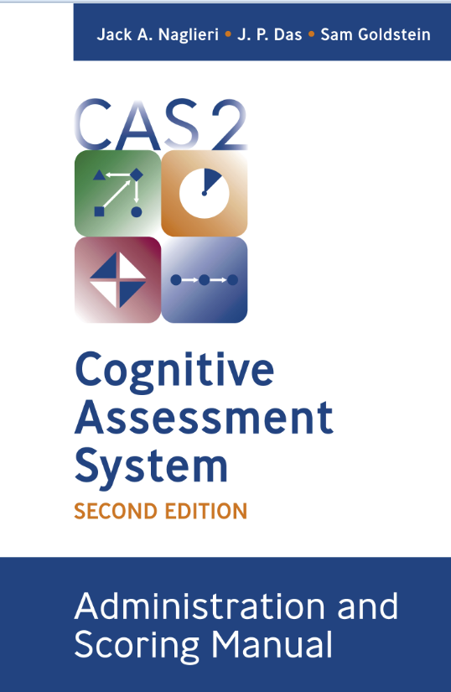
CAS2
Structure of the Second Edition

Slide 8
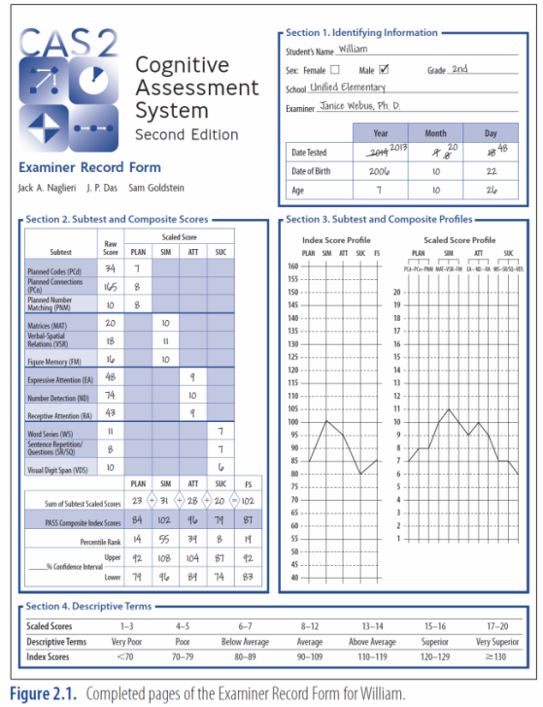
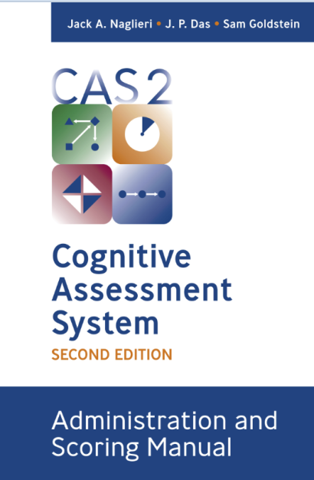
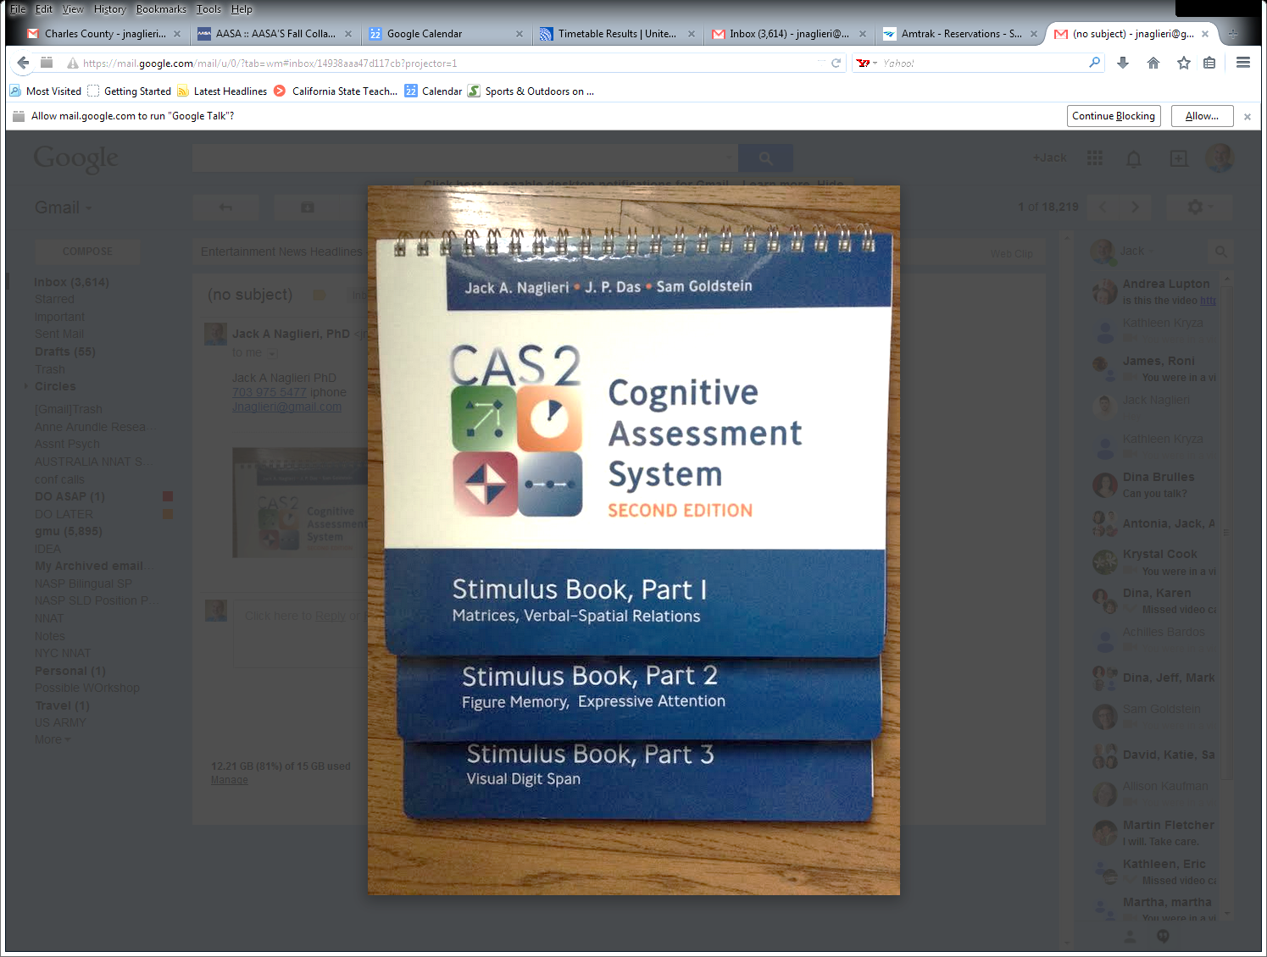
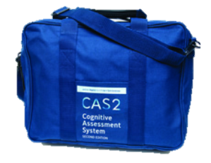
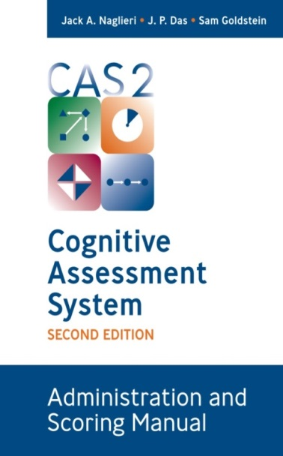

CAS2 (Ages 5-18 yrs.)
Interpretive Manual

Slide 9
CAS2 Development Goals
CAS2
  New norms
  Strengthen reliability of the scales by modifying subtest formats
  Improve factor structure
  Add/delete items
  Add a visual Successive subtest
  Add new scales beyond PASS
  Retain Administration format of
    Examiner demonstrates,
    Child does a sample
    Directions for remaining items is given
    And opportunity to Provide Help is given

Slide 10

CAS2
Same 8 (40 minutes) or 12 (60 minutes) subtest versions as in CAS
PASS and Full Scales provided (100 & 15) subtests (10 and 3)

Slide 11
CAS2 Scale and Subtest Structure

Slide 12
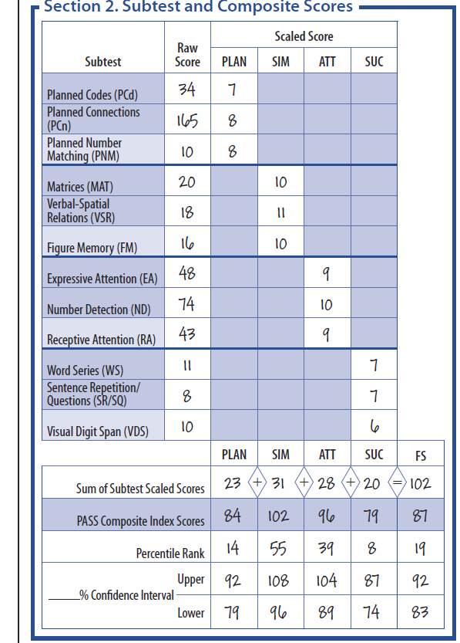
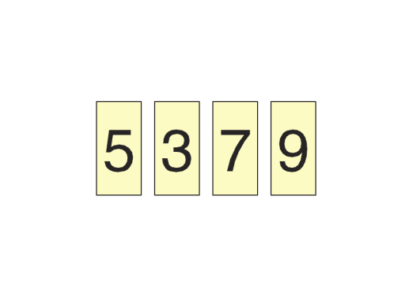
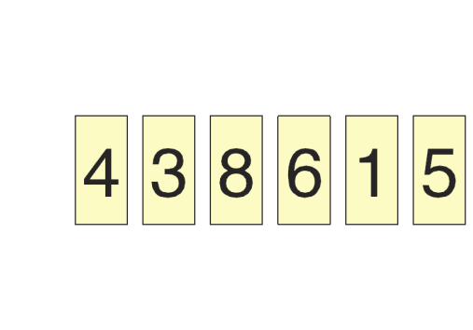
CAS2
All subtests modified
Planning subtests have more items
Speech Rate deleted
New: Visual Digit Span subtest

Slide 13
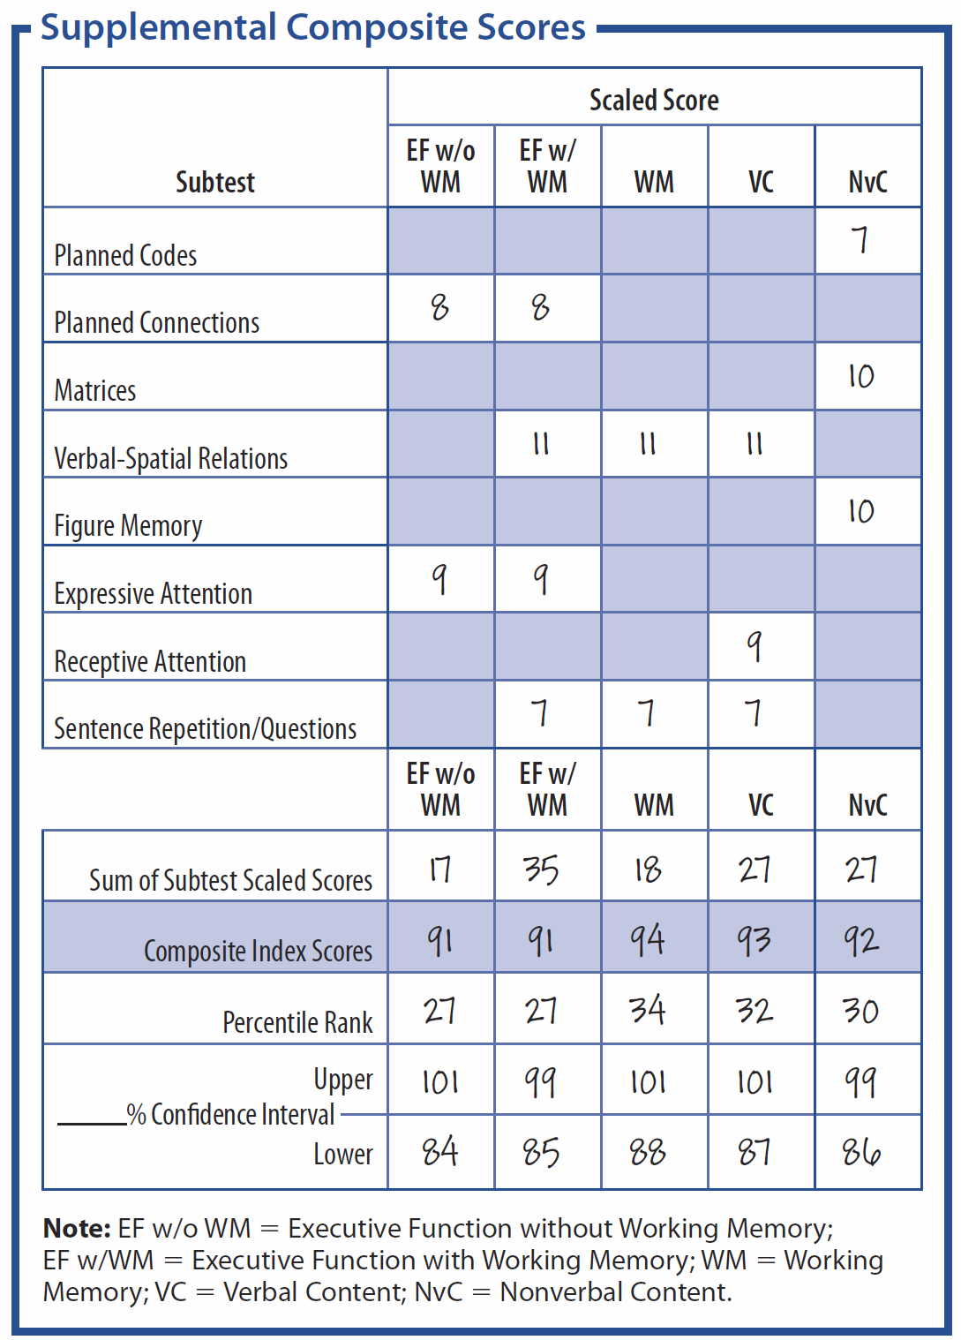
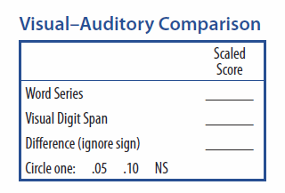
CAS2
Supplementary Scales: Executive Function, Working Memory, Verbal, Nonverbal, Visual and Auditory comparison, Speed/Fluency

Slide 14
CAS2 Planning & Simultaneous
Planned Number Matching
  Variation on the original version
Planned Codes
  Variation on the original version
Planned Connections
  Additional items
Matrices
  More items added
Verbal-Spatial Relations
  More items added
Figure Memory
  More items added

Slide 15
CAS2 Attention & Successive
Expressive Attention
  No in color
Number Detection
  New format
Receptive Attention
  New format
Word Series
Sentence Repetition
  Ages 5-7
Sentence Questions
  Ages 8-18
Visual Digit Span
  New subtest

Slide 16
CAS2 Spanish Supplement
CAS2 can be administered in Spanish using the following additional materials
  CAS2: Spanish Administration and Scoring Manual
  CAS2: Spanish Stimulus Book
  CAS2: Spanish Examiner Record Form

Slide 17
CAS2 Online Scoring and Report Writing

Slide 18
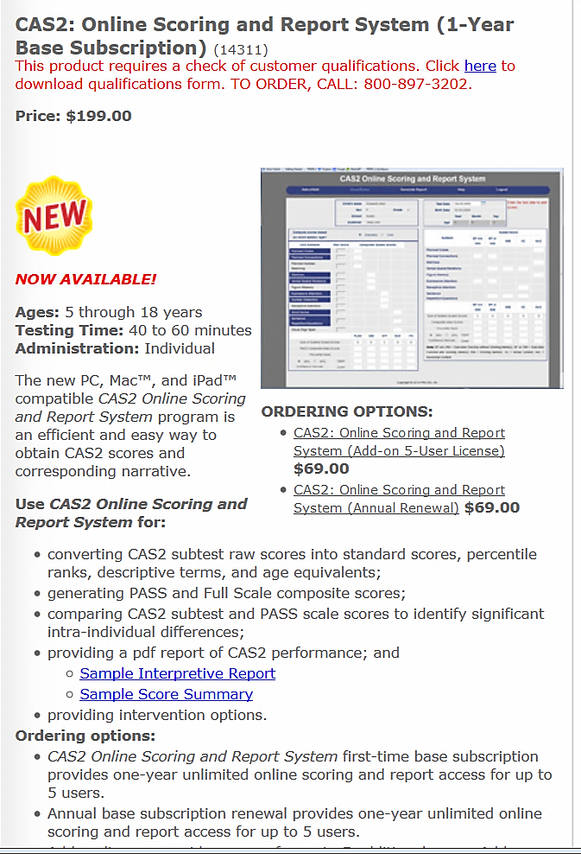
CAS2 Online Score & Report http://www.proedinc.com/customer/ProductView.aspx?ID=7277
Enter data at the subtest level or enter subtest raw scores
Online program converts raw scores to standard scores, percentiles, etc. for all scales.
A narrative report with graphs and scores is provided

Slide 19
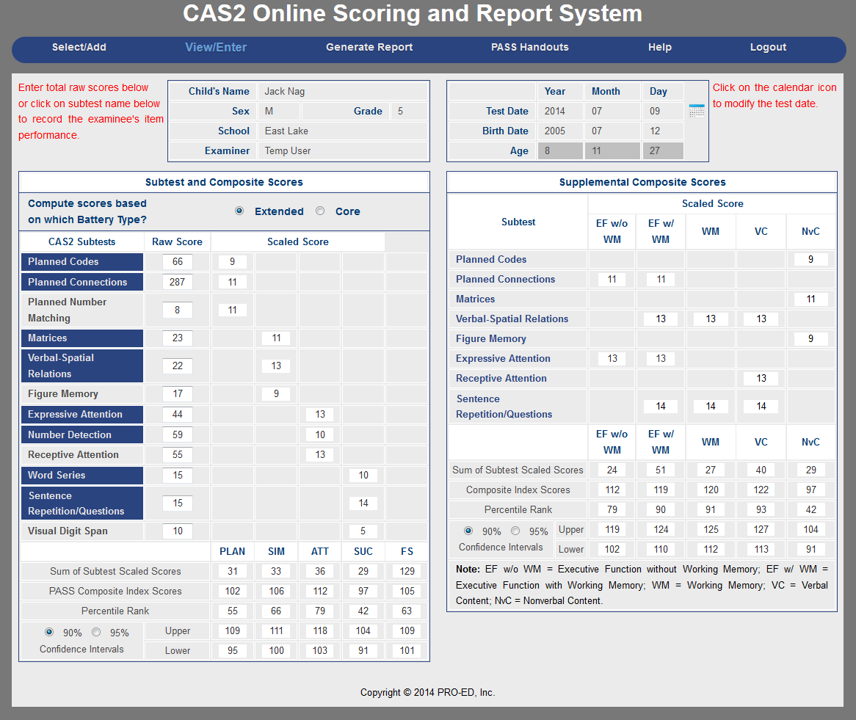
CAS2 Online Score & Report
As values are entered the program completes the record form
Supplemental scales are automatically computed
  Executive Function
  Working Memory
  Verbal
  Nonverbal
  Speed/Fluency

Slide 20
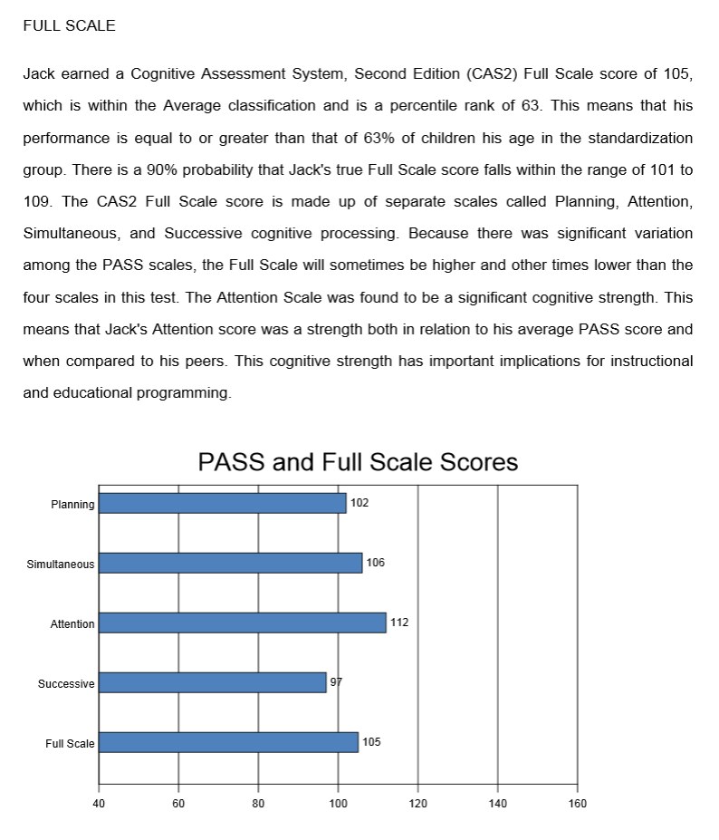
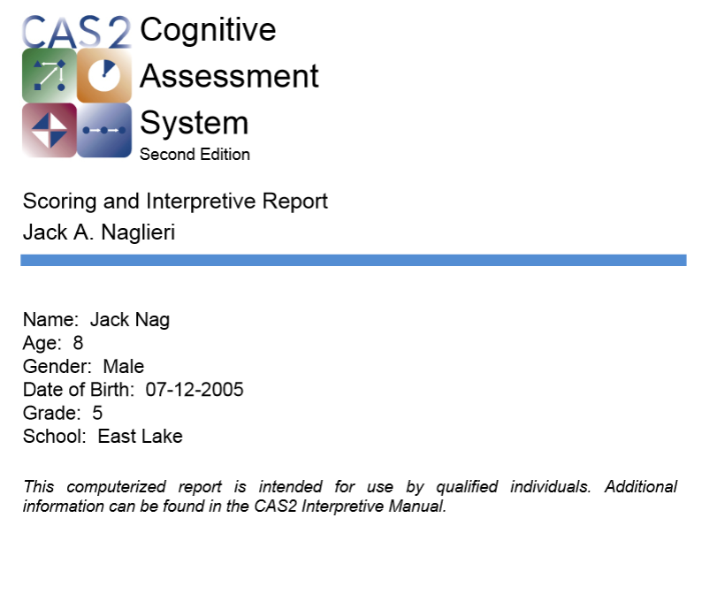
CAS2 Online Score & Report
Narrative report can be obtained in Word or PDF

Slide 21
CAS2 Online Report Text

Slide 22
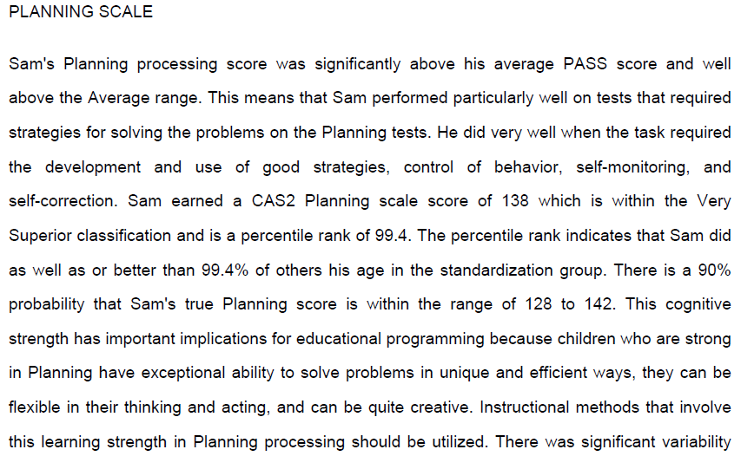
CAS2 Online Report Text

Slide 23
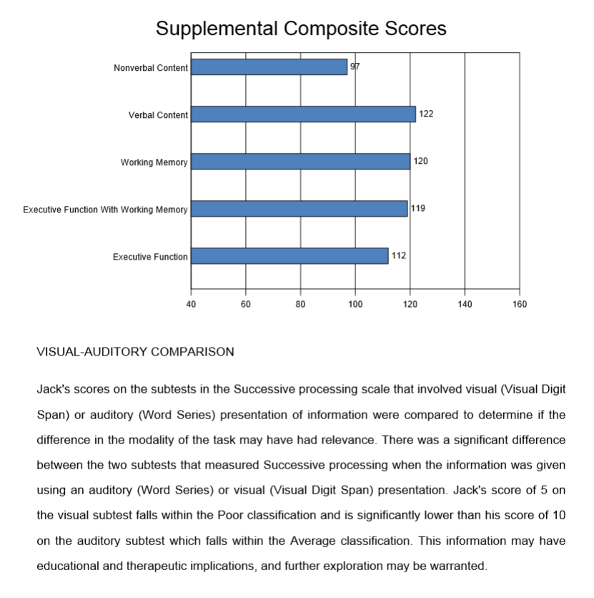
CAS2 Online Score & Report
Narrative report includes additional scales

Slide 24
CAS2 Online Score & Report

Slide 25
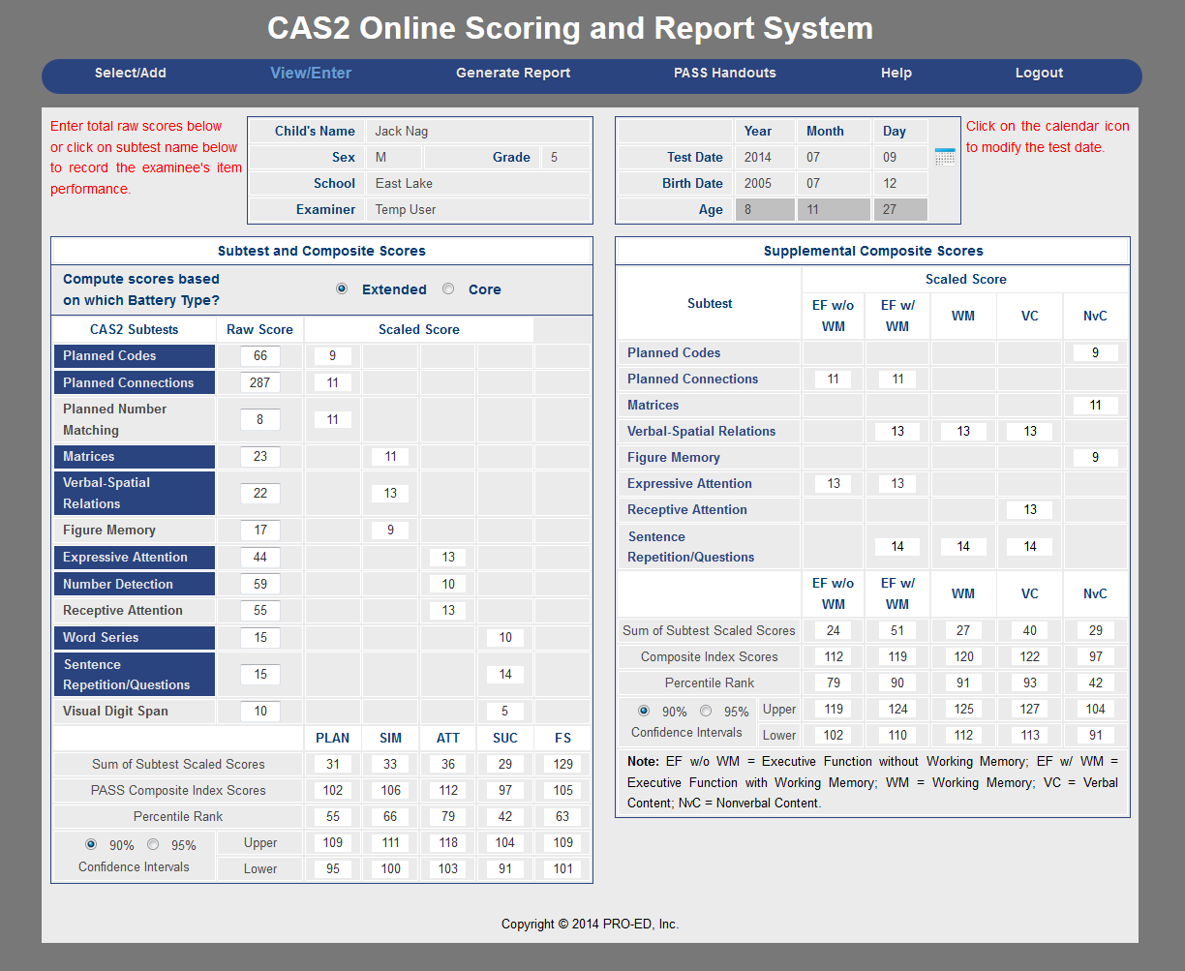
CAS2 Online Score & Report
Online program includes PASS handouts from Helping Children Learn (2nd Edition) in English and Spanish

Slide 26

CAS2: Brief
Structure and features

Slide 27
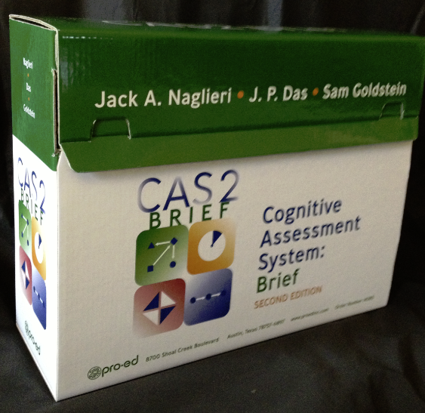
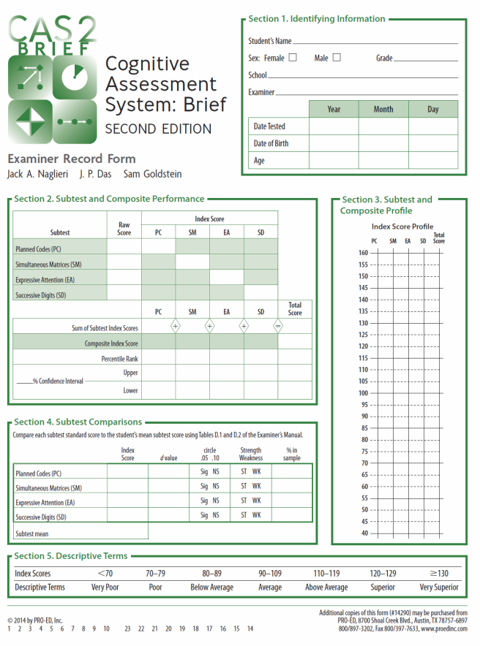

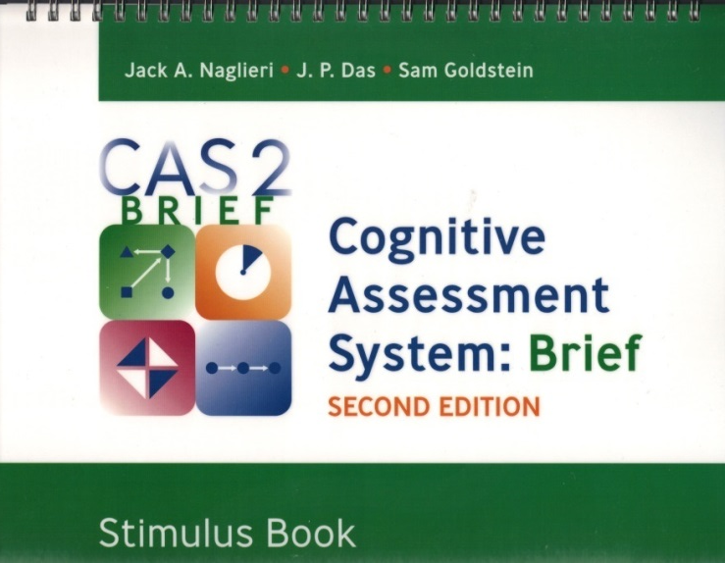
CAS2: Brief for Ages 4-18 years
Interpretive Manual

Slide 28
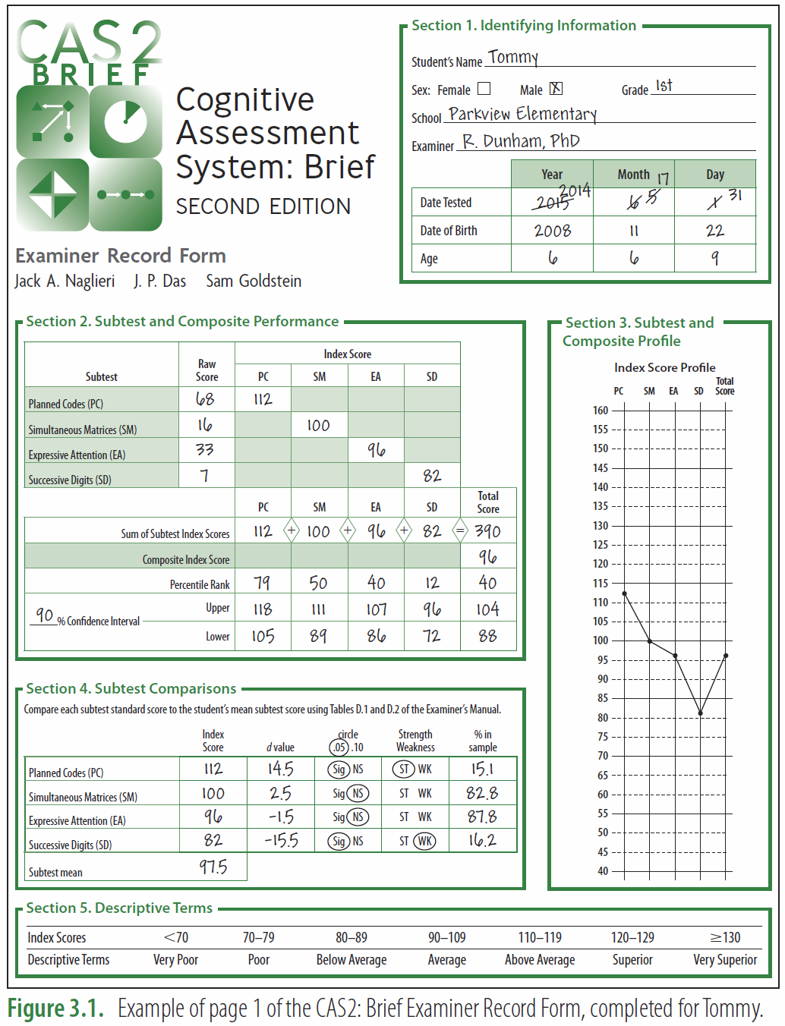
CAS2: Brief
Give in 20 minutes
Good for reevaluations
Yields PASS and Total standard scores (Mn 100, SD 15)
All items are different from CAS2
  Planned Codes
  Simultaneous Matrices
  Expressive Attention
New Subtest
  Successive Digits (forward only)

Slide 29
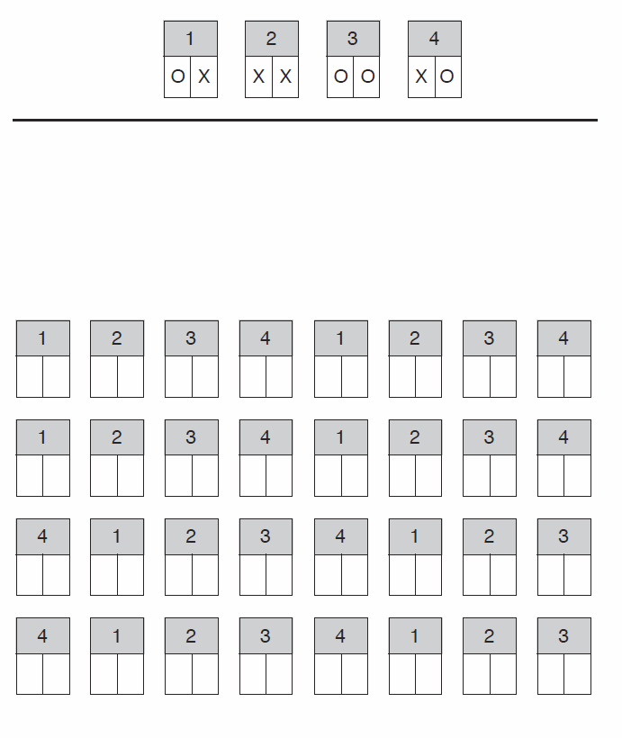
CAS2: Brief Scale
Planned Codes is used for Planning ability
Eight items using numbers not letters as in CAS2 and different orientation of the pages

Slide 30
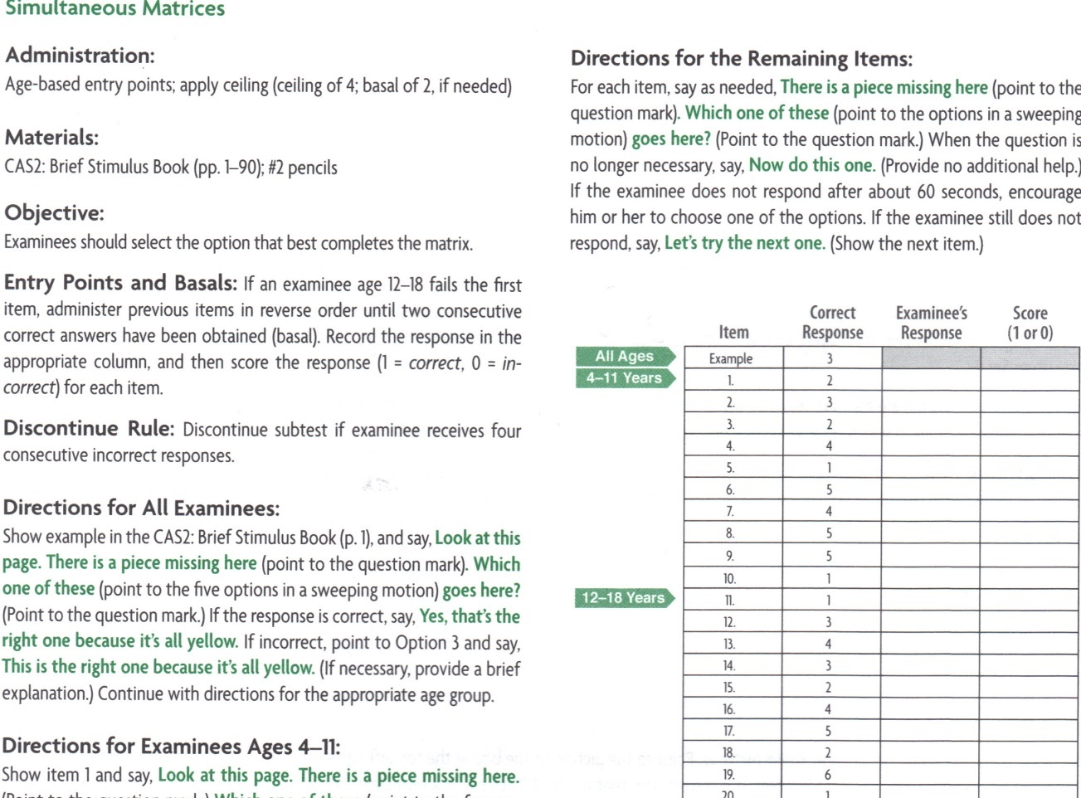

CAS2: Brief Simultaneous Matrices

Slide 31
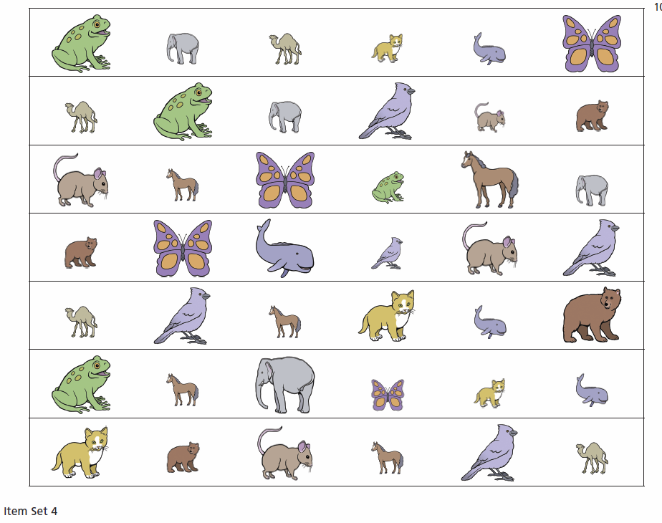
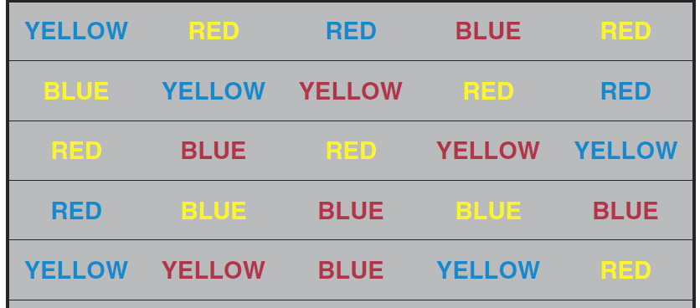
CAS2: Brief Scale
Expressive Attention (Stroop) used
Big/Little animals (ages 4-7 years)
Color Words (ages 8-18)

Slide 32
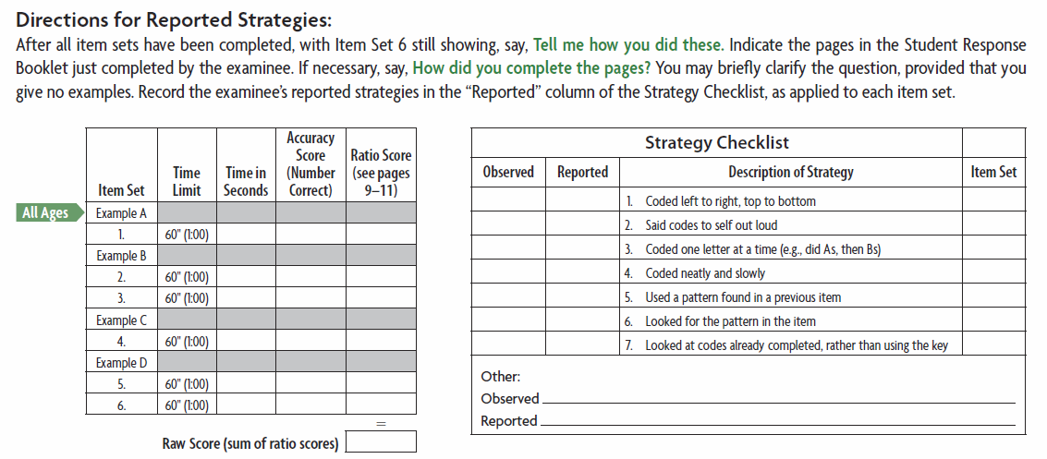
CAS2: Brief Planned Codes & Successive Digits
Planned Codes has 8 items using numbers not letters and has different patterns
Successive Digits uses numbers (not words)

Slide 33
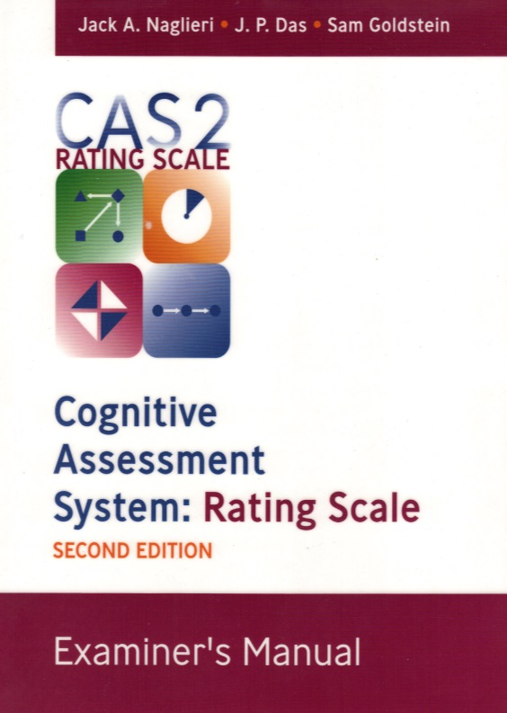
CAS2: Rating Scale
Structure and features

Slide 34
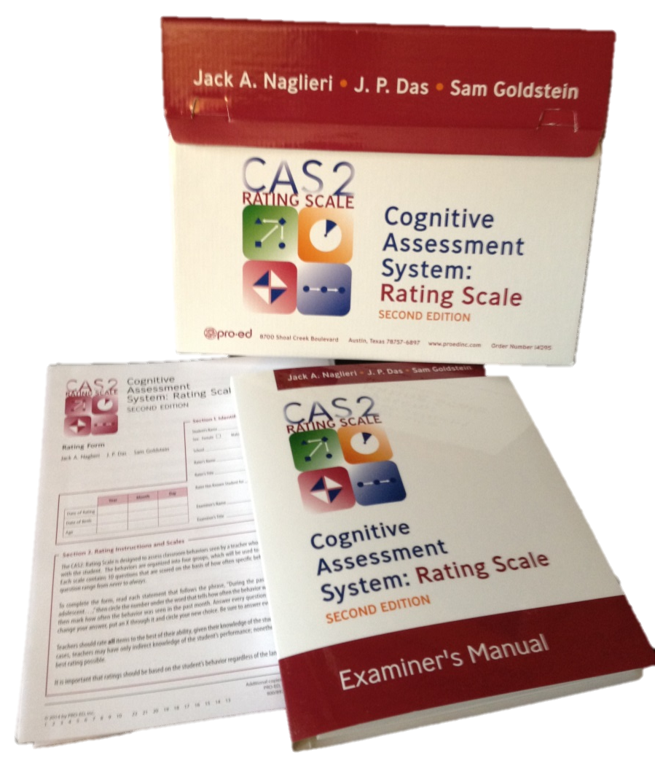
CAS2 Rating Scales (Ages 4-18 yrs.)
Interpretive Manual
The CAS2: Rating measures behaviors associated with PASS constructs
Normed on a nationally representative sample of 1,383 students rated by teachers

Slide 35
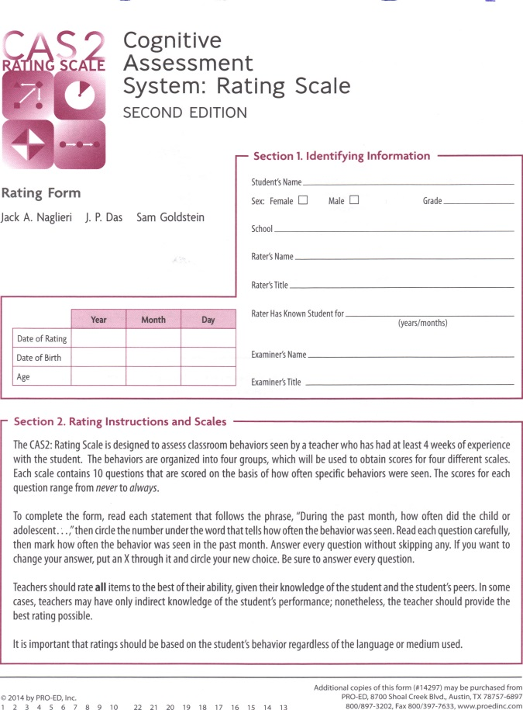
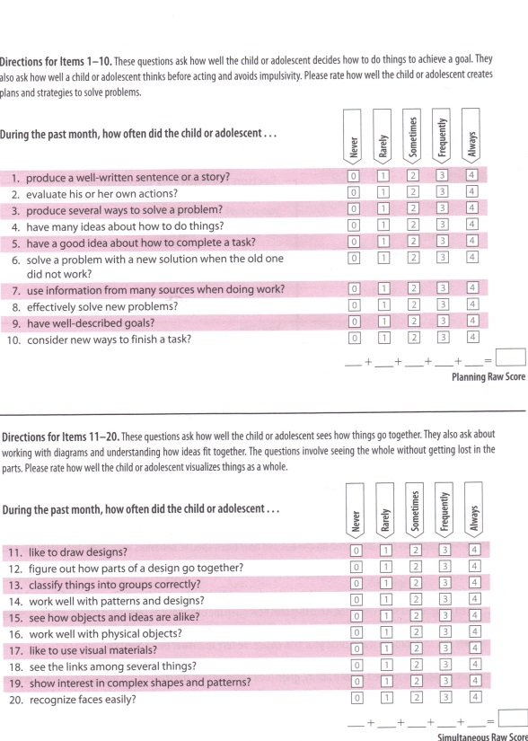
CAS2 Rating Scales
The CAS2: Rating form contains 40 items
10 items for each PASS scale
PASS and Total scales are set to have a mean of 100 and standard deviation of 15

Slide 36
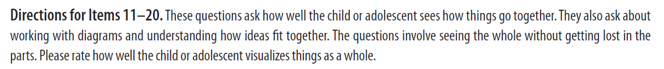
CAS2 Rating Scales
The rater is given a description of what each scale is intended to measure.
This informs teachers about PASS

Slide 37
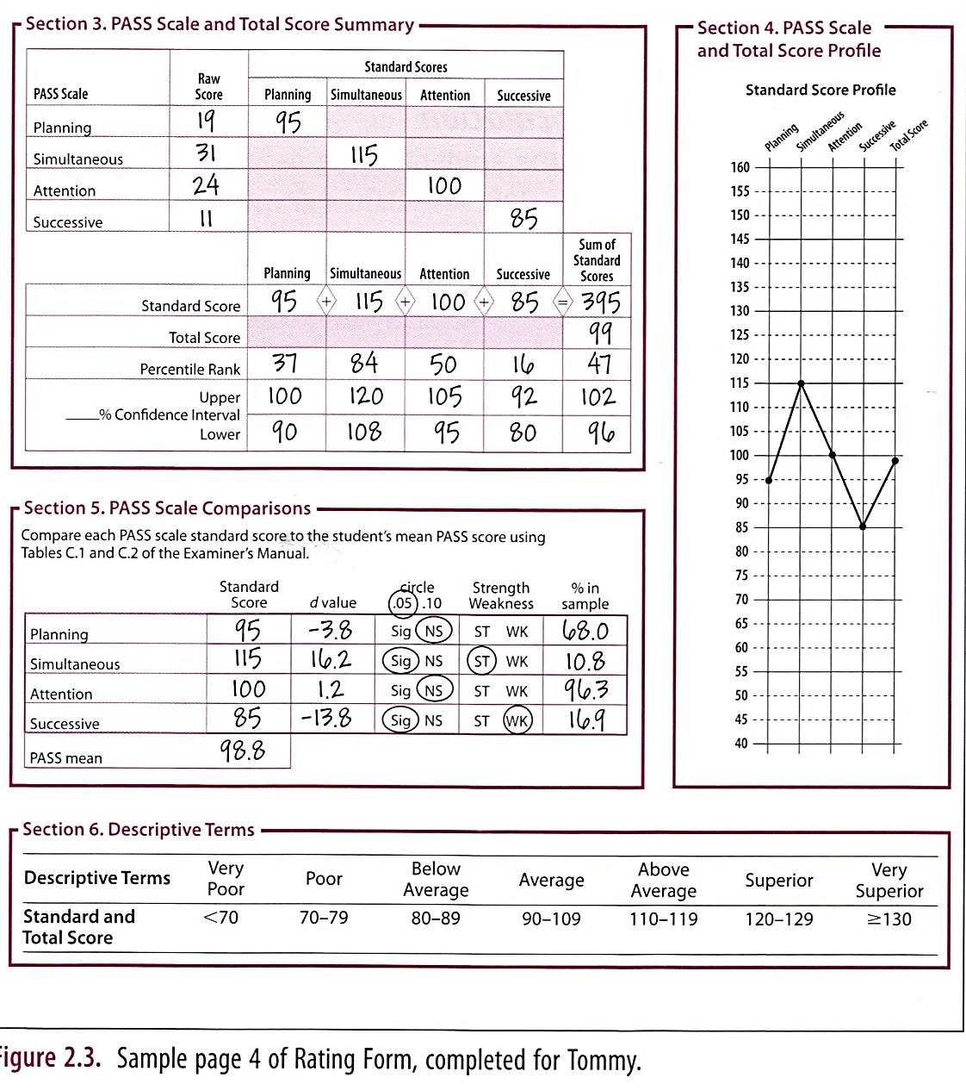
CAS2 Rating Scales
The CAS2: Rating Scale scores can be used as part of a larger comprehensive evaluation or for instructional planning

Slide 38
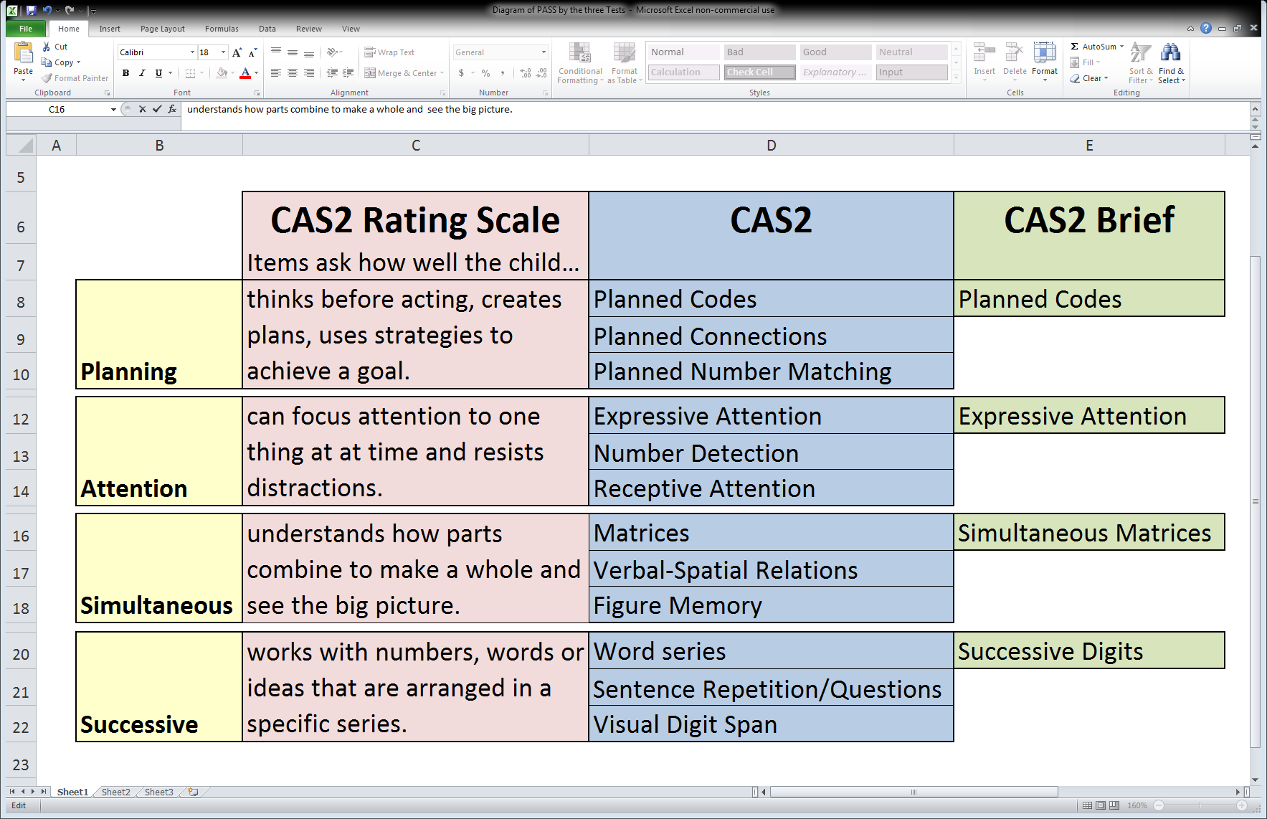
PASS: Across the Three Measures

Slide 39
Characteristics of the
CAS2,
CAS2: Brief
CAS2: Rating Scale
A Summary

Slide 40
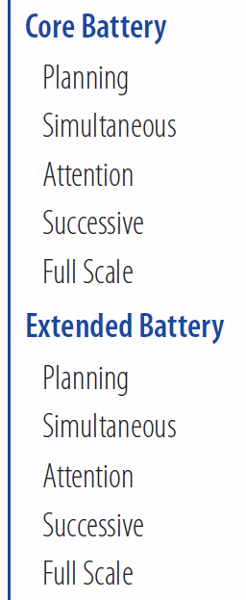
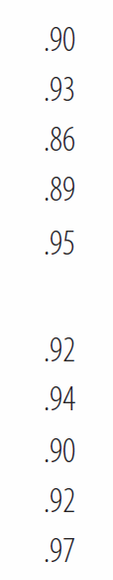
CAS2: Scale Reliability (ages 5-18)
CAS2 Scale Reliabilities are very high
Full Scale = .97 for 12 subtest Extended Battery CAS2
  (.95 for 8-subtest Core Battery)

Slide 41
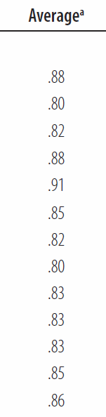
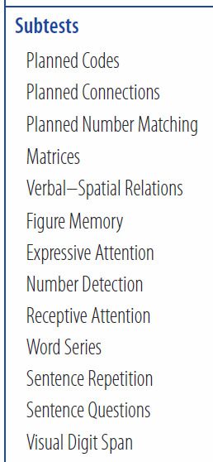
CAS2: Subtest Reliability
CAS2 Subtests Reliabilities are high
(ages 5-18)

Slide 42
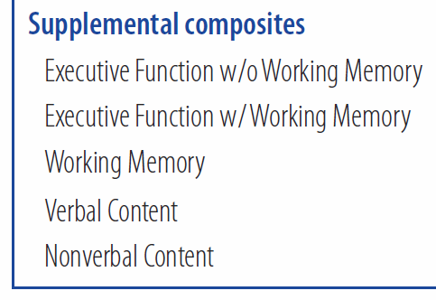
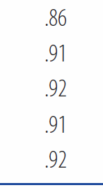
CAS2: Scale Reliability (ages 5-18)
Supplemental Scales reliabilities are also high

Slide 43
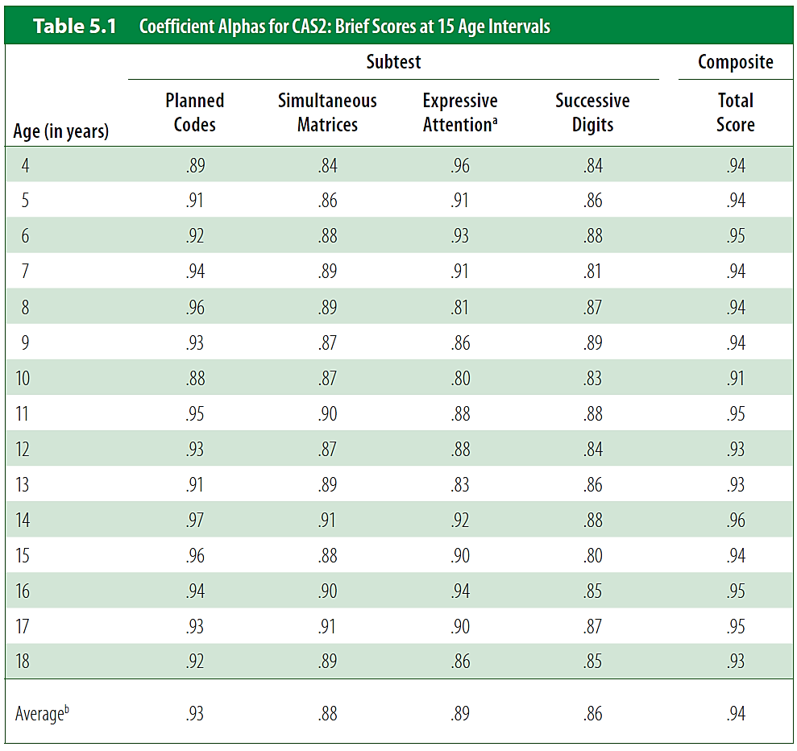
CAS2: Brief Reliability
Average reliability across ages 4 – 18 years:
Planning = .93
Simultaneous = .88
Successive = .86
Successive = .85
Total Score = .94

Slide 44
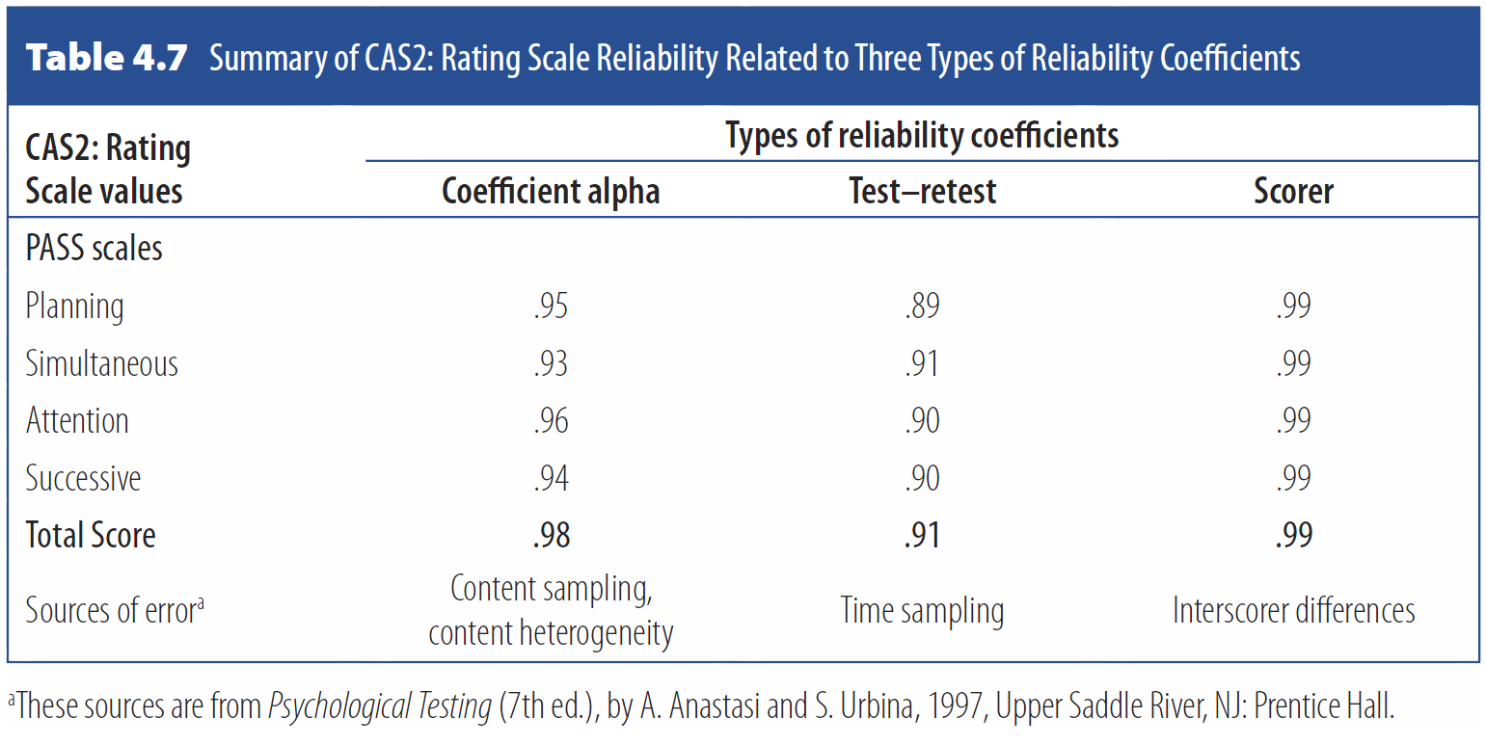
CAS2: Rating Scale Reliability

Slide 45
Confirmatory Factor Analysis
Three PASS scales and the same findings…

Slide 46
CFA Results
All Confirmatory Factor Analyses for each of the three scales tested these solutions:
  1 factor - no PASS scales
  2 factor - Planning/Attention, Simultaneous/Successive
  3 factor - Planning/Attention, Simultaneous, Successive
  4 factor - Planning, Attention, Simultaneous, Successive
Analyses were at the subtest level for CAS2, Item packets for the CAS2: Brief, and the item level for CAS2: Rating Scale.

Slide 47

CAS2 Fit Indexes By Age
Examiner’s Manual

Slide 48

CAS2: Brief Fit Indexes by Age

Slide 49
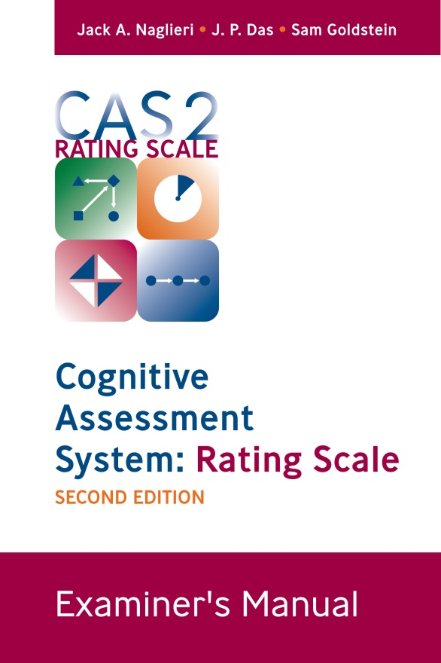
CAS2: Rating Scale Fit Indexes

Slide 50
Differences by
Race, and Ethnicity

Slide 51
CAS2 Race Comparison
CAS2 Manual (page 105)
  African Americans and non–African Americans differed on the Full Scale Extended Battery by 4.5 standard score points (4.9 on the Core Battery) with controls for demographic characteristics.
  These findings, which are similar to those found for the CAS (Naglieri, Rojahn, Matto, and Aquilino (2005) and suggest that race has a small relationship to scores obtained on the CAS2.

Slide 52
CAS2 Ethnic Comparison
CAS2 Manual (page 106)
  Hispanics and non-Hispanics Full Scale standard scores differed by 1.8 points (2.3 on the Core Battery) with controls for demographic characteristics.
  These findings suggest that Hispanic origin has only a small relationship to scores obtained on the CAS2, as was found for the CAS (Naglieri, Rojahn, & Matto, 2007).

Slide 53
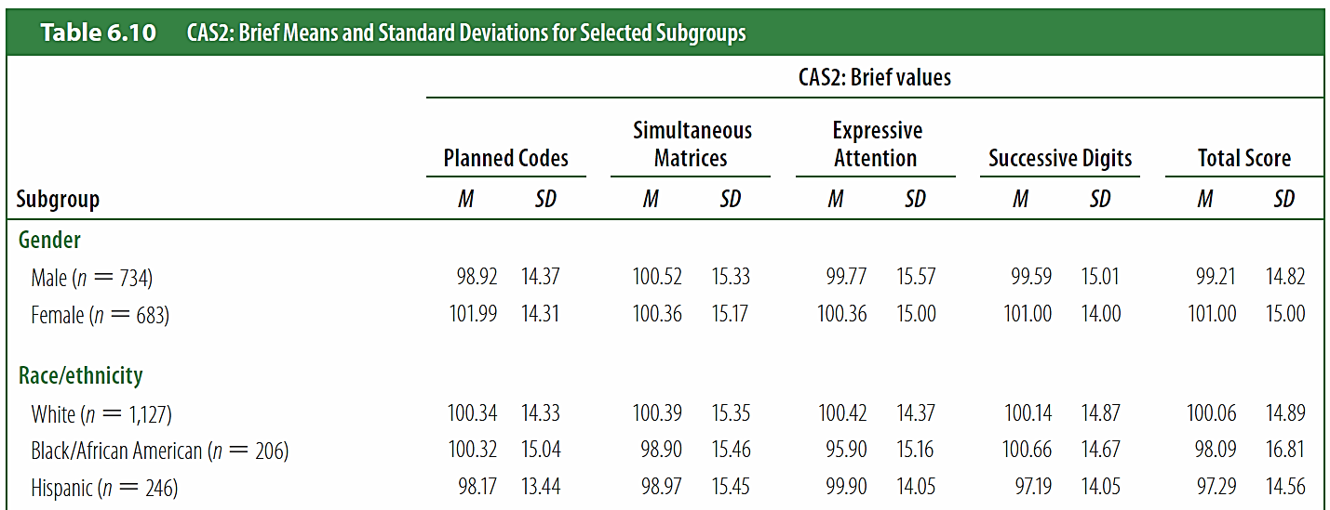
CAS2: Brief
Very small differences by Race/ethnicity

Slide 54
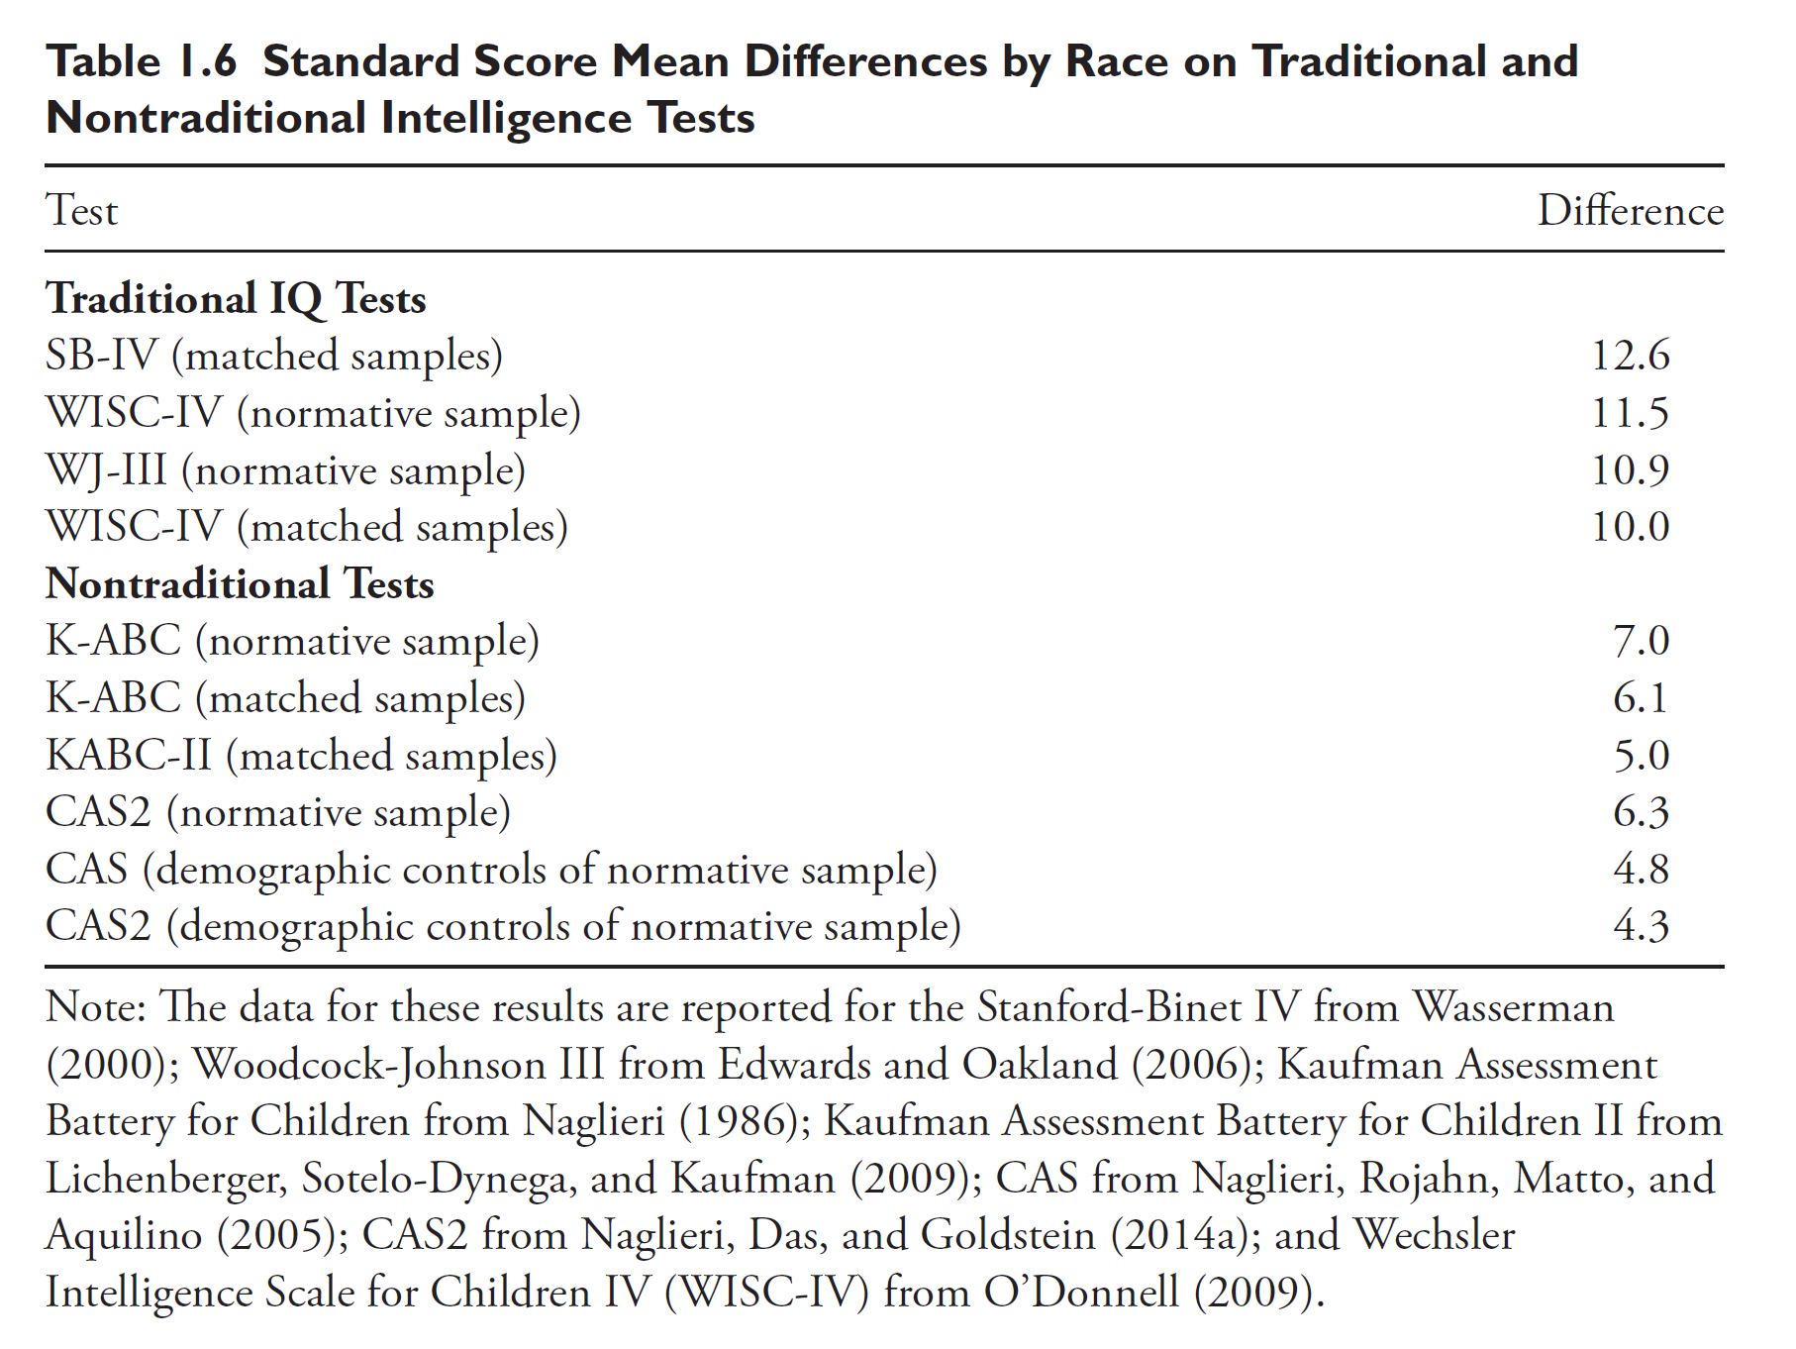
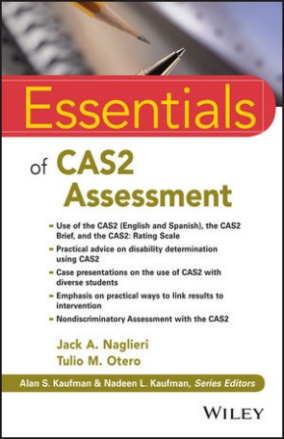
Race Differences Across Tests
The CAS yields the smallest race difference across all these ability tests

Slide 55

Naglieri, Rojahn, Matto (2007)
Hispanic White difference on CAS Full Scale of 4.8 standard score points (matched)

Slide 56
Topical Outline
PASS Comprehensive System using CAS2
PASS Theory
  A Brief Look at Validity of the PASS Theory
Interpretation of CAS2, CAS2: Brief, and CAS2: Rating Scale
  Using PASS Theory and CAS2 Tests for Eligibility Determination
  Using CAS2 for Academic Intervention
  Case Studies
Conclusions

Slide 57
PASS Neurocognitive Theory
PASS theory is a modern way to measure neurocognitive processes defined by brain function
Planning = THINKING ABOUT HOW YOU DO WHAT YOU DECIDE TO DO
Attention = BEING ALERT AND RESIST DISTRACTIONS
Simultaneous = GETTING THE BIG PICTURE
Successive = FOLLOWING A SEQUENCE

Slide 58




Brain, Cognition, & Intelligence
The brain is the seat of abilities called PASS
These neurocognitive processes are the foundation of learning (Naglieri & Otero, 2017)
Planning ability
Simultaneous
processing Ability
Also see: Naglieri, J. A. & Otero, T. (2011). Cognitive Assessment System: Redefining Intelligence from A Neuropsychological Perspective. In A. Davis (Ed.). Handbook of Pediatric Neuropsychology (320-333). New York: Springer Publishing.
Successive Processing Ability
Attention

Slide 59
What is a Neurocognitive Process?
We use the tern neurocognitive as a way to describe PASS because the theory is built on neuropsychology (e.g., Luria) and cognitive psychology
How did we identify the neurocognitive constructs?
  Not by using factor analysis
  Not by assigning new labels to traditional IQ tests
  We used the literature in cognitive and the neuropsychology
  Our focus was on A. R. Luria’s conceptualization of the three functional units

Slide 60
What is a Neurocognitive Process?
The term cognitive process is a modern term for concepts like ability
The term describes a basic psychological processing theory based on brain function
PASS neurocognitive abilities provide us the means to function in this world and acquire knowledge and skills
  Skills, like reading decoding or math calculation, are not examples of a cognitive process, they are the application of a cognitive process in a specific content area

Slide 61
What is a Neurocognitive Process?
A specific cognitive process provides a unique kind of function
A variety of cognitive processes is needed to meet the many demands of our complex environment
A variety of cognitive processes gives us away of achieving the same goal using different types of or different combinations of processes (this is important for intervention planning).

Slide 62
What is a Neurocognitive Process?
We must assess neurocognitive processes from a THEORY of brain function (not factor analysis).
Assess achievement with tests that adequately evaluate the domain of interest (e.g., reading, math, etc.)
Assess neurocognitive processes using questions that are as free of academic content as possible

Slide 63





PASS: A neurocognitive approach
Three Functional Units described by A. R. Luria (1972)

63
Notes:
This diagram of the brain illustrates the location within the brain where these processes occur. Let’s see how they work and are interrelated.
QLT - Investor ppt - v1
2/14/2019
63

Slide 64

CAS2: Rating Scale Planning

Slide 65
PASS Theory
Planning is a basic neurocognitive ability which we use to determine, select, and use efficient solutions to problems
  problem solving
  developing plans and using strategies
  impulse control and self-control
  control of processing
  retrieval of knowledge

Slide 66
Planned
Codes
A
X O
B
O O
C
X X
D
O X
Child fills in the codes in the empty boxes
Children are encouraged to think of a good way to complete the page
A
B
C
D
A
A
B
C
D
A
A
B
C
D
A
A
B
C
D
A

Slide 67
Planned
Codes
A
X O
B
O O
C
X X
D
O X
A
B
C
D
A
Page 2
What is a good plan to complete this page?
Note orientation
D
A
B
C
D
C
D
A
B
C
B
C
D
A
B

Slide 68


Math Strategies
This work sheet encourages the child to use strategies (plans) in math such as: “If 8 + 8 = 16, then 8 + 9 is 17”

Slide 69

Planning Subtests and Strategy Use

Slide 70


PASS Theory: Planning
Planning
Evaluate a task
Select or develop a strategy to approach a task
Monitor progress during the task
Develop new strategies when necessary
Examples of classroom problems related to Planning
  Using the same strategy even if it is not effective
  Struggling with how to complete tasks
  Not monitoring progress during a task
  Misinterpretation of what is read
  Naglieri, J. and Pickering, E., Helping Children Learn, 2003
70





Notes:
Planning- a set of decisions or strategies and individual adopts and modifies to solve a problem and to reach a goal. How does the student approach a task? Planning provides control of thought as well as the use of other processes, knowledge, and skills. Students think about how to learn.
QLT - Investor ppt - v1
2/14/2019
70

Slide 71
PASS Theory
Attention is a basic neurocognitive ability we use to selectively attend to some stimuli and ignores others
  focused cognitive
  activity
  selective attention
  resistance to
  distraction
No Response
Response
No Response

Slide 72

CAS2: Rating Scale Attention

Slide 73
CAS2 Expressive Attention
The child says the color not the word
Score is time and number correct
RED
BLUE
GREEN
YELLOW
YELLOW
GREEN
RED
BLUE
RED
YELLOW
YELLOW
GREEN
BLUE
GREEN
RED
BLUE
GREEN
YELLOW
RED
YELLOW

Slide 74

Expressive Attention: 5-7 years
The child tells if the animal is large or small, regardless of the relative size on the page.

Slide 75

Number Detection
Items 1 - 4 have 180 numbers on each page
Each child is given two pages
Targets appear at the top of the page
Score for targets found and
false detections
that look like this:
4 6
3 1 6
1 6 2
1
2
3
1
2
4
3
2
5
3

Slide 76

Attention
This sheet has a strong Attention demands because of the similarity of the options

Slide 77
PASS Theory: Attention
Attention
Focus on one thing and ignore others
Resist distractions in the learning environment
  Trouble focusing on what is important
  Difficulty resisting distractions
  Difficulty working on the same task for very long
  Unable to see all the details
  Providing incomplete or partially wrong answers
Examples of classroom problems related to Attention
  Naglieri, J. and Pickering, E., Helping Children Learn, 2003
77




Notes:
Children learn to selectively focus on things heard or seen and resist being distracted by other sights and sounds. Great example--- math exercise, tens and ones, series of numbers where the options were so similar, so many distractions. Commands considerable attention to the details.
QLT - Investor ppt - v1
2/14/2019
77

Slide 78
PASS Theory
Simultaneous processing is a basic neurocognitive ability which we use to integrate stimuli into groups
  Stimuli are seen as a whole
  Each piece must be related to the others
  Wechsler Nonverbal Scale
  KABC Simultaneous Scale

Slide 79

CAS2: Rating Scale Simultaneous

Slide 80
PASS Theory
Simultaneous processing is what Gestalt psychology was based on
Seeing the whole

Slide 81

CAS2 Matrices
Child selects one of the options that best completes the matrix

Slide 82

CAS2 Verbal-Spatial Relations
Which picture shows a cross between two circles that is below a triangle between two squares.

Slide 83

Numbers from 1 to 100
Simultaneous processing is facilitated by this work sheet

Slide 84

PASS Theory: Simultaneous
Simultaneous Processing
Relate separate pieces of information into a group
See how parts related to whole
Recognize patterns
Examples of classroom problems related to
  Difficulty comprehending text
  Difficulty with math word problems
  Trouble recognizing sight words quickly
  Trouble with spatial tasks
  Often miss the overall idea
Simultaneous
Processing

84




Notes:
Examples: seeing patterns in numbers, seeing a group of letters as a word, words to sentences, sentences to paragraphs, paragraphs to complete story. Seeing how an image should look from various perspectives. Simultaneous processing connected to reading comprehension because it “requires the integration and understanding of word relationships and how all the elements of the text fit together.” Relating and integrating discrete pieces of information.
QLT - Investor ppt - v1
2/14/2019
84

Slide 85
Modern Theory: Successive
Successive processing is a basic neurocognitive ability which we use to manage stimuli in a specific serial order
  Stimuli form a chain-like progression
  Stimuli are not inter-related
Cow
Wall
Car
Girl

Slide 86

CAS2: Rating Scale Successive

Slide 87
Word Series
The child repeats a series of words in the same order the examiner says them
1. Wall-Car
2. Shoe-Key
...
10. Cow-Wall-Car-Girl
11. Dog-Car-Girl-Shoe-Key
...
27. Cow-Dog-Shoe-Wall-Man-Car- Girl-Key-Book

Slide 88
Sentence Repetition (Ages 5-7) or Sentence Questions (Ages 8-17)
Sentence Repetition
  Child repeats sentences exactly as stated by the examiner such as:
  The red greened the blue with a yellow.
Sentence Questions
  Child answers a question about a statement made by the examiner such as:
  The red greened the blue with a yellow. Who got greened?

Slide 89


CAS2
Visual Digit Span subtest allows for a Visual Auditory comparison

Slide 90

Successive
The sequence of the sounds is emphasized in this work sheet

Slide 91

Learning Math Facts
* +
8 + 9 = 1 7
8 + 9 = 1 7
8 + 9 = 1 7

Slide 92

PASS Theory: Successive
Successive Processing
Use information in a specific order
Follow instructions presented in sequence
  Trouble blending sounds to make words
  Difficulty remembering numbers in order
  Reading decoding problems
  Difficulty remembering math facts when they are taught using rote learning (4 + 5 = 9).
Examples of classroom problems related to
Successive
Processing
  Naglieri, J. and Pickering, E., Helping Children Learn, 2003
92
Notes:
Examples of classroom activities- segmenting and chunking; strategies for word study/spelling; math strategies, e.g., touch math, word problems, number squares for math concepts
QLT - Investor ppt - v1
2/14/2019
92

Slide 93
Topical Outline
PASS Comprehensive System using CAS2
PASS Theory
  A Brief Look at Validity of the PASS Theory
Interpretation of CAS2, CAS2: Brief, and CAS2: Rating Scale
  Using PASS Theory and CAS2 Tests for Eligibility Determination
  Using CAS2 for Academic Intervention
  Case Studies
Conclusions

Slide 94
Ability & Achievement
IQ scores correlate about .5 to .55 with achievement Intelligence (Brody, 1992)
What advantage do traditional tests have in research that examines correlations to achievement?
They have achievement in them

Slide 95


Two Studies of Correlations to Achievement
Naglieri (1999) summarized the correlations between several tests and achievement
  The median correlation between each test’s Full Scale score and all achievement variables was obtained
In order to look at the correlations between ability and achievement tests EXCLUDING the scales that require academic knowledge Naglieri & Otero, (2017) examined these relationships a second time

Slide 96
Ability & Achievement (Naglieri, 1999)
Tests require much knowledge
Little knowledge needed
WISC-III DAS WJ-R K-ABC CAS
FSIQ GCA Cog MPC FS
Median r .590 .600 .625 .630 .700
% of Var 35% 36% 39% 40% 49%
Increase over
WISC-III - 3% 12% 14% 41%
N 1,284 2,400 888 2,636 1,600
WISC-3: WIAT Manual Table C.1 ages 6-16; WJ-R Technical Manual; CAS Interpretive Handbook; K-ABC Interpretative Manual; DAS Handbook. Increase = (r²₁ - r²₂)/ r²₁ where r²₁ = WISC-3 WIAT correlation

Slide 97
Correlations with Achievement
The 1999 study of ability test correlations with achievement was based on Full Scales
In order to study the ability test correlations with achievement EXCLUDING the scales that clearly require knowledge we can look at the average correlations of the SCLAES with achievement with and without those scales on ability tests that are so contaminated with achievement

Slide 98

Correlations with Achievement
Average correlations between the scales of ability tests & achievement test scores
The strength of measuring PASS basic psychological processes is clear
Note: All correlations are reported in the ability tests’ manuals. Values per scale were averaged within each ability test using Fisher z transformations.

Slide 99

CAS and Achievement

Slide 100
WISC-III and CAS: Which Correlates Higher with Achievement?
Naglieri, Goldstein, Delauder
(2003)

Slide 101

Naglieri, Goldstein, Delauder (2003)
119 Referred children
Each child administered the WISC-III, CAS, and WJ-III tests of achievement
All children referred for evaluation due to learning problems

Slide 102
Naglieri, Goldstein, Delauder (2003)
WISC-III CAS
FSIQ FS t-test
Note: Correlations were compared using a t-test for the difference between correlated correlations (Guilford & Fruchter, 1978). With Bonferroni correction * = p < .01
Broad Reading .69 .79 2.5*
Broad Math .81 .88 2.5*
Math Calculation .72 .84 3.4*
Academic Skills .65 .80 3.9*
Fluency .63 .83 5.2*
Median .69 .83 3.4*

Slide 103
Take Away Message
Why does PASS theory work?
  It measures Planning, Attention, Simultaneous and Successive basic psychological processes which are more effective than traditional tests
  Even though CAS2 does not measure ability using subtests like vocabulary, information, arithmetic, and so on, it still correlates higher with achievement than tests that includes knowledge.
  The four PASS scales have more power to explain academic variability than any of the measures studied

Slide 104
Ability Test Profiles
Do Students with SLD Have a Pattern of Cognitive Strengths and Weaknesses?
This is essential for intervention planning

Slide 105




Which Ability Tests have Useful Profiles ?

Slide 106

Naglieri & Goldstein (2011)
2. Subtest profile analysis is UNSUPPORTED so use scale profiles instead
1. We need to know if intelligence tests yield distinctive profiles

Slide 107

Naglieri & Goldstein (2011)
Scales should fit a theory and show mean score differences within a measure
Limitations: different samples and accuracy of diagnostic group likely varies

Slide 108
Profiles for SLD (reading decoding)

Slide 109
Profiles for students with ADHD

Slide 110
Profiles for SLD (reading decoding) & ADHD

Slide 111

Evidence for Discrepancy Consistency Method using PASS
Students receiving special education were more than four times as likely to have at least one PASS weakness and a comparable academic weakness than those in regular education

Slide 112

SLD Profiles on CAS (Huang, Bardos, D’Amato, 2010)

Slide 113
SLD Profiles on CAS (Huang, Bardos, D’Amato, 2010)
Nine Distinct Profiles
 | 1 | 2 | 3 | 4 | 5 | 6 | 7 | 8 | 9
Planning | 99 | 86 | 87 | 85 | 88 | 111 | 102 | 87 | 93
Simultaneous | 105 | 103 | 97 | 96 | 83 | 102 | 86 | 101 | 92
Attention | 102 | 97 | 80 | 81 | 91 | 106 | 99 | 87 | 96
Successive | 90 | 85 | 85 | 97 | 75 | 89 | 99 | 103 | 82

Slide 114
9 CAS Profiles

Slide 115

Johnson, Bardos & Tayebi, 2003
“this study suggests that the CAS…yields information that contributes to the differential diagnosis of students suspected of having a learning disability in writing”

Slide 116

Canivez & Gaboury (2010)
“the present study demonstrated the potential of the CAS to correctly identify students who demonstrated behaviors consistent with ADHD diagnosis.” glcanivez@eiu.edu

Slide 117

Georgiou & Das (2013)

Slide 118
Georgiou & Das (2013)

Slide 119
Performance Across Race, Ethnicity, Culture and Language
We must use tests that
are fair to minority groups

Slide 120

Which Ability tests are Non-Discriminatory?
non discriminatory assessments

Slide 121

Race Differences
PASS psychological processes measured by CAS and CAS2 is most fair
WISC-V (normative sample) = 11.6
WISC-V (Sex PEL adjusted) = 8.7

Slide 122
PASS neuropsychological abilities in other languages

Slide 123
Naglieri, Rojahn, Matto (2007)
Hispanic White difference on CAS Full Scale of 4.8 standard score points (matched)

Slide 124

Hispanic ELL Students with Reading Problems

Slide 126

English Spanish CAS

Slide 127
English Spanish CAS Summary
The PASS cognitive weakness profiles on both the Spanish and English versions of the CAS were studied
90% of the time children had the same PASS weakness on both the English AND Spanish versions of the CAS:
  Planning 92.7%
  Simultaneous 89.1%
  Attention 100%
  Successive 78.2%

Slide 128


Otero, Gonzales, Naglieri (2013)
SLD and PASS scores

Slide 129


Otero, Gonzales, Naglieri (2013)
“Fagan (2000) as well as Suzuki and Valencia (1997) suggested that a cognitive processing approach like that used in the CAS would avoid the knowledge base required to answer verbal and quantitative questions found on most traditional IQ tests and would be more appropriate for culturally and linguistically diverse populations. The results of this study support the assertion (p. 8).”

Slide 130

WJ-III and ELL Hispanic Students
(Sotelo-Dynega, Ortiz, Flanagan & Chaplin, 2013)
11 point mean score difference in GAI
As English skills go down so does the GAI

Slide 131
International PASS Results

Slide 132
Van Luit, et al (2002) Dutch
186 Dutch Children
  PASS Scale Mean SD
  Planning 98.3 11.0
  Attention 102.0 11.7
  Simultaneous 105.2 13.0
  Successive 100.9 13.0
  FULL SCALE 101.6 12.2

Slide 133
Van Luit, et al (2002)

Slide 134

CAS in Italy

Slide 135


US and Italian Samples– Mean Scores
Italian mean = 100.9 &US mean = 100.5

Slide 136
Why PASS works across race, ethnicity, language, and culture
It measures important basic neurocognitive processes
It does not measure ability using…
  Vocabulary
  Arithmetic
All traditional IQ tests with verbal and quantitative tests are contaminated by knowledge
IS VERBAL IQ REAL?
  Similarities
  Comprehension

Slide 137
Topical Outline
PASS Comprehensive System using CAS2
PASS Theory
  A Brief Look at Validity of the PASS Theory
Interpretation of CAS2, CAS2: Brief, and CAS2: Rating Scale
  Using PASS Theory and CAS2 Tests for Eligibility Determination
  Using CAS2 for Academic Intervention
  Case Studies
Conclusions

Slide 138
Interpretation of CAS2
Step 1- Full Scale and PASS scales
Step 2- Examine PASS scale profile
Step 3 – Examine subtest scaled scores
Step 4 - Examine Supplemental Scales
Step 5 – Comparisons of PASS scores to achievement using the Discrepancy/Consistency model

Slide 139



Interpretation of CAS2
Step 1- Full Scale and PASS scales are described in relation to the norm.

Slide 140


Interpretation of CAS2
Step 2- Examine PASS scale profile
Use two reference points – the differences from the child’s mean and the normative mean of 100 – to determine Strength or Weakness

Slide 141

Interpretation of CAS2
Step 3 – Examine subtest scaled scores
This level of analysis should be very limited because subtest profile analysis has a history of being unsupported by the research
Only interpret in unusual cases (e.g. spoiled subtest)

Slide 142

Interpretation of CAS2
Step 4 - Examine Supplemental Scales
Make comparisons to the normative mean
These additional scales help relate findings from CAS2 to other concepts

Slide 143
CAS2 Working Memory Scale
The Working Memory scale is composed of…
  Verbal–Spatial Relations and Sentence Repetition (ages 5–7 years) or Sentence Questions (ages 8–18 years) subtests.
  Working memory has been described as the capacity of the individual to store information for a short period of time and manipulate it using a phonological loop and visual–spatial sketchpad (Baddeley & Hitch, 1974).

Slide 144
CAS2 Working Memory Scale
The visual–spatial sketchpad has been described as a mental image of visual and spatial features (Engle & Conway, 1998)
The phonological loop refers to retention of information when order of information is required (Engle & Conway, 1998)
Because the Verbal–Spatial Relations and Sentence Repetition/Sentence Questions subtests have cognitive demands similar to those of the visual–spatial sketchpad and phonological loop, respectively, they comprise the CAS2 Working Memory scale

Slide 145
CAS2 EF Scales
Theories of EF often differ in regard to the role of working memory, so in the CAS2 we have two scales for measuring EF
  The Executive Function Without Working Memory and Executive Function With Working Memory
Both measure the neurocognitive component of behaviors related to EF as measured by scales such as the Comprehensive Executive Function Inventory (CEFI; Naglieri & Goldstein, 2013).

Slide 146
CAS2 EF Scales
The Executive Function Without Working Memory composite is composed of …
  Weyandt et al. (2013) found that trail-making (Planned Connections) and Stroop (Expressive Attention) are among the most widely used measures of executive functioning.
    Planned Connections and Expressive Attention measure shifting and inhibition (Georgiou, Das, & Hayward, 2008) and therefore they make up this EF scale

Slide 147
CAS2 EF Scales
The Executive Function With Working Memory scale includes the ..
  Planned Connections, Expressive Attention, Verbal–Spatial Relations, and Sentence Repetition (ages 5–7 years) or Sentence Questions (ages 8–18 years)
  This scale adds the working memory aspect of executive functioning that some believe is central to the concept of executive functioning (Baddeley & Hitch, 1974).

Slide 148
CAS2 EF Scales
The Executive Function Scale on the CA2 provides one of three ways to evaluate this concept
  EF Ability (CAS2)
  EF Behaviors (CEFI)
  EF Social Emotional Skills (DESSA)
The combination of these three ways to address EF provides a thorough view of: “how and whether a person goes about doing something" (Lezak, 1995, p. 42)

Slide 149



Executive Function - Measured
The concept of EF should be assessed by measuring behaviors, ability, and social emotional skills:
  EF Behaviors - Comprehensive Executive Function Inventory (CEFI, Naglieri & Godstein, 2014)
  EF Ability Cognitive Assessment System – Second Edition (CAS2, Naglieri, Das & Goldstein, 2014)
  EF Social Emotional Skills - Devereux Student Strength Assessment K-8th Grade (DESSA; LeBuffe, Sharipiro & Naglieri, 2012)

Slide 150

CAS2 EF Scales
The CAS2 EF score should be compared to EF behaviors and social emotional skills using tests that have good psychometrics, especially good standardization samples
Two measures that meet these descriptions:
  Comprehensive Executive Function Inventory (Naglieri & Godstein, 2014)
  Devereux Student Strength Assessment K-8th Grade (DESSA; LeBuffe, Sharipiro & Naglieri, 2012)

Slide 151
CAS2 Verbal
The Verbal Content Scale is made from
  Verbal–Spatial Relations
  Receptive Attention (Picture or letter matching)
  Sentence Repetition (5–7 years) or Sentence Questions (8–18 years)
The Verbal Content scale is different from traditional verbal IQ tests because there are no vocabulary or word analogies items
It is a measure of cognitive processing of linguistic content that is not contaminated by knowledge

Slide 152
CAS2 Nonverbal
The Nonverbal scale is composed of
  Matrices
  Figure Memory
  Planned Codes
This scale provides a measure of cognitive processing within a non-linguistic context that included three of the four PASS constructs
  Most nonverbal test scores only involve Simultaneous processing

Slide 153



CAS2 Visual Auditory Comparison
Cumulative Percentages of the Standardization Sample Obtaining Difference Scores Between Subtests
Word Series
  Verbal presentation of high imagery single syllable words
  Word lengths vary from 2 to 9
Visual Digit Span
  Visual presentation of the numbers 1 through 9 with oral response
  Number lengths vary from 2 to 9
Both subtests require Successive processing but they differ by the type of presentation
A 3 point difference is significant

Slide 154
CAS2 Visual Auditory Comparison
When we suspect a child differs across modality, we usually are comparing visual tests (e.g., Block Design) to auditory tests (Digit Span) that not only differ on modality but they differ on PASS processes (Simultaneous and Successive, respectively)
The CAS2 Visual/Auditory Comparison provides a way to compare modality across one PASS neurocognitive Process (Successive)
  Word Series (Auditory) vs Visual Digit Span

Slide 155

CAS2 Speed/Fluency Scale
A Speed/Fluency scale was added to the CAS2 in 2018
Derived from the first pages of the Attention tests that do not contribute to the Attention score

Slide 156
CAS2 Brief (Ages 4 – 18)
interpretation

Slide 157

CAS2 Brief Interpretation
Average internal reliability coefficients across ages 4 – 18 are strong
Total Score reliability across the ages is .94

Slide 158

Interpretation
PASS scales are compared to the child’s mean and to the national norm
Because each scale has only one subtest, the results should be used for screening not eligibility determination

Slide 159
CAS2 Rating Scale
(Ages 4 – 18)
interpretation

Slide 160

CAS2: Rating Scale
Average internal reliability coefficients across ages 4 – 18 are strong
Total Score reliability across the ages is .98

Slide 161

CAS2: Rating Scale
PASS scales are compared to the child’s mean and to the national norm
Interpret results in conjunction with CAS2 or CAS2: Brief to explain behaviors related to PASS constructs

Slide 162
CAS2: Rating Scale
Note, that the CAS2: Rating Scale provides a measure of BEHAVIORS related to PASS
  The Planning and Attention scores (EF measures) may be different from the behaviors related to these neurocognitive processes because of the environmental influences (e.g., schooling)

Slide 163
Topical Outline
PASS Comprehensive System using CAS2
PASS Theory
  A Brief Look at Validity of the PASS Theory
Interpretation of CAS2, CAS2: Brief, and CAS2: Rating Scale
  Using PASS Theory and CAS2 Tests for Eligibility Determination
  Using CAS2 for Academic Intervention
  Case Studies
Conclusions

Slide 164

Discrepancy Consistency Method (DCM)
The Discrepancy Consistency Method (DCM) was first introduced in 1999
2017

Slide 165
The Discrepancy Consistency Method (DCM)
DCM (1997, 2017) is based on finding the following:
  Significant Discrepancy among neurocognitive processing scores in relation to the student’s average PASS score
    This is determined using ipsative method so that we can determine if the student’s PASS scores form a Pattern of Strengths and Weakness relative to the student’s mean
  Significant Discrepancy between good PASS neurocognitive scores and weak academic scores
    This discrepancy helps us distinguish a student with SLD versus ID
  And Consistency between low PASS and academic scores
    In many ways the consistency is the most important aspect of the DCM because it answers the question: “Why do the student fail”

Slide 166
Discrepancy Consistency Method for SLD
Discrepancy #1 between high and low processing scores
Discrepancy #2 between high processing and low achievement
Consistency between low processing and low achievement
AVERAGE SCORES
in Basic Psychological Processes and Achievement
Significant Discrepancy
Significant Discrepancy
BELOW AVERAGE scores in academic skills
BELOW AVERAGE scores in basic psych processes
NOTE: The consistency between low cognitive processing and low achievement answers the question: WHY the student fails
Consistency

Slide 167
How to Determine a Disorder
But a profile alone is NOT enough for SLD diagnosis
Two PASS profiles
  Significant variation in relation to student’s average has instructional relevance
  Significant variation in relation to student’s average AND a standard score less than 90 (< 25th %tile) supports designation as SLD
  NOTE: PASS scales NOT SUBTESTS are used
Significant Weaknesses
Significant Weaknesses

Slide 168
Discrepancy Consistency Method for SLD
The Discrepancy Consistency Method is based on PASS because…
  PASS subtests are not dependent on Vocabulary, Information, Arithmetic word problems, etc.
  Specific PASS profiles have been found in several studies
  PASS scores show strong correlations to achievement
  PASS scores from CAS and CAS2 provide the fairest way to measure ability
  PASS scores have been shown to be related to intervention

Slide 169
Is the DSM Time Consuming?
Assessment of PASS processes with the CAS2 takes
  40 (8 subtests) or 60 (12 subtests) minutes using the CAS2
  20 minutes using the CAS2:Brief
Analysis of the PASS scores with Achievement
  Step 1. The significance of the PASS profile
  Step 2. PASS Strengths and Weaknesses
    Significant difference AND below above Normal
  Step 3. Compare achievement & PASS scores using reliability of the difference tables from Naglieri & Otero
  Step 4. Build the Discrepancy Consistency Method triangle.

Slide 170


CAS2 PSW Analyzer for WJ4, KTEA3, FAR, FAM
FREE PASS and achievement test score analyzers are available for the Woodcock-Johnson IV, Kaufman TEA3, Feifer Assessment of Reading and Math on the web site: www.jacknaglieri.com

Slide 171

CAS2 PSW Analyzer for WJ4, KTEA3, FAR, FAM
Instructions

Slide 172

CAS2 PSW Analyzer for WJ4, KTEA3, FAR, FAM
Enter PASS and Achievement test standard scores and all comparisons are calculated
PASS Strengths & Weaknesses Identified
Discrepancies & consistencies Identified
Results rendered in Triangle

Slide 173
The Case of Alejandro– Discrepancy Consistency Model example
From assessment to intervention

Slide 174
COGNITIVE ASSESSMENT

Slide 175
Discrepancy Consistency Model for SLD for Alejandro
Discrepancy between high and low processing scores
Discrepancy between high processing and low achievement
Consistency between low processing and low achievement
Planning (102) & Simultaneous (96)
Significant Discrepancy
Significant Discrepancy
Math Word Problems (76), Reading Comp (78)
Attention (67) & Successive (84)
Consistent Scores

Slide 176
Documenting a ‘disorder in processing’
CAS2 Extended Battery or CAS2 Basic Battery is most appropriate for identifying a ‘disorder in one or more of the basic psychological processes’ included in IDEA
CAS2 Rating Scale gives information about the behaviors related to PASS but CAS2 results are best suited for eligibility determination
CAS2 Rating Scale and CAS2: Brief could be used at a Tier 2 screening tool

Slide 177
Topical Outline
PASS Comprehensive System using CAS2
PASS Theory
  A Brief Look at Validity of the PASS Theory
Interpretation of CAS2, CAS2: Brief, and CAS2: Rating Scale
  Using PASS Theory and CAS2 Tests for Eligibility Determination
  Using CAS2 for Academic Intervention
  Case Studies
Conclusions

Slide 178
Intervention
There has been a tremendous efforts to use traditional IQ tests to guide instruction
There have been many attempts but research has shown that traditional IQ tests do not aid in instructional planning
Kaufman and Kaufman stressed intervention with the publication of the K-ABC in 1983
Naglieri and Das further stressed intervention with the publication of the CAS in 1997 and CAS2 (Naglieri, Das & Goldstein, 2014)

Slide 179
Intervention
In order to obtain information from that has relevance to instruction…
  The ability test must be different from traditional verbal/quantitative/nonverbal
  A cognitive processing perspective should be used
  A THEORY of ability based on neuropsychological understanding of the brain should be used
  Research which supports the connection between scores on the test with instruction must be provided
  See Naglieri & Otero (2014) Essentials of CAS2 Assessment for a detailed summary of intervention research related to PASS theory.

Slide 180

Intervention Examples
From Helping Children Learn Second Edition (Naglieri & Pickering, 2009)

Slide 181

Teach Children about their Abilities
Helping Children Learn
Intervention Handouts for Use in School and at Home, Second Edition
By Jack A. Naglieri, Ph.D., & Eric B. Pickering, Ph.D.,
Spanish handouts by Tulio Otero, Ph.D., & Mary Moreno, Ph.D.

Slide 182


Slide 183

Step 1 – Talk with Students

Slide 184

Step 1 – Talk with Students

Slide 185

Step 1 – Talk with Students

Slide 186

Step 1 – Talk with Students

Slide 187

Step 1 – Talk with Students

Slide 188

Step 1 – Talk with Students

Slide 189

Step 1 – Talk with Students

Slide 190

Step 1 – Talk with Students

Slide 191


Step 1 – How to Teach about Planning

Slide 192
Case of Ben

Slide 193


Slide 194
Ben’s Problem with Successive processing Ability

Slide 195

Case of Ben
Planning = Strength
Successive = Weakness and it is < 85; so it can be considered a ‘disorder in basic psychological processes’

Slide 196
Discrepancy Consistency
Model for Ben
Discrepancy between high and low processing scores
Discrepancy between high processing and low achievement
Consistency between low processing and low achievement
Planning, Attention, Simultaneous with good Reading Comp and Math Reasoning
Significant Discrepancy
Significant Discrepancy
Reading Decoding, Spelling & Math Calculation
Successive Processing Cognitive Weakness
Consistent Scores

Slide 197
Ben’s Problem with
Successive Processing
Ben has difficulty whenever ANY task requires sequencing
  Academic or ability tests
  Visual or auditory tests
  Math or spelling or reading
  Tasks that require memory of sequences
How do we help him learn better?

Slide 198

Ben’s Problem with Successive
Teach him to use his strength in Planning

Slide 199



Ben’s Problem with Successive Ability
Teach him to recognize sequences

Slide 200
Ben’s Problem with Successive Ability
Teach him to recognize sequences

Slide 201



Ben’s Problem with Successive Ability

Slide 202


Ben’s Problem with Successive Ability
Teach him to use strategies

Slide 203
The Case of Larry – Age 8 Years 8 months
Linda M. Einhorn-Marcoux, M.A.,
Examiner & Intervention Instructor
Naglieri, J. A. (in press). Best Practices in Linking Cognitive Assessment of Students with Learning Disabilities to Interventions in A. Thomas and J. Grimes (Eds.) Best Practices in School Psychology (Fifth Edition). Bethesda: NASP.

Slide 204
Case of Larry
Larry is a third grader who was evaluated at the request of his parents because of their concern about his chronic problems with spelling and written language
Larry likes to read but he has spelling problems
Larry frequently confused the letters b and d and often writes his numbers backwards and reads words backwards (mop as pom)
Larry says certain words within his sentences out of order

Slide 205
Larry’s PASS scores

Slide 206
Larry’s Achievement Scores
Letter Word Recognition 83
Written Expression 81
Word Attack 86
Decoding Fluency 81

Slide 207
Larry
Meets the definition of SLD
  “… a disorder in 1 or more of the basic psychological processes involved in understanding or in using language, spoken or written, which disorder may manifest itself in the imperfect ability to listen, think, speak, read, write, spell, or do mathematical calculations.”

Slide 208
PREP Intervention
Larry attended nine one-hour sessions three times a week over the course of approximately 3 weeks
During this time Larry received individualized instruction and completed four tasks from the PASS Reading Enhancement Program (PREP; see Naglieri & Das, 2005)
  The PREP tasks focused on improving the use of Successive processing strategies.
Larry completed several homework assignments as a way of practicing the various rules and skills being taught

Slide 209
Larry’s Pre-Post skills scores

Slide 210
Larry’s Pre-Post Standard Scores

Slide 211
ADHD – Case of Christopher
Hyperactive-Impulsive
And
Inattentive Types

Slide 212
Case of Christopher - Is He ADHD?
Problems
  behavior problems
  impulsive & disorganized
  forgets assignments
  can’t stay on task
  poor grades
Clinical Observations
  anxious about testing
  used simple strategies
  did sloppy work
  control problems (threw pencil when frustrated)
  impulsive choices made
RESULTS
CBCL Externalizing = 68
  failure in control, impulsivity problems, arguing, attention-getting behaviors.

Slide 213
Case of Christopher – Which Handouts?
How do we help Christopher with his math problem?
WJ-Achievement
  Broad Reading = 106
    Comprehension = 117
    Word Attack = 108
    Dictation = 82
  Broad Math = 100
    Applied Problems = 93
    Calculation = 86
-11.8(W)
10.3(S)
-3.8
5.3
Child’s mean = 95.8; d values are above

Slide 214
Helping Children Learn
Planning Facilitation (p. 109)
Plans for Basic Math Facts (p. 113)
Touch Math for Calculation (p. 117)
Seven Step Strategy for Math Word Problems (p. 121)
Chunking Strategy for Multiplication (p. 123)

Slide 215

Math
Planning facilitation teaches children to be strategic
This helps children who are low in planning

Slide 216


Iseman & Naglieri (2010)
A cognitive strategy instruction of mathematics to appear in Journal of Learning Disabilities

Slide 217
Design of the Study
Experimental and Comparison Groups
7 worksheets with Normal Instruction
Experimental Group
19 worksheets with Planning Facilitation
Comparison Group
19 worksheets with Normal Instruction

Slide 218
Instructional Sessions
Math lessons were organized into “instructional sessions” delivered over 13 consecutive days
Each instructional session was 30-40 minutes
Each instructional session was comprised of three segments as shown below
10 minutes
10-20 minutes
10 minutes
10 minute math worksheet
Planning Facilitation or Normal Instruction
10 minute math worksheet

Slide 219
Planning Strategy Instruction
Teachers facilitated discussions to help students become more self-reflective about use of strategies
Teachers asked questions like:
  What was your goal?
  Where did you start the worksheet?
  What strategies did you use?
  How did the strategy help you reach your goal?
  What will you do again next time?
  What other strategies will you use next time?

Slide 220
Student Plans
“My goal was to do all of the easy problems on every page first, then do the others.”
“I do the problems I know, then I check my work.”
“I do them (the algebra) by figuring out what I can put in for X to make the problem work.”
“I did all the problems in the brain-dead zone first.”
“I try not to fall asleep.”

Slide 221

List of Strategies

Slide 222
Worksheet Means and Effect Sizes for the Students with ADHD
ES =
0.6
ES =
0.6
ES =
2.4
ES =
2.4
Raw Scores for Worksheets
Reminder
< .2 = no effect
.2 - .5 = small
.6 - .8 = medium
> .8 = large

Slide 223
WJ Math Fluency Means and Effect Sizes for the Students with ADHD
ES =
0.1
ES =
0.1
ES =
1.3
ES =
1.3
Raw Scores for WJ Math Fluency
Reminder
< .2 = no effect
.2 - .5 = small
.6 - .8 = medium
> .8 = large

Slide 224
WIAT Numerical Operation Means and Effect Sizes for Students with ADHD
ES =
0.4
ES =
0.4
ES =
-0.2
ES =
-0.2
Raw Scores for WIAT
Reminder
< .2 = no effect
.2 - .5 = small
.6 - .8 = medium
> .8 = large

Slide 225
Iseman (2005)
Baseline Intervention means by PASS profile
Different response to the same intervention

Slide 226


One Year Follow-up

Slide 227
Instructional Implications
Planning Strategy Instruction is easily implemented in the classroom
The method yields substantial results within a minimal of time (10 half-hour sessions over 10 days)
Planning Strategy Instruction can be applied in math as well as other content areas (e.g., reading comprehension)

Slide 228
Frankie
Severe Attention Problem with poor academics and anxiety

Slide 229

Frankie – Attention CW
Referred by parents (at age 11) after a history of reading difficulties and self esteem problems
Cognitive Assessment System
WJ-R, WRAT-3, PPVT-III
Behavioral/Emotional
  Devereux Scales of Mental Disorders
Self Concept
  Bracken Multidimensional Self Concept Scale

Slide 230

Frankie
High level of anxiety
  he was too anxious to look closely at the words, and he would rather get the task completed and move on.
  Frankie could not attend to the details of the sequence of letters for correct spelling, and the order of sound–symbol associations

Slide 231
Frankie
Tests Score %tile
Letter-Word Id 81 10
Passage Comp 86 17
Word Attack 85 16
Spelling 83 13
Calculation 104 60
PPVT-III 111 82

Slide 232
Frankie

Slide 233
Frankie Discrepancy Consistency Results
Discrepancy between high and low processing scores
Discrepancy between high processing and low achievement
Consistency between low processing and low achievement
Significant Discrepancy
Plan (94), Sim (94), Succ (92), Math Calc (104); PPVT-III=111
Significant Discrepancy
Scores of 81 (LWid), 86 (Comp), 85 (WA), WRAT-3 Spell=83
Cognitive Weakness in Attention (71)
Consistent Scores

Slide 234
Frankie
Frankie has weaknesses in
PASS & achievement which are consistent with a Specific Learning Disability
  “… a disorder in one or more of the basic psychological processes (Attention from CAS)…[with an] impaired ability to...read, write, spell...” (IDEA, 1997).
Also – Inattentive Type of ADHD

Slide 235
Frankie
Attention Handouts
  Teaching Students About Attention (p.58)
  Overcoming Problems with Inattention (p. 67)
  Improving Attention (p. 76)
These handouts encourage the teacher and Frankie’s parents to help him understand him options for overcoming his attention weakness
Notes:
This step was very important for Frankie, as it is for many children like him, because it helped him realize that he can be successful despite his cognitive weaknesses and that he is not “stupid,” as he put it.

Slide 236

What Should Teacher s& Parents do?

Slide 237

Frankie
Help Frankie better manage his attention problem

Slide 238
Frankie - Intervention
Level I: Help child understand the deficit
  Attention, resistance to distraction,
  Recognition of how the deficit affects daily functioning
Level II: Improve Motivation & Persistence
  Promote success via small steps
  Ensure success at school and at home
  Allow for oral responses to tests to circumvent reading when possible

Slide 239
Frankie - Intervention
Teach rules for approaching tasks
  Define tasks accurately
  Assess child’s knowledge of the problem
  Consider ALL possible solutions
  Evaluate value of all possible solutions
  Checking work carefully is required
  Correct your own test strategy (see Pressley & Woloshyn, 1995, p. 140).

Slide 240
Frankie - Intervention
Discourage passivity / encourage independence
  Teacher should only provide as much assistance as is needed
  Discourage exclusive use of teacher’s solutions
  Child needs to correct own work
  Child needs to learn to be self-reliant (Scheid, 1993).

Slide 241

Frankie - Intervention
Improve resilience and self-esteem
  Goldstein & Mather (1998) suggest that the child
    have a significant adult who is positive and supportive
    tutor younger children
    know that everyone makes mistakes
    become good at some things

Slide 242
Frankie - Intervention
Level III: Problem-Solving Strategies
  1. Teach strategies that increase inhibition and organization
    encourage the use of date books
    teach the child to count to 10 before answering
  2. Teach strategies to increase the level of alertness
  3. Teach other relevant strategies
    mnemonic devices (Mastropieri & Scruggs, 1991)
    reading or math strategies (Pressley & Woloshyn, 1995)

Slide 243



Mastropieri & Scruggs (1991)
Mnemonics are strategies:
  for learning
  for improving memory
Topics include:
  vocabulary, science, reading, spelling, math

Slide 244
Frankie
Spelling
  Strategies for Spelling (pp.102–103)
  Segmenting Words for Reading/Decoding and Spelling (p. 89)
These are designed to help him perform better when tasks require a lot of Successive processing.

Slide 245

Frankie - Use Planning Strength

Slide 246

Frankie - Use Planning Strength
This strategy helps him organize the sequence of sounds and letters thereby focus is achieved

Slide 247

Jeremy
Low Simultaneous Processing from Helping Children Learn

Slide 248
Jeremy
Likable social fifth grade student
Paid attention, worked hard
Sometimes he got confused
  Had problems finding his way at school
  Missed the main idea
  Integration of ideas was difficult
  Trouble grasping new concepts
  Couldn’t pick out important parts of problems
  Did not use context cues

Slide 249

Jeremy

Slide 250
Jeremy
Story Grammar for Reading Comprehension (p. 77)
Story Grammar for Writing (p. 101)
Seven Step Strategy for Math Word Problems (p. 121)

Slide 251

Jeremy
Story maps give Jeremy a graphic way of organizaing relevant information

Slide 252

Jeremy
Story plans also help Jeremy see how text is or can be organized

Slide 253

Jeremy
Story maps also help Jeremy see how information is organized

Slide 254
Conclusions
Main Points and Implications

Slide 255
Conclusions
A neurocognitive approach to assessment is a modern way to conceptualize cognitive functioning
  Traditional IQ tests serve an important role in our field but they have limitations in today’s world
PASS theory as measured by CAS provides a way to measure “basic psychological processes”
Research shows that
  PASS profiles are useful for eligibility determination
  PASS is very appropriate for diverse populations
  PASS leads to Instructional design

Slide 256
Conclusions
It is time to move beyond the IQ tests built on the Army Mental Tests of the early 1900s
We can advance the field by moving toward theoretically based approaches to defining and measuring abilities
Uniting a modern approach with its application to instruction will allow us to better assess and educate students for the future
Thank you…

