Slide 1


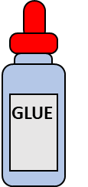
Art and Craft time

Slide 2

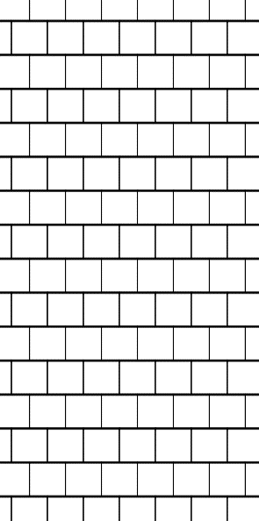
Seniors sheet 2
Complete the verse: Psalm 116
⁵ The Lord is ________ and ________; our God is full of _________.
⁶ The Lord _____ the ______; when I was _______ low, he _____ me.
Find the words from the story

Slide 3
Code breaker
Psalm 116
¹ I love the Lord, for
he heard my voice;
he heard my cry for
mercy.
² Because he turned his
ear to me,
I will call on him as
long as I live.
A | A | a | a
B | B | b | b
C | C | c | c
D | D | d | d
E | E | e | e
F | F | f | f
G | G | g | g
H | H | h | h
I | I | I | I
J | J | j | j
K | K | k | k
L | L | l | l
M | M | m | m
N | N | n | n
O | O | o | o
P | P | p | p
Q | Q | q | q
R | R | r | r
U | U | u | u
S | S | s | s
T | T | t | t
V | V | v | v
W | W | w | w
X | X | x | x
Y | Y | y | y
Z | Z | z | z
1 | 1
2 | 2
3 | 3
4 | 4
5 | 5
6 | 6
7 | 7
8 | 8
9 | 9
0 | 0
Seniors sheet 1

Slide 4
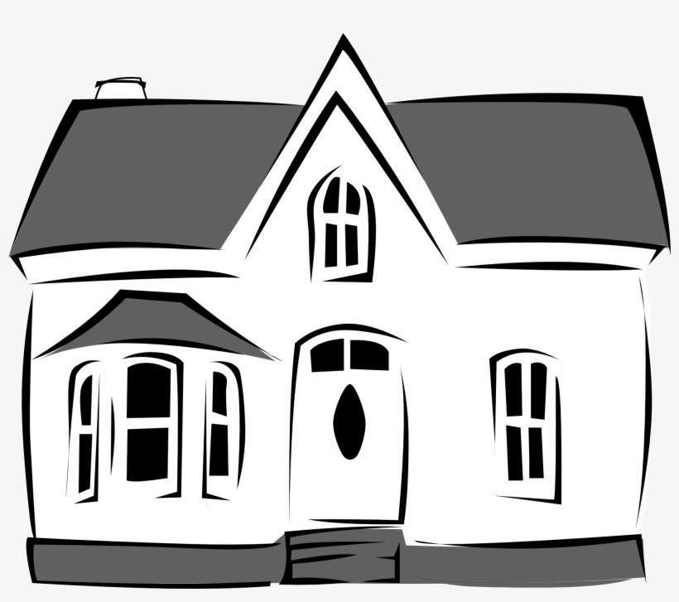
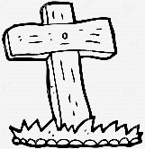

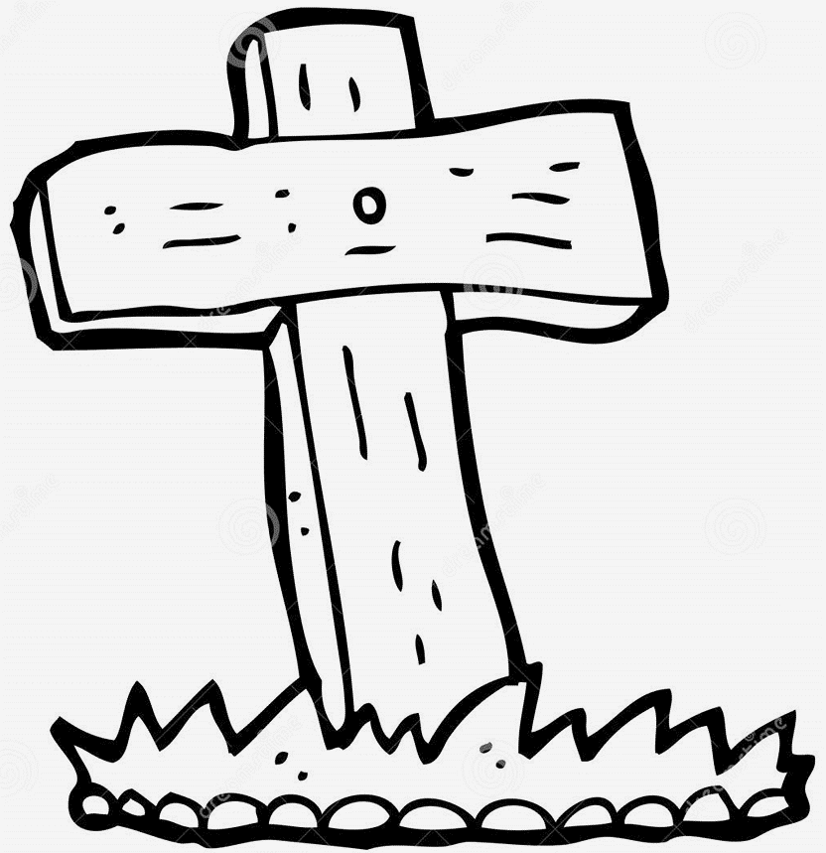
Juniors and beginners
sheet 1
Why did Jesus have to die for us?
What must we do with Jesus’ blood?
Cut along dotted line
If we trust in Jesus where will we live?

Slide 5
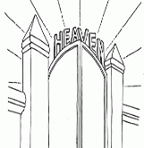
Juniors and beginners
sheet 2
Apply glue along here
Cut these out and stick on the front sheet, asking children about the story
Apply glue along here
Apply glue along here
Psalm 116
¹ I love the Lord, for he heard my voice;
he heard my cry for mercy.
² Because he turned his ear to me,
I will call on him as long as I live.

Slide 6
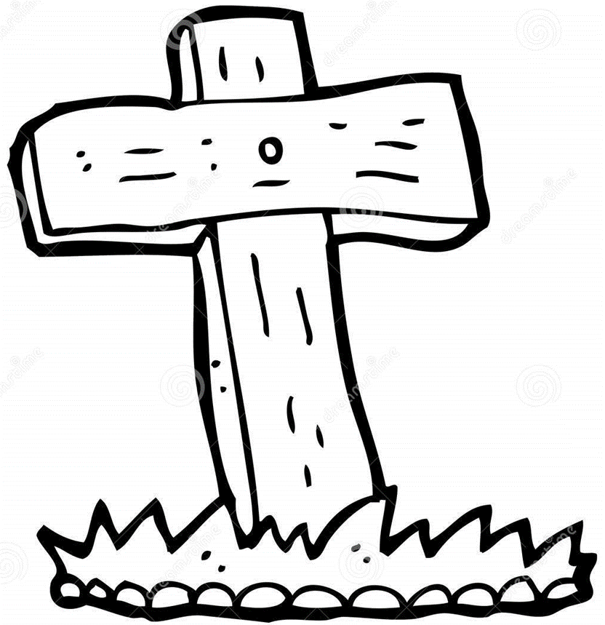
All sheet

Slide 7
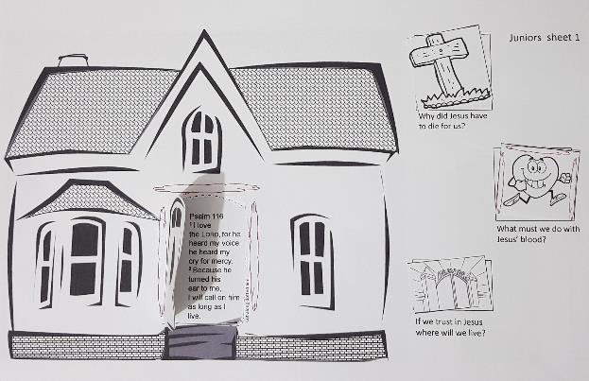
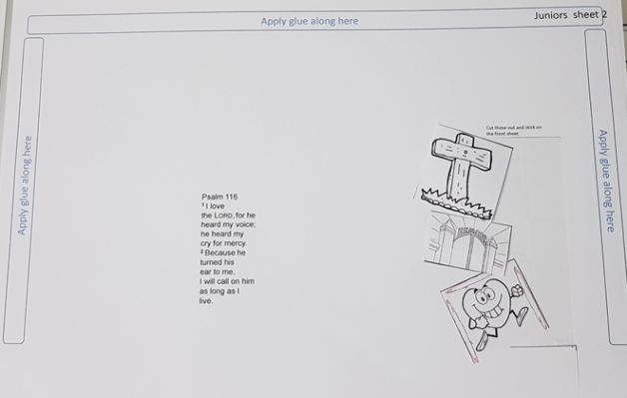
Juniors and Beginners

Slide 8
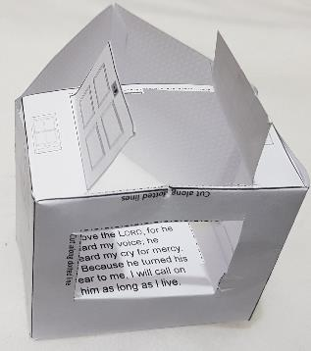
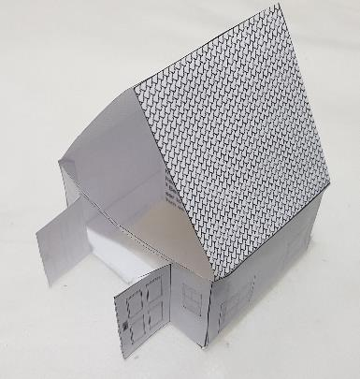
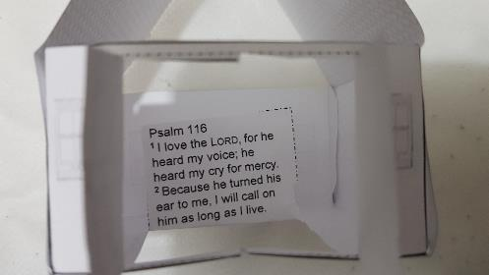
Everyone

