Slide 1
A level Criminal Law
Jessie Venegas
Msc (Oxon), LLB, BA (Hons), PGCE,
Property offences

Slide 2
What is the difference between ?
Burglary
Robbery
Theft

Slide 3
Lesson objectives
Can you tell the difference between Burglary/ Theft and Robbery?
Can you identify Burglary under S.9(1)(a) and Burglary under S.9(1)(b)
Can you apply the law to problem questions.

Slide 4
Theft
Theft Act 1968
“A person is guilty of theft if he dishonestly appropriates property belonging to another with the intention of permanently depriving the other of it”
The maximum sentence for theft is seven years.

Slide 5
Theft
Am I a criminal?
Theft Act 1968
“A person is guilty of theft if he dishonestly appropriates property belonging to another with the intention of permanently depriving the other of it”

Slide 6
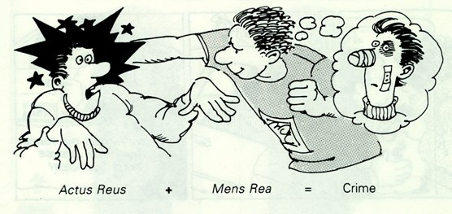
The Elements of an offence
The basics

Slide 7
The Elements of Theft
ACTUS REUS
- Appropriation (s.3)
- Property (s.4)
- Belonging to another (s.5)
DISHONESTY TEST
- Dishonesty (s.2)
MENS REA
- Intention to permanently deprive the other of it (s.6)

Slide 8
Robbery
Definition
Theft Act 1968
“Robbery is a form of aggravated theft, in that it involves the offence of theft plus force or threat of force on a person.
Due to the violent nature of robbery, it is treated as being more serious than theft and the maximum sentence is life.

Slide 9
The Elements of Robbery
ACTUS REUS
A theft must take place
“Appropriation of property belonging to another”
MENS REA
Intention to permanently deprive the other of it (s.6)
- Uses force with the intent to steal.

Slide 10
burglary
Definition
Burglary under S.9(1)(a)
A person commits burglary under s.9(1)(a) if he enters a building, or any part of a building, as a trespasser, with intent to either:
steal anything in the building,
inflict GBH on any person in the building
or doing unlawful damage
The maximum sentence is 14 years.

Slide 11
The Elements of Burglary The Elements of Burglary S9(A)
ACTUS REUS
Entry
A building or part of a building
As a trespasser
MENS REA
Intention to:
steal anything in the building,
inflict GBH
unlawful damage

Slide 12
burglary
Definition
Burglary under s.9(1)(b)
A person commits an offence of burglary under s.9(1)(b) if, having entered as a trespasser, he steals, attempts to steal anything in the building or inflict or attempts to inflict GBH on any person therein.
The maximum sentence is 14 years.

Slide 13
The Elements of Burglary
ACTUS REUS
Entry
A building or part of a building
As a trespasser
Theft or attempted ad theft
GBH or attempt GBH
MENS REA
Intention to: (after entry)
steal anything in the building,
inflict GBH
unlawful damage

Slide 14
Revision Chart
Theft Act 1968
Theft
AR
Appropriation
of property
belonging to another
MR
intention of permanently deprive
Dishonest
Robbery
AR
AR for theft
+
Use of force or threat of force
at the or immediately before
To steal
MR
MR for theft +
Intent to use force to steal
Burglary S9 (A)
AR
Entry
Building
Trespass
MR
Intention steal (MR theft)
Intention to cause GBH
Intention to cause unlawful damage.
Burglary S9 (B)
AR
Entry
Building
Trespass
Theft (AR)
GBH (AR)
MR (Post-entry)
Intention steal (MR theft)
Intention to cause GBH (MR)

Slide 15
Can you Identify the offence
?

Slide 16
Robbery, Burglary or Theft?

Slide 17
Robbery, Burglary or Theft?

Slide 18
Theft, Robbery or Burglary?

Slide 19
Theft, Robbery or Burglary?

Slide 20
Robbery, Theft or Burglary?

Slide 21
Robbery, Theft or Burglary?

Slide 22
Theft, Burglary or Robbery?

Slide 23
Theft, Burglary or Robbery?

Slide 24
Burglary, Theft, Robbery?

Slide 25
Burglary, Theft, Robbery?

Slide 26
Theft, Burglary or Robbery?

Slide 27
Theft, Burglary or Robbery?

Slide 28
Burglary, Theft, Robbery?

Slide 29
Burglary, Theft, Robbery?

Slide 30
Burglary, Robbery or Theft?

Slide 31
Burglary, Robbery or Theft?

Slide 32
The Elements of Burglary S9(A)
ACTUS REUS
Entry
A building or part of a building
As a trespasser
MENS REA
Intention to:
steal anything in the building,
inflict GBH
unlawful damage

Slide 33
The Elements of Burglary S9 (B)
ACTUS REUS
Entry
A building or part of a building
As a trespasser
Theft or attempted ad theft
GBH or attempt GBH
MENS REA
Intention to:
( forms after entry)
steal anything in the building,
inflict GBH
unlawful damage

Slide 34
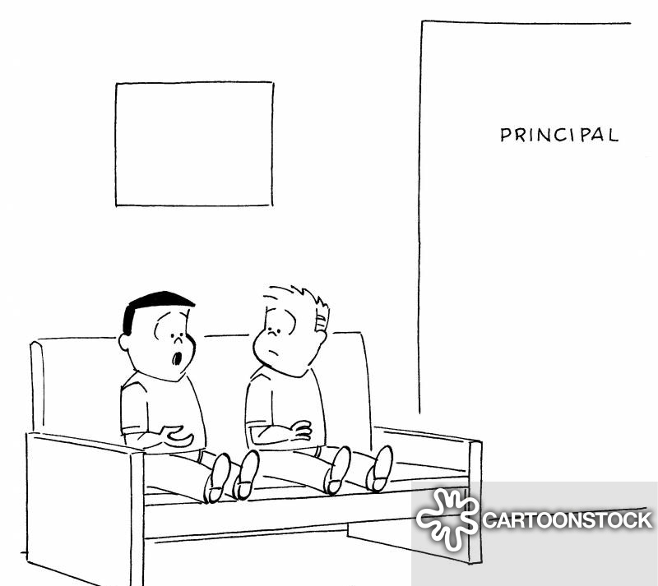
Burglary at the principal office
Principal Smith calls Jonny into his office to talk to him about his behaviour. His mate Steve comes with him uninvited for “moral support”. When they enter the office they see the principal is not there and take a seat even though they both know they are not supposed to stay there if the principal is not the office (there is a sign).
Jonny see’s the principal has left his watch on his desk and decides to steal it.
Who sees a permanent marker on the desk writes this message all over the principal’s favourite painting ruining it forever.
Jonny and Steve

Slide 35
Burglary at the principal office
ACTUS REUS
Entry
A building or part of a building
As a trespasser
Theft or attempted ad theft (B only) or
GBH or attempt GBH (B only)
MENS REA
Intention to:
before =A / after = B
steal anything in the or building,
inflict GBH or
unlawful damage (Only A)
Jonny and Steve

Slide 36
More resources
thelawbank.co.uk/aaclesson

