Slide 1
Theft
Mens Rea

Slide 2
Starter
1. You are given a vase by your gran, and have it valued. The auctioneer tells you it is worth £10 and buys it from you. He then resells it for its actual price of £1000
2. You are in Tescos and notice that they have priced your favourite bottle of wine at only 10p on the shelf, when it should be £10. You buy 10 bottles.
Look at the ten different scenarios and answer the four questions below:
Would you do any of these things: do you think are OK to do?
Why did you decide the way you did?
Can you think what we mean by the word dishonest?
Can you devise a short test to establish dishonesty?
3. Your bag is stolen and you make a claim. In the details, you say that your phone is a better version than it was, and that you had £50 in your wallet (you only had £5)
4. You take £200 from your teacher’s staff fund to feed the homeless.
5. You are owed money by your employer and so when you do some extra work, you over charge them to get your money.
8. You take £5 from your mum’s purse to buy your lunch and travel to school.
6. You are from a country where, if goods are put outside a to shop, you can just help yourself. You walk past a shop which has clothes on display outside it and take a pair of jeans.
9. You go into the common room and pick up your coat. It is not yours.
7. You are panicking about the Law Exam, and go into the library and take one of the law books, assuming the librarian would be ok with this
10. You find an envelope on the floor and it has £100 in it. You look around and see a man disappearing in the distance.

Slide 3
Objectives
State the mens rea of Theft
Explain cases that illustrate the mens rea of theft
Apply the rules relating to both the actus reus and mens rea of theft to a given situation
Look at each of the objectives and then taking into account your pre-reading colour code yourself for each of them.
Red – I don’t get it. I need some help understanding
Amber – I think I understand but I need a little support
Green – I understand and can try to help others who are not so clear

Slide 4
Dishonesty
So what does the law actually say? Take your copy of the Theft Act and identify which sections apply to the mens rea element and then reassess your answers to the questions from the starter.
2. You are in Tescos and notice that they have priced your favourite bottle of wine at only 10p on the shelf, when it should be £10. You buy 10 bottles.
1. You are given a vase by your gran, and have it valued. The auctioneer tells you it is worth £10 and buys it from you. He then resells it for its actual price of £1000
3. Your bag is stolen and you make a claim. In the details, you say that your phone is a better version than it was, and that you had £50 in your wallet (you only had £5)
6. You are from a country where, if goods are put outside a to shop, you can just help yourself. You walk past a shop which has clothes on display outside it and take a pair of jeans.
5. You are owed money by your employer and so when you do some extra work, you over charge them to get your money.
4. You take £200 from your teacher’s staff fund to feed the homeless.
7. You are panicking about the Law Exam, and go into the library and take one of the law books, assuming the librarian would be ok with this
10. You find an envelope on the floor and it has £100 in it. You look around and see a man disappearing in the distance.
8. You take £5 from your mum’s purse to buy your lunch and travel to school.
9. You go into the common room and pick up your coat. It is not yours.

Slide 5
Dishonesty
Theft Act 1968, s2:
(1) A person’s appropriation of property belonging to another is not to be regarded as dishonest—
(a) if he appropriates the property in the belief that he has in law the right to deprive the other of it,
on behalf of himself or of a third person; or
(b) if he appropriates the property in the belief that he would have the other’s consent if the other
knew of the appropriation and the circumstances of it; or
(c) (except where the property came to him as trustee or personal representative) if he appropriates
the property in the belief that the person to whom the property belongs cannot be discovered by
taking reasonable steps.
(2) A person’s appropriation of property belonging to another may be dishonest notwithstanding that he is willing to pay for the property.
Is dishonesty the only mens rea element? If not what is the full mens rea?

Slide 6
Dishonesty
What is the problem with Section 2?
Why do you think the drafters wrote Section 2 in this way?
How do you think the issues therefore have to be resolved?
Can you think of any problems with allowing the jury to decide?
What does section 2(2) tell us?
The word was used so as to have no specific legal meaning other than its ordinary natural meaning
Notes:
Does not define dishonesty – it only gives three specific situations where a person would not be deemed dishonest
Because they expected everyone to know what dishonesty meant and therefore a jury or magistrate would be able to decide easily enough
Through case law
What do we mean by dishonest in today’s society
A person may still make a dishonest appropriation even though he is willing to pay for the property

Slide 7
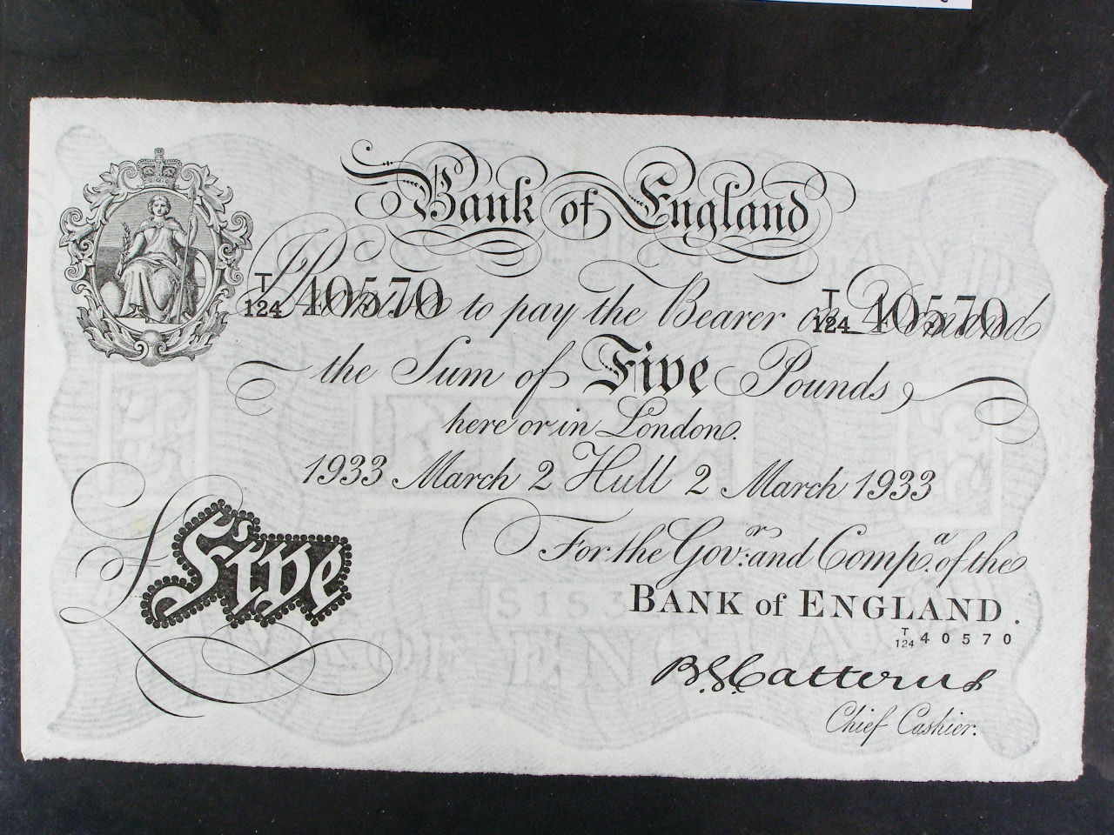
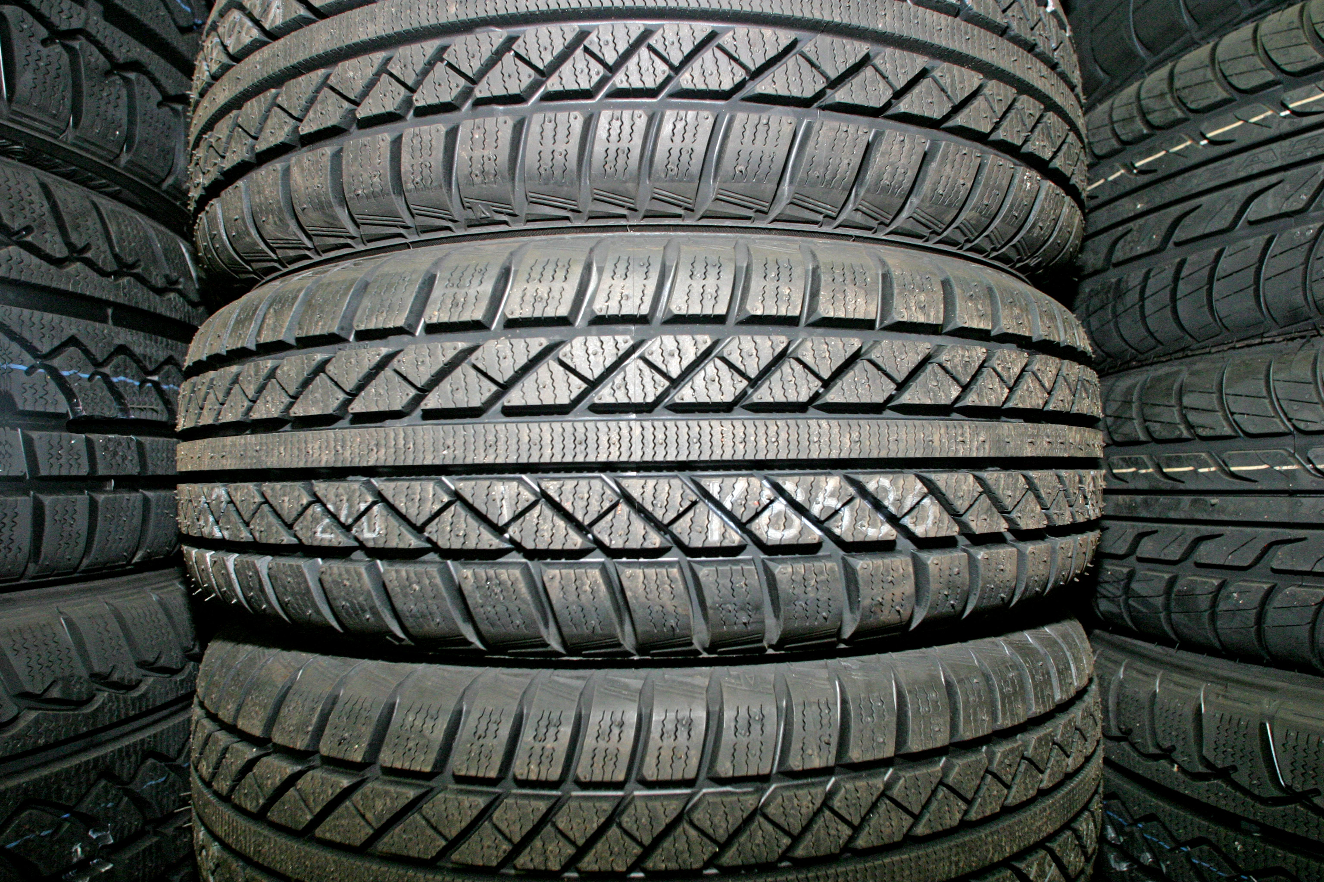
The Big Three
Carry out a LOBO task and then apply your given subsection to the piece of case law that you have been given.
S2(1)(a) R v Small [1987]
S2(1)(b) R v Holden (1991)
S2(1)(c) R v Thurborn (1848)
Notes:
LOBO – Learning on behalf of others. The groups will need to be assigned one of the three subsections each and then a copy of the three pieces of case law and in their groups decide the key issues of the reading. They can share with the other groups and feedback to the main group. See the LOBO task sheet on the site.

Slide 8
R v Small [1987] Crim LR 777 Court of Appeal
D saw a car for two weeks parked at an angle on a corner of a road, with the doors unlocked and keys in the ignition. One tyre was flat, as was the battery. The petrol tank was empty and the windscreen wipers did not work. D thought it was abandoned property and so he could take it.
Held: The jury should have been directed to consider:
whether according to the standards of the ordinary reasonable and honest person what D did was dishonest; and
if so, whether D must have realised what he was doing was dishonest by the standards of ordinary reasonable and honest people.
A belief unreasonably held could be an honest belief.
Not Guilty

Slide 9
R v Holden [1991] Crim LR 478 Court of Appeal
The appellant worked for Kwikfit. He took some used tyres and was convicted of theft. He appealed contending that he was not dishonest since other workers did the same and he believed that he was allowed to do the same. However, his contract of employment contained a clause forbidding the taking of used items.
Held: His conviction was quashed by the Court of Appeal. The question of dishonesty under the exceptions in s.2(1) Theft Act 1968 is judged entirely subjectively. It is the defendant's belief alone that counts not what he was actually permitted or forbidden from doing.
The reasonableness of a defendant's belief was irrelevant to the question of dishonesty. The question was whether H had, or might have had, the necessary honest belief, reasonably or not.
Not Guilty

Slide 10
R v Thurborn (1849) 1 Den 387
D found a bank note 5lb dropped on the road. There was no mark, or indication who the owner was. The next day someone claimed to have dropped it. D changed the note and kept the change appropriating the value for himself. The issue was whether the original taking of the bank note found by the D was innocent?
Held: The Court held that it was innocent. If a man finds goods that have been actually lost and appropriates them with intent to take dominion over them, believing the owner cannot be found it is not larceny (theft). The first taking did not amount to larceny because the note was really lost and there was no mark on it or circumstance to indicate the owner. Although the possession afterward was accompanied by dishonest intent, it was still lawful possession, and not larceny. This would be different if (a) the owner claimed the money after noticing the D of the loss. The D kept the money with the intent to take dominion; or (b) there was no mark on the note to suggest who the owner was, the individual could not prove it was his note.
Not Guilty

Slide 11
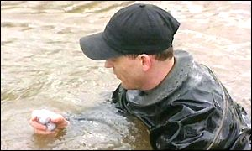
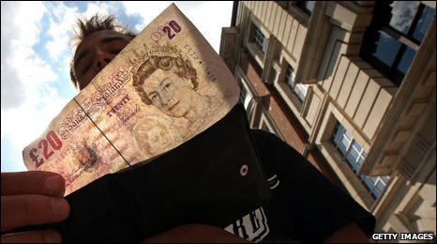
Try these three …
Research the three following articles and decide which part of S2 applies to them.
Furthermore do either have any wider or longer term implications?
Click on the names or pictures to access the full stories
Freegans
R v Rostron & Collinson [2003]
Finders Keepers

Slide 12
R v Rostron & Collinson, [2003] EWCA Crim 2206
DD collected "lost" golf balls in the middle of the night from a golf course. They were dressed in frogman, or diving suits, and in possession of a sack, of very wet golf balls. They had recovered the balls from stretches of water. There is a good trade in "lake balls".
Held: Evidence from the club professional that lost balls belonged to the club was supported by Hibbert v McKiernan [1948]. DD knew they were not entitled to go onto the golf course to recover the balls and were dishonest in the Ghosh sense.
Guilty
Comment: This case merely confirms the ratio in Hibbert as applicable to the Theft Act 1968. It received great publicity at the time particularly when one defendant received and immediate custodial sentence (reduced to a community penalty on appeal).

Slide 13
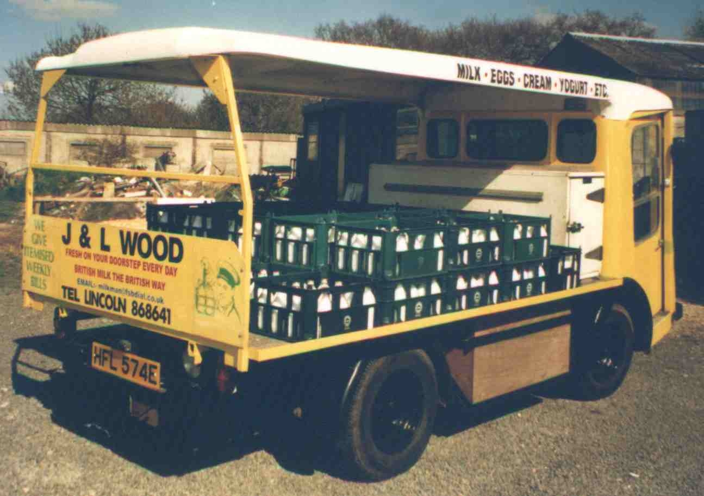
What about Section 2(2)
Theft Act 1968, s2:
(2) A person’s appropriation of property belonging to another may be dishonest notwithstanding that he is willing to pay for the property.
How might the silly example of the milk float be linked to the famous work of art? Can you justify this section? Is it fair to criminalise someone even if they agree to pay for what they took? Why? (or why not?).
How does this justify this?
Notes:
If I leave £1 on the milkmans seat for a pint of milk because he is not around this is theft (given all other circumstances are present)
It is justified because otherwise there would be no theft where D took V’s original work of art that he had long coveted leaving its listed valuation price

Slide 14
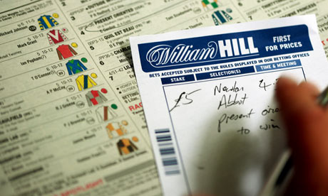
Is it a subjective or an objective test?
The case of R v Gilks is often studied to illustrate a point of law surrounding ‘belonging to another’. However, Lord Justice Cairns makes a statement that deals with dishonesty.
1. Read the case facts and then consider the position of the test after Gilks.

Slide 15
R v Gilks [1972] 1 WLR 1341
D was overpaid winnings by mistake by a bookmaker. D knew that the bookmaker had made a mistake, but he kept the money. D said that "bookmakers are a race apart." It would be dishonest if your grocer gave you too much change and you kept it, but it was not dishonest in the case of a bookmaker.
Held: It was correct to invite the jury to put themselves in the defendant's position and decide whether he thought that he was acting dishonestly or honestly.
Cairns LJ
"On the face of it the defendant's conduct was dishonest: the only possible basis on which the jury could find that the prosecution had not established dishonesty would be if they thought it possible that the defendant did have the belief which he claimed to have."
Guilty

Slide 16
What about this fella?
No not Russell Crowe silly …
Using what you have learnt so far decide whether Robin Hood would have been guilty of theft
Is he dishonest: truly?
Following the decision in Gilks how would you defend Robin in Court?
Notes:
You can always use the Robin Hood activity as a debate or as Moot Court making this activity a very versatile one

Slide 17
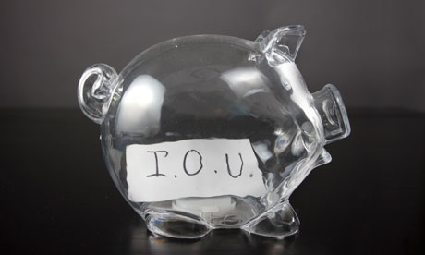
The Problems
Section 2 is a NEGATIVE test (i.e. it says what is not dishonest)
The three exceptions are a subjective test: no requirement that D’s belief is reasonably held
Question of dishonesty must be left for the jury to decide
Often D’s claim they have not been dishonest
No standard test

Slide 18
The last word – R v Ghosh
R v Ghosh (1982)
Read the case extract:
What are the facts of the case?
What are the issues concerning subjectivity and objectivity?
Why was Ghosh found guilty?
What is the two stage Ghosh Test?
Is dishonesty really an element of mens rea or a defence?

Slide 19
R v Ghosh [1982] 3 WLR 110 Court of Appeal
The appellant was a surgeon who claimed money in respect of operations which he had not carried out. He argued his actions were not dishonest as the same sums were legitimately due to him for consultancy fees. The jury convicted and he appealed.
Held: His conviction was upheld. The test for determining dishonesty: Lord Lane CJ "In determining whether the prosecution has proved that the defendant was acting dishonestly, a jury must first of all decide whether according to the ordinary standards of reasonable and honest people what was done was dishonest. If it was not dishonest by those standards, that is the end of the matter and the prosecution fails.
If it was dishonest by those standards, then the jury must consider whether the defendant himself must have realised that what he was doing was by those standards dishonest."

Slide 20
Dishonesty
After Ghosh dishonesty is now a two part test the first being objective and the second subjective.
Would the defendant’s behaviour be regarded as dishonest by the standards of reasonable and ordinary people?
(if the answer is ‘no’, the defendant is not guilty of theft as he has not been dishonest)
If the answer is ‘yes’ the second question is:
2. Was the defendant aware that his conduct would be regarded as dishonest by reasonable and ordinary people?

Slide 21
Finally – Let’s revisit Robin
After the decision in Ghosh would your decisions from earlier change and if so how?
Has Ghosh eliminated the Robin Hood defence entirely?
Why might it still be available – can you give some current alternate examples of how it would work?
What are the two possible ways that you could still defend Robin in court even after Ghosh?
Notes:
Robin Hood defence still works if the jury think that what the D did was not dishonest (even though it quite clearly was). Consider the animal rights activist who steals a beagle that is going to be experimented on.
D would have to be acquitted if the jury think either a) that what Robin Hood did (rob the rich to feed the poor) was not dishonest or b) that Robin thought the plain man would not consider what he did as dishonest

Slide 22
Intention to Permanently Deprive
Theft Act 1968, s6:
“With the intention of permanently depriving the other of it”.
A person appropriating property belonging to another without meaning the other permanently to lose the thing itself is nevertheless to be regarded as having the intention of permanently depriving the other of it if his intention is to treat the thing as his own to dispose of regardless of the other’s rights; and a borrowing or lending of it may amount to so treating it if, but only if, the borrowing or lending is for a period and in circumstances making it equivalent to an outright taking or disposal.
a. Disposing of the property regardless of the other’s rights
b. A borrowing or lending making it equivalent to outright taking or disposal
OR

Slide 23
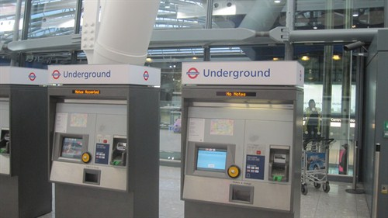
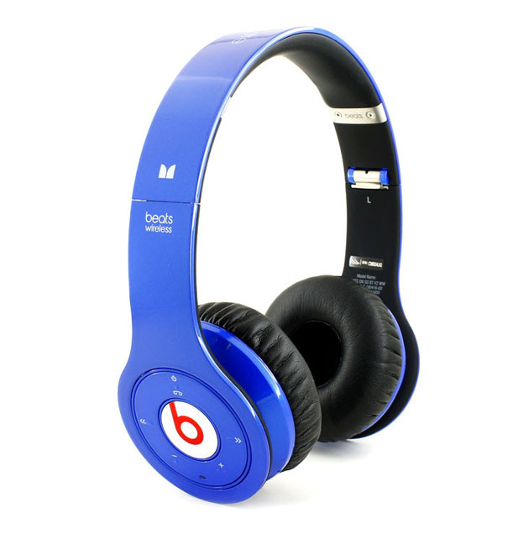
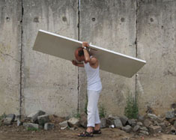
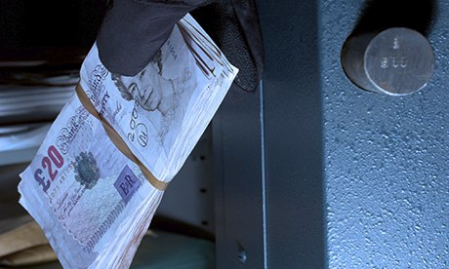
Some scenarios to ponder…
Selling an underground ticket to another traveller - R v Marshall (1998)
Taking a pair of headphones, breaking them and then giving them back – DPP v J and others (2002)
Removing films from a cinema to illegally copy them - R v Lloyd (1985)
Now you have guessed go and carry out some internet research and find out how the court interpreted the intention to permanently deprive in these cases.
Takes money from a safe intending to return it later - R v Velumyl (1989)
Swapping doors from one house to put in another house - R v Lavender(1994)

Slide 24
R v Marshall, Coombes & Eren [1998] 2 Cr App R 282 Court of Appeal
The appellants obtained unexpired travel tickets from commuters on the London Underground and sold them on to others. The trial judge ruled that the tickets remained the property of London Underground, that there had been an appropriation with intent to permanently deprive. He was going to leave the question of dishonesty to the jury. The defendants changed their plea to guilty then appealed against the judge's ruling with regards to intention to permanently deprive on the grounds that the tickets would be returned to London Underground and would have no less value or loss of virtue than when they had been issued. It was argued that the issuing of the ticket is analogous to the drawing of a cheque in that in each instance a chose in action is created which in the first case belongs to the customer and in the second to the payee. So the property acquired belonged to the customer and not London Underground and there can have been no intention on the part of the appellant to deprive London Underground of the ticket which would in due course be returned to the possession of London Underground.
Held: The convictions were upheld. The appellants had intended to treat the tickets as their own to dispose of regardless of the other's rights within the meaning of s.6.

Slide 25
DPP v J and Others [2002] All ER (D) 260
DD who were 14 robbed another boy. They snatched his headphones and broke them in half, and then returned them to the boy.
Held: An intention to permanently deprive could be inferred from the acts of the defendants. Once they had snapped the headphones, they had rendered them useless. Moreover by snatching and snapping the article, they had in reality disposed of it.
An action whose result rendered property useless, was in effect no different from an action which risked the loss of that article.
Guilty

Slide 26
R v Lloyd, Bhuee & Ali [1985] QB 829 Court of Appeal
Lloyd worked as a chief projectionist at a cinema. Over a period of some months Lloyd took films from his place of work, gave them to Bhuee & Ali who copied them for distribution and gave them back to Lloyd who returned them to the cinema. The judge left the issue of intention to permanently to deprive for the jury to decide. They were all convicted with conspiracy to steal contrary to s.1 Criminal Law Act 1977 (liability requires proof of theft under the Theft Act 1968). They appealed contending that as a matter of law the issue of intention to permanently deprive could not arise in the circumstances so the judge was wrong to put it to the jury.
Held: Appeal allowed. The convictions were quashed. The wording of section 6(1) "and a borrowing or lending of it may amount to so treating it if, but only if, the borrowing or lending is for a period and in circumstances making it equivalent to an outright taking or disposal" requires all the goodness, virtue and practical value to be taken from the goods. The films were returned in much the same condition as when they were taken and thus did not fall within the definition.
Not Guilty

Slide 27
R v Velumyl [1989] Crim LR 299
D, a company manager borrowed £1050 from safe at work without authority and contrary to company rules and leant it to a friend. He intended to return the money on the following Monday.
Held: D's intention to repay the money (with different notes or coins) did not afford V a defence. He had the requisite intention permanently to deprive. He had no intention to return the objects he had taken. It had not been suggested that there was a lack of dishonesty on V's part.
Guilty

Slide 28
R v Lavender [1994] Crim LR 297
The defendant removed some doors from a council property that was due for demolition. He installed the doors in his girlfriend's flat which was also owned by the council.
Held: He did have the intention to permanently deprive under s.6(1) as he treated the doors as his own to dispose of regardless of the owner's rights.
Guilty

Slide 29
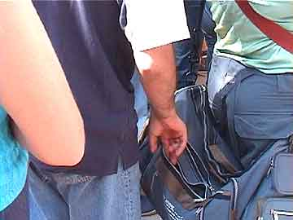
A Conditional Intent
R v Easom (1971)
Read the facts of the case and answer the following questions:
What are the facts of the case?
Was the D guilty or not guilty?
Why?
How might you frame the charge differently to gain a different outcome?

Slide 30
R v Easom [1971] 2 ALL ER 945 (CA)
D in a cinema picked up a handbag and sorted through the contents. He left the handbag with its contents intact in front of the seat which he had vacated. The handbag had been attached by cotton to a police sergeant's wrist.
Held: D merely had it in mind to deprive the owner of such of his property as, proved worth taking but actually took nothing, he would not have stolen it. D's state of mind is important.
Furthermore there could be no valid conviction of attempted theft unless it were established that he was animated by the same intention to permanently to deprive as would be necessary to establish the full offence.
Lord Scarman: "In every case of theft the appropriation must be accompanied by the intention of permanently depriving the owner of his property. What may be loosely described as a 'conditional' appropriation will not do. If the appropriator has it in mind merely to deprive the owner of such of his property as, on examination, proves worth taking and then, finding that the booty is valueless to the appropriator, leaves it ready to hand to be repossessed by the owner, the appropriator has not stolen."
Not guilty

Slide 31
Consolidate your understanding of Mens Rea
Facts | Dishonest? | Why?
John, a student, picks up and keeps a £5 note that he finds on the floor outside the Principal’s office.
Peter travels abroad on a business trip and works extra hours unpaid. In lieu of this, he claims extra expenses to which he was not entitled.
Daisy, in a long queue in a coffee shop at a train station, notices that her train is soon to depart and takes a bottle of water leaving the money for it on the counter.
Paige finds an IPod on the table in a pub. There are no other customers around, so after checking with the staff behind the bar, she decides to keep the IPod
Alfie borrows his brother new, expensive digital camera to take on holiday without asking.
Choose an example appropriate to your level of understanding – try and push yourself.
Then ask – ‘you sent for a dress from Next online. You wear it to a party and the next day send it back claiming it did not fit. Are you dishonest and at what point did your dishonesty become apparent?

Slide 32
Plenary & Consolidation
Consider whether the property in the following situations can truly be said to have lost all of its goodness or virtue.
Andrew borrows Jane’s car without Jane’s permission in order to take it for a joyride. Andrew returns the car with a large dent at the front.
Would you answer to the joyride question differ if Andrew dumped the car which he had written off?
Simon borrows Dan’s pen without permission and returns it with a small amount of ink left in it.
Jess borrows Suzy’s Criminal Law textbook and revision notes without permission a week before Suzy’s Criminal Law exam. Jess returns the textbook and notes on the day after the exam.
Imogen borrows Charley’s digital camera and returns it once the rechargeable battery has died.
Chris borrows Sharon’s one-month cinema pass (which entitles the person to watch unlimited films for free for one month) without permission. D returns the pass on the day of expiry.
Would your answer to the camera question be different if the camera had disposable batteries.

Slide 33
Objectives
State the mens rea of Theft
Explain cases that illustrate the mens rea of theft
Apply the rules relating to both the actus reus and mens rea of theft to a given situation
Look at each of the objectives and then colour code yourself for each of them.
Red – I don’t get it. I need some help understanding
Amber – I think I understand but I need a little support
Green – I understand and can try to help others who are not so clear

