Slide 1
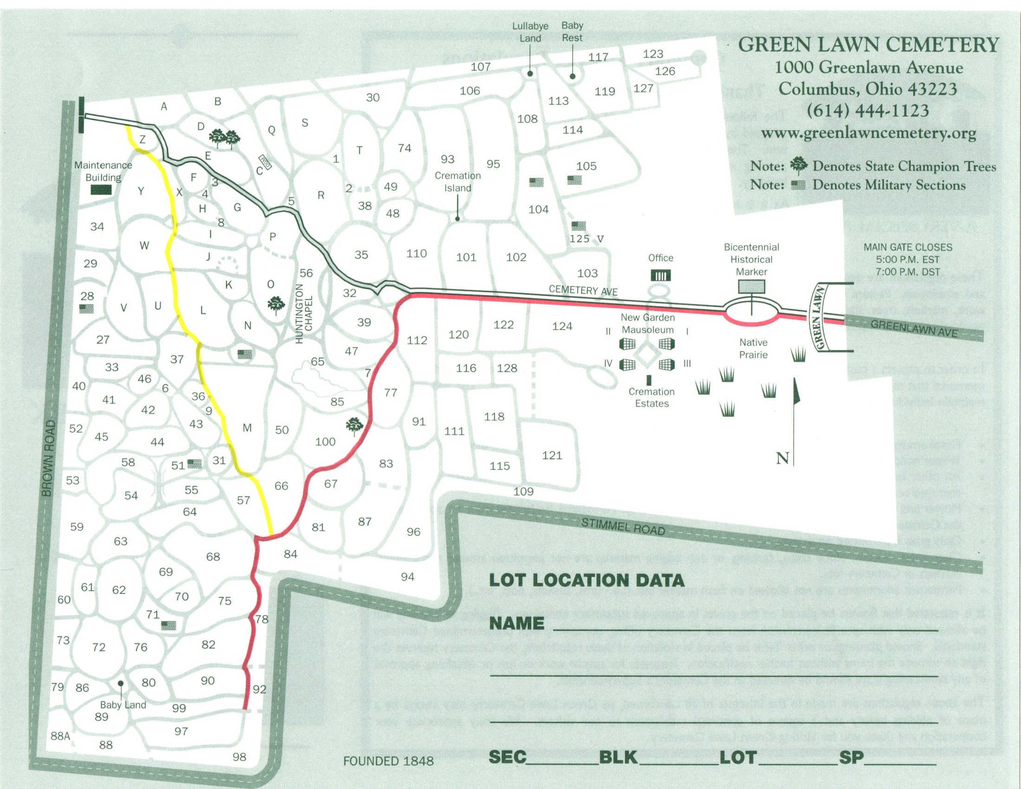
7
OPEN DAILY 7:00 am
GATE CLOSES:
07:00 pm DST
05:00 pm after OCT 22nd
5
9
3
2
1
8
6
4
Birds are found all over the grounds, but these are a few common areas for birding:
The Pond
Bird Feeders
Passenger Pigeon Memorial
The Ravine
Norway Spruce (crossbills some winters)
Siskins and Crossbills found in large sweet gums in this area
Woody edges in this area good for orioles and migrant warblers
Prairie and Swift Tower
Central Ridge – scan tree tops for Merlin
Birder Information Board
Please Lock Your Car and Do Not Leave Valuables in Plain View!

Slide 2

Bird Feeders Sponsored By
Columbus Audubon Society

