Slide 1
CX Audit Campaign
May 2020

Slide 2
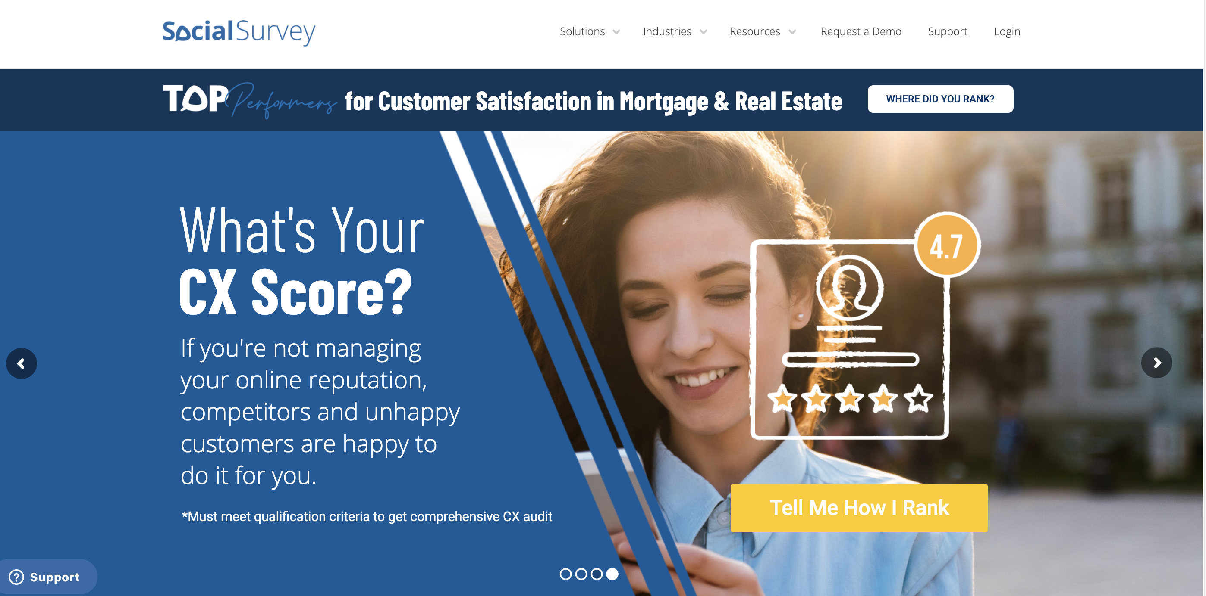
Home Page Banner

Slide 3
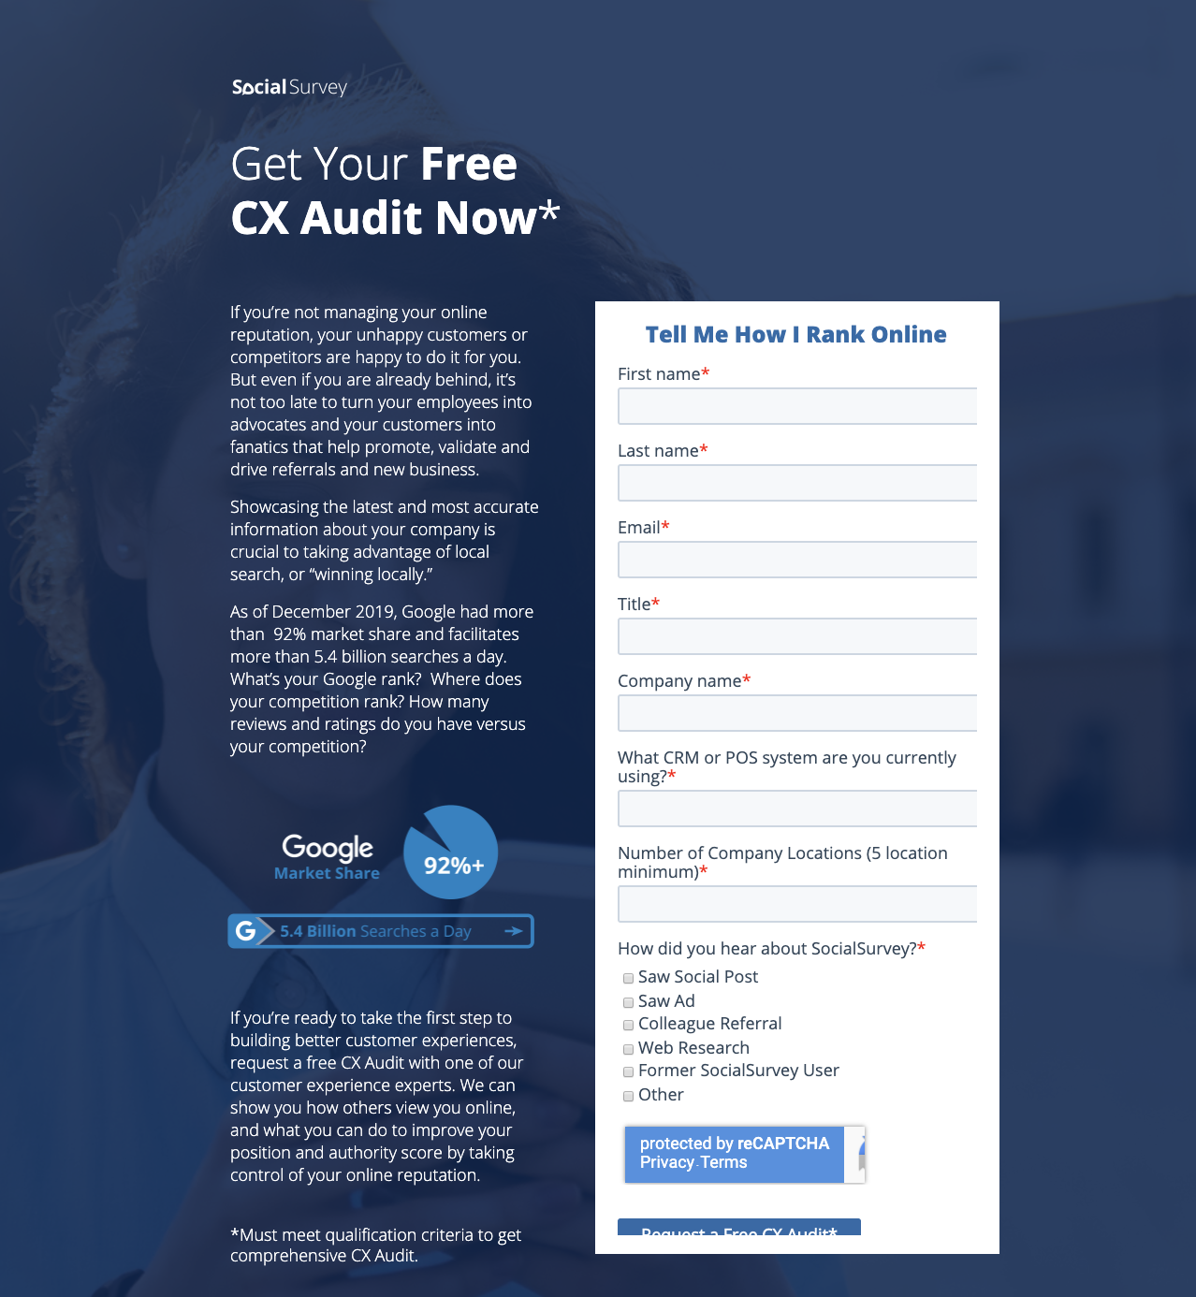
Landing Page

Slide 4




Social Media Page Banners

Slide 5
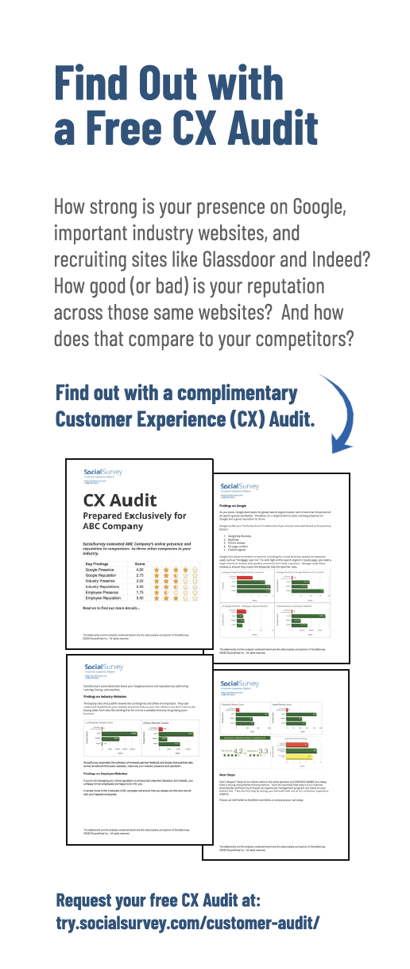
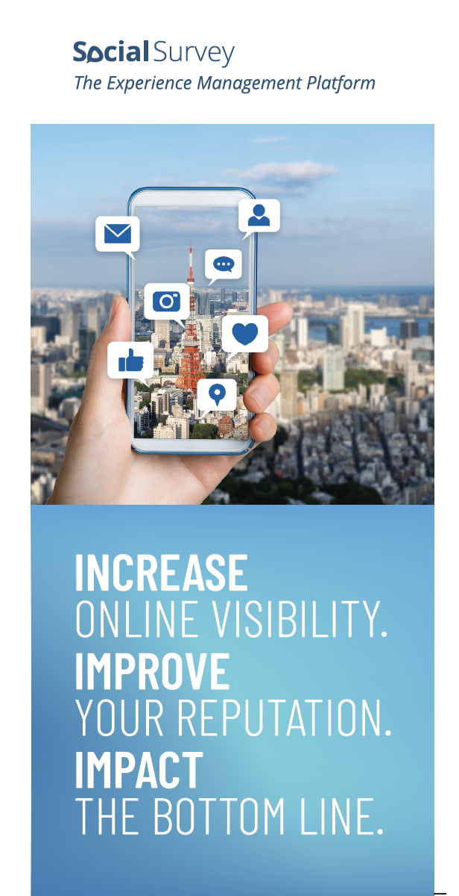
Event Collateral

Slide 6
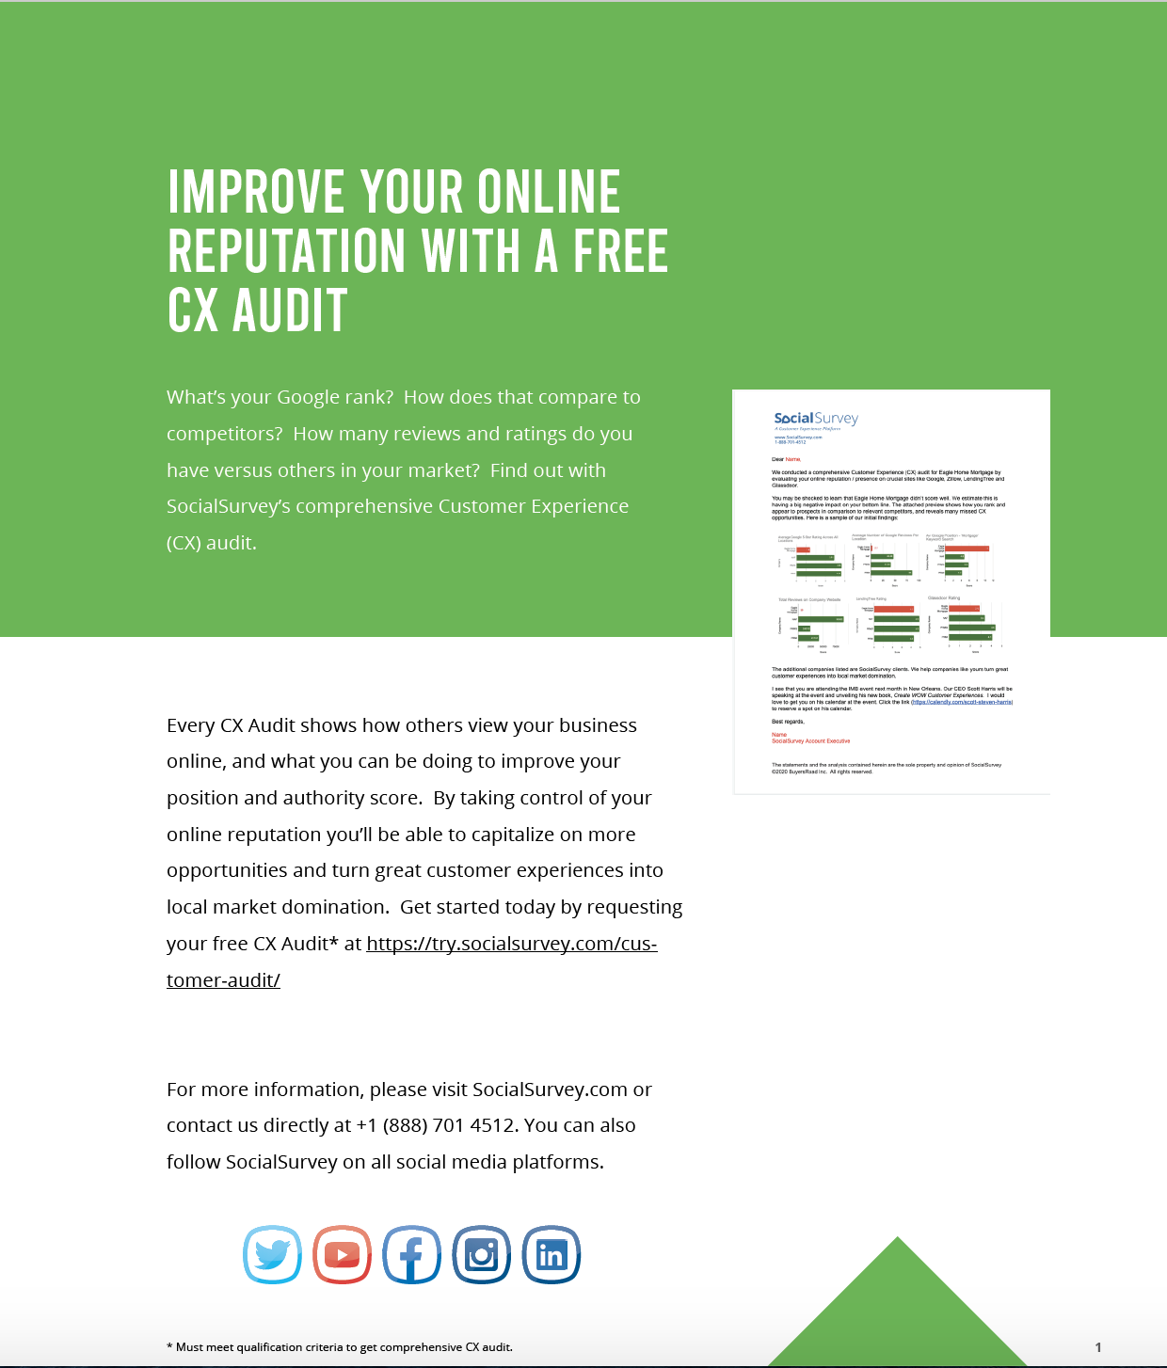
Cross Promotion in eBooks

Slide 7
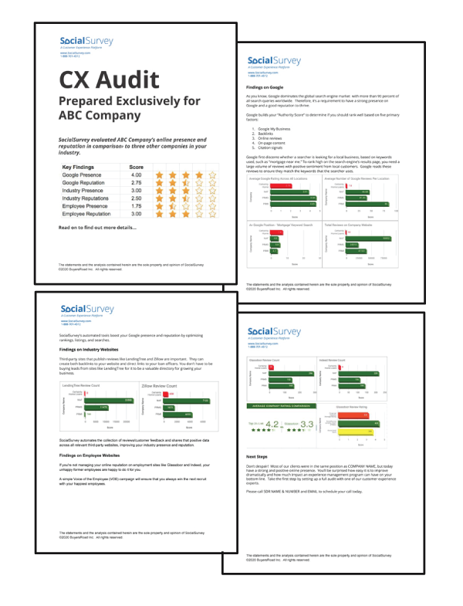



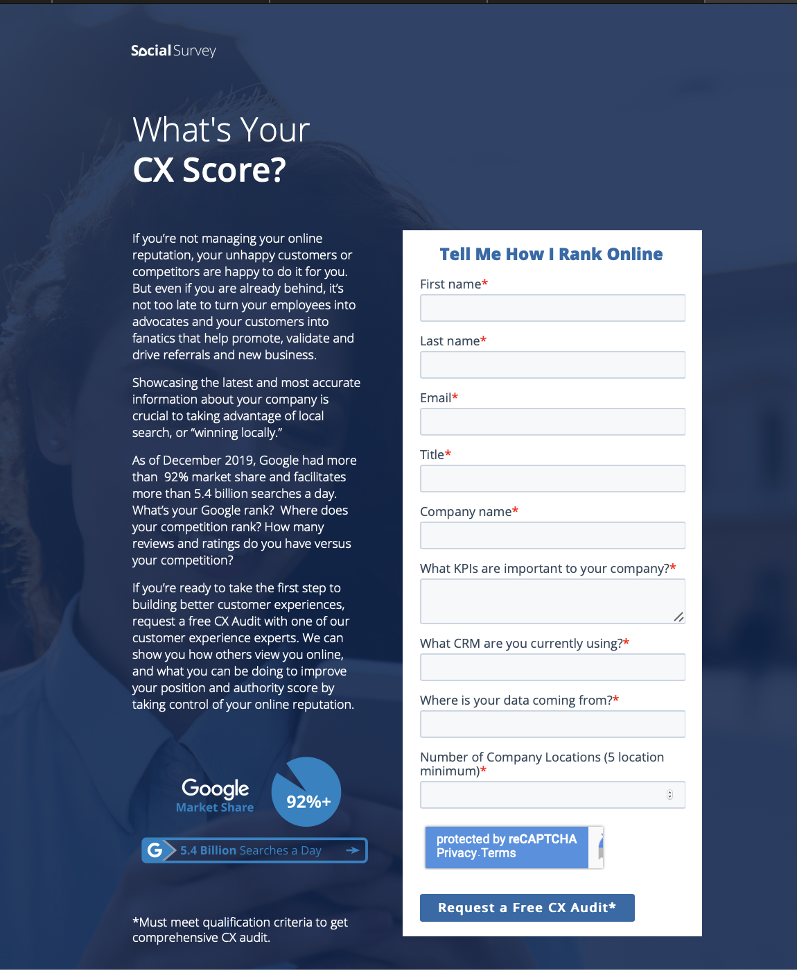




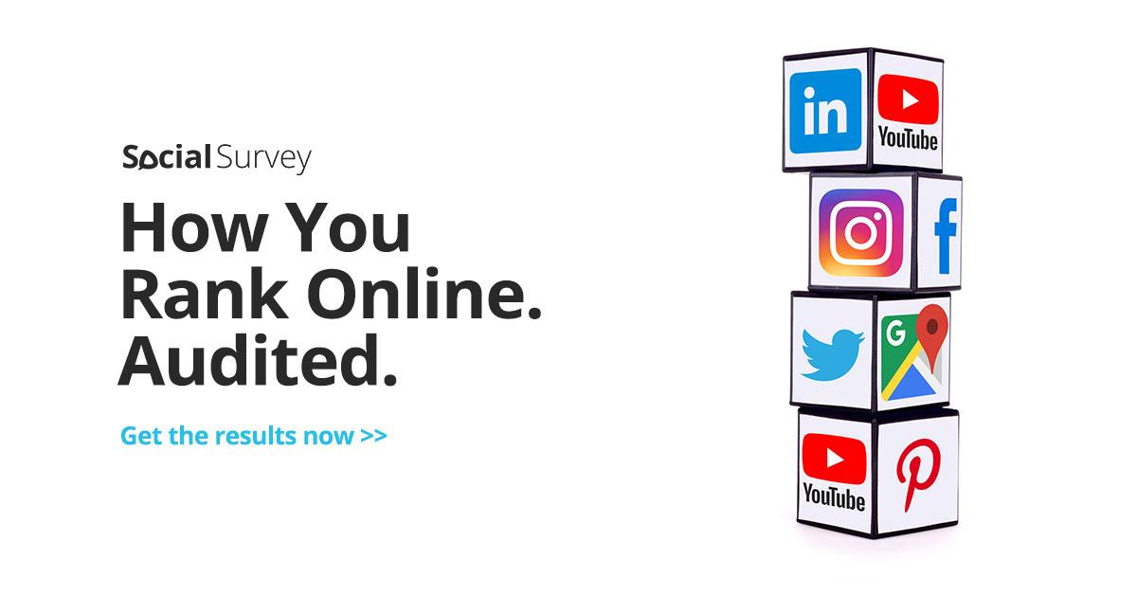

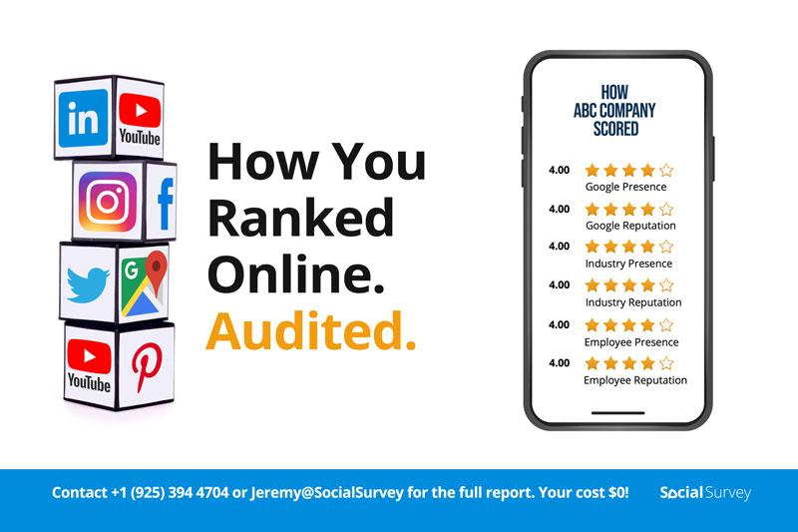

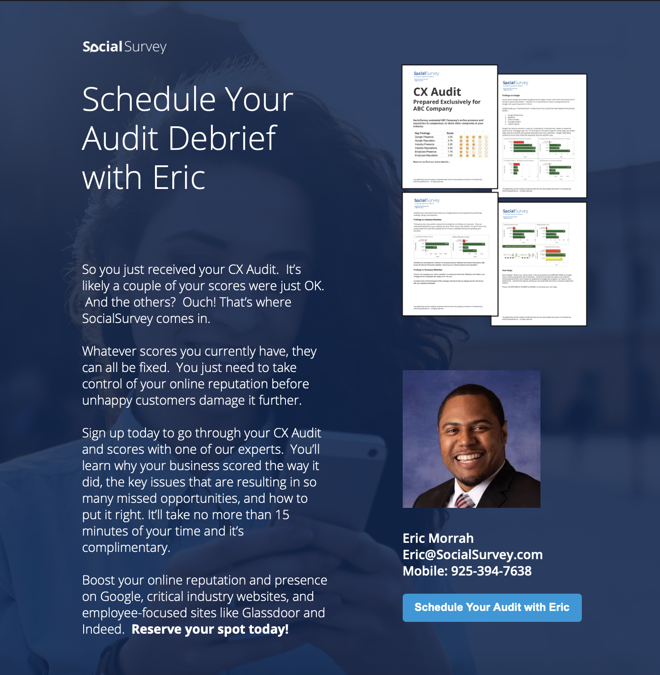
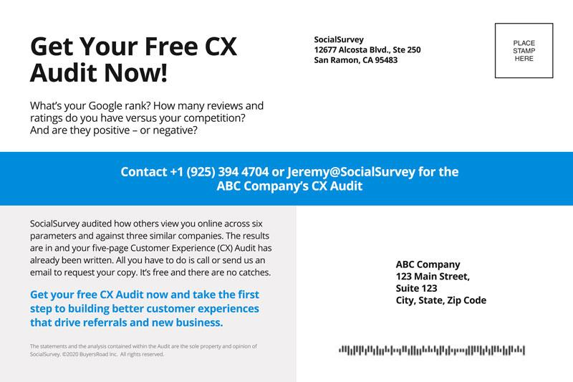


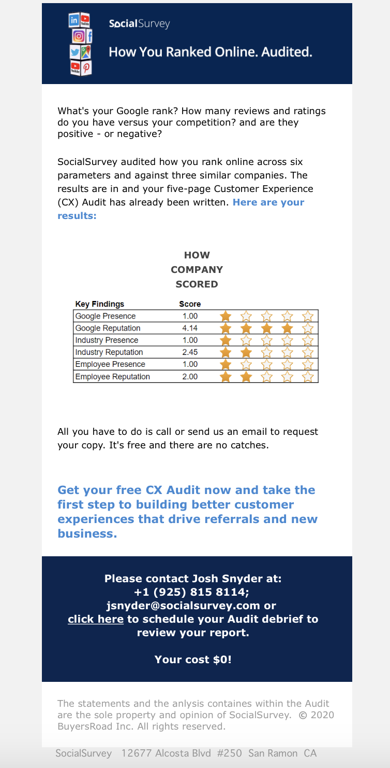






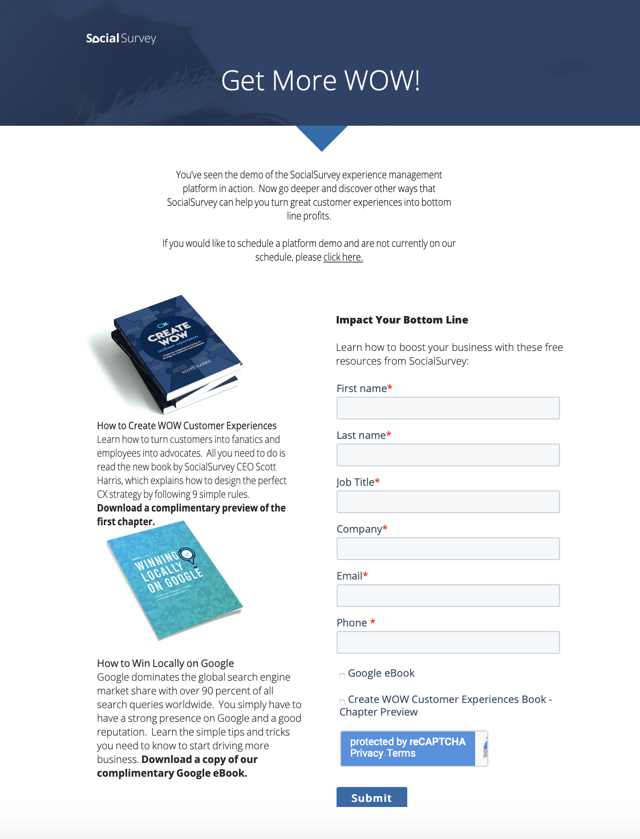




Audit Workflow Steps
BUILD LIST
CONSTRUCT AUDITS
PHASE 1 ADS
ISSUE POSTCARD MAILER
PHASE 2 ADS
SCHEDULE A
DISCOVERY CALL / DEMO
ISSUE AUDIT EMAIL
SDRs FOLLOW-UP
AE Prep For DEMO
DEMO WITH AE -
STAGE 3 CREATED
PHASE 3 ADS

Slide 8





Audit Phase 1 Ads –
LinkedIn, Facebook & Instagram

Slide 9
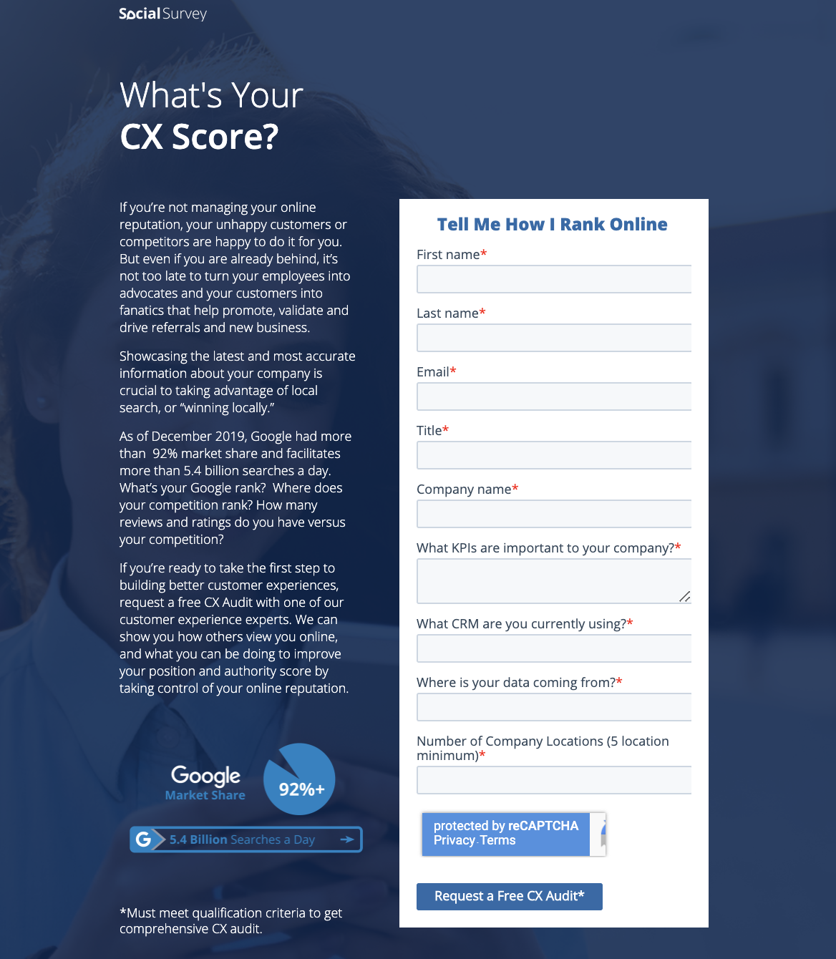
Phase 1 Landing
Page Ads

Slide 10
Audit Postcard

Slide 11
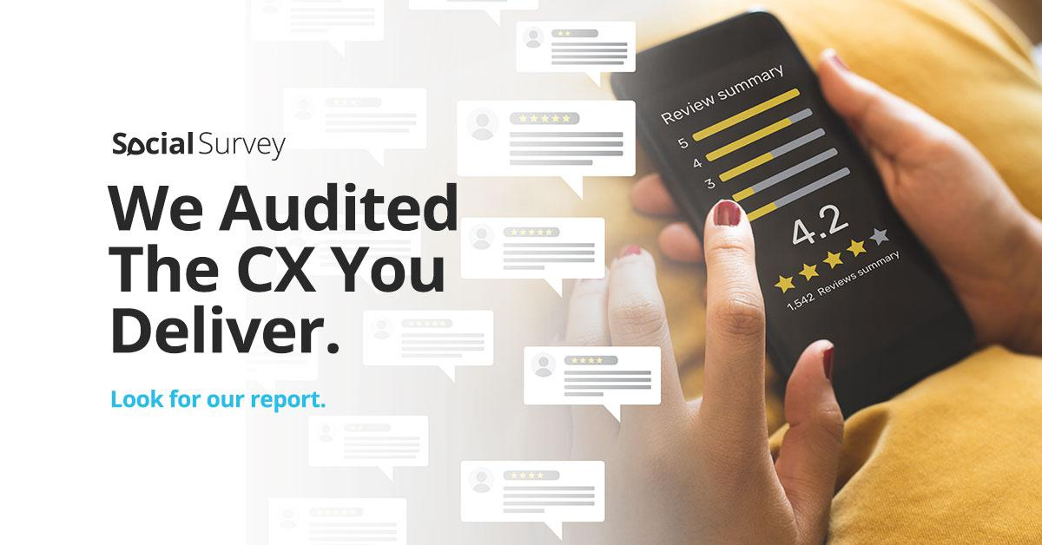
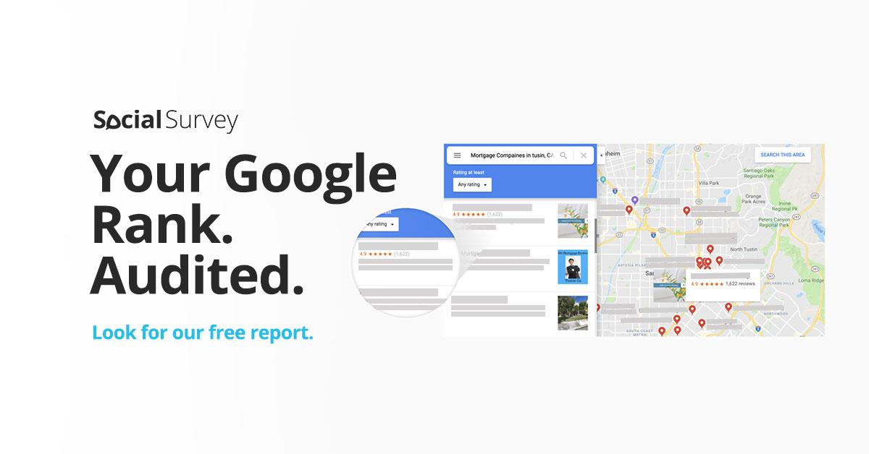
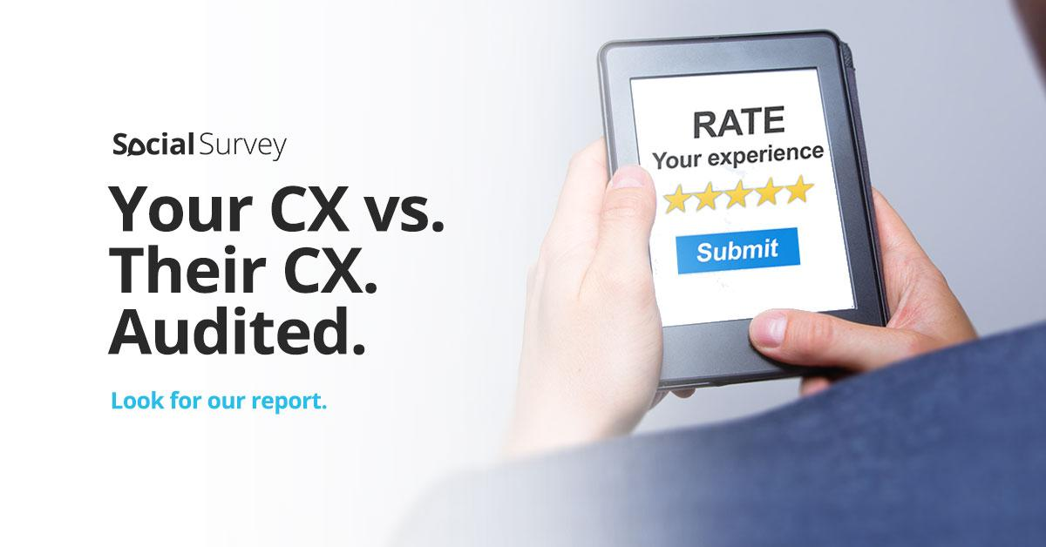
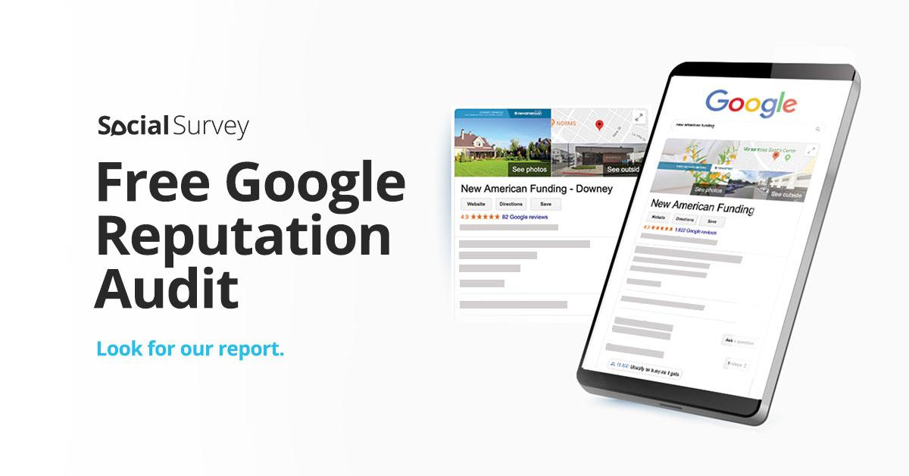


Audit Phase 2 Ads –
LinkedIn, Facebook & Instagram

Slide 12
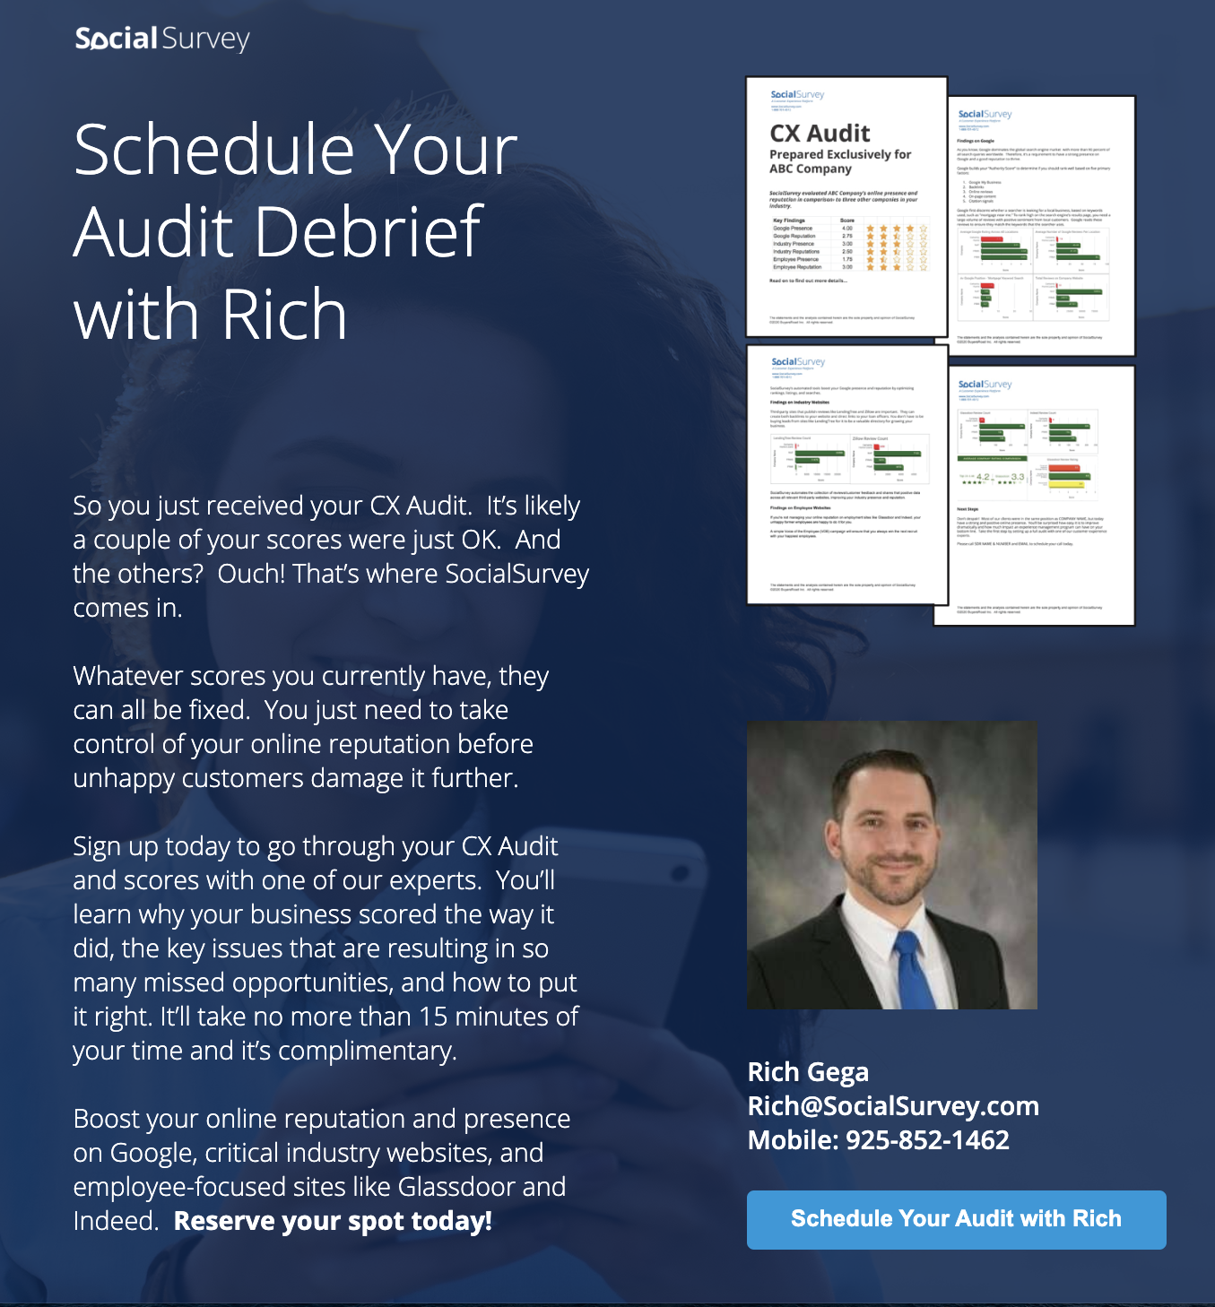
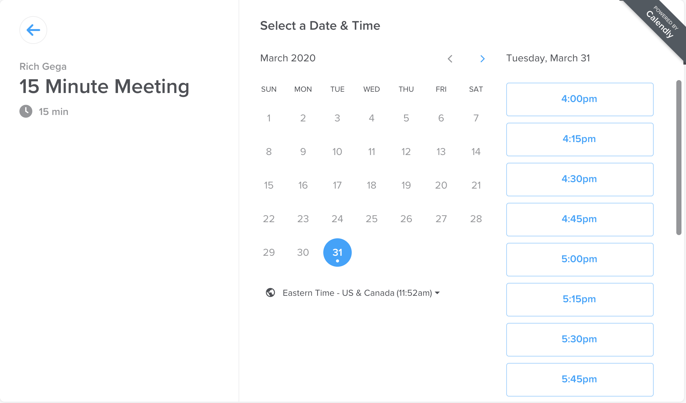
Phase 2 Landing Page Ads

Slide 13
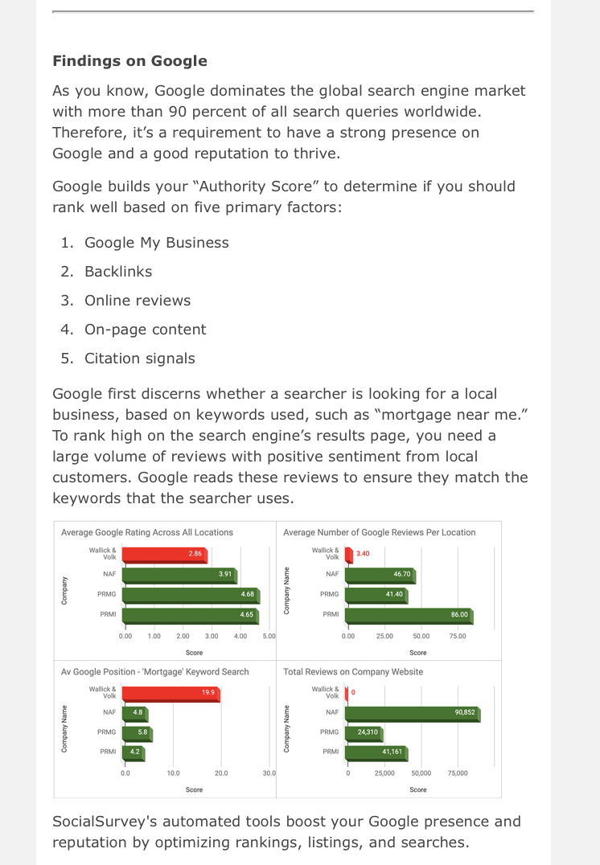

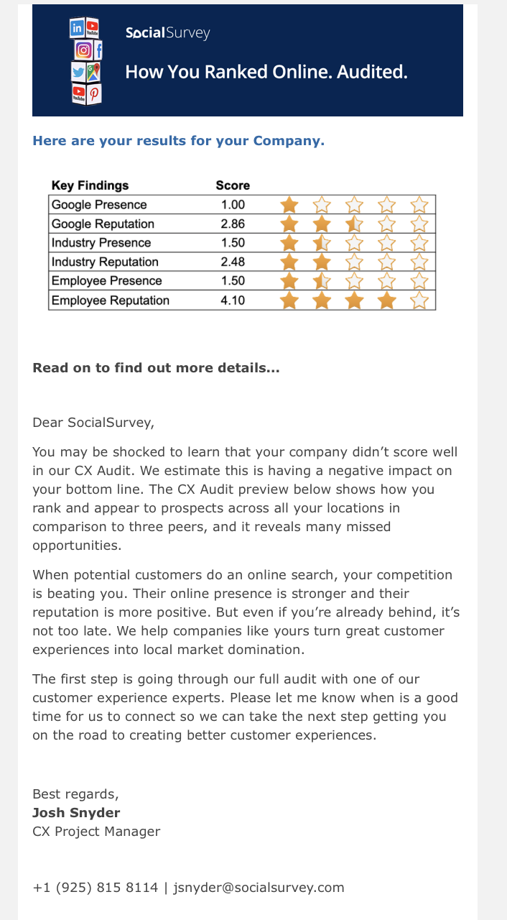
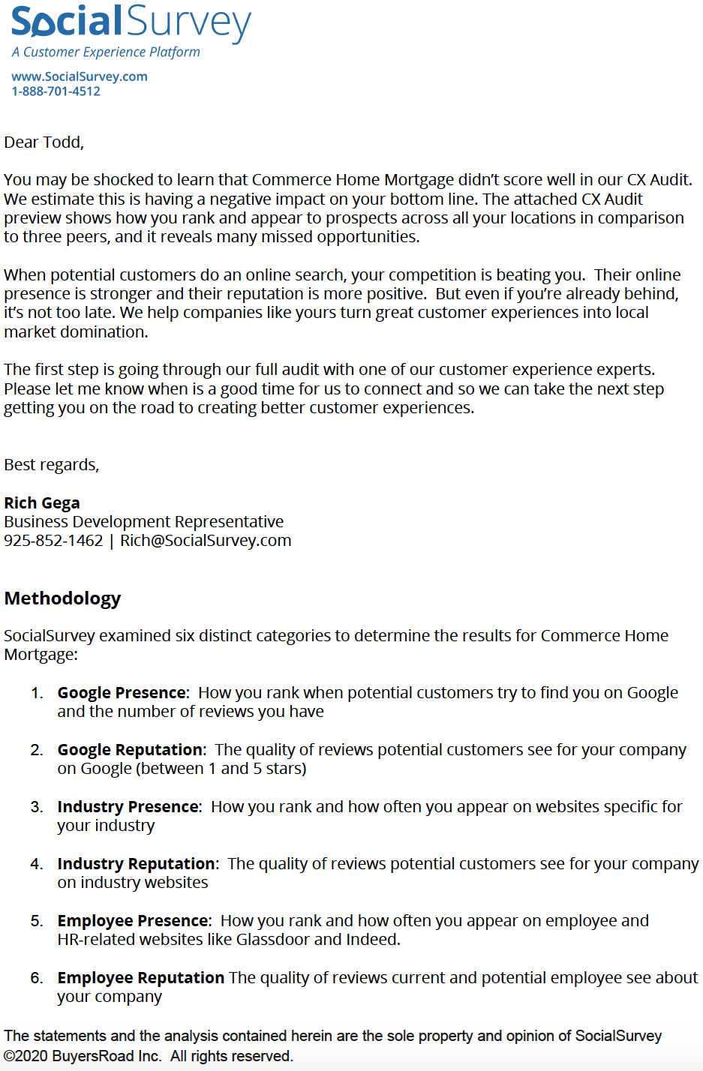
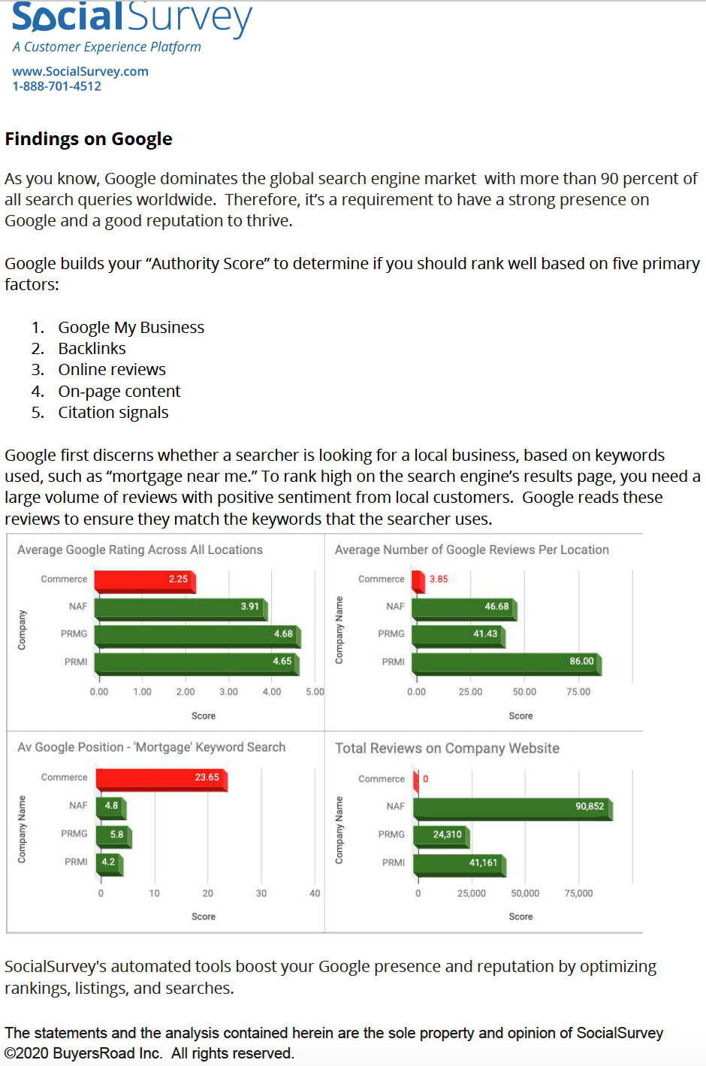
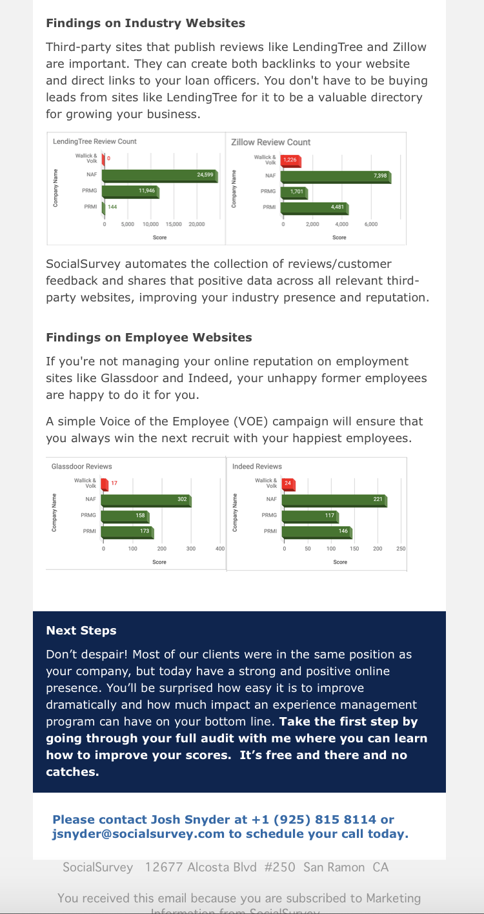
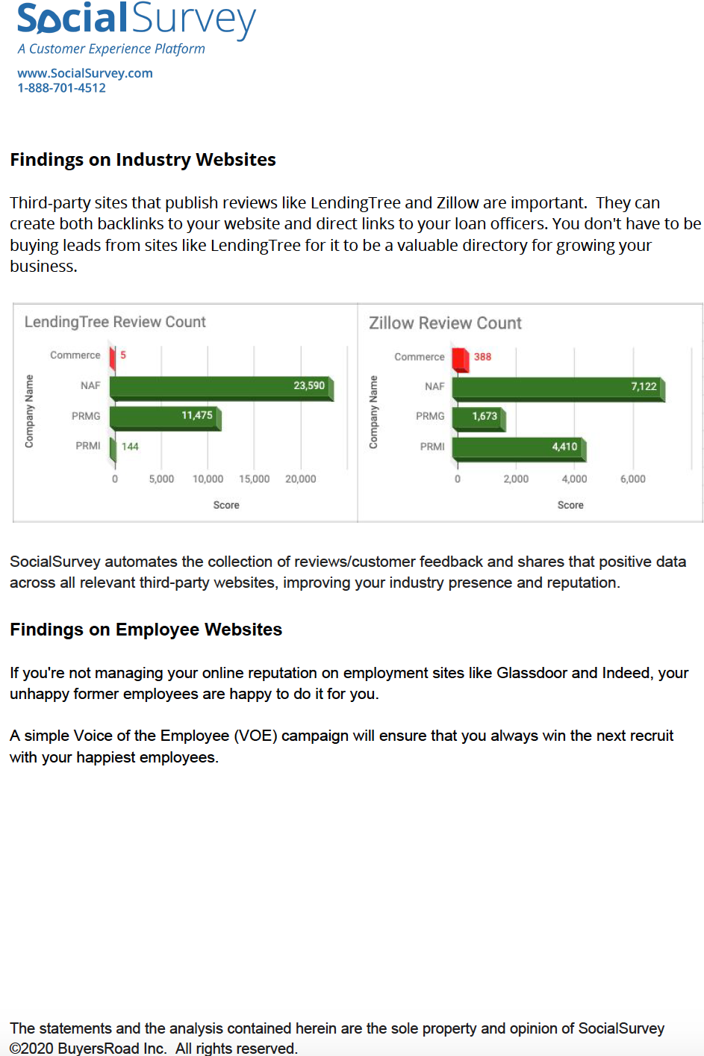
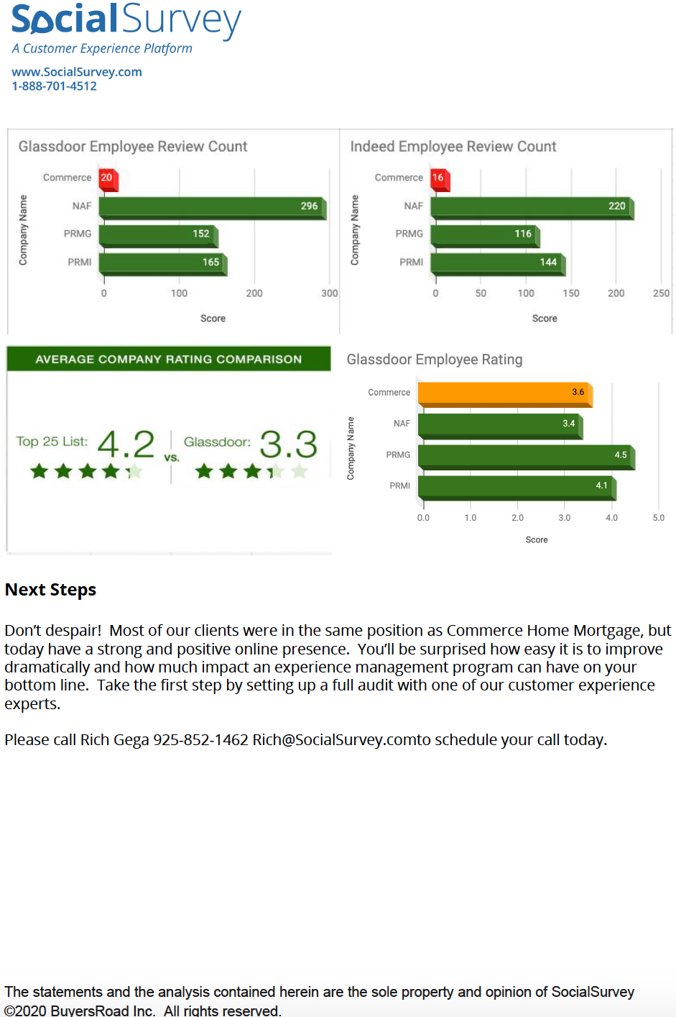
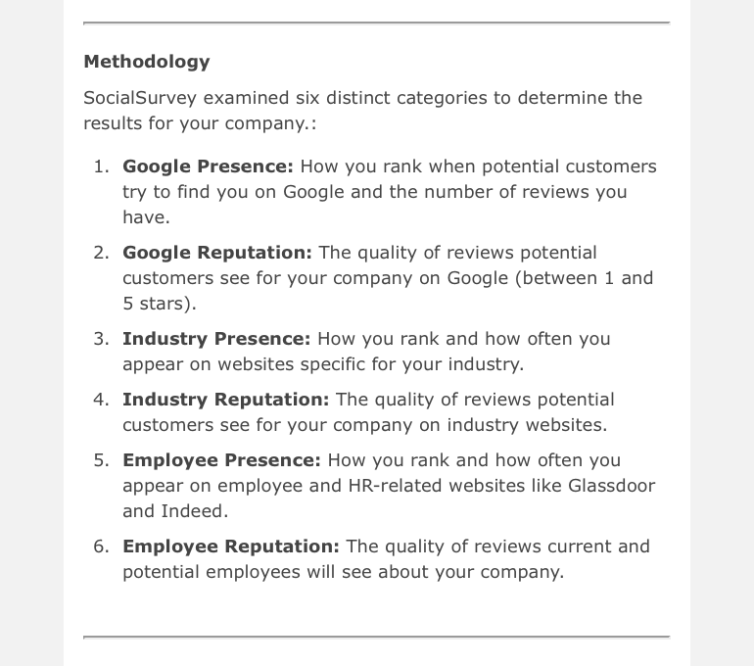
Audit HTML Mailer

Slide 14

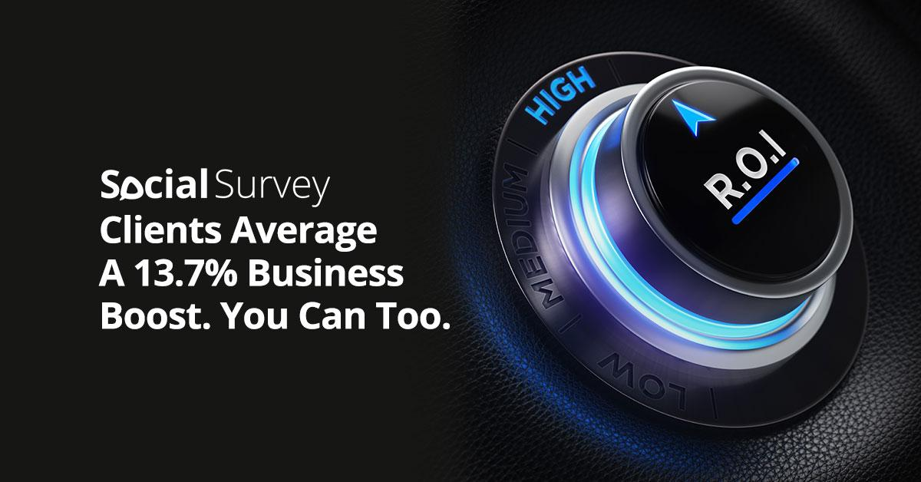


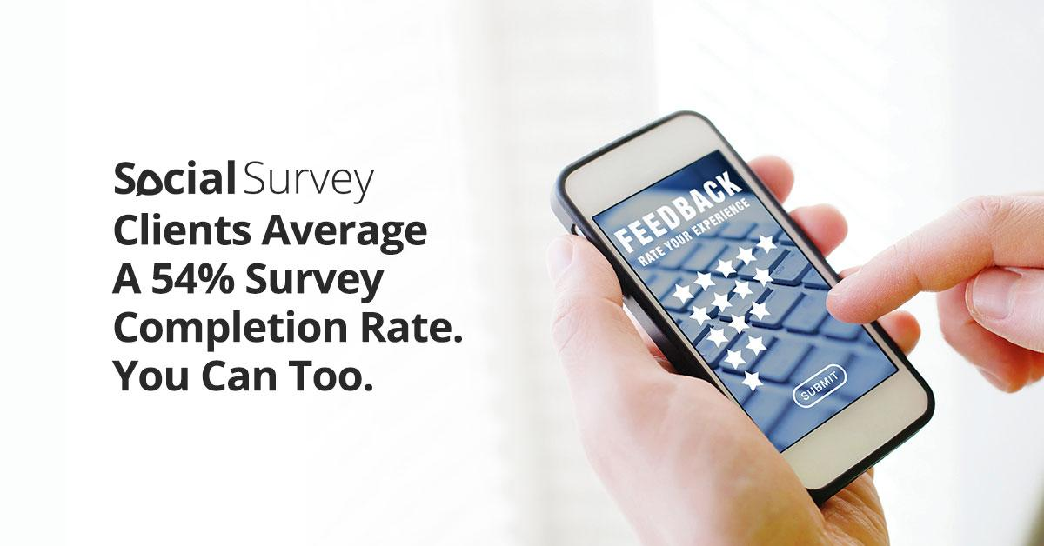
Audit Phase 3 Ads –
LinkedIn, Facebook & Instagram

Slide 15
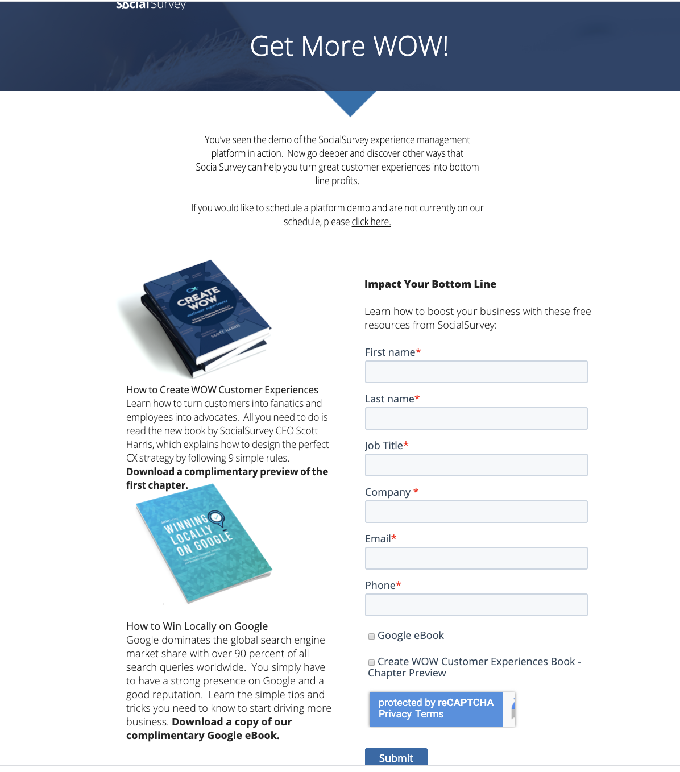
Phase 3 Landing Page Ads

