Slide 1
NAF Case Study
May 2020

Slide 2
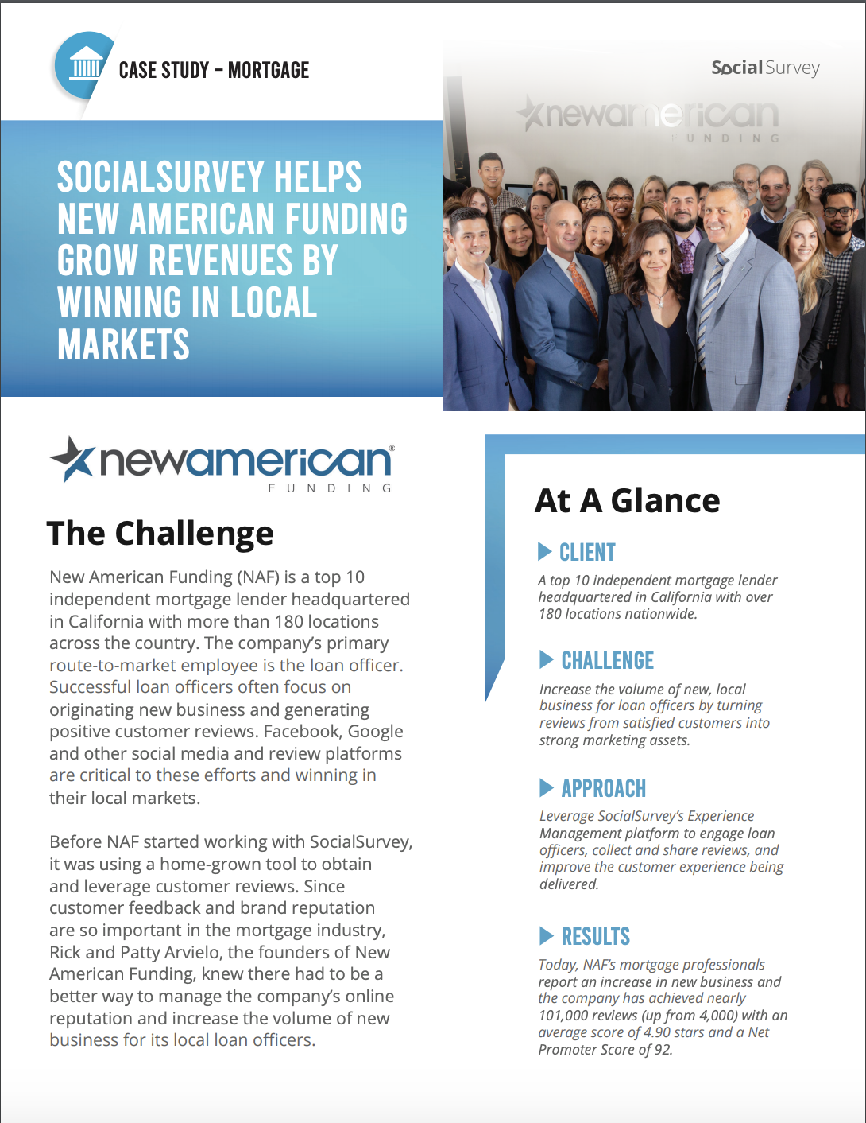
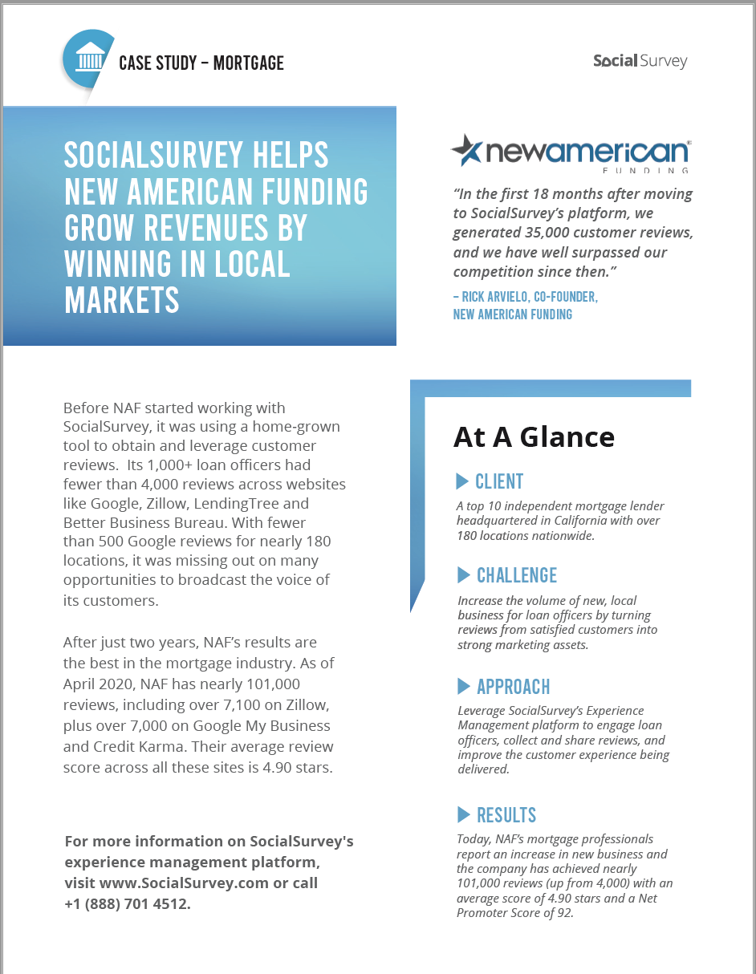
Case Study: Four Pager and One Pager Versions

Slide 3
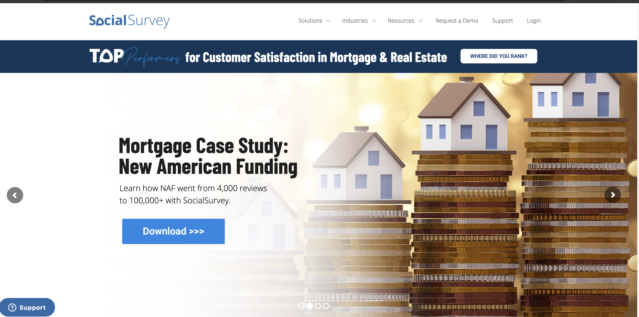
Website Banner:

Slide 4
Demand Generation: Social Campaigns

Slide 5
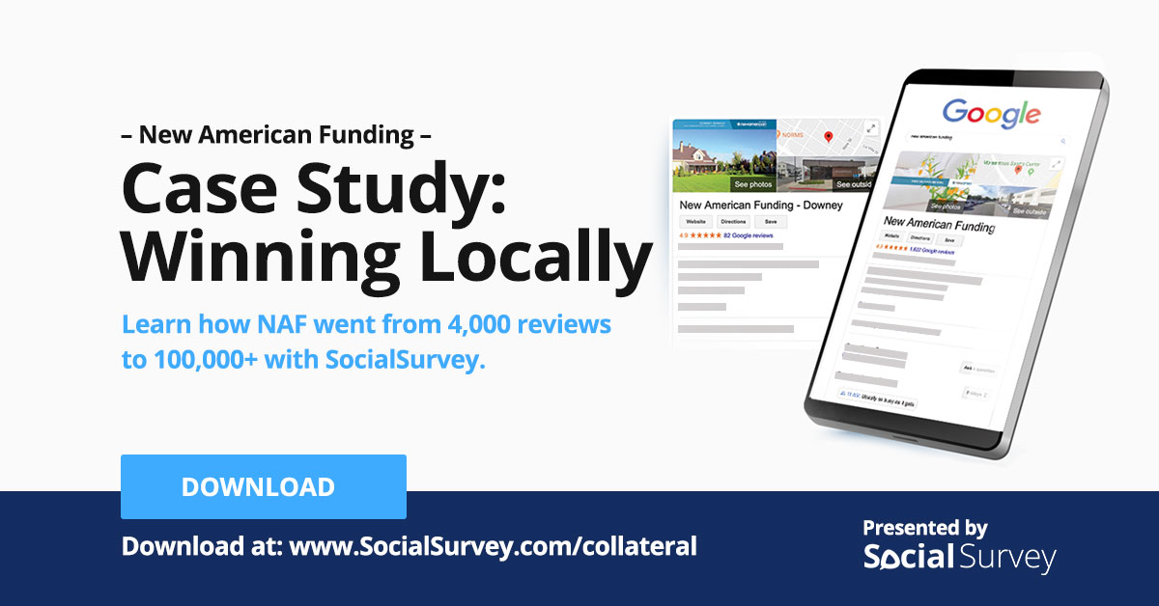
Demand Generation: Social Campaigns

Slide 6
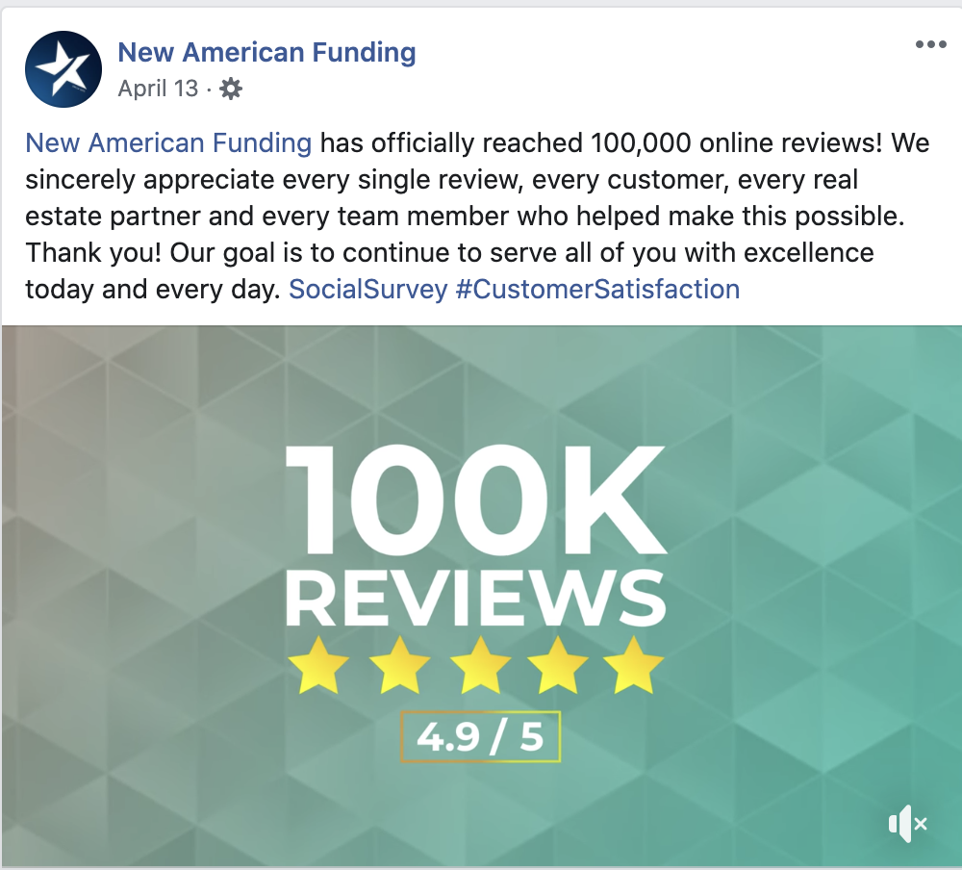
Demand Generation: Social Campaigns

