Slide 1
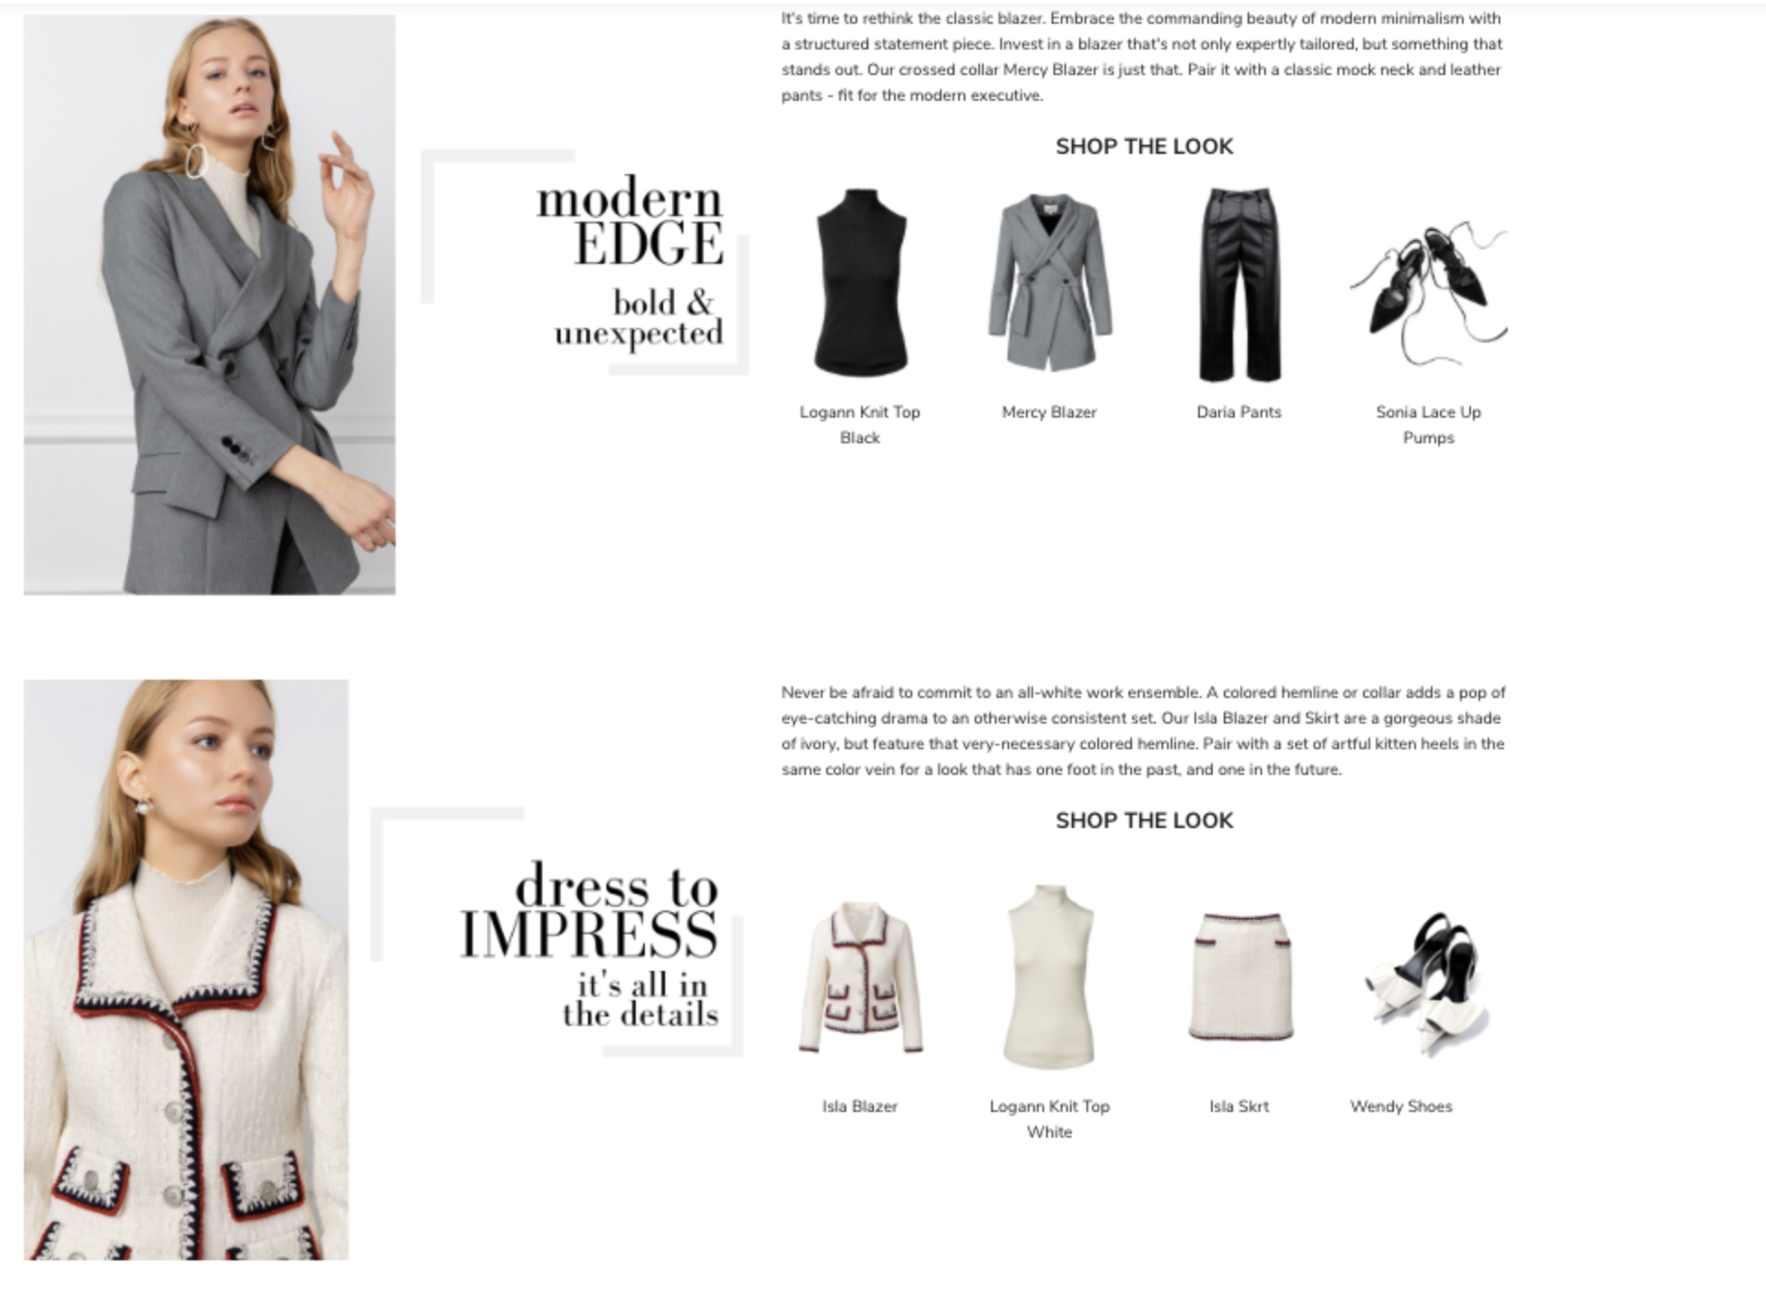
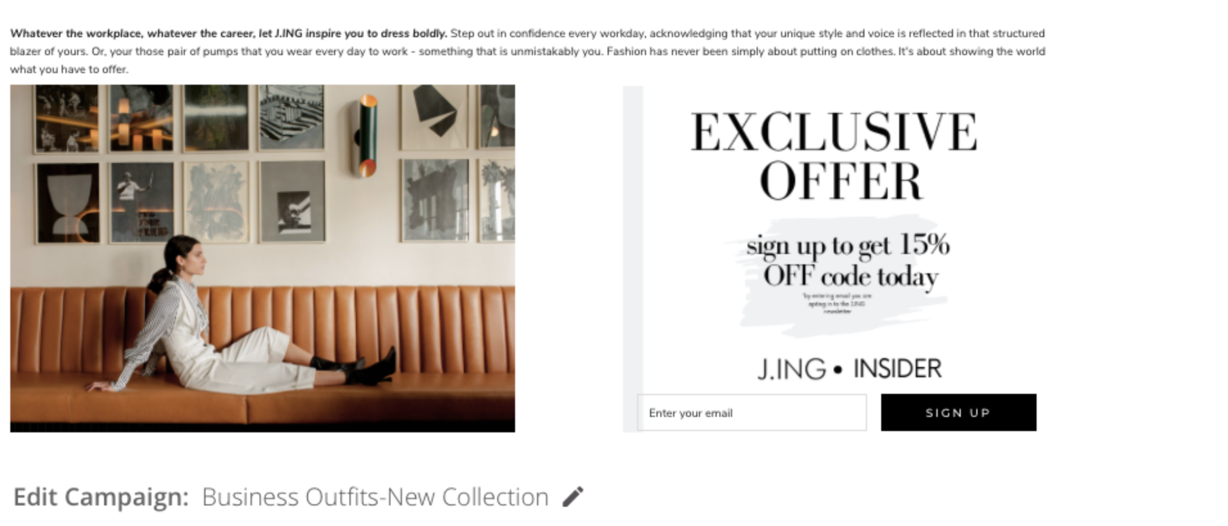
Demand Generation Content Focused To Drive Traffic
Launch Blog on Friday, Feb 8
Launch Social Media – Feb 8
Launch HTML Mailer – Feb 8
*Launch with Shop the Look Sets

