Slide 1


General Meeting
September 12, 2023
Welcome to

Slide 2
Agenda
Welcome and Board Intro
By-Laws
Budget & Treasurer Report
Scholarships
Sponsorship
PTSO Needs
Wrap up and Questions

Slide 3

2023-2024 PTSO Board
President
Inez Austin
Vice President
Brie Dupree Jennie Brown
Vickie Fraser
Treasurer
Kelly Flock
Secretary
Christy Pagano

Slide 4

PTA Meetings: Virtual or In-Person
This is the first of 3 meetings we will have throughout the year.
Each one will have a google meeting link for virtual viewing.
All meeting presentations will also be on our website

Slide 5

Copy can also be found on our website
Click the link below to review
https://rb.gy/pdzby

Slide 6
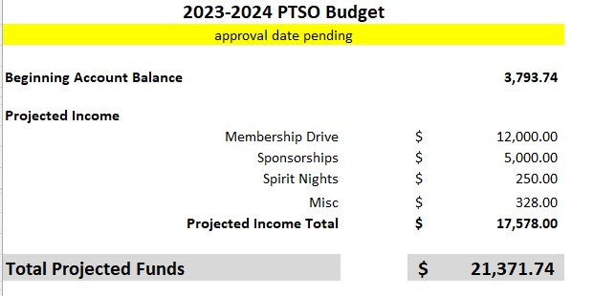
Approve ’23-’24 Budget
Carry over from last year
What a GREAT Start! As needed the budget will be adjusted with membership transparency and next meeting. As of today, we have 310 parent and student members.
Notes:
Jim to give a brief update on expenses

Slide 7
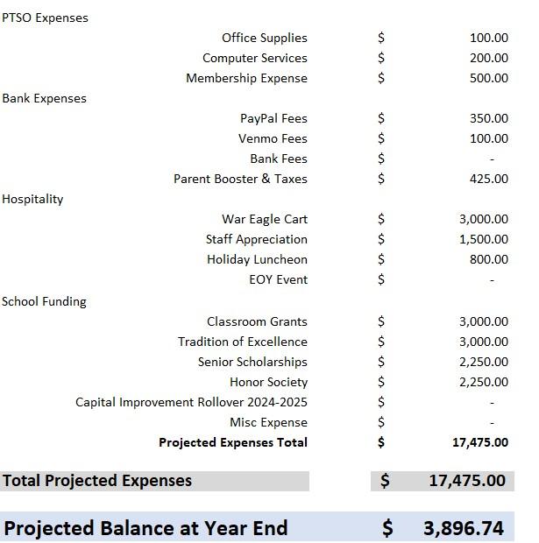

Slide 8


Slide 9

We love our Sponsors!
Please support those business that support our students and staff!
Email ptsosouthforsyth@gmail.com for information on how you can become a sponsor.
https://southforsythptso.com/sponsorship

Slide 10


Slide 11
THANK YOU FOR YOUR SUPPORT!

