Slide 1

Plum Creek Wetland Preserve – Master Planning
July 1, 2021
Tyler Sanderson & Stephen Risinger
Guadalupe-Blanco River Trust

Slide 2

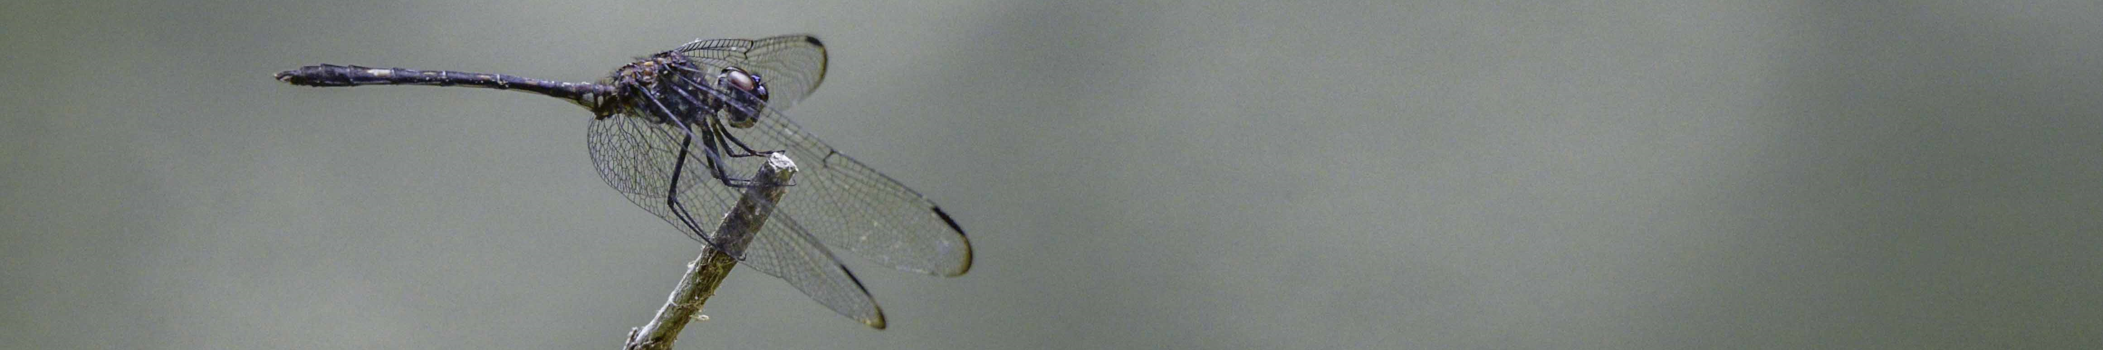
Introductions
History of PCWP
Current state and goals
Why are you on the committee? What will be asked of you?
Action items
Discussion
Meeting 2 scheduling
Closing

Slide 3
P
Plum Creek WP Planning Committee
Joshua Tuck – RTCA Program, National Park Service
John DeFillipo – Director, John Bunker Sands Wetland Center
Cinde Thomas-Jimenez – Enviro Ed. Administrator, GBRA
Jason Biemer – Board Member, Plum Creek Watershed Partnership
Joann Garza-Mayberry – Game Warden, Caldwell County
Lee Rust – Luling City Council / Arborist
Virginia Condie – Executive Director, San Marcos River Foundation
Lockhart State Park
A&M AgriLife Extension

Slide 4
P
Plum Creek WP Planning Committee
Grant Development Services
Gandolf Burrus - President
Latrice Hertzler
Katerina Dittemore
GBRT
Bill Blackwell - President
Oscar Fogle – Vice President
Wilfred Korth – Trustee
Tyler Sanderson – Executive Director
Stephen Risinger – Conservation Manager

Slide 5

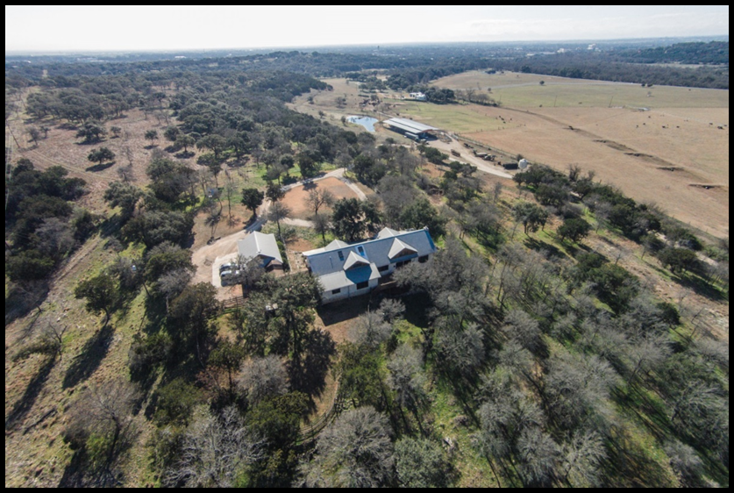
GBRT is a “land trust”
A nonprofit organization whose mission is to preserve natural resources and open space.

Slide 6
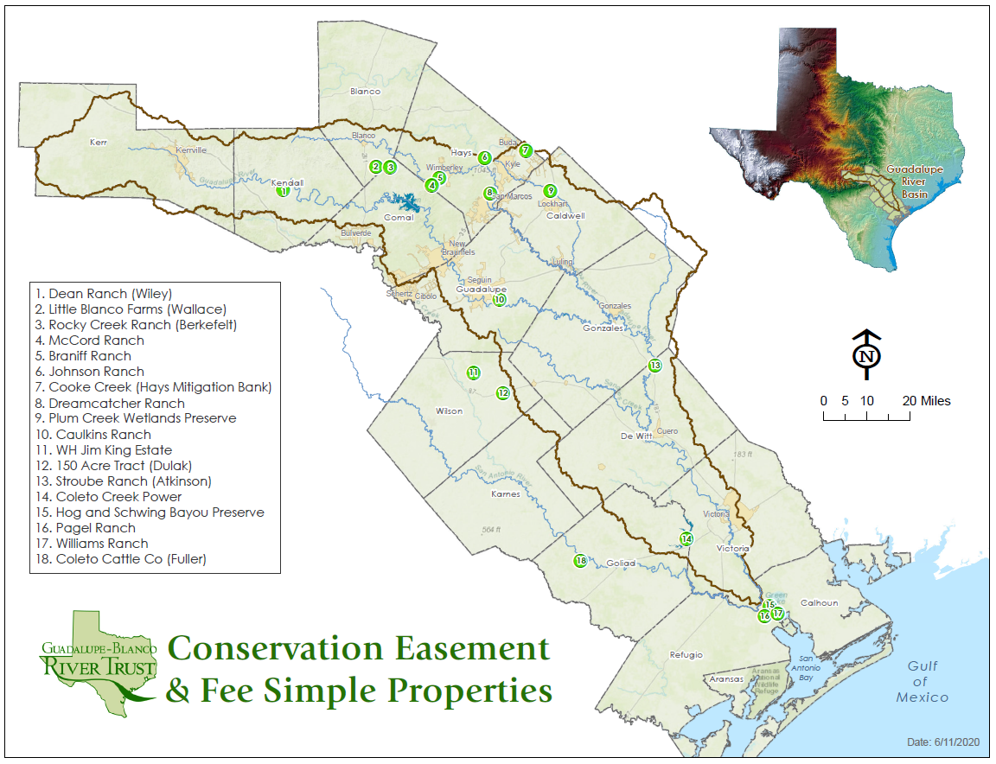
Preserved 11,077 total acres to date:
9,980 conservation easement acres

Slide 7
Benefits of land conservation
Preserve prime farm and ranch lands
Protect water quality
Reduce the impact of urban sprawl
Create recreation opportunities through parks and trails
Protect wildlife habitat and threatened ecosystems
Enhance the quality of life

Slide 8
Benefits of Preserving the Plum Creek Wetland Preserve
Preserve prime farm and ranch lands
Protect water quality
Reduce the impact of urban sprawl
Create recreation opportunities through parks and trails
Protect wildlife habitat and threatened ecosystems
Enhance the quality of life

Slide 9
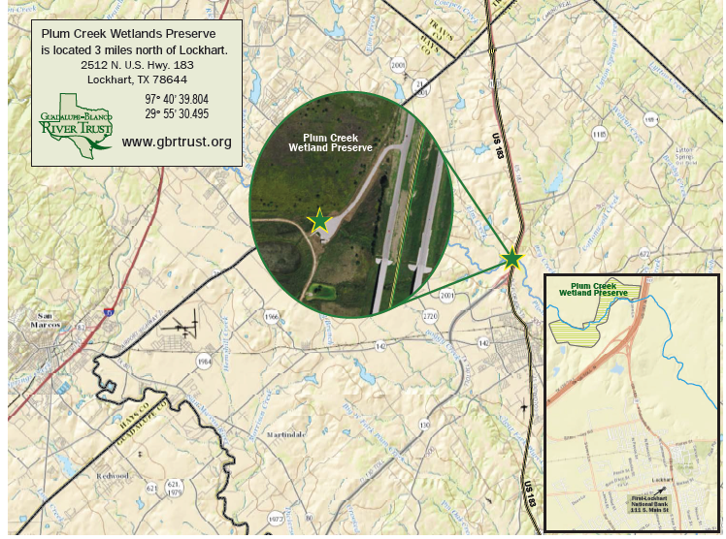

Slide 10
Your Current Perceptions?
What do you know about the Preserve?
What’s the buzz?

Slide 11
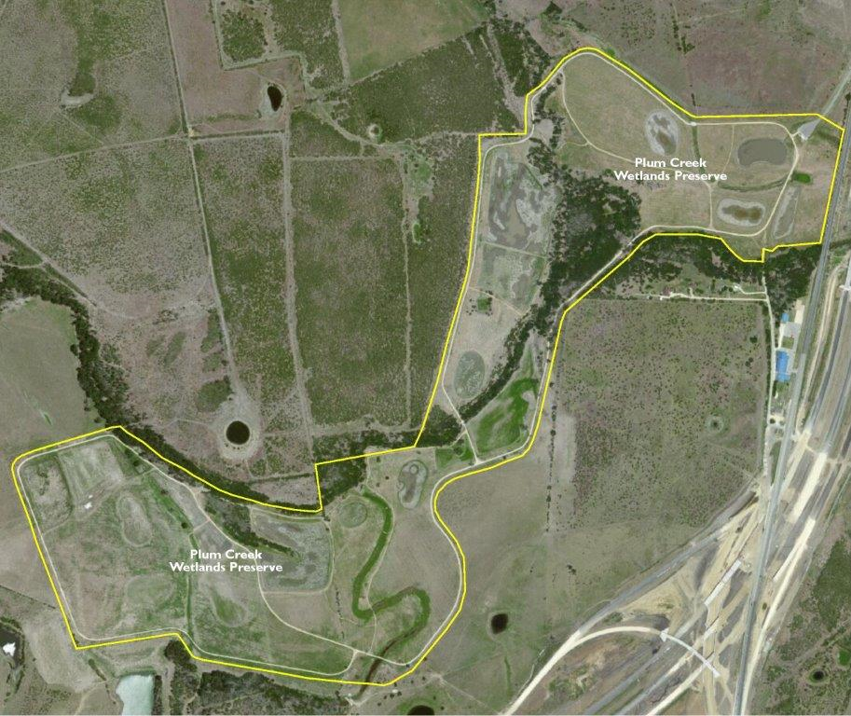
265 Acres
Wetland mitigation site
21 constructed ponds and wetlands
2 miles of Plum Creek
.5 miles of Elm Creek
5 miles of trails
11+ stream crossings
Bathrooms
Entrance and parking

Slide 12
Master Planning – Nature Center
Why are we here?
GBRT is preparing a master development plan to grow into a nature center for environmental education and life adventure.

Slide 13
Timeline of Progress
TXDOT mitigation site identified (2001)
Mitigation Plan approved / construction begin (2008)
Mitigation construction complete (2009)
Project met all terms / monitoring complete (2013)
TX Dot transfer (2014)
Survey & Plat Resolution (2015)
Conservation Deed Recorded (2016)
ANCA Visit (2016)
Conservation Easement complete (2016)
PCWP Planning Committee
  Meetings (2016)

Slide 14
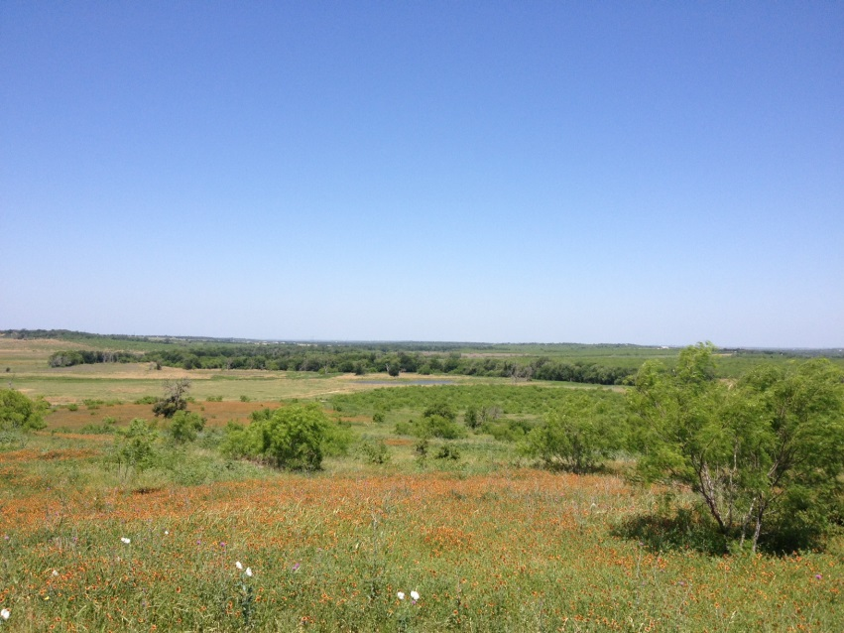
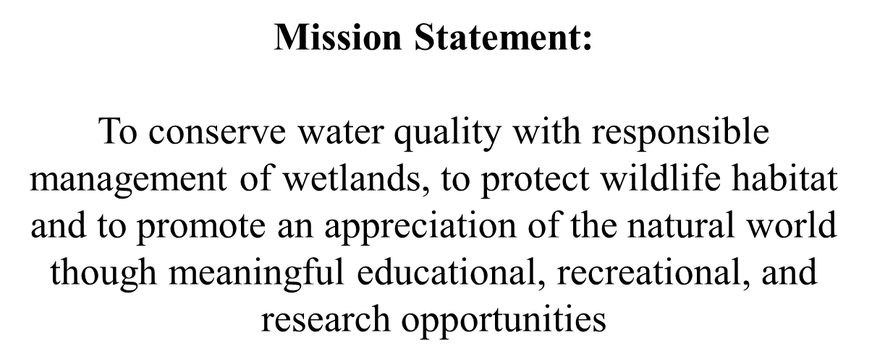

Slide 15
Primary Management Goals
Protect, maintain and enhance the wetland, riparian and additional wildlife habitat on the property
Provide appropriate outdoor recreational opportunities while protecting the conservation values of the property
Provide scientific and educational opportunities related to wetlands, wildlife and conservation

Slide 16
Prohibited Activities
Destruction of Plants and disturbance of natural habitat, other than invasive species
No soil dumping
No change in topography
No structures unless approved – this includes hunting blinds and agriculture
Roads are not to be impervious. No new roads on property. No construction of roads, trails or walkways
No altering or manipulating water course
No off road vehicles unless for maintenance or monitoring
No signage except those whose placement, number, and design do not significantly diminish the scenic character
No grazing unless for limited time for vegetative control

Slide 17
Timeline of Progress
Management
Grants and Support
Management Plan
Cattle lease
ReLeaf plots
Chinaberry removal
Managing trails
Monthly monitoring
Hog eradication
Trail cams – Security
Trail cams – wildlife
Land Trust Alliance
National Park Service
UTSA Designs
TX State Marketing
TPWD trails

Slide 18
Goals for GBRT – What are we planning for?
GBRT is preparing a master development plan:
Nature / Welcome Center
Environmental education and life adventure
Public Attraction
Managed access
Research
GBRT’s Outreach and Education Hub

Slide 19
What is the committee and why are you on it?
Public input from targeted key stakeholders
Knowledgeable individuals with varied perspectives
Provide guidance and establish goals for the Plan
Technical assistance and occasional between-meeting requests, if needed
Review of Master Plan draft phases

Slide 20
What is the commitment?
Anticipated schedule
Meeting 1: Orientation (July 1, 2021)
Meeting 2: Discussion of background information and establishment of targeted activities (July/Aug 2021)
Meeting 3: Further committee input and discussion (August 2021)
Recess to research and create a draft plan
Meeting 4: Review of first stage Master Plan (2022)
Meeting 5: Review of final stage Master Plan (2022)
Meeting 6: Final Clean up (Target = Sept 2022)

Slide 21
How do you start?
SAVE THIS LINK – gbrtx.org/pcwp-links
Visit the site and review download material
Begin thinking creatively
Come to meeting 2 ready to discuss

Slide 22
Discussion
Who are we trying to serve?
Will we be open to the public at all?
Are there threats or opportunities with neighboring property?

Slide 23
Meeting 2
Get on site
Meeting room nearby in Lockhart
Approximately 3 hours?
When are the next two meeting target dates
Don’t forget about ReLeaf

Slide 24
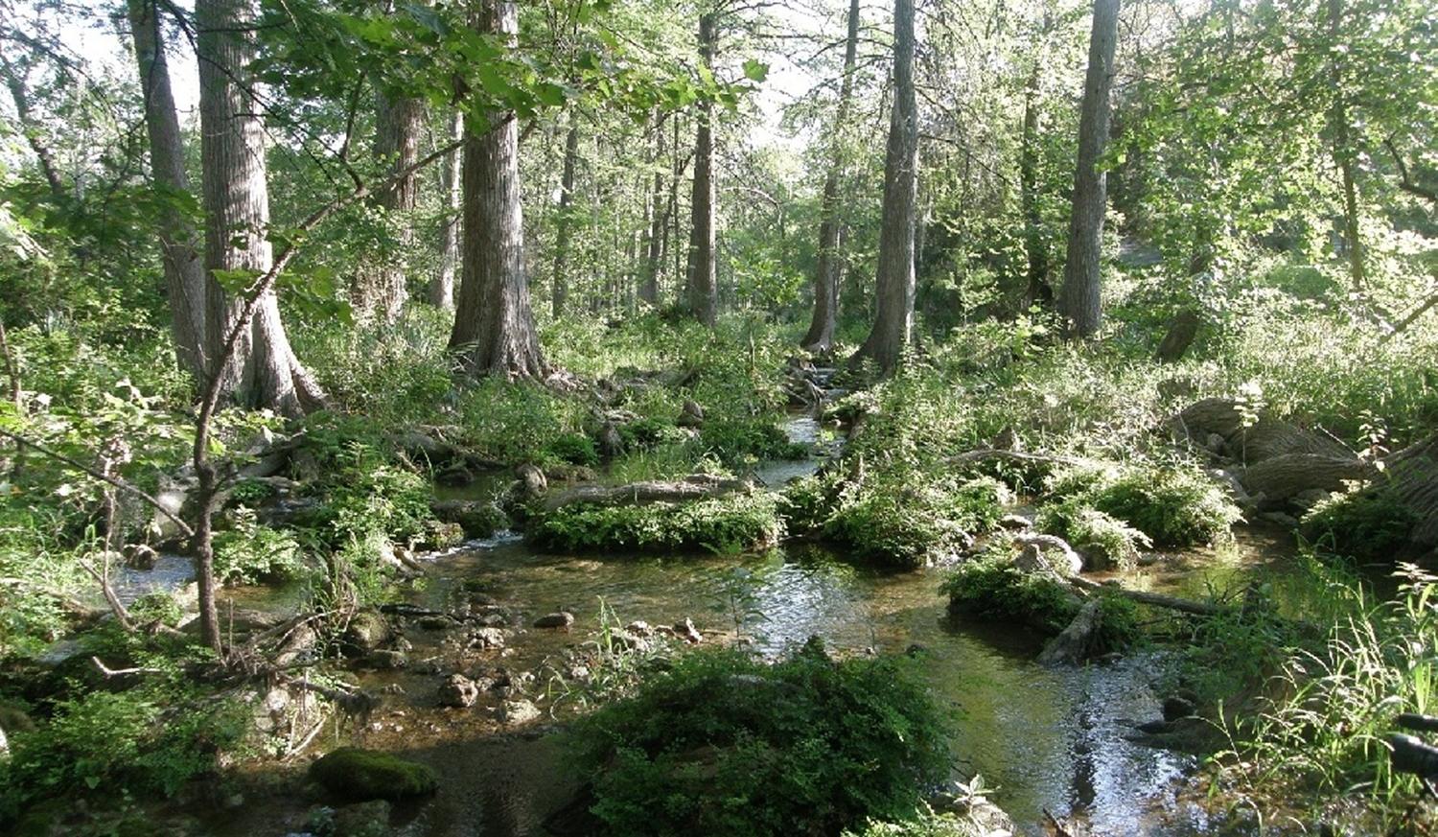


Tyler Sanderson, Executive Director
tyler@gbrtx.org
Phone: 830.305.6873
Stephen Risinger, Conservation & Stewardship Manager
Stephen@gbrtx.org
Phone: 830.632.2292
Like us on Facebook
Follow us on Instagram: gbrivertrust
www.gbrtx.org
Questions?

