Slide 1
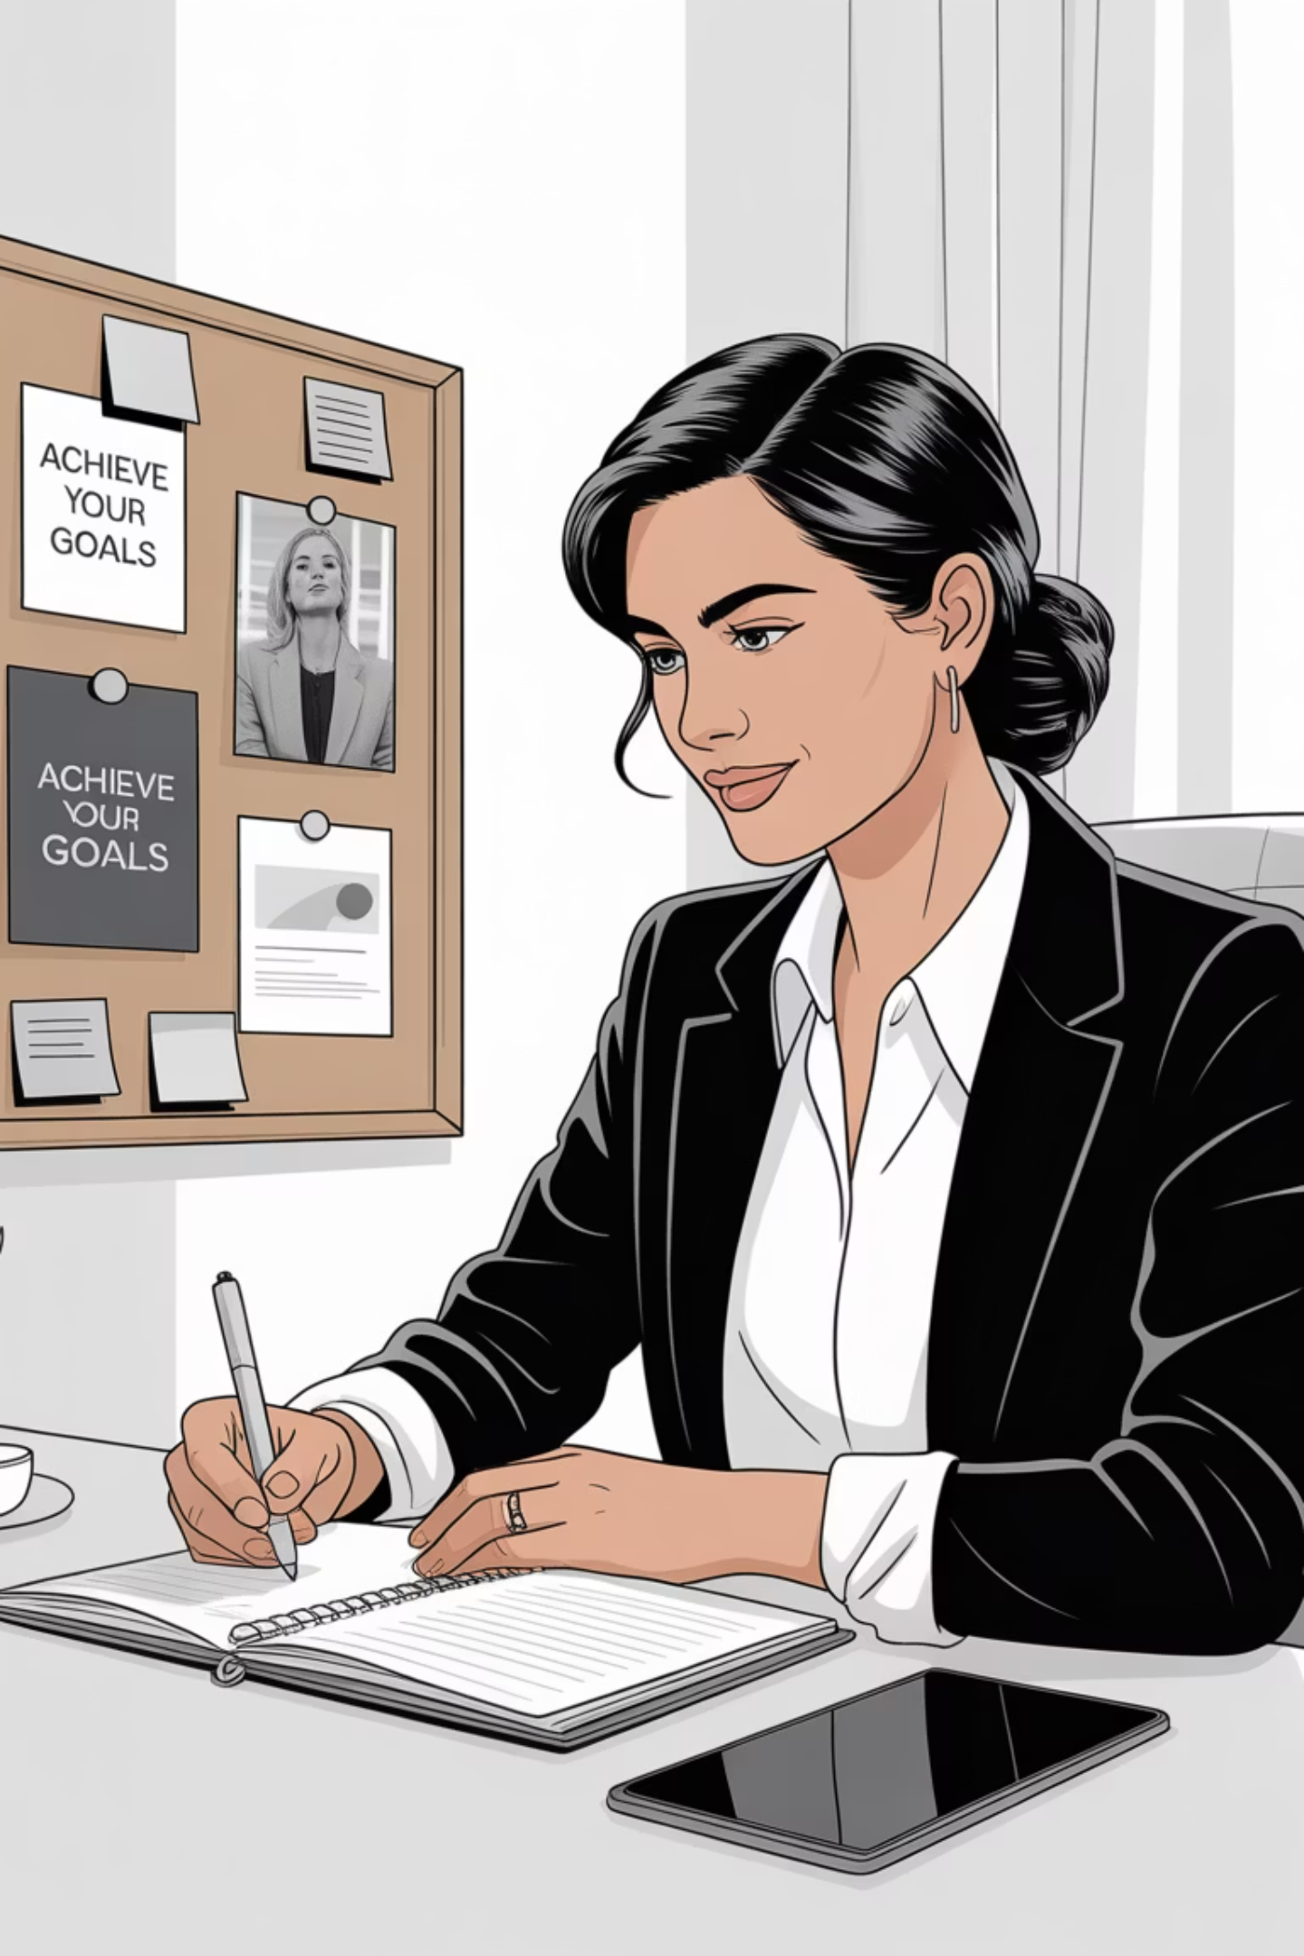
Tricking Your Brain for Business Success
Overcoming Mental Barriers in Entrepreneurship
By: Dr. Stevie Pena

Slide 2
The Battle Plan
1
Your brain's current state
2
What your brain WANTS to do
3
What YOU want your brain to do
4
How to win this battle

Slide 3
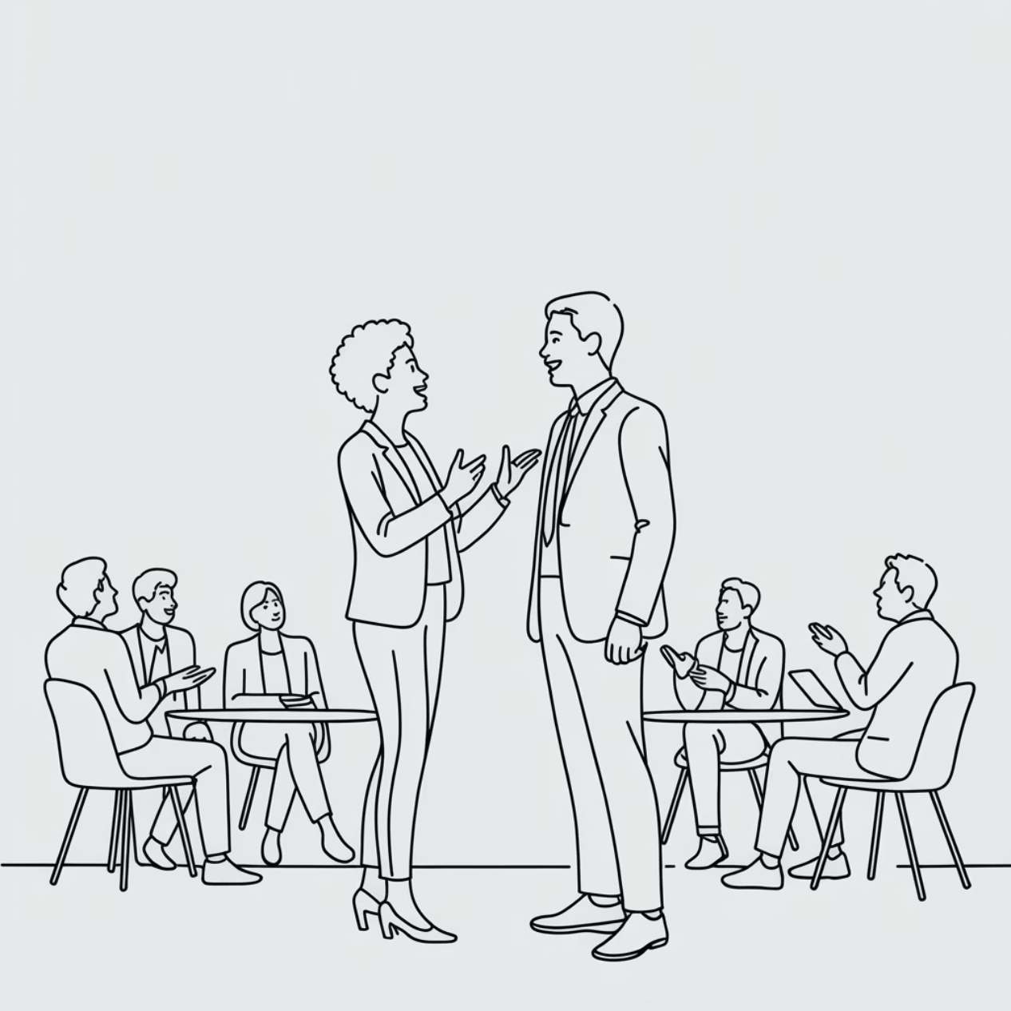
Why We're Really Here
Networking
Chase trends & strategies
Get that motivation boost
Start exciting new ventures
You're already ahead - the faint of heart don't show up!

Slide 4
We've All Been Here Before
PUMPED UP!
1
Amazing speakers! Great plan! We're ready!
2
2-4 WEEKS
Enthusiasm fading...
6 WEEKS
3
Back to square one
This time is different... right?

Slide 5
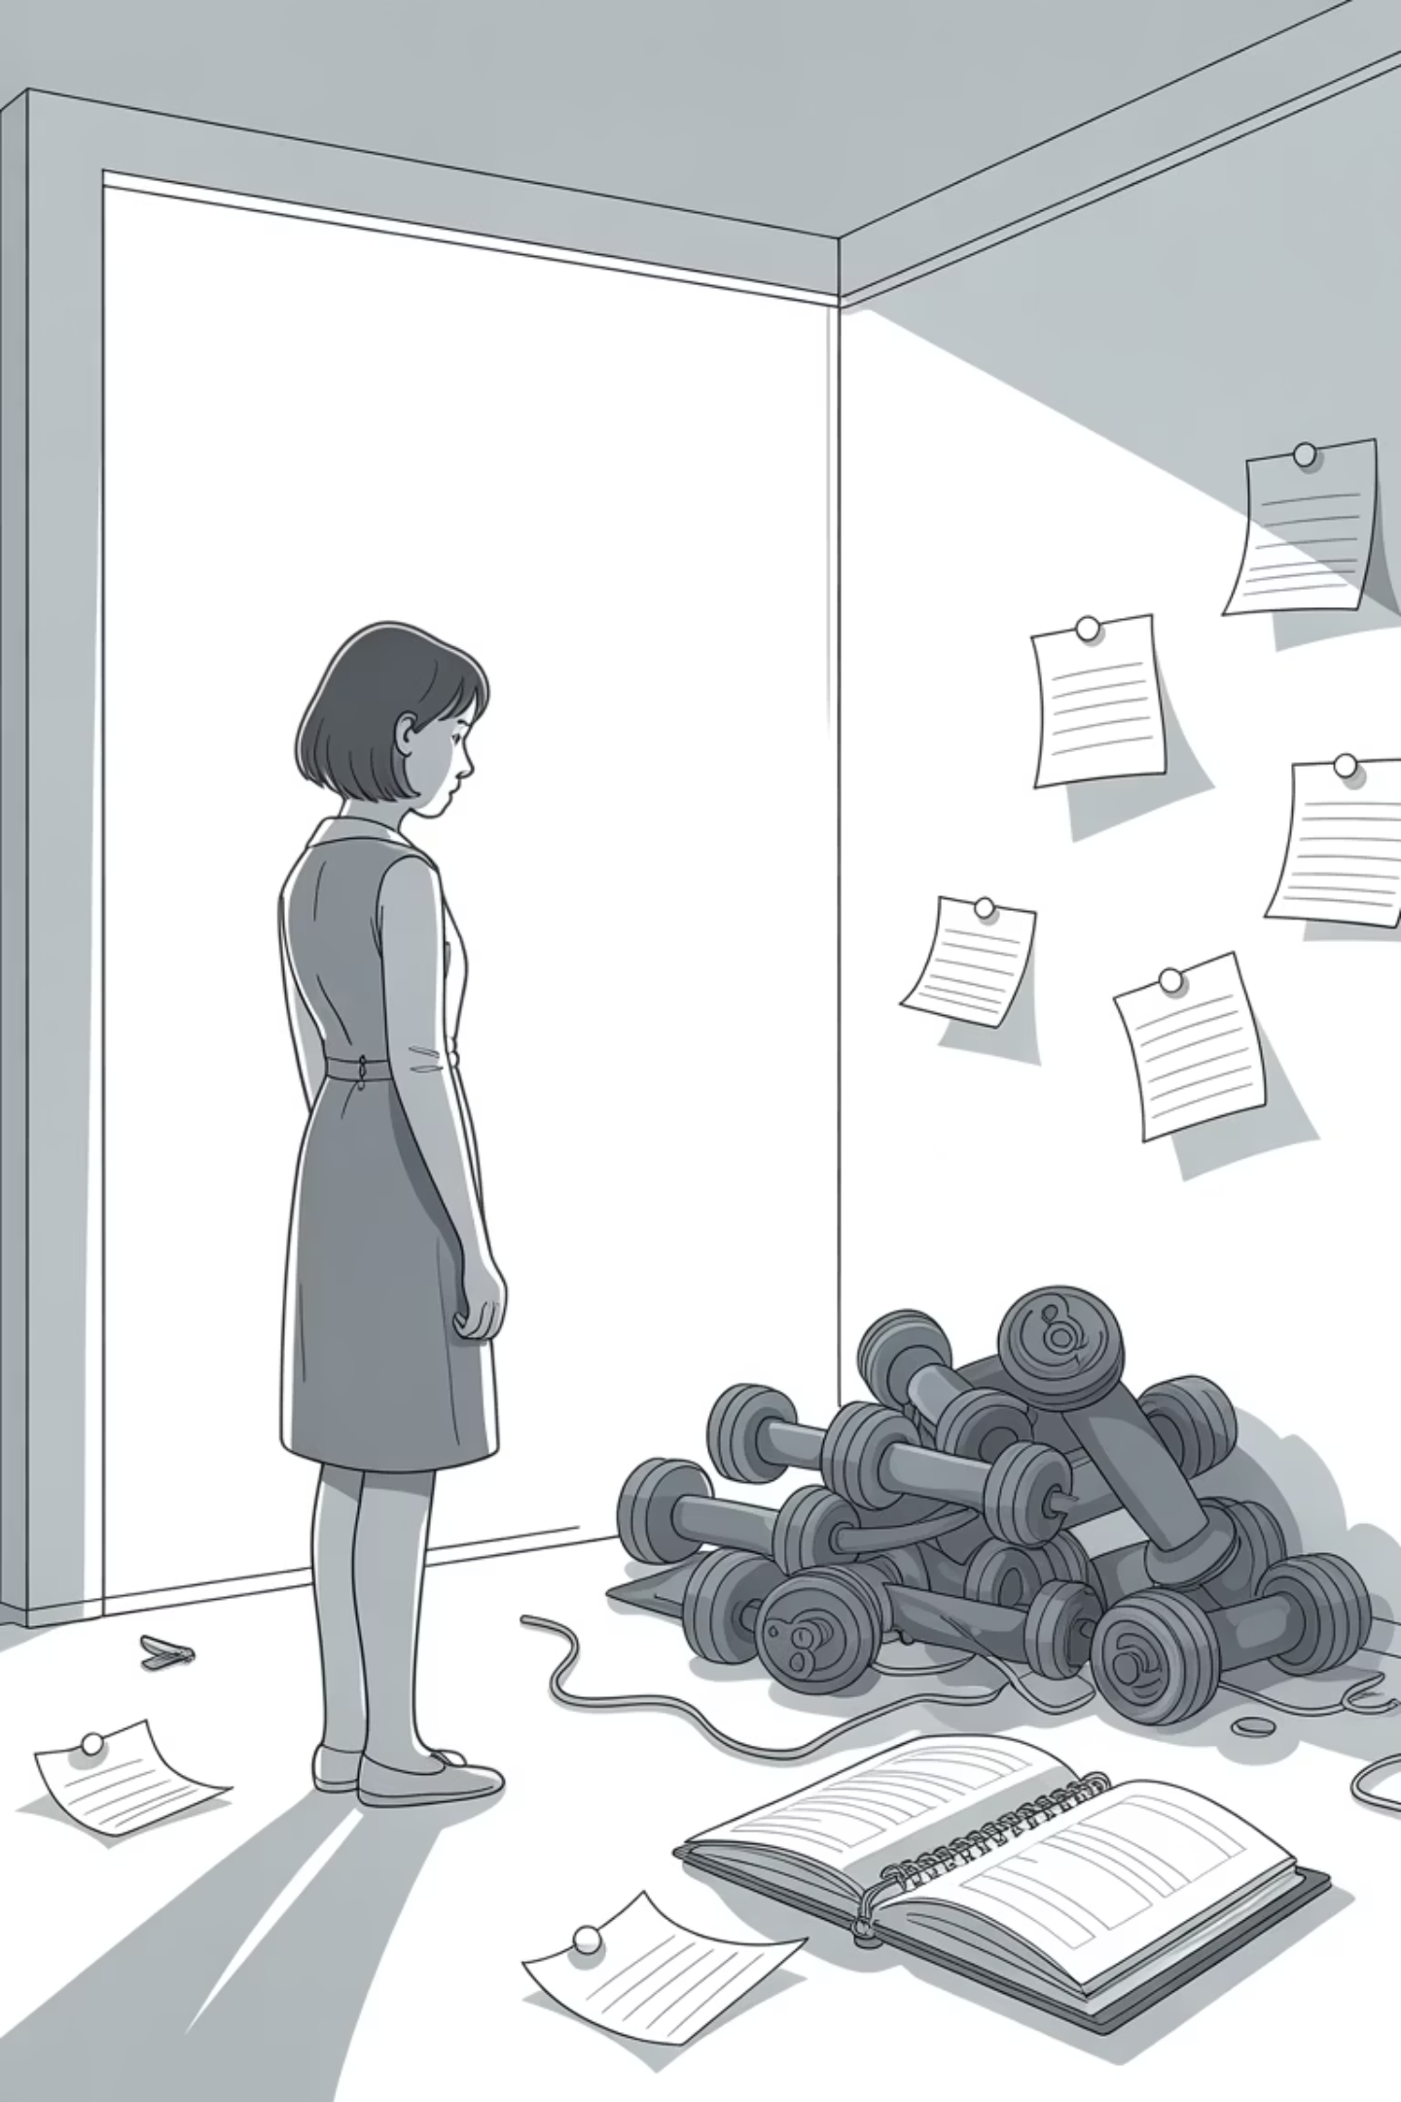
The New Year's Resolution Crisis
This time, something's going to stick.

Slide 6

Your Brain's Hidden Agenda
LAZY
1
Prefers status quo. Less effort = better.
PROTECTIVE
2
Perceives change as danger. Keeps you "safe."
This is what you're fighting every single day.

Slide 7
The Sabotage Toolkit
Imposter Syndrome
Fear of Failure/Success
Perfectionism
70% of business owners feel it
Both require energy & change
The ultimate avoidance tactic
"What I do is easy. Anyone could do it."
"Why even try? Let's just stay safe."
"If it can't be perfect, why start?"

Slide 8








Habit > Willpower
Safe
Low Energy
Your brain doesn't fight established routines
Requires minimal mental effort to maintain
Start Small
Add, Don't Create
One or two regular actions, build over time
Build on existing patterns, don't overhaul

Slide 9
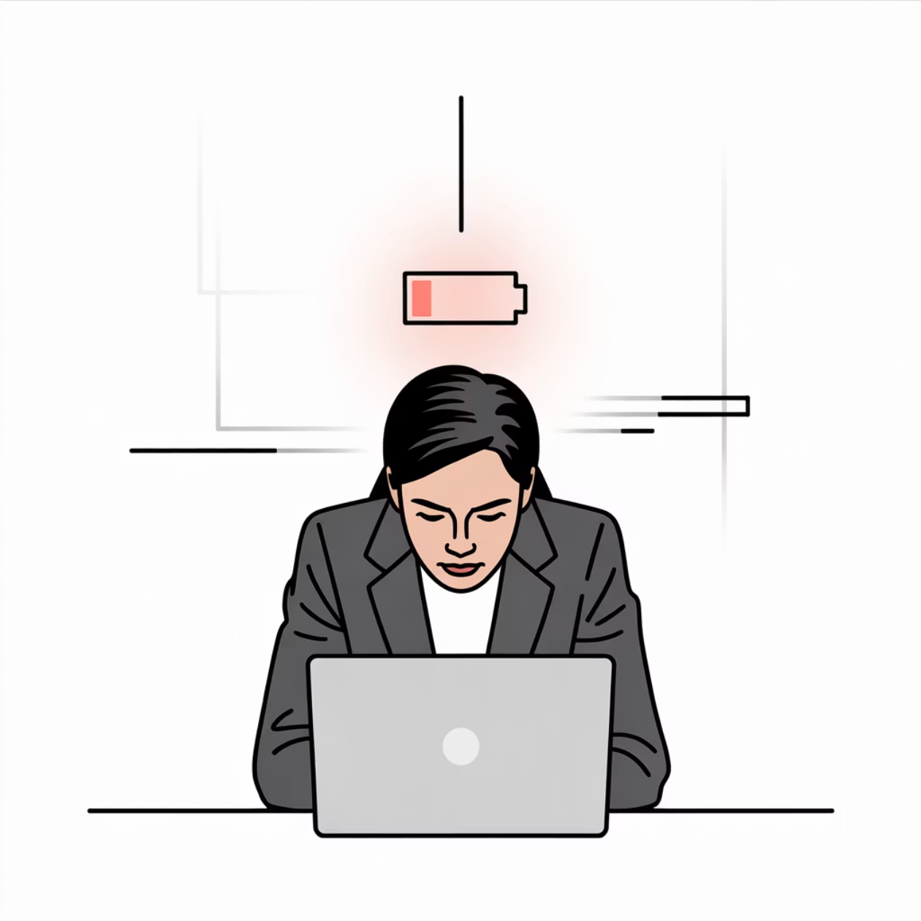

Willpower Is Finite
It's exhaustible. Once depleted, it's gone.
Relying on willpower alone = burnout

Slide 10

Find your WHY

Slide 11
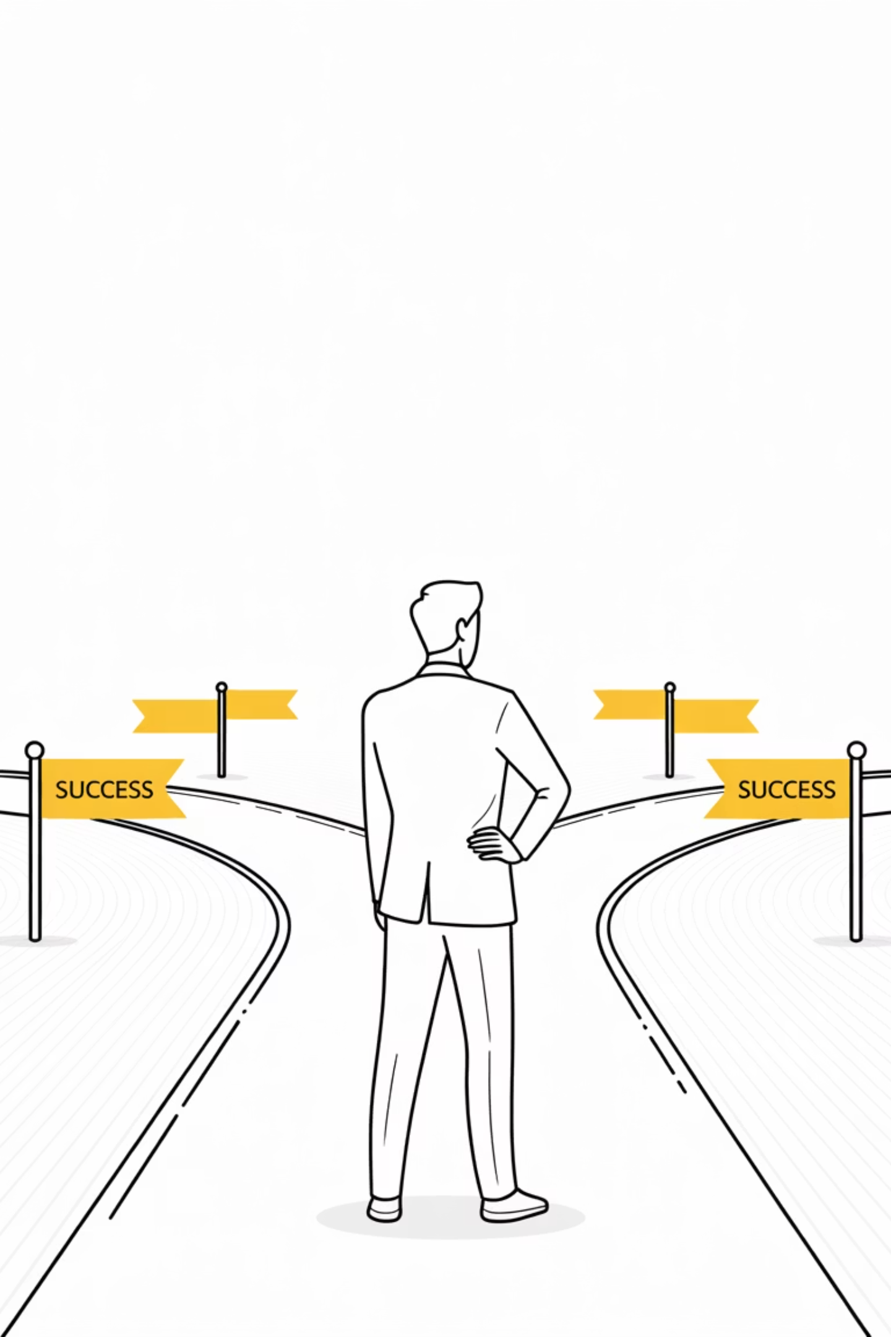
Be Specific About Your Destination
When temptations arise, ask:
"Is this getting me where I want to go?"
If not, don't do it.

Slide 12

Break It DOWN
ACTUAL PROGRESS
BREAK INTO PARTS
You'll know you've succeeded when you start moving
BIG SCARY GOAL
Make them small enough to feel doable
Result: Productive procrastination elsewhere
If you're not working toward your goal, the parts aren't small enough.

Slide 13

Your Secret Weapon: PEOPLE
Tell people your plans
Reach out regularly
Give support to get support
Find your community and USE IT
(It's NOT getting the new certification, taking the latest class, or buying the perfect gadget)

Slide 14
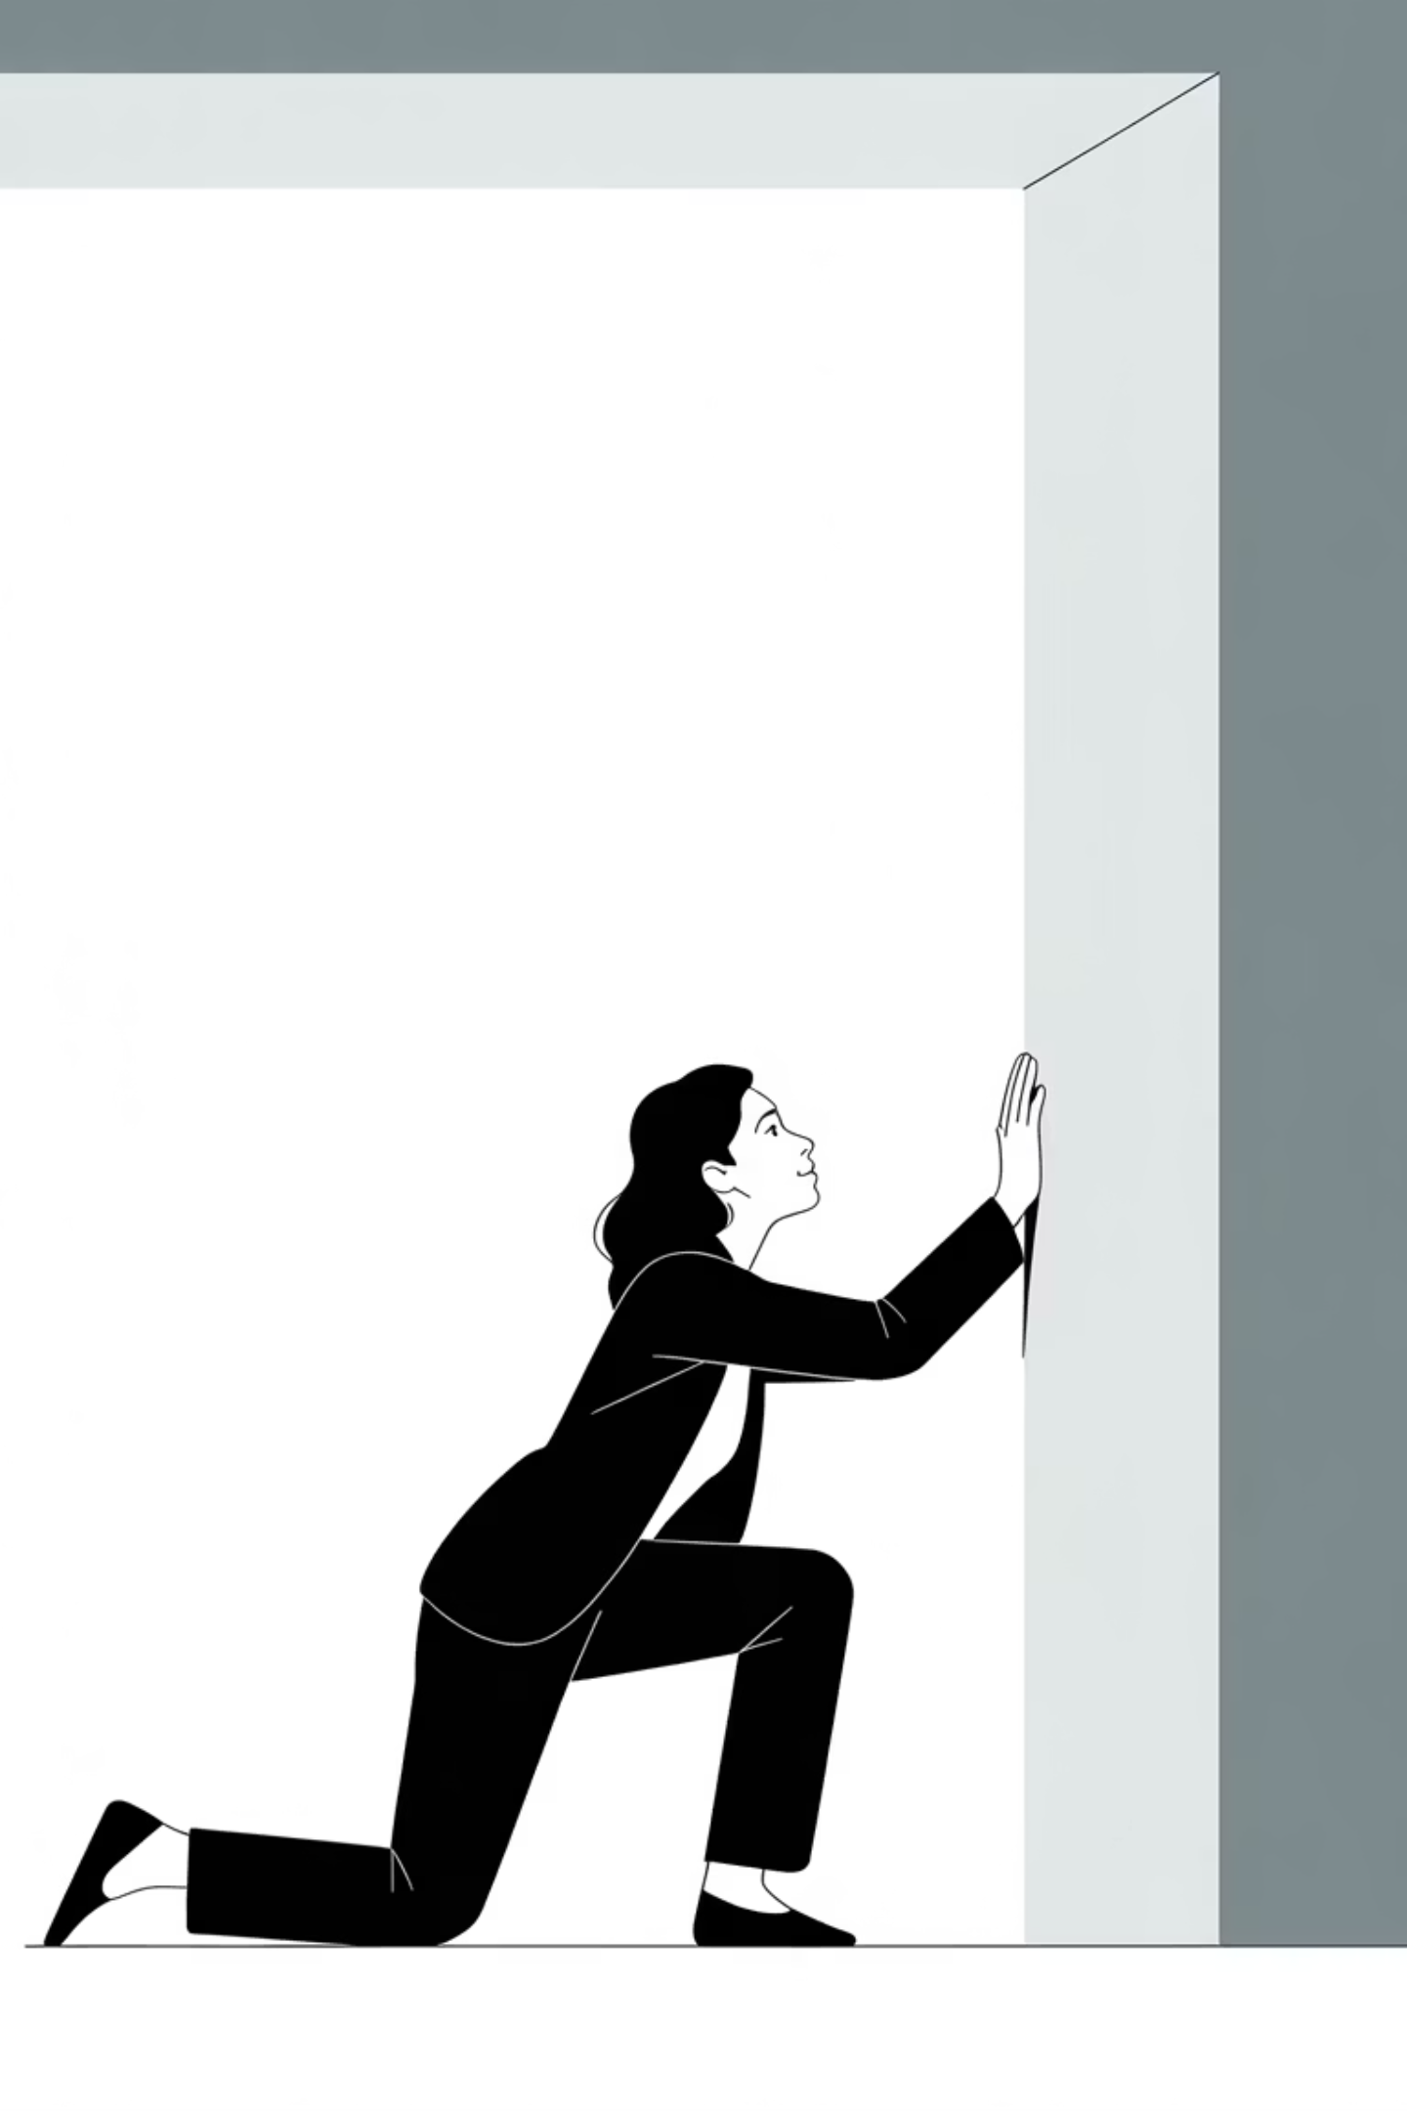
When You Fall (and you will)
Take 1-2 days max
Then get back to it
  Take a deep breath and go
  Count down from 5
Rewire your brain through consistency
Success is like melting an ice cube in a large room. It takes a lot of heat, but you won't see results right away.
People quit before the cube melts.

Slide 15

Embrace Your "Impostor"
"Yes, you're an impostor. It won't last. Enjoy it!"
"Are you calling your customers dumb? They chose YOU!"
"EVERYONE feels it. You're not special in your doubt."
There is no other YOU out there. Your customers are not fools.
Now let's fix this so you can do all the exciting things you came for...

Slide 16
Sustainable Success Tricks
MOTIVATED
FOCUSED
RESILIENT
Your "Why" - make it strong & tell everyone!
Know your goals. Publicize them widely.
Working through hard stuff makes you great.

Slide 17
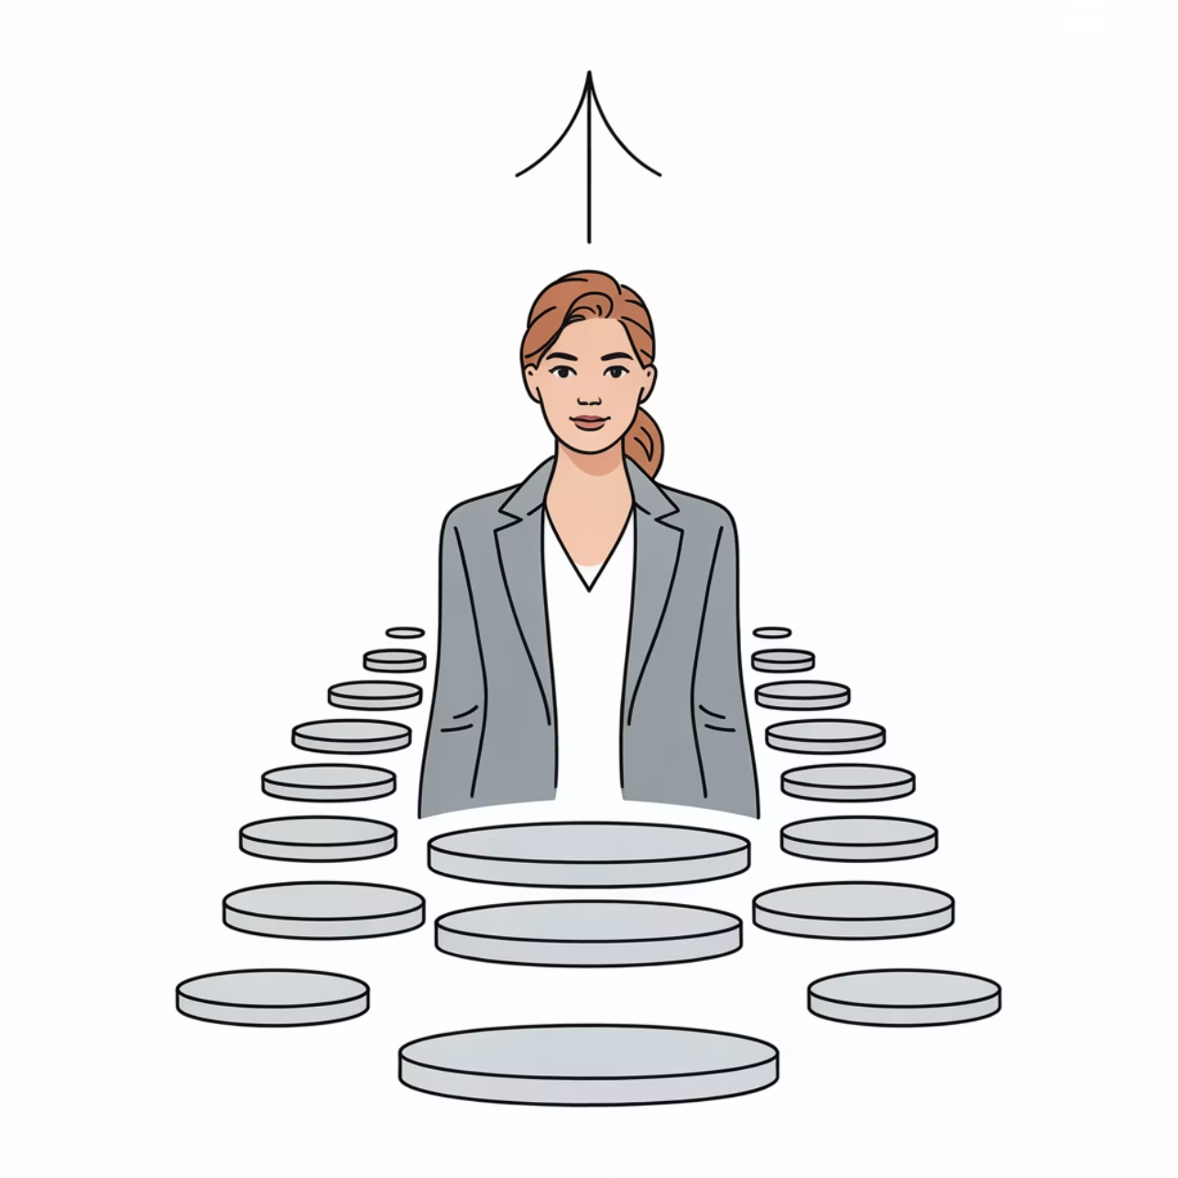
You Have What You Need
Entrepreneurship isn't just strategy and networking—it's overcoming mental barriers that block execution.
Success requires:
Patience with yourself
Clear destination
Shared journey
You've got this.

