Slide 1
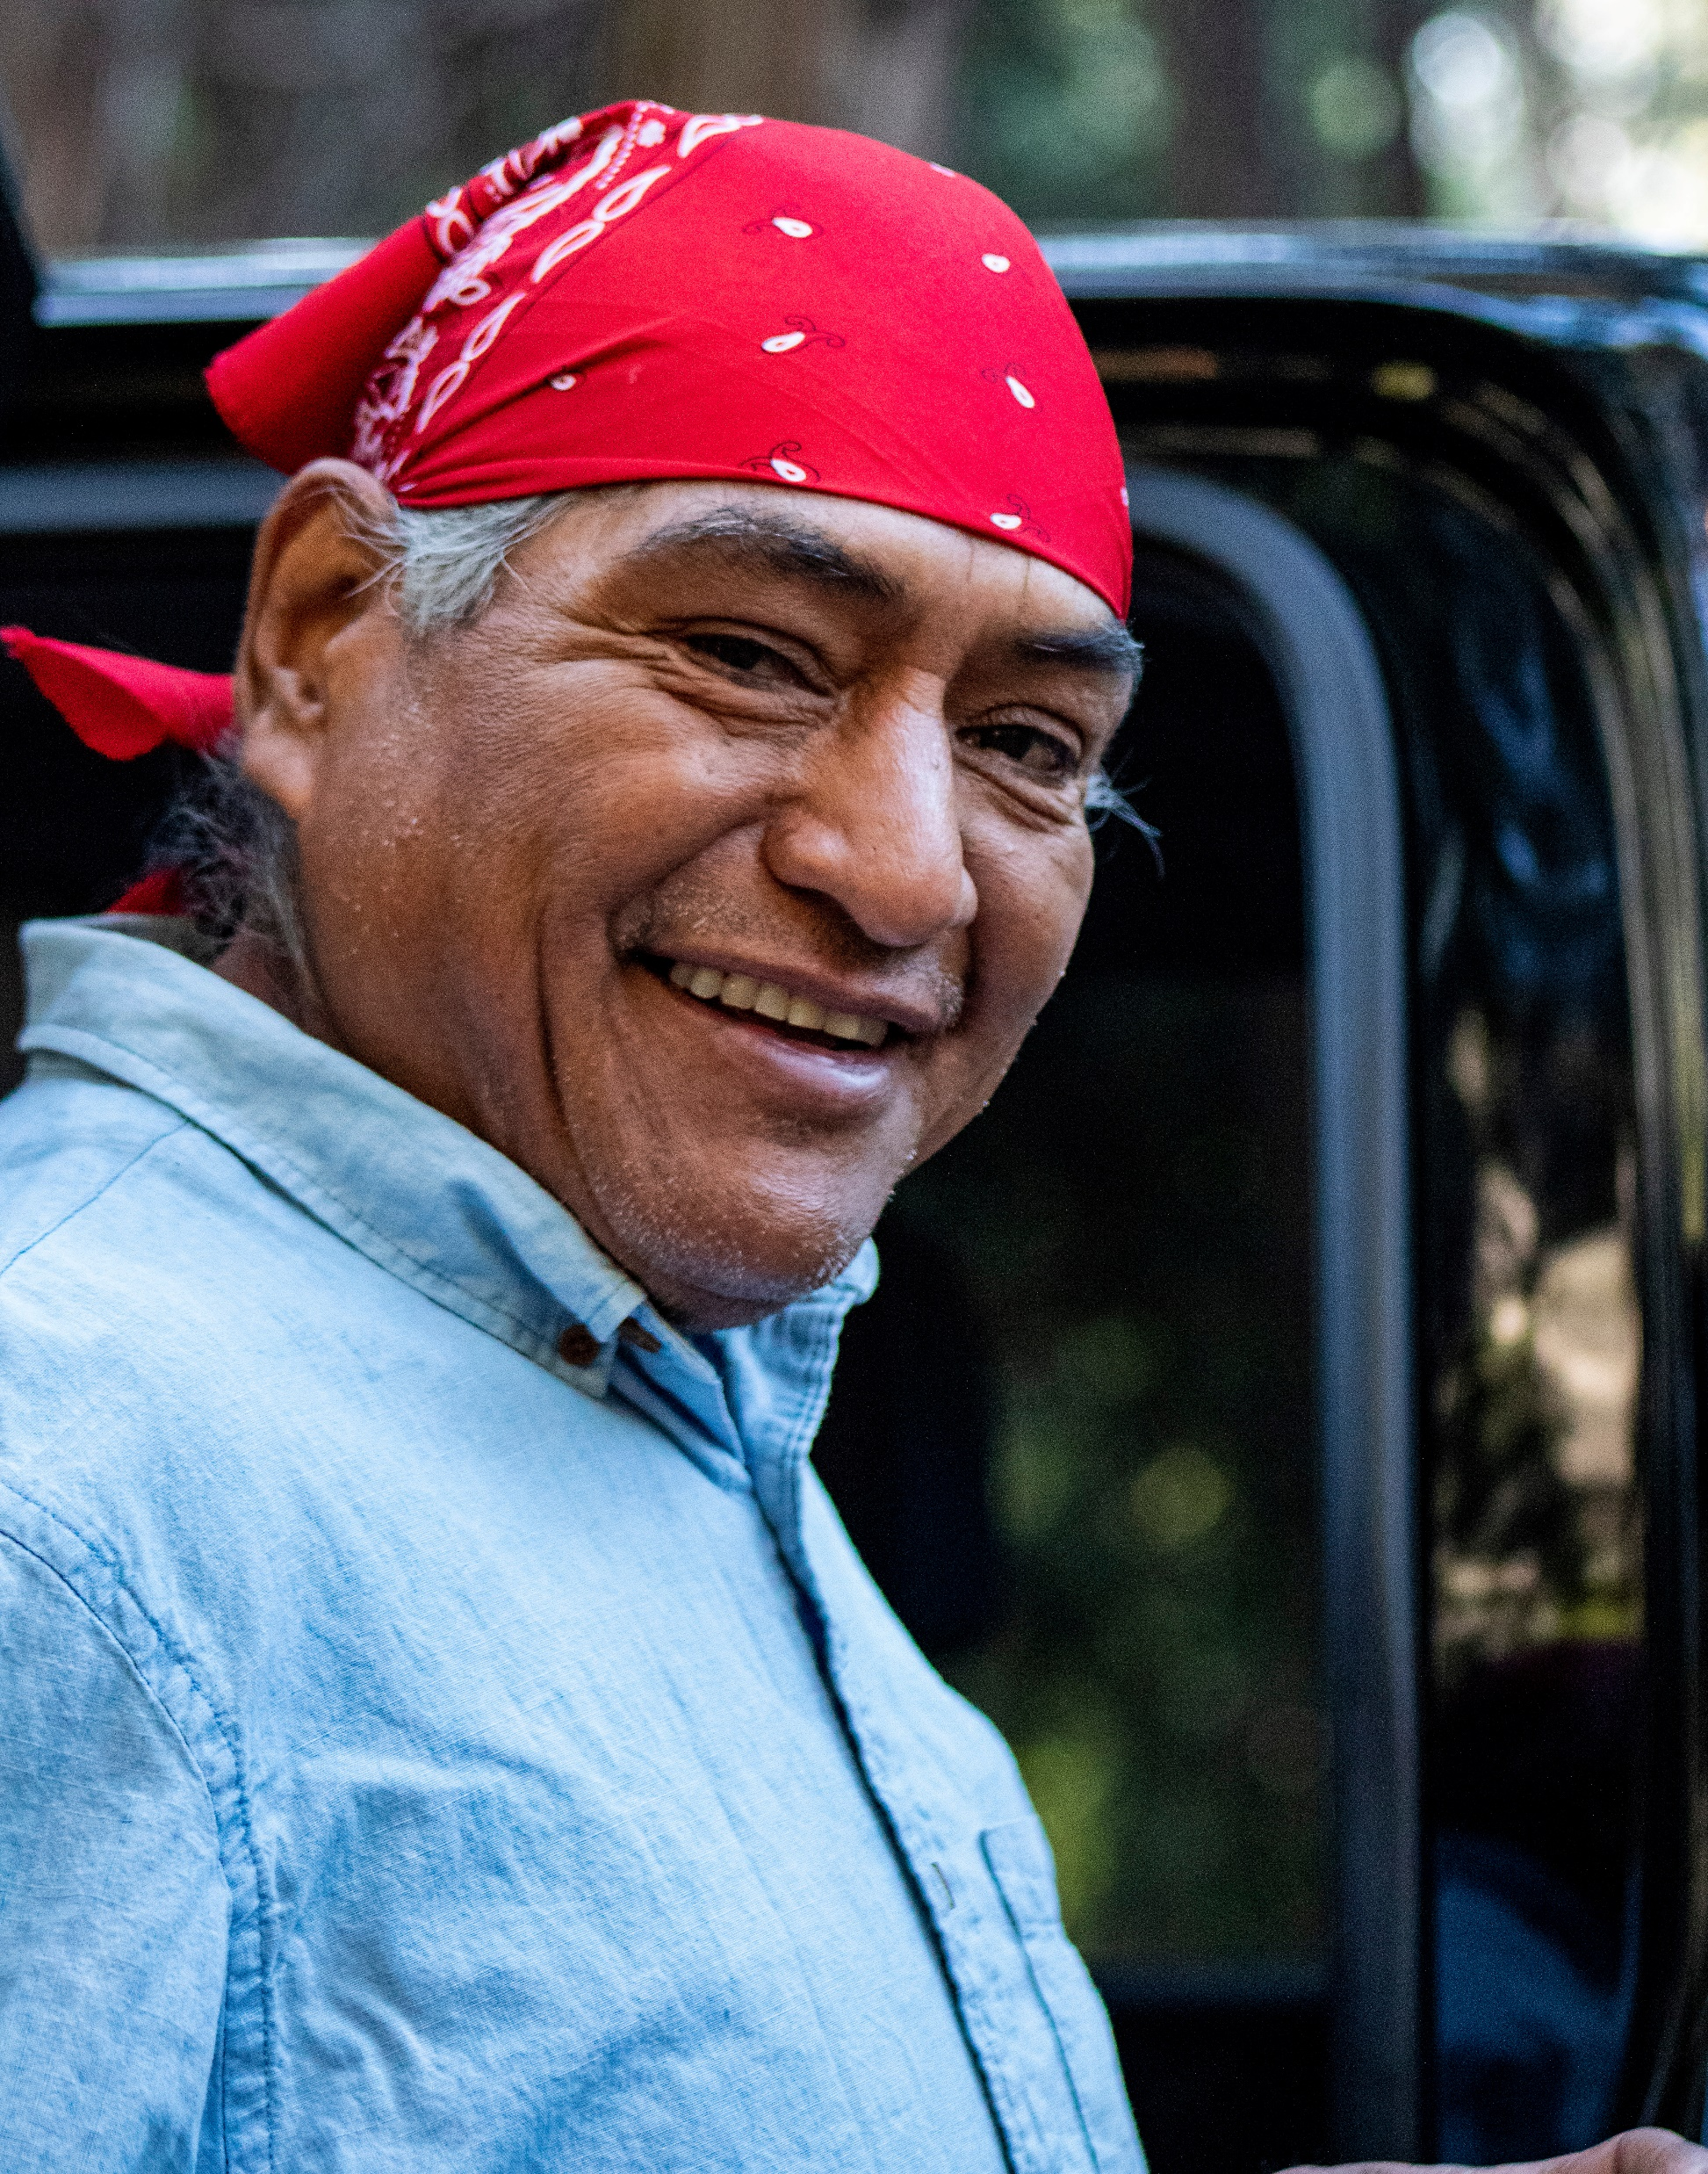

Talking about opioid medications
Learn more about…
Caregiver:
“I’ve noticed you seemed extra tired lately and skipped coffee with your friends.
Adult:
“I guess I’ve just been a little off. Maybe it’s the weather.”
How to talk about opioid misuse
txopioidresponse.org/
how-to-help-someone
wapc.org/programs/education/
older-adult-medication-safety
Naloxone and overdose info
stopoverdose.org
Opioid use disorder and treatment
Older adult medication safety
learnabouttreatment.org
Medication management
aarp.org/pri/initiatives/
home-alone-alliance
Safe medication return
medtakebackwashington.org
Non-opioid pain management
voices.uchicago.edu/icope/
at-home-treatments
Step 1:
Share an observation
Step 2:
Share an emotion and be curious
“I’m sad that you haven’t seen your friends. I also wonder if your pain medicine might be making you feel more tired.”
“Maybe. I’ve been taking my pills the same as always.“
“Susan’s dad had trouble keeping track of his pills. Have you had any trouble like that?”
“Sometimes I forget if I took it already. I do feel off, but I don’t want to change it.”
Step 3:
Talk about a friend with a similar problem
Opioid Medications and Adults:
A resource for family caregivers
Step 4:
Normalize experience and learn more
“That’s normal to have a hard time keeping track. What changes have you noticed with your pain medication?”
“Mostly the dizziness. I’m afraid if we change the dose, the pain will come back.”
Step 5:
Offer options but don’t rush
“Maybe we start by using a pill organizer or talking to your doctor about the dizziness the next time we see her.”
“That might be helpful. I’ve been meaning to ask her about the dizziness anyway."
Call the Washington Recovery Help Line 24 hours a day/7 days a week to talk about options and connect to care: 866-789-1511
This brochure provides basic information for educational purposes. Speak with a health care professional to make an informed decision that best fits your family’s needs.
©2025 by Saul Petersky, licensed under CC BY-NC 4.0
For list of references visit: saulpetersky.com/research

Slide 2


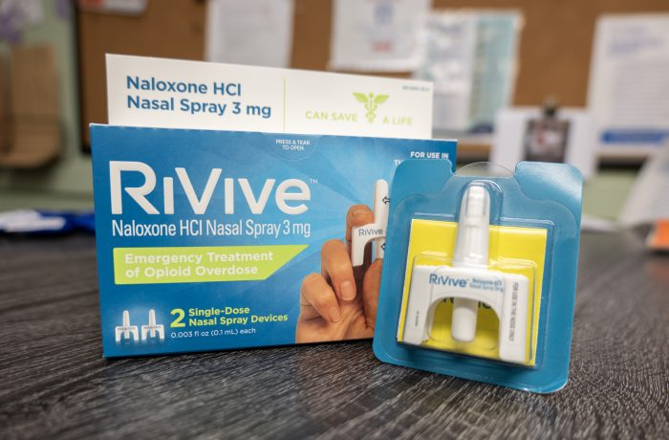
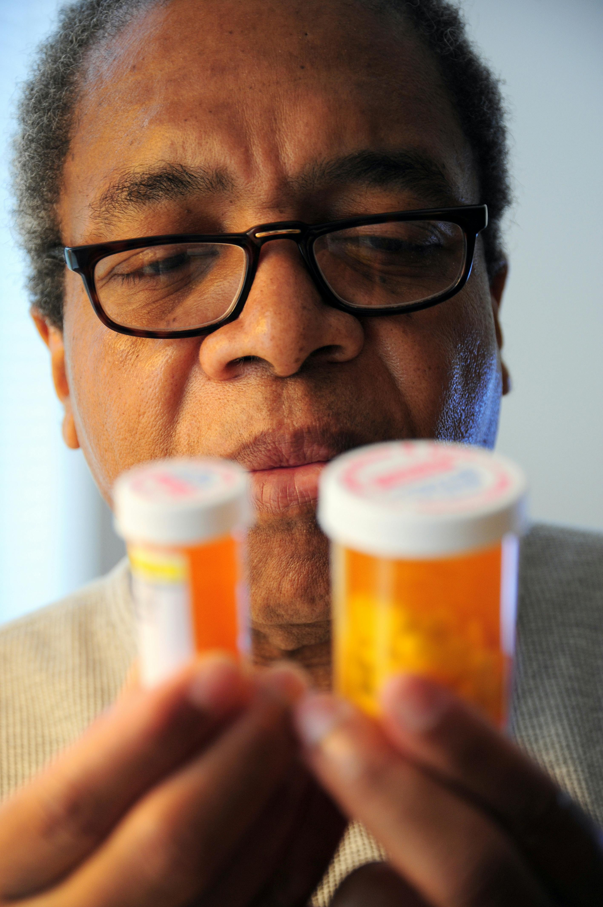
Are you a caregiver?
What is opioid misuse?
Your role as a caregiver
Medication management
Taking too much medication or too often
Doubling doses to “catch up” on pain
Using someone else’s medication
Using opioids that are obtained illegally
Sometimes, misuse happens because:
The person gets confused about doses
They’re afraid of more pain or withdrawal
They use opioids intentionally for enjoyment or to cope with emotions
8 in 10 family caregivers find pain management stressful
When a family caregiver is involved, the adult is more likely to stick to the doctor’s plan for pain management
Conversations about opioid medication misuse get easier for families with time and practice
Involve the adult and their doctor
Keep a medication list
Use pill organizers
Dispose of unused opioids safely
Secure opioids away from other household members and pets
Document medication doses and times
As a family caregiver, you might:
Help organize medications
Watch for side effects
Talk to healthcare providers
Offer emotional support
Accidental overdose
Medication access
What are opioids?
Pros of restricting medication access
Reduces risk of mixing up pills
Increases caregiver peace of mind
Cons of restricting medication access
Can hurt trust
May cause hiding pills; research shows this may increase risk of accidental overdose
Opioids are pain medicines, like:
Oxycodone (OxyContin, Percocet)
Hydrocodone (Vicodin, Norco)
Morphine
Fentanyl
Opioids can:
Help with pain
Cause relaxation or emotional comfort
Cause side effects like sleepiness, confusion, constipation, or falls
Be easy to misuse by accident
Risk development of opioid use disorder (OUD)
If someone takes more opioids than their body can handle, they can pass out, stop breathing, and die
Anyone who uses opioids can overdose
Nearly 40% of opioid overdose deaths occur with a bystander present
Naloxone (Narcan) is a safe medicine used to quickly stop the effects of overdose, like an EpiPen does for allergies.
It helps a person start breathing again
It can be sprayed in the nose or injected
Caregivers' naloxone knowledge can increase by 33% after receiving training
How to start talking
Adults who misuse might:
Face stigma by healthcare providers
Struggle to get good pain care
Hide problems out of fear or shame
Feel judged or misunderstood about needing stronger pain medicine
Choose the right time to talk
Don’t take control without talking about it first and receiving permission
Offer options and make a plan together
See next page for a conversation guide

